Slide 1
接口性能趋势分析报告
生成时间: 2025-09-23 16:26:21

Slide 2
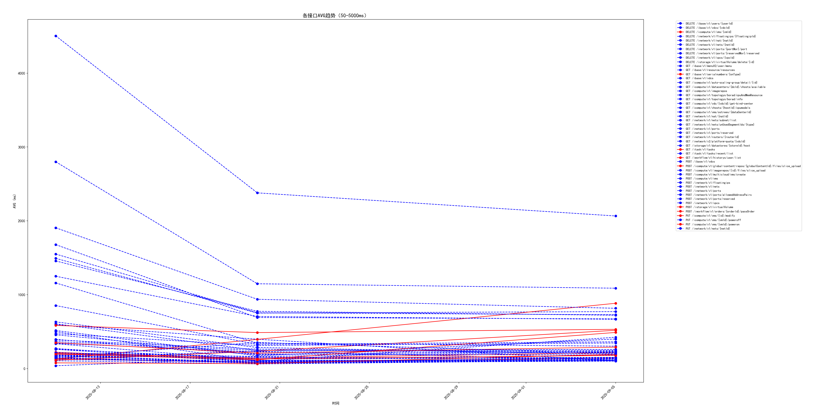
各接口AVG趋势（50-5000ms）

Slide 3
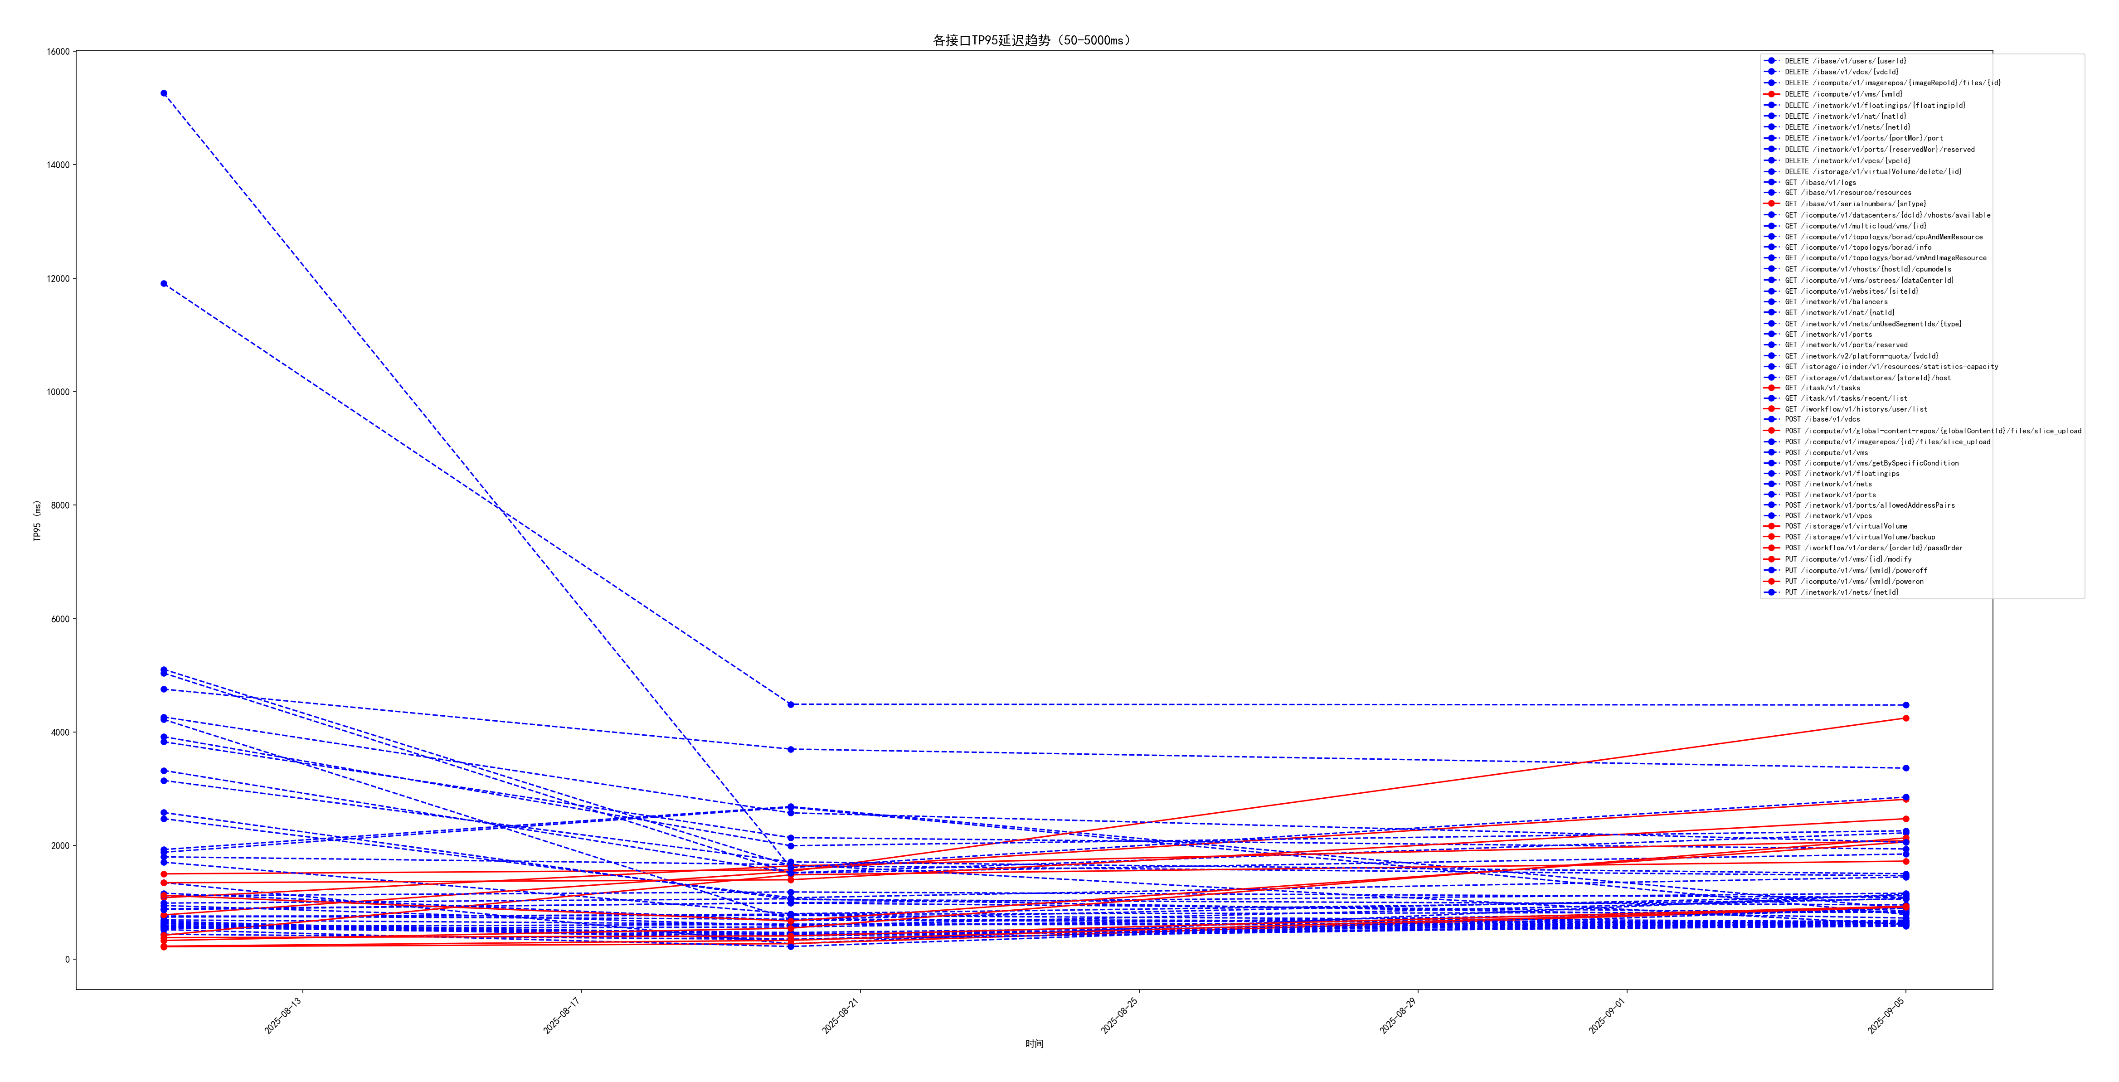
各接口TP95延迟趋势（50-5000ms）

Slide 4
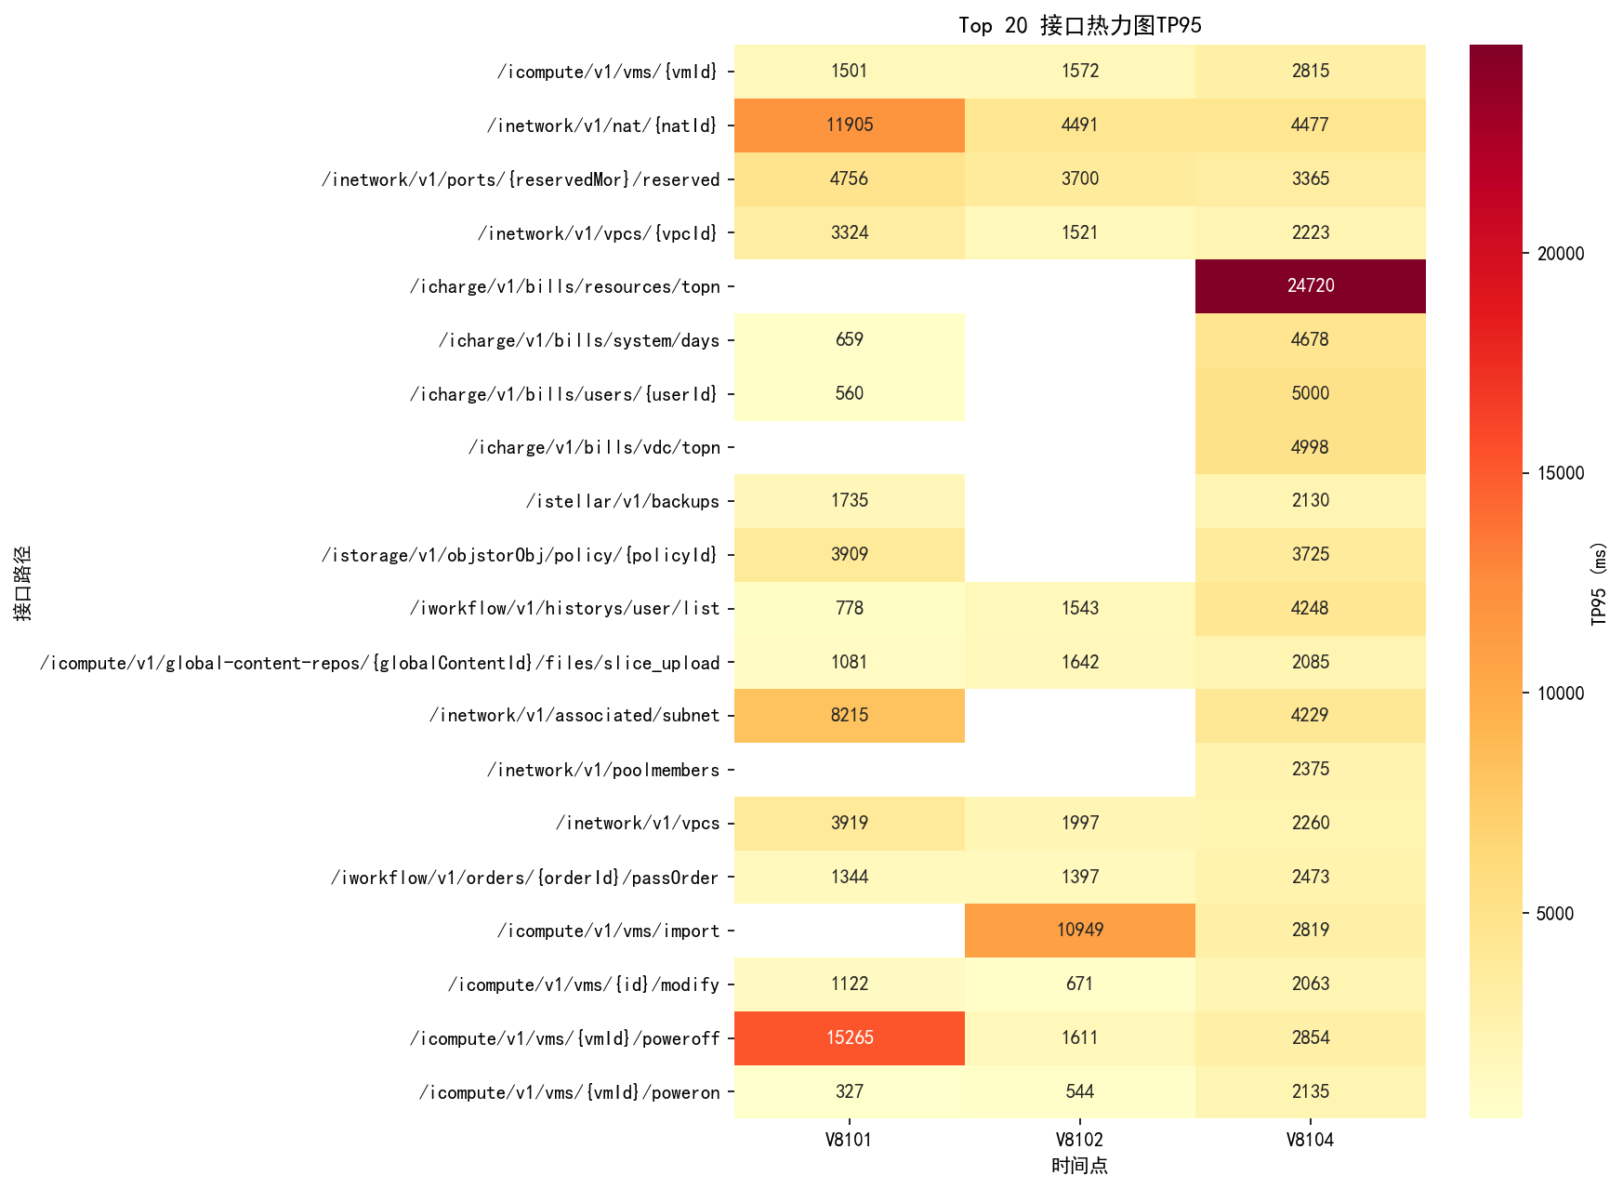
接口TP95热力图

Slide 5
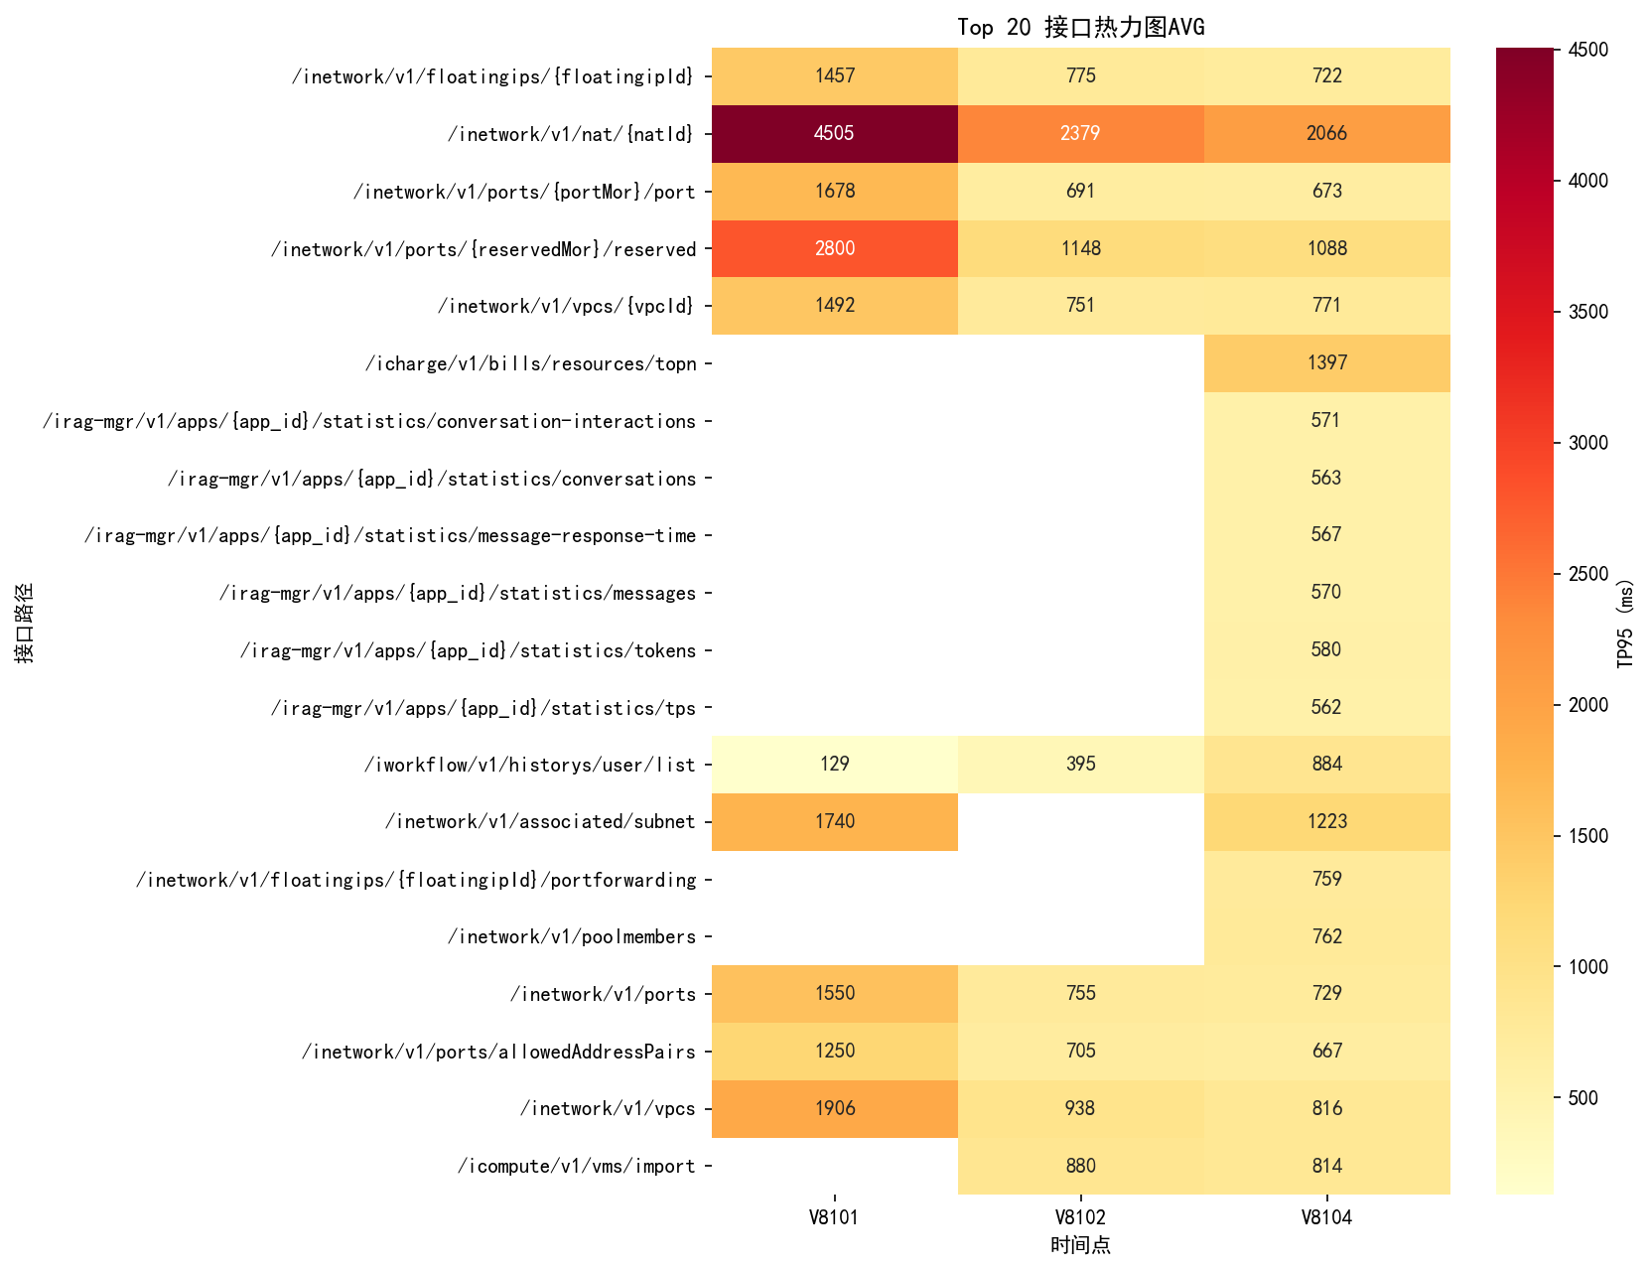
接口AVG热力图

Slide 6
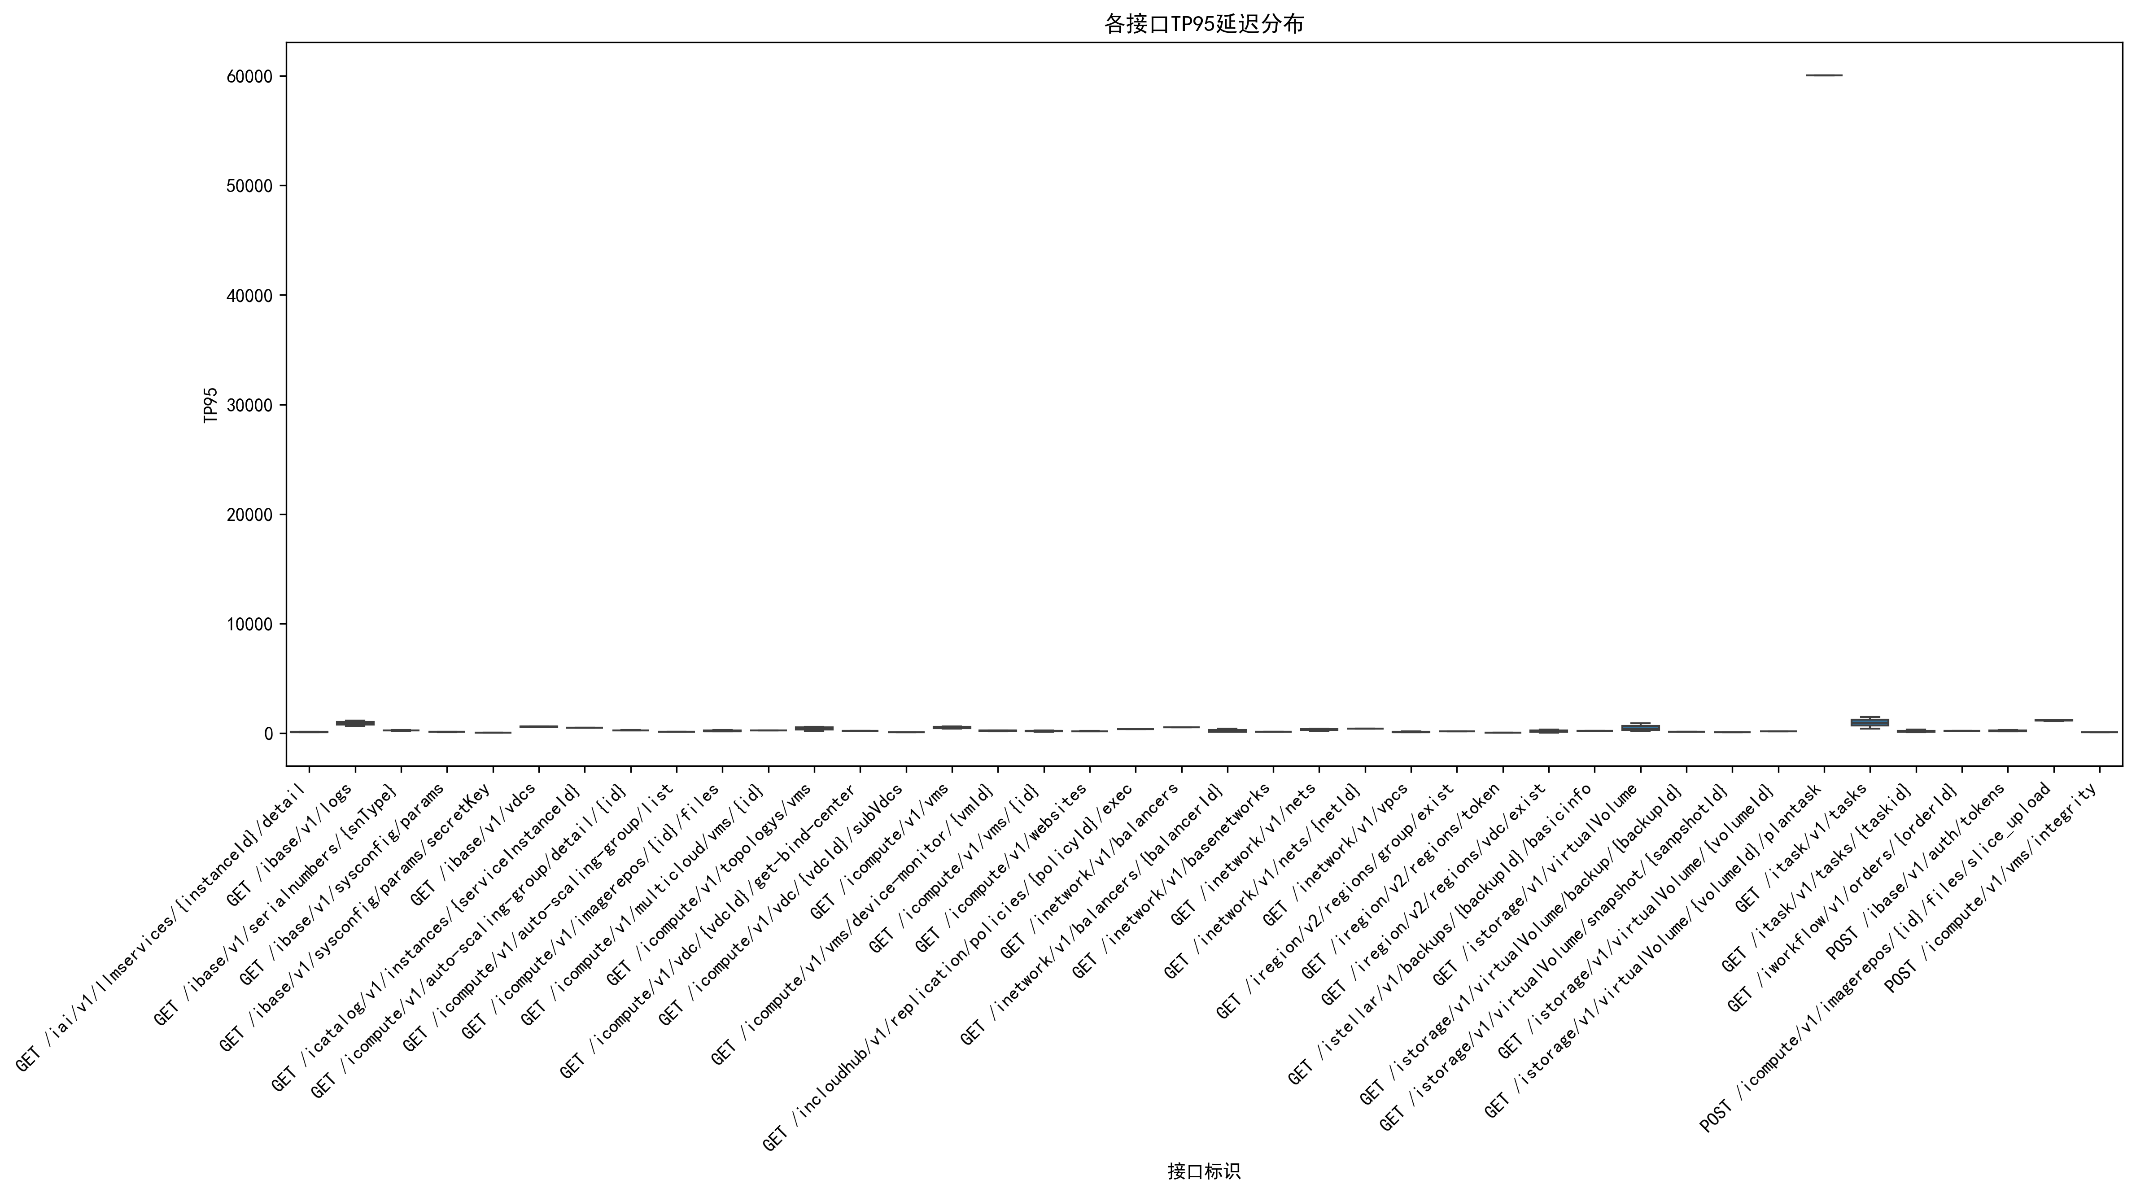
接口TP95箱线图

Slide 7
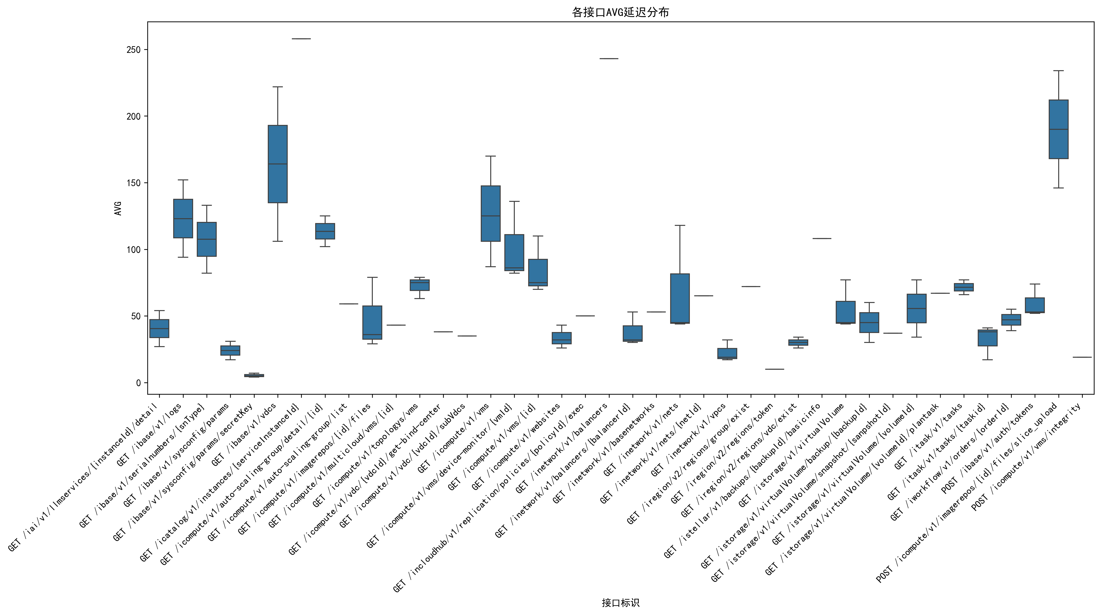
接口AVG箱线图

Slide 8
Top 10 TP95性能退步接口
接口标识 | TP95_V8101 | TP95_V8104 | TP95_变化 | TP95_变化率
GET /icharge/v1/bills/users/{userId} | 560 | 5000 | 4440 | 792.86
GET /icharge/v1/bills/system/days | 659 | 4678 | 4019 | 609.86
GET /iworkflow/v1/historys/user/list | 778 | 4248 | 3470 | 446.02
PUT /icompute/v1/vms/{vmId}/poweron | 327 | 2135 | 1808 | 552.91
DELETE /icompute/v1/vms/{vmId} | 1501 | 2815 | 1314 | 87.54
GET /itask/v1/tasks | 419 | 1726 | 1307 | 311.93
GET /icharge/v1/bills/overview | 526 | 1691 | 1165 | 221.48
POST /iworkflow/v1/orders/{orderId}/passOrder | 1344 | 2473 | 1129 | 84.0
POST /icompute/v1/global-content-repos/{globalContentId}/files/slice_upload | 1081 | 2085 | 1004 | 92.88
PUT /istorage/v1/objstorObj/upload-check | 809 | 1775 | 966 | 119.41

Slide 9
Top 10 TP95性能优化接口
接口标识 | TP95_V8101 | TP95_V8104 | TP95_变化 | TP95_变化率
PUT /icompute/v1/vms/{vmId}/poweroff | 15265 | 2854 | -12411 | -81.3
DELETE /inetwork/v1/nat/{natId} | 11905 | 4477 | -7428 | -62.39
POST /inetwork/v1/associated/subnet | 8215 | 4229 | -3986 | -48.52
DELETE /inetwork/v1/ports/{portMor}/port | 5106 | 1468 | -3638 | -71.25
POST /inetwork/v1/ports | 5040 | 1851 | -3189 | -63.27
POST /ibase/v1/vdcs | 4223 | 1119 | -3104 | -73.5
PUT /inetwork/v1/ports/{portMor} | 4131 | 1802 | -2329 | -56.38
PUT /inetwork/v1/nets/{netId} | 4266 | 2058 | -2208 | -51.76
DELETE /inetwork/v1/floatingips/{floatingipId} | 3829 | 1940 | -1889 | -49.33
POST /inetwork/v1/vpcs | 3919 | 2260 | -1659 | -42.33

Slide 10
Top 10 AVG性能退步接口
接口标识 | AVG_V8101 | AVG_V8104 | AVG_变化 | AVG_变化率
GET /iworkflow/v1/historys/user/list | 129 | 884 | 755 | 585.27
POST /icompute/v1/global-content-repos/{globalContentId}/files/slice_upload | 114 | 518 | 404 | 354.39
PUT /icompute/v1/vms/{vmId}/poweron | 197 | 489 | 292 | 148.22
GET /itask/v1/tasks | 77 | 192 | 115 | 149.35
GET /icompute/v1/vdc/{vdcId}/get-bind-center | 38 | 137 | 99 | 260.53
PUT /inetwork/v1/nets/{netId} | 155 | 202 | 47 | 30.32
GET /istorage/imanila/v2/users | 39 | 75 | 36 | 92.31
GET /istorage/imanila/v2/users/{id} | 44 | 78 | 34 | 77.27
POST /istorage/v1/objectstor/buckets | 109 | 138 | 29 | 26.61
POST /icompute/v1/auto-scaling-group/add | 89 | 110 | 21 | 23.6

Slide 11
Top 10 AVG性能优化接口
接口标识 | AVG_V8101 | AVG_V8104 | AVG_变化 | AVG_变化率
DELETE /inetwork/v1/nat/{natId} | 4505 | 2066 | -2439 | -54.14
DELETE /inetwork/v1/ports/{reservedMor}/reserved | 2800 | 1088 | -1712 | -61.14
GET /istorage/v1/objstorObj/policy/{policyId} | 1575 | 367 | -1208 | -76.7
POST /inetwork/v1/vpcs | 1906 | 816 | -1090 | -57.19
DELETE /inetwork/v1/ports/{portMor}/port | 1678 | 673 | -1005 | -59.89
GET /inetwork/v1/nets/unUsedSegmentIds/{type} | 1159 | 303 | -856 | -73.86
POST /inetwork/v1/ports | 1550 | 729 | -821 | -52.97
DELETE /inetwork/v1/floatingips/{floatingipId} | 1457 | 722 | -735 | -50.45
DELETE /inetwork/v1/vpcs/{vpcId} | 1492 | 771 | -721 | -48.32
POST /inetwork/v1/ports/allowedAddressPairs | 1250 | 667 | -583 | -46.64

