Slide 1

The Dynamics of Triple Star Systems

Slide 2
Warm up: Binary Dynamics
Two-body problem
Two main parameters
Semi-major axis
Eccentricity
Analytical solution stable

Slide 3
General three-body problem
No analytical solution unstable
Chaotic

Slide 4
Three-Body Problem

Slide 5
Three-Body Problem

Slide 6
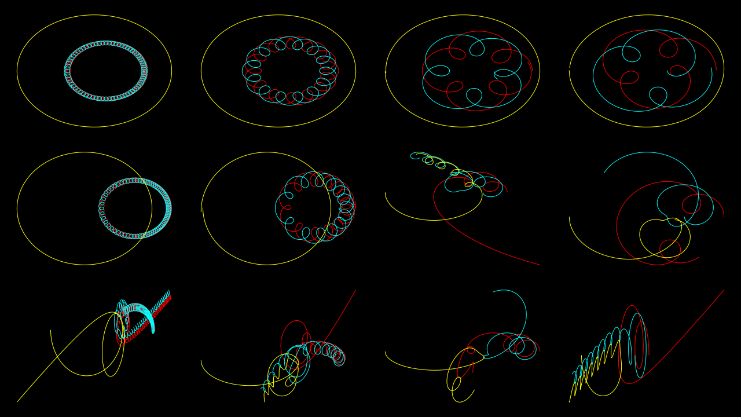
Increasing inner semi-major axis
Increasing outer eccentricity

Slide 7
Earth Day resources
List resources here

