Slide 1

Group-3
Task-1
Notes:
Hello world!

Slide 2
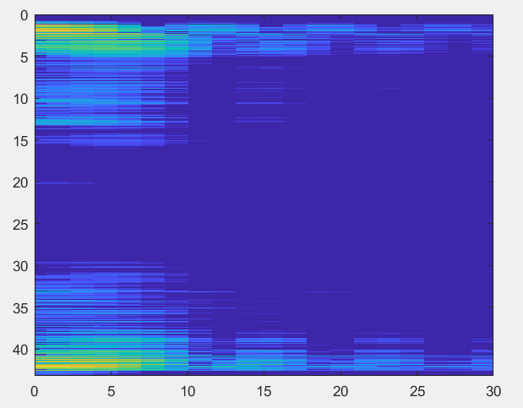
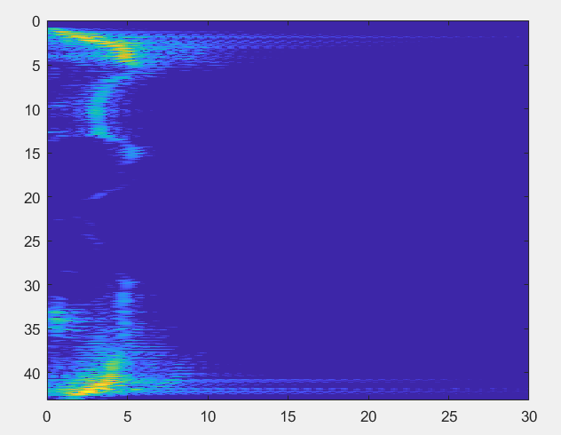
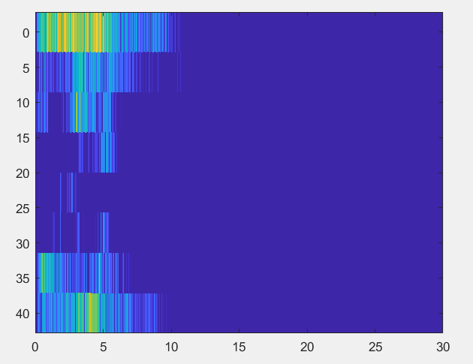
Subgroup-1 (CW)
What happens if we change Tp? (Normalisation 1):
Tp = {0.01, 0.1, 5}
Tp = 0.01
Tp = 0.1
Tp = 5
Notes:
With high Tp we will have longer “same” velocity. So we are oversampling in the first picture, good sampling in the middle and downsampling at the last picture.

Slide 3

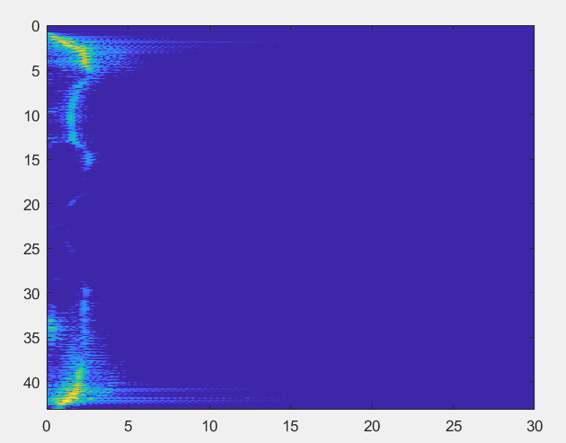
Subgroup-1 (CW)
What happens if we change centre frequency?
5 GHz
Notes:
We will have less velocity

Slide 4
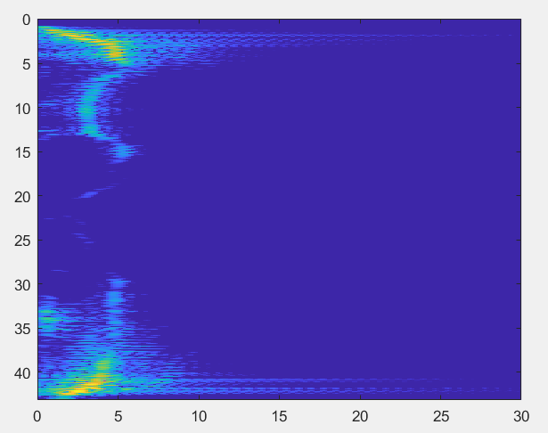
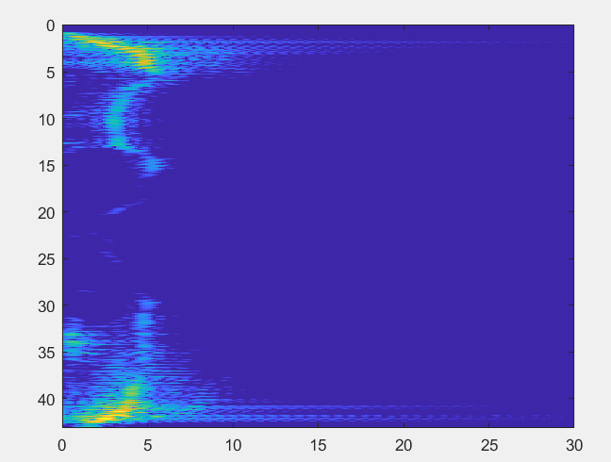
Subgroup-1 (CW)
What happens if we change MS clutter rejection from On/Off?
Without
With
Notes:
We can’t see any difference

Slide 5
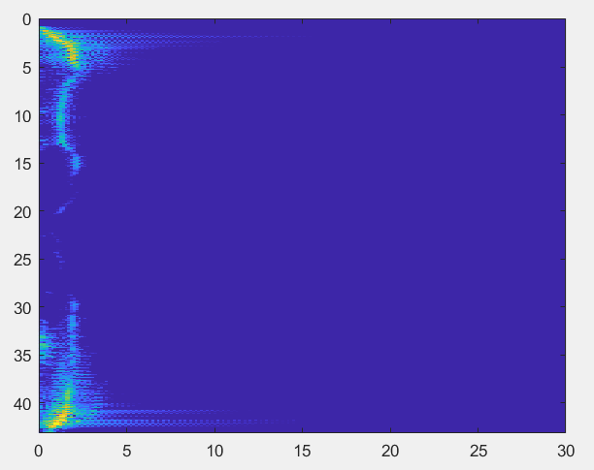
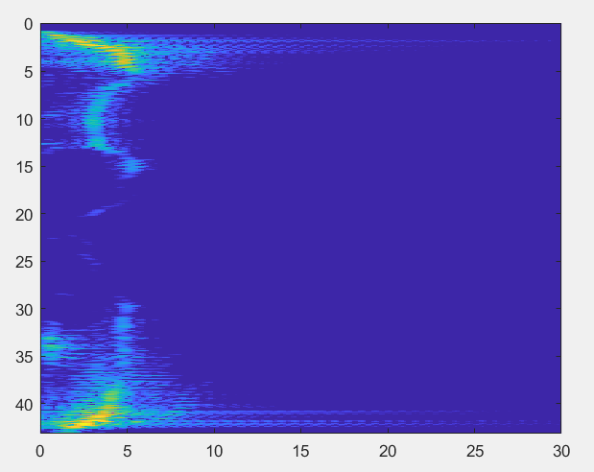
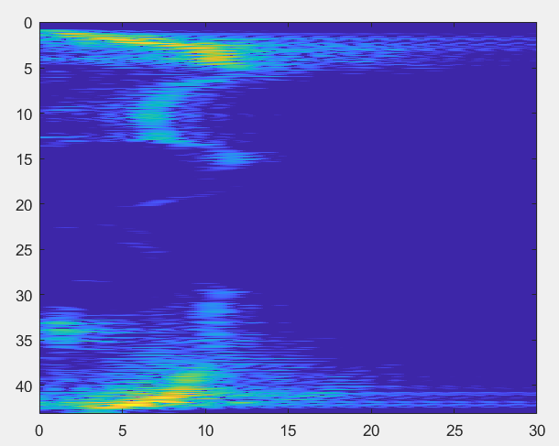
Subgroup-1 (CW)
What happens if we change the number of zeros (padding)?
1*N
4*N
10*N
Notes:
With low numbers of zeros (padding), we can see that graph looks thin and the last looks smeared out. This is because we take the more samples for the same amount of fq-range.

Slide 6
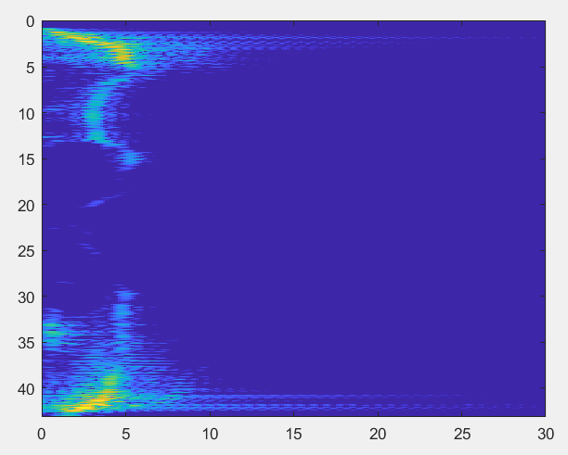
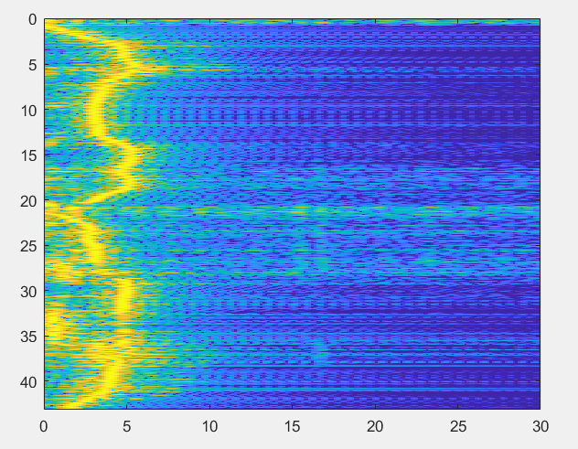
Subgroup-1 (CW)
What happens if we change the normalisation?
Max for the whole FFT
Max for each Row (M)
Notes:
We can see that we get a more distinct velocity when we are taking the max for each row instead of the whole FFT-matrix. This is because we get only one velocity for each Tp

Slide 7
Plans for next week
Subgroup-1 and subgroup-2:
Build the baseband circuit
Record the video for the first test

