Slide 1

Don’t Reinvent the Brick
Reusable Libraries in .NET

Slide 2
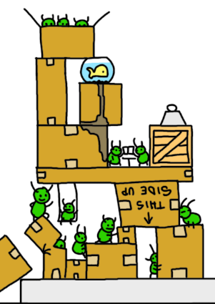

CBSS
Persons
Bricks
?
CBSS
Companies
FBZ
Core?
CBSS
Dmfa
FBZ
?
CBSS
…
Payments
Documents

Slide 3
Reusable libraries ~ CBSS Person Brick
Default
implementation
Fetch from
anywhere
Fetching xml or zip files
Correct processing
Strict sequential in order processing
Correct processing and interpretation (very complex)!
Provide interface for get / find
Packages · Global Technology Applications
Platform
independent
Persistence
EF vs ?
Country NIS/ISO
Provide your own
implementation
AuditLogs
Track last fetched and last processed
Read vs Write
Support any form of background
processing
Notifications

Slide 4
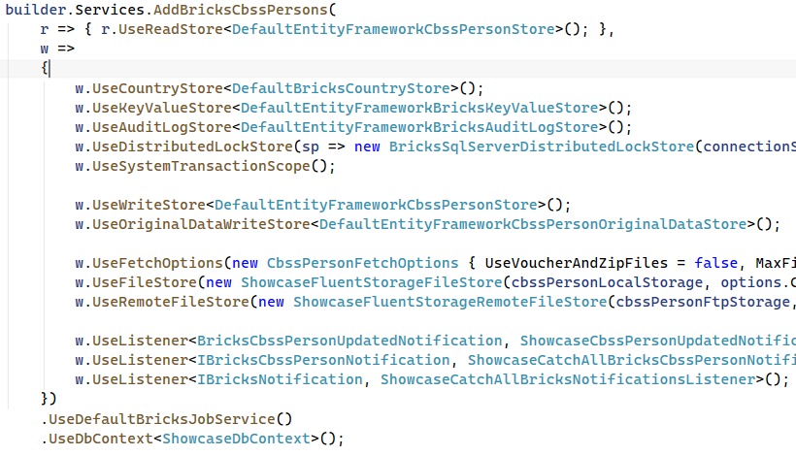
Reusable libraries ~ CBSS Person Brick

Slide 5
Reusable libraries ~ Workshop
Making our own customizable Library
Read the README.md, UserStories.md
Ask Questions, we are here to help!
https://github.com/casperdon/Bricks-Workshop

