Slide 1

Landscaping Quote Management System
IST659 – Final Project
David Caspers (dcaspers@syr.edu)
Syracuse University
School of Information Studies, Applied Data Science
Notes:
Good Afternoon, my name is David Caspers. I did this project on my own as part of the IST659 Final Project, where I designed and built the data infrastructure to support a Landscape Quote Management System NEXT SLIDE

Slide 2
Project Overview
The objective of this project was to develop a comprehensive quote estimation system tailored for landscaping businesses. This system is designed to assist businesses in providing accurate, professional estimates for their services, thereby enhancing customer satisfaction and operational efficiency. By integrating features to track customer information, costs, and service rates the system helps maintain profitability through accurate cost calculations and detailed invoices.
Notes:
The intent of this project was to develop a quote estimation system specifically for a landscaping business. Where I currently live, there are a lot of small landscape businesses that don’t necessarily have the commercial footprint to support buying enterprise Customer Relationship Management software. This system is designed to be a really light weight application to assist a business in designed to assist businesses in providing accurate, professional estimates for their services, thereby enhancing customer satisfaction and operational efficiency.
In order to accomplish this, the system needed to have some way to track customer information, costs to include material and labor, and service rates. Given those inputs, businesses can then quickly and consistently build accurate quotes and invoices.

Slide 3
Key Features
Customer Management: Store and manage customer information for streamlined communication and accurate billing.
Service and Product Tracking: Maintain a database of service rates and material costs to provide precise estimates.
Quote Generation: Create detailed, versioned quotes that include all relevant costs, with an approval workflow for customer confirmation.
Invoice Management: Automatically generate invoices from approved quotes, ensuring consistency and reducing errors. Allow for invoice updates to reflect true costs after project completion as well as application of discounts.
Payment Processing: Accept payments only when they match invoice totals, preventing partial payments and maintaining financial accuracy.
Automated Calculations: Use triggers to automate line item and total calculations, minimizing manual input and errors.
Notes:
On this slide you can see some of the relevant modules built into this application.

Slide 4
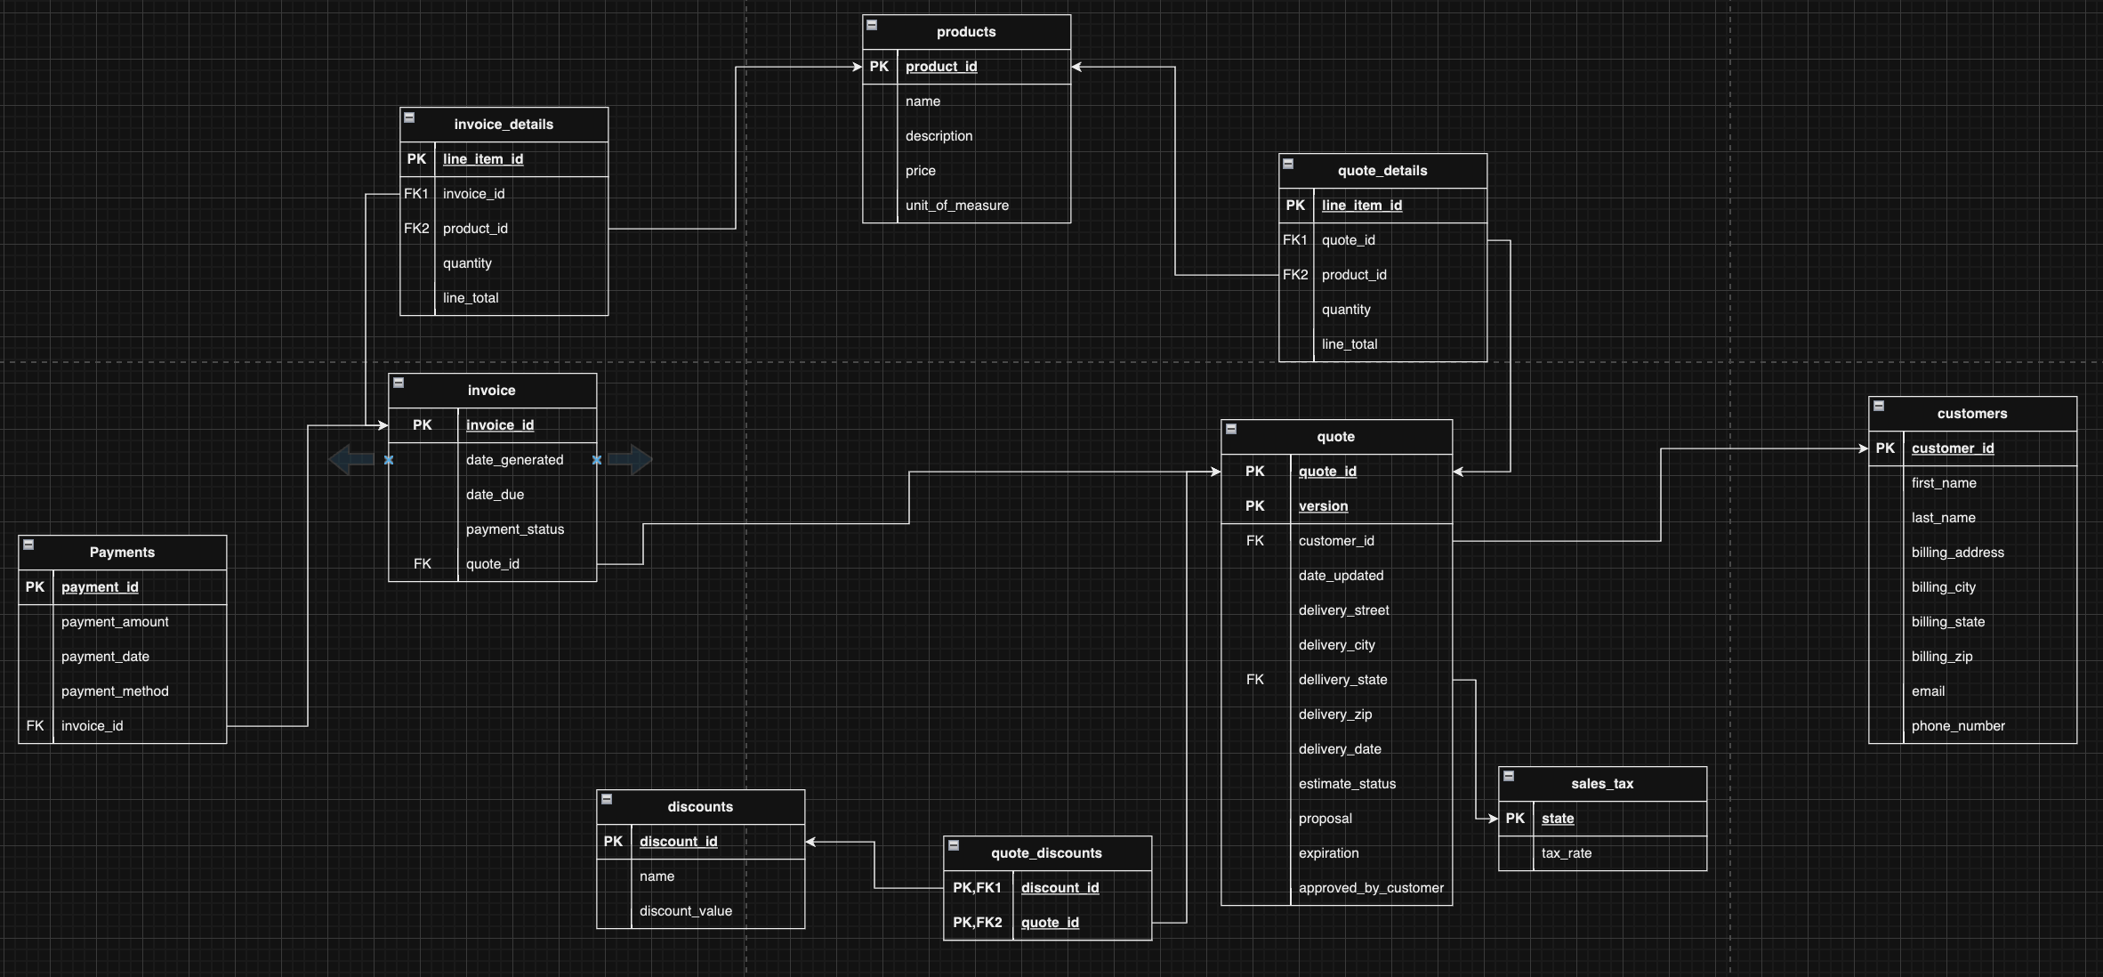
Logical Application Design
Notes:
Going into the actual design of the application, you can see the logical flow here.
- Every Quote must be associated with a customer
– A quote has various attributes such as where the work needs to be done, the project description, when the quote expires, and whether the quote has been approved by the customer
You can easily version quote with the compound primary key, which allows you to have a back and forth with the customer until they agree on the scope of the work
Associated with it is a line item table that lists out the various labor and material costs that the total cost can be derived from
This pulls from the products table
Additionally, sales tax is applied to the final quote based on the state the work is being done
From there, once the customer has approved the quote, an invoice can be generated from the quote.
Generating the quote copies over the quote details into the invoice details, which can then be edited separately if the estimate proves to be inaccurate and additional costs need to be added into the invoice once the job is completed
From there the payments table allows you to track whether the invoice has actually been paid. To generally simplify the design of this application, I assumed that no partial payments were allowed – so any invoice should only have 1 payment associated with it.

Slide 5
Database Procedures
InsertCustomer
Description: Adds a new customer to the system.
Constraints: Ensures all required customer details are provided. Rolls back if the insertion fails.
InsertOrUpdateDiscount
Description: Adds a new discount or updates an existing one.
Constraints: Validates discount information. Rolls back on error.
InsertOrUpdateProduct
Description: Adds a new product or updates an existing product.
Constraints: Checks product details for completeness. Rolls back if any errors occur.
GenerateQuote
Description: Creates or updates a quote for a customer.
Constraints: Verifies customer exists and generates a new quote ID or version if needed. Rolls back on error.
AddItemsToQuoteDetails
Description: Adds or updates items for a specific quote.
Constraints: Ensures quote and product exist. Adds to the latest quote version only. Rolls back on error.
Notes:
To actually allow this application to work, a lot of different procedures needed to be created.

Slide 6
Database Procedures (cont’)
GenerateInvoiceFromQuote
Description: Generates an invoice from an approved quote.
Constraints: Only generates invoices for approved quotes. Includes all quote details. Rolls back on error.
AddOrUpdateInvoiceDetails
Description: Adds or updates items on an invoice.
Constraints: Validates that the invoice and product exist. Updates existing items or adds new ones. Rolls back on error.
ProcessPayment
Description: Processes a payment for an invoice.
Constraints: Only allows payments that match the exact invoice total (no partial payments). Updates invoice status to "Paid" if the total is met. Rolls back if conditions are not met or an error occurs.

Slide 7


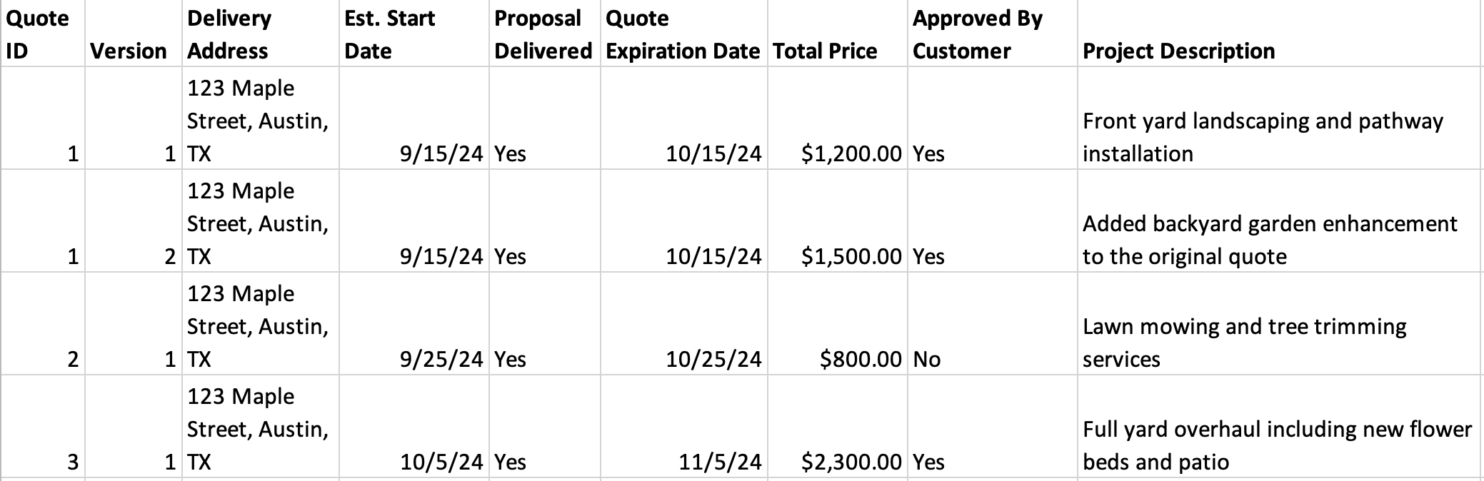

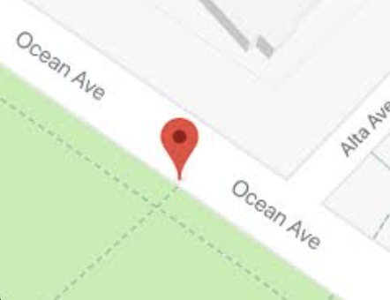
Customer Management
Customer Directory
John Doe
John Doe
Jane Smith
James Johnson
Emily Brown
Michael Davis
Sarah Miller
David Wilson
Laura Moore
Daniel Taylor
Jessica Anderson
Generate Invoice From Quote
Generate New Quote
View Quote Line Items
John Doe
Address
Contact Info
Quotes
Invoices
Notes:
This is an example of how the customer management feature might look in the finished application.
You can query your customers on the left hand side
Once you select a customer (in this example, we’ve selected john doe) our application will display the relevant information about the customer to include their address, contact info, outstanding quotes, and invoices
In this case we can see that John has approved 3 quotes – quote 1 was made ofr landscaping his front yard and pathway, and in the second version of that he added a backyard garden enhancement
From there we’d have several options, including viewing the line items of the quote, as well as generating an invoice for the approved quote

Slide 8
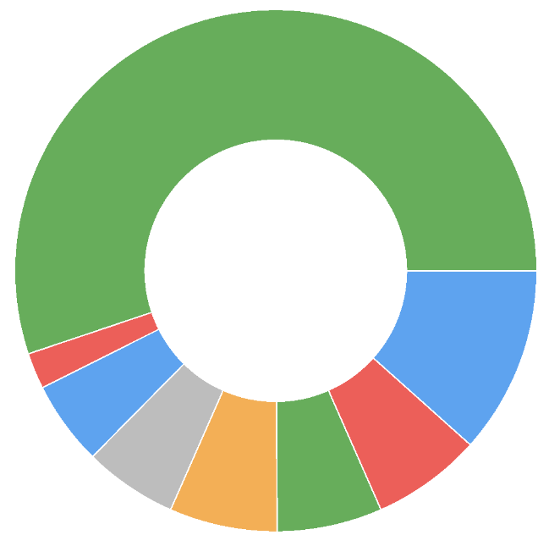
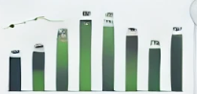
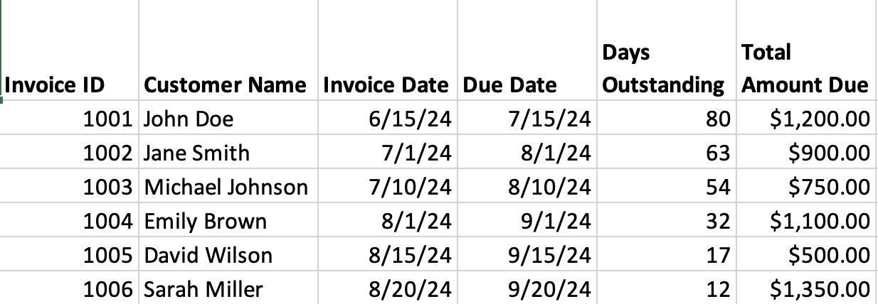
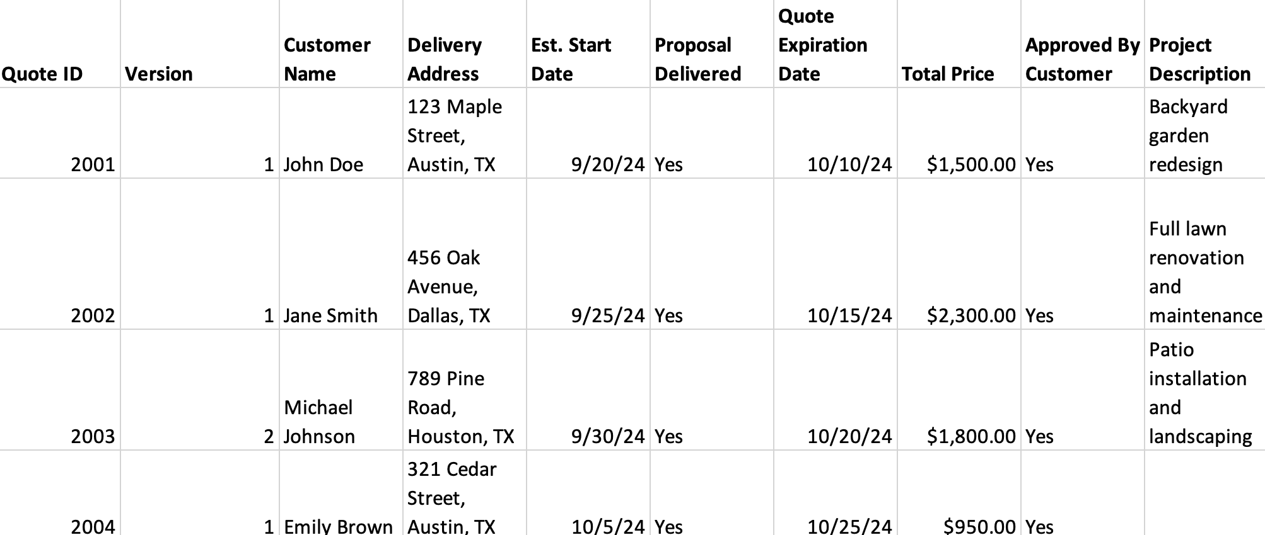
Reports
Business Unit:
Landscaping
Mowing
Pressure Washing
Sales
Quotes
Accounts Receivable
Material Usage
Quotes Days Since Issued:
Aged Invoices:
Revenue By Month:
Quotes Requiring Invoice:
Notes:
Beyond just customer management, we’d also want to generate various reports on the status of the sales, quotes, and invoices.
- The data in this application could easily be used to track materials used in the project and also revenue by month
Similarly the business owner will want to track outstanding quotes and how long it’s been since they’ve been issued to follow-up with the homeowner as well as ones that have been approved that an invoice needs to be generated.
Once an invoice is generated, the business owner will need to track payment and keep an eye out for ones that have been outstanding for an extended period of time.

Slide 9
Questions?
Feel free to reach out at dcaspers@syr.edu

