Slide 1

Using Deep learning for alignment-free and error-tolerant identification of peptide sequences across different species.
Satwant Kaur

Slide 2
Proteins – dynamic macromolecules
Proteins control a vast array of functions within organisms.
Identification strategy: Mass Spectrometry database search.
De novo search is one of the popular approaches for protein identification.
Original Sequence | Prediction | Probability
DENGYSAVVADFGIAEK | DENGYSAVVADFGIAEK | 0.704688
NIAIMDSSSSISR | NIAIMDSSSSSIR | 0.7117
DAPEGGFDAVIQAAVCK | DAPEGGFVGEIQAAVCK | 0.7710
ITIARDSK | ITIARDSK | 0.7408

Slide 3
Hybrid search strategy
Using De novo in tandem with database search algorithm.
Preprocessing mass spectrum data
De novo search using Deep Novo (ver: 0.0.1)
Siamese network - supervised metric learning
Extract embedding vectors of trained data and K-NN search
to identify unknown peptides from different species.
Validate peptides with Blosum62 to minimise false positives.
Compare results with database search

Slide 4
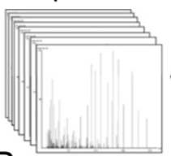
Preprocessing of the data
ProteomeTools HCD Spectral Library - synthetic peptide database.
2,595,595 sequences
Train (2076658)
Validation (259193)
Test (259744)
De novo search using DeepNovo.
QLVHDSGR
QLVHDGSR
QLVHDQAT
NLLHDSGR
De novo
search
Spectra
QLVHDSGR
QLVHDGSR
QLVHDVSN
NLLHDGSR
QLVHDVGSG
LLNHDSGR
10 candidates per spectra

Slide 5
Scan
Predicted
sequence
Predicted
Score
Predicted position score
DeepNovo
prediction
F1:1951 | E,Y,E,T,A,E,R | 0 | -0.00,-0.00,-0.00,-0.00,-0.00,-0.00
F1:1951 | E,Y,E,T,A,E,R | -0.04 | -0.00,-0.00,-0.00,-0.00,-0.30,-0.00
F1:1951 | E,Y,E,T,Q,V,E | -0.23 | -0.00,-0.00,-0.00,-0.00,-1.44,-0.17
F1:1951 | E,Y,E,T,Q,V,Qmod | -1.14 | -0.00,-0.00,-0.00,-0.00,-1.44,-0.17
F1:1951 | E,Y,E,T,N,N,K | -1.06 | -0.00,-0.00,-0.00,-0.00,-7.42,-0.00
F1:1951 | E,Y,E,T,G,A,V,E | -0.66 | -0.00,-0.00,-0.00,-0.00,-5.17,-0.04,-0.10
F1:1951 | Qmod,Y,E,T,A,E,R | -0.92 | -0.00,-0.00,-0.00,-0.00,-0.00,-0.00
F1:1951 | E,Y,E,T,A,E,R | 0 | -0.00,-0.00,-0.00,-0.00,-0.00,-0.00
F1:1951 | E,Y,T,E,A,E,R | -1.46 | -0.00,-0.00,-10.18,-0.00,-0.00,-0.00
F1:1951 | E,Y,Qmod,T,A,E,R | -1.25 | -0.00,-8.72,-0.00,-0.00,-0.00,-0.00
F1:1951 | N,Cmod,F,T,A,E,R | -1.64 | -0.04,-11.44,-0.00,-0.00,-0.00,-0.00
Prediction from
modified version
of DeepNovo

Slide 6
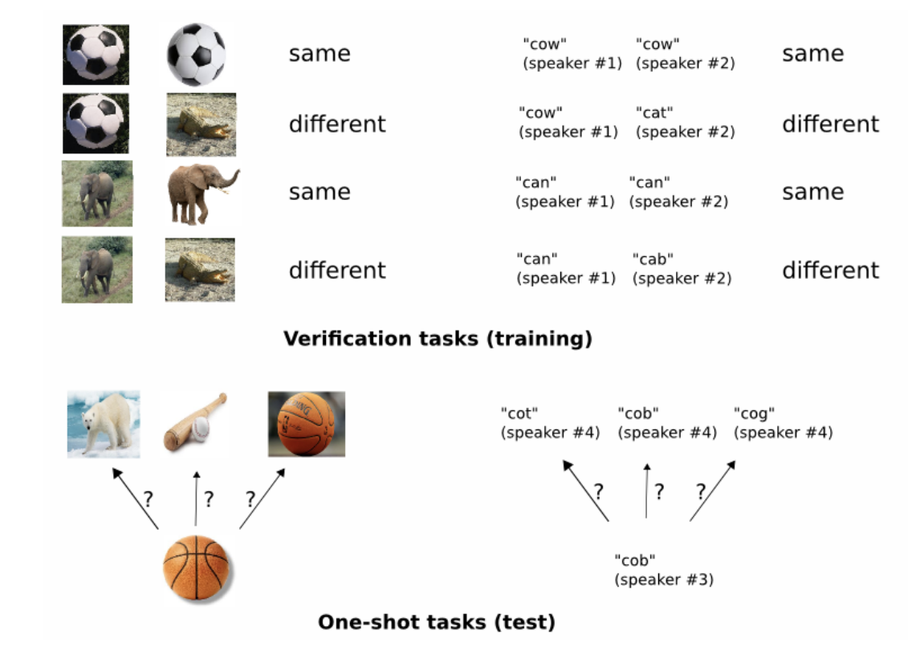
Siamese network

Slide 7
Siamese model architecture
(a)
(b)

Slide 8
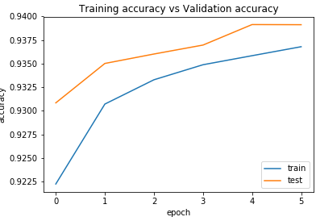
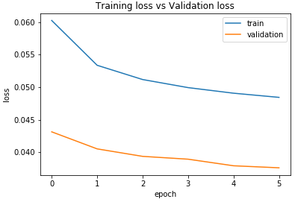
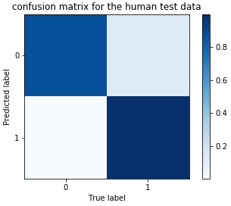
Results
0.88
1.00
 | Human-1 | Human-0
Precision | 0.89 | 1.00
Recall | 1.00 | 0.88
F1 score | 0.94 | 0.93
0.88
0.12
0.00
1.00

Slide 9
Model validation with other species
Yeast data obtained from
https://drive.google.com/open?id=0By9IxqHK5MdWalJLSGliWW1RY2c
Mouse data obtained from
ftp://massive.ucsd.edu/MSV000081382/peak/DeepNovo/HighResolution/
Data was pre-processed similarly to generate peptides in the correct format for model
validation.
Accuracy
Mouse - 0.91756
Yeast - 0.9433
 | Mouse-1 | Mouse-0 | Yeast-1 | Yeast-0
Precision | 0.86 | 1.00 | 0.90 | 1.00
Recall | 1.00 | 0.84 | 1.00 | 0.89
F1 score | 0.92 | 0.91 | 0.95 | 0.94

Slide 10
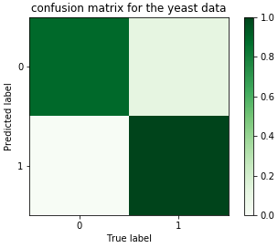
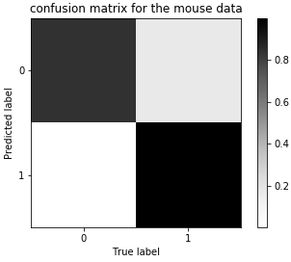
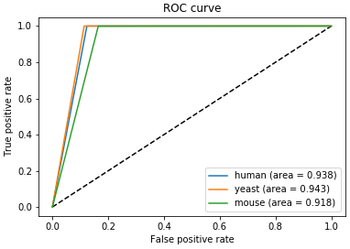
0.89
0.11
0.84
0.16
0.00
1.00
0.00
1.00

Slide 11
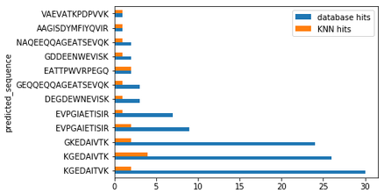
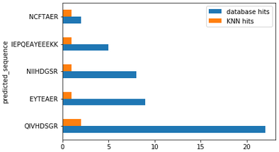
Comparison of a small subset of 100 peptides identified by K-NN search and database mapping
Peptides identified in mouse
Peptides identified in yeast

Slide 12
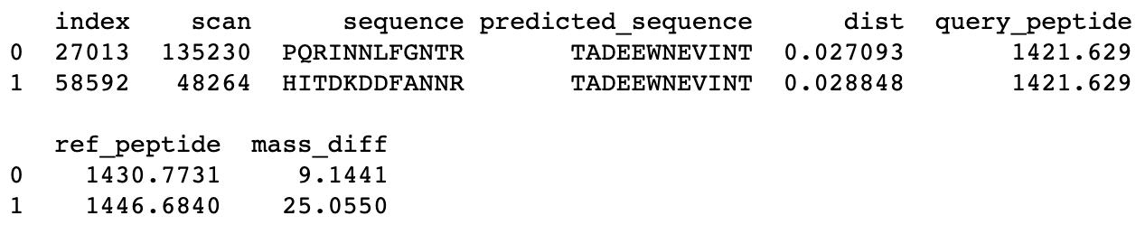
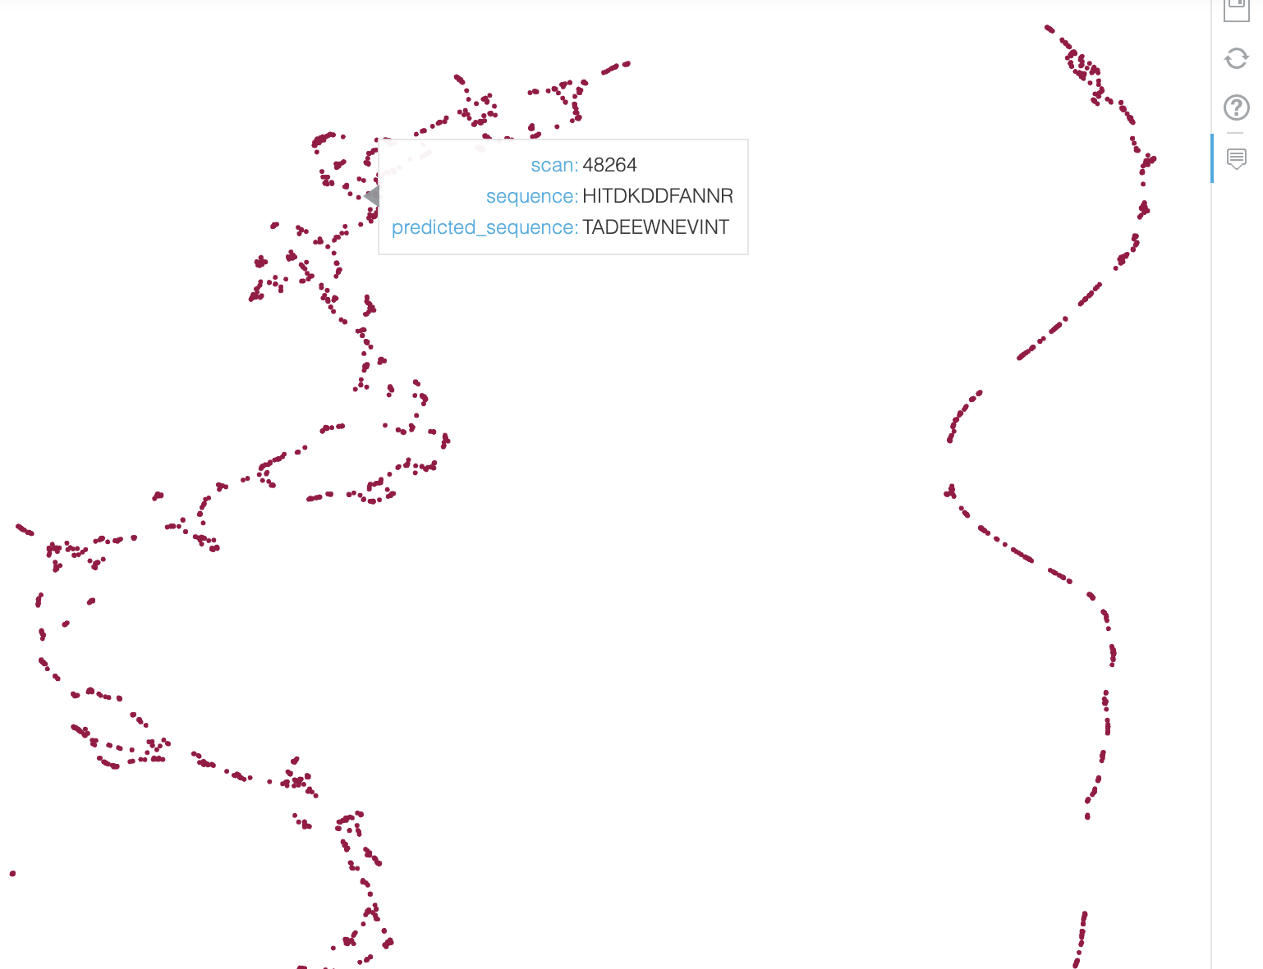
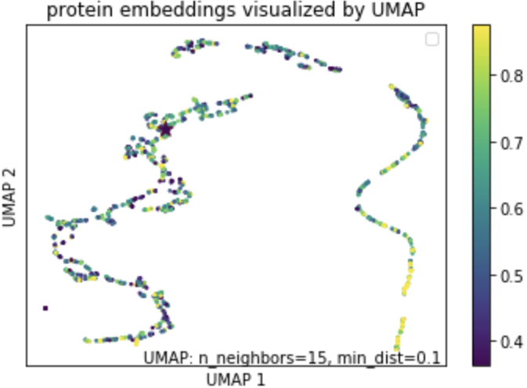
Visualisation of results with umap - mouse
umap static representation
Interactive map showing the hits in mouse

Slide 13
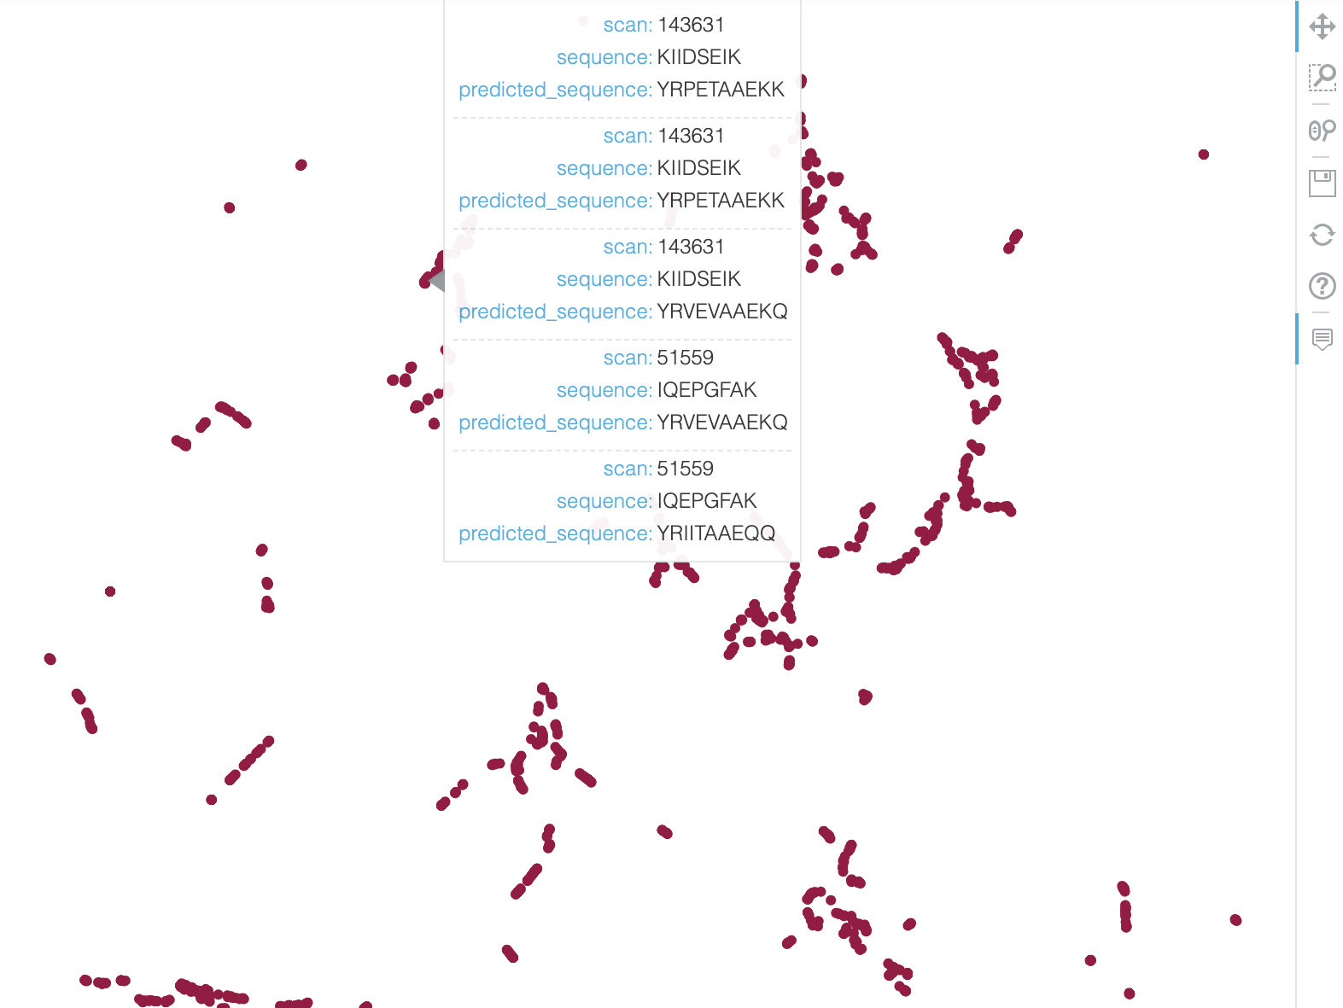
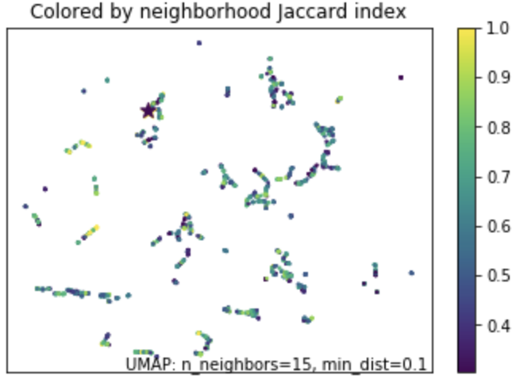
Visualisation of results with umap - yeast
umap static representation
Interactive map showing the hits in yeast

Slide 14
Summarising results
The hybrid approach is very promising – adds confidence to protein identification.
Model accuracy is above 0.9 - indicates that the model learns well to separate decoy peptides from real peptides.
The K-NN approach is faster compared to standard database search.
Validation of sequence with blosum62 substitution matrix minimises false positives and allows incorporating peptides with a meaningful substitutions.

