Slide 1
BioSPARQL-NL
How to query biomedical disease databases using natural language
Cassiano Ricardo Neubauer Moralles
Advisor: Prof. Sandro J. Rigo | Graduate Program in Applied Computing — UNISINOS | April 2026

Slide 2
The Biomedical Research Challenge
Imagine you are a physician and want to know:
"Which diseases cause memory loss and affect children?"
The data exists — but is stored in structured databases that require technical language to query.
• Disease Ontology (DOID): database with 12,000+ catalogued diseases
• Human Phenotype Ontology (HPO): 16,000+ symptoms and phenotypes
• HPOA: 320,000+ disease-phenotype associations

Slide 3
What Are These Databases?
Think of a highly structured medical encyclopedia:
DOID (Diseases) 12,000+ diseases organized by family (e.g., diabetes → metabolic disease)
HPO (Symptoms) 16,000+ phenotypes (e.g., memory loss, seizures, jaundice)
HPOA (Associations) Which diseases cause which symptoms — 320,000+ connections
Problem: querying this data requires learning a technical language — SPARQL

Slide 4
The Technical Barrier: SPARQL
To query these databases, a specialist would need to write:
SELECT ?doenca ?label WHERE { GRAPH <urn:hpoa> { ?a hpoa:has_phenotype obo:HP_0002354 } GRAPH <urn:doid> { ?d rdfs:label ?label } BIND(REPLACE(?xref,"MIM:","OMIM:") AS ?omim) }
vs. what the user wants to type:
"Which diseases cause memory loss?"
BioSPARQL-NL makes this translation automatically.

Slide 5
Our Proposal: BioSPARQL-NL
Question in natural language
Pipeline BioSPARQL-NL
Valid SPARQL Query
Database Answer
→
→
→
• Runs locally on your computer — your data never leaves your machine
• Does not require the user to know SPARQL
• Automatically validates whether the generated query is correct
• Corrects errors and retries if needed

Slide 6
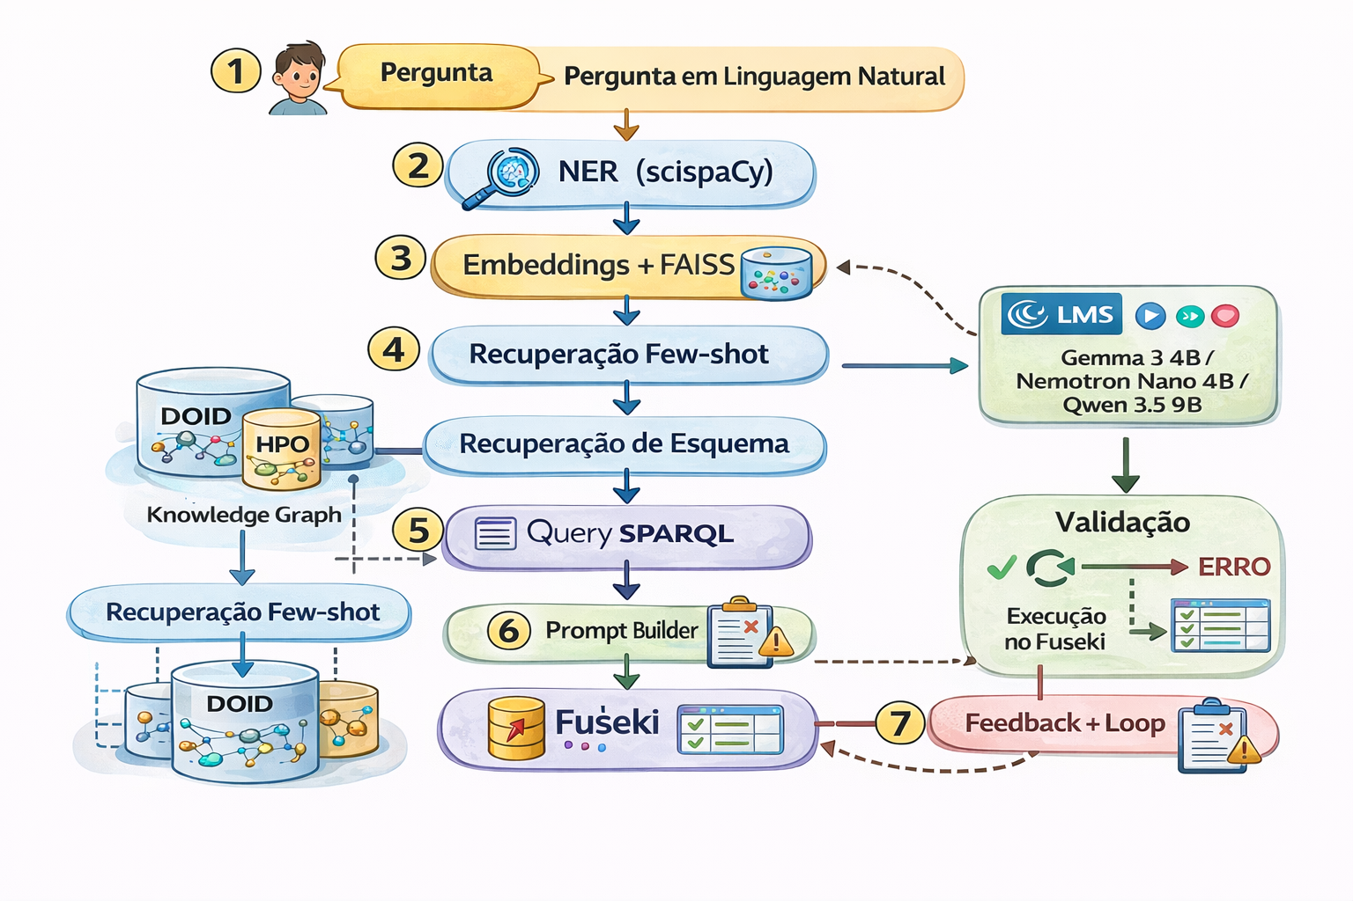
How It Works: Pipeline Architecture
• ① Extracts entities from the question (NER)
• ② Retrieves similar examples (few-shot)
• ③ Builds prompt with context
• ④ LLM generates the SPARQL query
• ⑤ Validates against the schema
• ⑥ Executes in the database

Slide 7
Step 1: Understanding the Question
The system uses Artificial Intelligence (scispaCy) to identify biomedical entities in the question:
"Which phenotypes are associated with Marfan syndrome?"
↓
Recognized: "Marfan syndrome" → URI: obo:DOID_0060618 (in the disease database)
This prevents the AI from needing to guess how the disease is registered in the system.

Slide 8
Step 2: Learning from Examples
The system maintains a library of 52 questions + already validated queries.
When a new question arrives, it retrieves the 3 most similar ones:
"Symptoms of Alzheimer's?" [92% similar]
"Phenotypes of Huntington's disease?" [87% similar]
"Clinical manifestations of multiple sclerosis?" [81% similar]
These examples are included in the AI prompt — it learns the pattern before generating the new query. This reduces hallucinations.

Slide 9
Step 3: The AI Generates the Query
The prompt sent to the AI contains:
• Instructions about the database structure
• Schema: which properties and classes exist
• Examples of similar questions already solved
• The user's question
Tested models (run locally on your PC):
Gemma 3 4B params
Nemotron Nano 4B params
Qwen 3.5 9B params
Claude Sonnet* commercial
* Claude Sonnet ran via API as a performance upper bound reference

Slide 10
Step 4: Validation and Auto-Correction
Problem: LLMs sometimes hallucinate properties that do not exist in the database.
AI-generated SPARQL
Schema Validation
✓ Valid → execute
→
→
↺
✗ Invalid → fix (up to 2x)
Validation uses introspection: the system automatically extracts from the database which properties and classes exist — no manual configuration required.
Qwen 9B: from 0% → 50% accuracy with this mechanism alone (+50pp)!

Slide 11
Real Working Example
Question: "What phenotypes are associated with Marfan syndrome?"
↓ SPARQL generated and executed:
SELECT DISTINCT ?phenoLabel WHERE { GRAPH <urn:hpoa> { ?ann hpoa:source_id "OMIM:154700" ; hpoa:has_phenotype ?pheno } GRAPH <urn:hpo> { ?pheno rdfs:label ?phenoLabel } } LIMIT 10
Results: Arachnodactyly, Ectopia lentis, Aortic root aneurysm, Scoliosis, Tall stature, Pectus excavatum ...
The user asked in plain English — the system queried 3 databases and returned the phenotypes.

Slide 12
How We Evaluated the System
We created a gold standard: 52 questions with expected answers verified by 2 annotators.
Easy 13 questions 1 graph, 1 entity Ex: symptoms of diabetes
Medium 18 questions 2 graphs, multiple entities Ex: diseases with 5+ symptoms
Hard 21 questions 3 graphs, complex joins, specific MIM/OMIM filters
Main metric: 'correctness' — did the query return the expected results?

Slide 13
The 4 AI Models Tested
Model
Parameters
Runs on
Cost
Gemma 3 4B
4 billion
Your PC (8GB GPU)
Free
Nemotron Nano 4B
4 billion
Your PC (8GB GPU)
Free
Qwen 3.5 9B
9 billion
Your PC (CPU+GPU)
Free
Claude Sonnet
undisclosed
Cloud (API)
Paid
The first three run locally — no data leaves your computer. Claude Sonnet serves as the performance ceiling reference (best possible).
Finding: a 4B parameter model outperformed the 9B one — size isn't everything!

Slide 14
Results: 30 Primary Questions
With validation enabled (best scenario for each model):
Nemotron Nano 4B
80%
Qwen 3.5 9B
50%
Gemma 3 4B
47%
Surprising finding: Nemotron 4B (80%) > Qwen 9B (50%) Architecture matters more than size!

Slide 15
Does Validation Make a Difference?
Comparison: with and without the schema-based auto-correction mechanism
Model
Without validation
With validation
Gain
Gemma 3 4B
46.7%
46.7%
0.0pp
Nemotron Nano 4B
86.7%
80.0%
-6.7pp
Qwen 3.5 9B
0.0%
50.0%
+50.0pp
• Qwen: validation is essential — from 0% to 50% accuracy (without it, useless!)
• Gemma: no difference — already generates queries that pass validation
• Nemotron: slight reduction — validates correctly but rejects some valid queries

Slide 16
Results by Difficulty Level
Model
Easy (10q)
Medium (10q)
Hard (10q)
Overall
Gemma 3 4B
60%
40%
40%
47%
Nemotron Nano 4B
80%
80%
80%
80%
Qwen 3.5 9B
50%
30%
70%
50%
Observations:
• Nemotron: uniform performance (80% across all levels) — most reliable
• Qwen: best on hard questions (70%) — good on complex queries with OPTIONAL/FILTER
• Gemma: fastest (4s/query) but less accurate

Slide 17
Local vs. Commercial: 52 Questions
We evaluated Claude Sonnet (commercial reference model) on the full gold standard, alongside the best local model (Gemma 3 4B) for comparison:
Model
Overall
Easy
Medium
Hard
Syntax
Gemma 3 4B (local)
46.2%
39%
56%
43%
75%
Claude Sonnet (cloud)
82.7%
100%
89%
67%
100%
Claude: 43/52 correct · Gemma: 24/52 correct
Gap: 36.5 percentage points
Claude Sonnet has 100% valid syntax — never generates broken SPARQL.

Slide 18
The Trade-off: Privacy vs. Precision
Gemma local 46.2%
Claude Sonnet 82.7%
• Gemma local: data stays on your PC, full privacy — but 36pp less accurate
• Claude Sonnet: maximum precision — but your data goes to the cloud (paid API)
• For sensitive medical data, the local model may be the right choice
• A PC with an 8GB GPU is sufficient to run Gemma 4B

Slide 19
What Does Each Component Contribute?
Ablation study: we removed one component at a time and measured impact (Gemma 3 4B, 30 questions)
Configuration
Syntax
Accuracy
Δ vs complete
Full pipeline
90%
50.0%
---
Without NER
90%
63.3%
+13.3pp
Without few-shot
90%
46.7%
-3.3pp
Without schema
77%
46.7%
-3.3pp
Without validation
67%
50.0%
0.0pp
Zero-shot (none)
87%
66.7%
+16.7pp
* NER (entity recognition) hurts Gemma — injects noise for this specific model.

Slide 20
Finding 1: Validation Is the Critical Component
The schema-based auto-correction loop is essential — see the impact without it:
Gemma 3 4B
With validation 46.2%
Without validation 25.0%
−21.2pp
→
Claude Sonnet
With validation 82.7%
Without validation 46.2%
−36.5pp
→

Slide 21
Finding 2: Architecture Matters More Than Size
Comparing models of different sizes:
Nemotron Nano (4 billion)
80%
Qwen 3.5 (9 billion)
50%
Gemma 3 (4 billion)
47%
Nemotron Nano has 4B parameters (FEWER than Qwen 9B) but achieves 80% vs 50%
Conclusion: model architecture and training are more determinant than parameter count for generating correct biomedical SPARQL.

Slide 22
Explainable Interface (XAI)
• Web interface developed in React + FastAPI
• User types the question in natural language
• Each pipeline step is shown in real time:
– → Recognized entities (NER)
– → Retrieved examples (few-shot)
– → Generated SPARQL query
– → Validation result and attempts
– → Final database result
• Aligned with Explainable AI (XAI) principles: nothing is a 'black box'

Slide 23
What Still Doesn't Work Well
Hardware as a Bottleneck
Models ≤4B run well on an 8GB GPU. Qwen 9B is 15× slower (63s per query). Models >20B don't fit on common hardware.
Idiosyncratic Conventions
9 questions (17%) fail even with Claude Sonnet. They involve technical incompatibilities between databases (e.g., DOID uses 'MIM:' but HPOA uses 'OMIM:').
Stochastic Variability
Gemma 3 4B varied ±3 correct answers across identical runs (temperature=0.1). Results are not 100% deterministic.

Slide 24
Comparison: 7 Models (52 Questions)
Model
Accuracy
Syntax
Note
BioGPT 1.5B
0.0%
0.0%
GPT-2 style — no instruction-following
BioMedLM 2.7B
0.0%
0.0%
GPT-2 style — no instruction-following
Gemma 3 4B
46.2%
75.0%
General model (baseline)
OpenBioLLM-8B
57.7%
61.5%
Biomedical — weak instruction-following
Llama3-Med42-8B
67.3%
90.4%
Biomedical — strong instruction-following
Qwen3-VL-8B
78.8%
98.1%
General multimodal — best local
Claude Sonnet
82.7%
100.0%
Commercial upper bound

Slide 25
Generalization: QALD-9+ (DBpedia)
Question: does the pipeline work in domains beyond biomedical?
We tested Gemma 3 4B on 30 questions from the public QALD-9+ benchmark (DBpedia) — without domain adaptation.
80%
0.106
3.3%
Execution OK
Avg F1
Exact match
SPARQL sent to DBpedia and accepted
Few correct results
Only 1/30 perfect
Conclusion:
The pipeline generates valid SPARQL in other domains (80% execution), but needs domain-specific examples and schema to succeed semantically. Syntactic transfer works; semantic transfer does not.

Slide 26
5 Main Findings
a
Validation Is Essential
Gemma: 46% → 25% without it; Claude: 83% → 46% — the auto-correction loop is the most critical component
b
Architecture > Size
Nemotron 4B (80%) beats Qwen 9B (50%) — training matters more than parameter count
c
Gap Nearly Closed with the Right Model
Qwen3-VL 78.8% vs Claude 82.7% (gap of 3.9pp) — next-gen local models enable privacy + precision
d
Irreducible Errors Exist
9/52 questions (17%) fail even with the best model — intrinsic data limitations
e
Biomedical Domain Helps, But Instruction-Following Is Required
Llama3-Med42 (67%) beats Gemma 4B (46%); BioGPT/BioMedLM GPT-2 style = 0%

Slide 27
Thank You!
Questions?
Cassiano Ricardo Neubauer Moralles
cass78@gmail.com | Graduate Program in Applied Computing — UNISINOS
Code and data: output/eval_*.json | output/ablation_*.json | output/relatorio/biosparql-nl.pdf

