Slide 1

Version Control and GitHub
GitHub Workshop day 1
Cassandra Hui
18 November 2024

Slide 2
Outline
Version Control
Git as Version Control
GitHub
What is a Repository
What is Cloning
Hands-on: Create a GitHub Repository
Hands-on: Clone a Repository
Collaboration
Hands-on: Resolving Conflicts

Slide 3
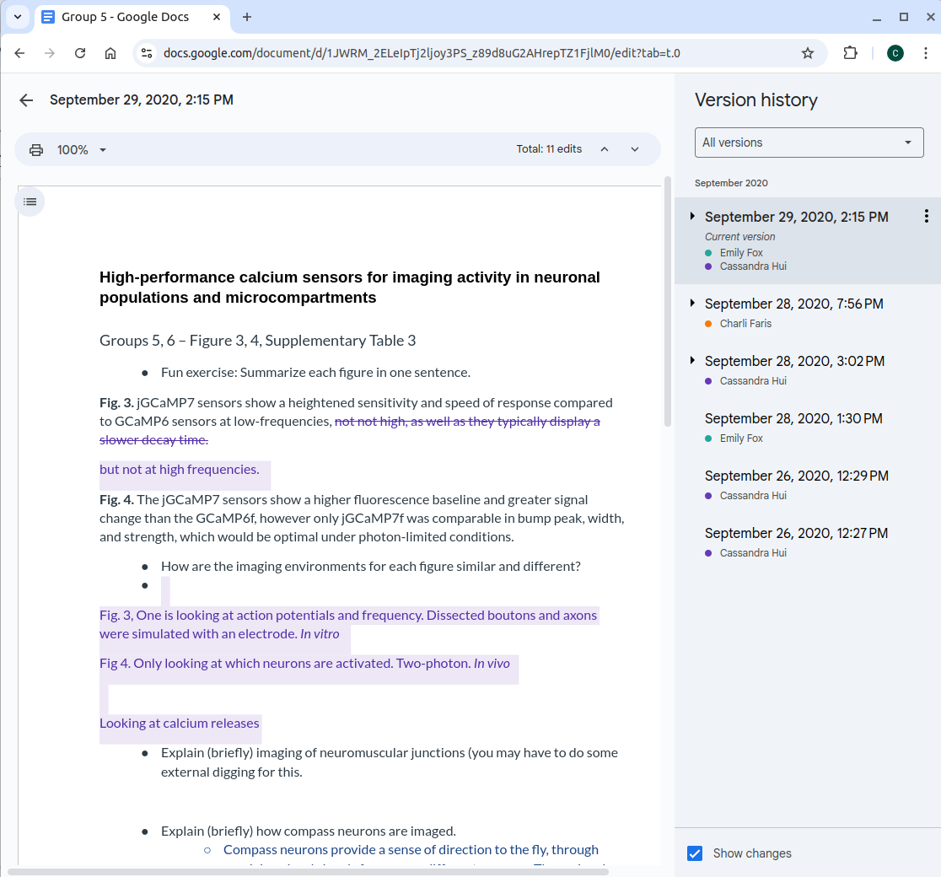
Version Control
A system that records your files over time
Gives you the ability to revert to older versions
Example: Google Docs

Slide 4

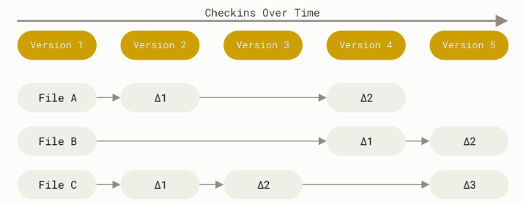
Git
Git is a Version Control
Commits create Snapshots not differences
Can be stored in a remote location

Slide 5
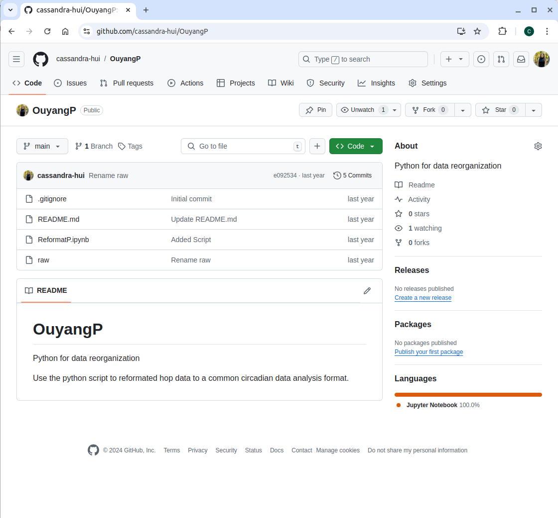
GitHub
User/Repository
Online (Remote)
Free
Collaboration
Find other repositories (Course Materials)
Personal Portfolio
Files

Slide 6
GitHub Definitions
Repository: A file of files
Clone: Create an exact copy of your repository on your local computer
Pull: Pulls new content from a remote repository
Push: Pushes new content from your local computer to a remote
Fork: Duplicates a repository under your repositories and allows for updating from the original-Covered Next Session
GitHub Pages: A static site hosting service (website)-Covered Next Session

Slide 7
What is a repository?
A file of files
Location where items are stored
This can be on:
Your personal computer
Remote location
Both

Slide 8



Remote Location
Emily's Computer
Remote
Project
Raw Data
Stats.R
README.md

Slide 9
Remote Location
Emily's Computer
Remote
Project
Raw Data
Stats.R
README.md
Commit

Slide 10
Remote Location
Emily's Computer
Remote
Project
Raw Data
Stats.R
README.md
Clone

Slide 11
Remote Location
Emily's Computer
Remote
Editing stats script
Writing manuscript
Project
Raw Data
Stats.R
README.md
Clone

Slide 12
Remote Location
Emily's Computer
Remote
Project
Raw Data
Stats.R (v2)
Commit
Push
README.md
Clone
Manuscript

Slide 13
Remote Location
Emily's Computer
Remote
Project
More work
Raw Data
Stats.R (v2)
Push
README.md
Clone
Manuscript

Slide 14
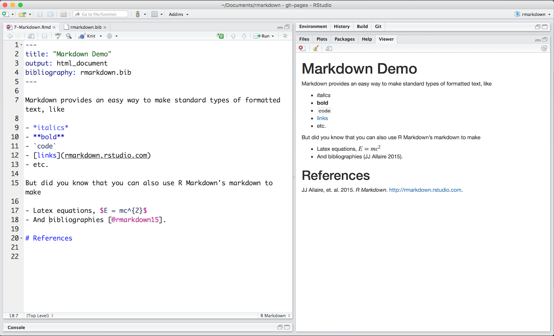
GitHub
Starting Files:
README.md

Slide 15
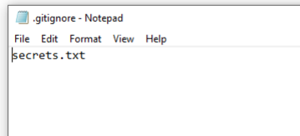
GitHub
Starting Files:
README.md
.gitignore

Slide 16
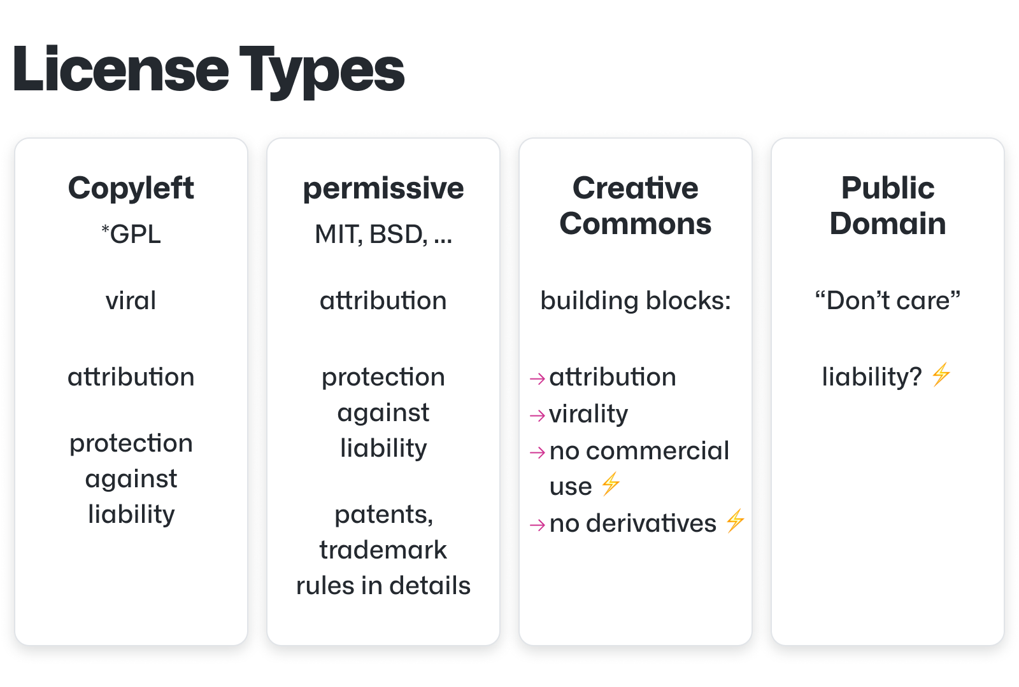
GitHub
Starting Files:
README.md
.gitignore
Liscence

Slide 17
GitHub

Slide 18
Hands-ON: Create a GitHub Repository
Test Repository
Follow setup.md in the Practice folder
Create repository
Add a file
Update README.md

Slide 19
Create a Repository

Slide 20
What is Cloning?
Create an exact copy of your repository on your local computer
This can be done:
On the command line
With GitHub Desktop
You can work from your local computer and update your repository:
Push to move new work to a remote location
Pull to bring new work to your local computer

Slide 21
Hands-On: Cloning
Working on your local computer
Follow cloning.md in the Practice folder
Download GitHub Desktop
Clone your repository
Edit/add files
Push

Slide 22
Clone a Repository

Slide 23
Collaboration

Slide 24
Remote Location – Collaboration
Emily's Computer
Remote

Slide 25
Remote Location – Collaboration
Emily's Computer
Remote
Commit

Slide 26
Remote Location – Collaboration
Emily's Computer
Remote
Clone

Slide 27

Remote Location – Collaboration
Emily's Computer
Remote
Bob's Computer
Clone

Slide 28
Remote Location – Collaboration
Emily's Computer
Remote
Bob's Computer
Clone
Clone

Slide 29
Remote Location – Collaboration
Emily's Computer
Remote
Bob's Computer
Clone
Clone

Slide 30
Remote Location – Collaboration
Emily's Computer
Remote
Bob's Computer
Push
Commit
Clone
Clone

Slide 31
Remote Location – Collaboration
Emily's Computer
Remote
Bob's Computer
Pull
Push
Clone
Clone

Slide 32
Remote Location – Collaboration
Emily's Computer
Remote
Bob's Computer
Pull
Push
Clone
Clone

Slide 33
Remote Location – Collaboration
Emily's Computer
Remote
Bob's Computer
Push
Pull
Push
Clone
Clone

Slide 34
Remote Location – Collaboration
Emily's Computer
Remote
Bob's Computer
Updated Project
Pull
Push
Pull
Push
Clone
Pull

Slide 35
Remote Location – Collaboration
Emily's Computer
Remote
Bob's Computer
More work
Pull
Push
Pull
Push
Clone
Pull

Slide 36
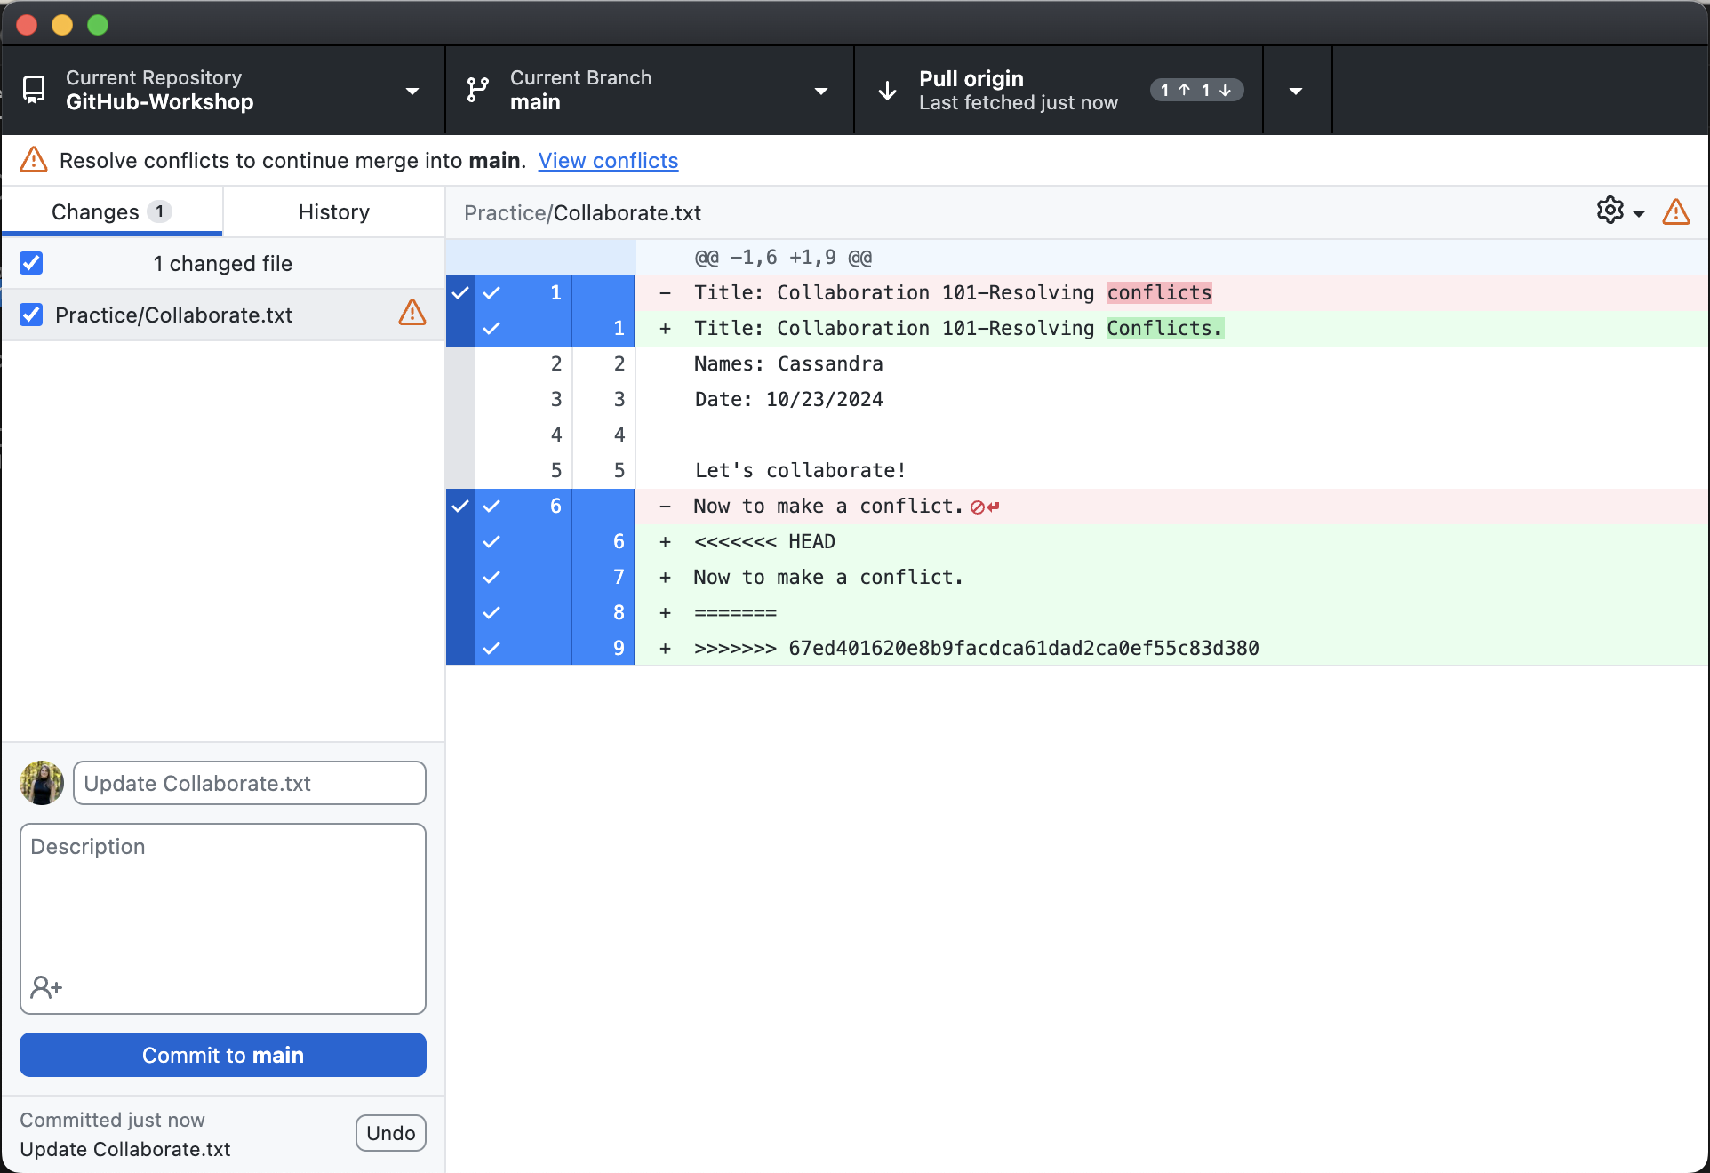
Resolving Conflicts

Slide 37
Collaborate
Follow the collaborate.md file in the Practice folder
Add a collaborator to your repository
Make conflicting edits
Resolve conflicts

Slide 38
Collaborate

Slide 39
Next Session:
Create your own personal website:
Forking a Repository
Creating a GitHub Pages site

Slide 40
THANK YOU
References:
https://docs.github.com/en
https://git-scm.com/book/en/v2

