Slide 1

Version Control and GitHub
GitHub Workshop day 1
Cassandra Hui
25 November 2024

Slide 2
Outline
Version Control
Git as Version Control
GitHub
What is a Repository
Hands-on: Create a GitHub Repository
What is Cloning
Hands-on: Clone a Repository
Collaboration
Hands-on: Resolving Conflicts

Slide 3
Version Control
A system that records your files over time.
Collaboration: Multiple people can work on the same project simultaneously without overwriting each other’s work.
History Tracking: Keeps a record of changes, so you can revert to earlier versions if something goes wrong.
Example: “Track changes” in Microsoft Word and “Undo” feature in any software.

Slide 4
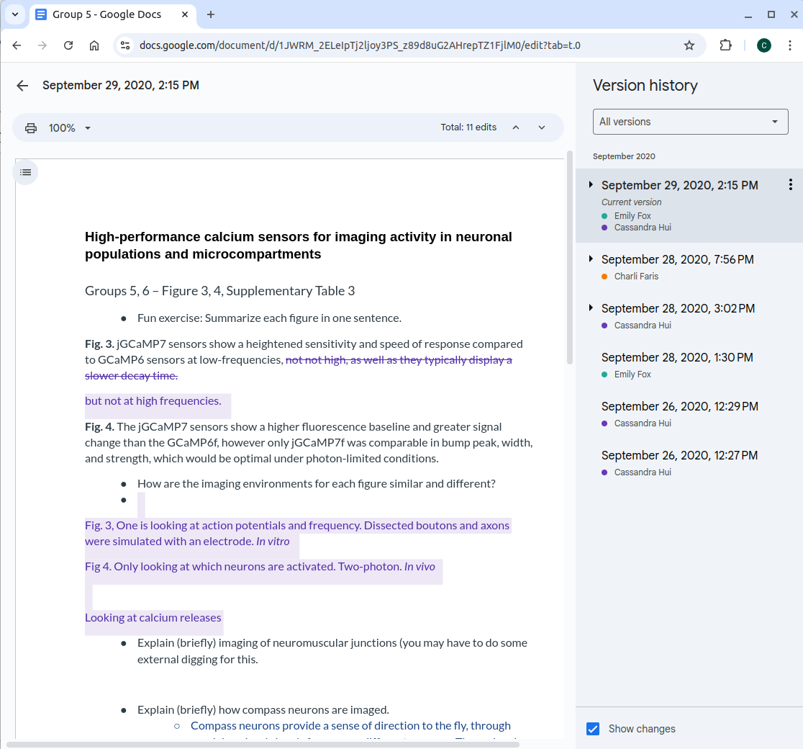
Version Control
Example: Google Docs

Slide 5

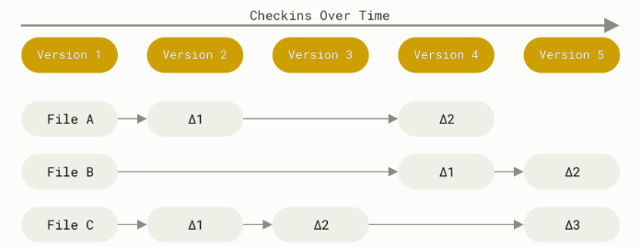
Git
Git is a version control
It tracks changes to files and allows collaboration
Allows you to work offline and sync changes later
Commits create “snapshots” of the entire project, not just the differences
Can be stored in a remote location

Slide 6
Git
Git is a version control
It tracks changes to files and allows collaboration
Allows you to work offline and sync changes later
Commits create “snapshots” of the entire project, not just the differences
Can be stored in a remote location

Slide 7
Git
Git is a version control
It tracks changes to files and allows collaboration
Allows you to work offline and sync changes later
Commits create “snapshots” of the entire project, not just the differences
Can be stored in a remote location

Slide 8
Git
Git is a version control
It tracks changes to files and allows collaboration
Allows you to work offline and sync changes later
Commits create “snapshots” of the entire project, not just the differences
Can be stored in a remote location

Slide 9
Git
Git is a version control
It tracks changes to files and allows collaboration
Allows you to work offline and sync changes later
Commits create “snapshots” of the entire project, not just the differences
Can be stored in a remote location

Slide 10
Git
Git is a version control
It tracks changes to files and allows collaboration
Allows you to work offline and sync changes later
Commits create “snapshots” of the entire project, not just the differences
Can be stored in a remote location

Slide 11
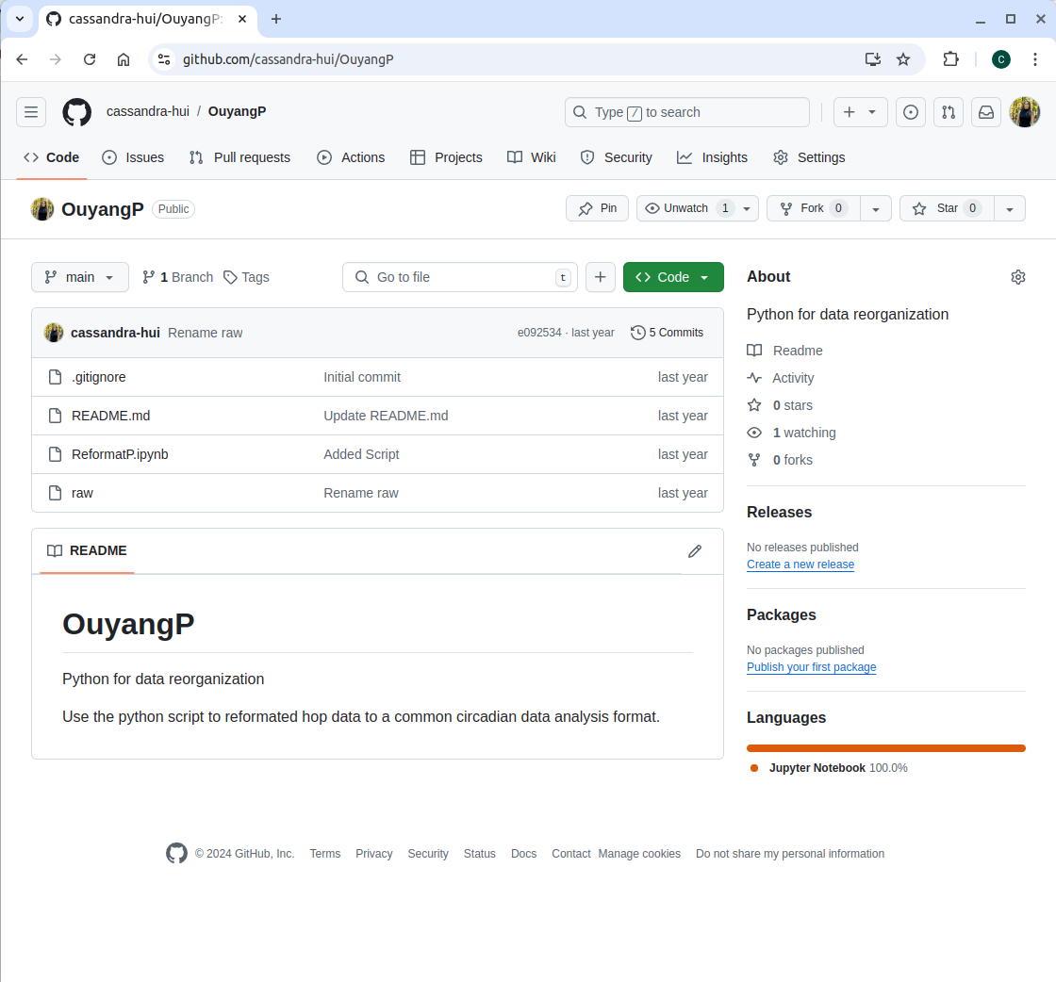
GitHub
User/Repository
Platform for hosting Git
Online (Remote) and free
Collaboration
Find other repositories (Course Materials)
Personal Portfolio
Files

Slide 12
GitHub Definitions
Repository: A file of files
Clone: Create an exact copy of your repository on your local computer
Pull: Pulls new content from a remote repository
Push: Pushes new content from your local computer to a remote
Branching: Duplicates an exact copy a repository in the same repository and allows you to make changes without altering the main-Covered Next Session
GitHub Pages: A static site hosting service (website)-Covered Next Session

Slide 13
What is a repository?
A file of files
Location where items are stored
This can be on:
Your personal computer
Remote location
Both

Slide 14



Remote Location
Emily's Computer
Remote
Project
Raw Data
Stats.R
README.md

Slide 15
Remote Location
Emily's Computer
Remote
Project
Raw Data
Stats.R
README.md
Commit

Slide 16
Remote Location
Emily's Computer
Remote
Project
Raw Data
Stats.R
README.md
Clone

Slide 17
Remote Location
Emily's Computer
Remote
Editing stats script
Writing manuscript
Project
Raw Data
Stats.R
README.md
Clone

Slide 18
Remote Location
Emily's Computer
Remote
Project
Raw Data
Stats.R (v2)
Commit
Push
README.md
Clone
Manuscript

Slide 19
Remote Location
Emily's Computer
Remote
Project
More work
Raw Data
Stats.R (v2)
Push
README.md
Clone
Manuscript

Slide 20
Setting up a Repository
Visibility Options:
Public: Anyone can see your repository.
Private: Only you and collaborators can access the repository.
Initialize: Initializing a repository means setting up a new project folder (repository) for Git to start tracking changes. You can do this on your local computer or when setting up your repository online by adding selected files:
Add a README: Automatically adds a README.md file to get started.
Add a .gitignore File: GitHub provides templates for common languages and tools (e.g., Python, Node.js).
Add a License: GitHub lets you select and add a license when creating a repository.

Slide 21
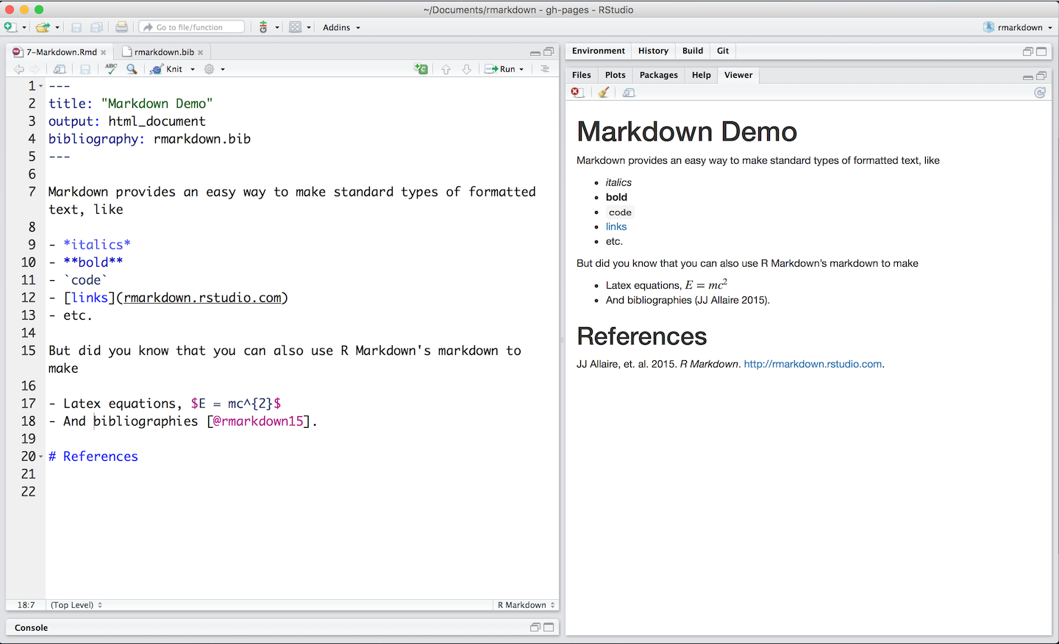
GitHub
README.md
Purpose: Provides a description of the repository and its purpose.
Why It’s Important: Helps others (and you!) understand what the project is about and how to use it.
What to Include:
Project title and description.
Installation instructions.
Usage examples.
Contact information or links.

Slide 22
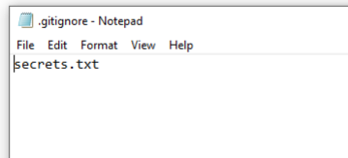
GitHub
.gitignore
Purpose: Specifies files or file types that Git should ignore (not track).
Why It’s Important: Prevents unnecessary or sensitive files (e.g., passwords, logs, system files) from being included in your repository.
Examples of Files to Ignore:
Temporary files (e.g., .DS_Store, *.tmp).
Files with sensitive information (e.g., personal files).

Slide 23
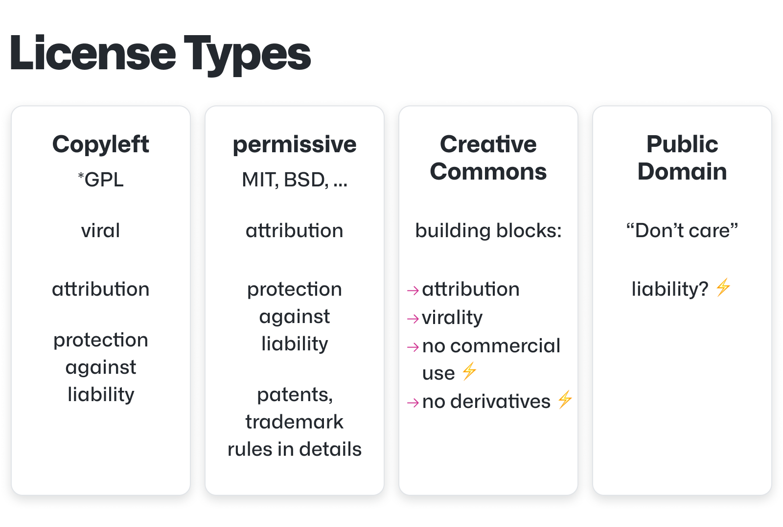
GitHub
LICENSE
Purpose: Specifies how others can use your code.
Why It’s Important: Protects your work and clarifies usage rights.

Slide 24
GitHub

Slide 25

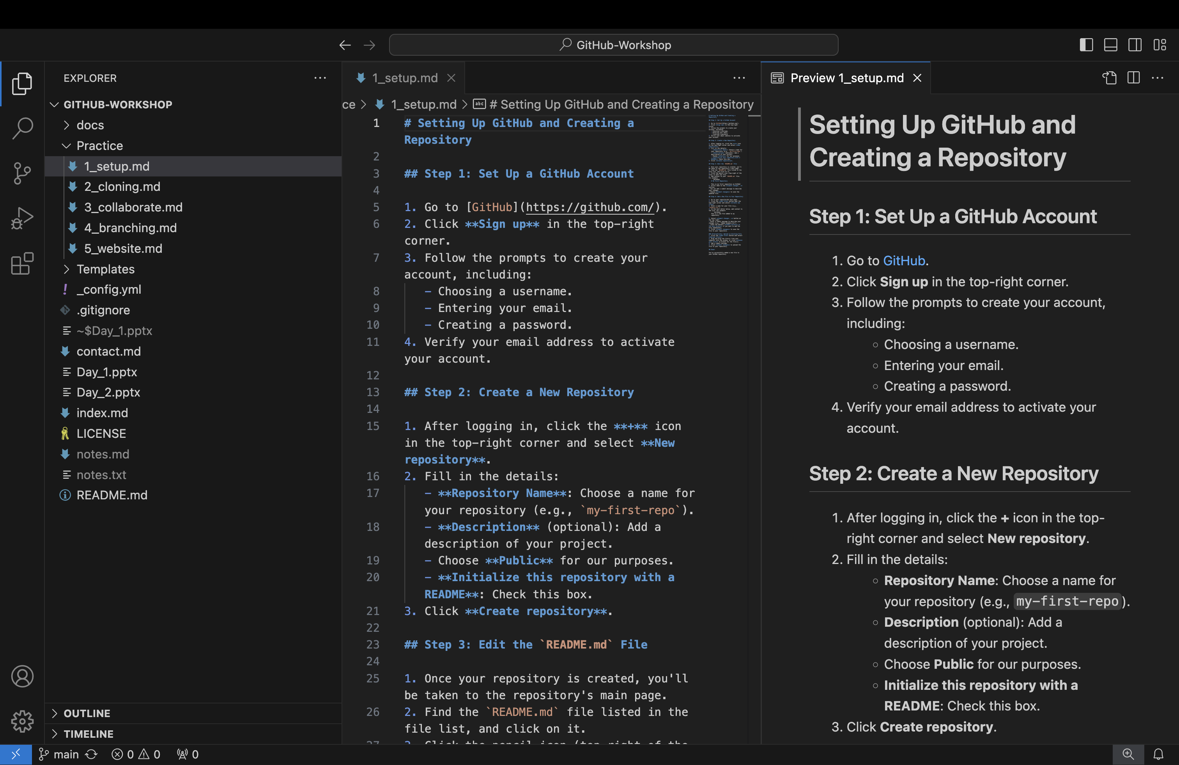
Text Editor

Slide 26
Hands-ON: Create a GitHub Repository
Test Repository
Follow 1_setup.md in the Practice folder
Create repository
Add a file
Update README.md

Slide 27
Create a Repository

Slide 28
What is Cloning?
Create an exact copy of your repository on your local computer
This can be done:
On the command line
With GitHub Desktop
You can work from your local computer and update your repository:
Push to move new work to a remote location
Pull to bring new work to your local computer

Slide 29
Hands-On: Cloning
Working on your local computer
Follow 2_cloning.md in the Practice folder
Download GitHub Desktop
Clone your repository
Edit/add files
Push

Slide 30
Clone a Repository

Slide 31
Collaboration

Slide 32
Remote Location – Collaboration
Emily's Computer
Remote

Slide 33
Remote Location – Collaboration
Emily's Computer
Remote
Commit

Slide 34
Remote Location – Collaboration
Emily's Computer
Remote
Clone

Slide 35

Remote Location – Collaboration
Emily's Computer
Remote
Bob's Computer
Clone

Slide 36
Remote Location – Collaboration
Emily's Computer
Remote
Bob's Computer
Clone
Clone

Slide 37
Remote Location – Collaboration
Emily's Computer
Remote
Bob's Computer
Clone
Clone

Slide 38
Remote Location – Collaboration
Emily's Computer
Remote
Bob's Computer
Push
Commit
Clone
Clone

Slide 39
Remote Location – Collaboration
Emily's Computer
Remote
Bob's Computer
Pull
Push
Clone
Clone

Slide 40
Remote Location – Collaboration
Emily's Computer
Remote
Bob's Computer
Pull
Push
Clone
Clone

Slide 41
Remote Location – Collaboration
Emily's Computer
Remote
Bob's Computer
Push
Pull
Push
Clone
Clone

Slide 42
Remote Location – Collaboration
Emily's Computer
Remote
Bob's Computer
Pull
Push
Updated Project
Pull
Push
Clone
Clone

Slide 43
Remote Location – Collaboration
Emily's Computer
Remote
Bob's Computer
More work
Pull
Push
Pull
Push
Clone
Clone

Slide 44
Collaboration
Share and Work Together: GitHub makes it easy to collaborate by allowing multiple people to work on the same project at the same time, sharing changes through repositories.
Syncing is Key: Always pull the latest changes from the repository before you start working to ensure you’re up to date with your team’s progress.
Track and Communicate Changes: Use clear commit messages to describe your updates so everyone understands what’s been changed and why.

Slide 45
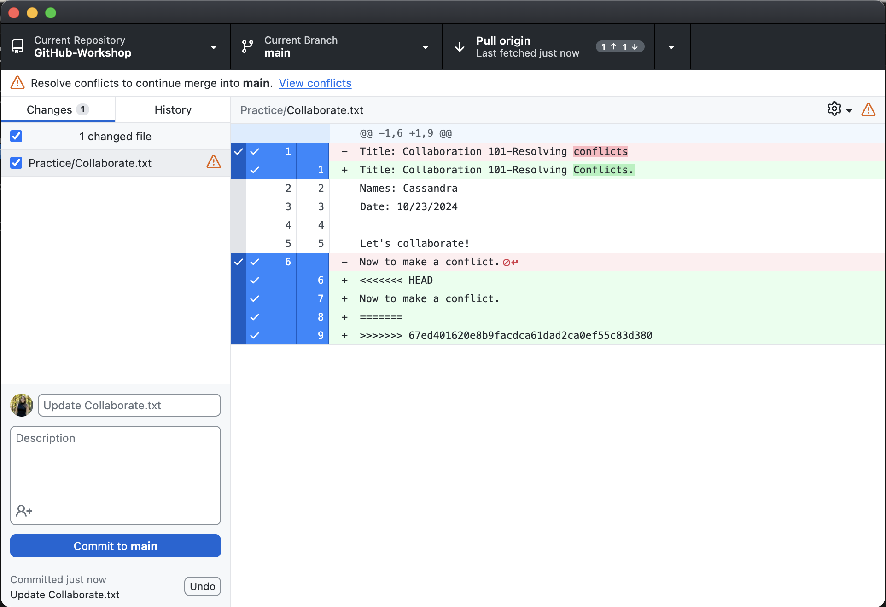
Resolving Conflicts
What Are Conflicts?
Conflicts happen when two people make changes to the same part of a file in a repository and Git cannot automatically decide which change to keep.
How to Resolve Conflicts?
Git shows you the conflicting sections, and you decide how to combine the changes.
Conflicts are resolved locally (on your computer) or online (on GitHub, using the conflict editor).

Slide 46
Collaborate
Follow the 3_collaborate.md file in the Practice folder
Add a collaborator to your repository
Make conflicting edits
Resolve conflicts

Slide 47
Collaborate

Slide 48
Next Session:
Branching:
Best for multiple people working on the same project
Create your own personal website:
Creating a GitHub Pages site

Slide 49
THANK YOU
References:
https://docs.github.com/en
https://git-scm.com/book/en/v2

