Slide 1

Version Control and GitHub
GitHub Workshop day 1
Cassandra Hui
25 November 2024

Slide 2
Outline
Version Control
Git as Version Control
GitHub
What is a Repository
Hands-on: Create a GitHub Repository
What is Cloning
Hands-on: Clone a Repository
Collaboration
Hands-on: Resolving Conflicts

Slide 3
Version Control
A system that records your files over time.
Collaboration: Multiple people can work on the same project simultaneously without overwriting each other’s work.
History Tracking: Keeps a record of changes, so you can revert to earlier versions if something goes wrong.
Example: “Track changes” in Microsoft Word and “Undo” feature in any software.

Slide 4
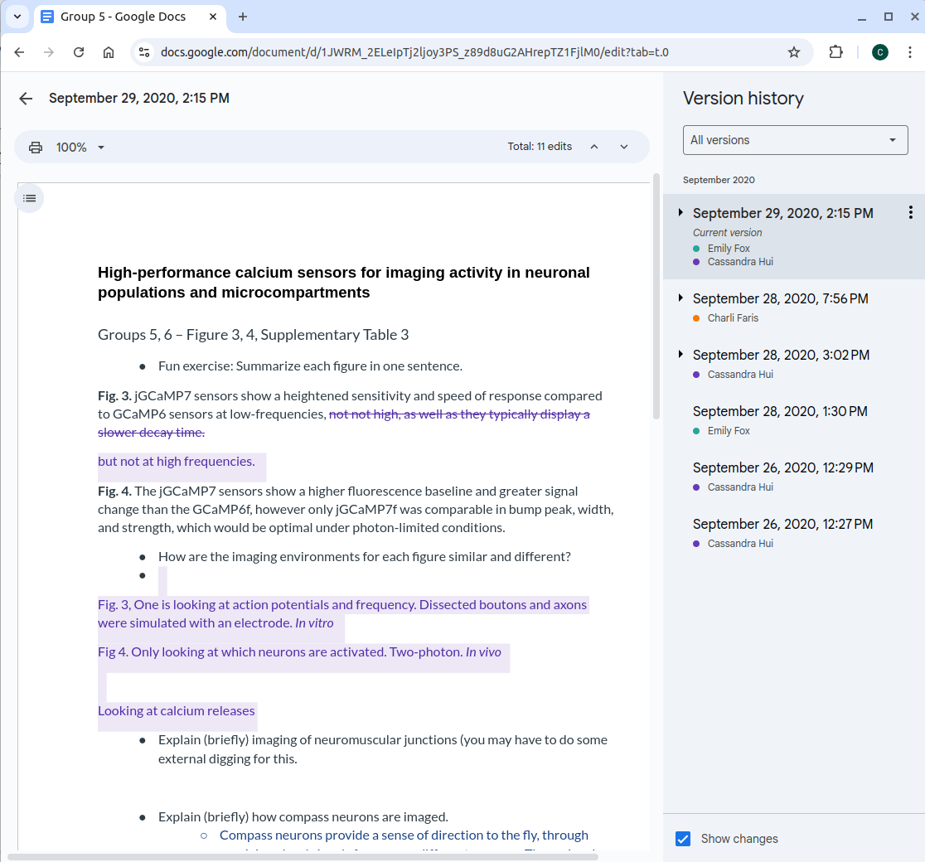
Version Control
Example: Google Docs

Slide 5

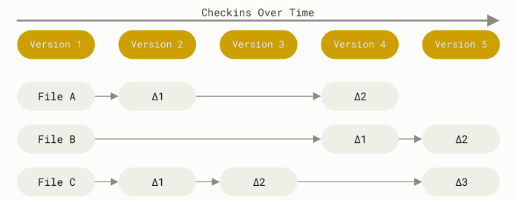
Git
Git is a version control
It tracks changes to files and allows collaboration
Allows you to work offline and sync changes later
Commits create “snapshots” of the entire project, not just the differences
Can be stored in a remote location

Slide 6
Git
Git is a version control
It tracks changes to files and allows collaboration
Allows you to work offline and sync changes later
Commits create “snapshots” of the entire project, not just the differences
Can be stored in a remote location

Slide 7
Git
Git is a version control
It tracks changes to files and allows collaboration
Allows you to work offline and sync changes later
Commits create “snapshots” of the entire project, not just the differences
Can be stored in a remote location

Slide 8
Git
Git is a version control
It tracks changes to files and allows collaboration
Allows you to work offline and sync changes later
Commits create “snapshots” of the entire project, not just the differences
Can be stored in a remote location

Slide 9
Git
Git is a version control
It tracks changes to files and allows collaboration
Allows you to work offline and sync changes later
Commits create “snapshots” of the entire project, not just the differences
Can be stored in a remote location

Slide 10
Git
Git is a version control
It tracks changes to files and allows collaboration
Allows you to work offline and sync changes later
Commits create “snapshots” of the entire project, not just the differences
Can be stored in a remote location

Slide 11
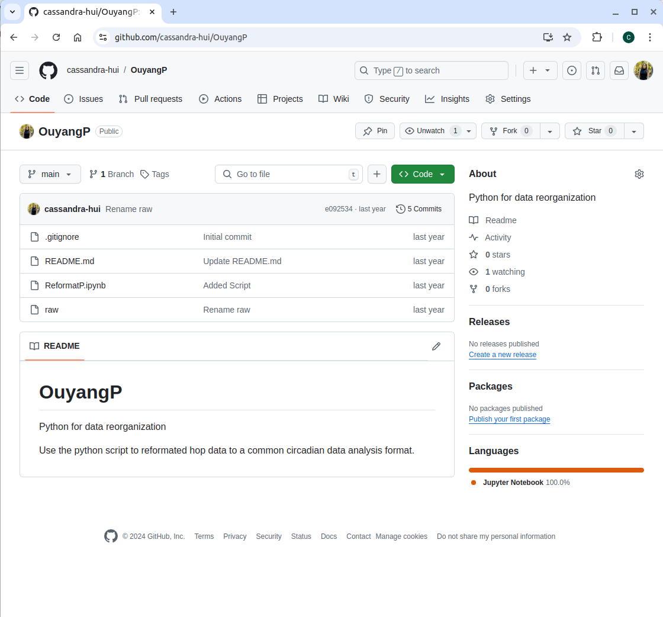
GitHub
User/Repository
Platform for hosting Git
Online (Remote) and free
Collaboration
Find other repositories (Course Materials)
Personal Portfolio
Files

Slide 12
GitHub Definitions
Repository: A file of files
Clone: Create an exact copy of your repository on your local computer
Pull: Pulls new content from a remote repository
Push: Pushes new content from your local computer to a remote
Branching: Duplicates an exact copy a repository in the same repository and allows you to make changes without altering the main-Covered Next Session
GitHub Pages: A static site hosting service (website)-Covered Next Session

Slide 13
What is a repository?
A file of files
Location where items are stored
This can be on:
Your personal computer
Remote location
Both

Slide 14



Remote Location
Emily's Computer
Remote
Project
Raw Data
Stats.R
README.md

Slide 15
Remote Location
Emily's Computer
Remote
Project
Raw Data
Stats.R
README.md
Commit

Slide 16
Remote Location
Emily's Computer
Remote
Project
Raw Data
Stats.R
README.md
Clone

Slide 17
Remote Location
Emily's Computer
Remote
Editing stats script
Writing manuscript
Project
Raw Data
Stats.R
README.md
Clone

Slide 18
Remote Location
Emily's Computer
Remote
Project
Raw Data
Stats.R (v2)
Commit
Push
README.md
Clone
Manuscript

Slide 19
Remote Location
Emily's Computer
Remote
Project
More work
Raw Data
Stats.R (v2)
Push
README.md
Clone
Manuscript

Slide 20
Setting up a Repository
Visibility Options:
Public: Anyone can see your repository.
Private: Only you and collaborators can access the repository.
Initialize: Initializing a repository means setting up a new project folder (repository) for Git to start tracking changes. You can do this on your local computer or when setting up your repository online by adding selected files:
Add a README: Automatically adds a README.md file to get started.
Add a .gitignore File: GitHub provides templates for common languages and tools (e.g., Python, Node.js).
Add a License: GitHub lets you select and add a license when creating a repository.

Slide 21
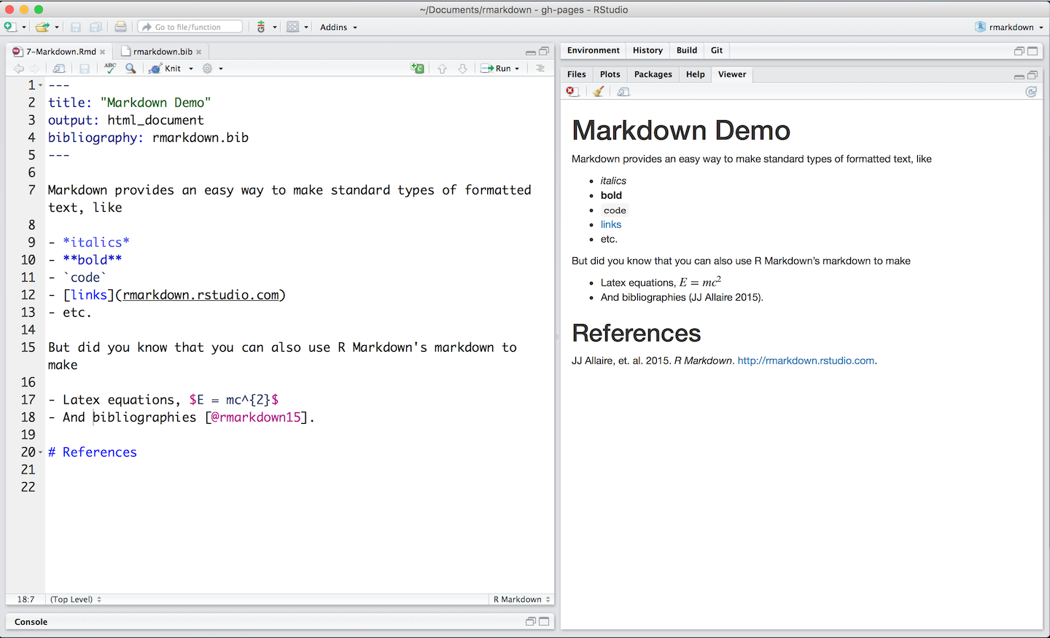
GitHub
README.md
Purpose: Provides a description of the repository and its purpose.
Why It’s Important: Helps others (and you!) understand what the project is about and how to use it.
What to Include:
Project title and description.
Installation instructions.
Usage examples.
Contact information or links.

Slide 22
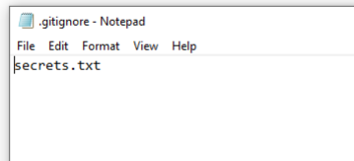
GitHub
.gitignore
Purpose: Specifies files or file types that Git should ignore (not track).
Why It’s Important: Prevents unnecessary or sensitive files (e.g., passwords, logs, system files) from being included in your repository.
Examples of Files to Ignore:
Temporary files (e.g., .DS_Store, *.tmp).
Files with sensitive information (e.g., personal files).

Slide 23
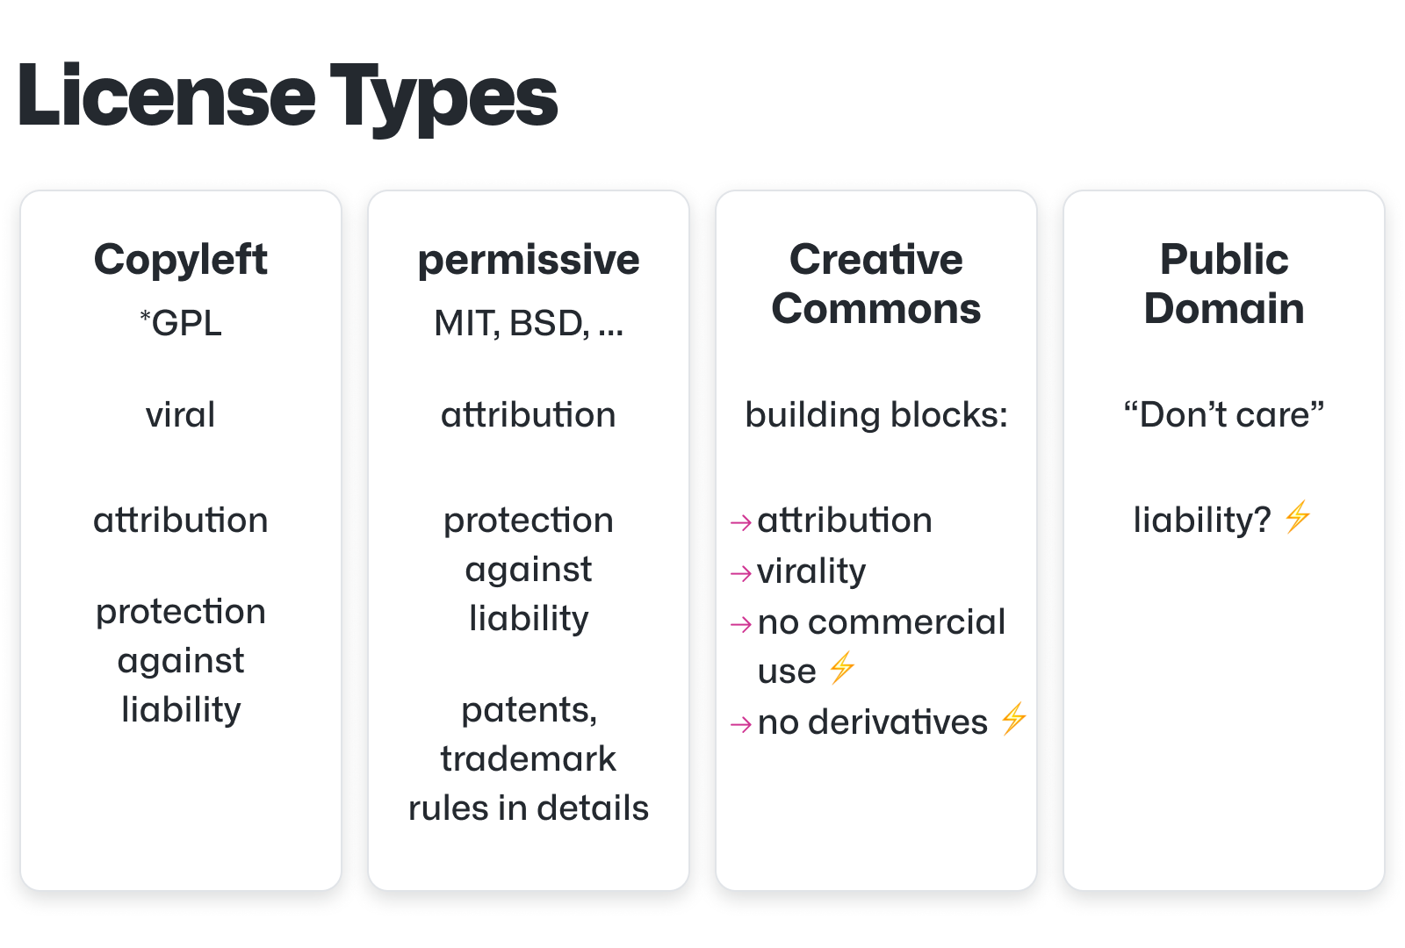
GitHub
LICENSE
Purpose: Specifies how others can use your code.
Why It’s Important: Protects your work and clarifies usage rights.

Slide 24
GitHub

Slide 25
Text Editor
What is a Text Editor?
A text editor is a tool for writing and editing plain text files, essential for coding.
Unlike word processors, text editors don’t add formatting, making them ideal for programming.
Why do we need a text editor? Allows you to write, modify, and save source code files (e.g., .md, .R, .html).

Slide 26
Text Editor
Why We Will Use Visual Studio Code?
Visual Studio Code (VS Code) is one of the most popular text editors for developers. Here’s why we recommend it:
Free and Cross-Platform:
Available for Windows, macOS, and Linux and completely free.
Beginner-Friendly:
Easy to install and set up.
Shows folders and makes it easy to add any type of file.
3. Powerful Features:
Syntax Highlighting and Autocomplete:
Highlights code based on the programming language and built in code completions.
Built-In Git Integration

Slide 27

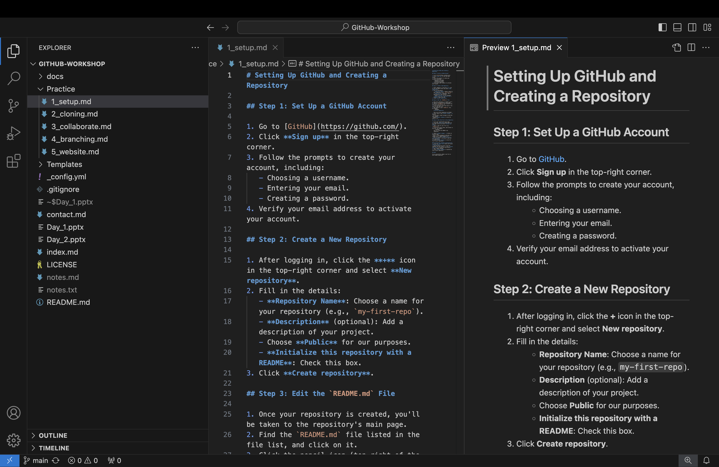
Text Editor

Slide 28
Hands-ON: Create a GitHub Repository
Test Repository
Download VS Code
Follow 1_setup.md in the Practice folder
Create repository
Add a file
Update README.md

Slide 29
Create a Repository

Slide 30
What is Cloning?
Create an exact copy of your repository on your local computer
This can be done:
On the command line
With GitHub Desktop
You can work from your local computer and update your repository:
Push to move new work to a remote location
Pull to bring new work to your local computer

Slide 31
Hands-On: Cloning
Working on your local computer
Follow 2_cloning.md in the Practice folder
Download GitHub Desktop
Clone your repository
Edit/add files
Push

Slide 32
Clone a Repository

Slide 33
Collaboration
Work Together Easily: GitHub allows multiple people to work on the same project simultaneously by syncing changes through repositories.

Slide 34
Remote Location – Collaboration
Emily's Computer
Remote

Slide 35
Remote Location – Collaboration
Emily's Computer
Remote
Commit

Slide 36
Remote Location – Collaboration
Emily's Computer
Remote
Clone

Slide 37

Remote Location – Collaboration
Emily's Computer
Remote
Bob's Computer
Clone

Slide 38
Remote Location – Collaboration
Emily's Computer
Remote
Bob's Computer
Clone
Clone

Slide 39
Remote Location – Collaboration
Emily's Computer
Remote
Bob's Computer
Clone
Clone

Slide 40
Remote Location – Collaboration
Emily's Computer
Remote
Bob's Computer
Push
Commit
Clone
Clone

Slide 41
Remote Location – Collaboration
Emily's Computer
Remote
Bob's Computer
Pull
Push
Clone
Clone

Slide 42
Remote Location – Collaboration
Emily's Computer
Remote
Bob's Computer
Pull
Push
Clone
Clone

Slide 43
Remote Location – Collaboration
Emily's Computer
Remote
Bob's Computer
Push
Pull
Push
Clone
Clone

Slide 44
Remote Location – Collaboration
Emily's Computer
Remote
Bob's Computer
Pull
Push
Updated Project
Pull
Push
Clone
Clone

Slide 45
Remote Location – Collaboration
Emily's Computer
Remote
Bob's Computer
More work
Pull
Push
Pull
Push
Clone
Clone

Slide 46
Collaboration
Share and Work Together: GitHub makes it easy to collaborate by allowing multiple people to work on the same project at the same time, sharing changes through repositories.
Syncing is Key: Always pull the latest changes from the repository before you start working to ensure you’re up to date with your team’s progress.
Track and Communicate Changes: Use clear commit messages to describe your updates so everyone understands what’s been changed and why.

Slide 47
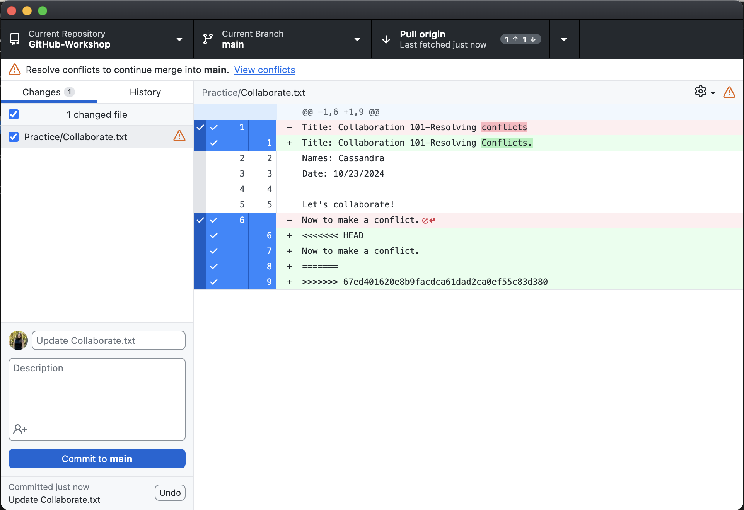
Resolving Conflicts
What Are Conflicts?
Conflicts happen when two people make changes to the same part of a file in a repository and Git cannot automatically decide which change to keep.
How to Resolve Conflicts?
Git shows you the conflicting sections, and you decide how to combine the changes.
Conflicts are resolved locally (on your computer) or online (on GitHub, using the conflict editor).

Slide 48
Collaborate
Follow the 3_collaborate.md file in the Practice folder
Add a collaborator to your repository
Make conflicting edits
Resolve conflicts

Slide 49
Collaborate

Slide 50
Next Session:
Branching:
Best for multiple people working on the same project
Create your own personal website:
Creating a GitHub Pages site

Slide 51
THANK YOU
References:
https://docs.github.com/en
https://git-scm.com/book/en/v2

