Slide 1
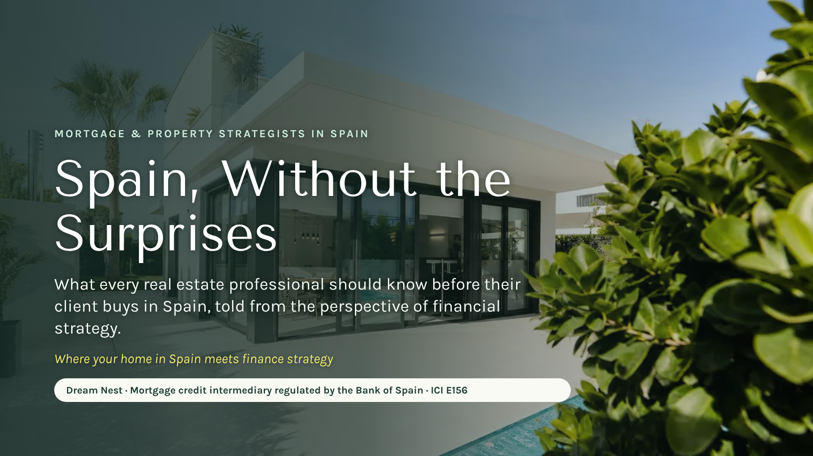
Notes:
[0:00 — 0:30] First line, so it is clear who is speaking and from where: "I’m Cassandra, from Dream Nest. We are financial and mortgage strategists in Spain, regulated by the Bank of Spain." Then: "In 20 minutes I want you to leave with one idea: when a client says Spain, you already know who to call."

Slide 2
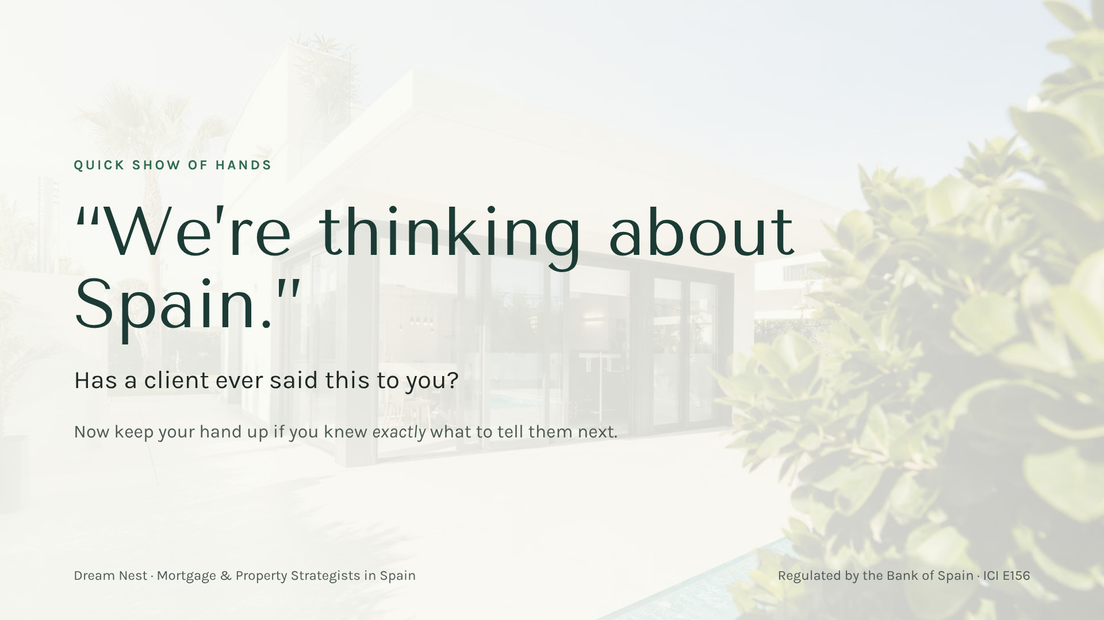
Notes:
[0:30 — 1:30] Real hands: "How many of you have had a client say ‘we’re thinking about Spain’?" Then: "Keep it up if you knew exactly what to answer." Laugh with the room. That gap is the opportunity: that’s where I come in.

Slide 3
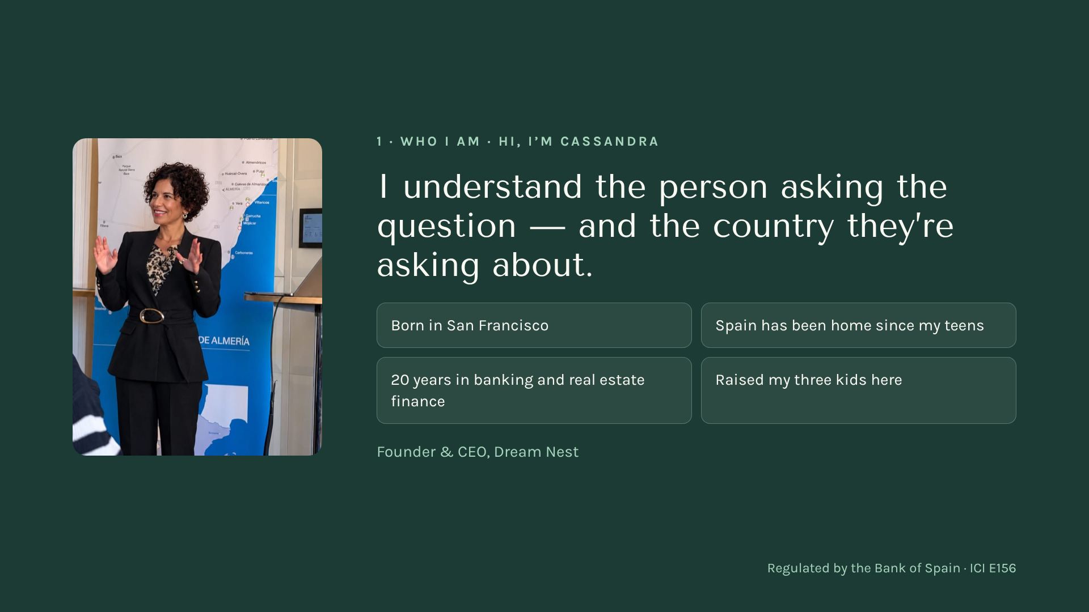
Notes:
[4:15 — 5:30] Your story in 60 seconds, no more: American from San Francisco, in Spain since your teens, twenty years in mortgage banking. "I know both sides of the table." And the team behind you: regulated by the Bank of Spain, E156. Bridge to block 3: "And this is where financial strategy comes in."

Slide 4
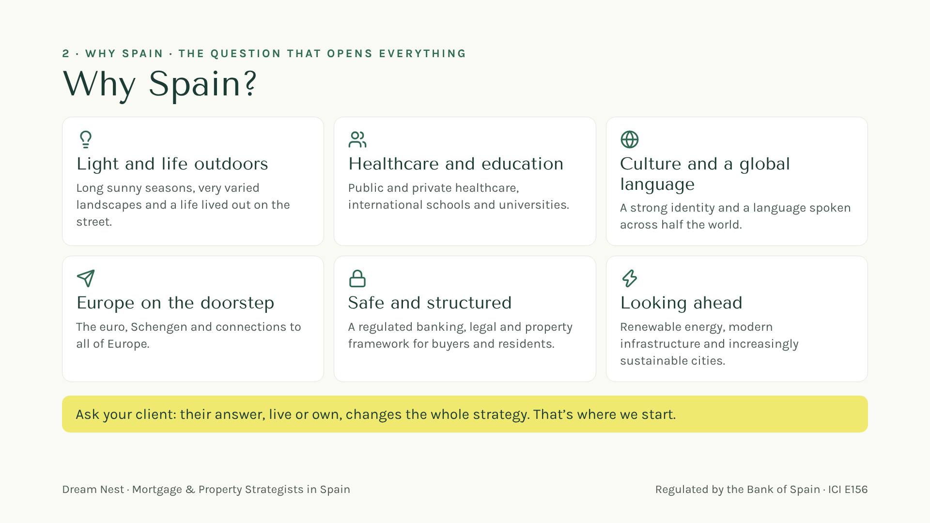

Your gift
Scan here
Notes:
[1:30 — 3:00] "Why Spain?" Ask the room first and let them answer. Then the six reasons, one line each, with your own experience: light and street life; healthcare and international schools; culture and Spanish; Europe on the doorstep with the euro and Schengen; a safe, regulated framework; a country looking ahead. Close with the yellow line: "Your client’s answer, live or own, changes the whole strategy. And that’s where I come in." No figures.

Slide 5
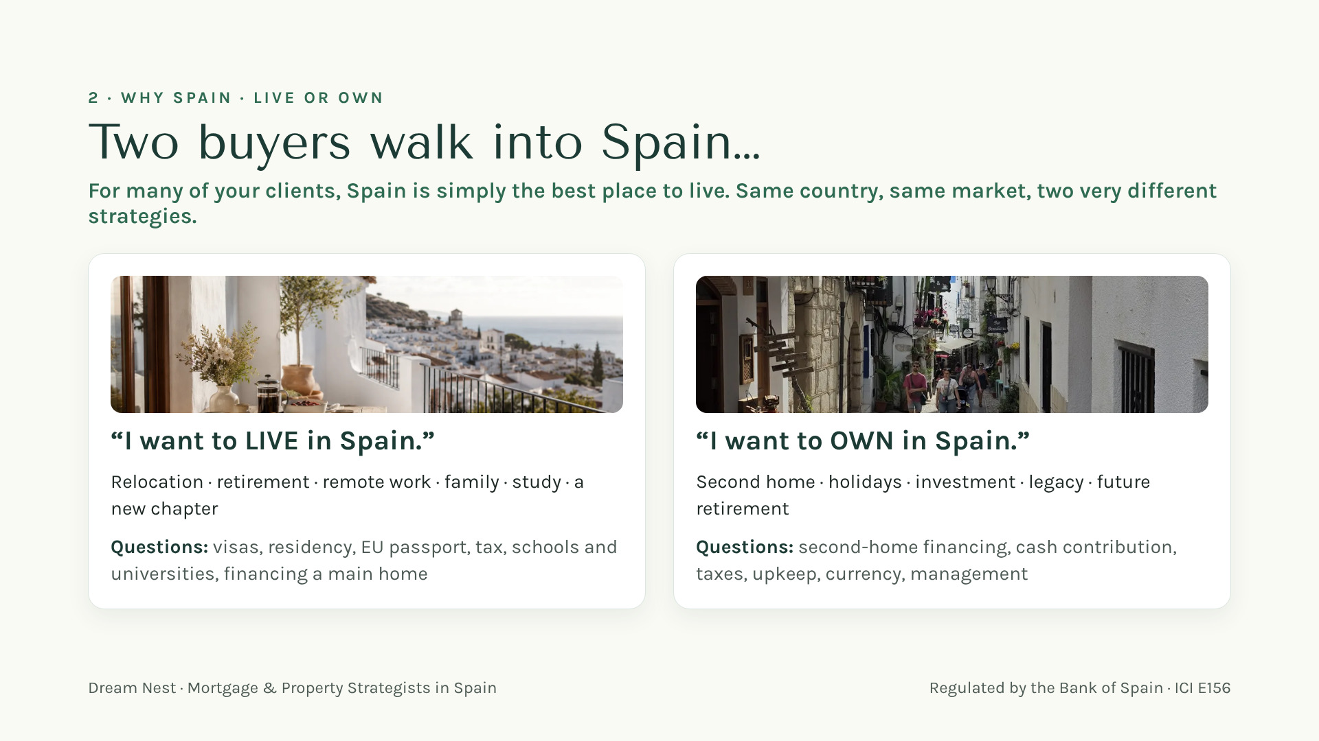
Notes:
[3:00 — 4:00] Make it a game: "Which one is your client? Hands up for LIVE… hands up for OWN." Our first question is not "which property?" but "live or own?", because the use of the home changes the strategy: main home or second home. Residency and visas are a separate, parallel project with their own professionals. Same flat in Valencia, two different strategies.

Slide 6
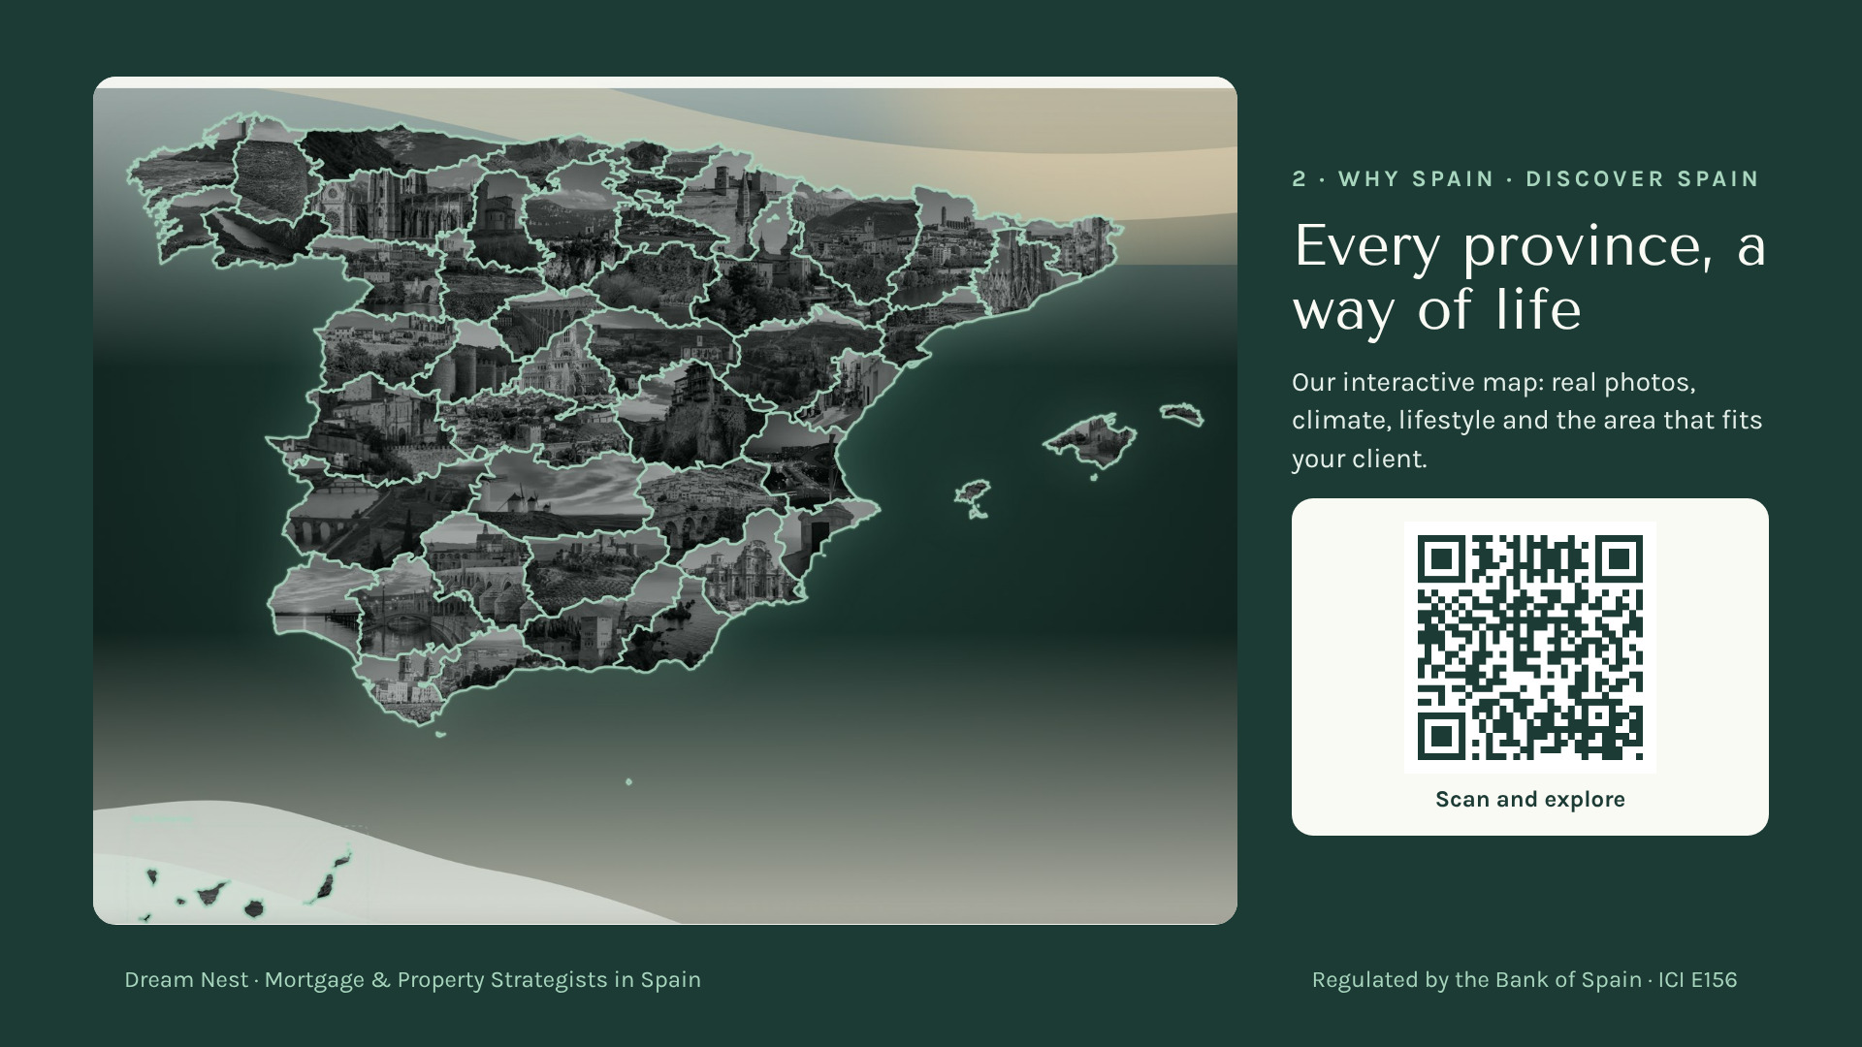
Notes:
[3:00 — 4:15] "You need to see this on your phone, right now." Ask them to scan the QR: it is the interactive map on our website, with a real photo of every province. Mention one or two areas you love, one line each. "When your client doesn’t know where, we start here." No prices.

Slide 7
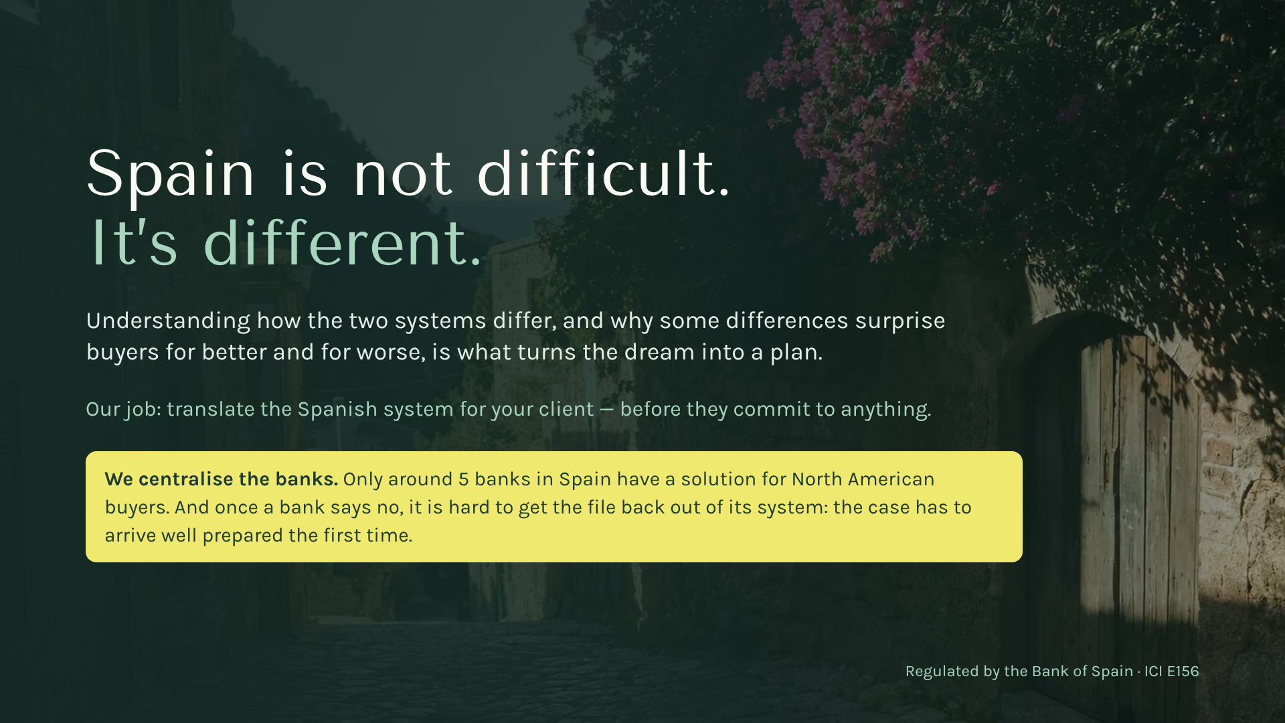
Your gift
Scan here
Notes:
[5:30 — 6:00] The line they take home: "Spain is not difficult. It’s different." Surprises come from assuming Spain follows the American script. Bridge: "Let me show you just three differences that can cost your client the house."

Slide 8
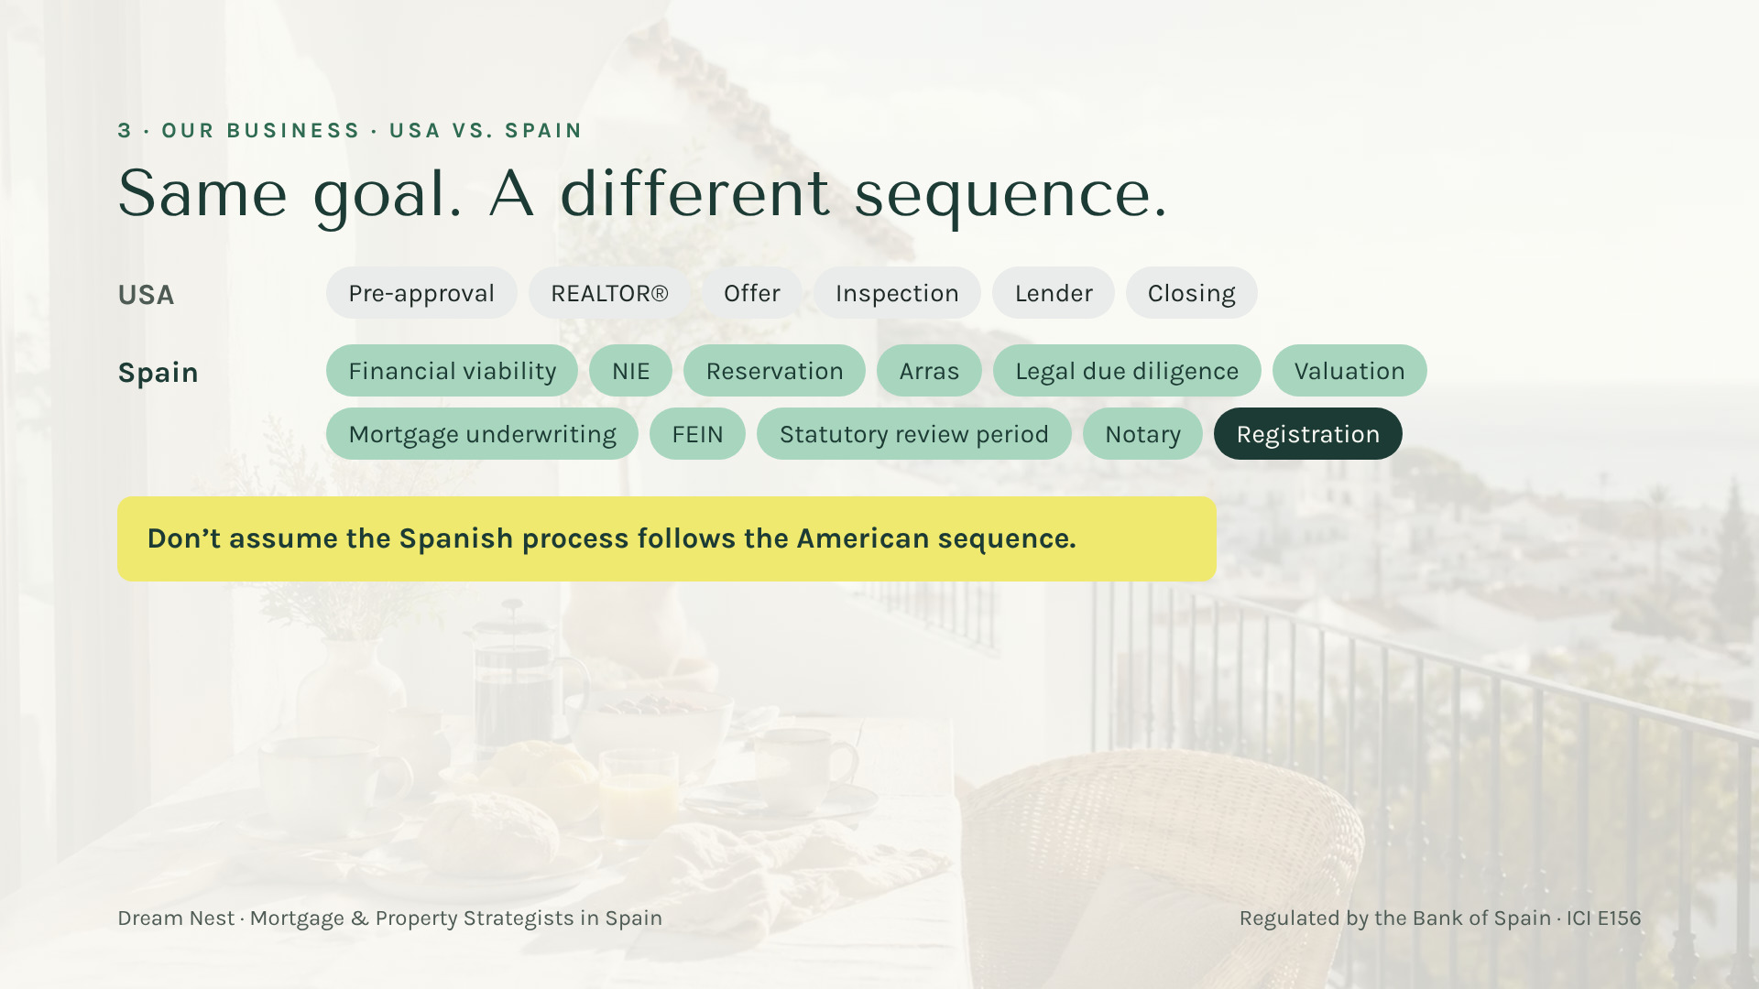
Your gift
Scan here
Notes:
[6:00 — 7:30] Difference 1, the sequence. Six steps they know by heart versus eleven new words. Explain ONLY two: arras (they commit money, sometimes before the bank has said anything) and the FEIN (the binding offer). "This is where a client loses money if nobody warns them. Call me BEFORE signing arras."

Slide 9
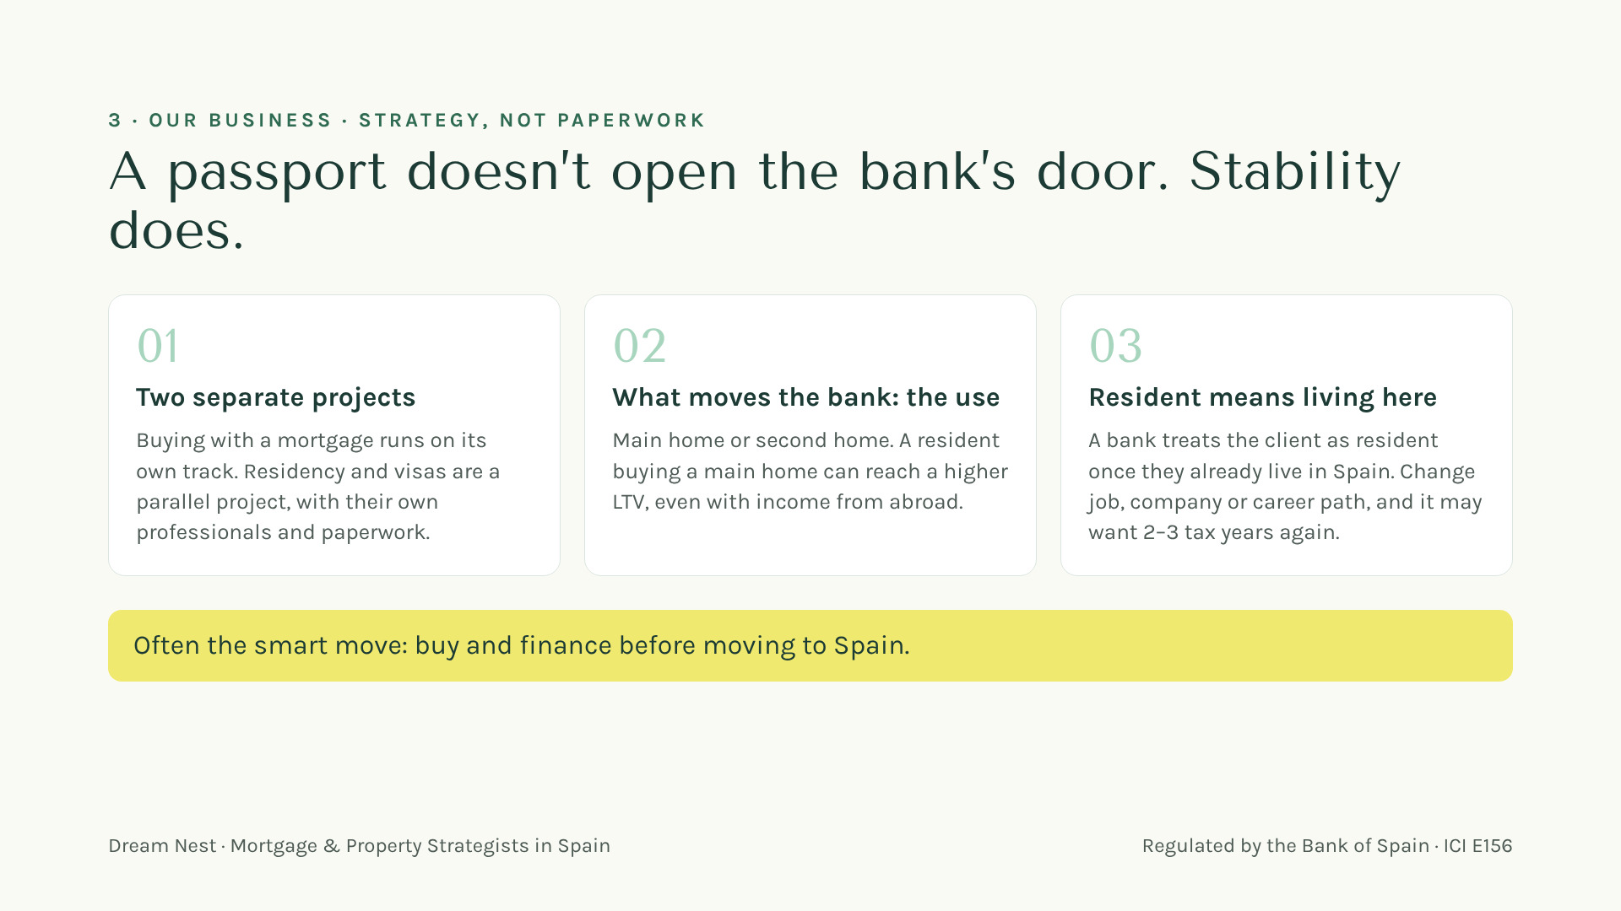
Your gift
Scan here
Notes:
[7:30 — 9:15] Difference 2, the myth: "With a passport or a visa the mortgage gets easier." No. The bank looks at stability and at the use of the home. For the bank, a resident is someone who already lives here, and a job change can mean 2–3 tax years again. Often the smart move is to buy and finance BEFORE moving. "This is strategy, and it’s what I do." ⚠️ LCCI/Orden EHA/2899/2011 — verificar antes de publicar — financing is mentioned.

Slide 10

Your gift
Scan here
Notes:
[9:15 — 10:15] "If you take a photo of one slide today, make it this one." Five numbers a bank looks at: up to ~80% for a main home in many cases, ~70% for second homes and investment, debt-to-income 30–35%, term 20–25 years, maximum age 75–80 when the loan ends. General references; every bank decides. Bridge: "Now let’s see how much cash it really takes." ⚠️ LCCI/Orden EHA/2899/2011 — verificar antes de publicar.

Slide 11
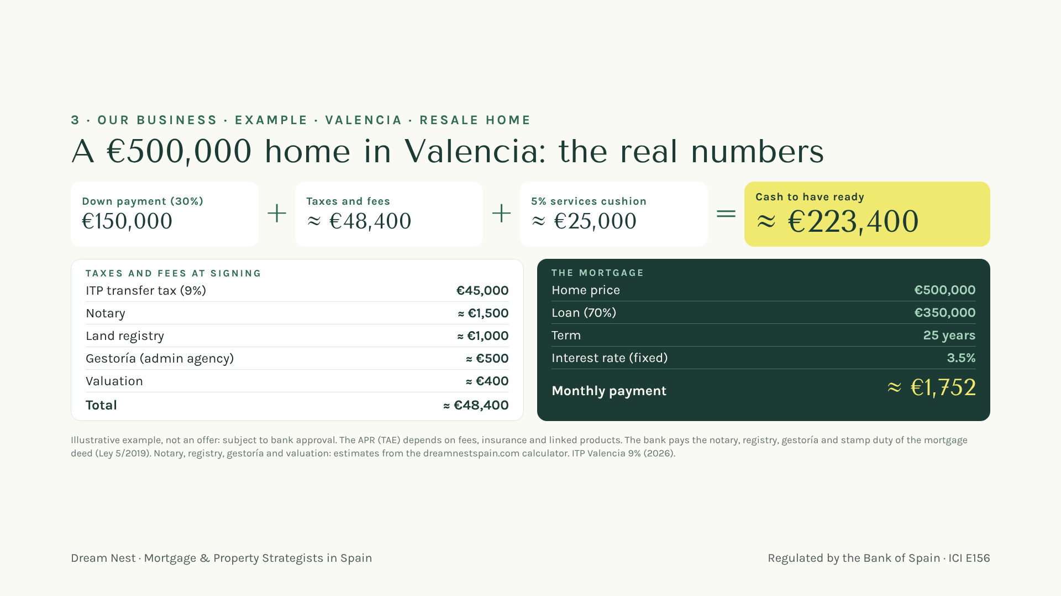
Your gift
Scan here
Notes:
[10:15 — 12:00] Difference 3, the money. Ask before showing: "How much cash does your client need ready for a €500,000 home?" Then the breakdown: about €223,400 with the 5% cushion. "I run this number with every client before they fall in love with a house." Say it is an illustrative example, not an offer. ⚠️ LCCI/Orden EHA/2899/2011 — verificar antes de publicar — illustrative rate and payment, no APR.

Slide 12
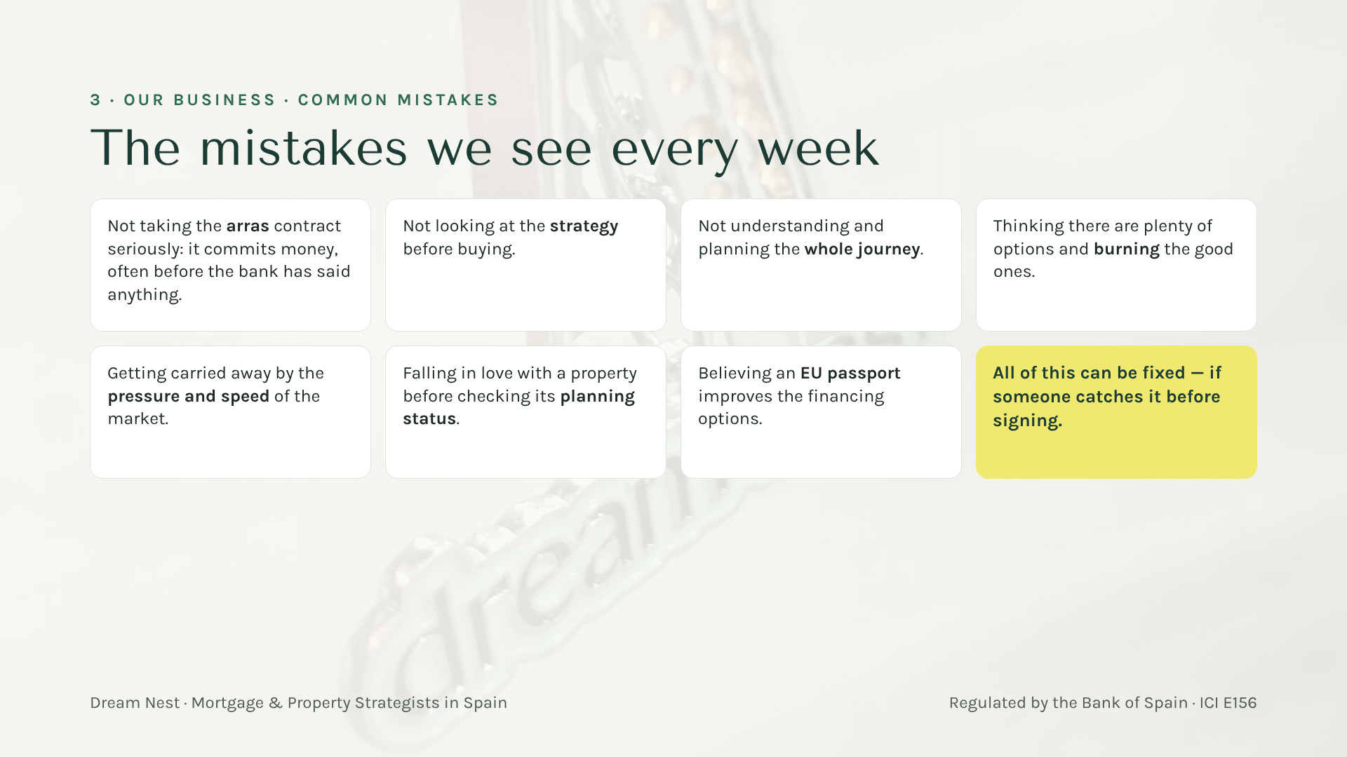
Your gift
Scan here
Notes:
[12:00 — 13:30] One slide, the main ones, quickly: arras (it commits money, often before the bank says anything); no strategy before buying; not planning the whole journey; thinking there are many options and burning the good ones; market pressure and speed; falling in love before checking the planning status; believing an EU passport helps the financing. Close with the yellow card: all of it is fixable if someone catches it before signing.

Slide 13
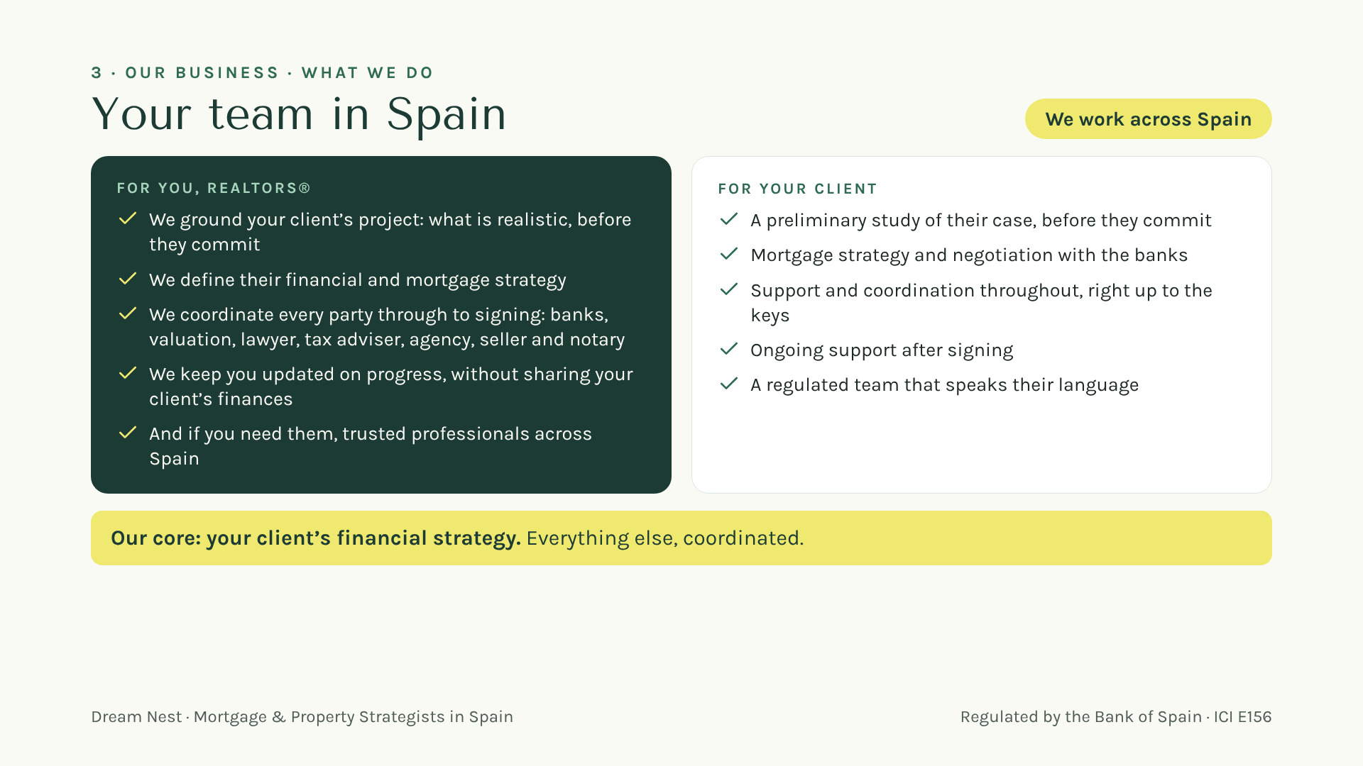
Notes:
[13:30 — 15:00] Stay on the core business. For them: we ground their client’s project and say what is realistic before they commit; we define the financial and mortgage strategy; we coordinate every party through to signing; and we keep them updated without sharing finances. Trusted professionals only in passing: "and if you need them, we’ll introduce you." For their client: preliminary study, strategy and negotiation with the banks, coordination up to the keys and support after. Close with the yellow line: "Our core is your client’s financial strategy. Everything else, coordinated." ⚠️ LCCI/Orden EHA/2899/2011 — verificar antes de publicar — do not mention rates or payments here.

Slide 14
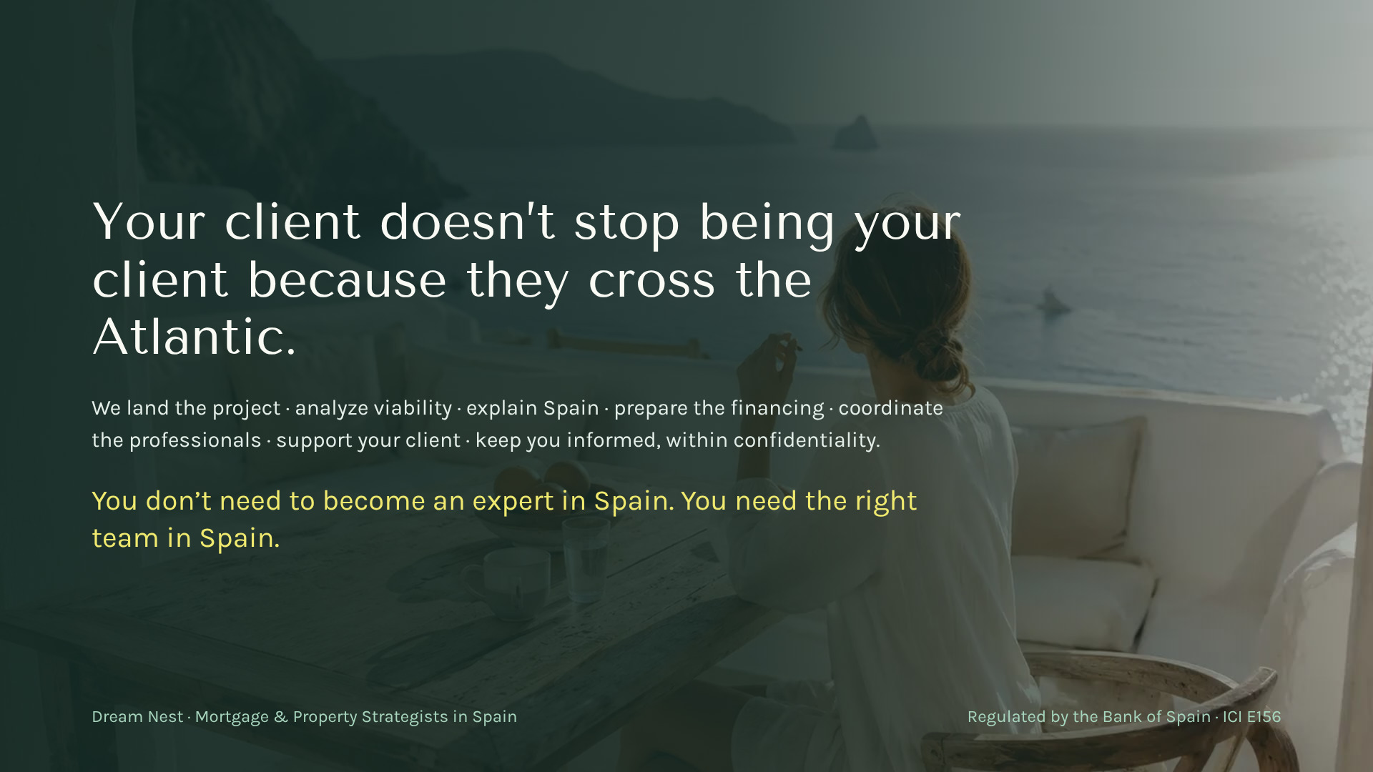
Your gift
Scan here
Notes:
[15:00 — 15:45] The heart of it for this audience: "Your client is still your client even if they cross the Atlantic. You stay their trusted person; I’m your team in Spain." Look at the room.

Slide 15

Notes:
[15:45 — 17:00] How we work together: they introduce a client in seconds from the app, see how it progresses, and we take care of Spain. Red line: we never share your client’s finances. Real screens, demo data.

Slide 16
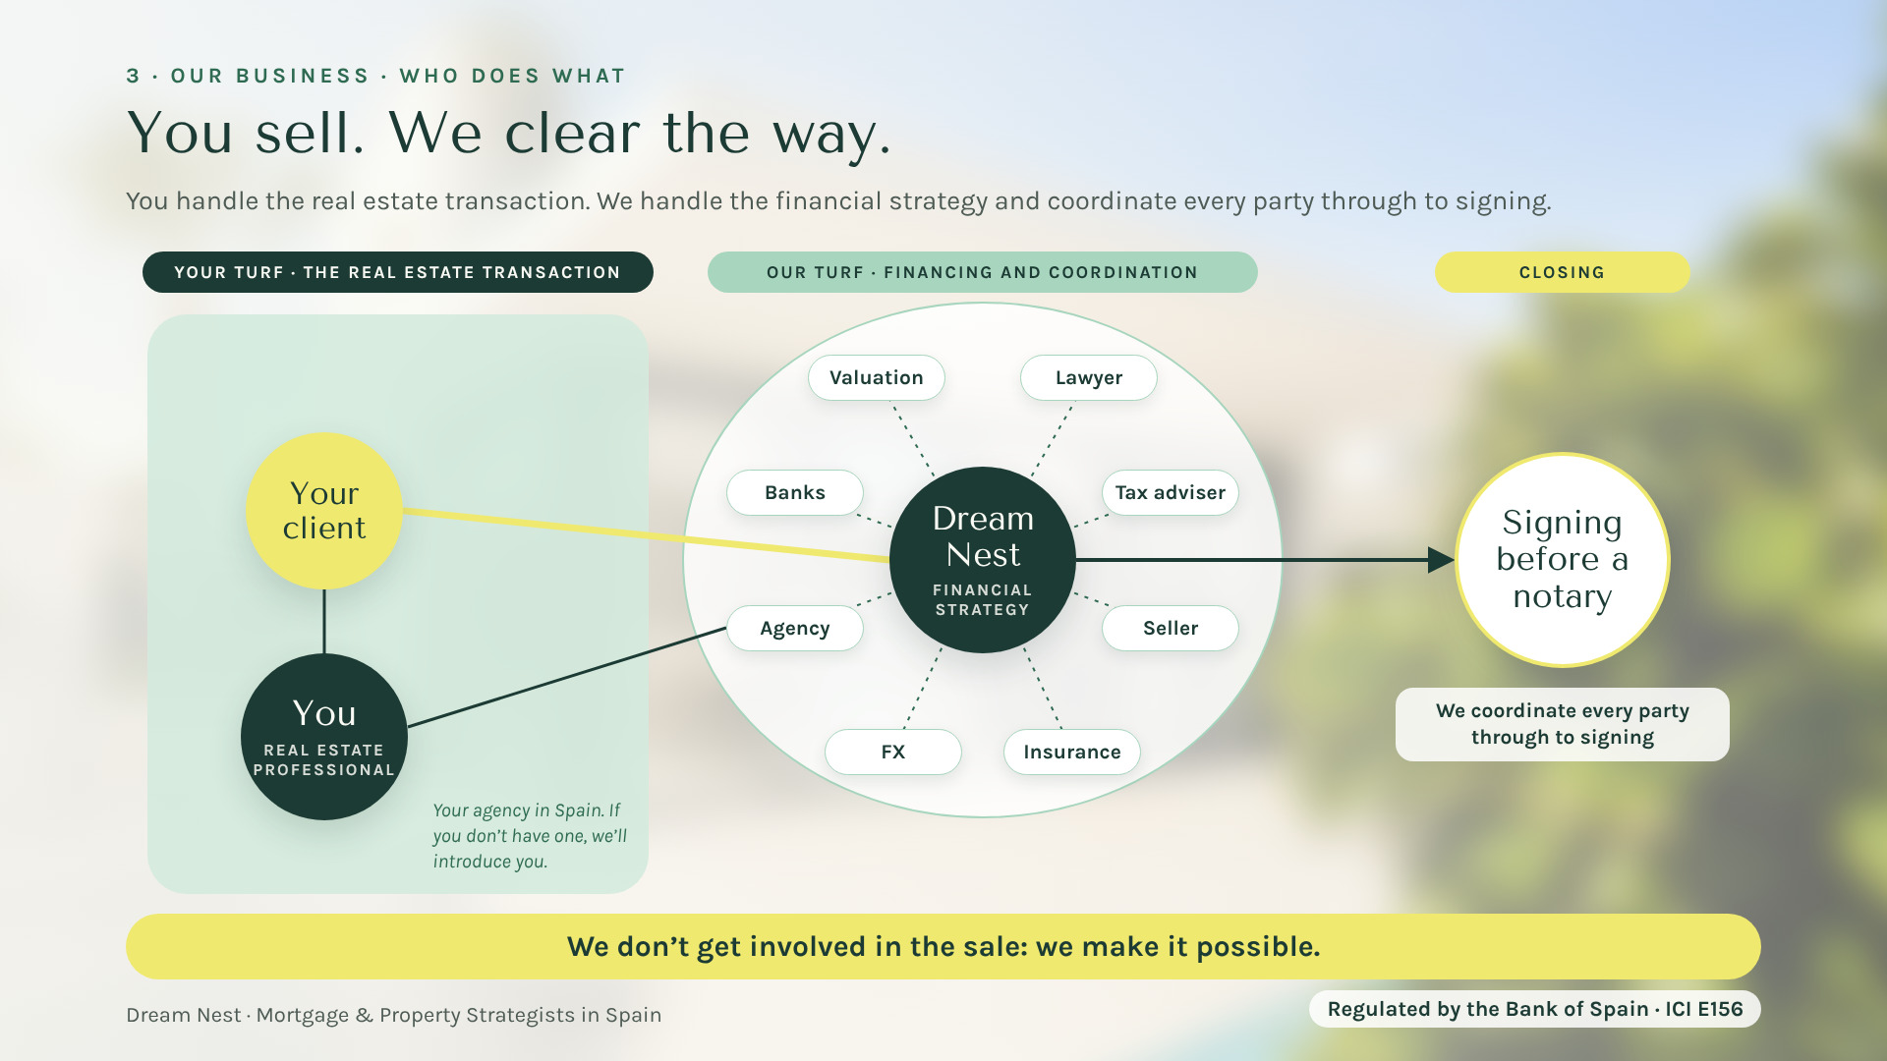
Your gift
Scan here
Notes:
[17:00 — 17:45] Summary of block 3, right before the call to action. "The real estate transaction is yours." You handle the client relationship and the property deal, with your agency in Spain; if you don’t have one, we’ll introduce you. We handle the financial strategy and coordinate every party: banks, valuation, lawyer, tax adviser, FX, insurance, the agency and the seller, through to signing before a notary. Final line: "We don’t get involved in the sale: we make it possible."

Slide 17
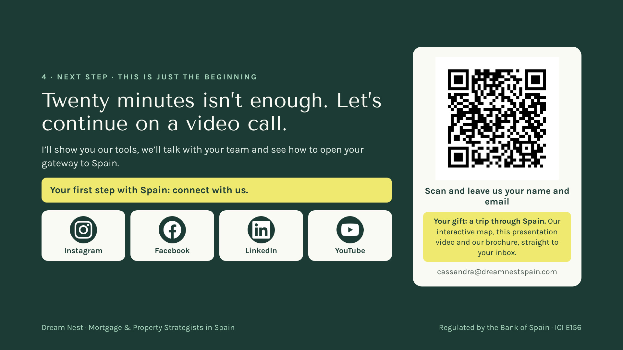
Notes:
[17:45 — 19:00] The call to action, calm and without arrogance: "I’m sorry we have so little time; I know these days are packed. But there is much more to tell you, and it can matter a lot for your global business and your gateway to Spain. Let’s set up a video call: I’ll show you the tools and we’ll talk with your team." Key line: "Your first step with Spain: connect with us." Ask them to scan the QR now for the gift: "Leave us your name and email and we’ll send you a gift: a trip through Spain — our interactive map, this presentation video and our brochure." Then stay quiet for a few seconds while they scan.

Slide 18
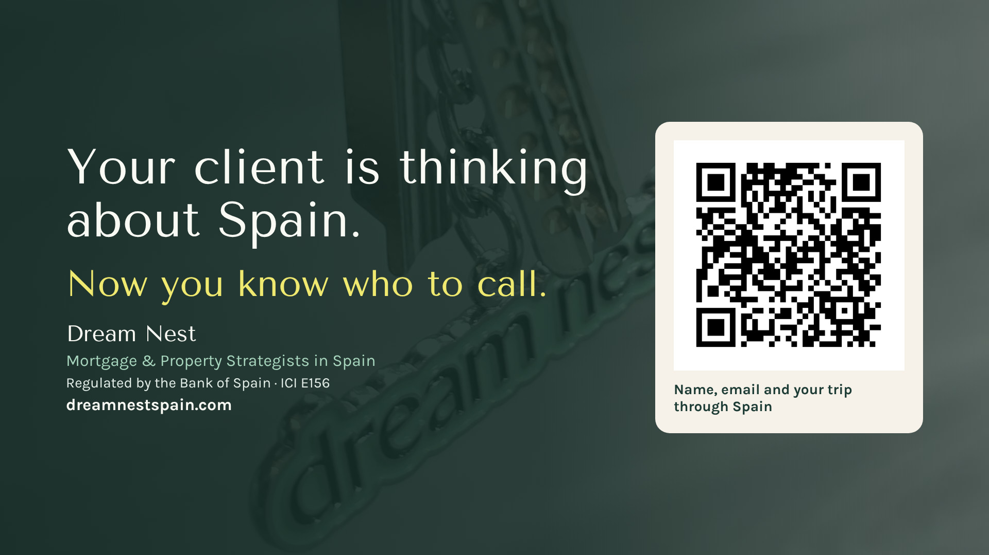
Notes:
[19:00 — 19:30] Slowly: "Your client is thinking about Spain. Now you know who to call." Thank them. Leave the QR up during questions (you have about 2 minutes of margin).

