Slide 1
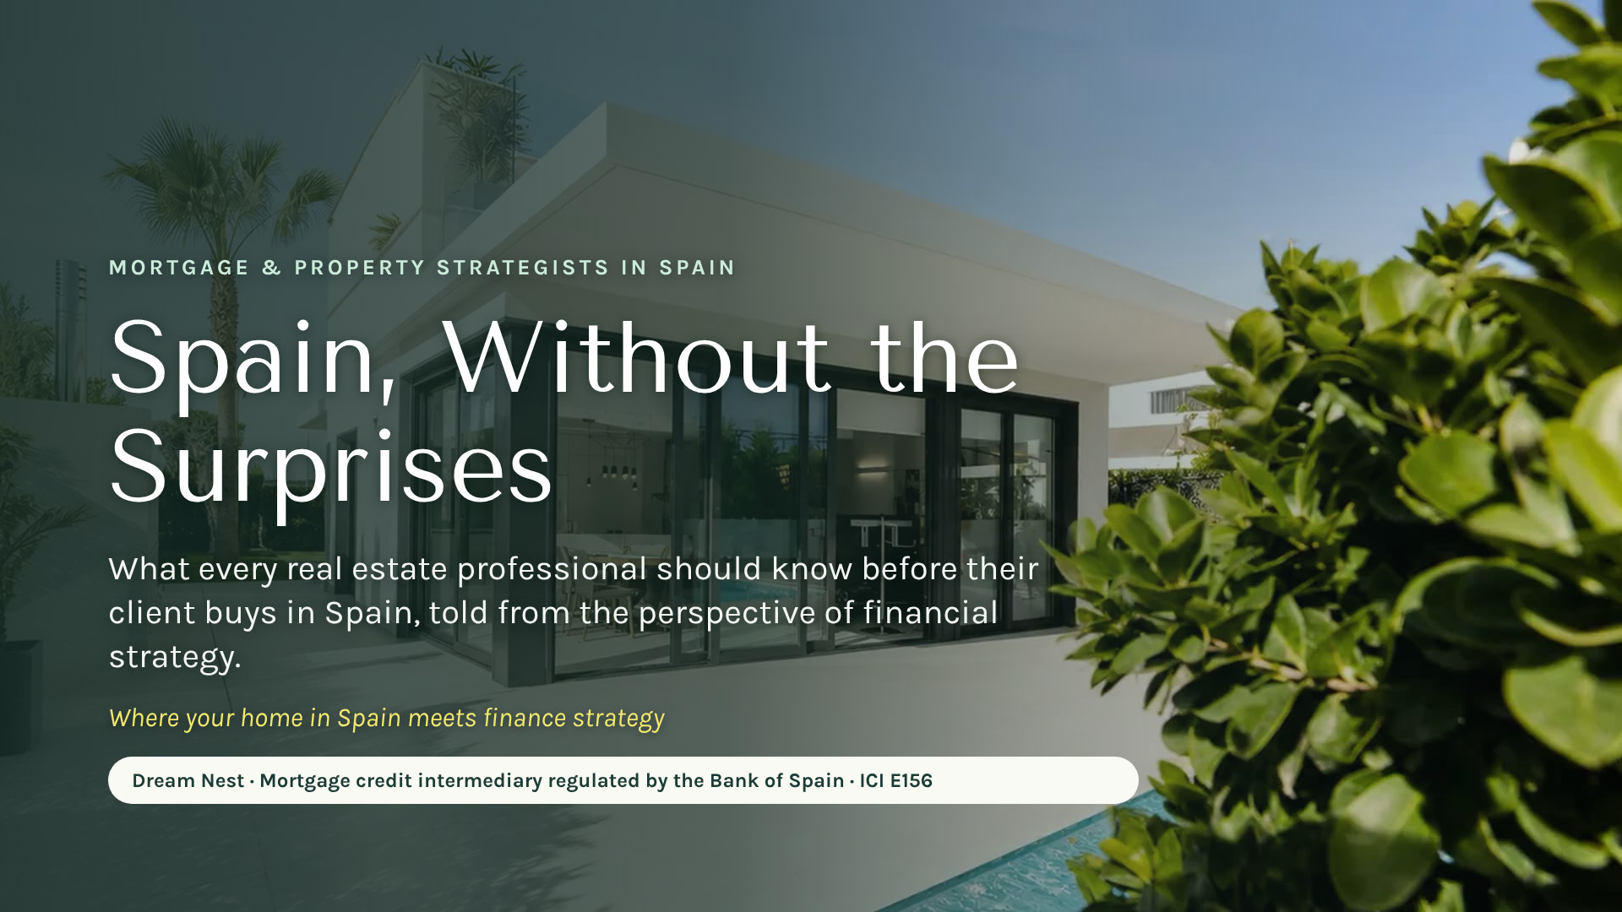
Notes:
[0:00 — 0:30] First line, so it is clear who is speaking and from where: "I’m Cassandra, from Dream Nest. We are financial and mortgage strategists in Spain, regulated by the Bank of Spain." Then: "In 20 minutes I want you to leave with one idea: when a client says Spain, you already know who to call."

Slide 2
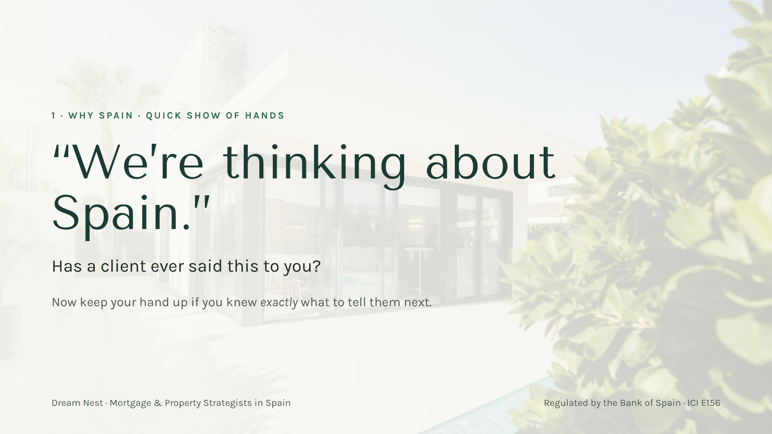
Notes:
[0:30 — 1:30] Real hands: "How many of you have had a client say ‘we’re thinking about Spain’?" Then: "Keep it up if you knew exactly what to answer." Laugh with the room. That gap is the opportunity: that’s where I come in.

Slide 3
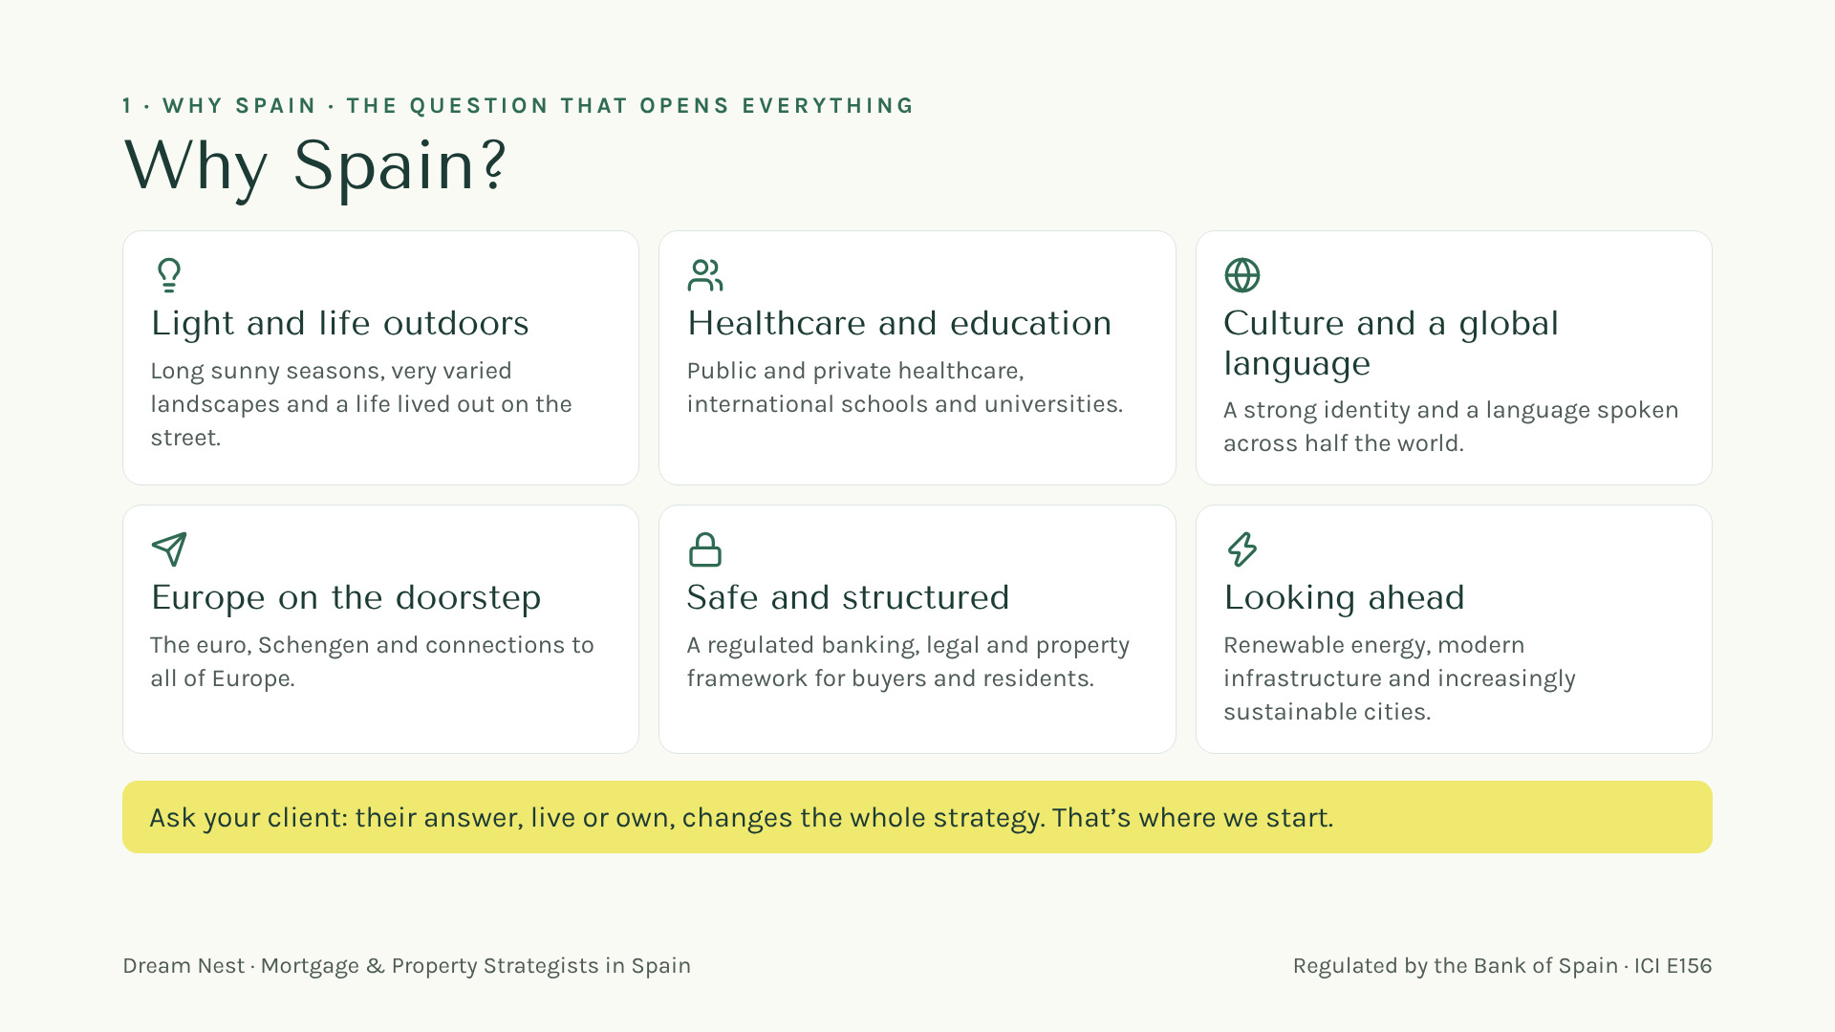

Your gift
Scan here
Notes:
[1:30 — 3:00] "Why Spain?" Ask the room first and let them answer. Then the six reasons, one line each, with your own experience: light and street life; healthcare and international schools; culture and Spanish; Europe on the doorstep with the euro and Schengen; a safe, regulated framework; a country looking ahead. Close with the yellow line: "Your client’s answer, live or own, changes the whole strategy. And that’s where I come in." No figures.

Slide 4
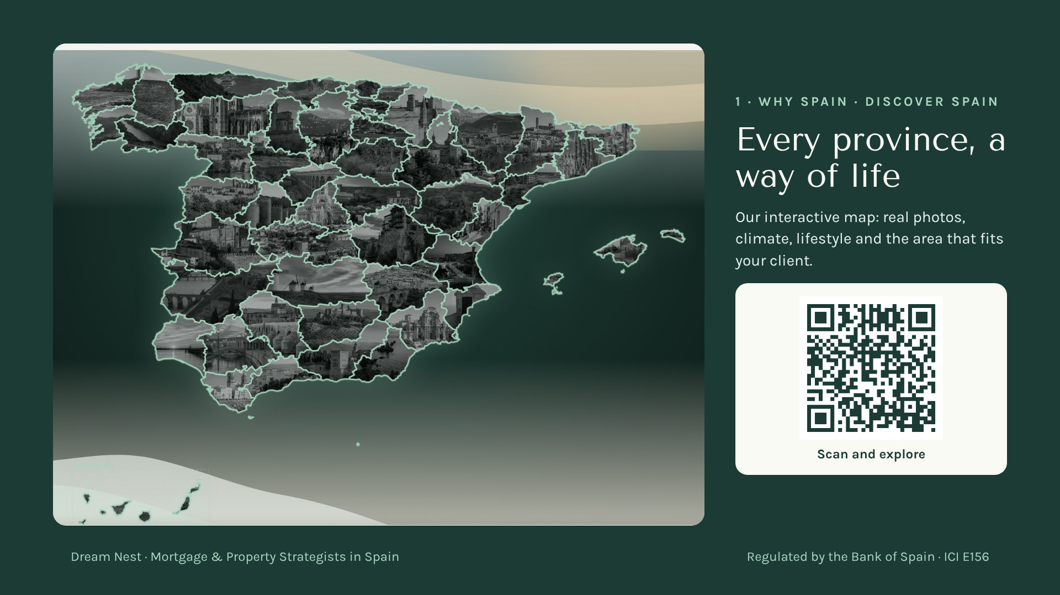
Notes:
[3:00 — 4:15] "You need to see this on your phone, right now." Ask them to scan the QR: it is the interactive map on our website, with a real photo of every province. Mention one or two areas you love, one line each. "When your client doesn’t know where, we start here." No prices.

Slide 5
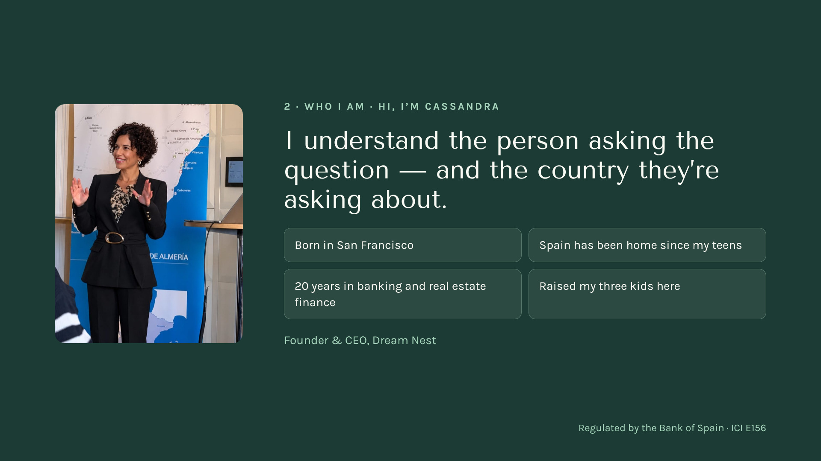
Notes:
[4:15 — 5:30] Your story in 60 seconds, no more: American from San Francisco, in Spain since your teens, twenty years in mortgage banking. "I know both sides of the table." And the team behind you: regulated by the Bank of Spain, E156. Bridge to block 3: "And this is where financial strategy comes in."

Slide 6
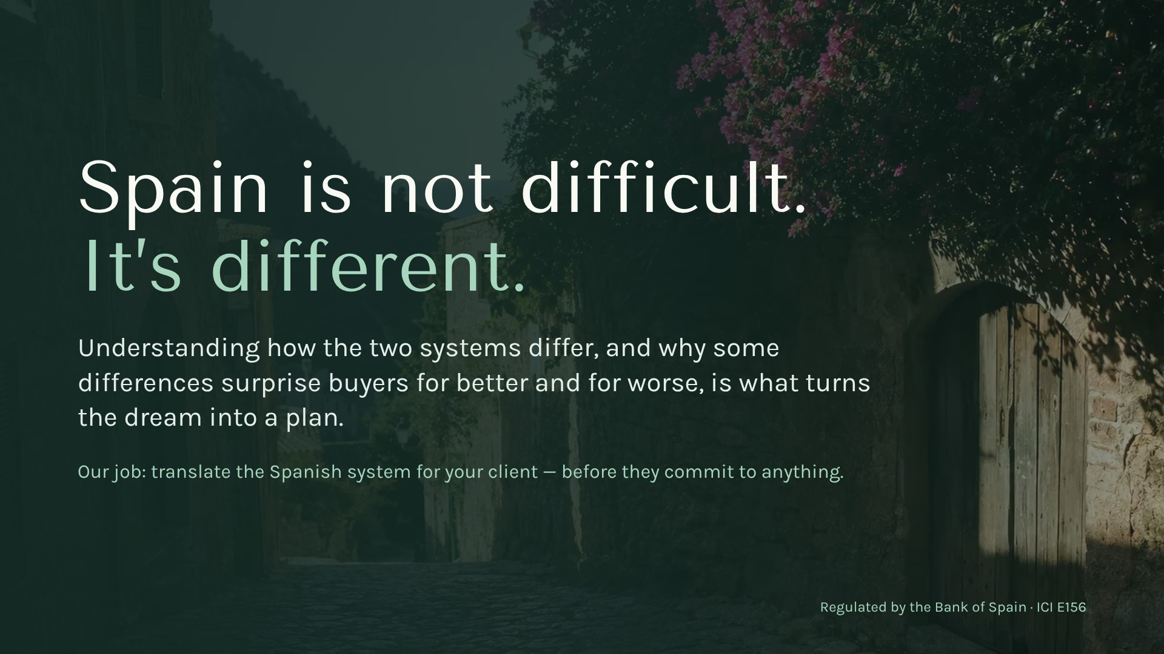
Your gift
Scan here
Notes:
[5:30 — 6:00] The line they take home: "Spain is not difficult. It’s different." Surprises come from assuming Spain follows the American script. Bridge: "Let me show you just three differences that can cost your client the house."

Slide 7
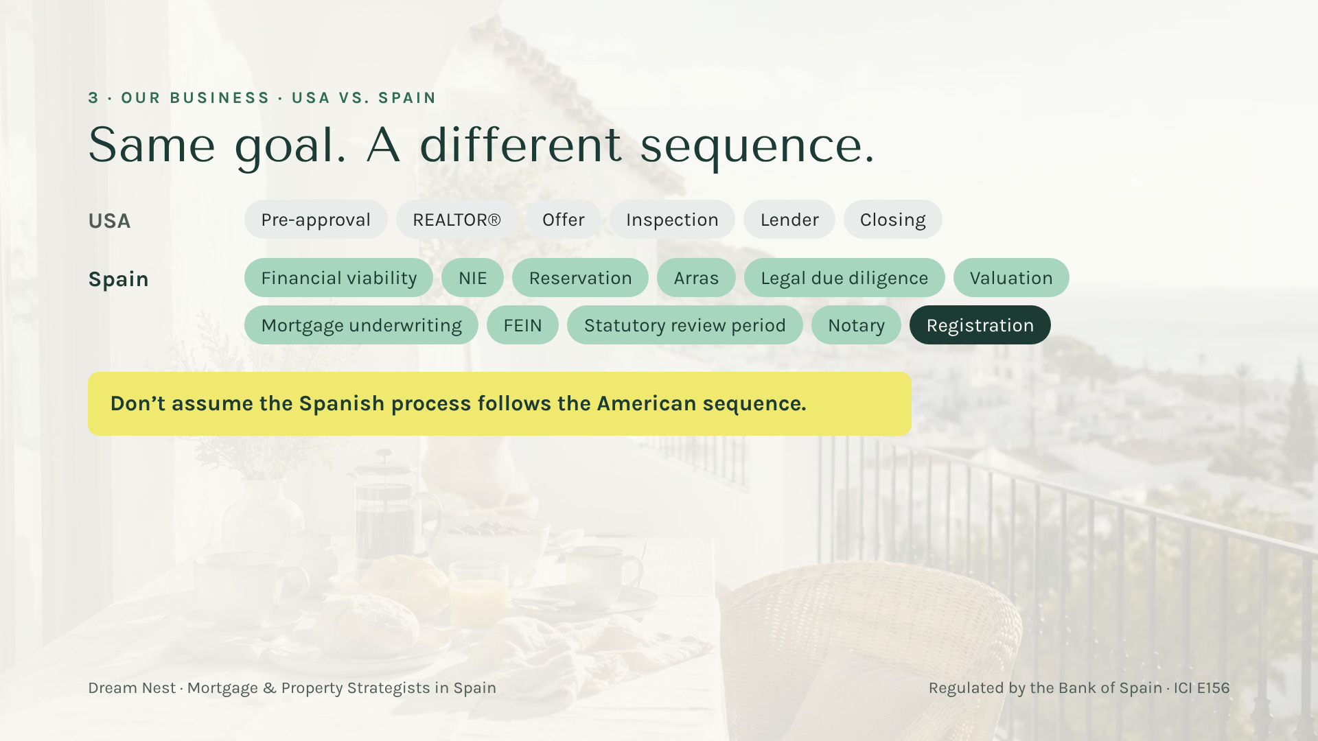
Your gift
Scan here
Notes:
[6:00 — 7:30] Difference 1, the sequence. Six steps they know by heart versus eleven new words. Explain ONLY two: arras (they commit money, sometimes before the bank has said anything) and the FEIN (the binding offer). "This is where a client loses money if nobody warns them. Call me BEFORE signing arras."

Slide 8
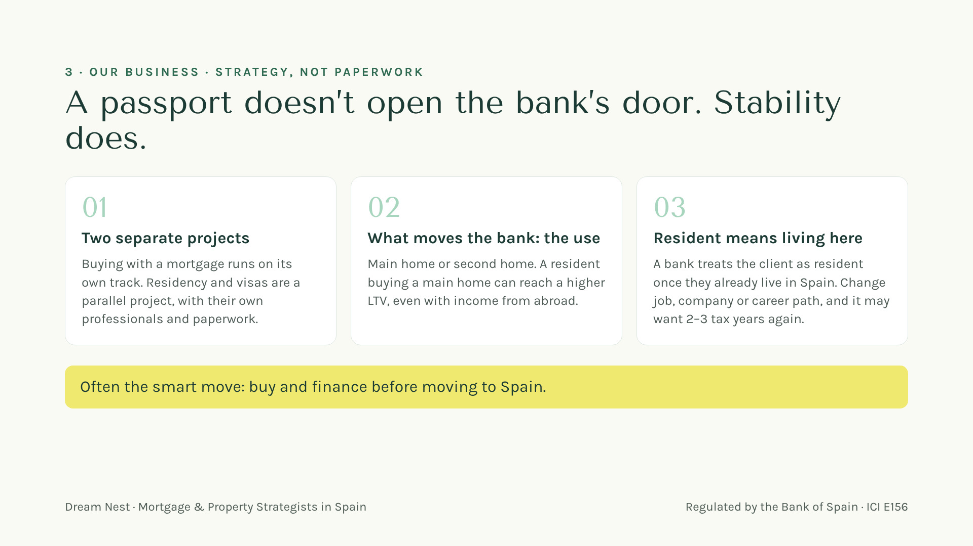
Your gift
Scan here
Notes:
[7:30 — 9:15] Difference 2, the myth: "With a passport or a visa the mortgage gets easier." No. The bank looks at stability and at the use of the home. For the bank, a resident is someone who already lives here, and a job change can mean 2–3 tax years again. Often the smart move is to buy and finance BEFORE moving. "This is strategy, and it’s what I do." ⚠️ LCCI/Orden EHA/2899/2011 — verificar antes de publicar — financing is mentioned.

Slide 9
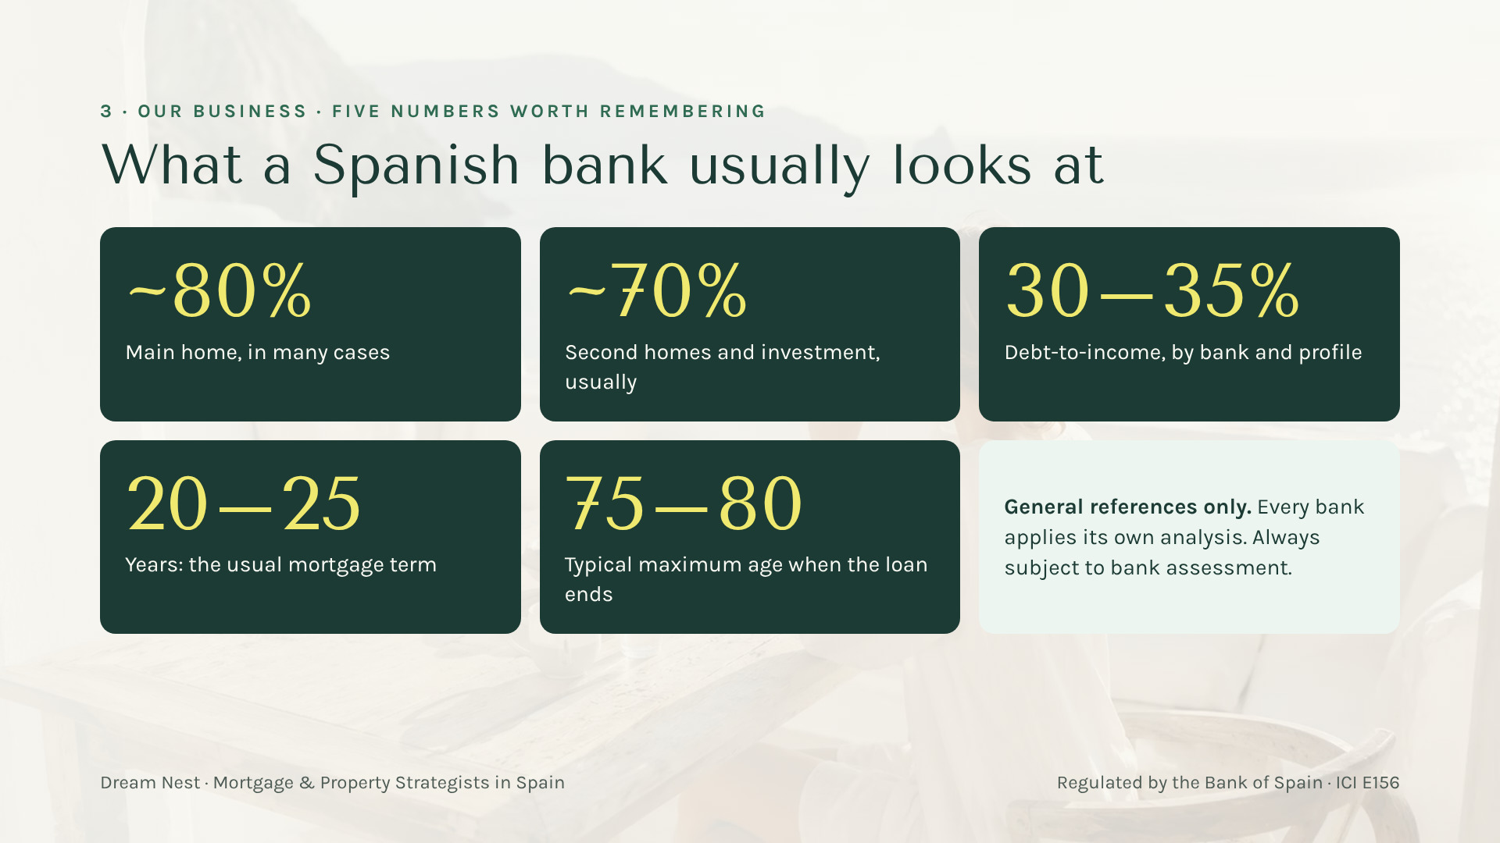
Your gift
Scan here
Notes:
[9:15 — 10:15] "If you take a photo of one slide today, make it this one." Five numbers a bank looks at: up to ~80% for a main home in many cases, ~70% for second homes and investment, debt-to-income 30–35%, term 20–25 years, maximum age 75–80 when the loan ends. General references; every bank decides. Bridge: "Now let’s see how much cash it really takes." ⚠️ LCCI/Orden EHA/2899/2011 — verificar antes de publicar.

Slide 10
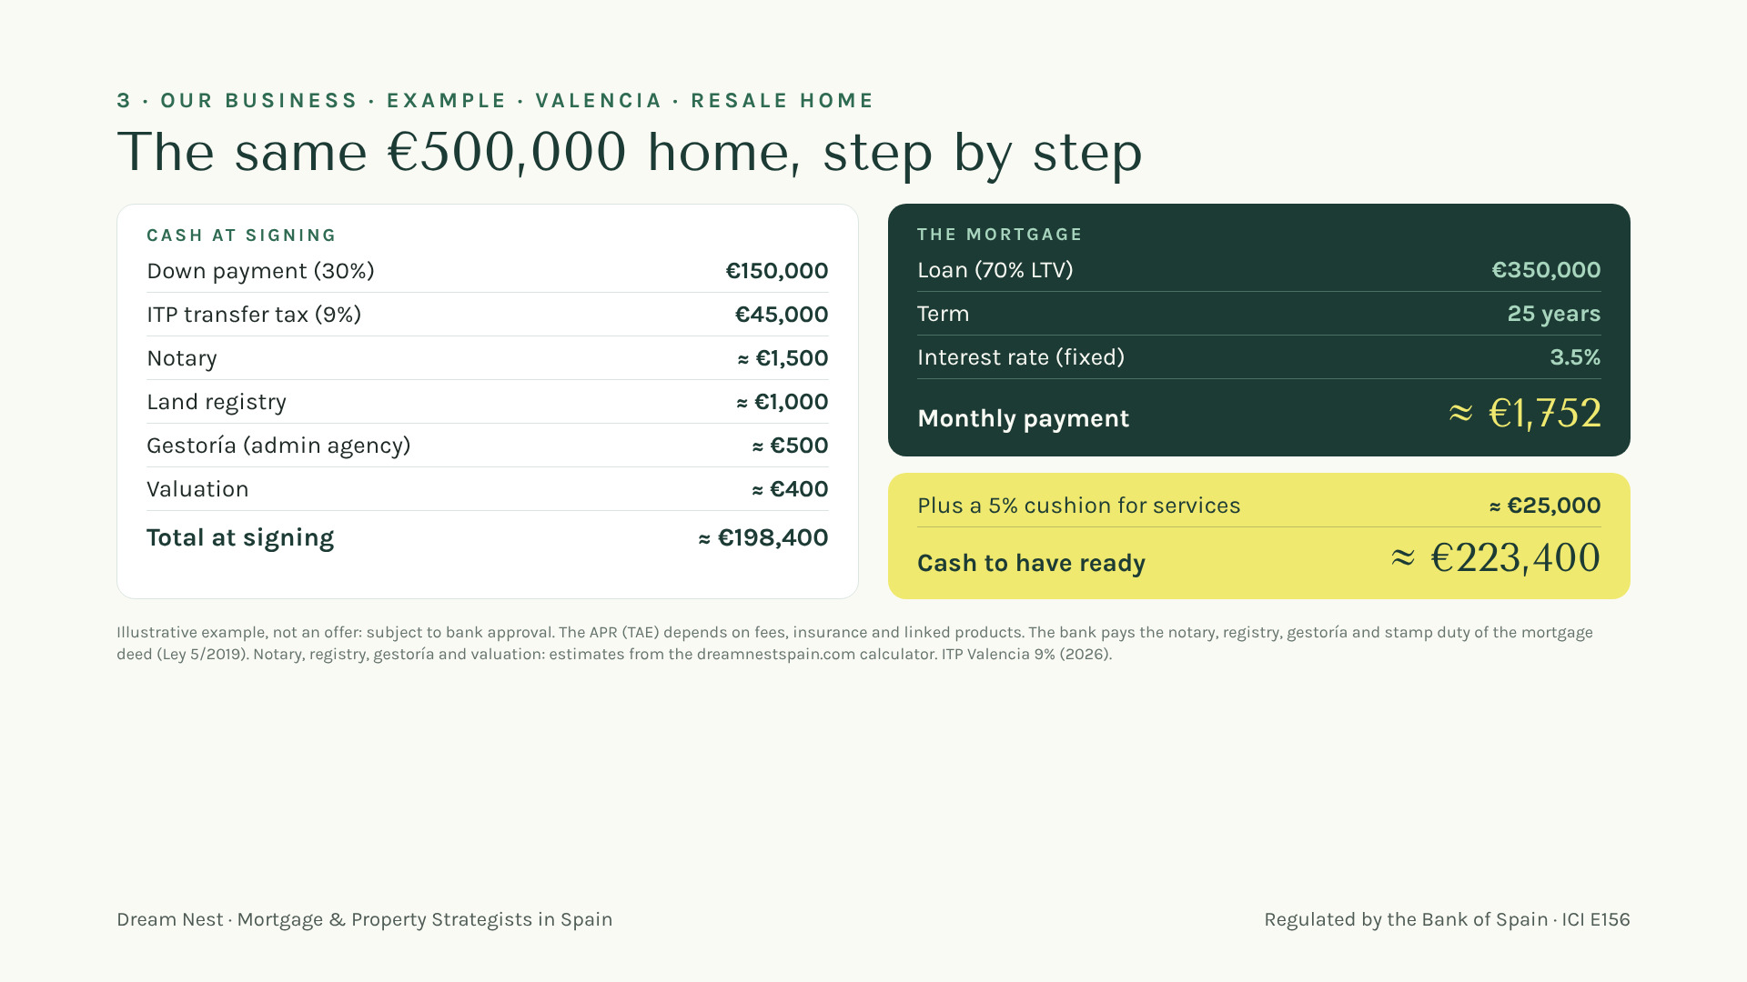
Your gift
Scan here
Notes:
[10:15 — 12:00] Difference 3, the money. Ask before showing: "How much cash does your client need ready for a €500,000 home?" Then the breakdown: about €223,400 with the 5% cushion. "I run this number with every client before they fall in love with a house." Say it is an illustrative example, not an offer. ⚠️ LCCI/Orden EHA/2899/2011 — verificar antes de publicar — illustrative rate and payment, no APR.

Slide 11
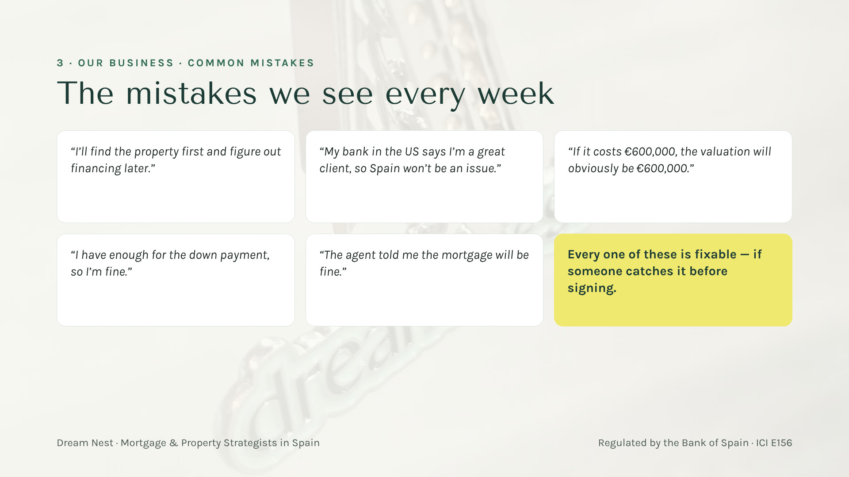
Your gift
Scan here
Notes:
[12:00 — 13:30] Quick game: read two or three quotes in the client’s voice and let the room shout "NO!". The good news: all of it is fixable if someone catches it before signing. "That someone is me."

Slide 12
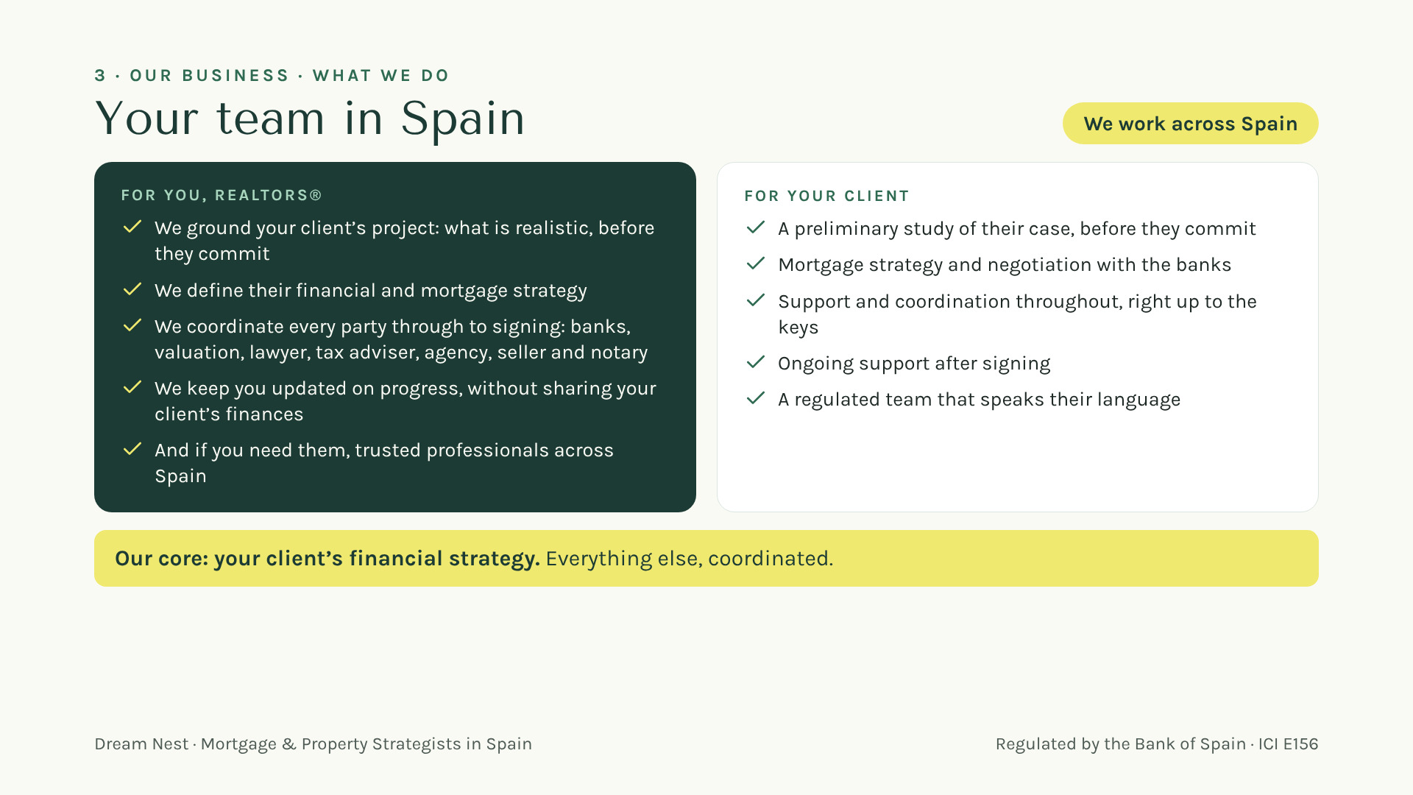
Notes:
[13:30 — 15:00] Stay on the core business. For them: we ground their client’s project and say what is realistic before they commit; we define the financial and mortgage strategy; we coordinate every party through to signing; and we keep them updated without sharing finances. Trusted professionals only in passing: "and if you need them, we’ll introduce you." For their client: preliminary study, strategy and negotiation with the banks, coordination up to the keys and support after. Close with the yellow line: "Our core is your client’s financial strategy. Everything else, coordinated." ⚠️ LCCI/Orden EHA/2899/2011 — verificar antes de publicar — do not mention rates or payments here.

Slide 13

Your gift
Scan here
Notes:
[15:00 — 15:45] The heart of it for this audience: "Your client is still your client even if they cross the Atlantic. You stay their trusted person; I’m your team in Spain." Look at the room.

Slide 14
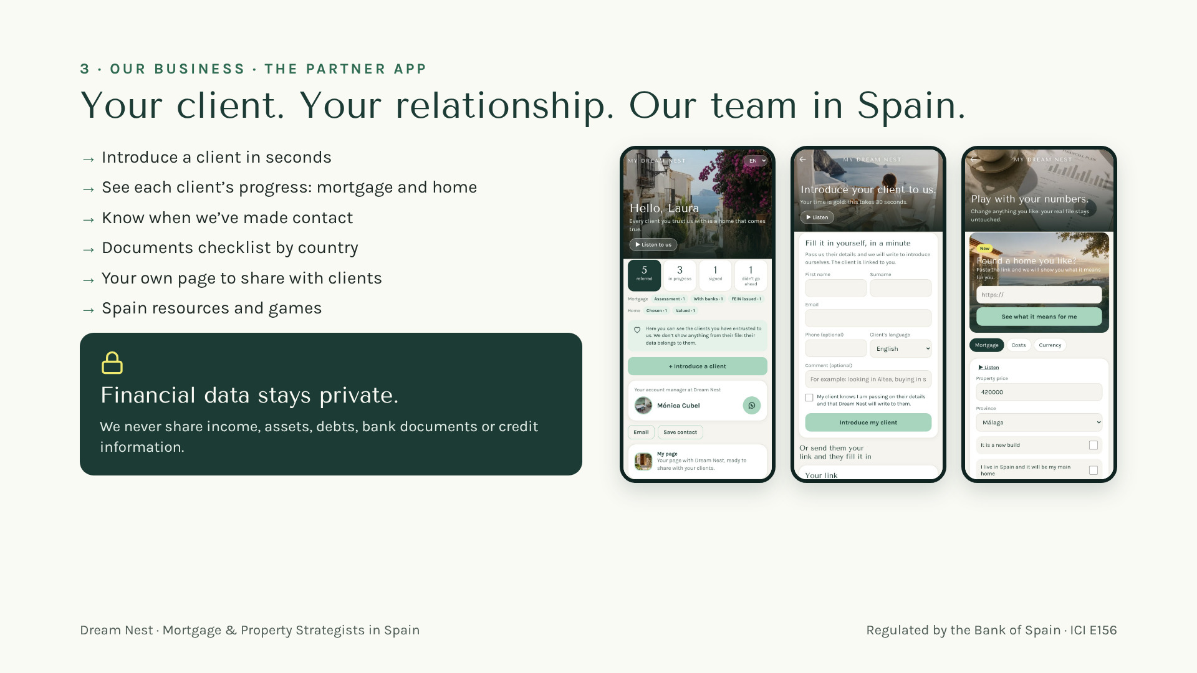
Notes:
[15:45 — 17:00] How we work together: they introduce a client in seconds from the app, see how it progresses, and we take care of Spain. Red line: we never share your client’s finances. Real screens, demo data.

Slide 15
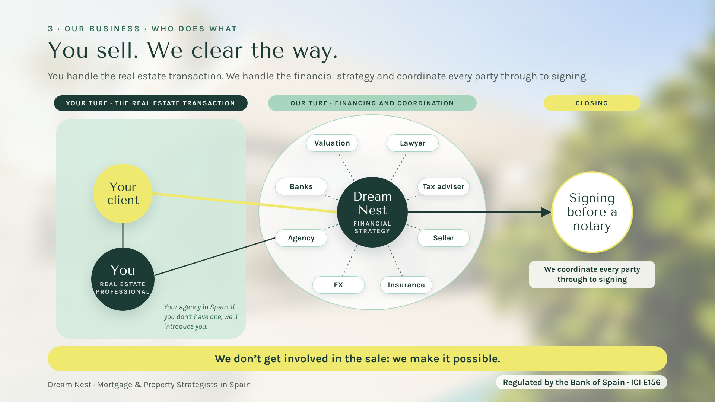
Your gift
Scan here
Notes:
[17:00 — 17:45] Summary of block 3, right before the call to action. "The real estate transaction is yours." You handle the client relationship and the property deal, with your agency in Spain; if you don’t have one, we’ll introduce you. We handle the financial strategy and coordinate every party: banks, valuation, lawyer, tax adviser, FX, insurance, the agency and the seller, through to signing before a notary. Final line: "We don’t get involved in the sale: we make it possible."

Slide 16
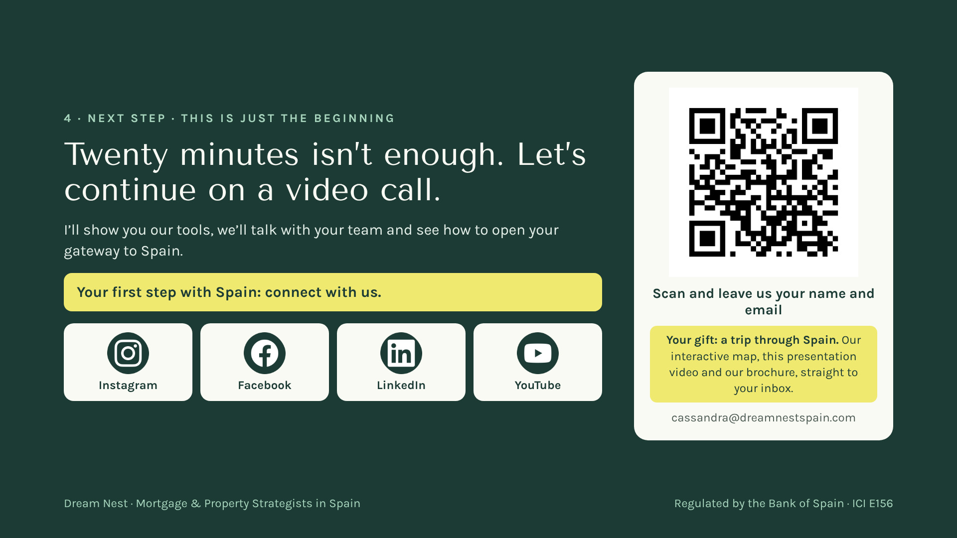
Notes:
[17:45 — 19:00] The call to action, calm and without arrogance: "I’m sorry we have so little time; I know these days are packed. But there is much more to tell you, and it can matter a lot for your global business and your gateway to Spain. Let’s set up a video call: I’ll show you the tools and we’ll talk with your team." Key line: "Your first step with Spain: connect with us." Ask them to scan the QR now, the same one as on the roll-up: "Leave us your name and email and we’ll send you a gift: a trip through Spain — our interactive map, this presentation video and our brochure." Then stay quiet for a few seconds while they scan.

Slide 17

Notes:
[19:00 — 19:30] Slowly: "Your client is thinking about Spain. Now you know who to call." Thank them. Leave the QR (the roll-up one) up during questions (you have about 2 minutes of margin).

Slide 18

Notes:
[19:30 — end] The Spain video starts on its own, full screen, with the Dream Nest music. Let it play: it is the close.

