Slide 1

Notes:
Welcome. Dream Nest: mortgage and property strategists in Spain, regulated by the Bank of Spain (ICI E156). Today: what buying in Spain with a mortgage really looks like, before you commit.

Slide 2

Notes:
Ask the room: who is thinking about buying in Spain in the next two years? The two questions on screen are the ones we hear most. Today we answer them with real criteria, not promises.

Slide 3

Notes:
Introduce Cassandra in the first person: born in San Francisco, Spain is home since her teens, 20 years in banking and real estate finance, raised her three kids here. She understands the person asking and the country they ask about.

Slide 4
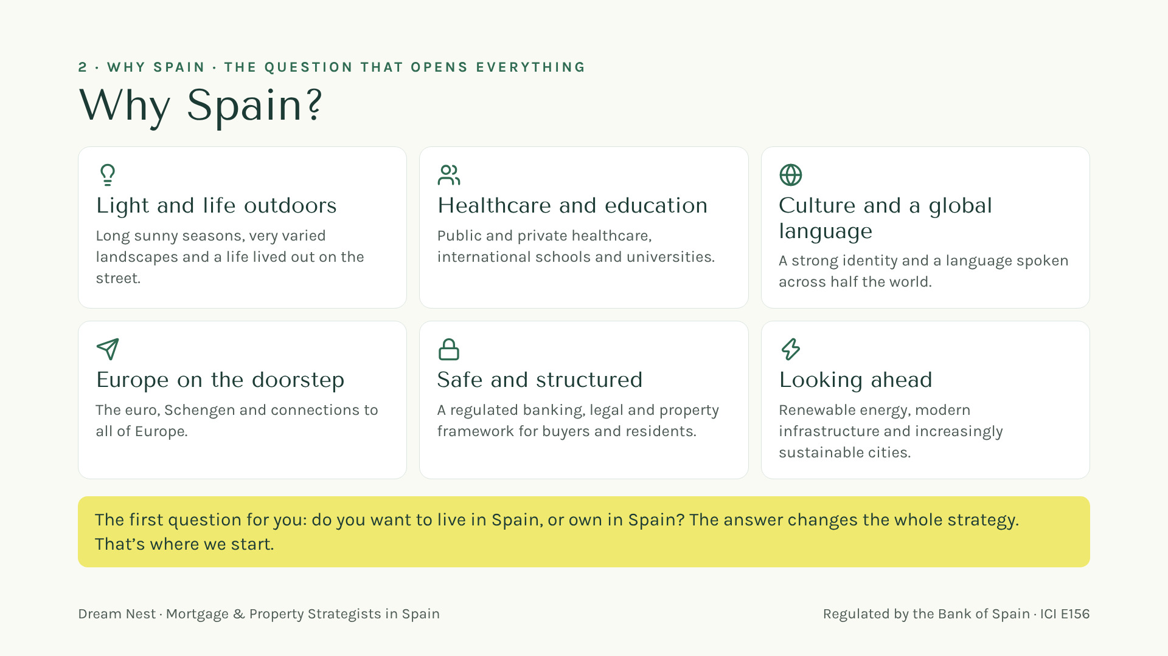
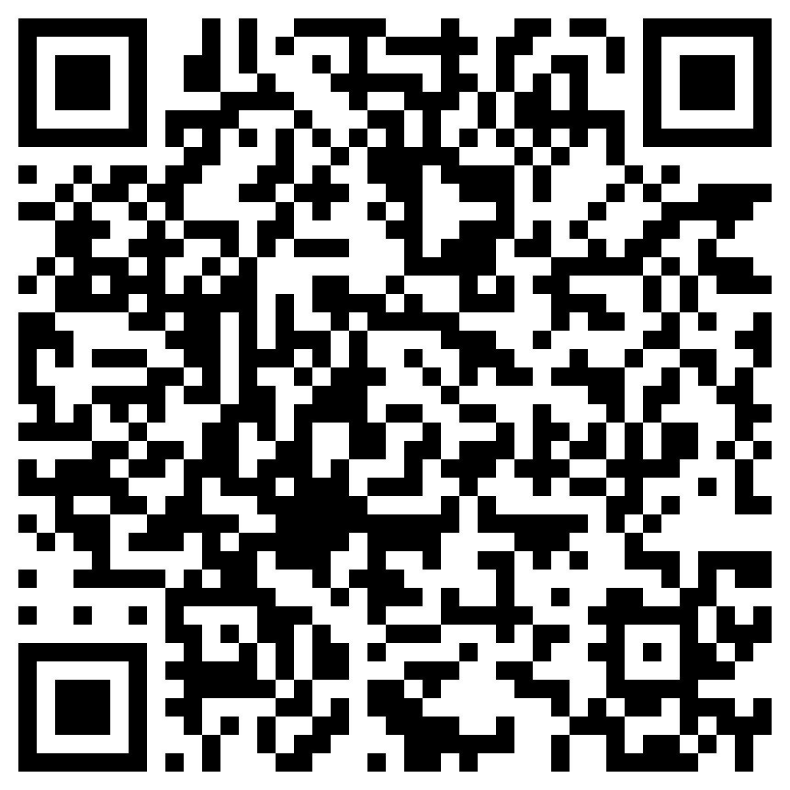
Your gift
Scan here
Notes:
Six reasons, one line each. Then the key question: live or own.

Slide 5

Notes:
Ask which one they are. The use of the home (main or second home) changes what the bank looks at.

Slide 6
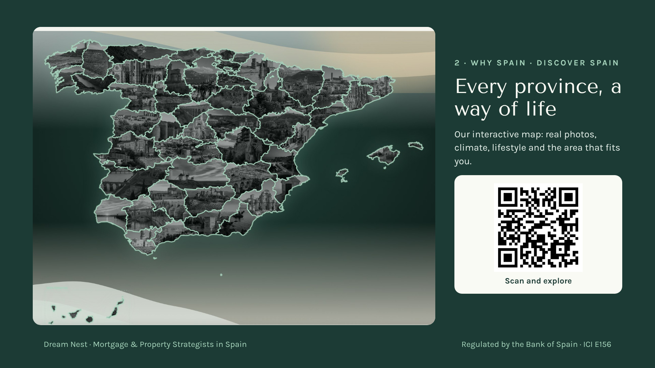
Notes:
Ask them to scan the QR: the interactive map on our website, every province with a real photo, climate and lifestyle.

Slide 7
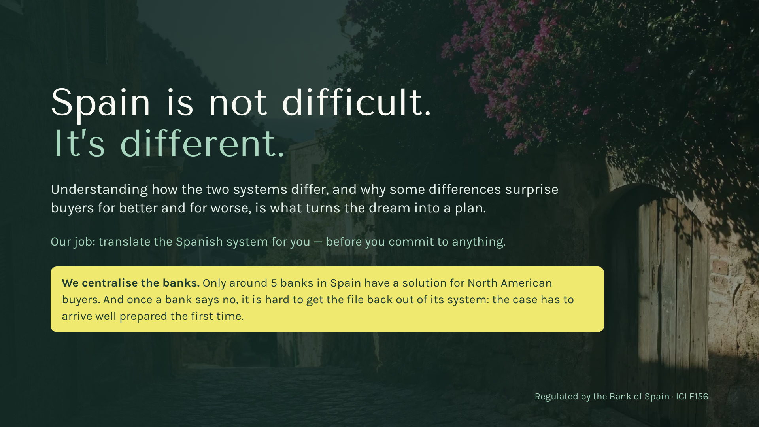
Your gift
Scan here
Notes:
Spain is not difficult. It is different. And the banks: only around five have a solution for North American buyers, and once a bank says no it is hard to get the file back out. The case has to arrive well prepared the first time.

Slide 8
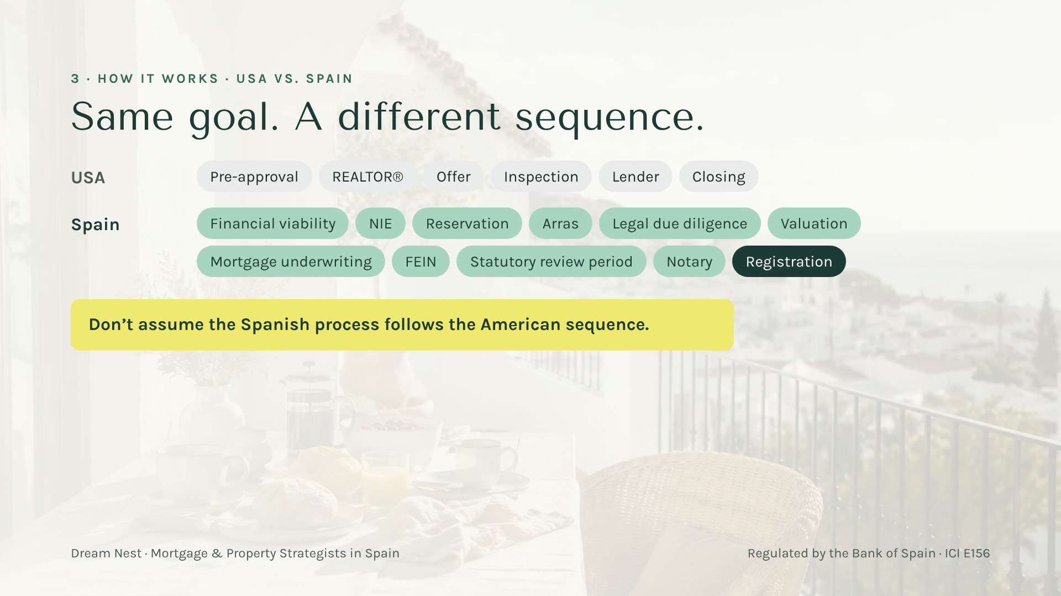
Your gift
Scan here
Notes:
[6:00 — 7:30] Difference 1, the sequence. Six steps you may know from the US versus eleven new words. Explain ONLY two: arras (they commit money, sometimes before the bank has said anything) and the FEIN (the binding offer). "This is where buyers lose money if nobody warns them. Talk to us BEFORE signing arras."

Slide 9
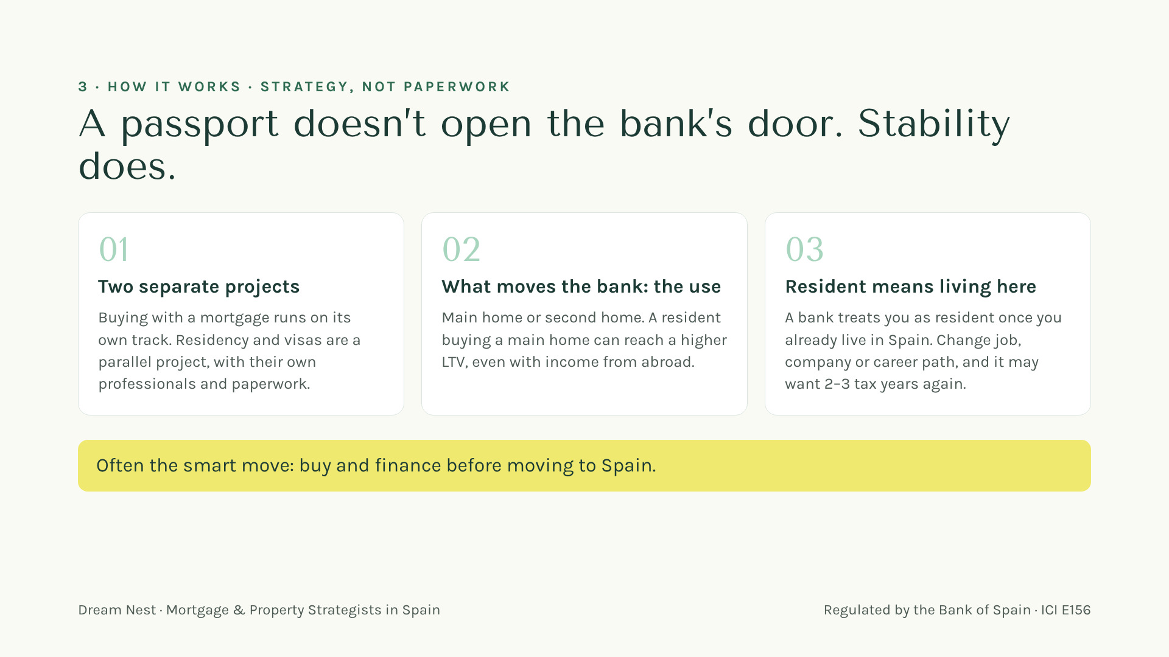
Your gift
Scan here
Notes:
[7:30 — 9:15] Difference 2, the myth: "With a passport or a visa the mortgage gets easier." No. The bank looks at stability and at the use of the home. For the bank, a resident is someone who already lives here, and a job change can mean 2–3 tax years again. Often the smart move is to buy and finance BEFORE moving. "This is strategy, and it’s what I do." ⚠️ LCCI/Orden EHA/2899/2011 — verificar antes de publicar — financing is mentioned.

Slide 10

Your gift
Scan here
Notes:
[9:15 — 10:15] "If you take a photo of one slide today, make it this one." Five numbers a bank looks at: up to ~80% for a main home in many cases, ~70% for second homes and investment, debt-to-income 30–35%, term 20–25 years, maximum age 75–80 when the loan ends. General references; every bank decides. Bridge: "Now let’s see how much cash it really takes." ⚠️ LCCI/Orden EHA/2899/2011 — verificar antes de publicar.

Slide 11
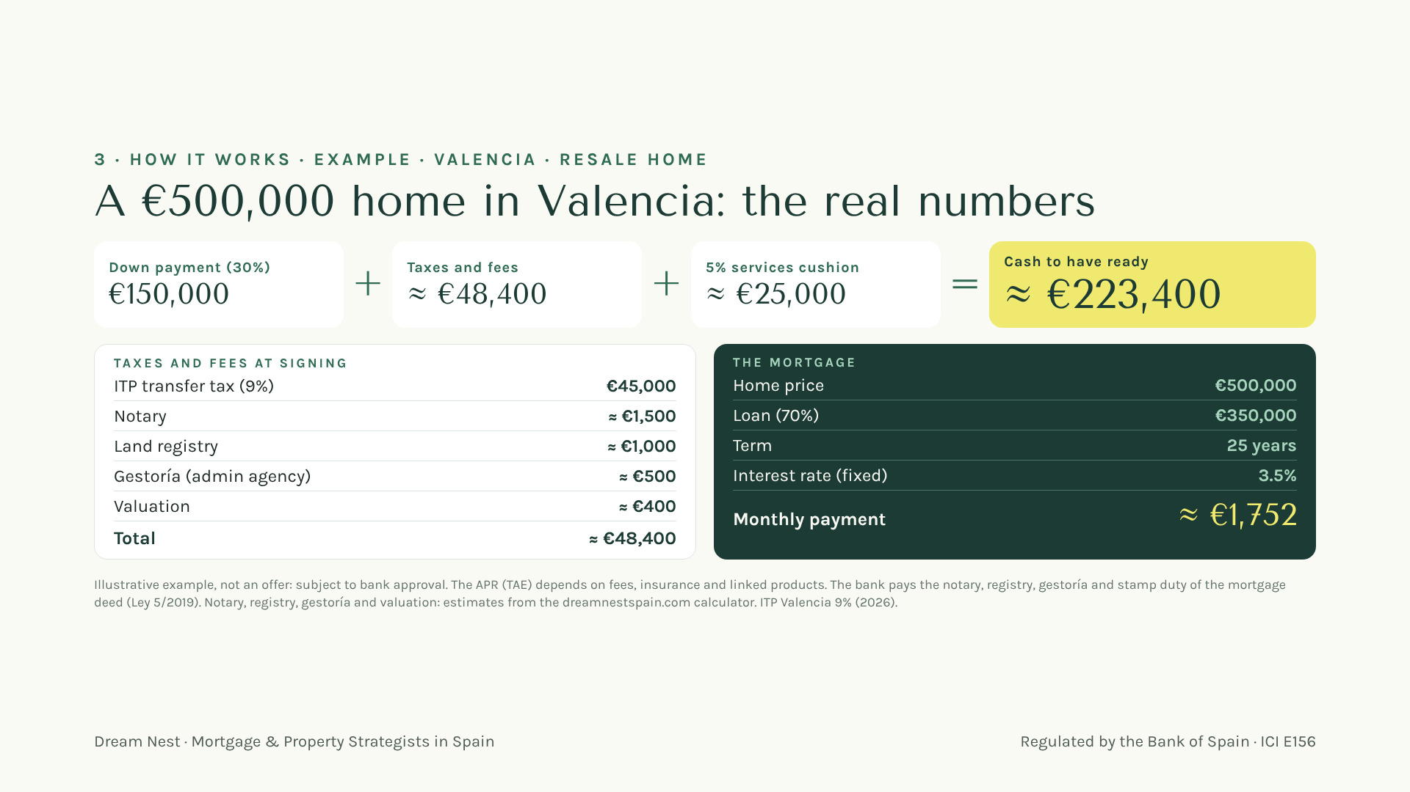
Your gift
Scan here
Notes:
[10:15 — 12:00] Difference 3, the money. Ask before showing: "How much cash do you think you need ready for a €500,000 home?" Then the breakdown: about €223,400 with the 5% cushion. "We run this number with every buyer before they fall in love with a house." Say it is an illustrative example, not an offer. ⚠️ LCCI/Orden EHA/2899/2011 — verificar antes de publicar — illustrative rate and payment, no APR.

Slide 12
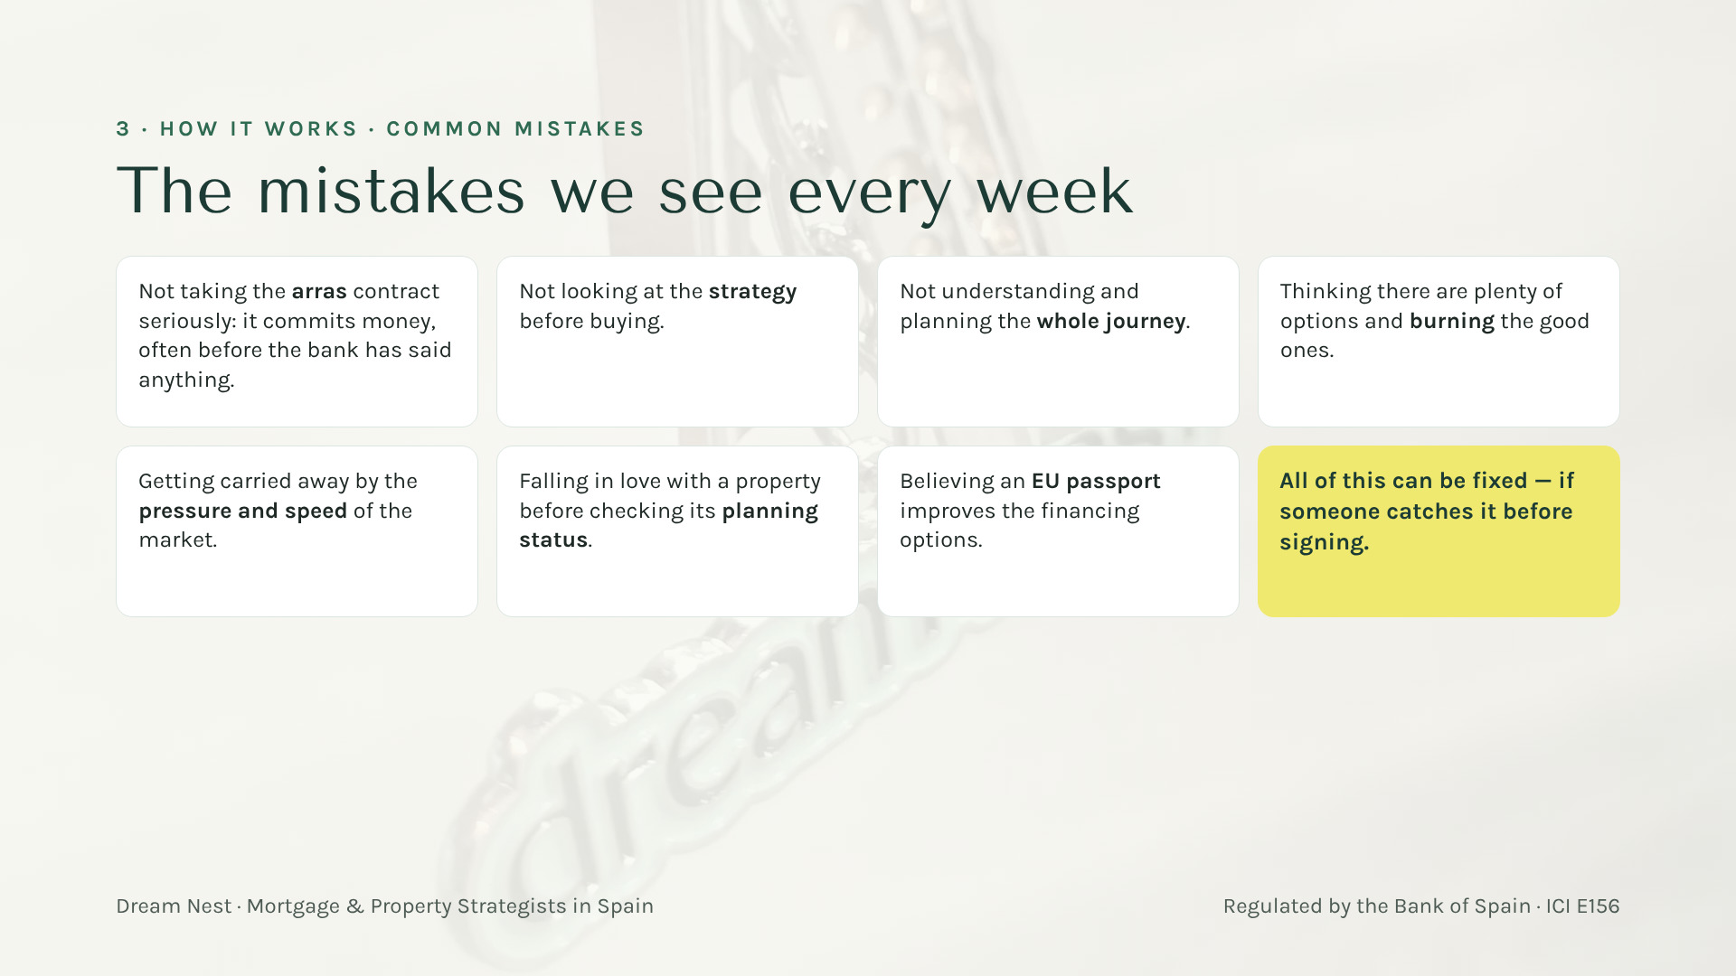
Your gift
Scan here
Notes:
[12:00 — 13:30] One slide, the main ones, quickly: arras (it commits money, often before the bank says anything); no strategy before buying; not planning the whole journey; thinking there are many options and burning the good ones; market pressure and speed; falling in love before checking the planning status; believing an EU passport helps the financing. Close with the yellow card: all of it is fixable if someone catches it before signing.

Slide 13
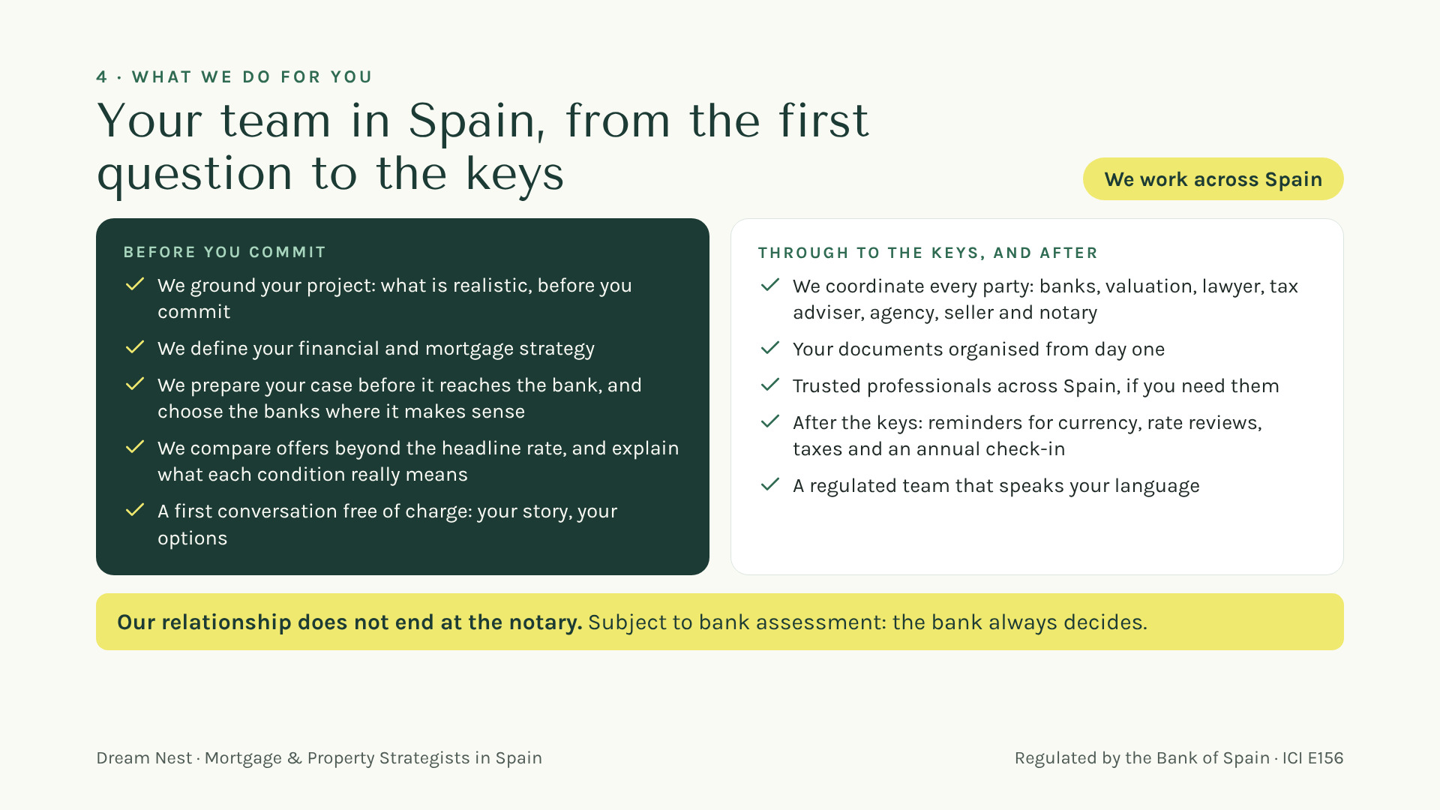
Notes:
What we do for you, in two moments: before you commit, and through to the keys and after. Say clearly: every offer is subject to the bank’s assessment.

Slide 14
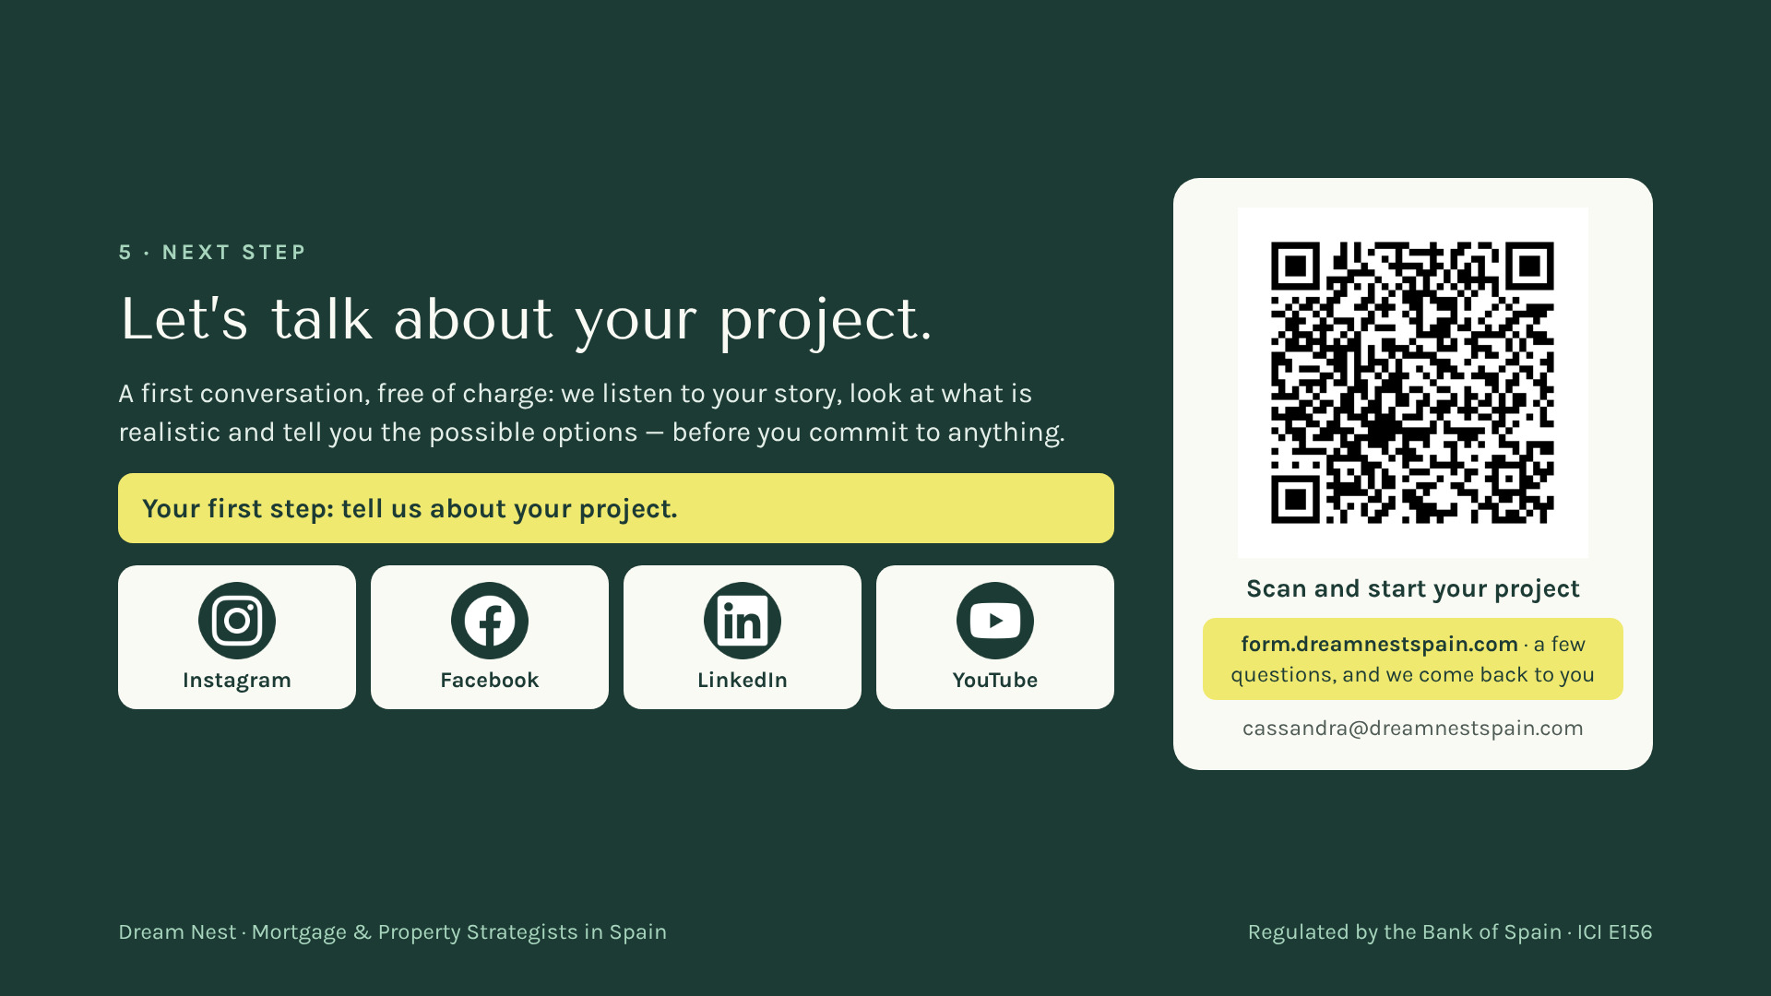
Notes:
The next step: a first conversation, free of charge. Ask them to scan the QR to start their project. Nothing is committed by filling it in.

Slide 15

Notes:
Thank them. Leave the QR on screen during questions.

Slide 16

Notes:
[19:30 — end] The Spain video starts on its own, full screen, with the Dream Nest music. Let it play: it is the close.

Slide 17
Notes:
After the video: the QR stays on screen during questions.

