Slide 1

Notes:
[0:00 — 0:35] Walk on while this is up. Don't read it. Smile, let the photo do the work. Opening line: "Good morning. By the end of the next forty-five minutes, I want you to have one name in your head the next time a client says the word Spain."

Slide 2

Notes:
[0:35 — 1:45] Ask for real hands. Wait. Count out loud, have fun with it. Then: "Keep it up if you knew exactly what to say next." Most hands drop. "That's normal — and that's exactly why we're here. Spain is not the US with better weather. It works differently, and the questions start the moment your client says the word."

Slide 3
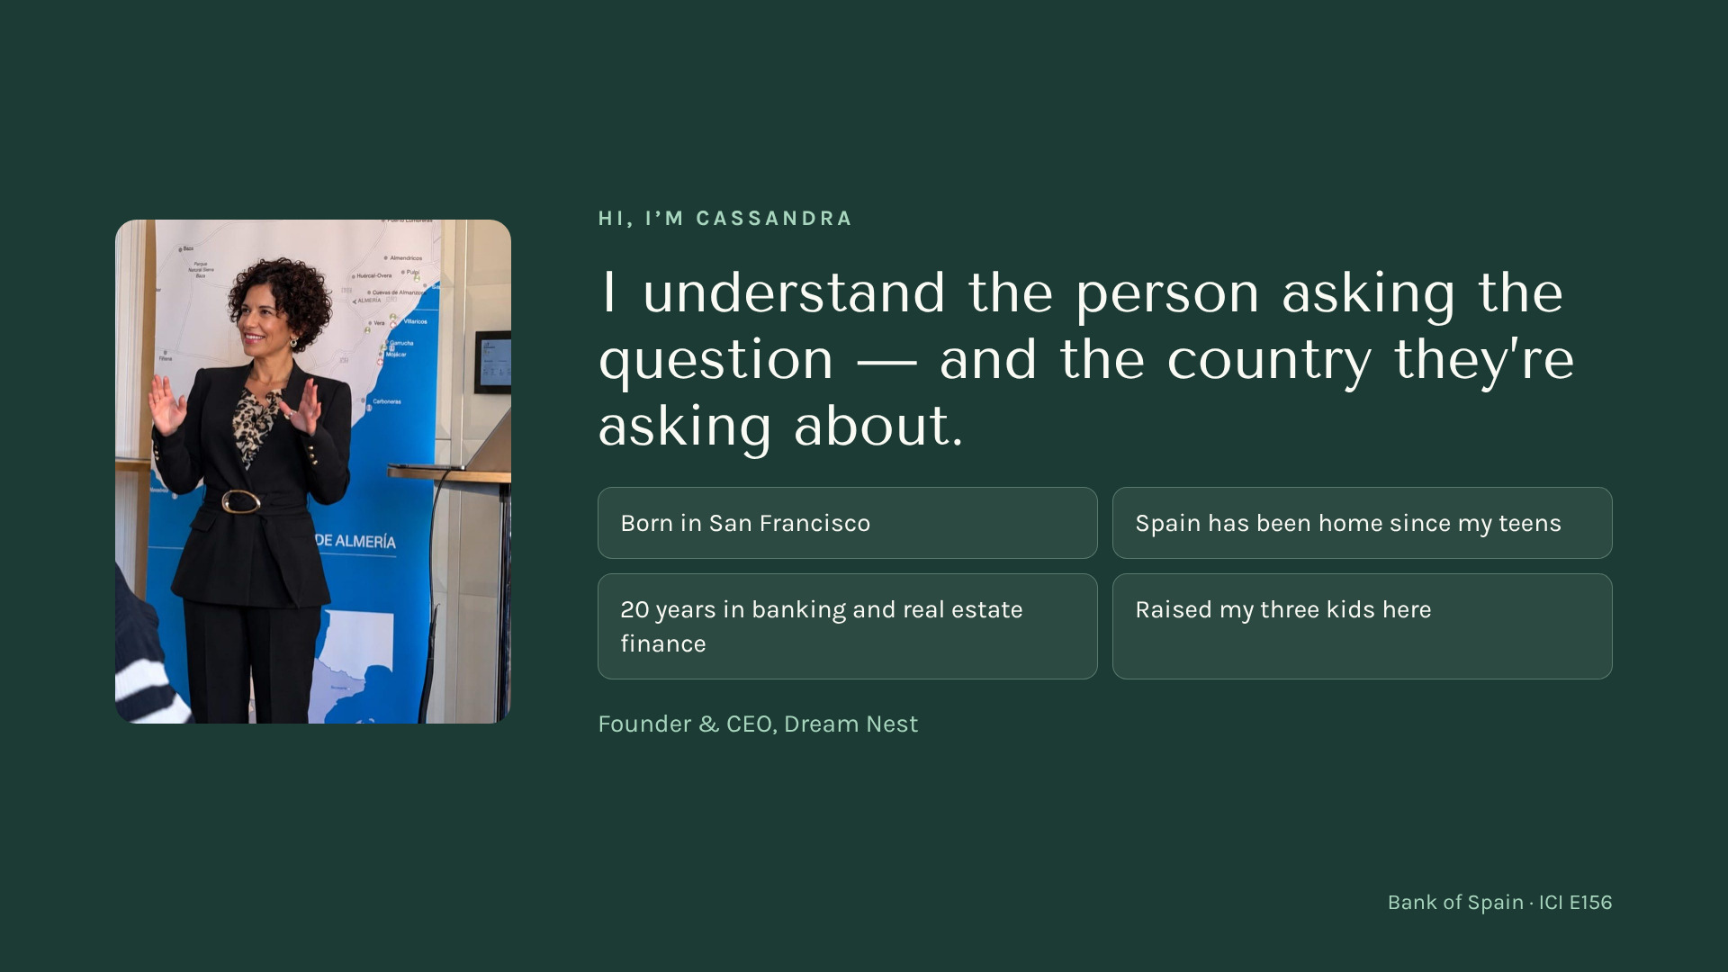
Notes:
[1:45 — 3:29] Keep it short and personal — this is about trust, not a biography. "I'm American. I was born in San Francisco, and Spain has been home since I was a teenager. I built my life here, my career in banking, and I raised my three kids here. So when an American client asks me a question about Spain, I usually remember asking the very same question myself." Pick ONE small real story (your own first contact with Spanish paperwork, a bank, a notary) — 30 seconds, with a smile. Then hand over to the team: "But this isn't the Cassandra show. Let me tell you who we are."

Slide 4

Notes:
[3:29 — 4:21] "From here on, it's the Dream Nest team." Explain in one breath: regulated by the Bank of Spain as a real estate credit intermediary, number E156. Mortgage financing is the heart of what we do — but we're there for the whole project. Introduce the team with warmth: Ioana speaks English, Italian, Romanian and Spanish; Mónica spent twenty years inside traditional banking (both are LCCI-certified); and María Amparo, our lawyer, reviews the legal and documentation side of every case so nothing moves forward until it's right. The background is our office in Burriana, Valencia region — a real office, real people.

Slide 5
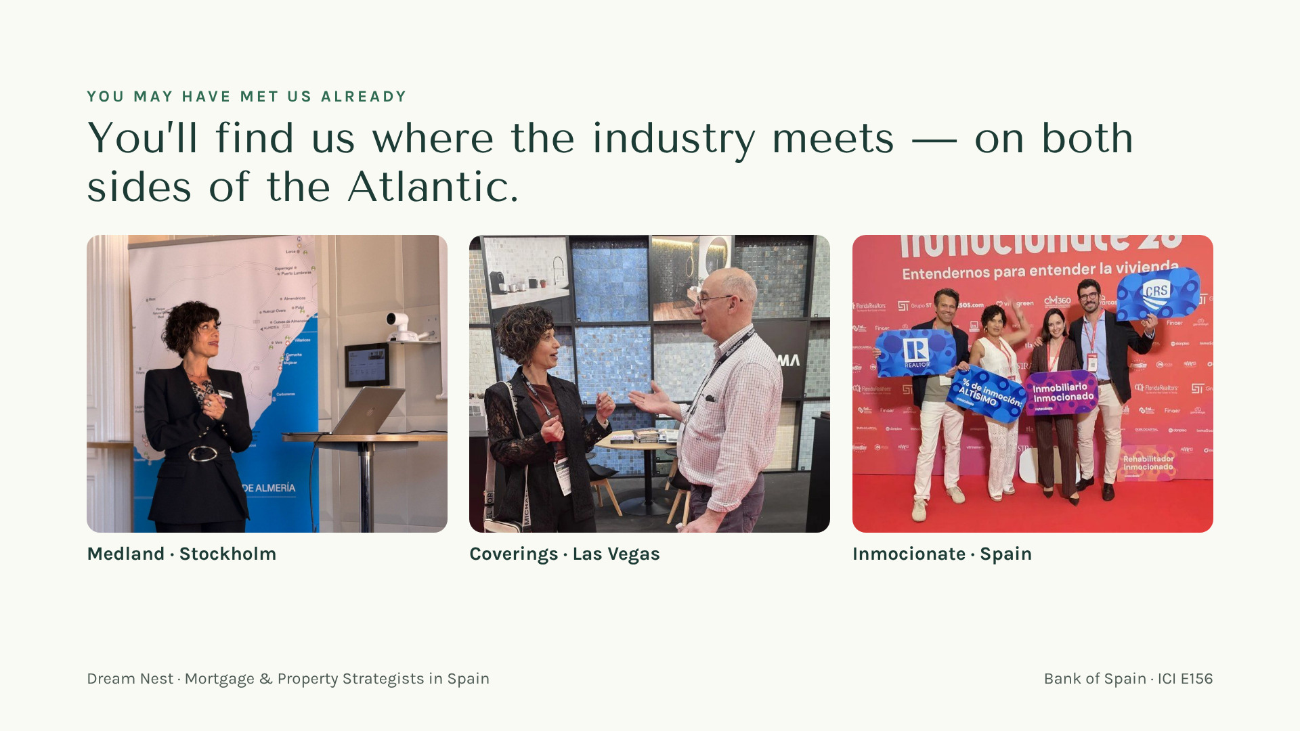
Notes:
[4:21 — 4:39] Fifteen seconds, with a smile: "Some of you may have seen us in Stockholm with Medland, at Coverings in Las Vegas or at Inmocionate in Spain. We go where you are — this works better when we've met in person." Move on.

Slide 6
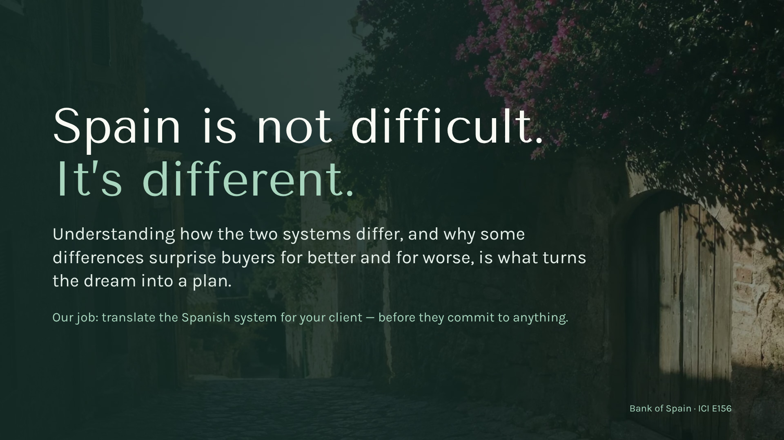
Notes:
[4:39 — 5:31] This is the thesis of the whole talk — say it slowly. "Spain is not difficult. It's different." Give one quick example of a US assumption that doesn't travel (e.g. "pre-approved" means something very different here, or the notary is not a formality). "Most surprises come from assuming Spain follows the American script. Some are good surprises, some aren't. Knowing them early lets your client enjoy the dream with their feet on the ground."

Slide 7
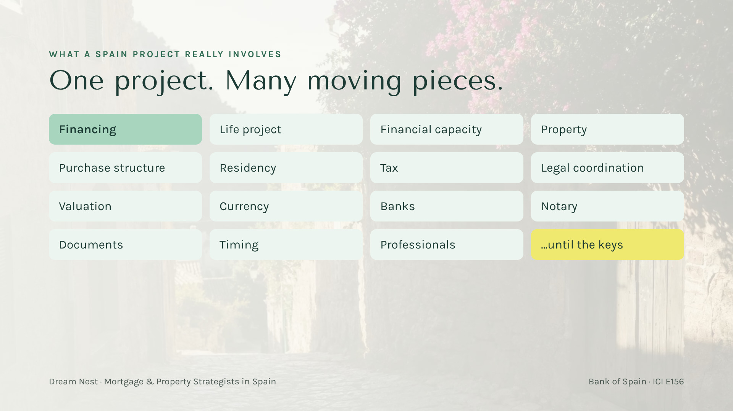
Notes:
[5:31 — 6:41] "Financing is our epicenter — we're a regulated mortgage intermediary and we know the Spanish banking system inside out. That's why it's highlighted. But look at everything around it." Point to a few: residency, tax, currency, notary. "When one of these pieces moves, others move with it. Change the use of the home and the financing changes. Change the financing and the cash needed changes."

Slide 8

Notes:
[6:41 — 7:15] Important for this audience — say it plainly: "We work alongside you, the lawyer and the tax advisor. We're the people who understand how all the pieces fit, and we help them work in the same direction." Pause. Move on.

Slide 9
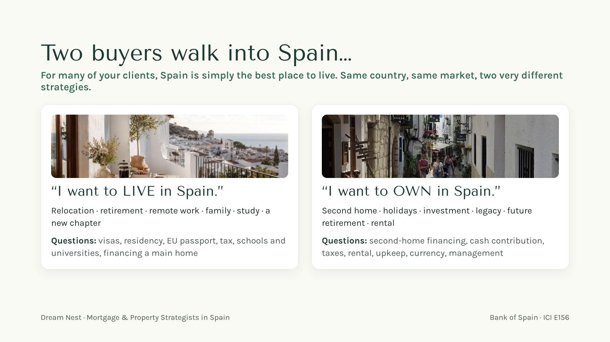
Notes:
[7:15 — 9:00] Make it a game: "Which one is your client? Hands up for LIVE… hands up for OWN." Explain that the first question we ask is not "which property?" but "LIVE or OWN?" — because the use of the home changes the strategy: a main home or a second home. For the bank, that is what moves the criterion, and not by much. Residency and visas are a separate project, with their own professionals and paperwork, running in parallel. Same apartment in Valencia, two different strategies.

Slide 10
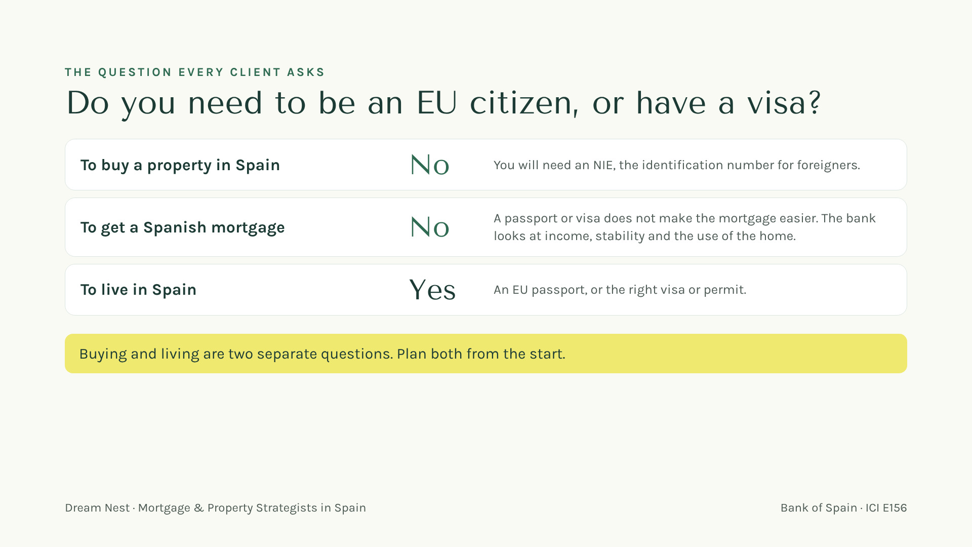
Notes:
[9:00 — 10:10] The clearest answer of the session, so say it slowly. Buy: no passport needed, just an NIE. Mortgage: no either. A passport or a visa does not make it easier. What the bank looks at is income, stability and the use of the home, main or second home. Every bank decides. Live: that needs an EU passport or the right visa or permit, a separate project handled by immigration lawyers. Then: "Two different questions. We make sure both are answered early."

Slide 11
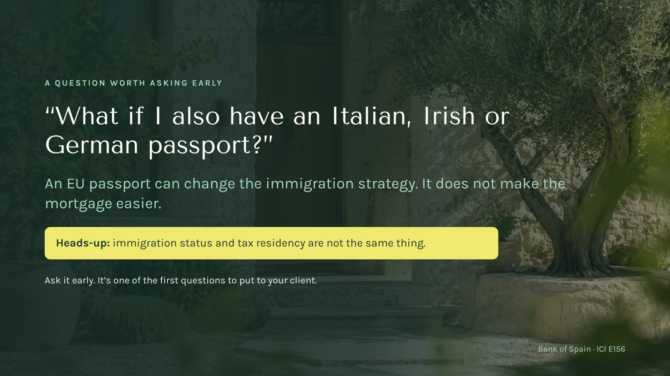
Notes:
[10:10 — 11:19] "Raise your hand if you have a client with an Italian grandmother." Laugh. Many Americans have — or could get — EU citizenship (Italian, Irish, German, others). EU/EEA/Swiss citizens have a much simpler path to living in Spain. Keep it simple, no legal detail. Then say it clearly: it changes how they can live here, not how a Spanish bank reads their mortgage. And the other nuance: being allowed to live here and being a tax resident here are two different things — that's a separate conversation with a cross-border tax advisor.

Slide 12
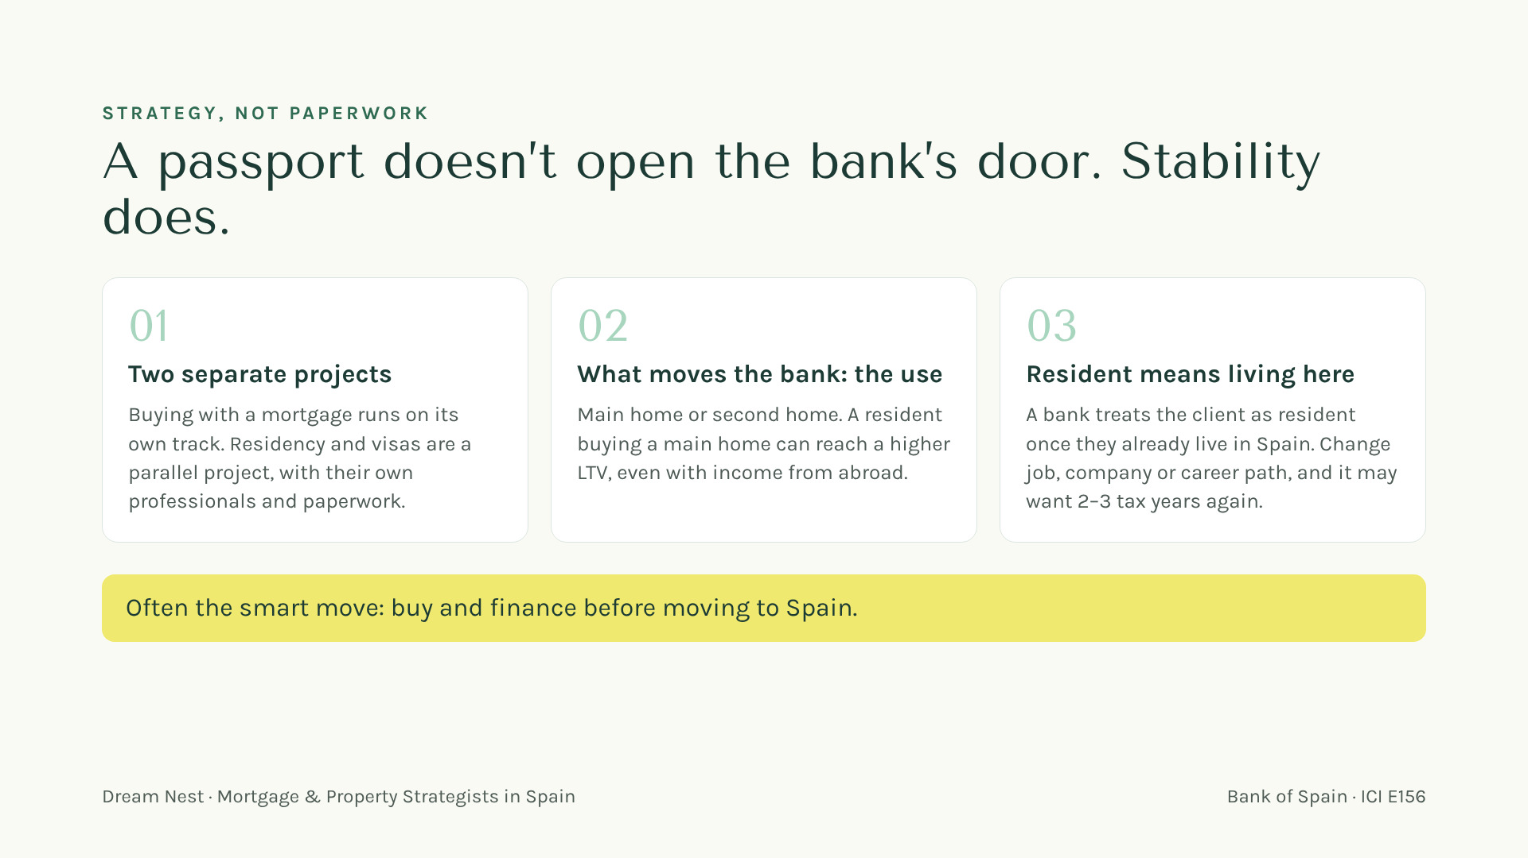
Notes:
[11:19 — 12:39] The myth to break: "once I have the passport or the visa, the mortgage gets easier." Not true. The mortgage is an independent process; residency and visas are a parallel project with their own professionals. What changes the bank's criterion, and not by much, is the use: a main home can reach a higher LTV than a second home, even for a resident with income abroad. To be treated as resident, the client has to be living in Spain already, and that is a double-edged sword: for a Spanish bank, stability comes first. If the move means a new job, a new company or a new career path, the bank may want 2–3 tax years again. So, unless there is real continuity of employment, it is usually better to buy and finance before coming. It is strategy. ⚠️ LCCI/Orden EHA/2899/2011 — LTV mentioned, verify before publishing.

Slide 13
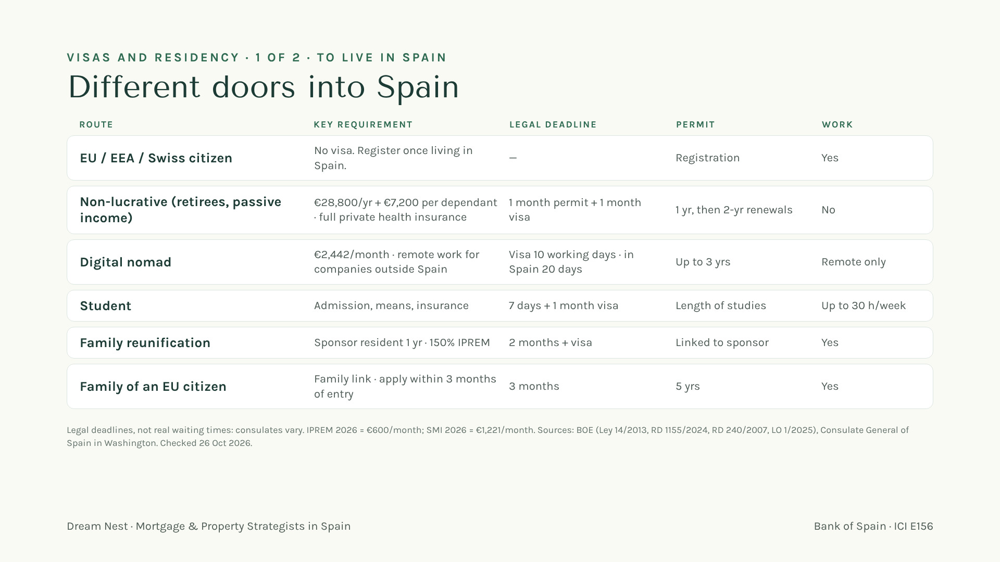
Notes:
[12:39 — 14:09] Not an immigration class, but they will ask. "There are different doors into Spain." Go row by row, one line each, and point at the deadline column: these are legal deadlines, real times depend on the consulate (Washington is moving appointments to BLS). Non-lucrative is the classic retiree route: no work at all, not even remote, and renewals need more than 183 days a year in Spain. Digital nomad: the fast one, income from outside Spain. Students can now work up to 30 h/week. Line to leave: owning a home and being allowed to live here are two separate projects, with immigration lawyers on that side. And the timing of the move matters for the mortgage. Figures: IPREM and SMI 2026 from BOE / consulate, checked 26 Oct 2026.

Slide 14
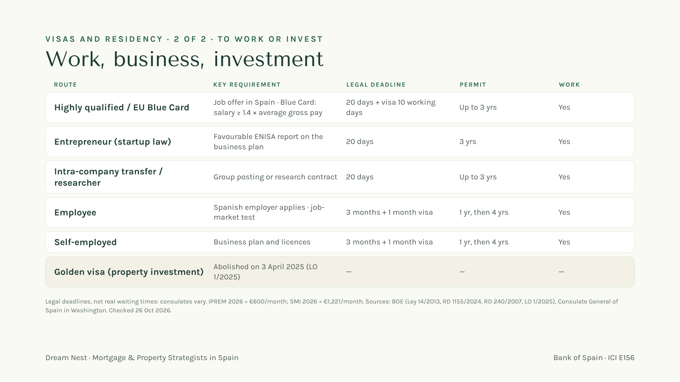
Notes:
[14:09 — 15:24] Second door: work and business. Highly qualified and Blue Card for those hired in Spain; entrepreneur through ENISA; intra-company transfers and researchers: all decided in 20 days by the UGE, and if it doesn't answer, the permit is granted. Employee and standard self-employed go through the immigration office: 3 months, then the visa. Golden visa: say it clearly, it no longer exists since 3 April 2025 — buying a home no longer gives residency in any form. (Arraigo exists for people already living in Spain; not a buyer route.) Then: "Which door your client uses changes the plan — not the bank's view of the mortgage."

Slide 15
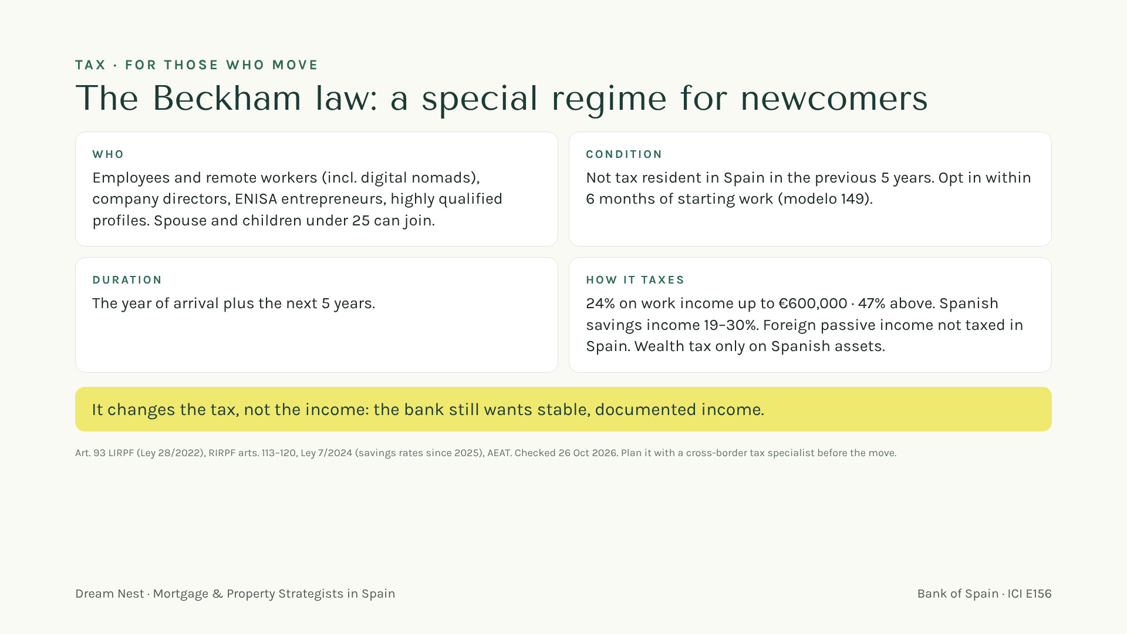
Notes:
[15:24 — 16:39] Many of your clients will have heard of it. "The Beckham law: Spain's special tax regime for people who move here to work." Who: employees, remote workers on the digital nomad visa, directors, entrepreneurs approved by ENISA, highly qualified profiles; family can join. Condition: no Spanish tax residency in the last 5 years, and opt in within 6 months, with modelo 149; once waived, it's gone. Duration: arrival year plus 5. Rates: flat 24% up to €600,000 of work income, 47% above; foreign passive income not taxed in Spain. Mortgage point: it changes the tax, not the income — the bank still reads stable income, and may ask for the 151 return instead of the usual one. Timing matters: it starts with the move, so it ties in with the buy-before-you-move strategy. Send them to a cross-border tax specialist for the numbers.

Slide 16
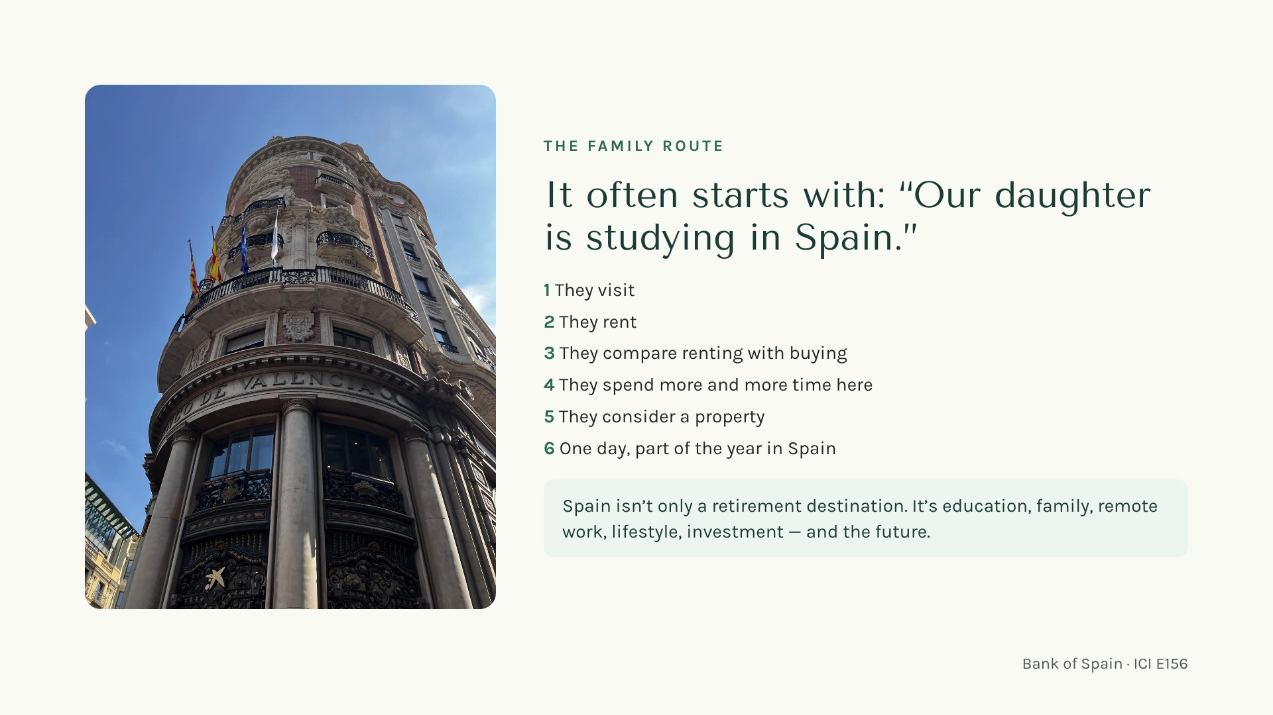
Notes:
[16:39 — 17:49] Tell this as a little story with a fictional family (never a real client): the Millers' daughter does a semester in Madrid or Valencia; parents visit, then rent for her, then do the math on rent vs. buy, then start spending summers here. "That journey takes two or three years — and every step is a moment when your client might mention Spain to you." The point for REALTORS: Spain's entry doors are many, not just retirement.

Slide 17
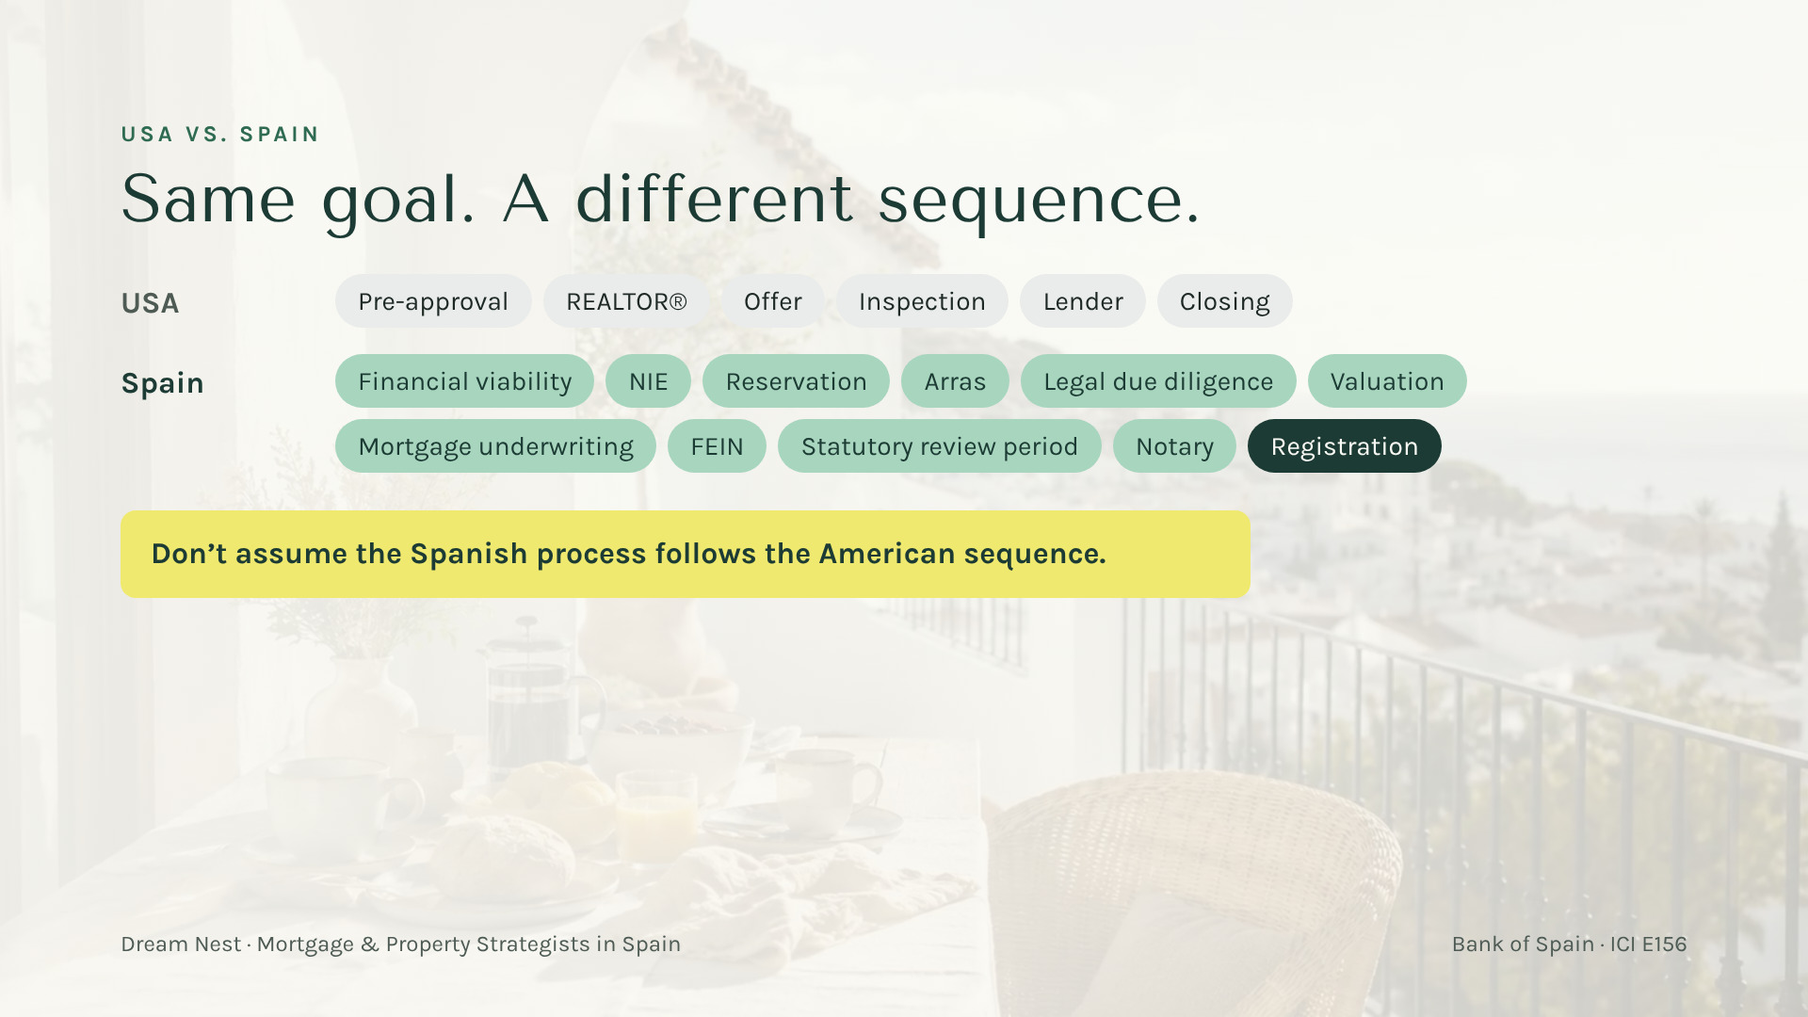
Notes:
[17:49 — 19:33] Have fun with the contrast: "Six steps you know by heart… and eleven words you've maybe never heard." Translate the key ones in plain English: NIE = the foreigner's ID number for the deal. Arras = a deposit contract that commits your client — often before the bank has said anything. FEIN = the binding mortgage offer. The statutory review period = by law, the buyer gets time to review the offer before signing. The notary is not a formality — it's where it all becomes real. The trap: signing arras before knowing the financing works.

Slide 18
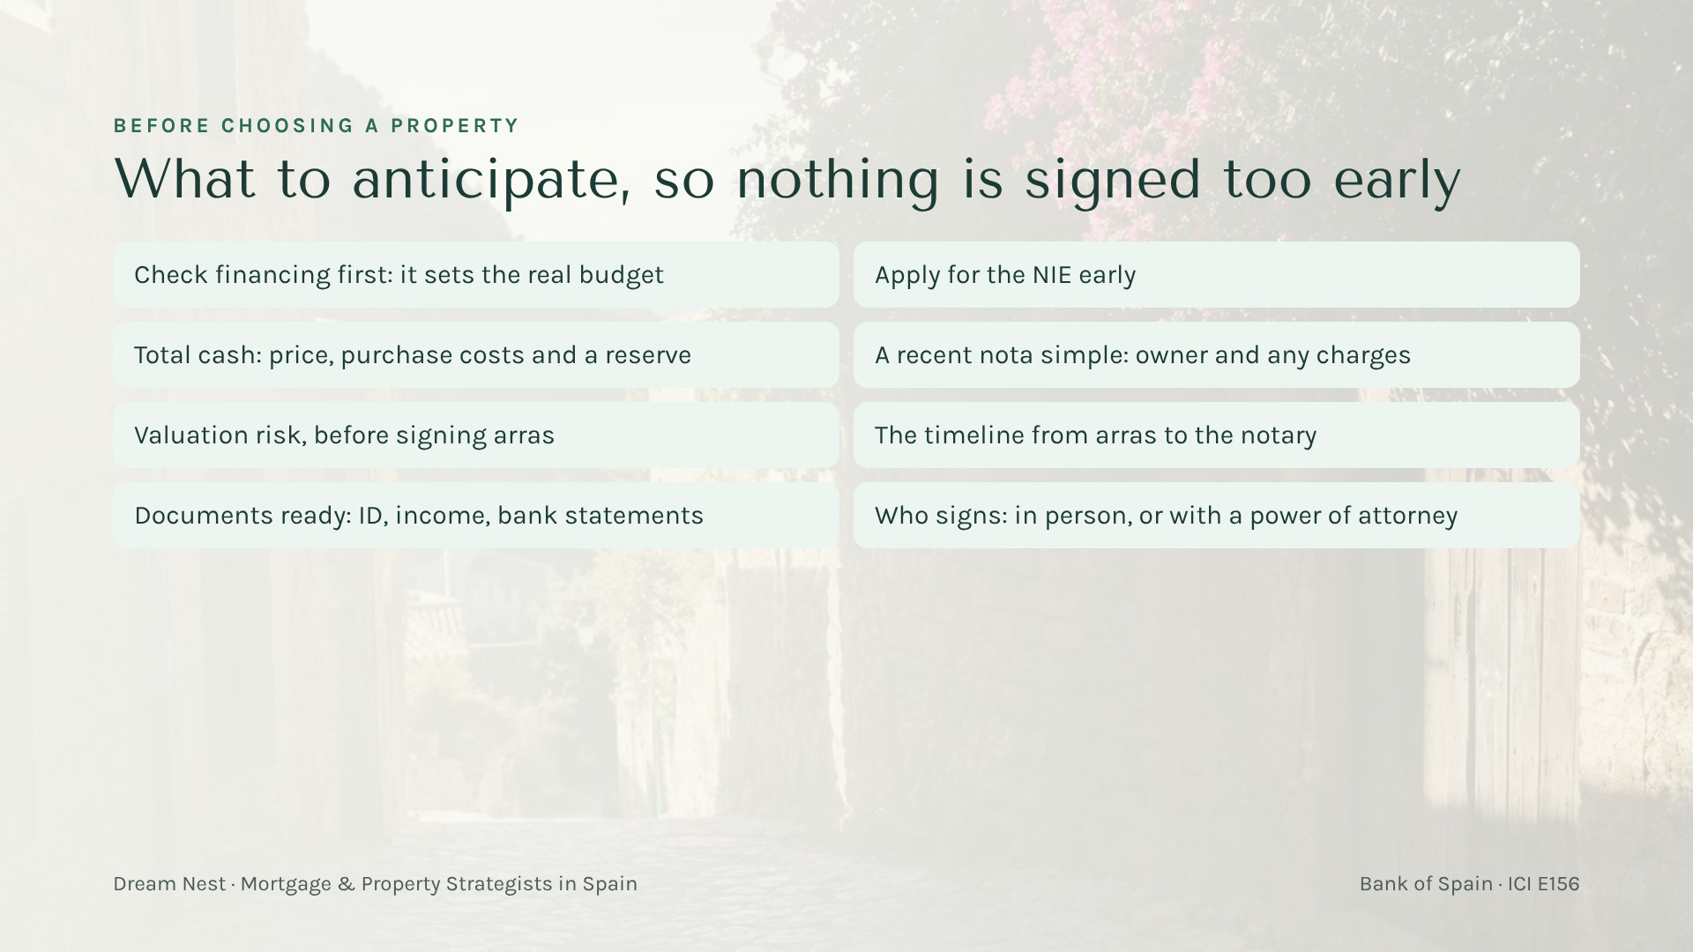
Notes:
[19:33 — 21:18] This is the roadmap in practice. "Most surprises come from signing before these eight things are clear." Walk through them quickly; the point is the order: financing and numbers first, then the property, then the signatures. A Spanish purchase can close without the buyer flying in, with a power of attorney, if it is planned ahead.

Slide 19
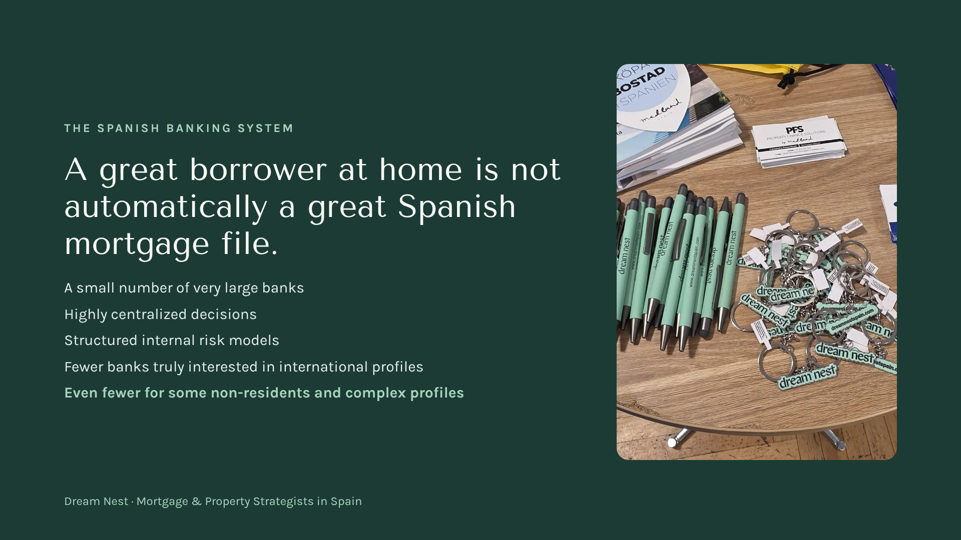
Notes:
[21:18 — 23:02] This is where the "great client at home" assumption breaks. In the US there are thousands of lenders; in Spain a handful of very large banks dominate, decisions are centralized and risk models are rigid. Some banks have international desks that work with non-residents — not all of them read an international client the same way. Line to land: "Your client can be excellent at home and still not fit a Spanish bank's risk model automatically. That's not a no — it's a file that needs to be built and presented properly."

Slide 20
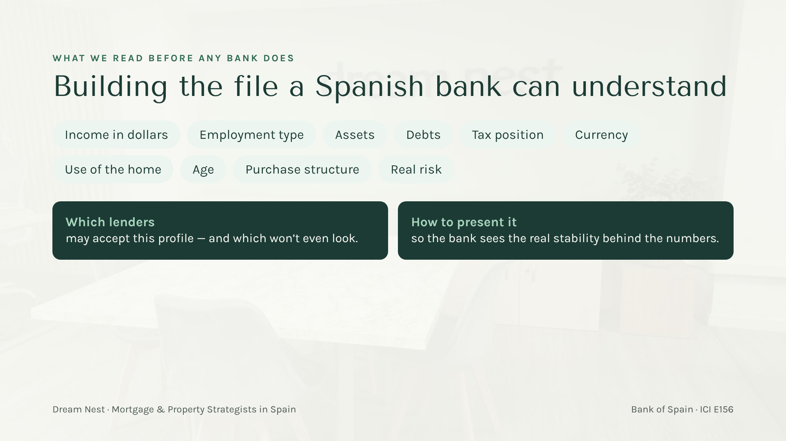
Notes:
[23:02 — 24:12] "Spanish banks don't always reject complex profiles. They reject profiles they don't understand." Give one quick example: dollar income — the bank thinks about what happens to a euro mortgage payment if the dollar moves; self-employed or 1099 income needs explaining; age shortens the possible term. Our work is to translate: what the client earns, where the money comes from, how stable it is, what the real risk is — and which banks make sense for that profile. The bank always decides; we make sure it decides on a well-prepared file.

Slide 21
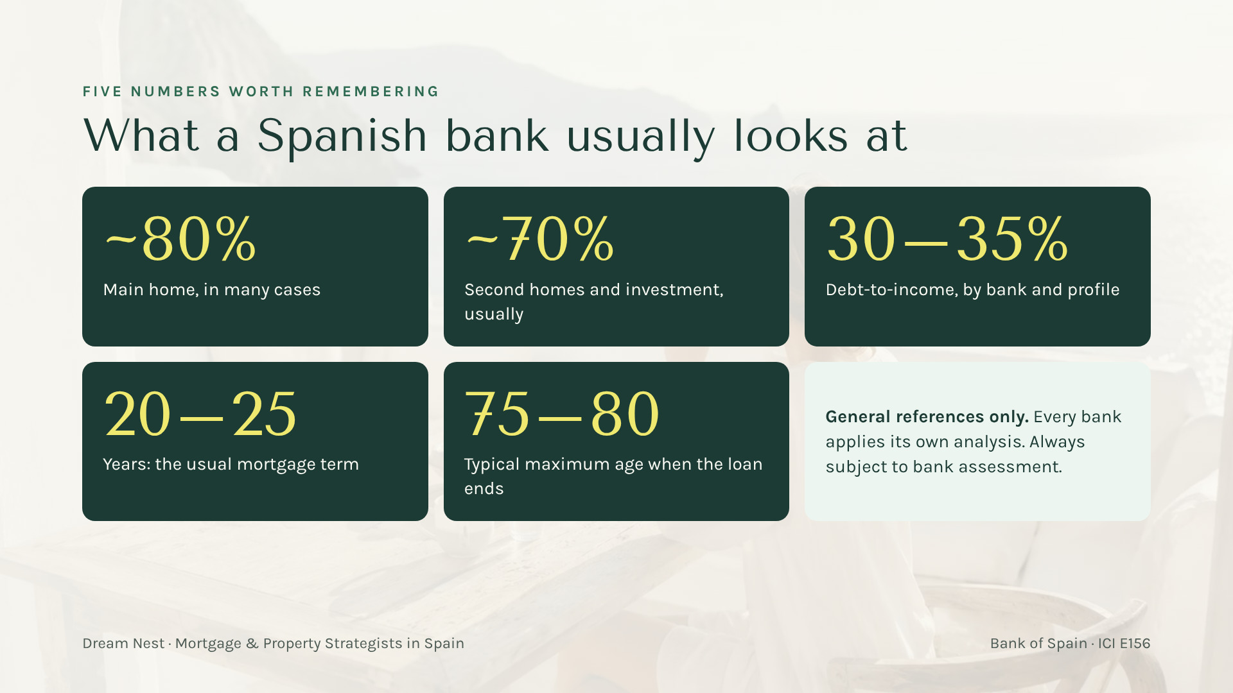
Notes:
[24:12 — 25:56] Keep it light: "If you take a photo of one slide today, make it this one." LTV depends mostly on the use: up to ~80% for a main home in many cases, including residents with income abroad and some qualifying buyers relocating to Spain; ~70% is the usual reference for second homes and investment, so that client brings at least ~30% plus costs. ⚠️ LCCI/Orden EHA/2899/2011 — verificar antes de publicar. DTI around 30–35%. Term usually 20–25 years. Age: explain verbally how the maximum age at maturity (around 75–80 depending on the bank) shortens the available term — a 60-year-old may not get 25 years. Stress: general references; each bank decides. (Compliance: no rates or payments are shown on this slide; if you mention any rate or monthly payment out loud, present it as an illustration, subject to bank assessment.)

Slide 22
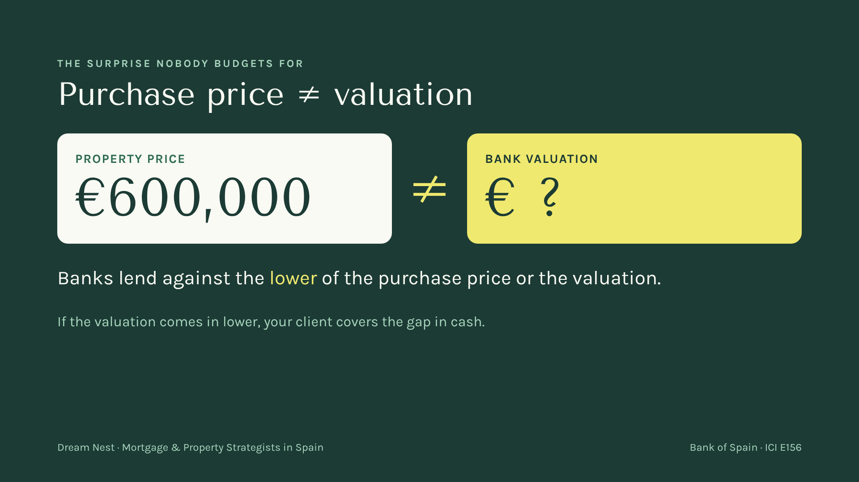
Notes:
[25:56 — 27:06] Ask the room: "If the property costs six hundred thousand, what's it worth to the bank?" Let them answer "six hundred thousand". Then: "Not necessarily." The official valuation is done by an approved appraiser; the bank lends on the lower figure. Walk through it in words: if the valuation comes in at less than the price, the financing percentage applies to the lower number and the difference comes out of your client's pocket. That's why we look at valuation risk before anyone signs a deposit.

Slide 23
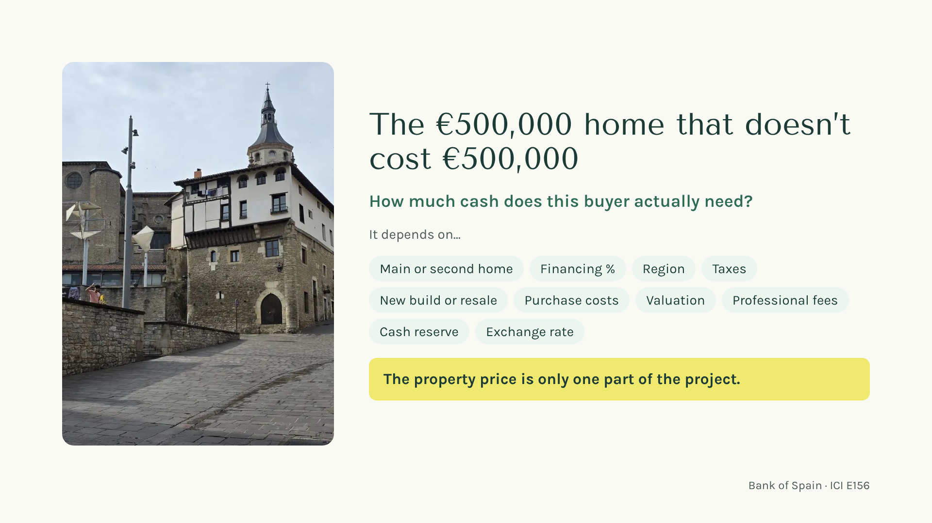
Notes:
[27:06 — 28:51] Game moment: "Shout out a number — how much cash does this buyer need on a €500,000 home?" Collect a few guesses, have fun with them. Then: "The honest answer is: it depends." Go through the chips: main home or second home changes the financing percentage; purchase taxes depend on the region and on new build vs resale; notary, registry, lawyer, valuation; keep a cash cushion; and if the money is in dollars, the exchange rate on the day can move the total. (No figure on the slide on purpose — if you give an example out loud, keep it as an illustration, not a quote.) "We calculate this with the client before they fall in love with a house."

Slide 24
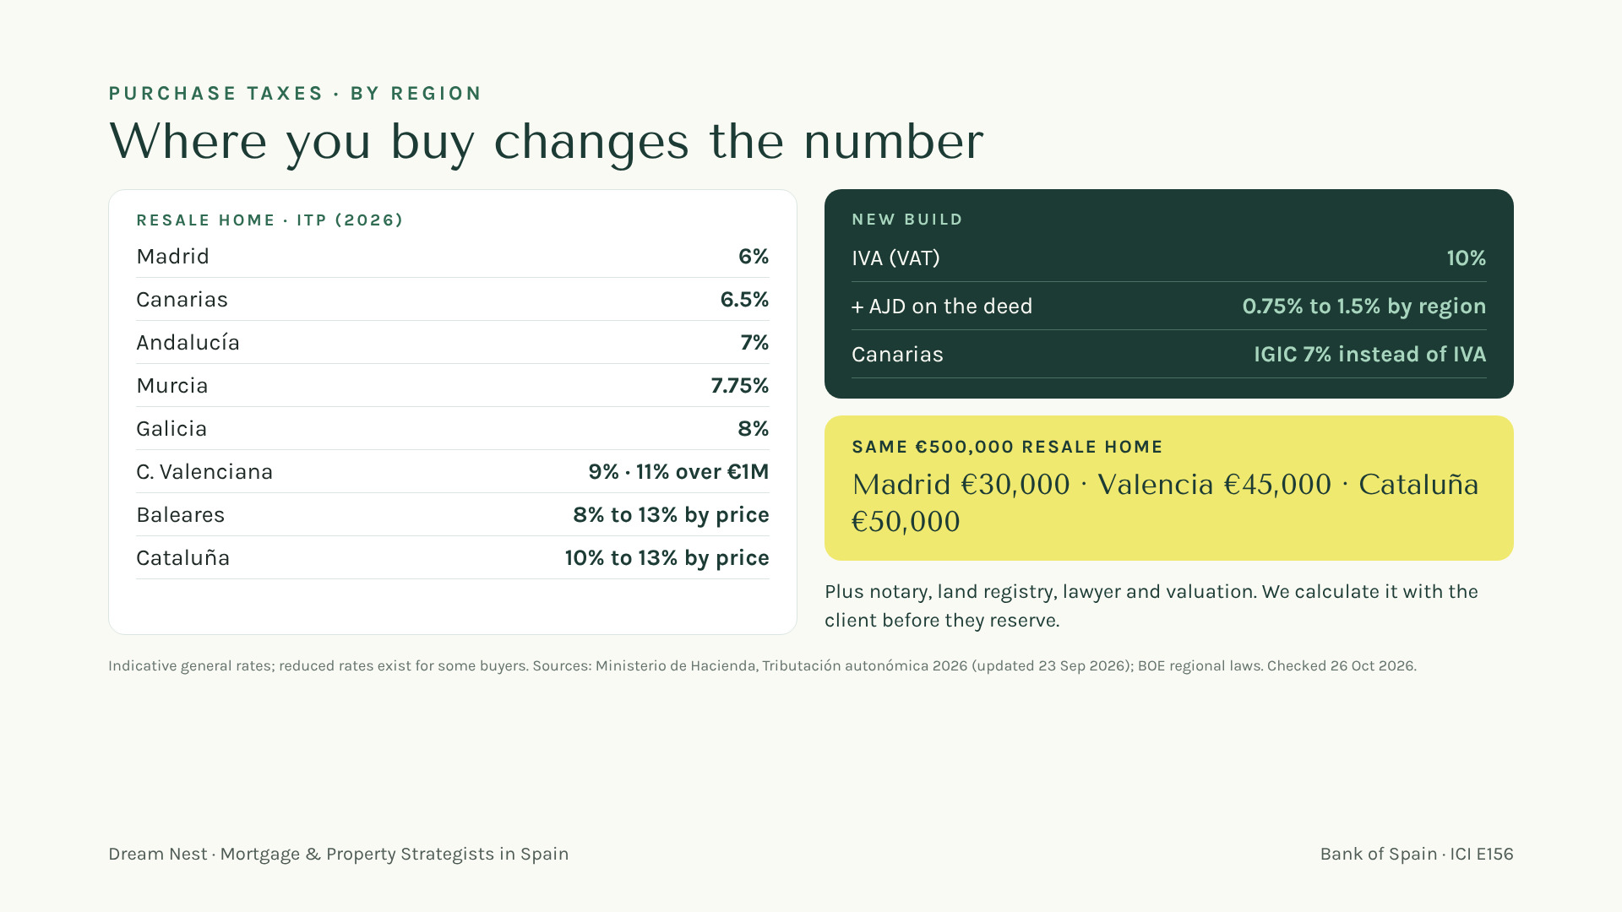
Notes:
[28:51 — 30:21] Now the numbers. Resale homes pay ITP, a regional tax, and the rate depends on where: from 6% in Madrid to 9% in the Valencian Community (11% over €1M since 1 June 2026) and up to 13% at the top of the scale in Baleares and Cataluña. New build pays 10% IVA plus a deed tax (AJD) of 0.75% to 1.5% by region; in the Canary Islands, IGIC 7% instead of IVA. Example on screen, resale €500,000: Madrid €30,000, Valencia €45,000, Cataluña €50,000 — a €20,000 difference before notary, registry, lawyer and valuation. The mortgage deed tax is paid by the bank since 2018. Rates as published by Hacienda 2026, checked 26 Oct 2026; reduced rates exist (young buyers, large families, etc.). Verify before publishing anywhere.

Slide 25
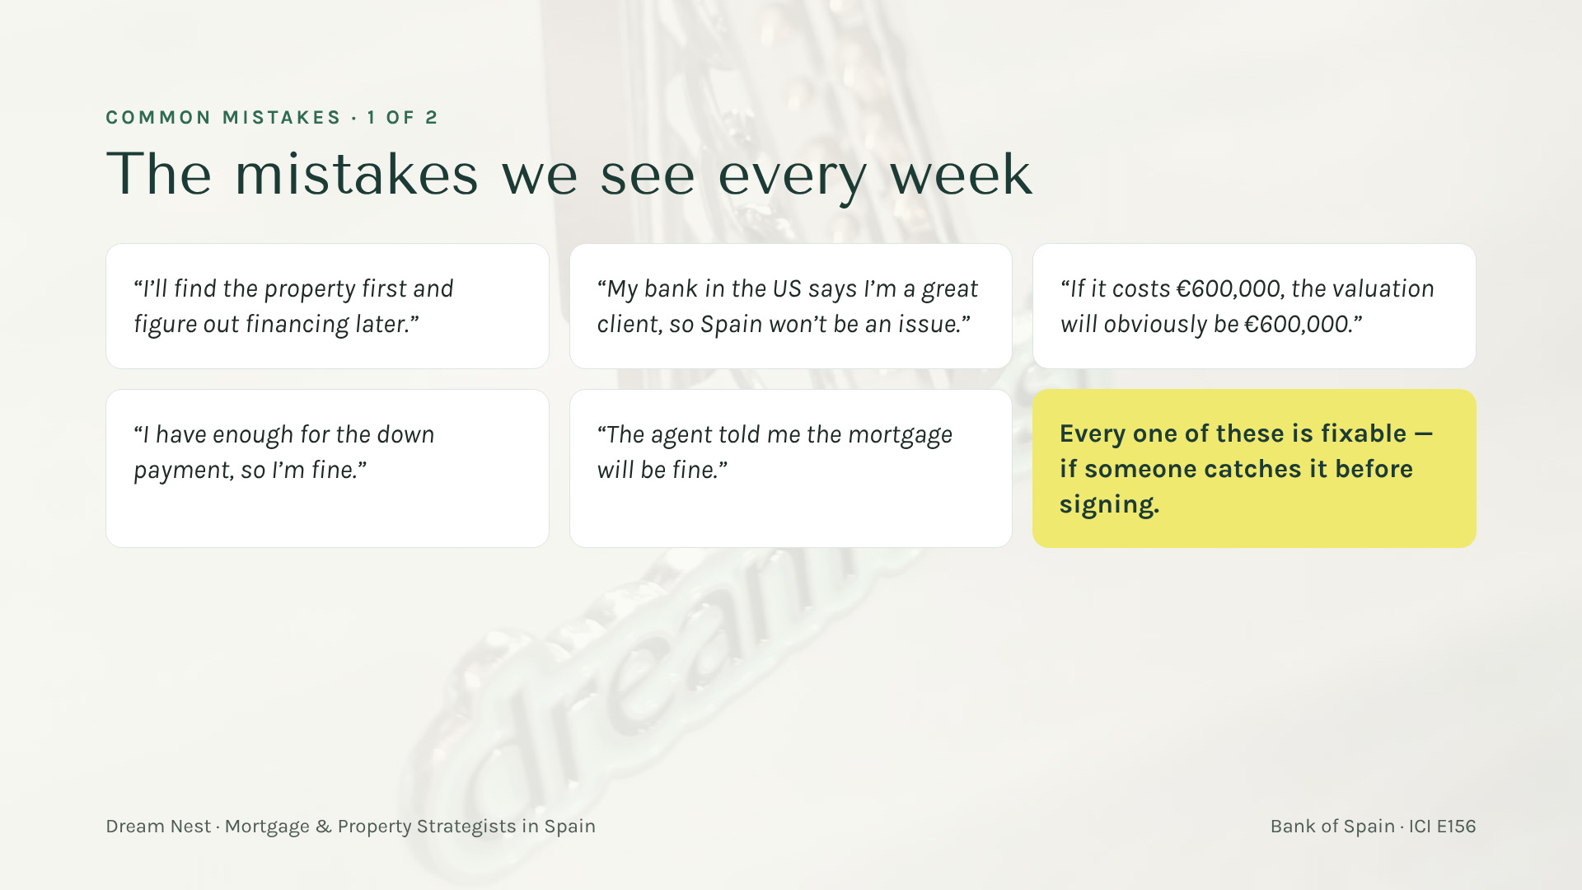
Notes:
[30:21 — 32:05] Read each quote in the client's voice (have fun with the accent). Wait for "NO!". One line of why for each: financing first, because the financing defines the budget. A great US client is not automatically a great Spanish file. Valuation can come in lower. The down payment is not the total cash needed — taxes and costs come on top. "The agent told me" — nobody can promise what a bank will do; even we don't promise approval. Last card: the good news — all of these are avoidable.

Slide 26
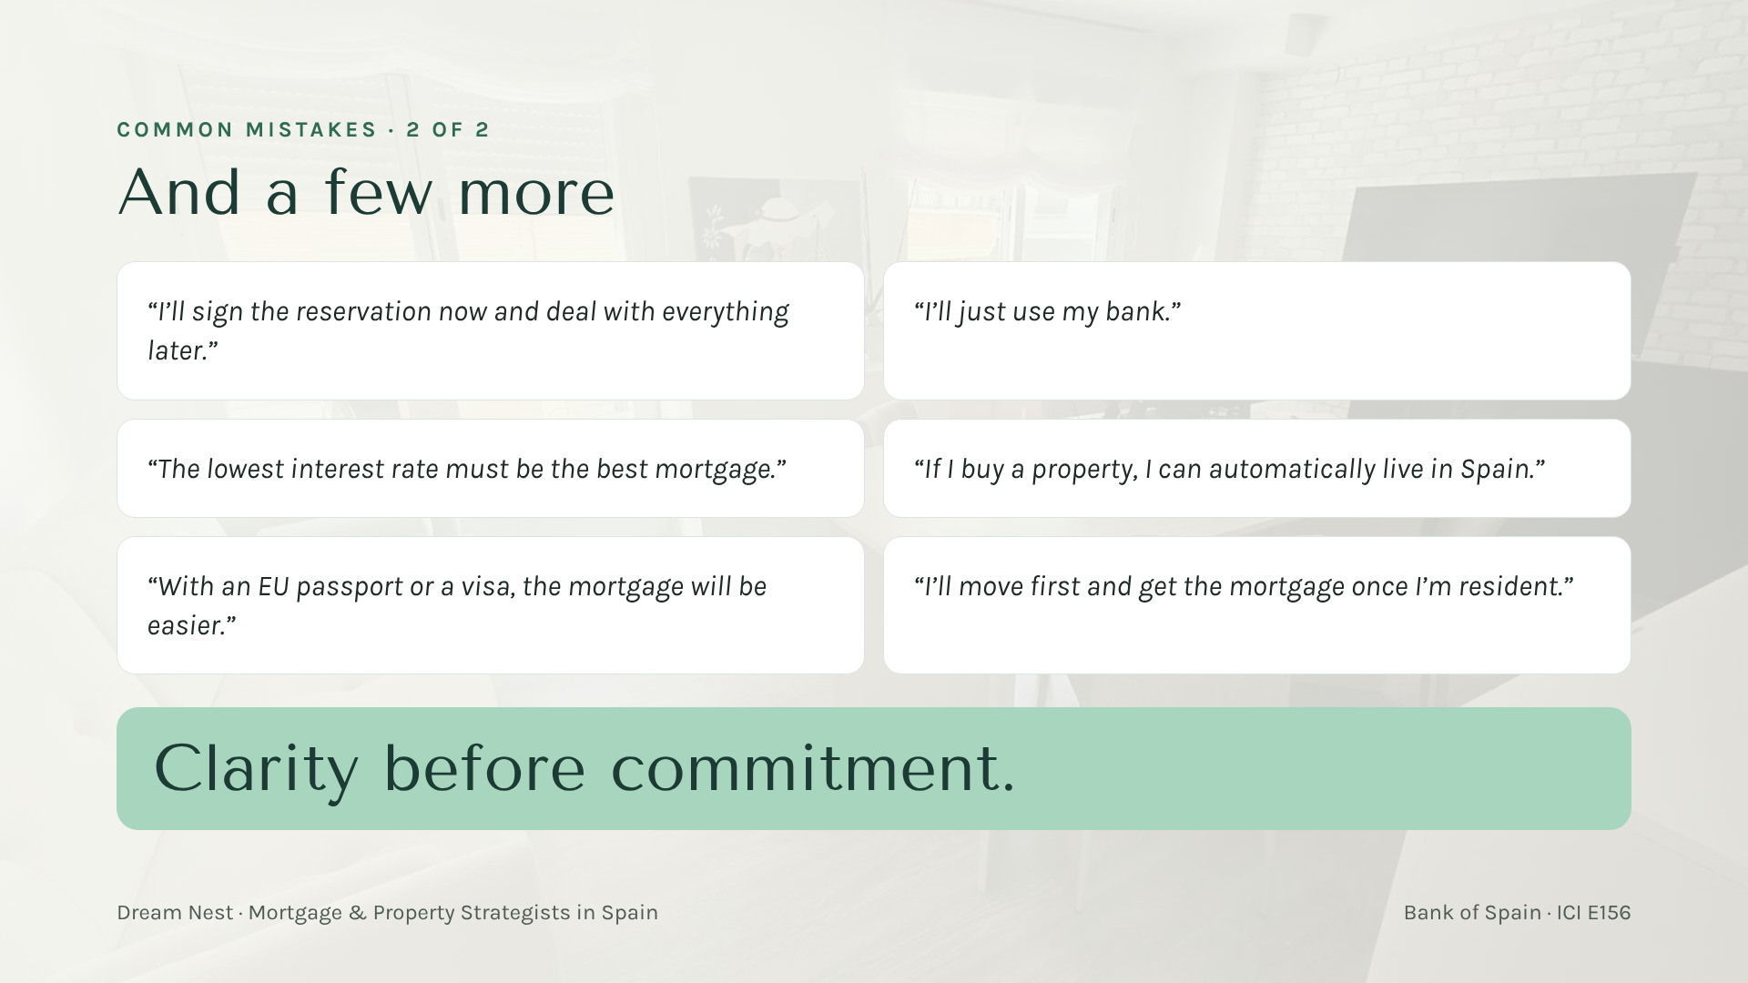
Notes:
[32:05 — 34:05] Same game. Reservation: in Spain early signatures commit money — reservation and arras can be lost if the financing fails. "My bank": their US bank usually doesn't lend in Spain, and one Spanish bank is one opinion. Lowest rate: the headline rate isn't the whole cost — linked products, insurance, fees and conditions matter. (Compliance: if you mention any rate example, say it's illustrative.) Buying = living: no — residency is a separate process. Passport or visa: does not make the mortgage easier; the bank looks at income, stability and use. Move first: risky — to count as resident the client must already live here, and if they changed job, company or career path, the bank may want 2–3 tax years again. Often the smart move is to buy and finance before moving. Finish with the phrase on screen: "Clarity before commitment." Let it sit for a second.

Slide 27
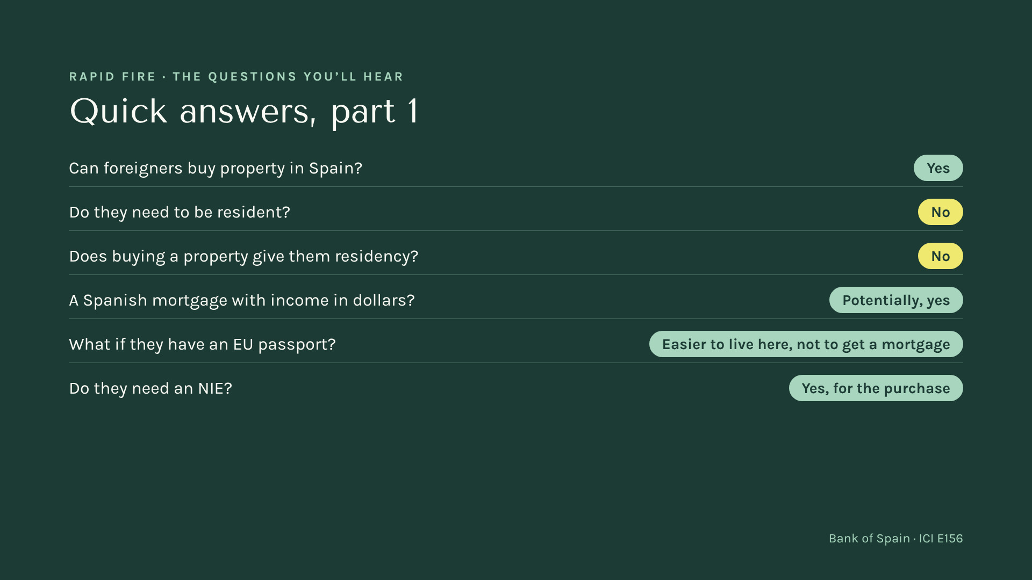
Notes:
[34:05 — 35:15] Game-show pace: read the question, let the room guess, reveal the answer, one sentence each. Dollar income: possible with the right bank and a well-built file — exchange-rate risk is part of the analysis. EU passport: it changes the immigration route, not the bank's criterion. NIE: the foreigner identification number; needed for the transaction.

Slide 28
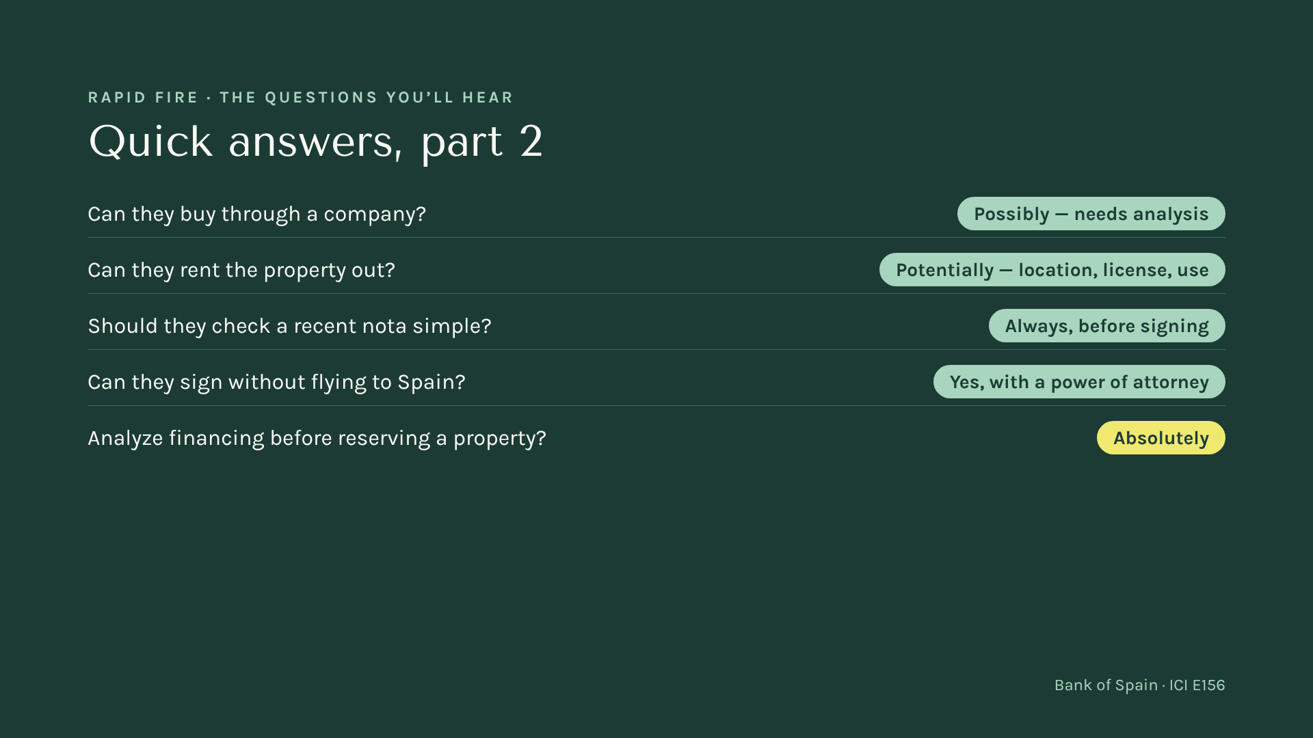
Notes:
[35:15 — 36:07] Same pace. Company purchase: possible in some cases, but financing, tax and costs change — it needs analysis first. Rentals: tourist rental rules depend on the region and the city, and they change; licensing matters. Nota simple: the registry extract that shows the owner and any charges. Power of attorney: planned ahead, the purchase can close without the buyer travelling. Big finish on the last one — "ABSOLUTELY."

Slide 29
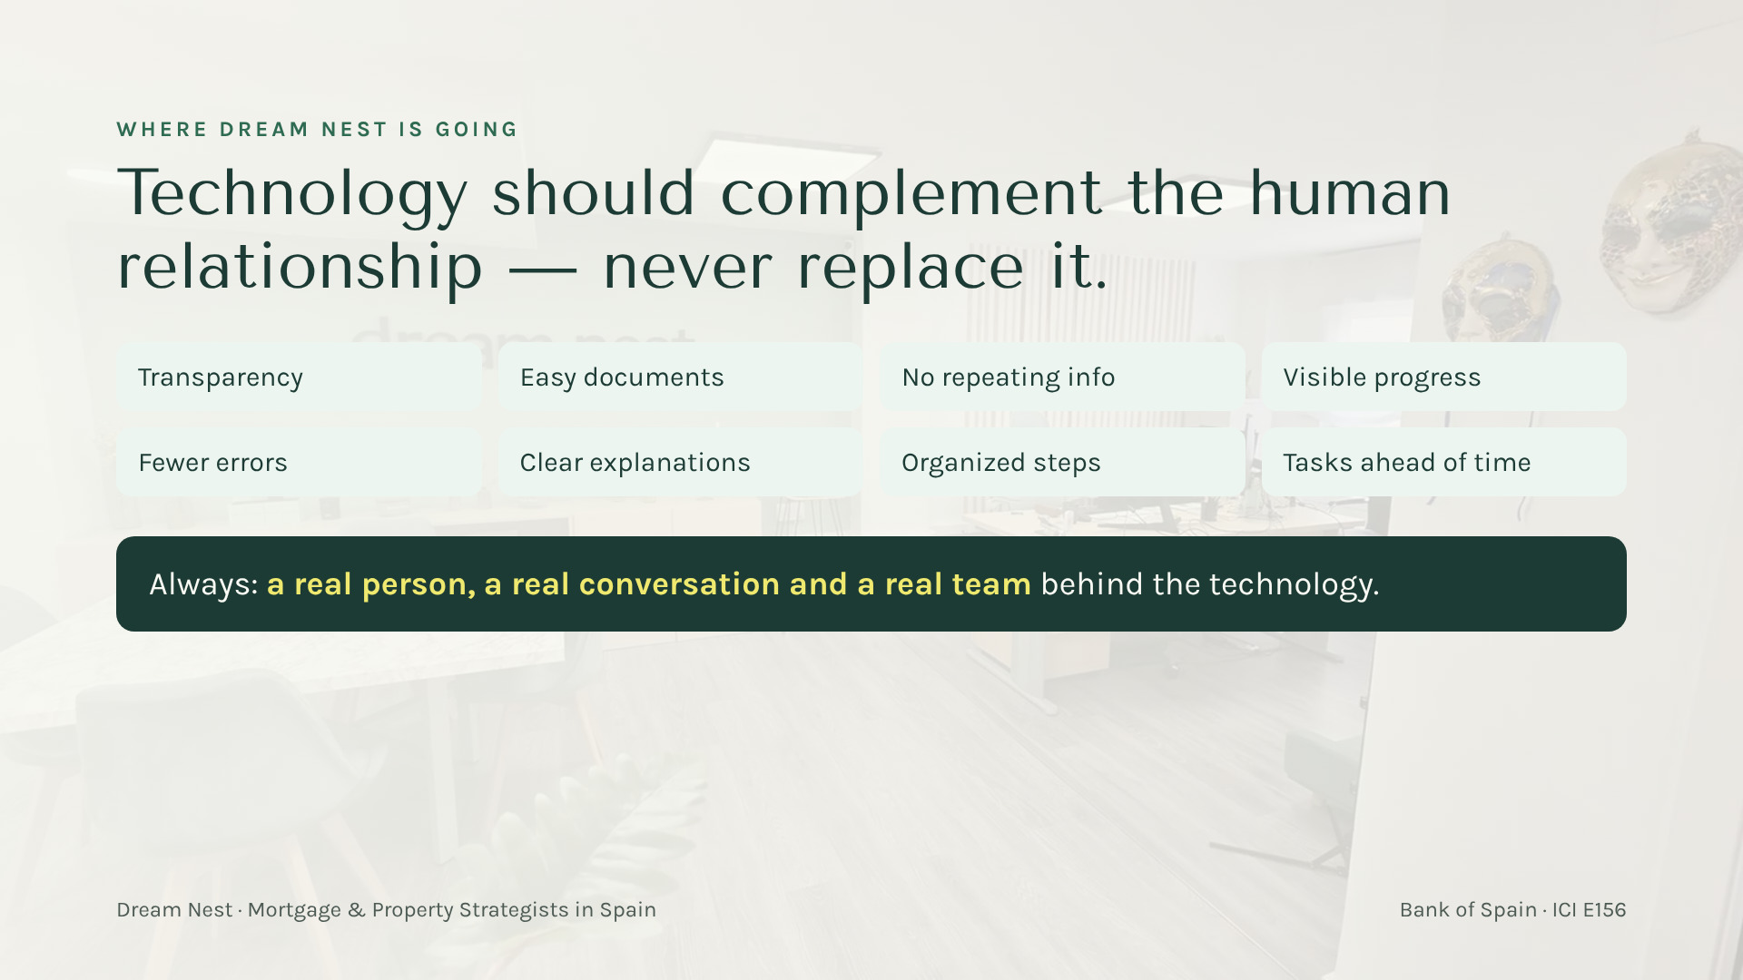
Notes:
[36:07 — 36:59] "We're investing seriously in technology. But we don't believe buying a home in another country should become an automated process." Technology is there so the client feels accompanied: they see where they are, what's missing, what comes next — and there's always a person who answers.

Slide 30
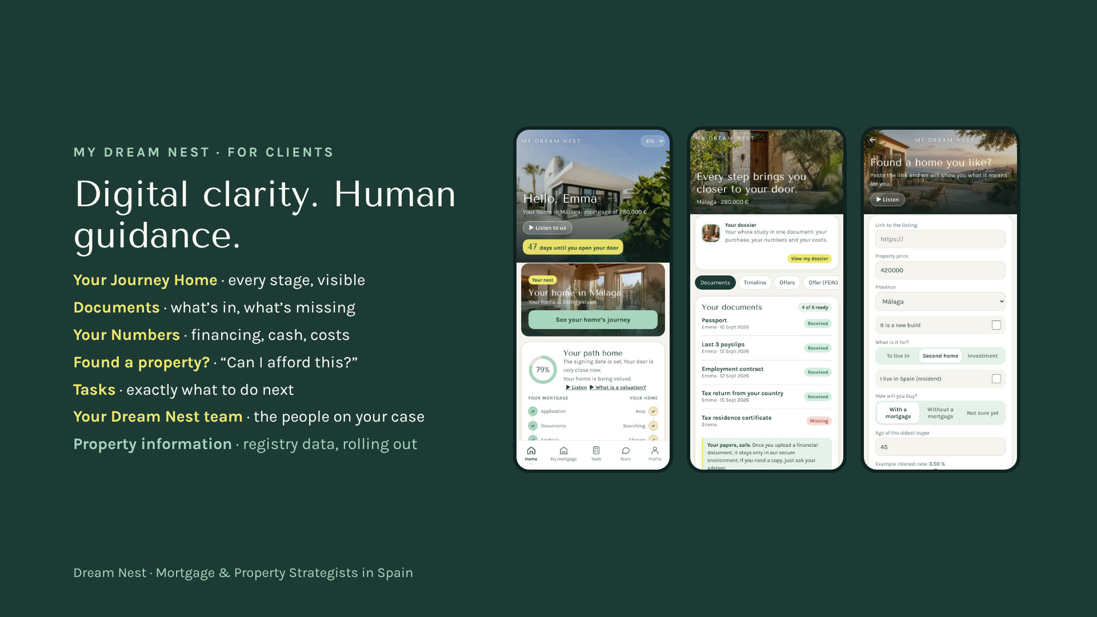
Notes:
[36:59 — 38:09] Show the app like a friend showing their phone. The journey: where am I, what's next. Documents: no more "did you get my email?". Numbers: the client understands financing, cash and costs. "Found a property?": the client shares a listing and asks "can I afford this?" — and a person looks at it. Be honest about timing: some features, like integrated property and registry information, are being rolled out progressively. These are the real app screens.

Slide 31
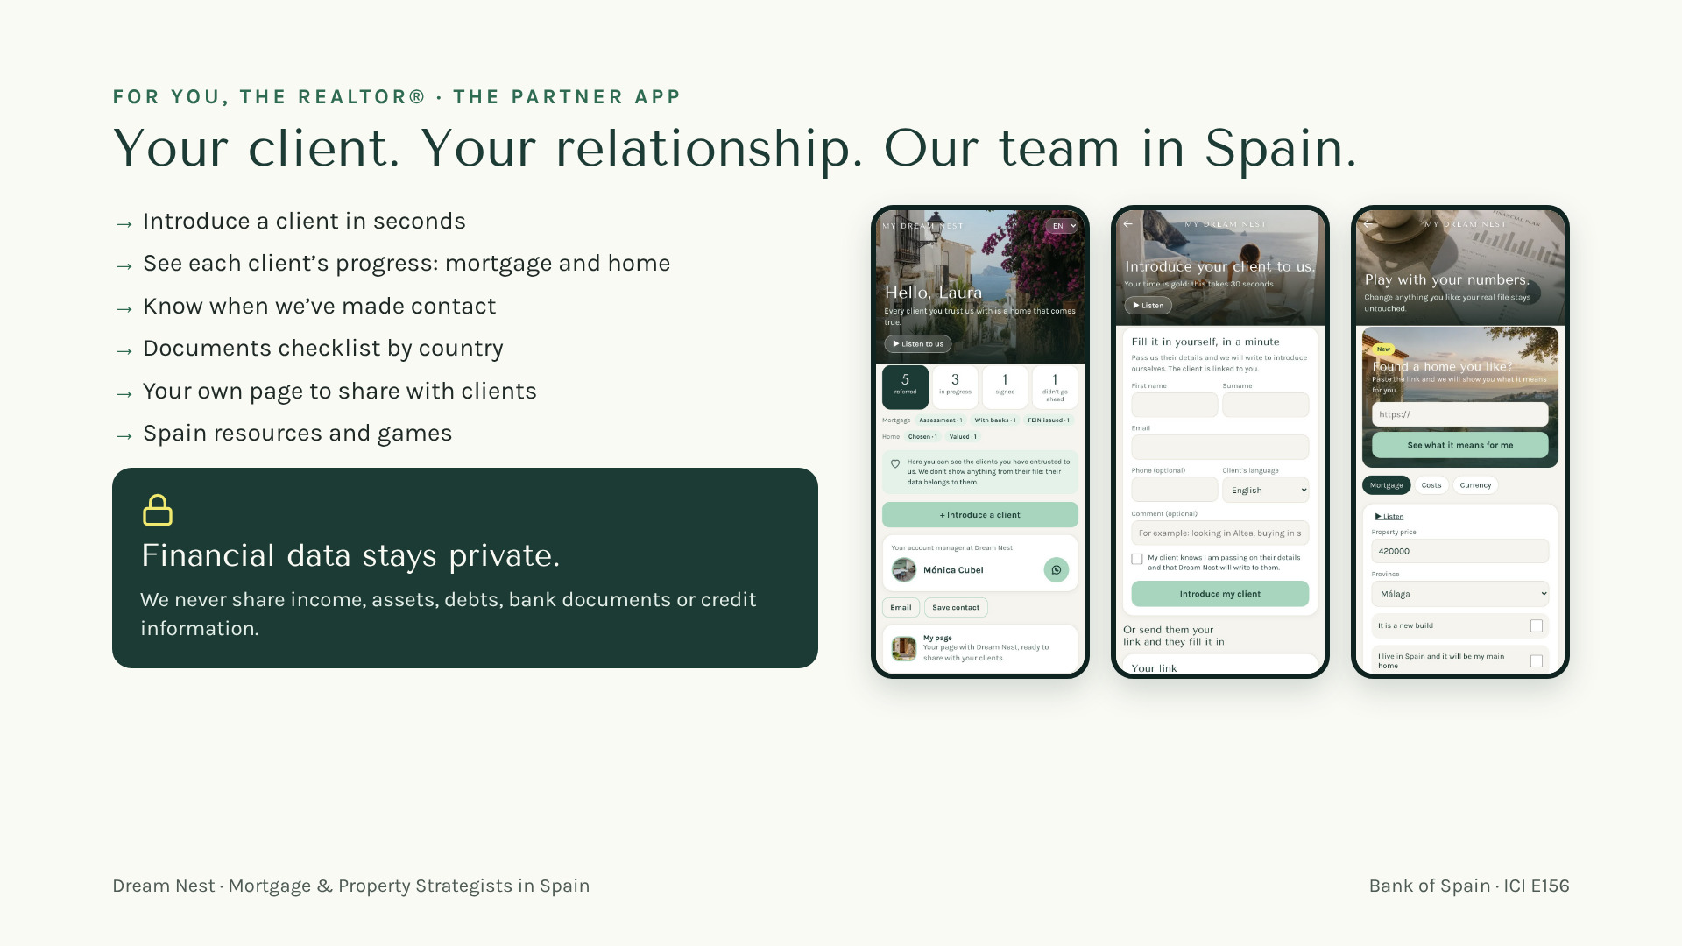
Notes:
[38:09 — 39:19] Speak directly to them: "You introduce a client — and then what? Usually silence. We want the opposite." The partner app is live: introduce a client in seconds, see each client's progress on two tracks (mortgage and home), know when we've made contact, a documents checklist by country for their clients, their own page to share, and Spain resources and games. Screens shown with demo data. Then the red line, said firmly: "We will never share your client's financial information with anyone — not income, not assets, not documents. You get visibility of the service, not of their finances."

Slide 32

Notes:
[39:19 — 39:54] Pause and let people scan — give them a few seconds, it's worth it. "Everything I talked about today is on the website, in seven languages. When a client says Spain, you can send them there — or better, send them to us."

Slide 33
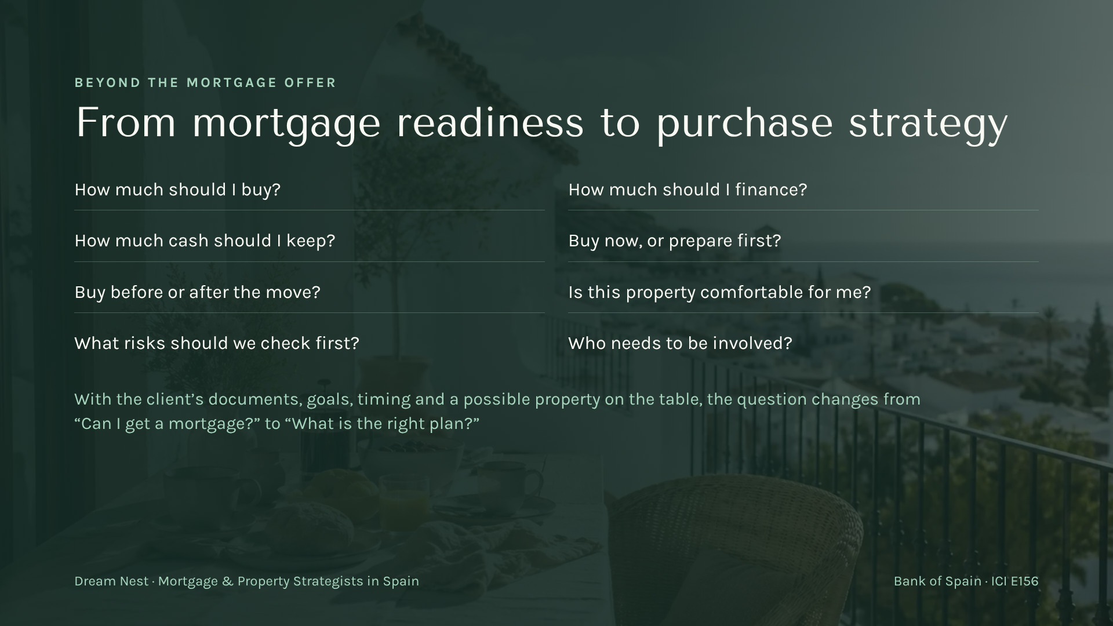
Notes:
[39:54 — 40:46] "When we have the full picture — documents, goals, the property, residency plans, timing — we can do much more than get an offer. We help the client decide how much to buy, how much to finance, how much cash to keep, and whether to buy now or prepare first." Keep it to the questions; don't promise outcomes.

Slide 34
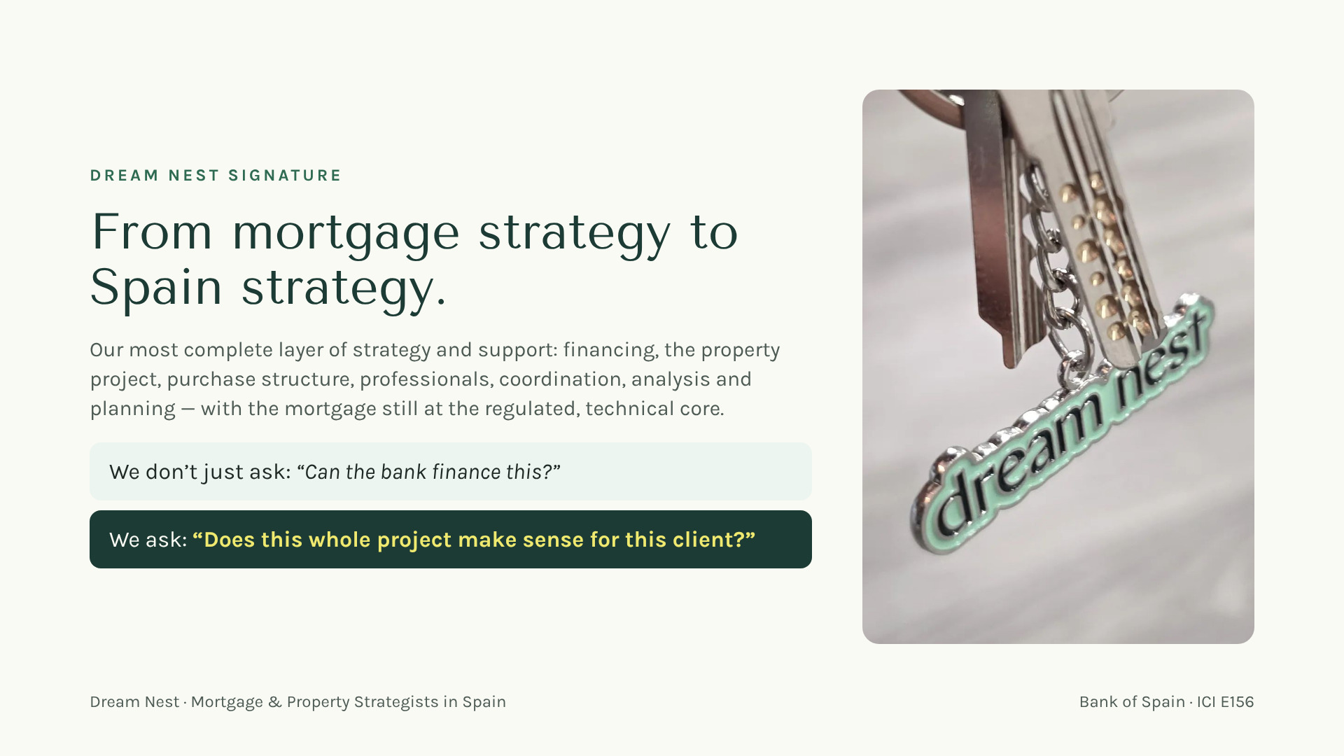
Notes:
[40:46 — 41:21] Present Signature not as a "premium product" but as the natural answer for clients whose project is bigger than a mortgage. The mortgage stays the regulated, technical heart. The two questions on screen are the whole idea — read the second one slowly.

Slide 35

Notes:
[41:21 — 41:56] The emotional core for this audience. "You spent years building that relationship. When your client starts dreaming about Spain, you don't have to let go — and you don't have to become an expert in Spanish banking either. Bring us into the conversation. You stay their person. We become your team in Spain."

Slide 36

Notes:
[41:56 — 42:13] Short and firm. "The best time to call us is when your client first says 'maybe Spain' — not the week before the notary."

Slide 37
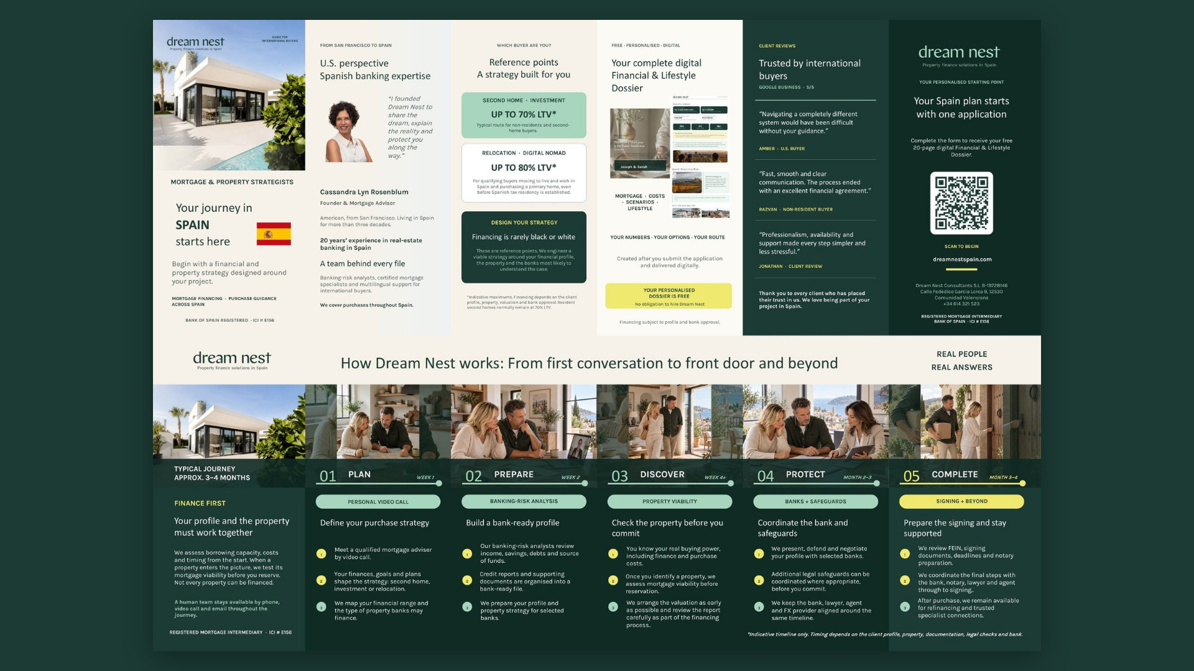
Notes:
[42:13 — 43:43] [Brochure · side 1] "This is the guide you'll take home tonight." Walk it left to right: who I am · which buyer are you (second home / investment vs relocation) · the free personalised dossier · what clients say · scan to begin. On the LTV figures (70% / 80%): say "indicative maximums, always subject to profile, valuation and bank approval" — never as a promise. ⚠️ LCCI/Orden EHA/2899/2011 — financing percentages.

Slide 38
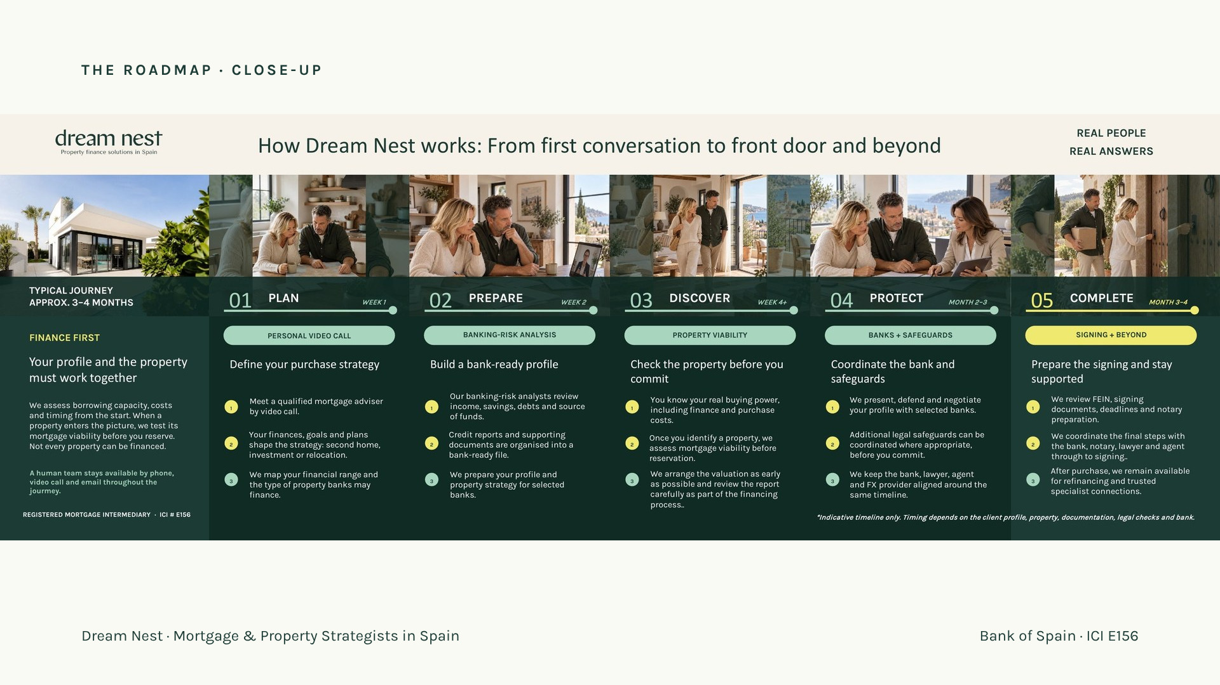
Notes:
[43:43 — 45:13] [Roadmap close-up] "From first conversation to front door — and beyond." Five steps: Plan (week 1) · Prepare (week 2) · Discover (week 4+) · Protect (month 2–3) · Complete (month 3–4). Key line: finance first — we test the property's mortgage viability before you reserve; not every property can be financed. Timeline is indicative only: depends on profile, property, documents, legal checks and bank.

Slide 39
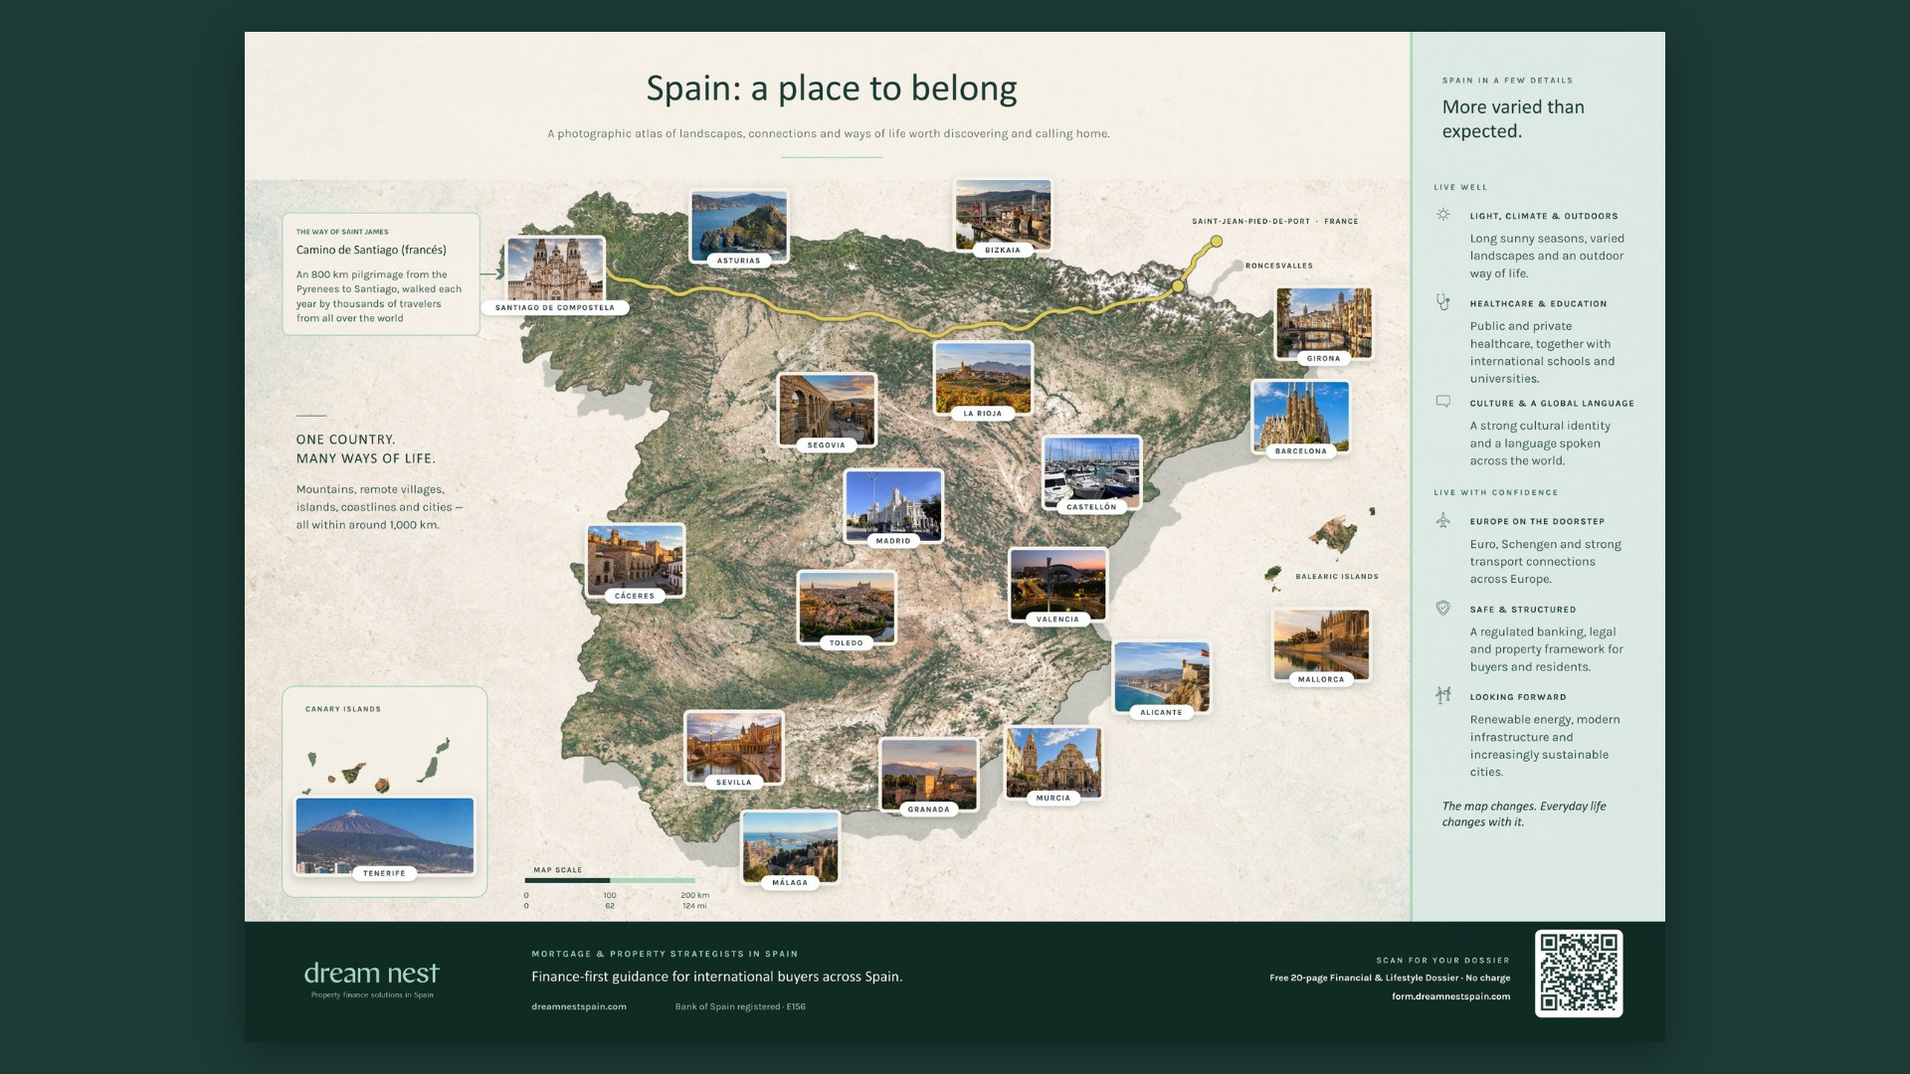
Notes:
[45:13 — 49:13] [Brochure · side 2 — the map] "One country, many ways of life — all within around 1,000 km." Pick the zones you want to talk about (map shows: Santiago & the Camino, Asturias, Bizkaia, La Rioja, Girona, Barcelona, Segovia, Madrid, Toledo, Cáceres, Castellón, Valencia, Alicante, Murcia, Mallorca/Balearics, Sevilla, Granada, Málaga, Tenerife/Canaries). Right column: live well (light, climate, healthcare, schools, culture) and live with confidence (euro & Schengen, regulated framework, looking forward). No prices or figures unless you have the source.

Slide 40

Notes:
[49:13 — 57:13] Energy up: “Everything we’ve talked about today, now on your phone. Right answers score, fast right answers score more. Let’s see who can get their client to the keys.” Then open the game: click “Open the game” on this slide, or switch to the browser tab where you already opened dreamnestspain.com/games/live?host=1 before the talk (it asks for the presenter code the first time on each browser). That page IS the big screen: it shows the QR, the PIN and every name that joins, and the voice plays from the laptop (make sure the laptop sound goes to the room speakers). When the names stop arriving, press Start the game (or Space). Language: tap English or Español on the game’s start screen (big screen and voice; each player can also switch EN/ES on their phone). Recommended: “International partners” game, 12 questions, 25 seconds, voice on, teams off. Space moves forward. After the podium, come back to the deck for the closing slide. If the connection fails, play on the big screen anyway: the room answers with hands up.

Slide 41

Notes:
[57:13 — 58:13] Closing line, slowly, looking at the room: "You don't need to remember everything I've told you today. Just remember Dream Nest." Thank them. Leave the QR on screen during Q&A.

