Slide 1
SHEPA PROJECT | CENTRAL HUB
HOMER Pro Simulation
Results Report
Full-Year Hybrid Solar – Battery – Hydrogen System
Merti, Isiolo County, Kenya | HOMER Pro 3.14.2
Author: Cassandra Lelei Model: SHEPA_CentralHub_v1.homer Version: 1.0 | 17th April 2026
First Simulation Complete
Central Hub – Full Year Model
Borehole system models will be presented in the next phase

Slide 2
PRESENTATION AGENDA
System Design Overview
Electrolyzer Performance
01
04
Architecture, loads, and design assumptions
Hydrogen production observations
Key Financial Results
Simulation Warnings
02
05
NPC, LCOE, and component cost breakdown
Issues identified and implications
Power Generation Analysis
Next Steps & Optimisation
03
06
Solar, battery, and generation profile
Recommended actions for the next simulation

Slide 3






SYSTEM DESIGN OVERVIEW
SOLAR PV
BATTERY
CONVERTER
200 kW
100 kWh
50 kW
Generic Flat Plate
Li-Ion · 3 strings
Bidirectional
ELECTROLYZER
H₂ TANK
GENERATOR
30 kW
20 kg
50 kW
H₂ Production
Hydrogen Storage
Diesel Backup
Dispatch Strategy: HOMER Cycle Charging | Location: Merti, Isiolo County, Kenya (1°4.0'N, 38°40.0'E) | Project Lifetime: 25 years

Slide 4
ANNUAL LOAD PROFILE
24-Hour Critical Loads
Daytime Deferrable Loads
Cold Room HVAC
8.5 kW
204 kWh/day
Electrolyzer (DC)
30.0 kW
240 kWh/day
Cold Room Fans & Controls
1.5 kW
36 kWh/day
H₂ Compressor + RO
4.1 kW
16.8 kWh/day
Cold Room Lighting
0.5 kW
12 kWh/day
AWG (Rainy Months)
1.2 kW
14.5 kWh/day avg
Control Room (SCADA)
0.8 kW
19.2 kWh/day
H₂ Auxiliary Systems
1.0 kW
24 kWh/day
TOTAL: 295 kWh/day | 18.75 kW peak
TOTAL: ~257 kWh/day | 35.3 kW peak (daytime)

Slide 5
KEY FINANCIAL RESULTS
TOTAL NPC
LCOE
OPERATING COST
$760,330
$0.4424
$23,297
25-Year Lifecycle Cost
per kWh generated
per year
Capital Costs
Solar PV (200 kW)
$170,000
Genset (50 kW)
$120,000
Li-Ion Battery
$54,000
Electrolyzer
$45,000
H₂ Tank
$20,000
Converter
$15,000
TOTAL
$424,000

Slide 6
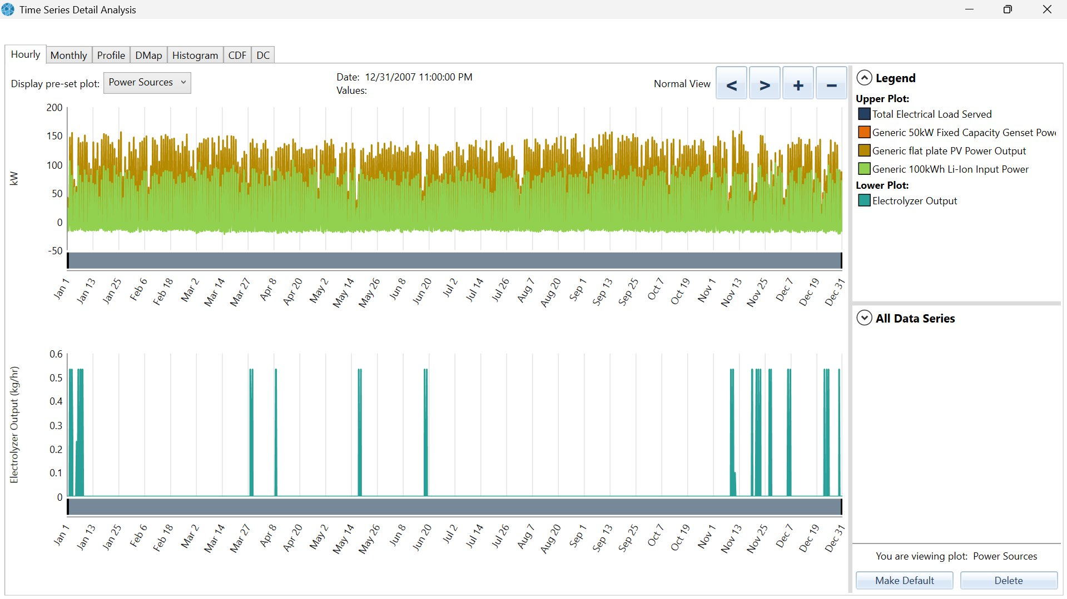


POWER GENERATION ANALYSIS
Key Observations
Solar PV dominates generation — covers daytime loads and charges battery
Battery provides continuous overnight discharge for critical cold room loads
Diesel generator activates during low-solar periods — system not fully renewable yet
Load range: 50–175 kW consistent throughout year, confirming stable demand profile
PV search space flagged as potentially insufficient — 200 kW may not be the optimal array size. Expand search space to 100–500 kW in next run.

Slide 7

ELECTROLYZER & HYDROGEN PRODUCTION
Electrolyzer Output – Annual Time Series
(from HOMER Pro Time Series Analysis)
CRITICAL FINDING
Peak Output:
~0.55 kg/hr (during operation)
Operation Pattern:
Highly intermittent — sparse events
Annual Production:
Well below 5 kg/day target
Daily Operation:
NOT achieving 8 hrs/day as designed
The electrolyzer is not being dispatched consistently. Insufficient excess PV capacity after meeting primary loads means hydrogen production targets cannot be met with the current 200 kW PV configuration.
Required Actions: (1) Increase PV capacity search space to 100–500 kW · (2) Review electrolyzer dispatch strategy to prioritise hydrogen production during surplus solar hours · (3) Consider a dedicated PV allocation for hydrogen production

Slide 8

SIMULATION WARNINGS
Converter Search Space Insufficient
Issue: Current 50 kW converter may be undersized. Peak loads during simultaneous electrolyzer and critical load operation can exceed 50 kW.
Expand converter search space to 50–150 kW
Gen50 Fuel Curve Incomplete
Issue: Generator efficiency curve may not be accurately modelled. This affects dispatch decisions and fuel cost accuracy throughout the simulation.
Verify and update the fuel consumption curve for the 50 kW genset
PV Search Space Insufficient
Issue: HOMER was constrained to 200 kW PV maximum. The true optimal array size may be larger — the search space did not allow exploration of this.
Expand PV search space to 100–500 kW and re-run optimisation
Note: Results are directionally useful but require refinement. A corrected simulation is needed before proposal documentation.

Slide 9
NEXT STEPS & OPTIMISATION ROADMAP
Expand Search Spaces
HIGH
Borehole Models
NEXT
01
PV: 100–500 kW
Converter: 50–150 kW
Battery: 100–400 kWh
05
5 × independent HOMER models (27 kWh/day each) — presented next phase
Fix Gen Fuel Curve
HIGH
Sensitivity Analysis
NEXT
02
Update Gen50 fuel consumption curve for accurate dispatch & cost modelling
06
Solar resource, battery cost, and diesel price sensitivity testing
Electrolyzer Dispatch
HIGH
03
Revise to controlled dispatch — ensure continuous H₂ production during surplus solar
Re-run Optimisation
HIGH
04
Full HOMER optimisation after all corrections — confirms final system sizing

Slide 10
SUMMARY
First simulation establishes
a viable baseline architecture.
Full-year integrated model successfully built — AWG seasonal load included
System architecture defined: 200 kW PV · 100 kWh battery · 30 kW electrolyzer · 50 kW genset
Three HOMER warnings require correction before results are final
Electrolyzer not meeting H₂ production target — expanded PV and dispatch revision needed
Next Presentation: Borehole System Models (5 × independent systems) + Refined Central Hub Simulation Results

