Slide 1
VAFusion Final Demonstration
Arjun Comar
Mary Roth

Slide 2
Since the last:
Goals:
  Re-work:
    Staff View
    Piano
  Create:
    Character Recognition Component

Slide 3
Staff View
The old one looked terrible
  Didn't resemble a piece of sheet music
  Difficult to read
  The output held no meaning

Slide 4
Piano
Poor design, poor implementation
  Original piano was hacked together
  Attempt to understand scope and breadth of project
  Difficult to add multitouch

Slide 5
Our Solution
Break up a “Staff View” into its components
  Staves, Notes, etc.
Create our own structures to hold information that our inputs collect
  Score, Measure, etc.
Display that collection in a meaningful way, resembling sheet music

Slide 6
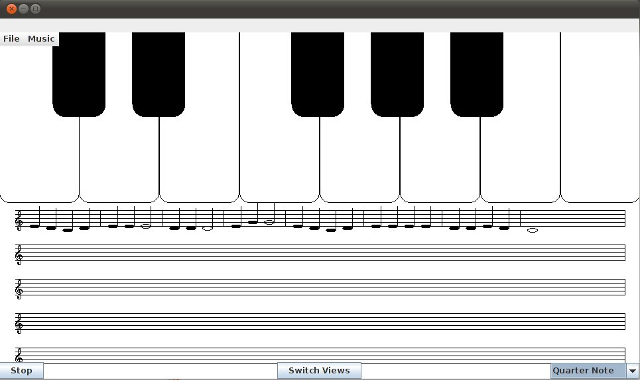
Our Result:

Slide 7
Features
Staff that supports playback
  Includes accidentals, ties, sane measures
  Implementation supports multiple parts and multitouch
Piano
  Correct pitches!
  No stuck keys / notes!
  Instruments
  Implementation support for multitouch

Slide 8
Issues
Multitouch
  PyMT
    Python + Java versus Us
  MT4j
    Input driver from scratch
Character Recognition
  Trained the network
  Trained it again
  And again... but it never took.

Slide 9
Multitouch
Almost functional driver for MT4j + Linux
  Currently only supports the Cando Panel
    Easy to add support for others
  Needs more work, but upstream commit coming

Slide 10
Multitouch Issues
Driver is almost functional
  But no time to add gestures / event system
  Used swing event system for input
    Threading problems ensued

Slide 11
Character Recognition
Neural Net came together quickly and easily
  Noticed a default architecture in Neuroph library
    Assumed it would work
    It doesn't.
  Assumptions are bad
    Trained network again and again
    Used time to implement other features

Slide 12
On the bright side
Character recognition: ready in ~1 week
  Network architecture rewrite: 2-3 days
  Retrain: 4-5 days
Memory usage is tenable
  ~300mb
  Netbooks have 1gb (256mb real)

Slide 13
Bright side 2
Project being cleaned up for upstream commits
  Staff viewer → JMusic
  Linux Multitouch driver → MT4j

Slide 14
Other issues
Team:
  Juggling work/school/project
    Mary's Co-op
    Rose classes
    Exhaustion set in
  Real world issues
    Illness – 9th week

Slide 15
Demo!

