Slide 1
Subthreshold Data Path Circuit Design:
Two Implementations of Low Power Simple Adder
Andrew Cassell
CSE 477
Fall 2005

Slide 2
Overview:
8 Bit Adder Used as Program Counter
  Music Player (MP3, CD)
Static CMOS and Dynamic CMOS Design
Used Mirror Adder (Fewer Transistors)
Low Speed & Low Power
Static CMOS design consumed less Power

Slide 3
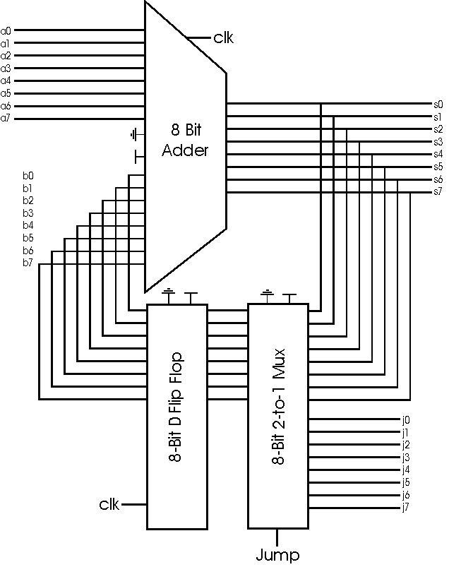
Block Diagram

Slide 4
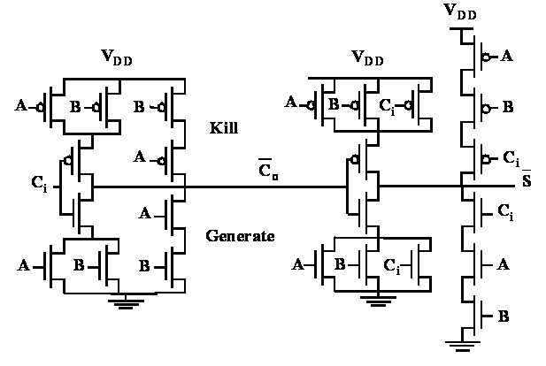
Mirror Adder

Slide 5
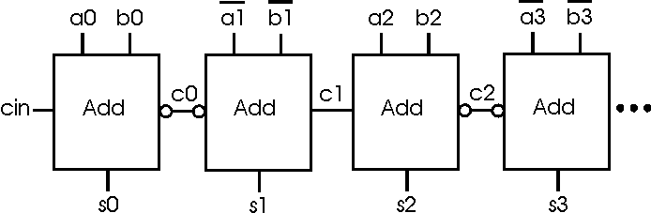
Adder Chain

Slide 6
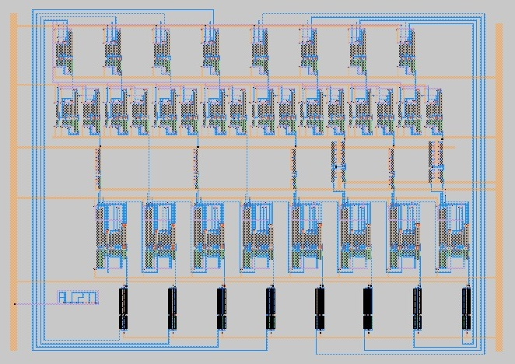
Max Layout

Slide 7
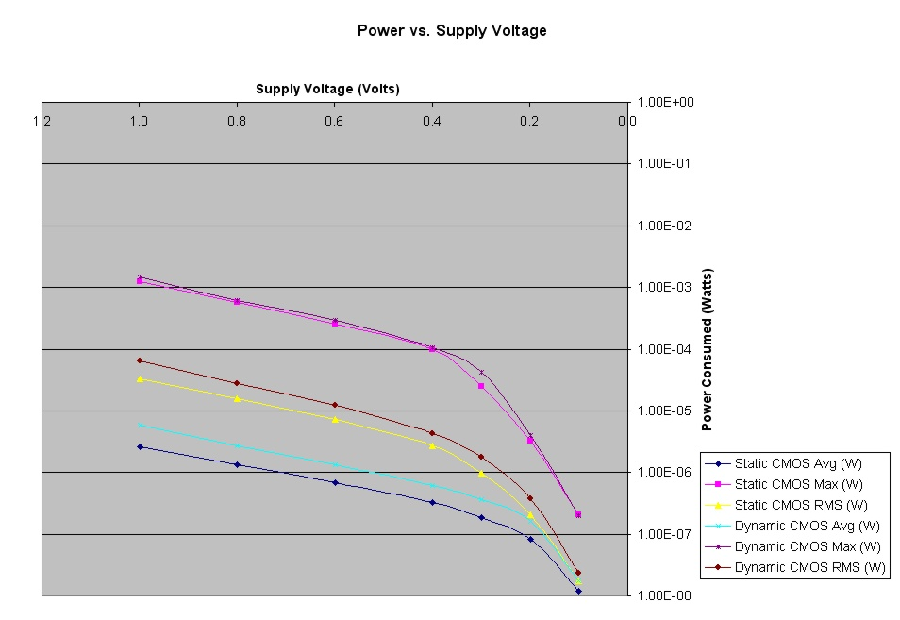
Power Vs. VDD
Threshold
Biggest Gains

