Slide 1

Does a larger budget produce a more lucrative movie?
Team #3

Slide 2

Starring
Amandeep Brar Arpine Bankikyan
Cassie Folkers Lindsey Giron
Ricardo Negrete Sriven Ankam
Featuring
TMDb (The Movie Database)
IMDb
OMDb
Netflix

Slide 3

Datasets
OBMd
Only 9,043 data available out of 84,294 titles
Kaggle
Netflix
568 titles with data available for only 44 titles
TMDb
Budget
IMDb
IMDb Ratings
Revenue
Genres
Movie titles

Slide 4


Slide 5


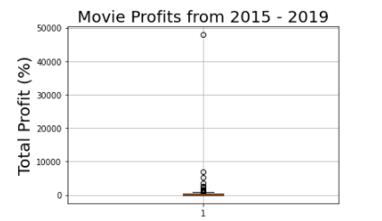
Identifying Outliers
Removed outlier for analysis

Slide 6

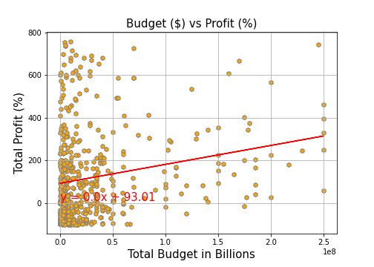

Slide 7

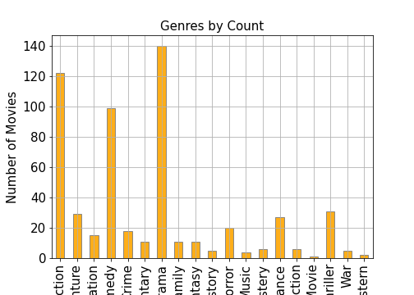

Slide 8

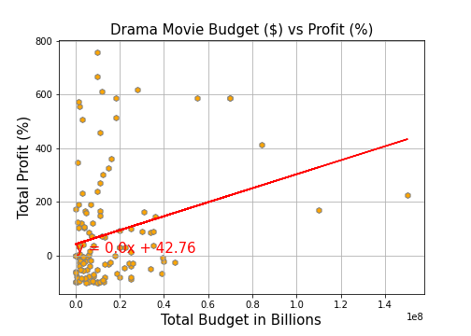

Slide 9
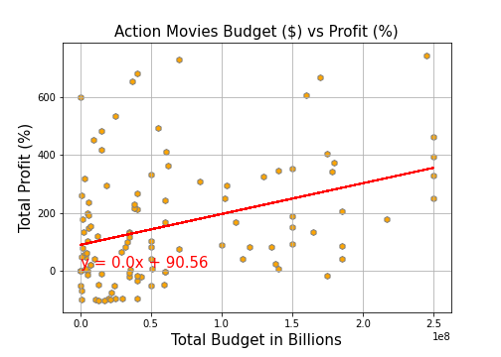

Slide 10
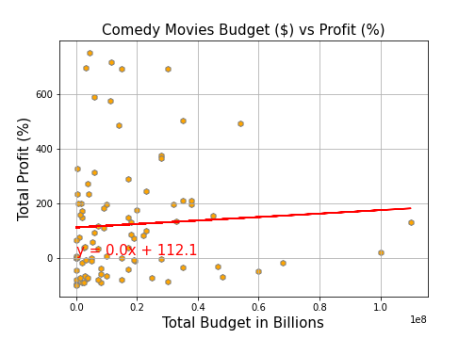

Slide 12


Slide 13


