Slide 1
PwC Professional
The PwC Professional
My goals
“I aspire to grow as a Trusted Leader who delivers Distinctive Outcomes”
“I have goals that challenge me to create value and grow my career at the firm”
How I lead and
deliver value as a PwC Professional
My performance & recognition
My support network
“I know how the value I deliver is evaluated and recognized”
“I have the right support to navigate the firm and advance my career”
My
feedback
My continuous development
“I understand the value I create and my impact on everyone around me”
“Every day presents new learning opportunities”

Slide 2
Leadership Development Experience
Performance management
Leadership Development Experience at PwC is the ongoing process of helping people grow into Trusted Leaders through feedback, coaching, stretch opportunities, meaningful career conversations, and living the PwC Professional behaviours to create value for clients, people, the firm, and society.
To implement it, PwC has a performance management process that creates transparent, development-focused, and trust-based system that aligns with the Evolved PwC Professional framework.

Slide 3
Performance is assessed holistically
There is no formula or simple scorecard. Team Leaders are expected to review all relevant evidence and make a holistic judgment.
Evidence includes:
Multi-directional feedback (upward, peer, downward)
PwC Professional behaviours
Knowledge, skills and expertise
Quality measures
KPI targets and compliance
Self and Manager Evaluations.
Performance is evaluated based on both "What” and "How"
PwC do not focus only on results and financial metrics.
Performance decisions consider:
What an employee achieves (outcomes, value creation)
How they achieve it (PwC Professional behaviours)
Quality of work
Compliance requirements
Feedback from multiple stakeholders.
Goal setting supports development rather than “box-ticking“
Goals are intended to:
Align employees with business strategy
Help prioritise development and value creation
Encourage stretch goals
Continuous feedback is central
Performance management is no longer a year-end exercise. We promote:
Real-time feedback
Coaching conversations
Feedback from peers, managers and team members
Continuous development discussions throughout the year.

Slide 4
Performance year journey
Remember, new joiners could join the firm at any point in the performance year. Work with HC to understand what from the journey below is relevant for you and when.
Career Outlook conversation
Team Leader communicates outcomes of moderation, including promotion decision (if applicate), bonus / rewards, and future development areas
CRT/Moderation
Your Team Leader participates in the career round table discussions
Start of FY (01 July)
Promotions & base compensation increases effective
Mid-year
Prepare for mid-year conversations
Q2 Check in(s)
Check in with your Team Leader on progress against self-defined/individual goals, feedback, and future focus areas
1 March
Mid-year promotions effective
Prepare for moderation
Meet with your Team Leader to discuss performance and progression readiness
Q3 Check in(s)
Check in with your Team Leader on progress against self-defined/individual goals, feedback, and focus areas
Q1 Goal setting
Meet your Team Leader to review assigned/organizational goals, discuss performance expectations, and set self-defined/individual goals
Feedback
Begin giving and receiving feedback
Start of Q4
Check in with your Team Leader as needed

Slide 5
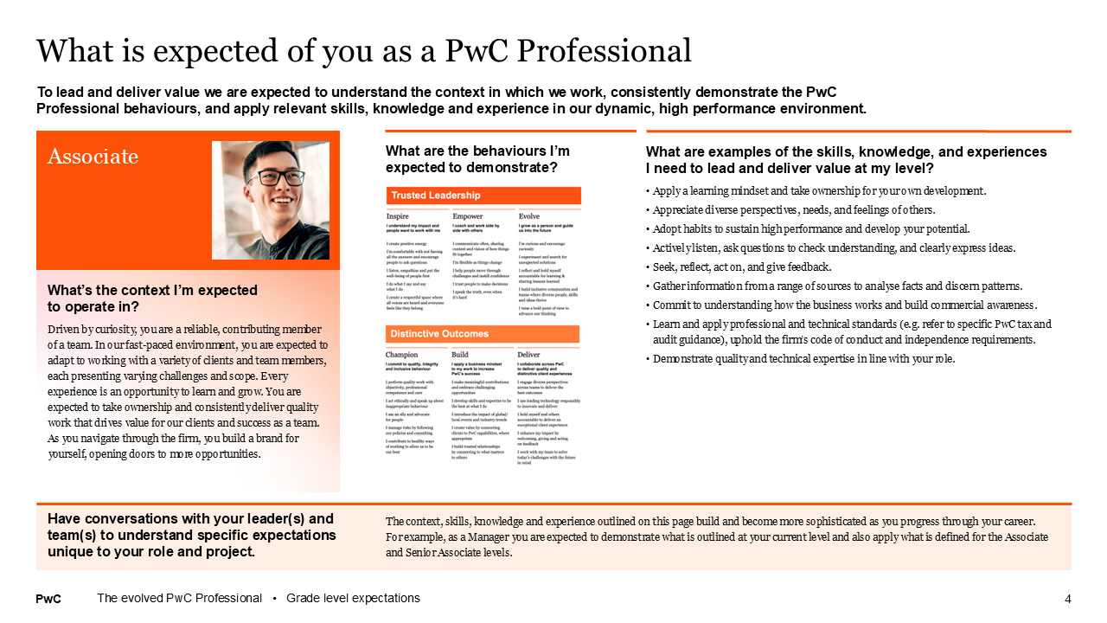
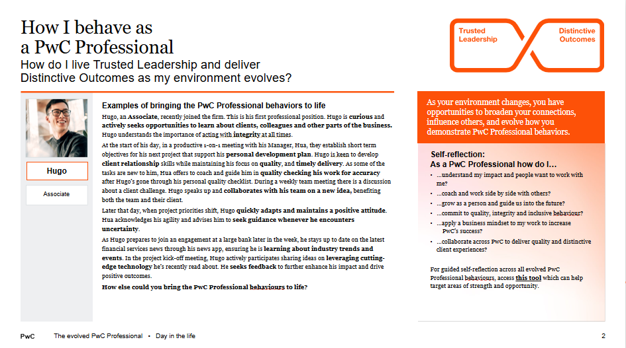
Use the PwC Professional grade-level expectations to understand high performance at PwC
The PwC Professional: Grade-level expectations
Grade-level expectations help you understand how to grow and lead as PwC Professionals. They include two parts:
What is expected of you as a PwC Professional Defines the skills, knowledge and experience each grade should apply to be successful
How I behave as a PwC Professional Describes what it looks like to live PwC Professional behaviours at each grade

Slide 6
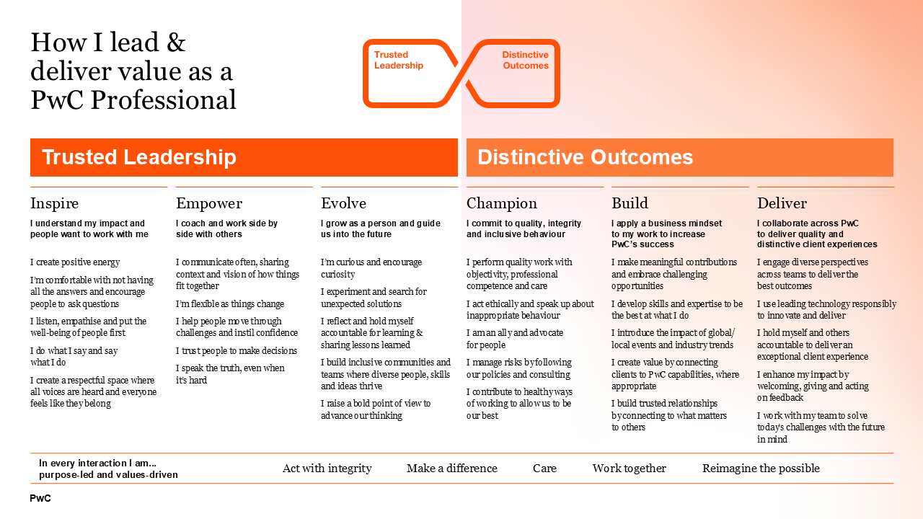
How we bring our culture to life: The PwC Professional

Slide 7
Your support network and goals help guide your continuous development journey
My goals
My support network
My continuous development
Assigned goals are aligned to our business strategy and are guideposts to help you prioritise your contributions and development.
Your Team Leader is responsible for supporting your overall performance, development and wellbeing.
Continuous development requires a growth mindset. Frequent, in-the-moment feedback, guided by the PwC Professional, enables all of us to grow as professionals and leaders.
Self-defined goals are set by you to help shape your development, behaviours, and unique contributions throughout the year.
Associates, Senior Associates and new hires at other grades are also assigned a Buddy to provide additional support for your onboarding (explain how things work here, etc.)

Slide 8
Feedback is a key enabler for development and an input into performance evaluation
My feedback
My performance & recognition
Use Feedback Exchange to request feedback, from all directions, that captures how you create value through both behaviours (the PwC Professional) and project contributions. Written feedback should be accompanied by conversations to support your growth and development.
Your performance is evaluated by assessing – on a peer relative basis – how you've created value for our clients, people, firm and society. 'Value creation' includes both what you did (outcomes) and how you did it (behaviours).
During the Career Outlook meeting, your Team Leader will share performance and promotion decisions, corresponding reward implications and areas for development.
Feedback Exchange
Share, Reflect, Act

Slide 9
Goal setting guidance
Assigned/Organization goals
Assigned/Organizational goals are aligned to our business strategy and are guidelines to help you prioritise your contributions and development. Review these goals and discuss how to bring our strategy to life. 1. Goal #1 2. Goal #2 3. Goal #3 …. The goals are guidelines to help us grow and deliver value in line with our FY27 strategy. They are not a ‘check-the-box exercise’. However, the value we deliver against your assigned/organizational goals can be captured in Self Evaluation at year-end. Metrics and compliance requirements Please discuss target metrics (e.g. Sales, Utilisation) and compliance requirements for the LoS and grade with your Team Leader. These support our firmwide strategy and help to outline expectations of high performers at the firm. They provide one input to year-end performance evaluation.
Self-defined/Individual goals
Self-defined/Individual goals help us shape our behaviours, unique contributions, and development in the year ahead. Value delivered against goals - rather than goal completion - influence performance decisions. Remember that an ‘incomplete’ stretch goal can deliver more value than a less challenging goal that is fully ‘achieved’. What to consider when setting self-defined goals Will my goal challenge me to perform at my best and grow as a PwC Professional? Does my goal help bring our values to life? If I achieve or partially achieve this goal, will I deliver significant value to our clients, people, firm, or society? How specific should my goal be (e.g. measurable - where applicable, timebound, clear)? Have I asked my Team Leader for feedback on my goals? Is my Team Leader aware of my aspirations and development priorities? Use Workday to set 1 - 3 self-defined stretch goals for the year ahead Review assigned/organizational goals and consider how your self-defined goals could support business priorities Establish 1 - 3 self-defined/individual stretch goals, each with the potential to deliver significant value to our clients, people, firm, and/or society Review self-defined/individual goals with your Team Leader and record them in Workday
PwC
9
Notes:
1-pager discussion aid

Slide 10
Examples of how goals can come to life
An illustrative example of annual goal setting guidance for Senior Associate within a client service practice. The example is hypothetical and assumes that additional communications would be used to support Managers through goal setting.
Assigned/Organizational goals (cascaded in Workday)
Self-defined/individual goals (created in Workday)
Consulting Practice | Senior Associate focus areas for FY:
Review assigned/individual goals and our FY strategy to determine how your self-defined goals should support business priorities.
Establish 2- 3 assigned/individual “stretch” and SMART goals, each with the potential to deliver value to our clients, people, firm, and / or society. For example, to improve business writing skills with a client; to sit CFA Level 1 exam; to improve presentation skills through…
Establish min. 1 development goal linked to Evolved PwC Professional behaviours each with the potential to deliver value to our clients, people, firm, and / or society. For example, to create and maintain a positive energy within the team via being empathetic, being an active listener, managing stress effectively
Review self-defined/individual goals with your Team Leader and record them in Workday
To drive our FY27 strategy, Senior Associate are expected to live the PwC Professional behaviours in their daily work. Additionally, you can prioritise your contributions and development by: Clients: Making One Firm a reality for our clients by contributing to pursuits and / or engagements that expose our clients to the value of xLoS Platforms, Integrated Solutions, BXT, or other xLoS capabilities People: Challenging yourself to lead with an inclusive mindset; learn how to identify and address unconscious biases and use your learnings to create a more inclusive environment for all PwC colleagues to learn, grow, and create value Firm: Taking personal responsibility to consistently deliver high quality work and enhance trust both internally at PwC and externally in the market | Additionally, Managers are expected to meet the following targets: 70% client utilisation sales participation- n/a 100% compliance training completion Additional territory / LoS-specific compliance requirements would be listed
10

Slide 11

Management/job levels structure for professional Staff
Partner
Job levels are additional attributes to categorize jobs (Associate 2, Senior Associate 2)
Director
Senior Manager
Transition through management levels is promotion
Manager
Transition through job levels is progression
Senior Associate 2
Senior Associate
Associate 2
Associate
Intern

Slide 12
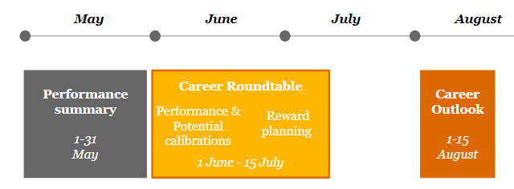
What does performance assessment mean?
Lowest
Impact Tier
Impact Tier
Impact Tier
Impact Tier
Impact Tier
Highest
5
4
3 (A,B,C)
2
1
Time to transition: Value added is not in line with expectations of peer group
Does not meet goals: Business and/or behavioural
Differentiators: Does not have enough impact across people, clients and firm (both in what is done and how it’s done, including quality, standards, values, etc)
Some individuals may have already been on a PIP yet still don’t meet expectations of peer group; Consider exiting
Guided distribution: 0-5%
Opportunity to improve: Value added is below level of high performing peer group
Meets or partially meets goals: Both business and behavioral
Differentiators: Contributes positive impact, but may not be consistent across people, client and firm (both in what is done and how it’s done, including quality, standards, values, etc)
A portion of these individuals may benefit from a PIP to address gaps
Demonstrates PwC values
Guided distribution: 0-5%
Meets expectations and is highly valued
Achieves key goals: Both business and behavioral
Differentiators: Demonstrates impact that positively influences people, client, and/or firm yet is clearly within the high performing peer group (both in what is done and how it’s done, including quality, standards, values, etc)
Models the PwC values
Guided distribution: 60-70%
Exceeds expectations: Adds value beyond level of peer group
Achieves goals: Both business and behavioural
Differentiators: Brings a distinguished level of impact across people, client, and firm that results in added value, beyond peer group (both in what is done and how it’s done, including quality, standards, values, etc)
Models the PwC values
Guided distribution: 0-20%
Truly distinctive: Exemplary among peer group
Achieves goals: Both business and behavioural
Differentiators: Consistently adds significant impact across people, clients and firm, and is considered at the highest level; producing extraordinary contributions (both in what is done and how it’s done, including quality, standards, values, etc)
Models the PwC values
Guided distribution: 0-10%

Slide 13
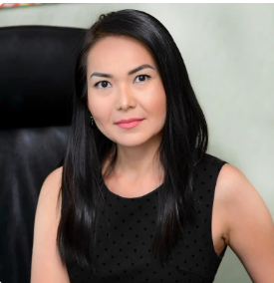
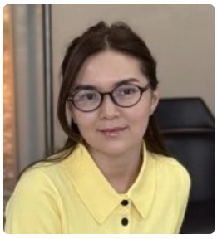
My support network
Team to support you in Performance management process
Your Team Leader &
Meruyert Artygaliyeva Alina Umaraliyeva

