Slide 1
CIS 1904: Haskell
Property-Based Testing

Slide 2
Logistics
HW 10 will be released tomorrow morning

Slide 3
Testing
Strategy so far: Write a few example inputs and expected outputs
testReplicate :: Test testReplicate = "replicate" ~: [ "zero-one" ~: replicate 0 1 ~?= [], "four-six" ~: replicate 4 6 ~?= [6,6,6,6] ]

Slide 4
Testing
Strategy so far: Write a few example inputs and expected outputs
Manual effort proportional to number of test cases → few test cases
Easy to miss entire categories of input (e.g., negative numbers)
Easy to make mistakes in expected output
testReplicate :: Test testReplicate = "replicate" ~: [ "zero-one" ~: replicate 0 1 ~?= [], "four-six" ~: replicate 4 6 ~?= [4,4,4,4,4,4] “neg-two-three” ~: replicate (-2) 3 ~?= [] ]

Slide 5
Property-Based Testing
Write tests for properties that should hold of all output.
E.g., sorting should:
Preserve elements (with multiplicities)
Result in a list where each element is less than or equal to the next
We can then randomly generate arbitrarily many inputs and check that the property holds for all of the outputs.

Slide 6
QuickCheck
sameElements :: (Eq a) => [a] -> [a] -> Bool sameElements xs ys = null (xs \\ ys) && null (ys \\ xs) prop_elements :: [Int] -> [Int] -> Bool prop_elements xs ys = sameElements (mergeSort xs ys) (xs ++ ys)
ghci> quickCheck prop_elements +++ OK, passed 100 tests.

Slide 7
QuickCheck
sameElements :: (Eq a) => [a] -> [a] -> Bool sameElements xs ys = null (xs \\ ys) && null (ys \\ xs) prop_elements :: [Int] -> [Int] -> Bool prop_elements xs ys = sameElements (mergeSort xs ys) (xs ++ ys)
ghci> quickCheck prop_elements *** Failed! Falsifiable (after 4 tests and 3 shrinks): [] [1,0]

Slide 8
Shrinking
[-5, -5]
→ [ [-5], [] ] Test fails on [-5], succeeds on []
→ [ [5], [] ] Test fails on [5], succeeds on []
→ [ [0], [] ] Test fails on [0], succeeds on []
→ [ [] ] Test succeeds on []
Final counterexample: [0] To view full shrinking process, use verboseCheck instead of quickCheck

Slide 9
QuickCheck
prop_elements :: [a] -> [a] -> Bool prop_elements xs ys = sameElements (mergeSort xs ys) (xs ++ ys)
Properties should use concrete types, not parametric polymorphism.
If QuickCheck is left to pick a value for a, it will usually pick ().

Slide 10
QuickCheck
-- | Assuming the input lists are sorted, combine the lists into sorted output. merge :: Ord a => [a] -> [a] -> [a] merge (x:xs) (y:ys) | x < y = x : merge xs (y:ys) | otherwise = y : merge (x:xs) ys merge [] ys = ys merge xs [] = xs prop_sorted :: [Int] -> [Int] -> Bool prop_sorted xs ys = isSorted (merge xs ys) ghci> quickCheck prop_sorted

Slide 11
QuickCheck
-- | Assuming the input lists are sorted, combine the lists into sorted output. merge :: Ord a => [a] -> [a] -> [a] merge (x:xs) (y:ys) | x < y = x : merge xs (y:ys) | otherwise = y : merge (x:xs) ys merge [] ys = ys merge xs [] = xs prop_sorted :: [Int] -> [Int] -> Bool prop_sorted xs ys = isSorted (merge xs ys) ghci> quickCheck prop_sorted *** Failed! Falsifiable (after 4 tests and 3 shrinks): [] [1,0]

Slide 12
QuickCheck
-- | Assuming the input lists are sorted, combine the lists into sorted output. merge :: Ord a => [a] -> [a] -> [a] merge (x:xs) (y:ys) | x < y = x : merge xs (y:ys) | otherwise = y : merge (x:xs) ys merge [] ys = ys merge xs [] = xs prop_sorted :: [Int] -> [Int] -> Bool prop_sorted xs ys = isSorted xs && isSorted ys ==> isSorted (merge xs ys) ghci> quickCheck prop_sorted

Slide 13
QuickCheck
-- | Assuming the input lists are sorted, combine the lists into sorted output. merge :: Ord a => [a] -> [a] -> [a] merge (x:xs) (y:ys) | x < y = x : merge xs (y:ys) | otherwise = y : merge (x:xs) ys merge [] ys = ys merge xs [] = xs prop_sorted :: [Int] -> [Int] -> Bool prop_sorted xs ys = isSorted xs && isSorted ys ==> isSorted (merge xs ys) ghci> quickCheck prop_sorted *** Gave up! Passed only 22 tests; 1000 discarded tests.

Slide 14
Arbitrary
class Arbitrary a where arbitrary :: Gen a -- Gen a is a generator for a shrink :: a -> [a]

Slide 15
Arbitrary
newtype OrderedList a = Ordered { getOrdered :: [a] }
instance (Ord a, Arbitrary a) => Arbitrary (OrderedList a) where arbitrary :: Gen (OrderedList a) arbitrary = … shrink :: OrderedList a -> [OrderedList a] shrink = …

Slide 16
Arbitrary
newtype OrderedList a = Ordered { getOrdered :: [a] }
instance (Ord a, Arbitrary a) => Arbitrary (OrderedList a) where arbitrary :: Gen (OrderedList a) arbitrary = … shrink :: OrderedList a -> [OrderedList a] shrink = … prop_sorted :: OrderedList Int -> OrderedList Int -> Bool prop_sorted (Ordered xs) (Ordered ys) = isSorted (mergeSorted' xs ys) ghci> quickCheck prop_sorted +++ OK, passed 100 tests.

Slide 17
genList
data AlmostList a = Empty | NonEmpty a (AlmostList a) instance Arbitrary (AlmostList a) where shrink = … arbitrary = genList

Slide 18
genList
genList :: Arbitrary a => Gen (AlmostList a) genList = do len <- choose (0, 10) vals <- replicateM len arbitrary return $ fromList vals

Slide 19
genList
sized :: (Int -> Gen a) -> Gen a genList :: Arbitrary a => Gen (AlmostList a) genList = sized $ \size -> do len <- choose (0, size) vals <- replicateM len arbitrary return $ fromList vals

Slide 20
genList
sized :: (Int -> Gen a) -> Gen a frequency :: [(Int, Gen a)] -> Gen a genList :: Arbitrary a => Gen (AlmostList a) genList = sized $ \size -> do frequency [ (1, return Empty), (size, do x <- arbitrary xs <- resize (size - 1) genList return (NonEmpty x xs) )]

Slide 21
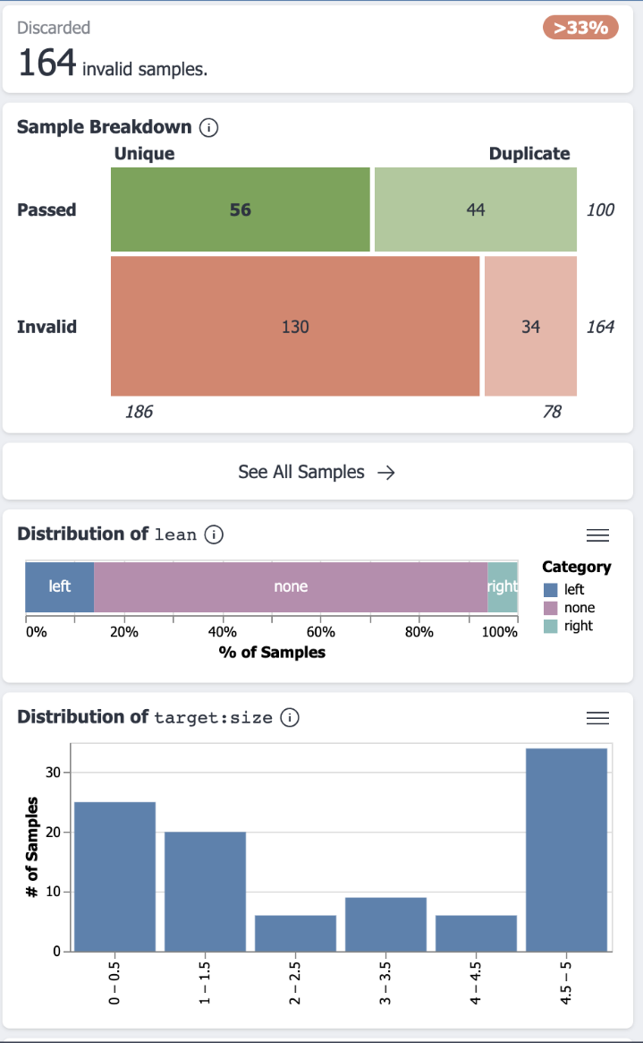
Tyche
Generator visualization tool
Fairly new!

Slide 22
Model-Based Testing
We may have an existing implementation we want to compare ours to.
E.g., an easy-to-understand version vs. an optimized version
prop_mergeSort :: [Int] -> Bool prop_mergeSort xs = mergeSortOpt xs == mergeSort xs This style can be quicker to write, but only do it if you are truly confident the existing implementation is correct!

Slide 23
Libraries
Hypothesis (Python)
JUnit-quickcheck, JQF, Jqwik (Java)
QuickCheck (Haskell)
theft - (C)
fast-check (JavaScript)
…

