Slide 1

Cassidy Williams and Michael Wee

Slide 2
Real-time online drawing
Draw from any mobile device
Guess from mobile devices
All drawings and guesses appear on the main desktop screen

Slide 3


Slide 4

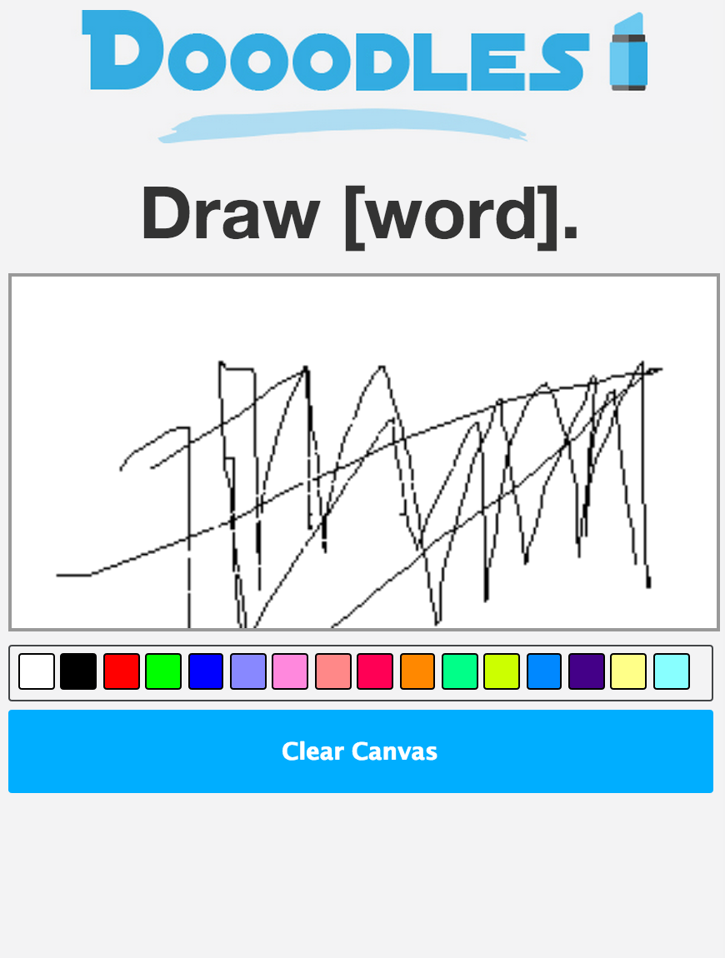

Slide 5

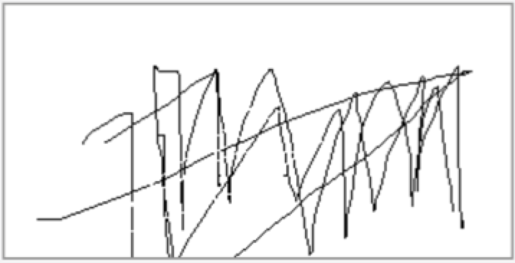

Slide 6
