Slide 1
A simple 2d camera
Camera moving other objects stay still

Slide 2
matrices
To support a simple camera or any camera you need to use a transformational matrix. This is built into the Matrix class which is included with XNA
The sprite batch Begin call allows for this matrix to used in all subsequent draw calls, where all position references (Vectors or Rectangles) are transformed by the Matrix provided
You have to maintain this matrix all the time in response to updates by the user to move a camera around
Here we use stationary objects and just draw them relative to the change in camera position
NOTE: you can have a few cameras active at the one time.
We implement a 2D Camera as a class for re-use

Slide 3
Transformational matrices
Transformational matrices are used to maintain the position, angle of rotation, and zoom of the camera.
Objects may move in an out of the cameras viewing frustum
The camera is mapped to the viewport of the game
XNA has a Matrix class to deal with Matrix operations
The Matrix class has a CreateTranslation function which is used to create a Translation matrix.
Everything in the camera focus or outside it is drawn using this Transform

Slide 4
The transform matrix
We need variables for position, scale or Zoom, an rotation. These will change in response to key presses
They are all public here as you have not covered visibility of variables
Should be protected and exposed as a property
public float zoom; // Camera Zoom
public Matrix transform; // Matrix Transform
public Vector2 pos; // Camera Position
public float rotation; // Camera Rotation

Slide 5
Making the transform
public Matrix get_transformation(GraphicsDevice graphicsDevice)
{
transform = Matrix.CreateTranslation(new Vector3(-pos.X, -pos.Y, 0)) *
Matrix.CreateRotationZ(rotation) *
Matrix.CreateScale(new Vector3(zoom, zoom, 1)) *
Matrix.CreateTranslation(new Vector3(graphicsDevice.Viewport.Width/2,
graphicsDevice.Viewport.Height/2, 0));
return transform;
}
Assumes origin of the Camera is focused the middle of the screen
The viewport is the frustum of the camera this is to facilitate rotations about the centre of the screen
Note –pos.X, -pos.Y has the effect of moving the camera in the reverse direction by the amount specified by it’s position

Slide 6
Moving the camera
We move the camera using the arrow keys. But note the position is increasing here and when we apply the reverse in the first translation of the camera
if (Keyboard.GetState().IsKeyDown(Keys.D))
cam.Move(new Vector2(1, 0) * speed);
new Vector3(-pos.X, -pos.Y, 0))
Camera

Slide 7
The resulting transformation
The resulting transformation is passed to a sprite batch begin call to offset all the draws by this amount
Character position is 0,0 but the Character is drawn at the origin of the camera which is set by the last Translation
spriteBatch.Begin(SpriteSortMode.BackToFront,
BlendState.AlphaBlend,
null,null,null,null,cam.get_transformation(GraphicsDevice));
spriteBatch.Draw(character, CharacterPosition, Color.White);
spriteBatch.End();

Slide 8
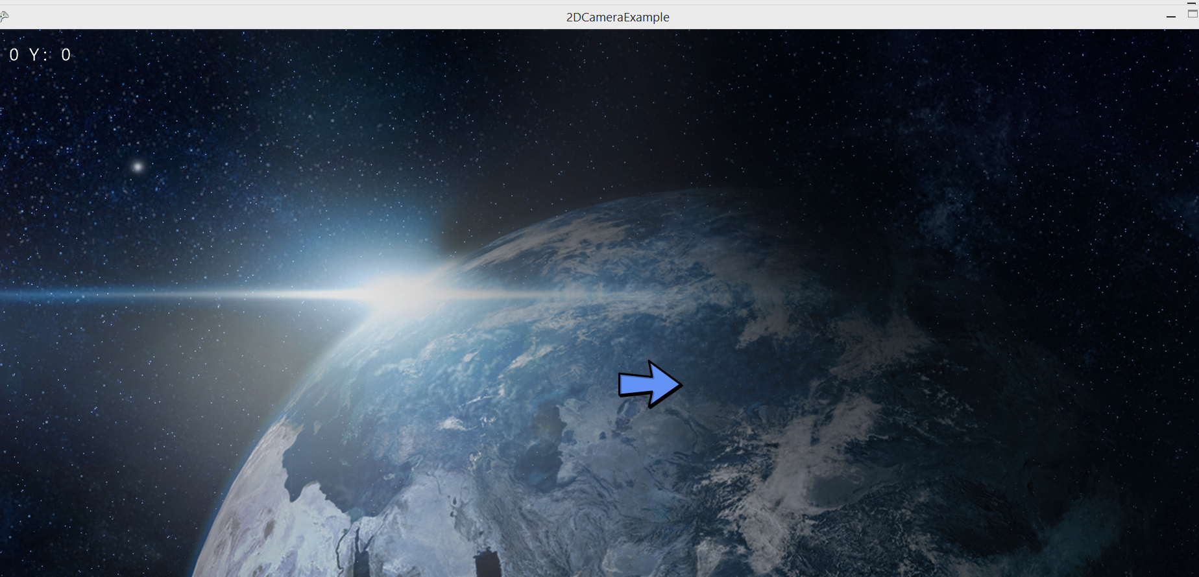
The resulting

