Slide 1
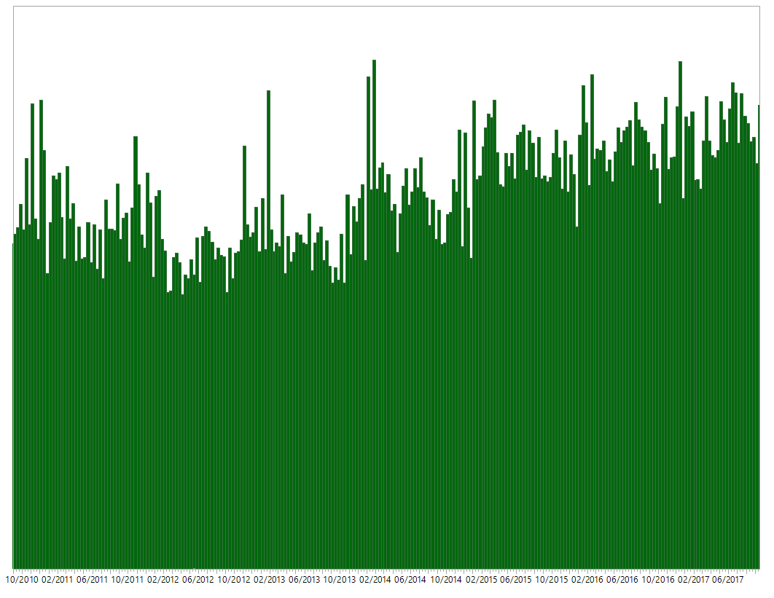
Distribution of Complaints by Year
The figure depicts the distribution of complaints by creation date shown in one month increments.
There are apparent spikes of reported complaints in January of every year. While there is a year over year increase in complaints, the highest number of complaints reported was in January 2014.
*The analysis and this graphic was produced using JMP Pro 13.0.
Number of Complaints
Year

Slide 2
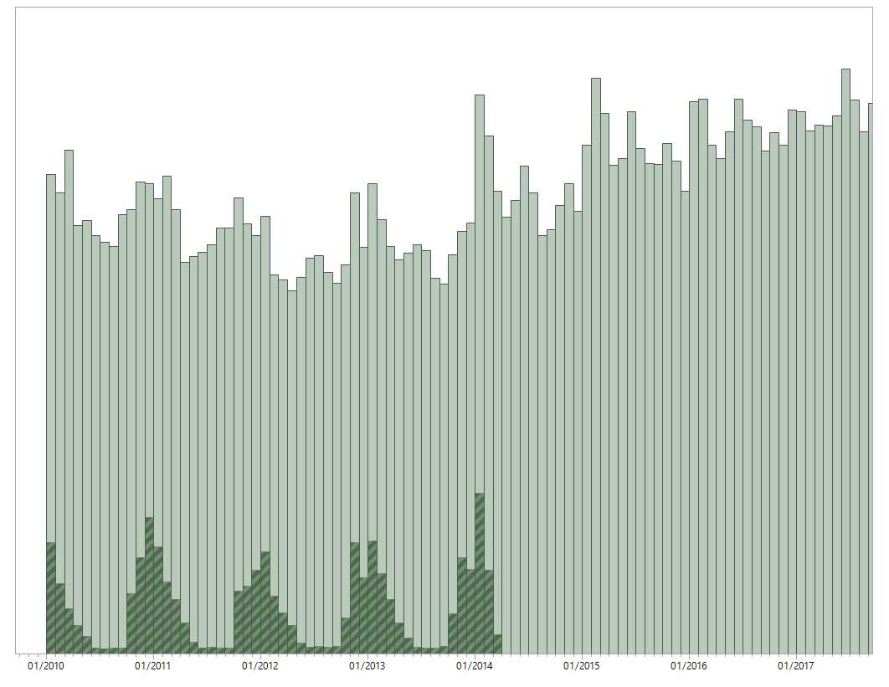
Distribution of Complaint Type (heating) by Year
The figure depicts the distribution of complaints by creation date shown in one month increments and highlights the complaints that were of type “heating”.
There is a clear spike in “heating” complaints in the colder months of December, January, and February. Surprisingly, these complaints cease after the year of 2014.
*The analysis and this graphic was produced using JMP Pro 13.0.
Number of Complaints
Year

Slide 3
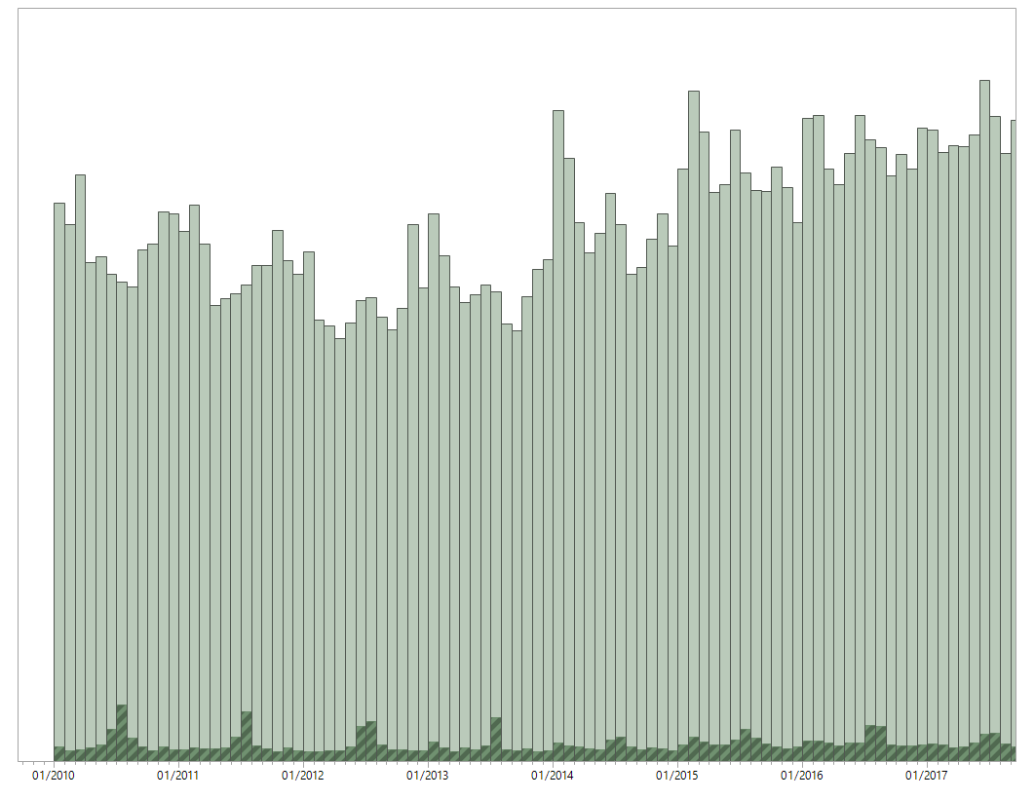
Distribution of Complaint Type (water system) by Year
The figure depicts the distribution of complaints by creation date shown in one month increments and highlights the complaints that were of type “water system”.
For the years 2010 through 2013, “water system” complaints increased in the hotter months. These spikes have become less drastic in recent years. This trend may be correlated with changes in climate, specifically the climate phenomenon known as El Nino and the following La Nina. Unusually warm ocean temperatures in the central and eastern tropical Pacific Ocean have created disruption in the atmosphere leading to increased rainfall in the eastern United States.
*The analysis and this graphic was produced using JMP Pro 13.0.
Number of Complaints
Year

Slide 4
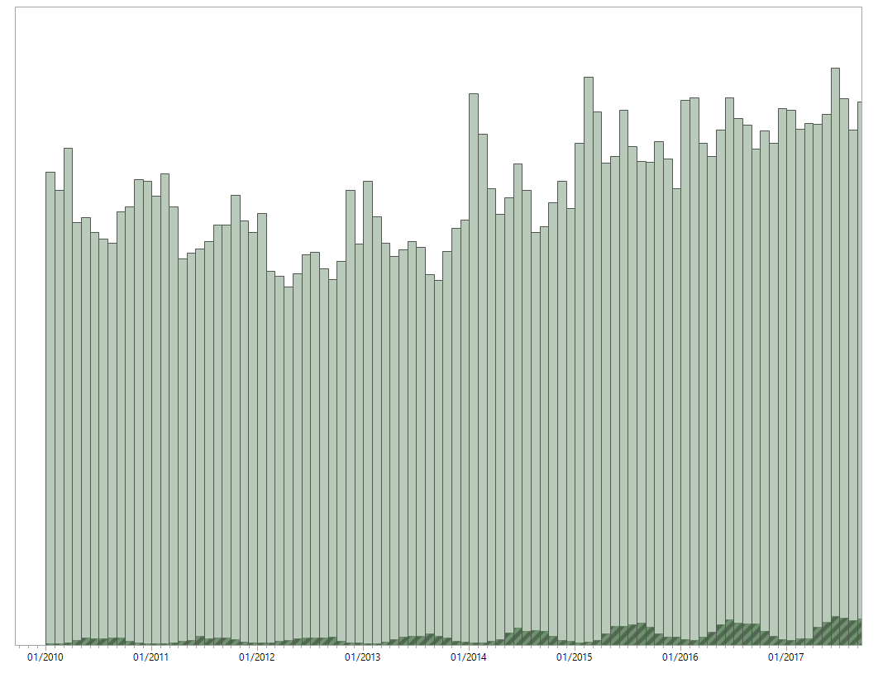
Distribution of Complaint Type (street/sidewalk noise) by Year
The figure depicts the distribution of complaints by creation date shown in one month increments and highlights the complaints that were of type “street/sidewalk noise”.
This particular complaint type is directly correlated with the seasons. “Street/sidewalk noise” complaints increase in the warmer months and decrease in the colder months. A possible explanation is that people are outside less when it’s cold out.
*The analysis and this graphic was produced using JMP Pro 13.0.
Number of Complaints
Year

Slide 5
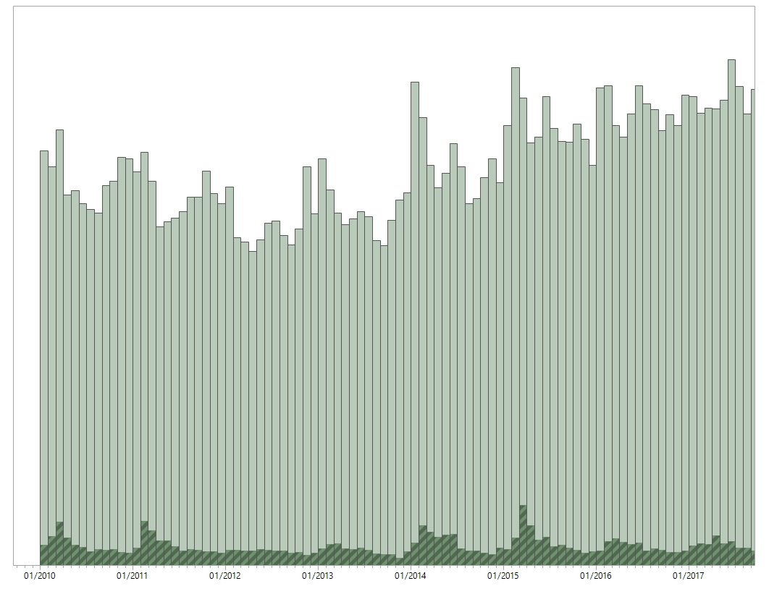
Distribution of Complaint Type (street condition) by Year
The figure depicts the distribution of complaints by creation date shown in one month increments and highlights the complaints that were of type “street condition”.
There is a spike in “street condition” complaints in April of 2015 – this is a clear global outlier. A google search revealed that the building One Vanderbilt was being constructed next to Grand Central Terminal at that time. A subset analysis on latitude and longitude confirmed that the spike in complaints originated in areas near Grand Central Station. We can therefore conclude that there is a strong correlation between the construction of this sky riser and the increase in complaints.
*The analysis and this graphic was produced using JMP Pro 13.0.
Number of Complaints
Year

Slide 6
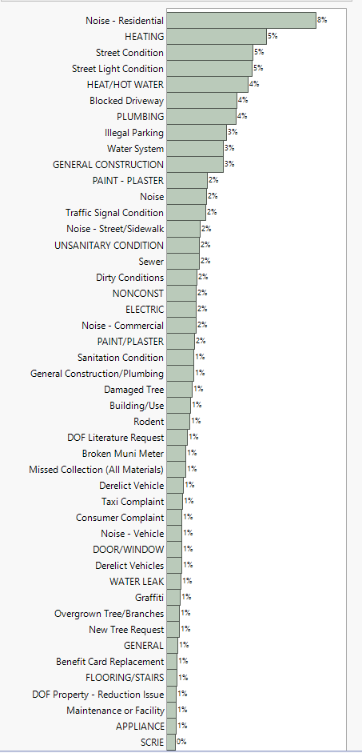
Simple Distribution of Complaints
There are 277 different complaint types at varying levels of granularity – there are a number of different noise complaints including “residential”, “helicopter”, “house of worship” . The top complaints are “residential noise”, “heating”, “street condition” and “street light condition”.
*The analysis and this graphic was produced using JMP Pro 13.0.

Slide 7
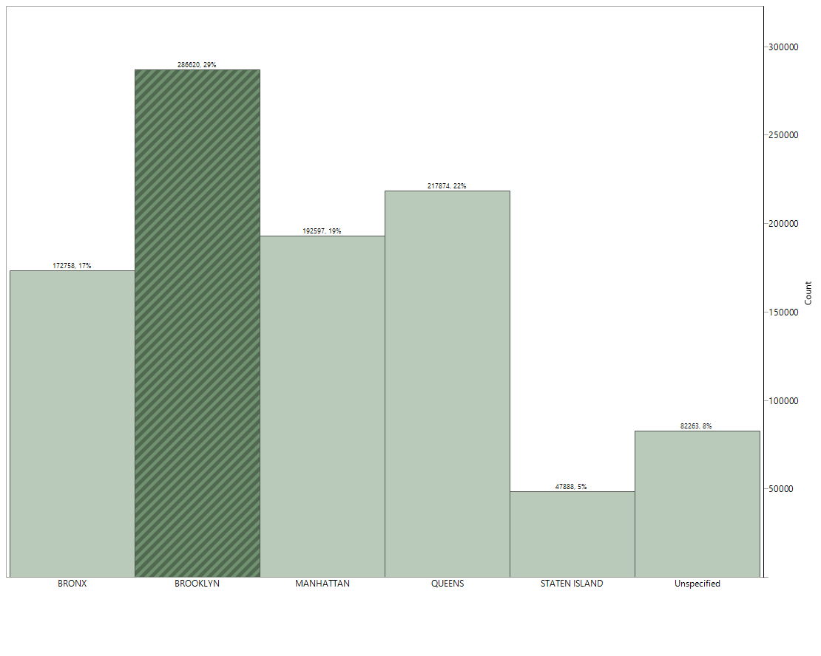
Distribution of Complaints by Borough
This figure shows the distribution of the number of complaints by borough. The number of complaints are correlated with population size. Brooklyn has the most complaints and the largest population. Queens is second and so on.
*The analysis and this graphic was produced using JMP Pro 13.0.
Borough

Slide 8
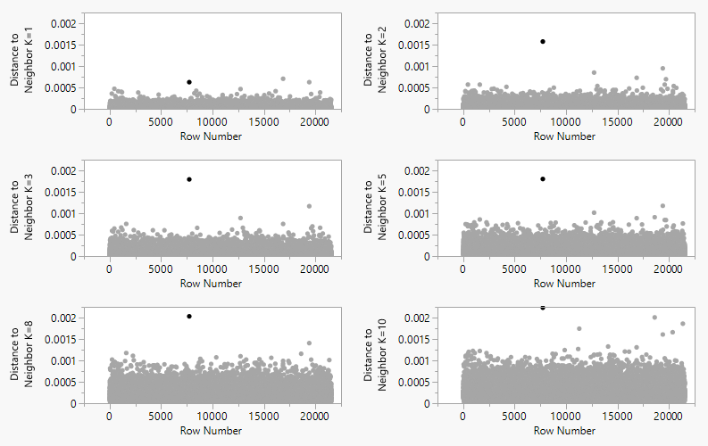
Noise Complaints by Location (lat. and long.)

Slide 9
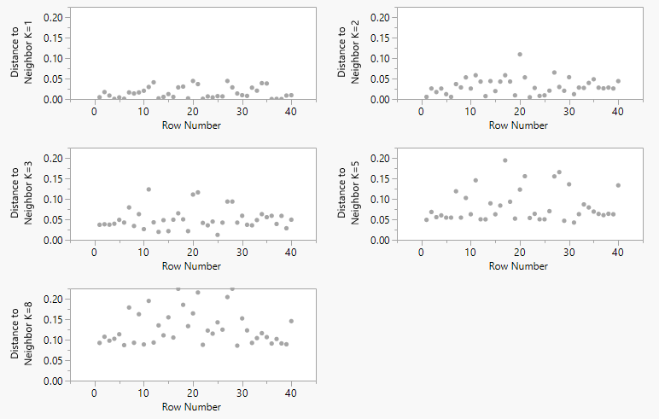
Tattooing Complaints by Location (lat. and long.)

