Slide 1
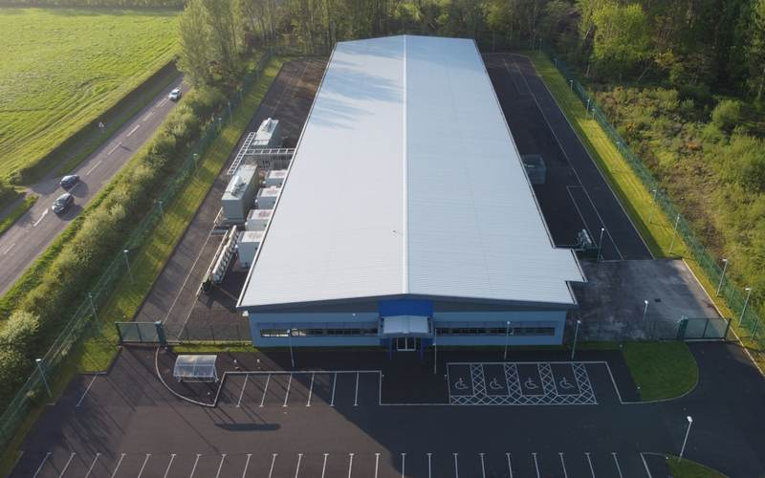
BOV
BROKER OPINION OF VALUE
Subject Property
2480 Distribution Way
Midwest Industrial Park
May 2026
Industrial Real Estate · Midwest Markets · May 2026

Slide 2
Executive Summary
BOV
Situation Overview
The subject is a 285,000 SF Class A distribution facility on 12.5 acres in the primary industrial submarket, currently vacant following lease expiration in Q1 2026. Building features include 28 dock doors, 2 drive-in doors, ESFR sprinkler systems, and recent roof recoating supporting top-of-market pricing.
SUMMARY OF VALUE
$52 – $58
Property Summary
SALE PSF
Size
285,000 SF
Year built
2008
Class
A
Docks / Drive-ins
28 / 2
$14.9M – $16.6M
Land area
12.5 acres
Status
Vacant — Sale Valuation
Total transaction range

Slide 3

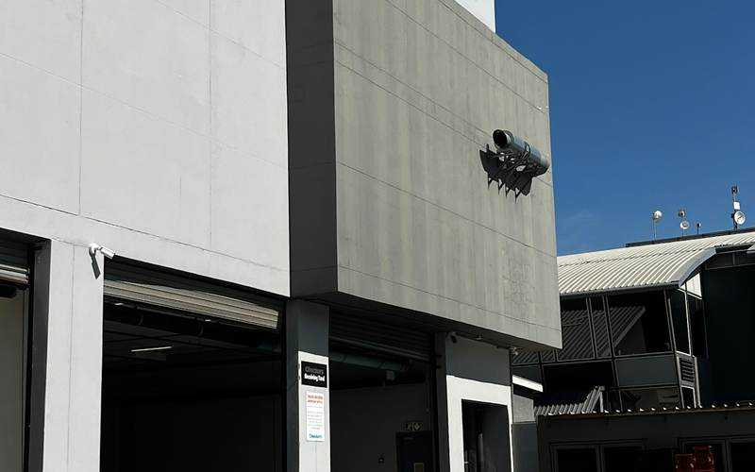


Sale Comparables
BOV
1850 Logistics Blvd
3220 Commerce Drive
4170 Distribution Ct
5610 Trade Center
Date
Aug 2024
Date
Mar 2025
Date
Jun 2024
Date
Nov 2024
Size
312K SF
Size
245K SF
Size
295K SF
Size
275K SF
Class
A
Class
A
Class
A
Class
A
PSF
$54.25
PSF
$58.10
PSF
$52.40
PSF
$56.40
Built
2015
Built
2012
Built
2018
Built
2010
Subject: 2480 Distribution Way · 285,000 SF · Class A · 2008

Slide 4
Recommended List Pricing
BOV
285,000 SF on 12.5 acres · Recommended range $52.40 – $58.10 PSF
$63.00 PSF · $17.96M
Speculative
RECOMMENDED LIST
Test ask · single-user with submarket fit and urgent timeline
$55.00 PSF
$15.68M total transaction
$60.50 PSF · $17.24M
Secondary
Achievable in multi-offer scenario or strategic adjacency premium
MARKET CONDITIONS
· Cap rates 4.5–5.25% in primary submarket
$58.50 PSF · $16.67M
· Class A demand outpacing supply ~1.3×
Ideal Alternative
Matches highest 2025 close in submarket — 3220 Commerce, $58.10 PSF
· Strong 18-month lease velocity
$56.50 PSF · $16.10M
TARGET BUYER POOL
Ideal
· Institutional investors (REITs, funds)
Mid-range of approved Class A comps · expected outcome
· Owner-users · 250–300K SF footprint
· 1031 exchange · high in current cycle
$55.00 PSF · $15.68M
Recommended List
Pulls broadest qualified buyer pool · drives competitive bids in 45–60 days
PROJECTED DAYS ON MARKET
45–60
60–90
at recommended list
at high range
Recommendation based on 4 approved Class A comps · primary + adjacent submarkets · vacant occupancy assumption

Slide 5
Thank You
CONTACT
Senior Broker
Sr. Managing Director · Industrial Specialist · Direct line on file
Any opinion or estimate of value in this presentation is based on a high-level preliminary review. It is not the same as the opinion of value in an appraisal developed by a licensed appraiser under USPAP. No physical tour has been conducted; all information is based on public data. This valuation assumes no deferred maintenance or environmental conditions exist.
BOV

