Slide 1
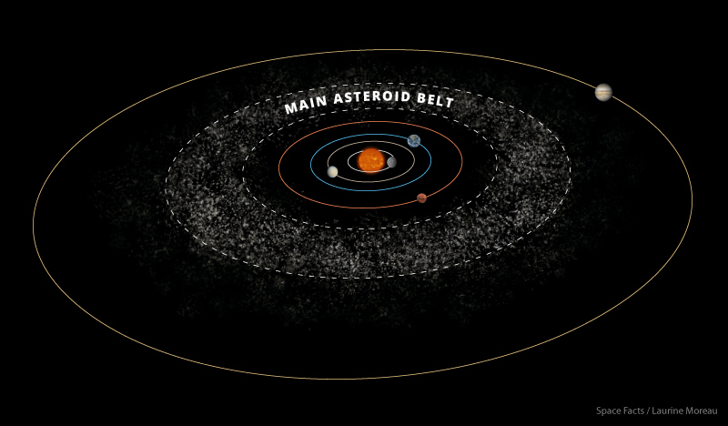
Recreating the Kirkwood Gaps
By Cassandra Bodin

Slide 2
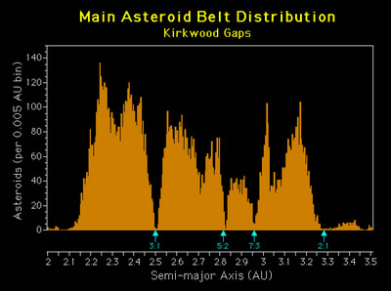
Goal of Project
Simulate the Asteroid Belt, Jupiter and the Sun
Input n number of asteroids in a range of semimajor axis
Gather data for every run
Create a histogram of the data
Recreate Kirkwood Gaps
Little to no asteroids found
Resonance ← Jupiter’s gravity clears the orbit
4:1

Slide 3
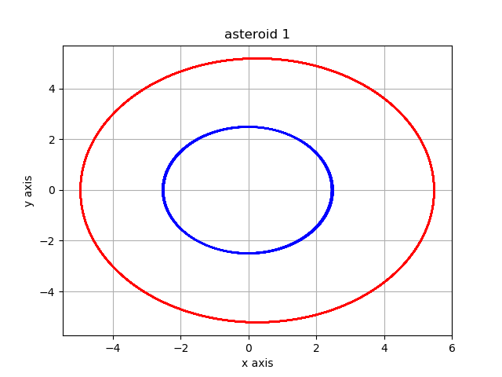
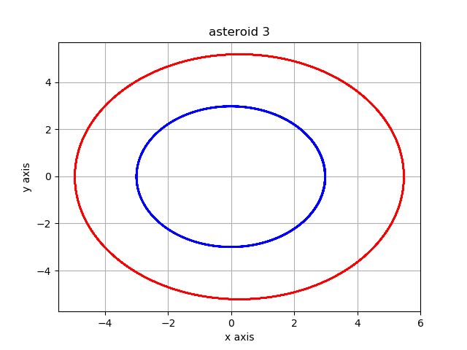
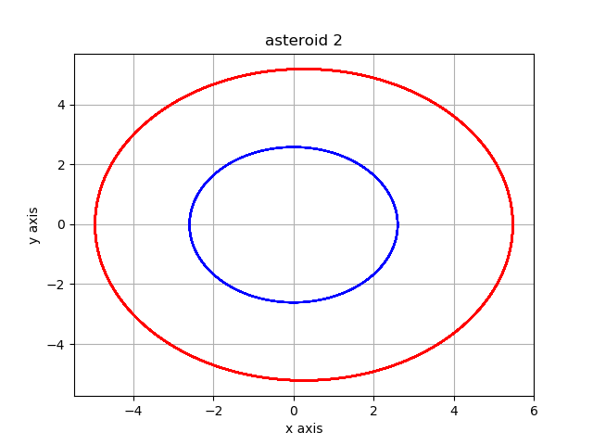
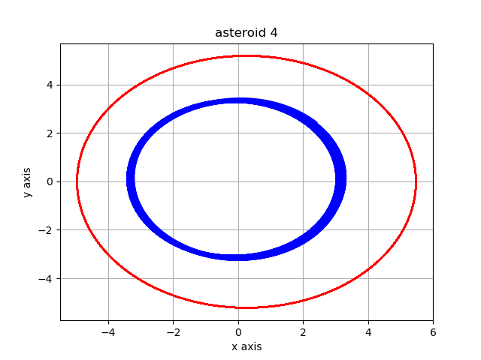
Where did I start?
3 body problem: Jupiter, the Sun, and an Asteroid
Homework 6: asteroid problem
Euler Cromer Method

Slide 4
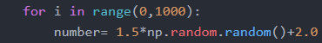

Modifications and Problems to Face
How to input an n number of asteroids and keeping track of the parameters for each asteroid throughout the code
Finding which orbits were stable and finding the semimajor axis of those orbits.
Finding a way to get multiple runs of data into one place in order to make a better histogram.

Slide 5
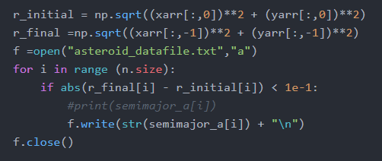
Hardest Solutions- Problem 2 & 3:
3
Choosing values to keep:
Find initial and final radii
Difference is less than a certain percent = stable
Allow multiple runs of program:
Create/open txt file and append data to file
Write in file the values to keep
1
2
4

Slide 6

Running the program
f’ string prints cycle number every 200 cycles
Run time:
5000 asteroids: 7+hrs
1000 asteroids: 1hr 17min 32sec
500 asteroids: 20min 36sec
100 asteroids: 5min 9sec
50 asteroids: 5min 3sec
Super cool!!!
What did the plots of the asteroids look like →

Slide 7
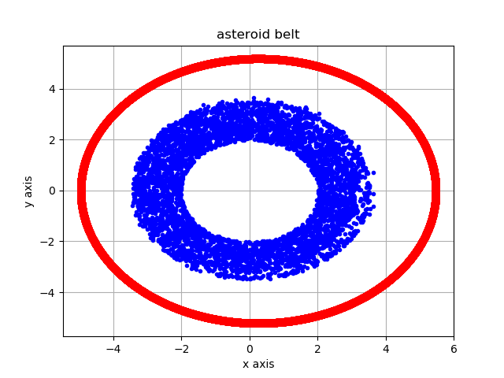
5000 Asteroids

Slide 8
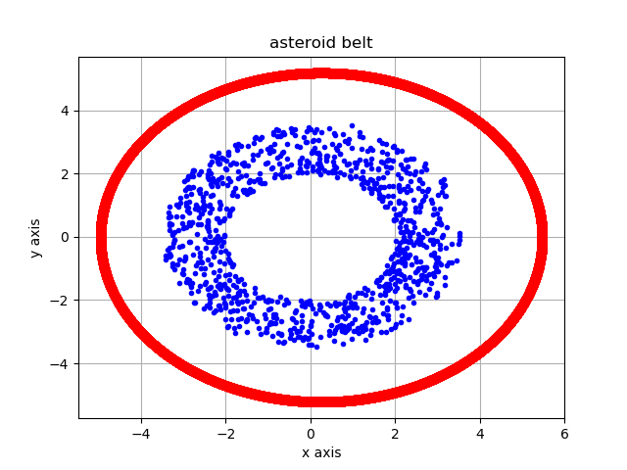
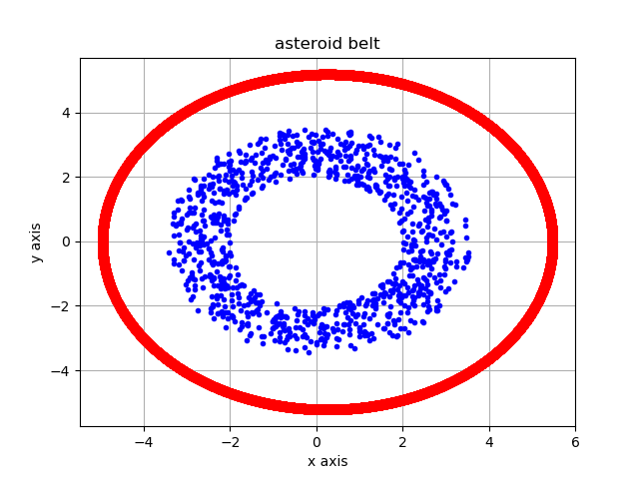
1000 Asteroids

Slide 9
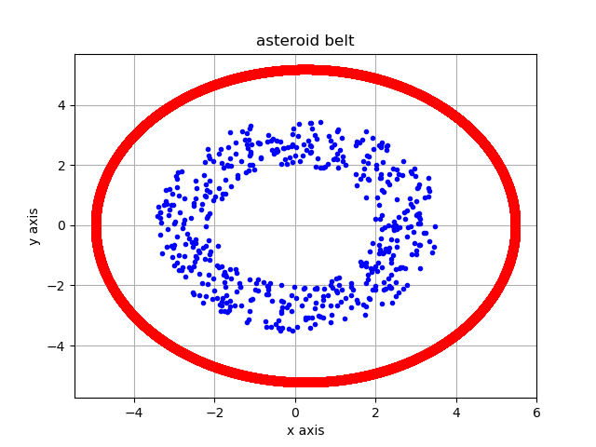
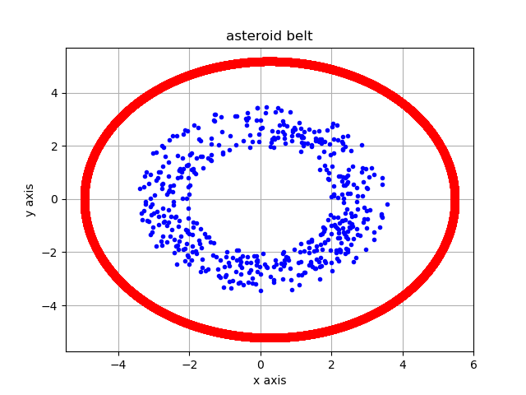
500 Asteroids

Slide 10
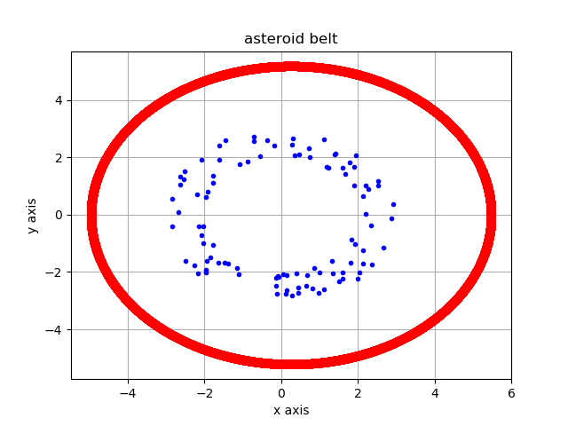
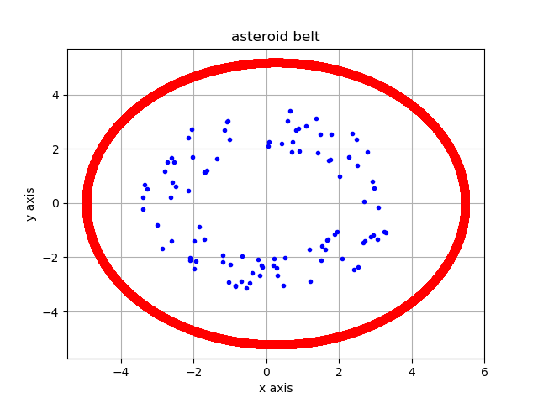
100 Asteroids

Slide 11
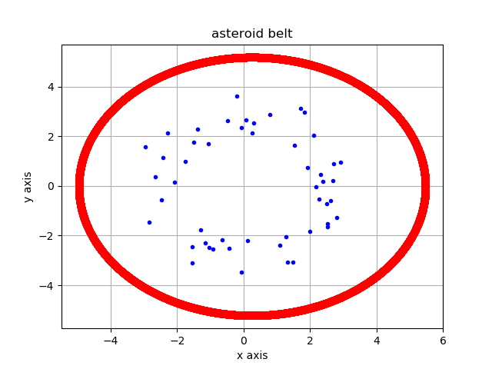
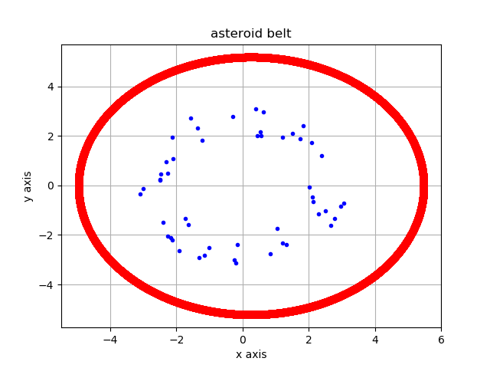
50 Asteroids

Slide 12
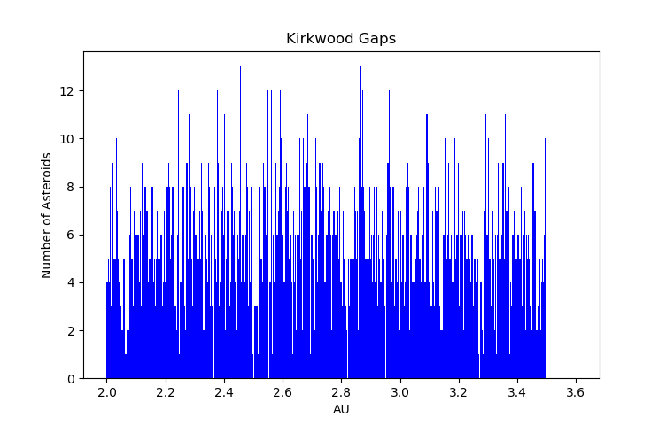

Results/Comparison:
Data File contains 2636 asteroids
Gaps in the right spots!!!
2.5 AU, 2.82 AU, 2.95AU, 3.27 AU
My histogram
Extra gaps at: 2.2, 2.36, 2.55
Does not show resonances

Slide 13
Conclusion:
How accurate was it?
Was there error? What caused it?
Not as many asteroids
Used randomly distributed asteroids, not real ones
Radii deleted from set, deemed unstable
Ideas for future:
Using real data
Resetting parameters to sort which are stable or unstable
Run program more

Slide 14

Questions?

Slide 15
Bibliography
Title page image- https://space-facts.com/asteroid-belt/ created by Laurine Moreau
Histogram comparison image- http://astronomy.swin.edu.au/cosmos/K/Kirkwood+Gaps created by NASA

