Slide 1
ITech
Team Quokka

Slide 2
Idea and basis of the application
An app to make connections with strangers.
Get matched with a partner at random
Answer questions developed by an American psychologist for getting to know people, anonymously
Read your partner’s answers
If you both want to get to know each other more after the questions, go to free chat

Slide 3
Why it is cool, unique, useful, and valuable?
The app allows people to have thought-provoking conversations with strangers
The question and answer portion allows users to screen their partners before continuing conversations with just the people they are interested in talking to.
Until the free conversation stage, all interaction between partners is anonymous

Slide 4
Who would use it?
Genuinely looking for friends
Attention seeking people
Nosy people
Time wasters

Slide 5
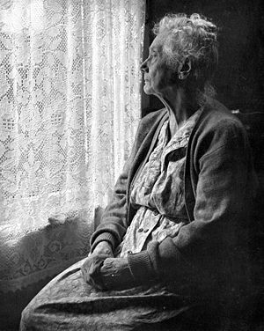
Who would use it?
Susan Solo
73 years old
Widowed
Surprisingly tech savvy
Genuinely looking for human connection

Slide 6

Who would use it?
Freddie Focus
25 years old
Postgraduate
Worked hard on degree, felt he missed out on social life
Always wanted a pen pal

Slide 7
What are the main requirements of the application
Functional Requirements:
Be paired with users
Answer questions
Recall previous answers
Continue conversation
End conversation
Access DB to get user info and answers
Nonfunctional Requirements:
DB quick to respond
Responsive interface
Not getting paired up with the same person multiple times
Social media account integration

Slide 8
What is going to look like (i.e. wireframe)

Slide 9
How a user would interact with the system (i.e. their experience)

Slide 10
high-level system architecture
DB
Client
Middleware
User

Slide 11
ER Diagram
has
has
has
writes

Slide 12
Database Schema
User(userID, name, age)
Question(questionID, text)
Match(user1ID, user2ID, question0, …, question 8)
Answer(userID, questionID, answerText)

