Slide 1

Data Structures and Algorithms for Information Processing
Lecture 2: Basics
Lecture 2: Basics

Slide 2
Today’s Topics
Intro to Running-Time Analysis
Summary of Object-Oriented Programming concepts (see slides on schedule).
Lecture 2: Basics

Slide 3
Running Time Analysis
Reasoning about an algorithm’s speed
“Does it work fast enough for my needs?”
“How much longer when the input gets larger?”
“Which algorithm is fastest?”
Lecture 2: Basics

Slide 4
Elapsed Time vs.
No. of Operations
Q: Why not just use a stopwatch?
A: Elapsed time depends on independent factors
Number of operations carried out is the same for two runs of the same code with the same arguments -- no matter what the environment might be
Lecture 2: Basics

Slide 5
Stair-Counting Problem
Two people at the top of the Eiffel Tower
Three methods to count the steps
  X walks down, keeping a tally
  X walks down, but Y keeps the tally
  Z provides the answer immediately (2689!)
Lecture 2: Basics

Slide 6
Stair-Counting Problem
Choosing the operations to count
  Actual time? Varies due to several factors not related to the efficiency of the algorithm
  Each time X walk up or down one step = 1 operation
  Each time X or Y marks a symbol on the paper = 1 operation
Lecture 2: Basics

Slide 7
Stair-Counting Problem
How many operations for each of the 3 methods?
Method 1:
  2689 steps down
  2689 steps up
  2689 marks on the paper
  8067 total operations
Lecture 2: Basics

Slide 8
Stair-Counting Problem
Method 2:
  3,616,705 steps down (1+2+…+2689)
  3,616,705 steps up
  2689 marks on the paper
  7,236,099 total operations
Lecture 2: Basics

Slide 9
Stair-Counting Problem
Method 3:
  0 steps down
  0 steps up
  4 marks on the paper (one for each digit)
  4 total operations
Lecture 2: Basics

Slide 10
Analyzing Programs
Count operations, not time
  operations is “small step”
  e.g., a single program statement; an arithmetic operation; assignment to a variable; etc.
No. of operations depends on the input
  “the taller the tower, the larger the number of operations”
Lecture 2: Basics

Slide 11
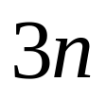


Analyzing Programs
When time analysis depends on the input, time (in operations) can be expressed by a formula:
  Method 1:
  Method 2:
  Method 3: no. of digits in number n
Lecture 2: Basics

Slide 12
Big-O Notation
The magnitude of the number of operations
Less precise than the exact number
More useful for comparing two algorithms as input grows larger
Rough idea: “term in the formula which grows most quickly”
Lecture 2: Basics

Slide 13


Big-O Notation
Quadratic Time
  largest term no more than
  “big-O of n-squared”
  doubling the input increases the number of operations approximately 4 times or less
  e.g.
    Method 2(100) = 10,200
    Method 2(200) = 40,400
Lecture 2: Basics

Slide 14

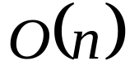
Big-O Notation
Linear Time
  largest term no more than
  “big-O of n”
  doubling the input increases the number of operations approximately 2 times or less
  e.g.
    Method 1(100) = 300
    Method 1(200) = 600
Lecture 2: Basics

Slide 15
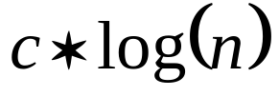
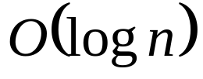
Big-O Notation
Logarithmic Time
  largest term no more than
  “big-O of log n”
  doubling the input increases the running time by a fixed number of operations
  e.g.
    Method 3(100) = 3
    Method 3(1000) = 4
Lecture 2: Basics

Slide 16
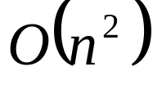

Summary
Method 1:
Method 2:
Method 3:
Run-time expressed with big-O is the order of the algorithm
Constants ignored:
Lecture 2: Basics

Slide 17
Summary
Order allows us to focus on the algorithm and not on the speed of the processor
Quadratic algorithms can be impractically slow
Lecture 2: Basics

Slide 18
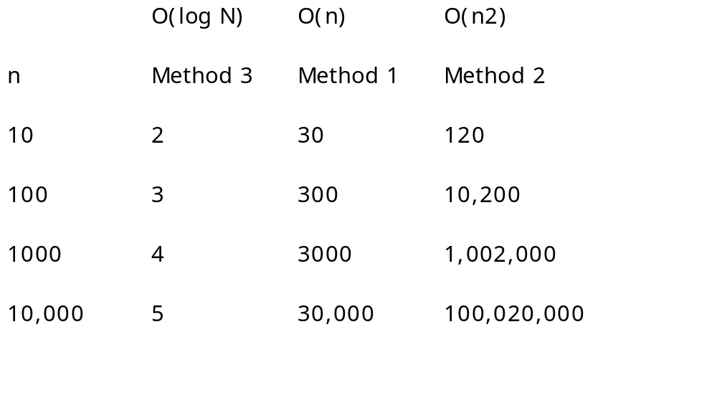
Comparison
Lecture 2: Basics

Slide 19
Time Analysis of Java Methods
Example: search method (p. 26)
public static boolean search(double[] data, double target) {
int i;
for (i=0; i<data.length; i++) {
if (data[i] == target) return true;
}
return false;
}
Lecture 2: Basics

Slide 20

Time Analysis of Java Methods
Operations: assignment, arithmetic operators, tests
  Loop start: two operations: initialization assignment, end test
  Loop body: n times if input not found; assume constant k operations
  Return: one operation
  Total:
Lecture 2: Basics

Slide 21
Time Analysis of Java Methods
A loop that does a fixed number of operations n times is O(n)
Lecture 2: Basics

Slide 22
Time Analysis of Java Methods
worst-case: maximum number of operations for inputs of given size
average-case: average number of operations for inputs of given size
best-case: fewest number of operations for inputs of given size
any-case: no cases to consider
Pin the case down and think about n growing large – never small.
Lecture 2: Basics

Slide 23
Object-Oriented Overview
Slides from Main’s Lecture
Lecture 2: Basics

