Slide 1
Many Problems are Hard
The Towers of Hanoi Puzzle
Data Structures and Algorithms

Slide 2
The Towers of Hanoi
Some problems are computationally too difficult to solve in a reasonable period of time.
While an effective algorithm exists, we don’t have the time to wait for its completion.
Data Structures and Algorithms

Slide 3
The Towers of Hanoi
Initially:
Three posts (named Left, Middle, Right)
n disks on leftmost post
the disks are in order - each disk, except the bottom one,
sits upon a larger disk.
Goal:
Move all the disks on the leftmost post to the rightmost
post. The original ordering must be preserved.
Data Structures and Algorithms

Slide 4
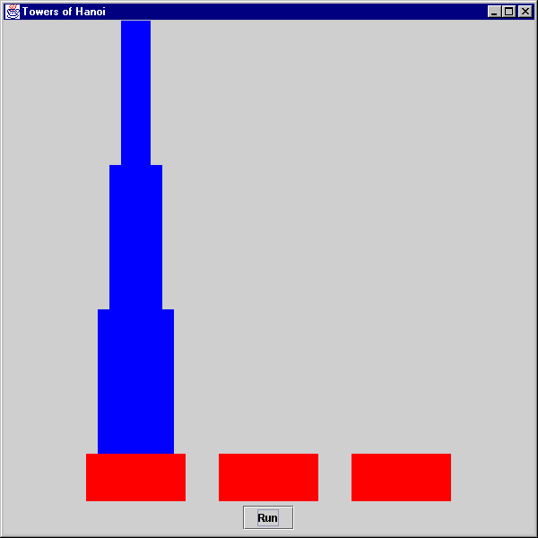
Data Structures and Algorithms

Slide 5
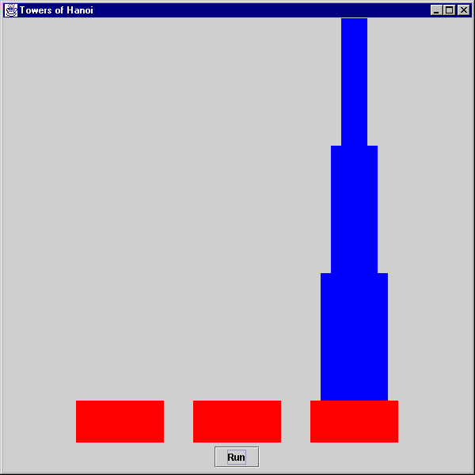
Data Structures and Algorithms

Slide 6
The Towers of Hanoi Puzzle
Constraints:
Only one disk may be moved at a time.
Disks may not be set aside but must always be placed on
a post.
A larger disk may never be placed on top of a smaller disk.
Data Structures and Algorithms

Slide 7
The Towers of Hanoi Puzzle
For n = 3, the fastest solution is:
Move from Left Post to Right Post
Move from Left Post to Middle Post
Move from Right Post to Middle Post
Move from Left Post to Right Post
Move from Middle Post to Left Post
Move from Middle Post to Right Post
Move From Left Post to Right Post
The minimum required number of moves is 7.
Data Structures and Algorithms

Slide 8
The Towers of Hanoi Puzzle
Run-Time Analysis
Disks Required Moves
1 1
2 3
3 7
4 15
5 31
: :
N 2^{N} - 1
There are no cases to consider.
2^{n} – 1 ε Big O(2^{n})
2^{n} – 1 ε Big Ω(2^{n})
And, therefore,
2^{n} – 1 ε Big θ(2^{n})
Data Structures and Algorithms

Slide 9
The Towers of Hanoi Puzzle
The number of operations executed by this algorithm
is less than or equal to some constant times 2^{N}.
So, we say that this algorithm is O(2^{n}).
The number of operations executed by this algorithm
is greater than or equal to some constant times 2^{N}.
So, we say that this algorithm is Ω(2^{n}).
Data Structures and Algorithms

Slide 10
Running Towers in Java on an old PC
Number of Disks Time Moves
15 38 Seconds 32,767
16 76 Seconds 65,535
Running Towers in C++ on an old PC
Number of Disks Time Moves
15 4 Seconds 32,767
16 8 Seconds 65,535
Data Structures and Algorithms

Slide 11
Performance (1/time) is impacted by:
The problem
The algorithm (Our interest in this course.)
The programmer
The clock speed
The architecture (RISC vs. CISC for example)
The compiler
So, it’s better to focus on operations.
Data Structures and Algorithms

Slide 12
C++ Vs. Java
How much faster is C++ for this program on the old machine?
Performance = 1/Time
Performance(C++) = 1/8
Performance(Java) = 1/76
Performance(C++) = N * Performance(Java)
N = Performance(C++) / Performance(Java)
N = (1/8) / (1/76) = 76/8 = 9.5
C++ is 9.5 times as fast !
Data Structures and Algorithms

Slide 13
The Towers of Hanoi Puzzle
The original problem requires 64 disks.
The time required for the Java Solution on the old PC:
Moves/Second = 65535/76 = 862 Moves/Second
Seconds/Move = 76/65535 = .00116
Seconds/Program = Moves/Program * Seconds/Move
= 2⁶⁴ - 1 Moves/Program * .00116 Seconds/Move
~ 2.1 X 10¹⁶ Seconds/Program
Data Structures and Algorithms

Slide 14
The Towers of Hanoi Puzzle
The Java Program
Years / Program = Seconds/Program X Years/ Second
= 2.1 X 10¹⁶ X 1/31536000
= 665,905,631 Years/Program
The C++ Program
Years/Program = 665,905,631/9.5 = 70,095,329
Data Structures and Algorithms

Slide 15
How About the World’s Fastest Machine?
The Tianhe-1 is the world’s fastest (November 2010).
It performs 2,570 trillion (a million million) calculations per second.
Suppose each calculation is a disk move.
Seconds/Program = Moves/Program * Seconds/Move
= 2⁶⁴ - 1 Moves/Program * (2570 X 10 ¹²)⁻¹ Seconds/Move
= 1.8 X 10¹⁹ Moves/Program * 3.89 X 10⁻¹⁶ Seconds/Move
~ 7002 Seconds/Program
= 1.945 hours
Homework. What is the smallest value of n that would keep the Tianhe-1 busy for 10 years?
Data Structures and Algorithms

