Slide 1
Using Data to Solve Detroit Fire Department Challenges:
From Mobility to Data Visualization
Cassie DeWitt—Data Scientist & Data Strategist
Applied Urban Science Group Discussion Series, CUSP, April 2018

Slide 2
Introduction and Overview
BACKGROUND
I HAVE …
TODAY WE’LL BE EXPLORING…
Professional
●Consultant & Advisor
●Data Scientist, Ford Motor Company
●Lead Data Scientist, Detroit Fire Department
Education
●Masters of Urban Planning, University of Michigan
●English Honors Degree (Double Hons), Wayne State University
●Learned how to utilize analytics and technology to solve urban challenges
●Figured out how analytics best works in fire industry culture
●Tested how analytics can efficiently work in midst of heavy fiscal constraint
●Overview of approach for utilizing urban data science to solve problems for DFD
●How to approach analytics in fire industry culture
●Exploration of selected works

Slide 3
Context of Business Challenges
●High Fire & EMS Response Time Averages
●High EMS Runs
●High Arson Numbers
●Old & Worn Out Apparatus
●Decreasing Fire Load
●Tightened Fiscal Oversight

Slide 4
Overview of Data Science Strategy

Slide 5
DFD Long-Term Analytical Project Framework
Operational Problem
Prototype Plan
Review & Feedback
Finalize Plan
DoIT & DFD Critique
Implement Prototype
Collect Data
Improve Prototype
Revised Project Plan
Collect Additional Data
Implement Project
Next Problem
Scheduled Validation
Legend
Start
Project Team*
Notes
*Project team comprises DoIT, key partners, Public Safety IT, and DFD’s Lead Data Scientist
**In this role, DoIT and DFD collaboratively fill the function of traditional critique (questioning assumptions, offering requests for improvement, etc.)
DFD+DoIT**
Stop

Slide 6
Ad Hoc Projects
Examples of Scaled Up Analytical Products & Projects
Performance Analytics
Angels Night
Engine 49 Analysis
Data Quality Assurance
Improvement of CompStat Data

Slide 7
Problem Formulation: Listening as an Exercise
How to Use Listening to Formulate Great Problem Statements
● Listen first without judging
● Be aware of biases
● Take notes and request confirmation of summary
● Walk through problem statement with client/problem owner
Initial Learning Moments
Formulating a problem before listening to the business increases investment of time
Initial Learning Examples
●Modification of Department-Wide Dashboard
●Publication of Open Fire Data
Amended Listening Practices
Began taking more time to listen to pain points and for challenges
Examples of Listening Avenues
●Weekly Cabinet Meetings
●Monthly Key Staff Meeting
●Monthly Community Meetings
●One-on-One Meetings

Slide 8
How to Approach Analytics in Fire Industry Culture?

Slide 9
Approaching Analytics in the Fire Industry
3 Focus Areas
CULTURE
ACTIONABLE INSIGHT
TECHNOLOGY
●Ease into paramilitary structure
●Find allies
●Achieve familiarity with formality
●Focus on end use
●Teach decision makers how to interpret visualization products
●Respond to pain points
●Focus on automation
●Notice difference between technology problem and decision making problem

Slide 10
Selected Detroit Fire Department Work
January 2015-January 2017

Slide 11
Cited Detroit Fire Department Work
DATA QUALITY PROGRAM
ENGINE 49 ANALYSIS
ISO ANALYSIS
Implementation of data quality program that weekly monitored and addressed data quality issues
Comprehensive analysis of Engine 49 feasibility
Analysis of response time, response time gaps and apparatus deployment

Slide 12
Cited Detroit Fire Department Work
Fire CompStat
OPEN DATA PORTAL
CAMPAIGN INTELLIGENCE
Weekly review & interrogation of performance metrics
Publishing of fire data on City of Detroit’s open data site
Fast-paced intelligence projects such as Angels’ Night in October

Slide 13
Detroit Fire Department CompStat
Processes and Methodology

Slide 14
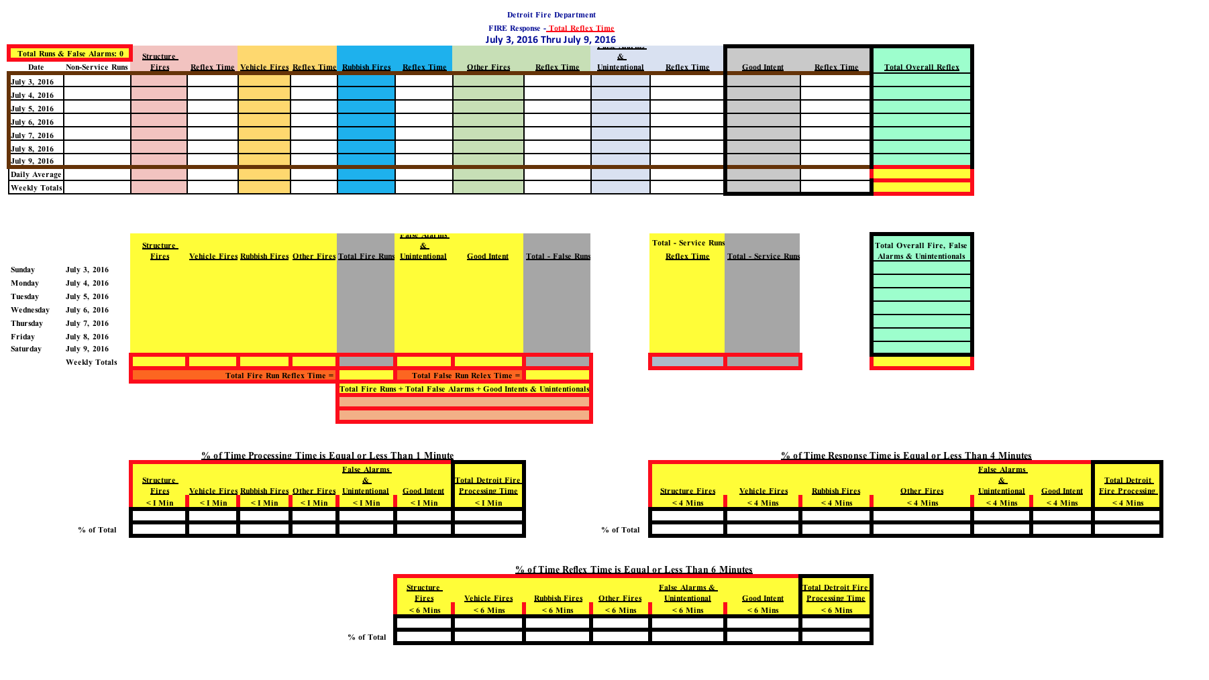
Fire CompStat

Slide 15
Engine 49 Feasibility Study
Processes and Methodology

Slide 16
Introduction to Engine 49
Context and Timeline of Engine 49
April 2013: requested bids for closed fire stations
October 2016: City Council halted the sale of fire stations
●One of these stations was Engine 49
●Majority of parties wanted to keep the fire station
Example of Engine 49

Slide 17
Methodology Overview
Starting Research Questions
●How busy is Engine 49’s boundaries?
●How often do surrounding engine companies go out of their
boundaries?
●What is the MFR load of Engine 49’s boundaries?
●What is the response time gap with and without Engine 49’s
boundaries?

Slide 18
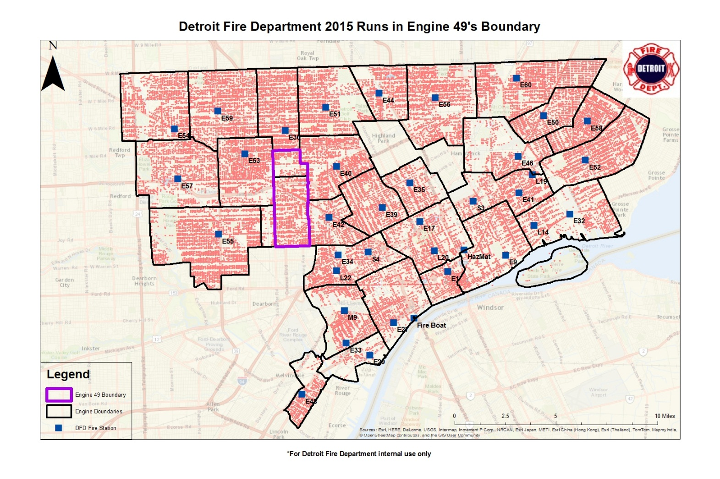
Fire Station Boundaries

Slide 19
ISO Analytics & Fire Station Feasibility Study
ISO
●Mayor Duggan’s Buy-In
●Scaling of Data Science & Civic Technology Projects
-Hydrant Redistricting Project
-Weekly Fire Response Time Metrics
-Application of Engine 49 Feasibility Study
Fire Station Feasibility Study
•Integrative Combination

Slide 20
Engine 49 Feasibility Study
Research Output Sample

Slide 21
Engine 49’s Boundaries Just as Busy as Neighboring Engine Boundaries in 2015
Run density and total runs slightly less than median amount in surrounding boundaries
*Median # of runs are 2381.5
**Median run density are 318.482
Engine | Total Runs* | Runs per Square Mile**
55 | 3,464 | 152.727
49 | 2,264 | 291.415
42 | 1,507 | 294.912
40 | 2,070 | 452.954
30 | 2,642 | 342.051
53 | 2,499 | 342.142

Slide 22
How Often do Other Engine Companies go to Other Companies for Fire Runs**
Engine Company | # X’s Goes to E30 | # X’s Goes to E40 | #X’s Goes to E42 | #X’s Goes to E49 | #X’s Goes to E53 | #X’s Goes to E55
30 | 587 | 45 | 2 | 55 | 35 | 5
40 | 18 | 421 | 14 | 49 | 6 | 1
42 | 2 | 45 | 180 | 215 | 3 | 27
49** | NA | NA | NA | NA | NA | NA
53 | 79 | 3 | 1 | 80 | 409 | 57
55 | 2 | 0 | 1 | 16 | 11 | 989
*Run data based on the first arriving unit
**Engine 49 was closed in 2012. As a result, data on the number of runs outside its engine area is not available

Slide 23
How Often do Surrounding Engine Companies go to Other Companies for MFR Runs*
Engine Company | # X’s Goes to E30 | #X’s Goes to E40 | # X’s Goes to E42 | #X’s Goes to E49 | # X’s Goes to E53 | # X’s Goes to E55
30 | 218 | 50 | 1 | 20 | 14 | 1
40 | 0 | 4 | 0 | 1 | 0 | 0
42 | 0 | 6 | 31 | 29 | 1 | 0
49** | NA | NA | NA | NA | NA | NA
53 | 14 | 1 | 0 | 5 | 182 | 7
55 | 0 | 0 | 0 | 0 | 0 | 152
*Run data based on the first arriving unit
**Engine 49 was closed in 2012. As a result, data on the number of runs outside its engine area is not available

Slide 24
Engine 49’s EMS Runs Indicate an Equally Heavy EMS Load in 2015
Engine 49 experiences EMS runs that slightly larger than median number of EMS runs of surrounding companies
*Median # of runs are 2,516
**Median run density are 372.709
Engine | Total EMS Runs | Runs per Square Mile
55 | 2,906 | 128.125
49 | 2,684 | 345.476
42 | 2,155 | 421.722
40 | 2,348 | 513.786
30 | 2,749 | 355.904
53 | 2,845 | 389.513

Slide 25
Engine 49 2013-2015 Trends of Code 1 Runs by Week

Slide 26
Engine 49 Feasibility Study
Spatial Analytics

Slide 27
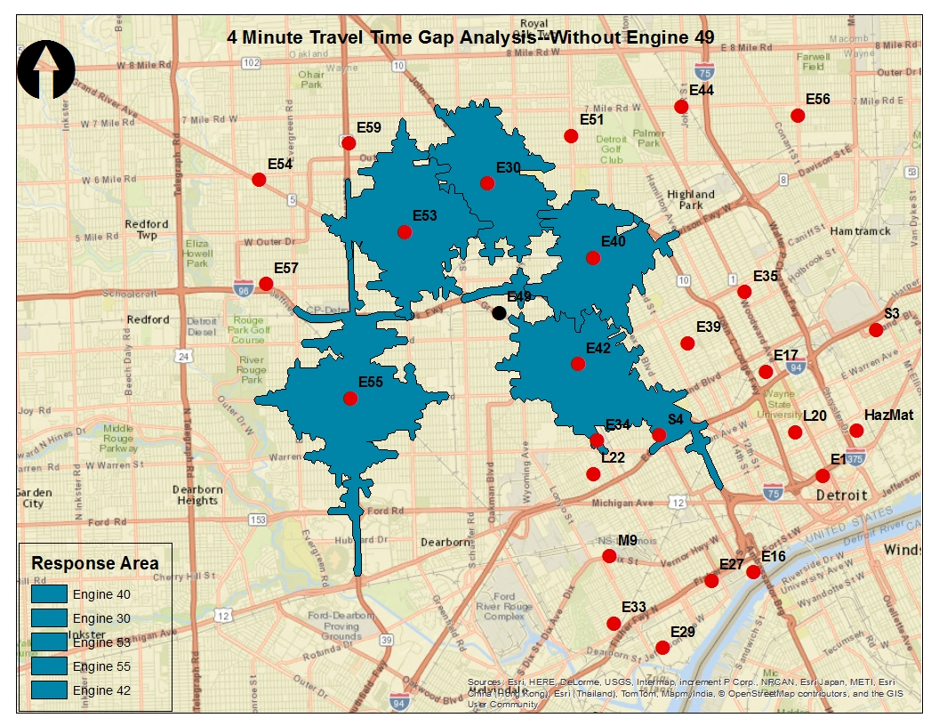
Analysis of Response Time Gaps

Slide 28
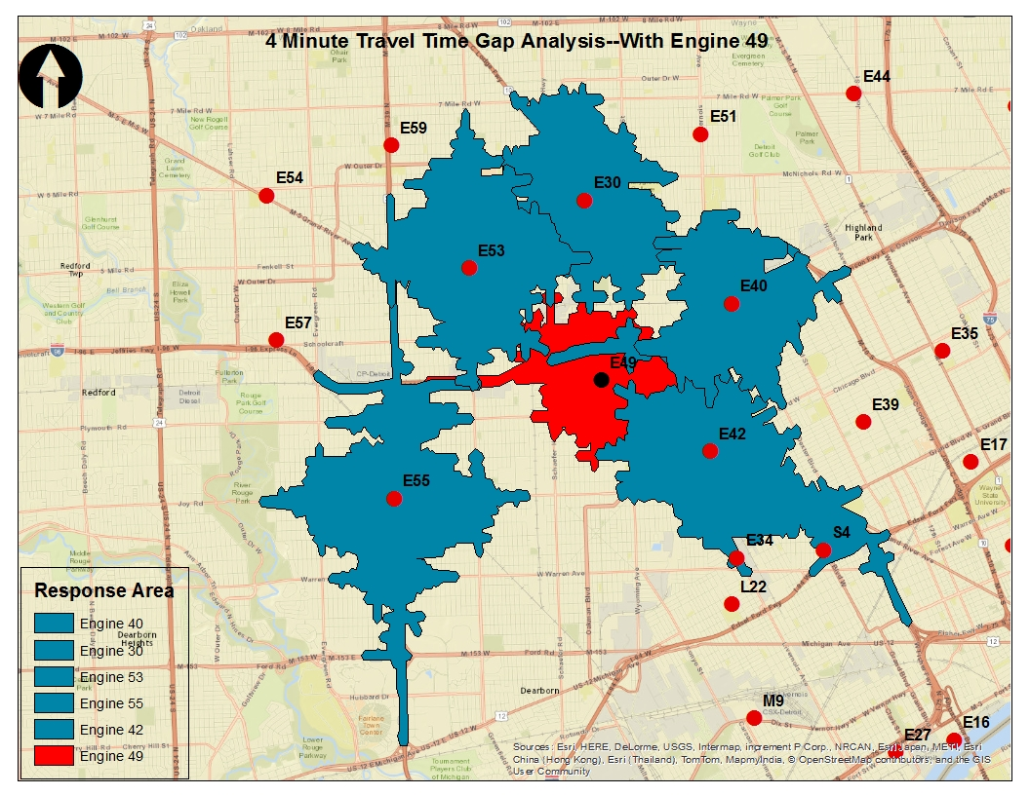
Analysis of Response Time Gaps With Engine 49

Slide 29
Final Thoughts
DFD DATA SCIENCE STRATEGY
FIRE INDUSTRY CULTURE & ANALYTICS
EXPLORATION OF SELECTED WORKS
●Listening as a practice
●Scaling up of analytics
●Strong foundation for long-term projects
●Integration of Mobility
●Application of Scientific Method
●Importance of actionable insight & visualization
●Ease into paramilitary culture
●Engine 49
●Fire CompStat
●Campaign intelligence
●Crisis Management
●Data quality control program

Slide 30
Thank You and Discussion
@cassie_dewitt | www.cassiedewitt.com

