Slide 1
Cloud Scale Machine Learning
The Intersection of Data Science and DevOps
aka.ms/cloudmlfeedback

Slide 2
Preamble – The Agenda
An Overview of Machine Learning
Lab – Hands on with scikit-learn and TensorFlow
Understanding Azure Machine Learning service
Lab – Your First Machine Learning Experiment in the Cloud
Advanced Experimentation Techniques in Azure Machine Learning service
Lab – Hands-on Advanced Experimentation in Azure Machine Learning service
The Intersection of Data Science and DevOps
Lab – Automating your Machine Learning Pipeline in the Cloud

Slide 3
Preamble – The Agenda
An Overview of Machine Learning
Lab – Hands on with scikit-learn and TensorFlow
Understanding Azure Machine Learning service
Lab – Your First Machine Learning Experiment in the Cloud
Advanced Experimentation Techniques in Azure Machine Learning service
Lab – Hands-on Advanced Experimentation in Azure Machine Learning service
The Intersection of Data Science and DevOps
Lab – Automating your Machine Learning Pipeline in the Cloud

Slide 4


Preamble – Some Initial Thoughts

Slide 5

Preamble – Some Initial Thoughts
https://github.com/cloudscaleml/

Slide 6
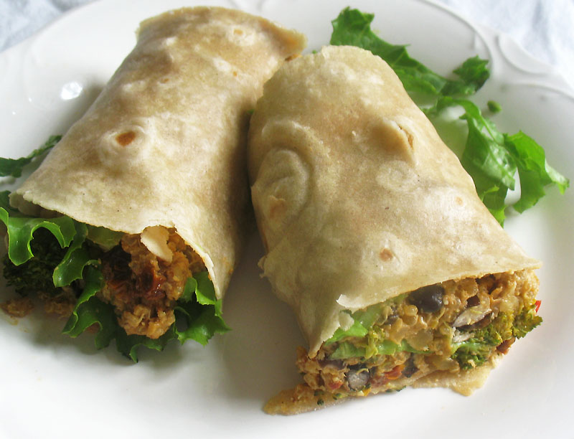

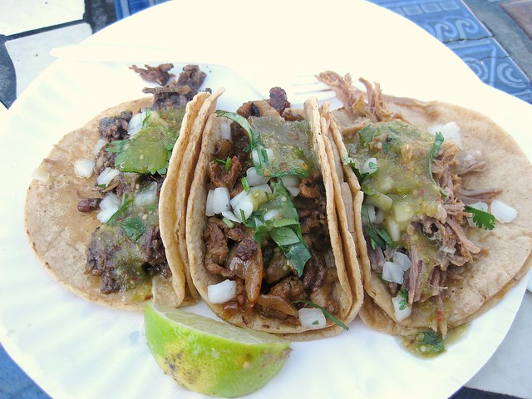
Preamble – What are we making?
burrito
tacos

Slide 7
ok, now for reals

Slide 8
AML Pipelines

Slide 9
Azure Machine Learning pipelines
Prepare data
Build & train models
Deploy & predict
Data Preparation
Model building & training
Model deployment
Data ingestion
Normalization
Hyper-parameter tuning
Deployment
Transformation
Automatic model selection
Batch scoring
Validation
Model testing
Data storage locations
Featurization
Model validation

Slide 10
Azure Machine Learning pipelines
Prepare data
Build & train models
Deploy & predict
Data Preparation
Model building & training
Model deployment
Data ingestion
Normalization
Normalization
Hyper-parameter tuning
Hyper-parameter tuning
Deployment
Automatic model selection
Batch scoring
Transformation
Automatic model selection
Transformation
Validation
Validation
Model testing
Model testing
Testing error
Featurization
Data storage locations
Featurization
Model validation

Slide 11
Azure Machine Learning pipelines
Prepare data
Build & train models
Deploy & predict
Data Preparation
Model building & training
Model deployment
Data ingestion
Normalization
Normalization
Hyper-parameter tuning
Hyper-parameter tuning
Deployment
Deployment
Batch scoring
Automatic model selection
Batch scoring
Transformation
Automatic model selection
Transformation
Validation
Validation
Model testing
Model testing
Model testing
Testing error
Featurization
Featurization
Model validation
Data storage locations
Model validation
Error resolved

Slide 12
Azure Machine Learning pipelines with new data
Prepare data
Build & train models
Deploy & predict
Data Preparation
Model building & training
Model deployment
Data ingestion
Normalization
Normalization
Hyper-parameter tuning
Hyper-parameter tuning
Deployment
Deployment
New data
Batch scoring
Automatic model selection
Batch scoring
Transformation
Automatic model selection
Transformation
Validation
Validation
Model testing
Model testing
Featurization
Featurization
Model validation
Data storage locations
Model validation

Slide 13
Advantages of Azure ML Pipelines
Unattended runs
Schedule a few steps to run in parallel or in sequence to focus on other tasks while your pipeline runs
Tracking and versioning
Name and version your data sources, inputs and outputs with the pipelines SDK
Reusability
Create templates of pipelines for specific scenarios such as retraining and batch scoring
Mixed and diverse compute
Use multiple pipelines that are reliably coordinated across heterogeneous and scalable computes and storages

Slide 14
Seer
… two pipelines

Slide 15
How does Seer work??
A demo

Slide 16
[SLIDE WORK ON SEER]
Describe process

Slide 17
Pipelines

Slide 18
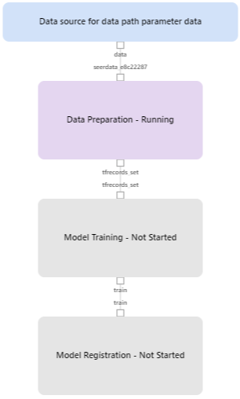

Slide 19
DevOps for Machine Learning

Slide 20


DevOps loop for data science
Prepare
Experiment
Deploy
…
Prepare Data
Build model (your favorite IDE)
Train & Test Model
Register and Manage Model
Build Image
Deploy Service
Monitor Model
Orchestrate

Slide 21
DevOps loop for data science
Prepare
Train & Test Model
…
Register and Manage Model
Build model (your favorite IDE)
Prepare Data
Deploy Service
Monitor Model
Build Image
Notes:
Here is the data scientist’s inner loop of work

Slide 22
Model management in Azure Machine Learning
Create/retrain model
Monitor
Register model
Deploy image
Create scoring files and dependencies
Cloud
Light Edge
Heavy Edge
Create and register image

Slide 23
Model management in detail
Create/Retrain Model
Enable DevOps with full CI/CD integration with VSTS
Register Model
Track model versions with a central model registry
Monitor
Oversea deployments through Azure AppInsights

Slide 24
Experimentation
Leverage service-side capture of run metrics, output logs and models
Manage training jobs locally, scaled-up or scaled-out
80%
75%
90%
95%
85%
Use leaderboards, side by side run comparison and model selection
Conduct a hyperparameter search on traditional ML or DNN

Slide 25
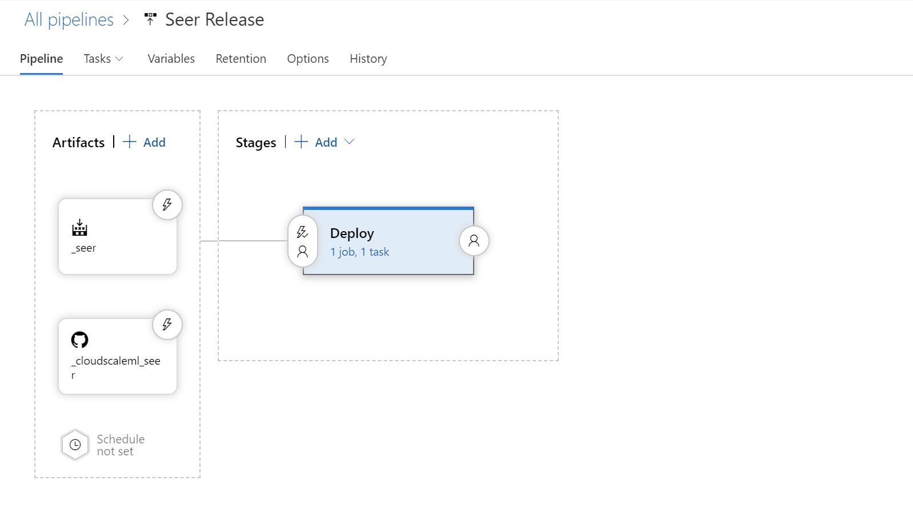

Slide 26
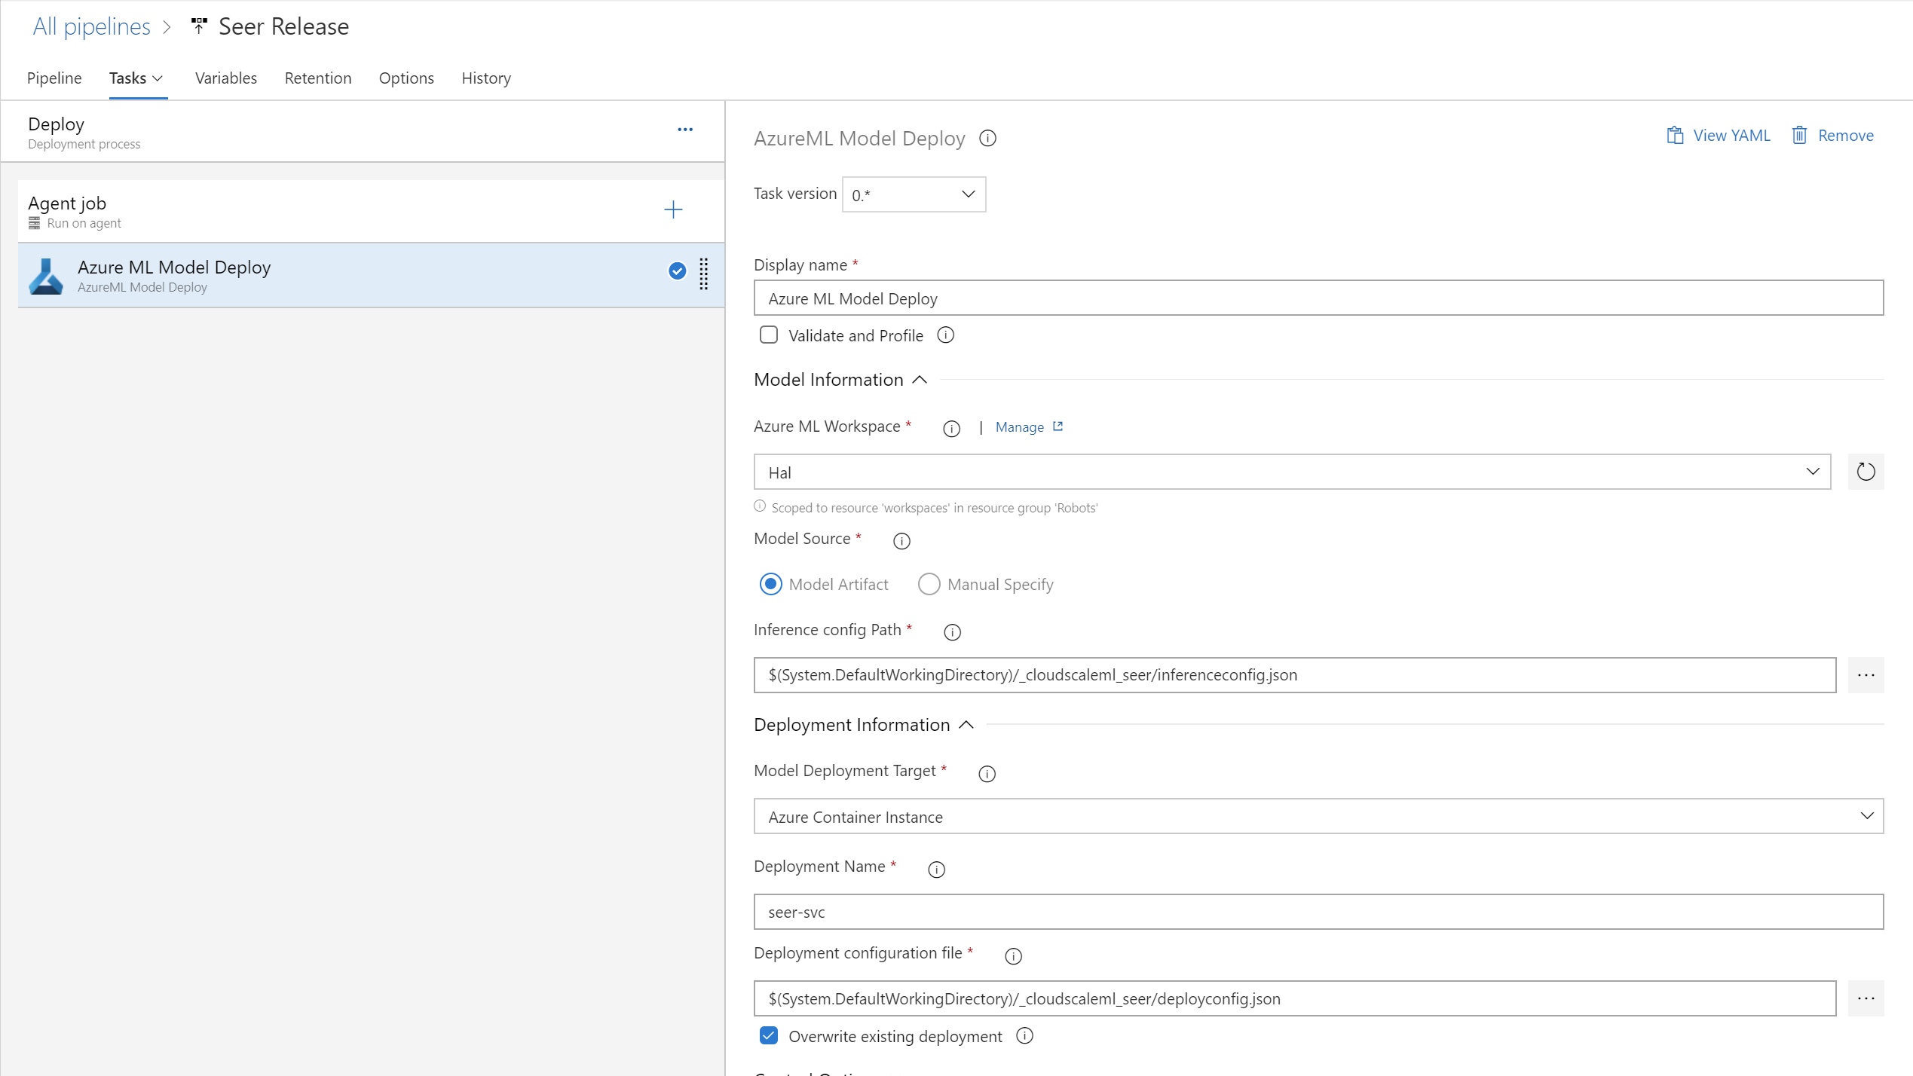

Slide 27

MLOps
Questions?

Slide 28
Lab
Automating your Machine Learning Pipeline in the Cloud

Slide 29
http://aka.ms/cloudmlfeedback
Please send us your feedback!!!

