Slide 1
Cloud Scale Machine Learning
An Overview of Machine Learning

Slide 2
Preamble – The Agenda
An Overview of Machine Learning
Lab – Hands on with scikit-learn and TensorFlow
Understanding Azure Machine Learning service
Lab – Your First Machine Learning Experiment in the Cloud
Advanced Experimentation Techniques in Azure Machine Learning service
Lab – Hands-on Advanced Experimentation in Azure Machine Learning service
The Intersection of Data Science and DevOps
Lab – Automating your Machine Learning Pipeline in the Cloud

Slide 3
Preamble – The Agenda
An Overview of Machine Learning
Lab – Hands on with scikit-learn and TensorFlow
Understanding Azure Machine Learning service
Lab – Your First Machine Learning Experiment in the Cloud
Advanced Experimentation Techniques in Azure Machine Learning service
Lab – Hands-on Advanced Experimentation in Azure Machine Learning service
The Intersection of Data Science and DevOps
Lab – Automating your Machine Learning Pipeline in the Cloud

Slide 4


Preamble – Some Initial Thoughts

Slide 5

Preamble – Some Initial Thoughts
https://github.com/cloudscaleml/

Slide 6
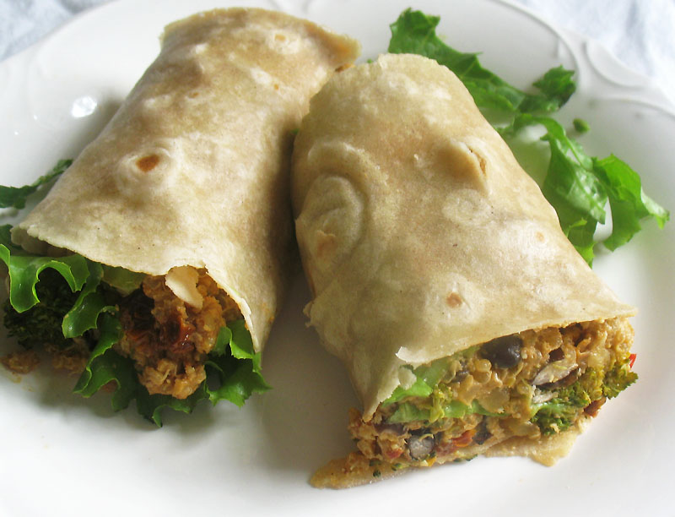

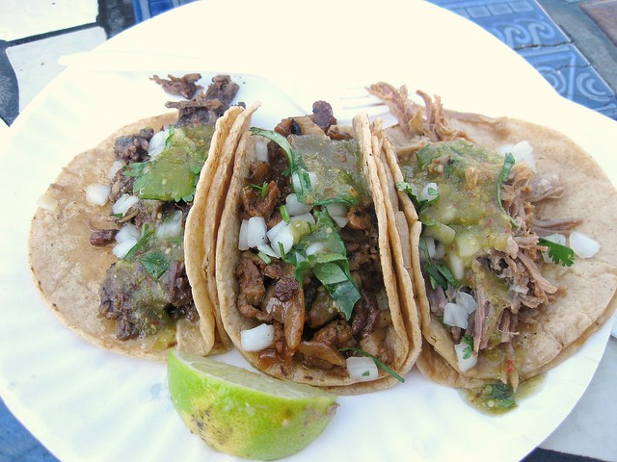
Preamble – What are we making?
burrito
tacos

Slide 7

Artificial Intelligence – Intuition
Why would this be hard to program?

Slide 8
what is it anyway?
artificial intelligence
machine learning
deep learning

Slide 9
programming
function
answers
input

Slide 10
machine learning
answers
function
input

Slide 11
machine learning
???
model
data

Slide 12
machine learning
data
magic
model / function
code
answers
input

Slide 13
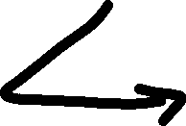
machine learning
data
magic
model / function
code
answers
input

Slide 14
machine learning
finding (and exploiting) patterns in data
replacing “human writing code” with “human supplying data”
system figures out what the person wants based on examples
need to abstract from “training” examples to “test” examples
most central issue in ML: generalization
starts with a sharp question

Slide 15
machine learning
how much / how many
which class does this belong to?
are there different groups? which does it belong to?
is this weird?
which option should I choose?

Slide 16
machine learning
(regression) how much / how many
(classification) which class does this belong to?
(clustering) are there different groups? which does it belong to?
(anomaly detection) is this weird?
(recommendation) which option should I choose?
supervised
learning
unsupervised
learning

Slide 17
machine learning
(regression) how much / how many
(classification) which class does this belong to?
(clustering) are there different groups? which does it belong to?
(anomaly detection) is this weird?
(recommendation) which option should I choose?
supervised
learning
unsupervised
learning

Slide 18
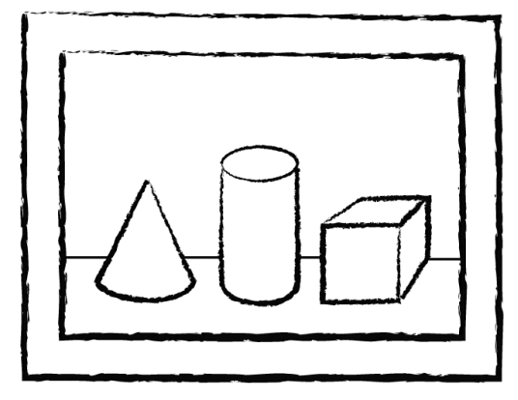

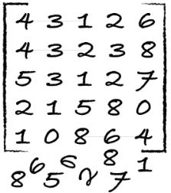
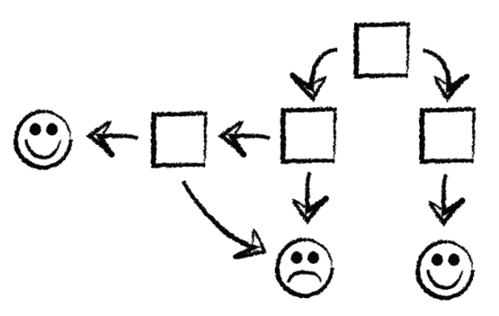
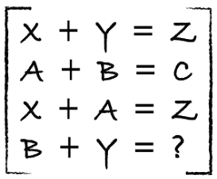
process
identify
predict
1
4
explore
analyze
encode
model
2
3

Slide 19
how well is it doing?
train
test
Use ~80%
Use ~20%

Slide 20
how well is it doing?
train
test
dev
Use ~80%
Use ~10%
Use ~10%

Slide 21
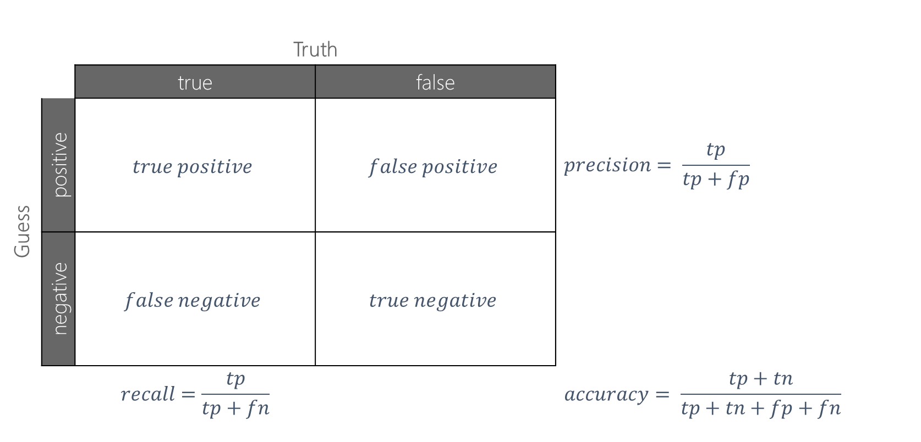
confusion matrix
 |  | Truth
 |  | true | false
Guess | positive | $$true positive$$ | $$false positive$$ | $$precision= \frac{tp}{tp+fp}$$
 | negative | $$false negative$$ | $$true negative$$
 |  | $$recall=\frac{tp}{tp+fn}$$ |  | $$accuracy= \frac{tp+tn}{tp+tn+fp+fn}$$

Slide 22
data example
Class | Outlook | Temp. | Windy
Play | Sunny | Low | Yes
No Play | Sunny | High | Yes
No Play | Sunny | High | No
Play | Overcast | Low | Yes
Play | Overcast | High | No
Play | Overcast | Low | No
No Play | Rainy | Low | Yes
Play | Rainy | Low | No
? | Sunny | Low | No
label (y)
play / no play
features
outlook, temp, windy
values (x)
[Sunny, Low, Yes]
Labeled dataset is a collection of (X, Y) pairs.
Given a new x, how do we predict y?

Slide 23
reminder
burrito
tacos

Slide 24
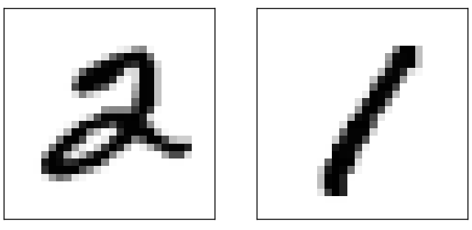

Slide 25
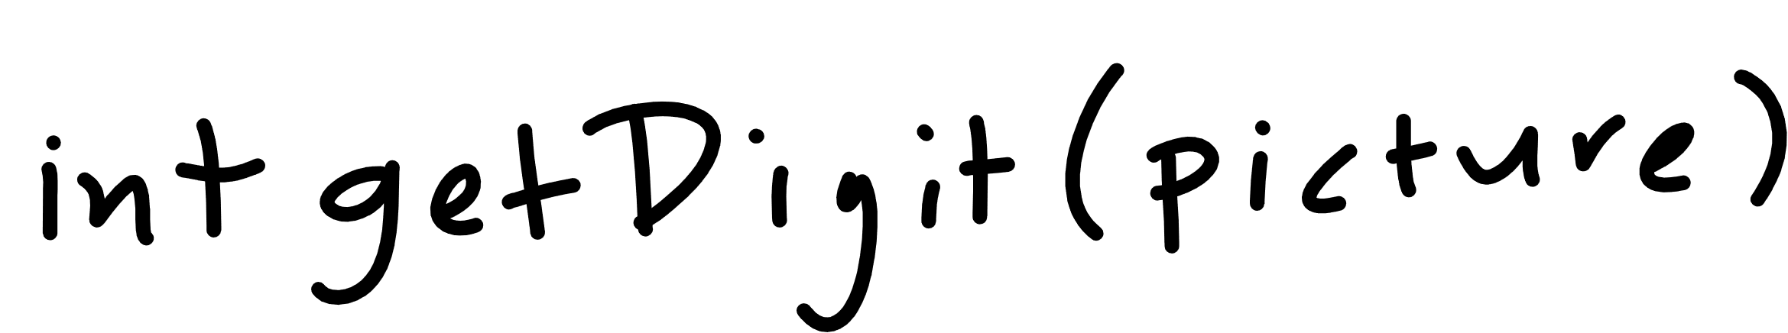

Slide 26
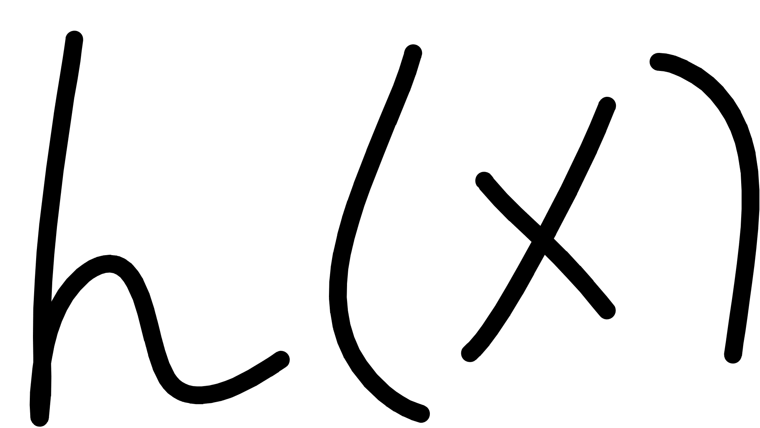
Notes:
Cover the fact that ML uses data to make its own functions

Slide 27


Notes:
Cover the fact that ML uses data to make its own functions

Slide 28
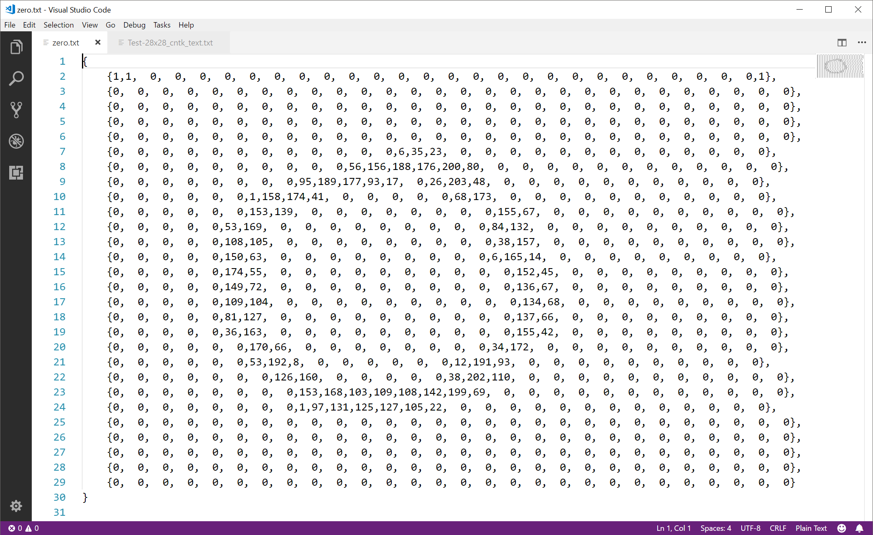

Slide 29

Notes:
Cover the fact that ML uses data to make its own functions

Slide 30
scikit-learn

Slide 31

scikit-learn – concepts
You “pick” the function “shape” – in scikit-learn these are called classifiers
You “fit” the data to the classifier
scikit-learn classifier
model
data
You use the classifier to predict
code
input
answers

Slide 32
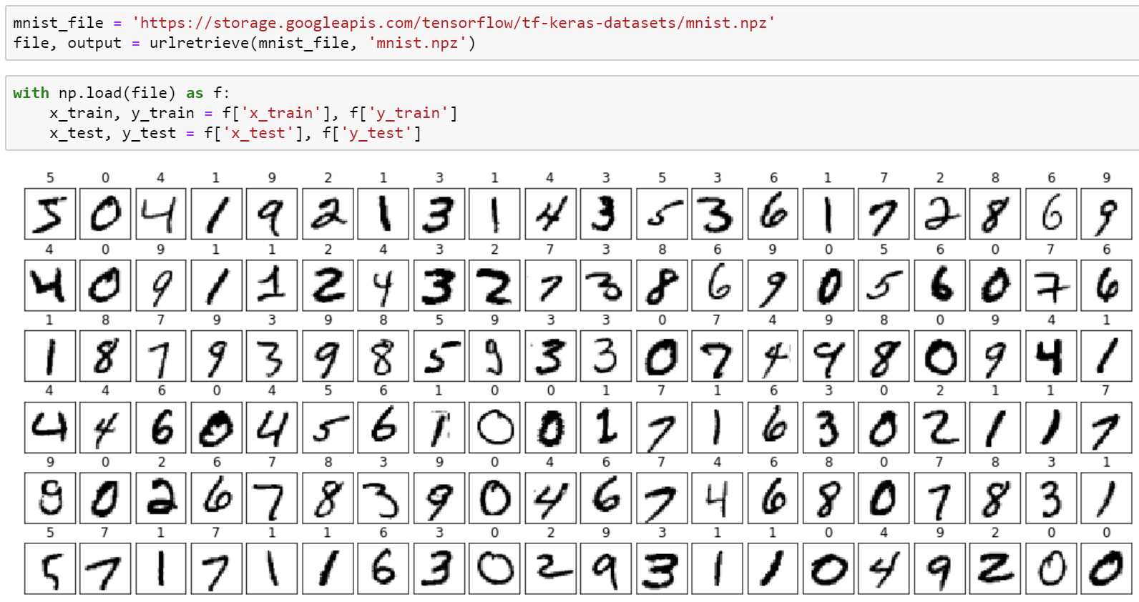
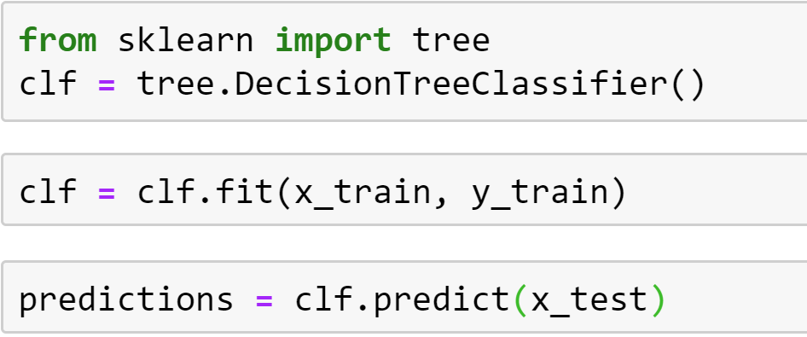
scikit-learn – concepts
You “pick” the function “shape” – in scikit-learn these are called classifiers
You “fit” the data to the classifier
You use the classifier to predict

Slide 33
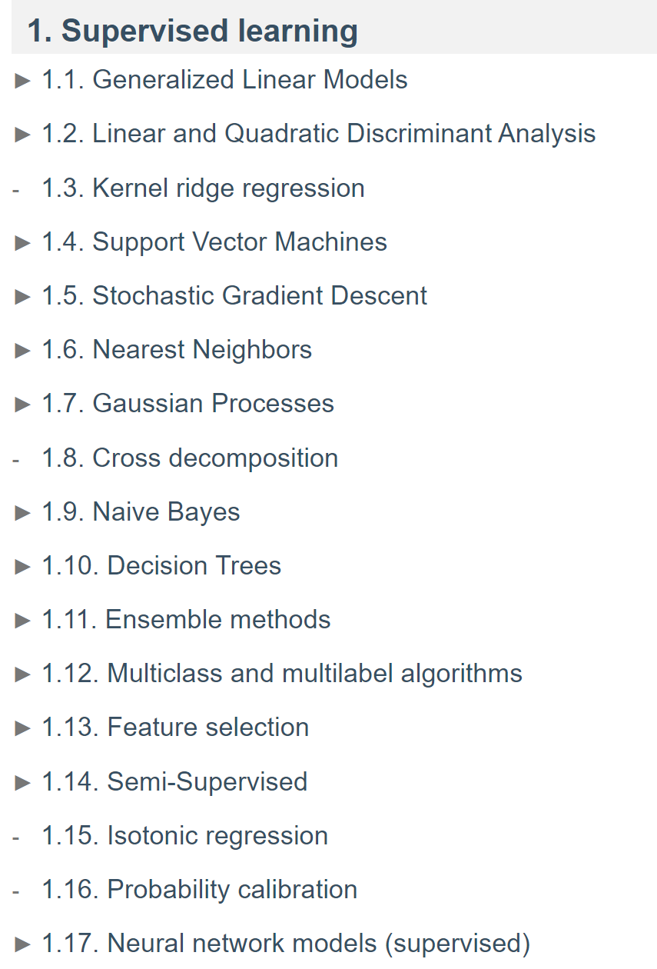
scikit-learn – classifiers
source: https://scikit-learn.org/stable/user_guide.html

Slide 34
scikit-learn – concepts
Questions?

Slide 35
science
Notes:
This is the idealized process
Make sure to include the notion of exploring data / visualizing data
Sometimes ML isn’t even needed based upon exploration

Slide 36
science
Notes:
This is what actually happens: the “loop of pain”, when we discover our assumptions were wrong, or the data was inadequate, or that we needed to solve a different problem entirely.

Slide 37
TensorFlow 2.0

Slide 38
TensorFlow – concepts
You “craft” the function “shape” – in TensorFlow this is a model
You “optimize” the model using a cost/loss function and optimizer
data
TensorFlow
model
You use the model to predict
code
input
answers

Slide 39




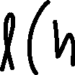
TensorFlow – concepts
model – the function shape we construct
cost/loss function – a function that tells us how bad we are at predicting
optimizer – method for reducing how bad we are at predicting

Slide 40
TensorFlow – concepts
You “craft” the function “shape” – in TensorFlow this is a model
You “optimize” the model using a cost/loss function and optimizer
data
TensorFlow
model
You use the model to predict
code
input
answers

Slide 41
TensorFlow – concepts

Slide 42
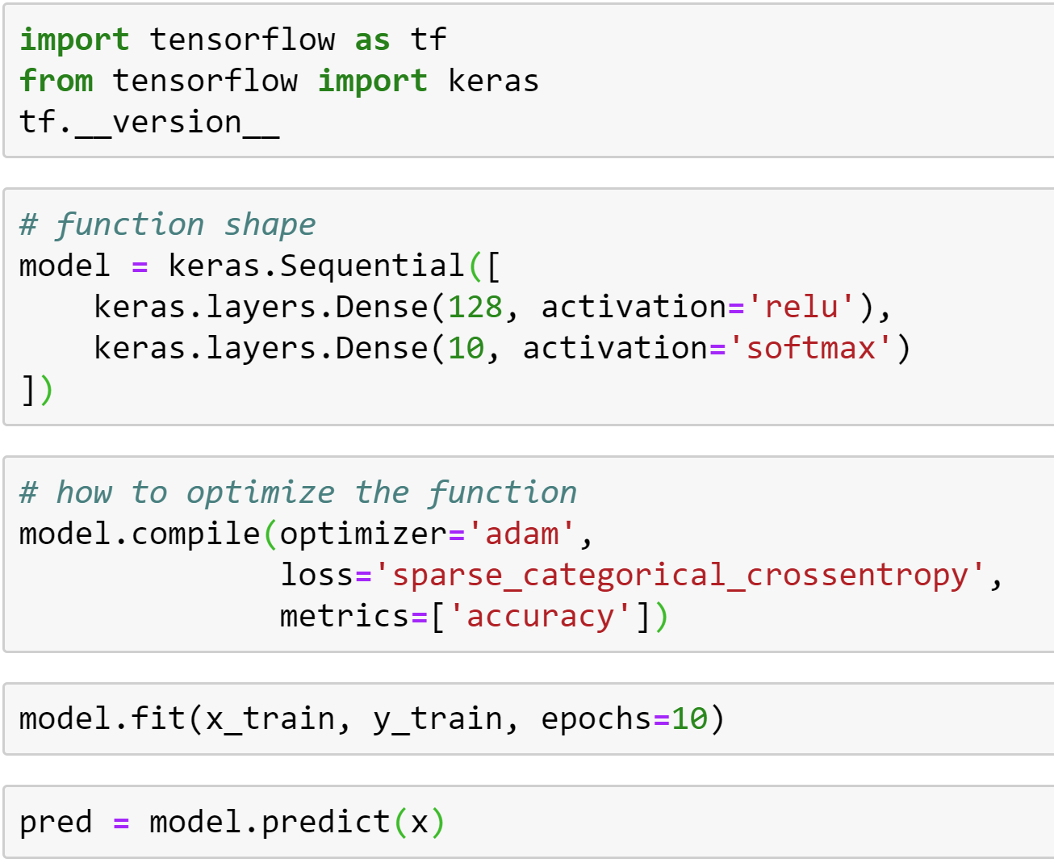
TensorFlow – concepts
You “craft” the function “shape” – in TensorFlow this is a model
You “optimize” the model using a cost/loss function and optimizer
You use the model to predict

Slide 43
TensorFlow – optimizers
class Adadelta: Optimizer that implements the Adadelta algorithm.
class Adagrad: Optimizer that implements the Adagrad algorithm.
class Adam: Optimizer that implements the Adam algorithm.
class Adamax: Optimizer that implements the Adamax algorithm.
class Ftrl: Optimizer that implements the FTRL algorithm.
class Nadam: Optimizer that implements the NAdam algorithm.
class Optimizer: Updated base class for optimizers.
class RMSprop: Optimizer that implements the RMSprop algorithm.
class SGD: Stochastic gradient descent and momentum optimizer.

Slide 44
TensorFlow – loss functions
class BinaryCrossentropy: Computes the cross-entropy loss between true labels and predicted labels.
class CategoricalCrossentropy: Computes the crossentropy loss between the labels and predictions.
class CategoricalHinge: Computes the categorical hinge loss between y_true and y_pred.
class CosineSimilarity: Computes the cosine similarity between y_true and y_pred.
class Hinge: Computes the hinge loss between y_true and y_pred.
class Huber: Computes the Huber loss between y_true and y_pred.
class KLDivergence: Computes Kullback Leibler divergence loss between y_true and y_pred.
class LogCosh: Computes the logarithm of the hyperbolic cosine of the prediction error.
class MeanAbsoluteError: Computes the mean of absolute difference between labels and predictions.
class MeanAbsolutePercentageError: Computes the mean absolute percentage error between y_true and y_pred.
class MeanSquaredError: Computes the mean of squares of errors between labels and predictions.
class MeanSquaredLogarithmicError: Computes the mean squared logarithmic error between y_true and y_pred.
class Poisson: Computes the Poisson loss between y_true and y_pred.
class SparseCategoricalCrossentropy: Computes the crossentropy loss between the labels and predictions.
class SquaredHinge: Computes the squared hinge loss between y_true and y_pred.

Slide 45
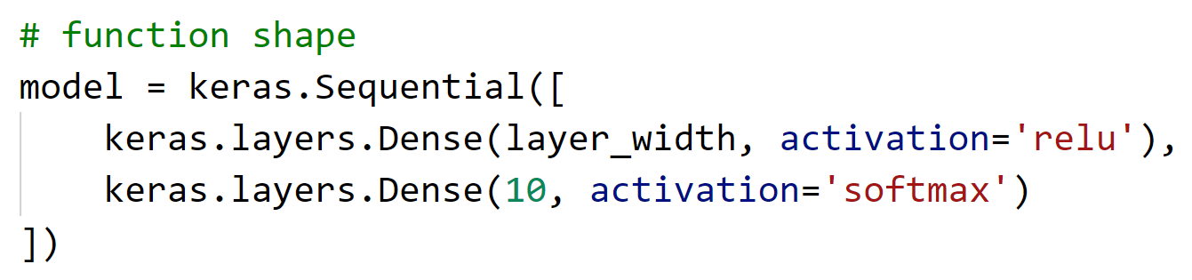
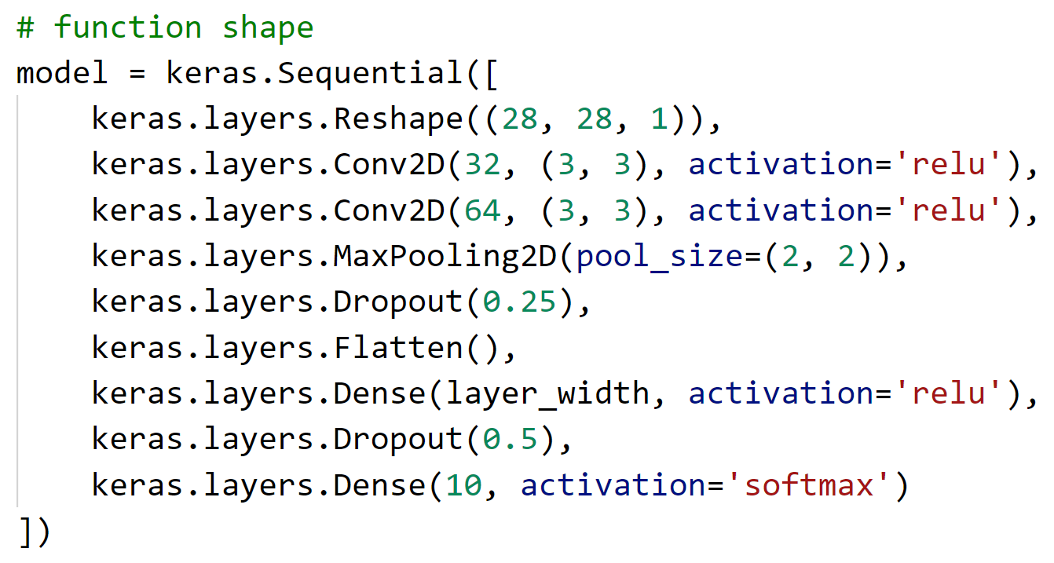
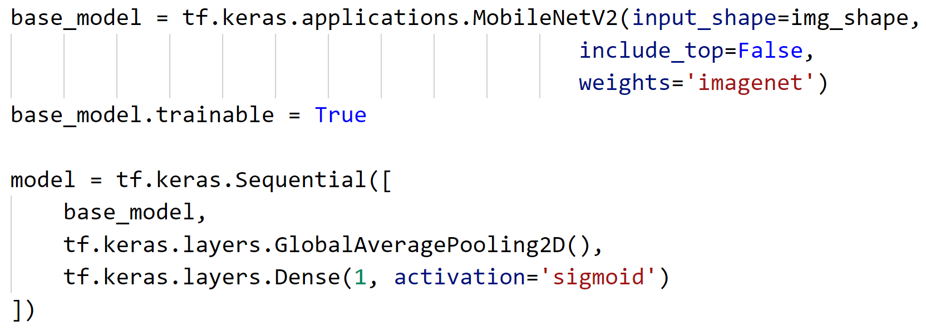
TensorFlow – models

Slide 46
TensorFlow – concepts
Questions?

Slide 47
Lab
Hands on with scikit-learn and TensorFlow

Slide 48
Login or Create an Azure Account
Go to aka.ms/techoramaNL to create and Azure Account
Go to www.microsoftazurepass.com to redeem a $100 Azure Credit

Slide 49
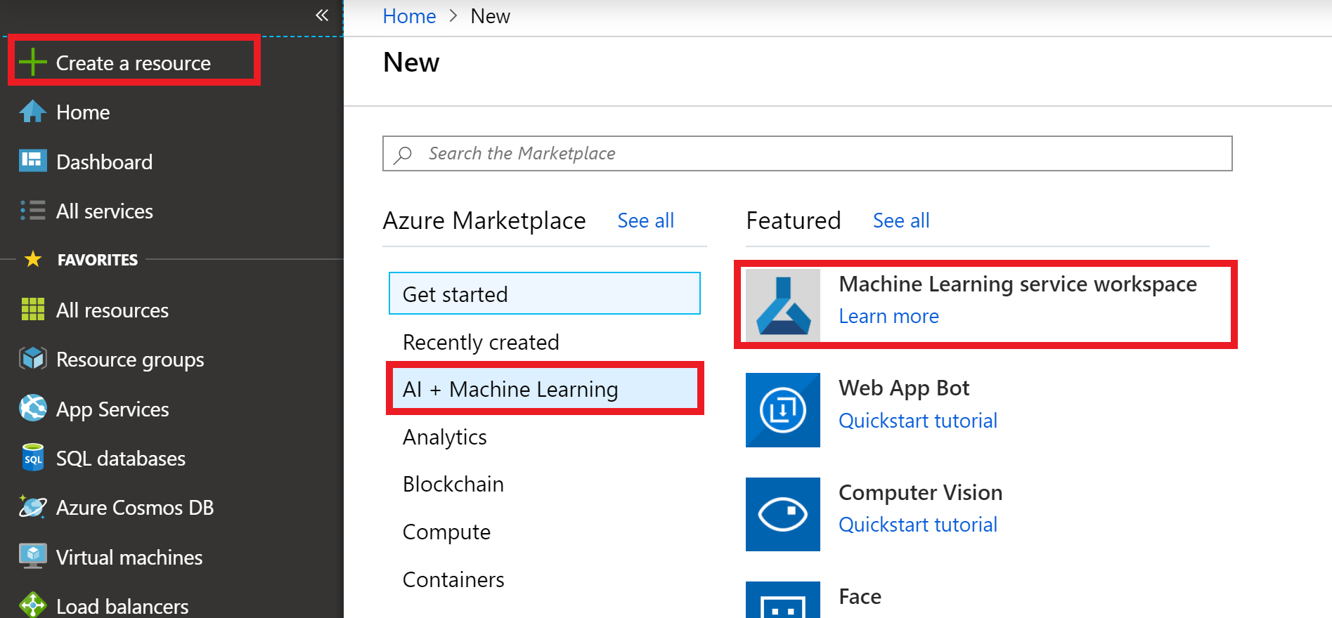
Create Azure Machine Learning Workspace

Slide 50
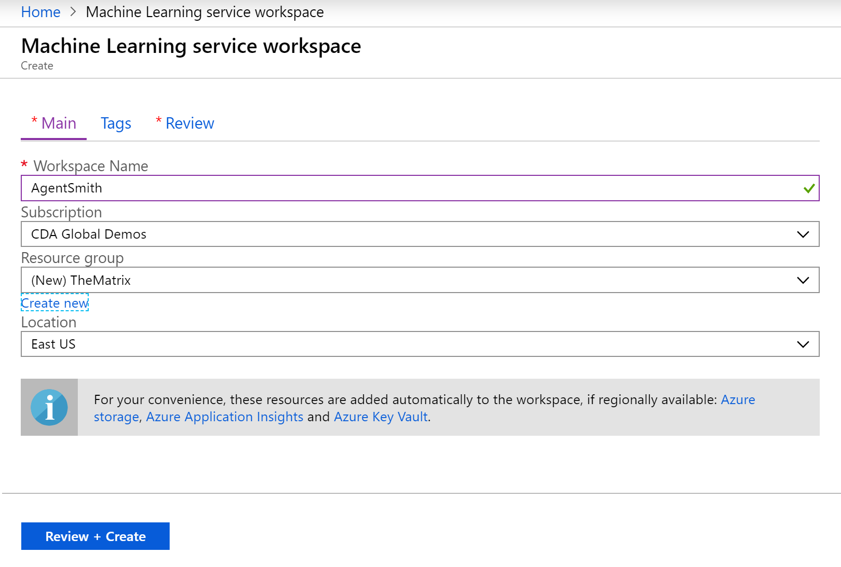

Slide 51
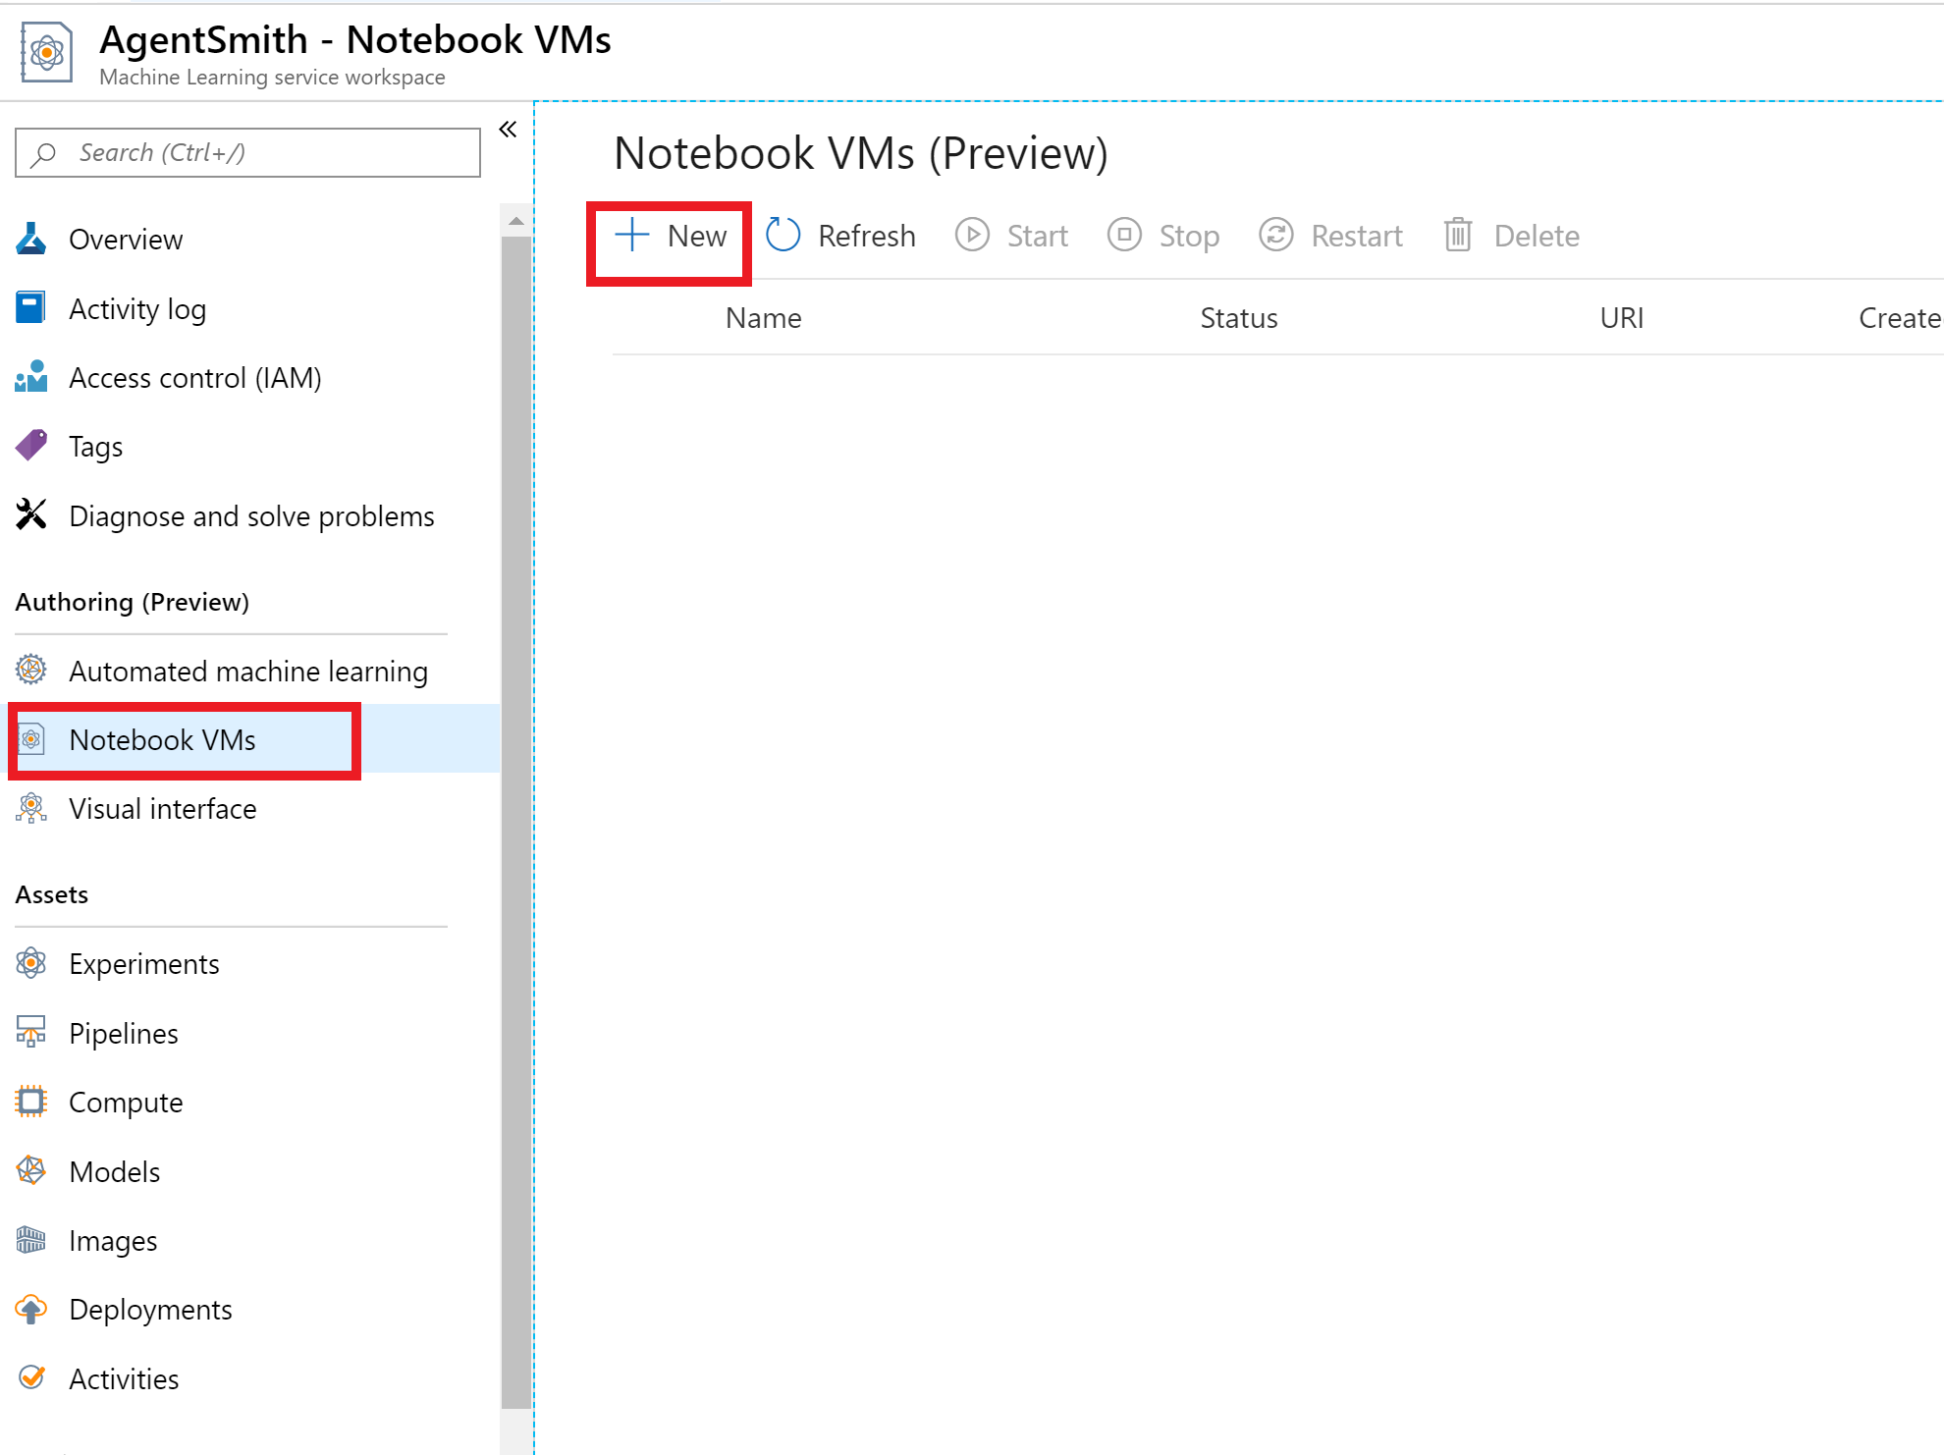

Slide 52
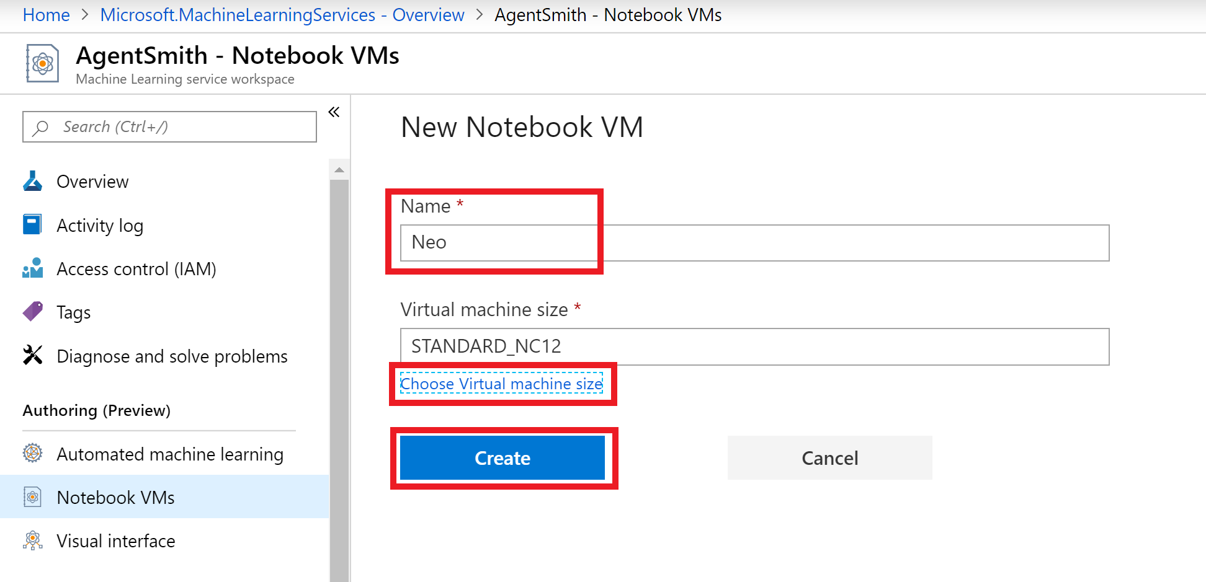

Slide 53
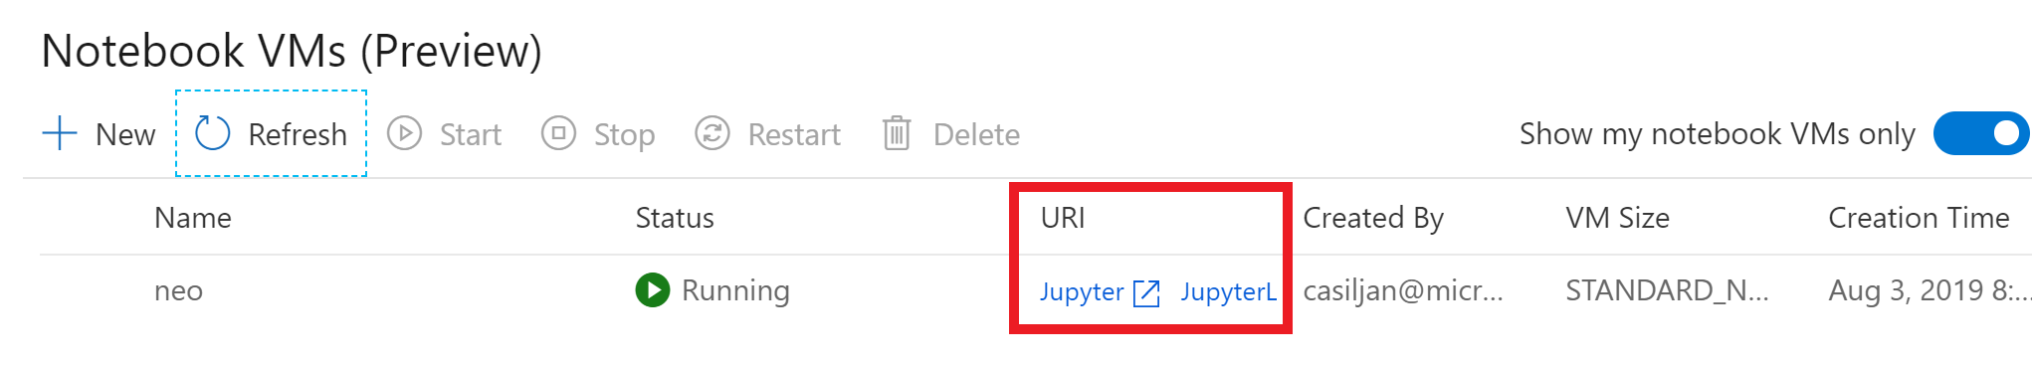

Slide 54
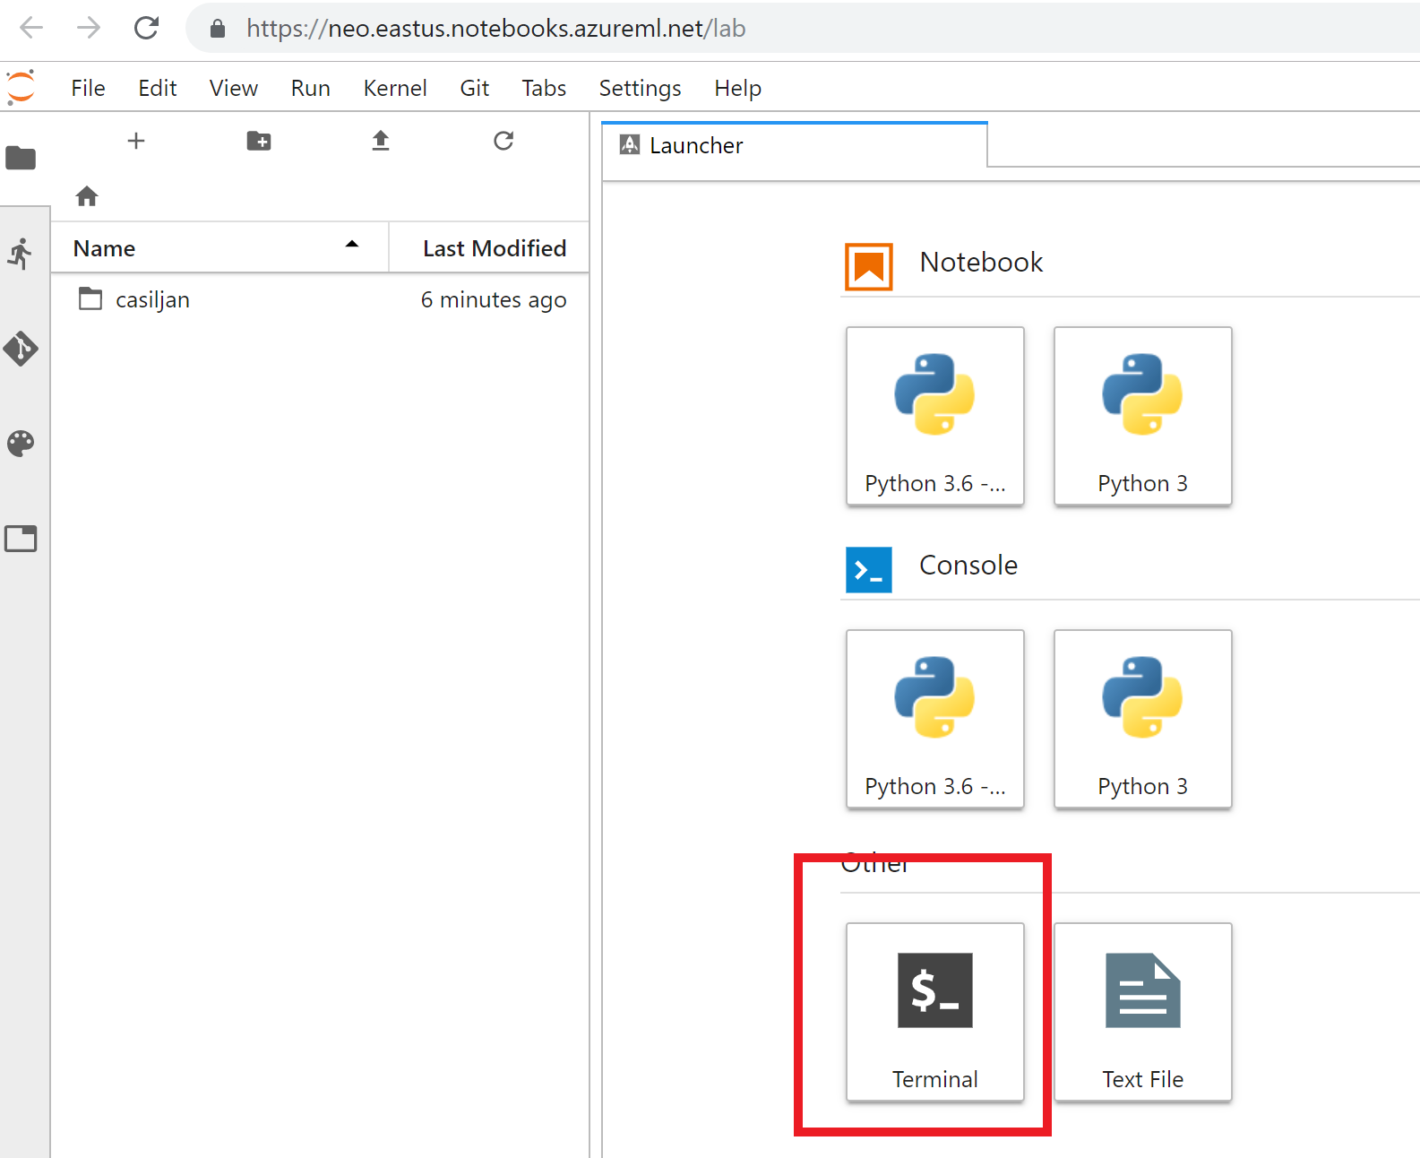

Slide 55
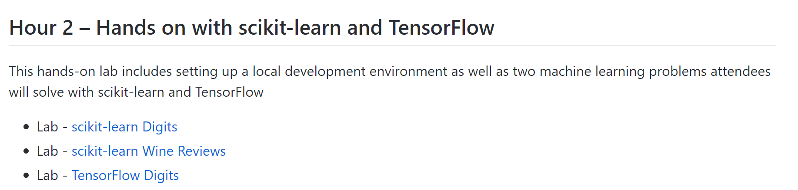
Workshop Overview
aka.ms/CloudScaleML

Slide 56
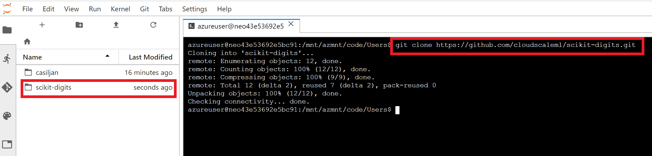
Select the workshop to complete
Copy the repo link
Go back to the terminal in Jupyter Lab
`git clone` and paste link with CTRL+SHIFT+V

