Slide 1
Cloud Scale Machine Learning
An Overview of Machine Learning

Slide 2
Preamble – The Agenda
An Overview of Machine Learning
Lab – Hands on with scikit-learn and TensorFlow
Understanding Azure Machine Learning service
Lab – Your First Machine Learning Experiment in the Cloud
Advanced Experimentation Techniques in Azure Machine Learning service
Lab – Hands-on Advanced Experimentation in Azure Machine Learning service
The Intersection of Data Science and DevOps
Lab – Automating your Machine Learning Pipeline in the Cloud

Slide 3
Preamble – The Agenda
An Overview of Machine Learning
Lab – Hands on with scikit-learn and TensorFlow
Understanding Azure Machine Learning service
Lab – Your First Machine Learning Experiment in the Cloud
Advanced Experimentation Techniques in Azure Machine Learning service
Lab – Hands-on Advanced Experimentation in Azure Machine Learning service
The Intersection of Data Science and DevOps
Lab – Automating your Machine Learning Pipeline in the Cloud

Slide 4


Preamble – Some Initial Thoughts

Slide 5

Preamble – Some Initial Thoughts
https://github.com/cloudscaleml/

Slide 6
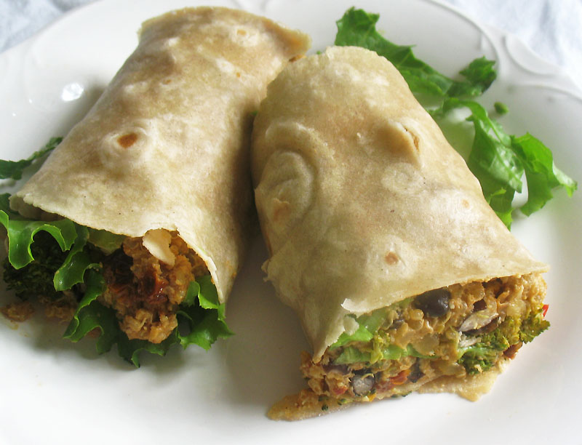

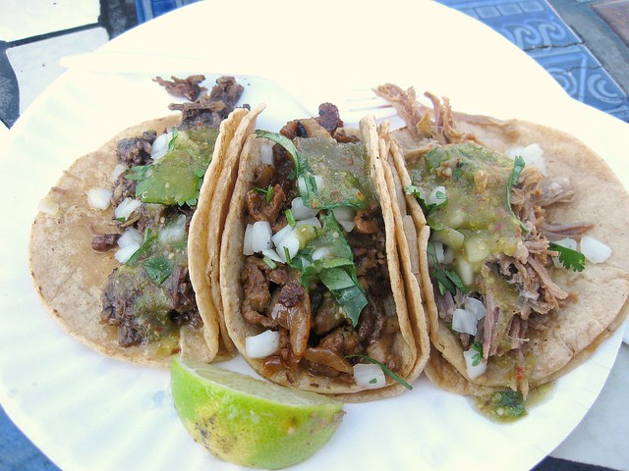
Preamble – What are we making?
burrito
tacos

Slide 7

Artificial Intelligence – Intuition
Why would this be hard to program?

Slide 8
Programming
Algorithm
Answers
Data
Notes:
When programming, we solve a problem by writing an algorithm
We run data (or input) through that algorithm and get an answer
Importantly, we know (or can work out) how to solve that problem
What happens when we don’t know what that algorithm looks like? E.g. is there a bird in the photo, or what is the probability that an applicant will default on a loan?

Slide 9
Machine Learning
Answers
Algorithm
Data
Notes:
These are the problems machine learning is good at
With machine learning, we solve these problems by flipping it around and providing a whole lot of examples of correct answers and corresponding input, and let the computer decide what that algorithm is

Slide 10
Machine Learning
Answers
Model
Data
Notes:
What we’re doing is letting the computer build a “model” to describe that data

Slide 11
Machine Learning
Answers
Model
Data
Notes:
What’s great about this, is we can use that model in place of the algorithm we would have written, had we known how.

Slide 12
Machine Learning
Answers
Data
Model
Predictions
Data
Notes:
By using the model, we can get predictions
Note: these are predictions - not answers the way we’d think of it
The quality and accuracy of those predictions depends on the techniques and algorithms we used to train the model, and importantly - the data we used to train the model
If you’re using biased data to train the model, you’ll get a biased model

Slide 13
machine learning
finding (and exploiting) patterns in data
replacing “human writing code” with “human supplying data”
starts with a sharp question
Notes:
system figures out what the person wants based on examples
need to abstract from “training” examples to “test” examples
most central issue in ML: generalization

Slide 14
machine learning
finding (and exploiting) patterns in data
replacing “human writing code” with “human supplying data”
system figures out what the person wants based on examples
need to abstract from “training” examples to “test” examples
most central issue in ML: generalization
starts with a sharp question

Slide 15
When should you use machine learning?
Regression: how much / how many
supervised
learning
Classification: which class does it belong to?
Clustering: are there different groups? which does it belong to?
unsupervised
learning
Anomaly Detection: is this weird?
Recommendation: which option should I choose?

Slide 16
When should you use machine learning?
Regression: how much / how many
supervised
learning
Classification: which class does it belong to?
Clustering: are there different groups? which does it belong to?
unsupervised
learning
Anomaly Detection: is this weird?
Recommendation: which option should I choose?

Slide 17
The Model Building Process
Prepare Data
Find, Select and/or Create Data
Train Model
Apply learning algorithm
Test Model
Test Candidate Model with unseen data
Deploy Model
Deploy Chosen Model
Apply preprocessing
Select Candidate model
Select good enough model
Application posts to API
Feature Engineering

Slide 18
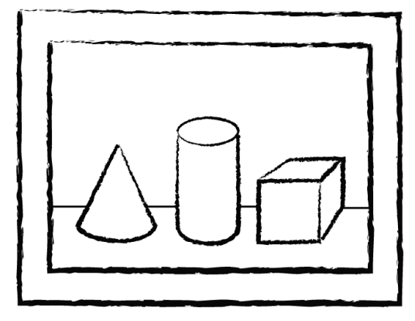
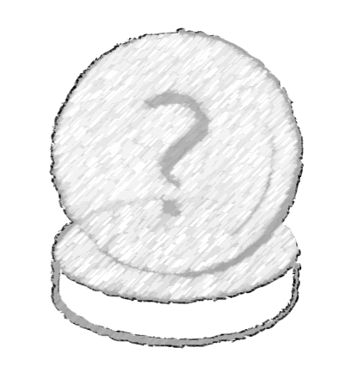
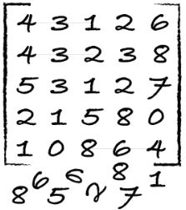
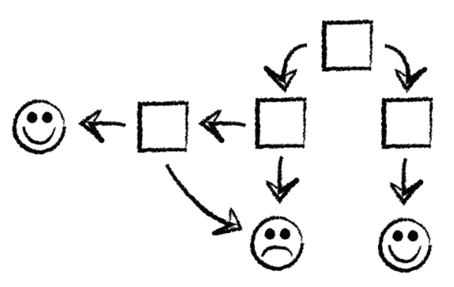
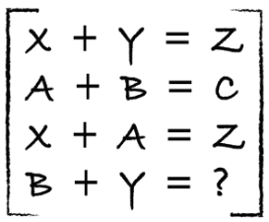
process
identify
predict
1
4
explore
analyze
encode
model
2
3

Slide 19
how well is it doing?
train
test
Use ~80%
Use ~20%

Slide 20
how well is it doing?
train
test
dev
Use ~80%
Use ~10%
Use ~10%

Slide 21
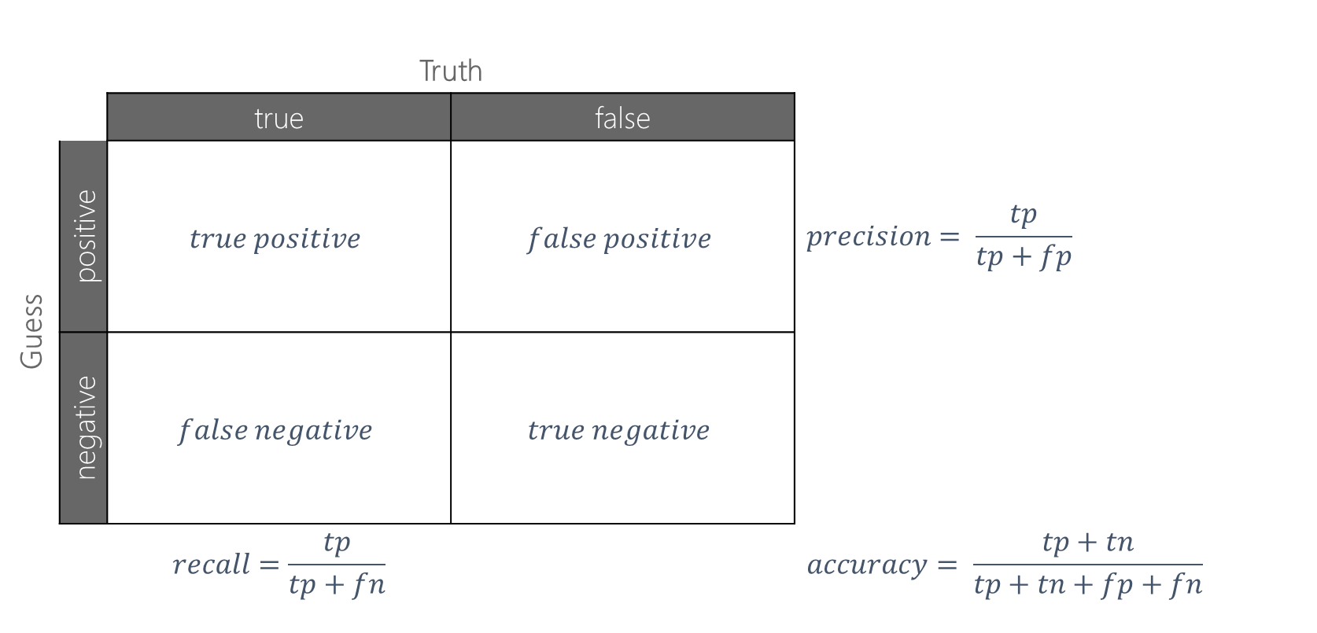
confusion matrix
 |  | Truth
 |  | true | false
Guess | positive | $$true positive$$ | $$false positive$$ | $$precision= \frac{tp}{tp+fp}$$
 | negative | $$false negative$$ | $$true negative$$
 |  | $$recall=\frac{tp}{tp+fn}$$ |  | $$accuracy= \frac{tp+tn}{tp+tn+fp+fn}$$

Slide 22
data example
Class | Outlook | Temp. | Windy
Play | Sunny | Low | Yes
No Play | Sunny | High | Yes
No Play | Sunny | High | No
Play | Overcast | Low | Yes
Play | Overcast | High | No
Play | Overcast | Low | No
No Play | Rainy | Low | Yes
Play | Rainy | Low | No
? | Sunny | Low | No
label (y)
play / no play
features
outlook, temp, windy
values (x)
[Sunny, Low, Yes]
Labeled dataset is a collection of (X, Y) pairs.
Given a new x, how do we predict y?

Slide 23
reminder
burrito
tacos

Slide 24


Slide 25
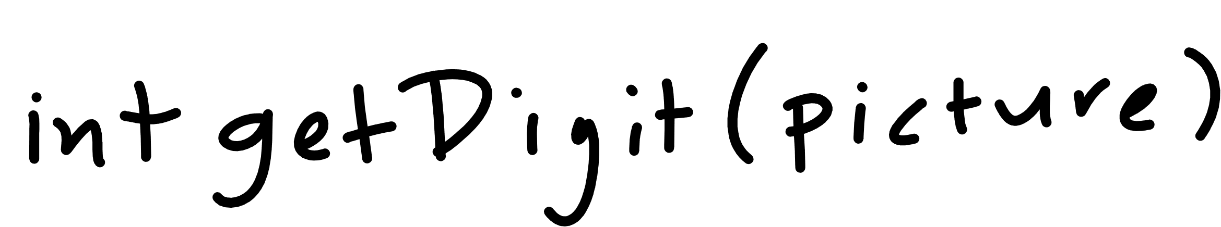

Slide 26
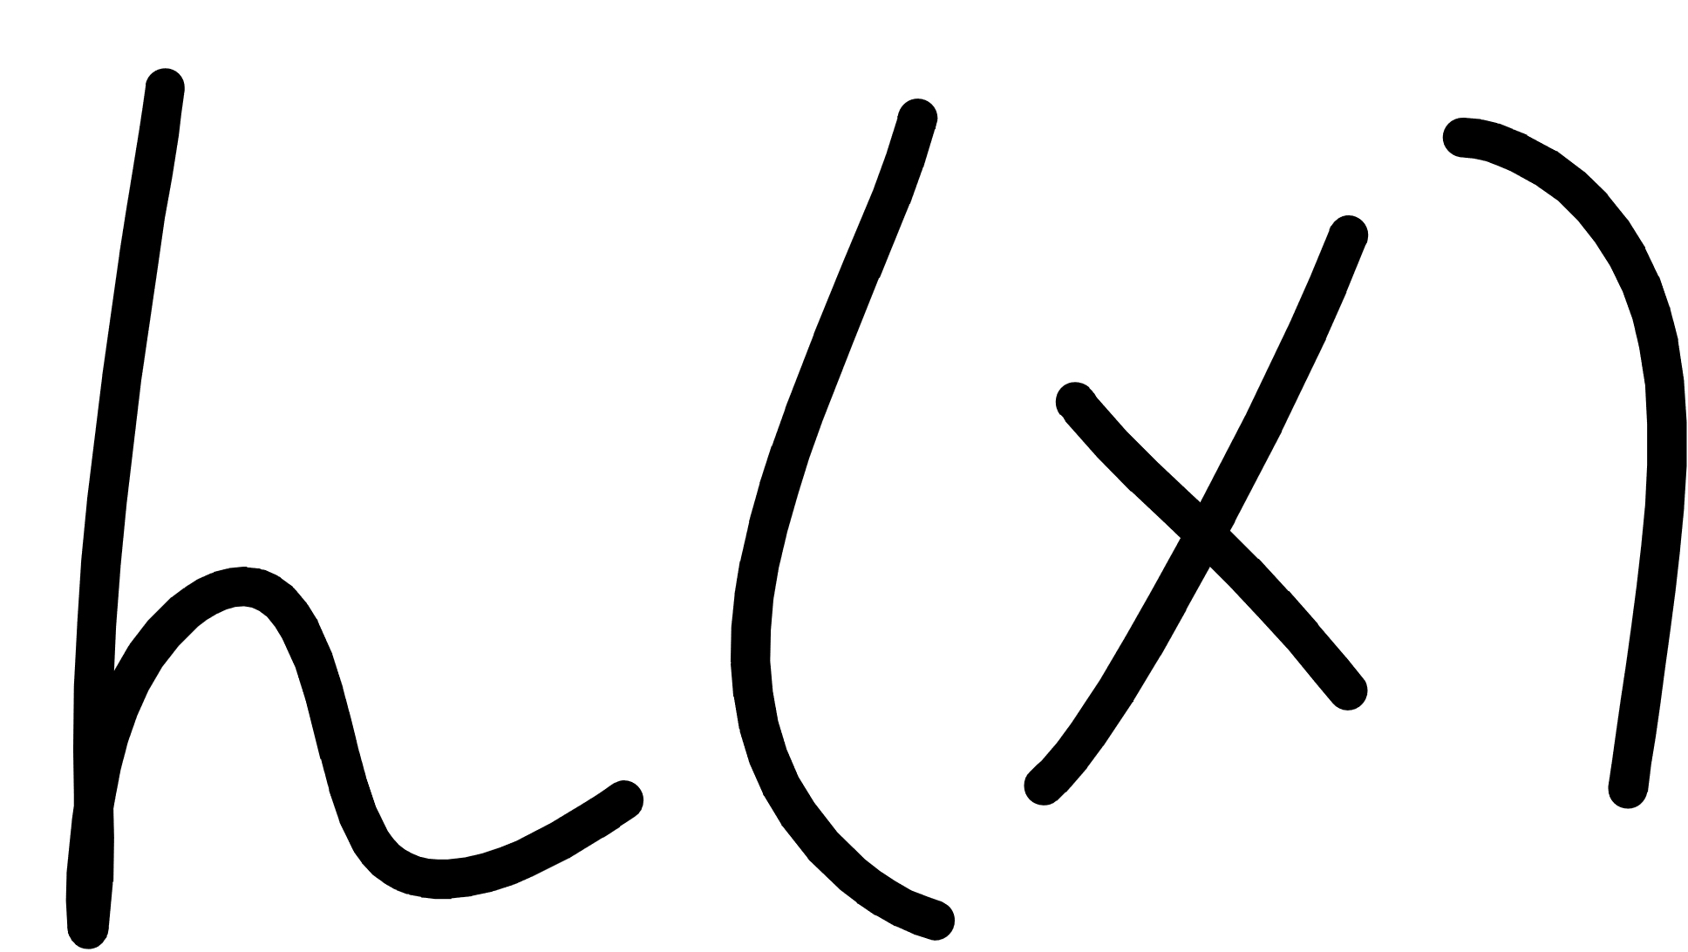
Notes:
Cover the fact that ML uses data to make its own functions

Slide 27


Notes:
Cover the fact that ML uses data to make its own functions

Slide 28
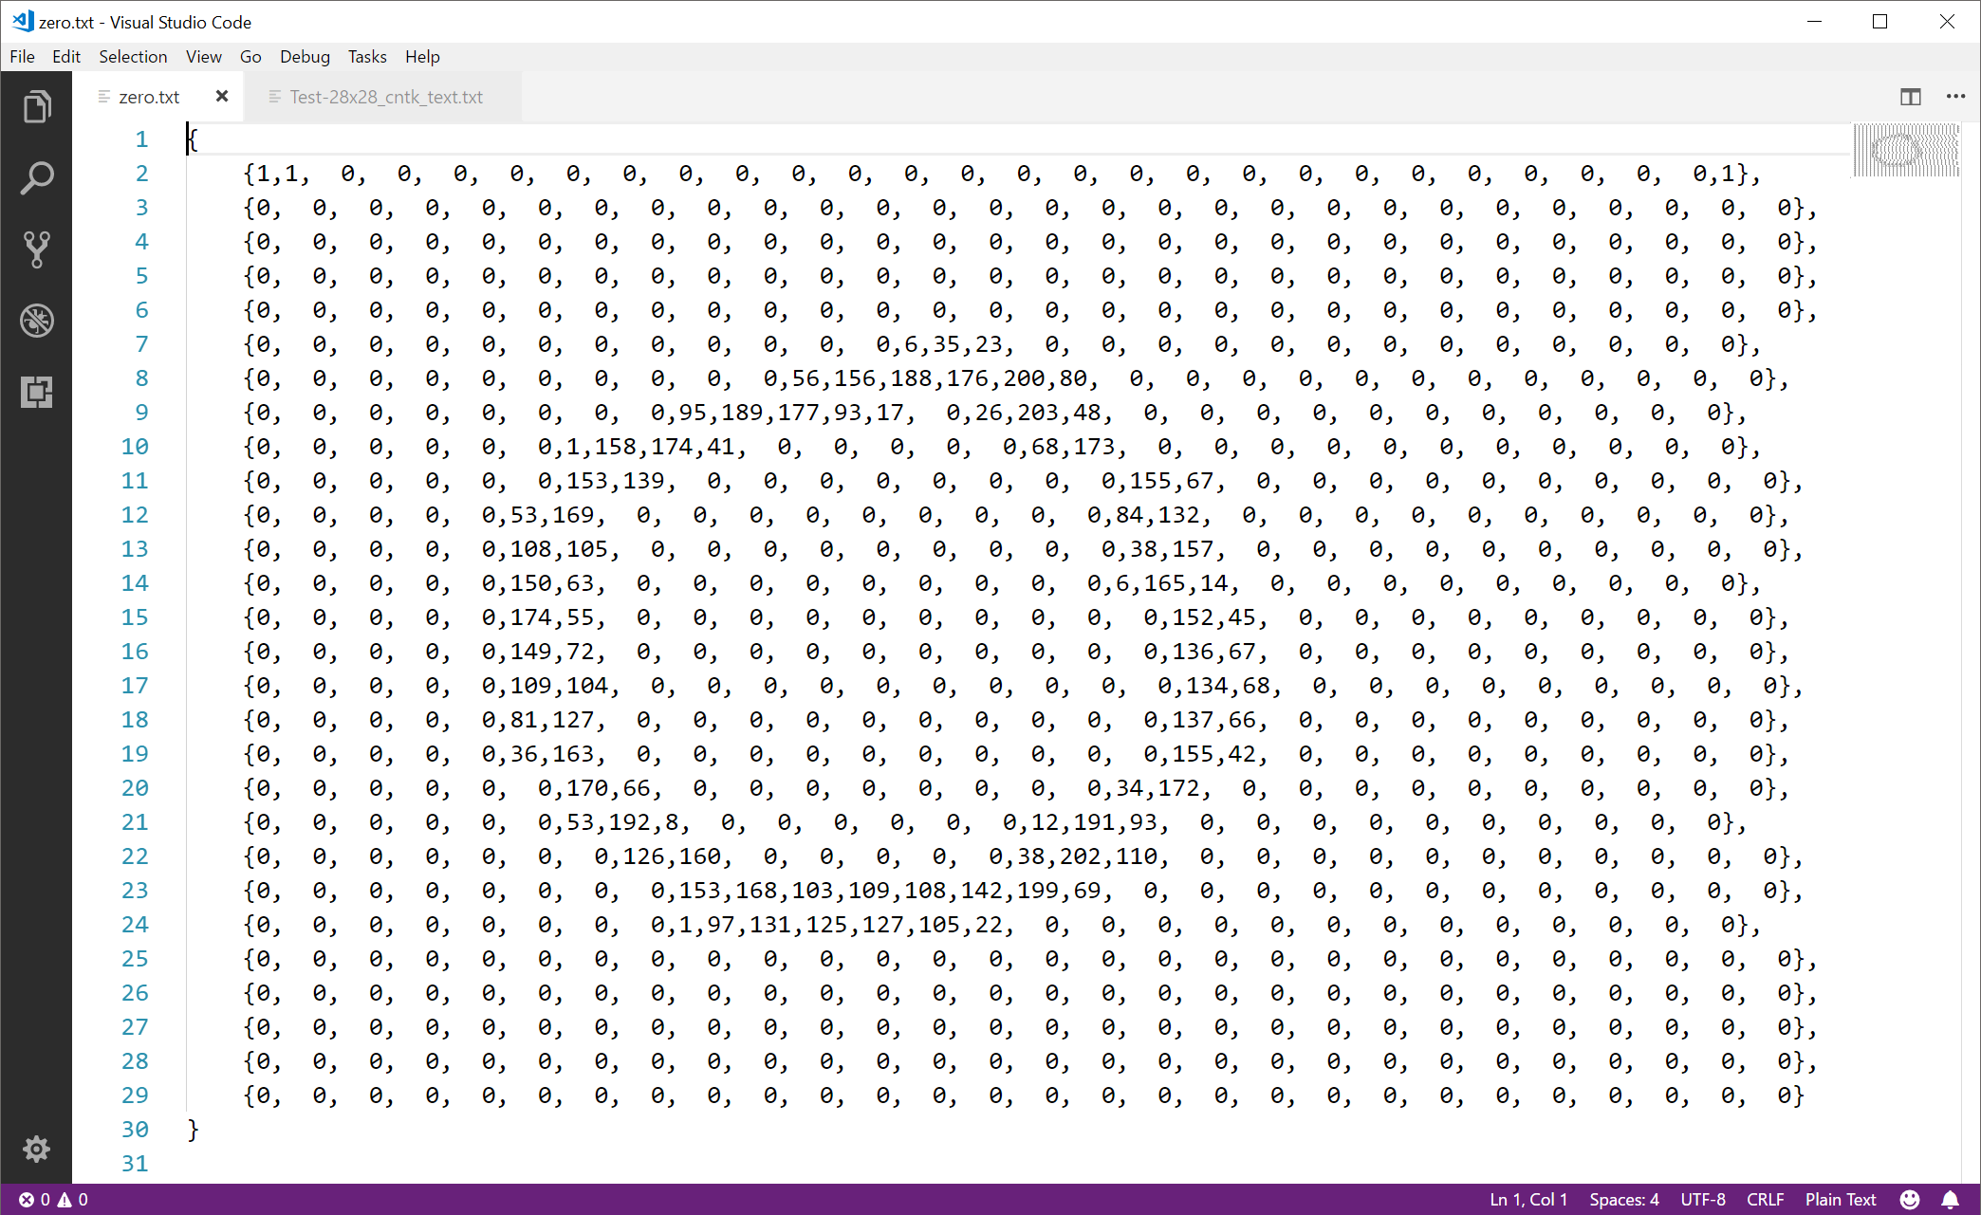

Slide 29

Notes:
Cover the fact that ML uses data to make its own functions

Slide 30
scikit-learn

Slide 31

scikit-learn – concepts
You “pick” the function “shape” – in scikit-learn these are called classifiers
You “fit” the data to the classifier
scikit-learn classifier
model
data
You use the classifier to predict
code
input
answers

Slide 32
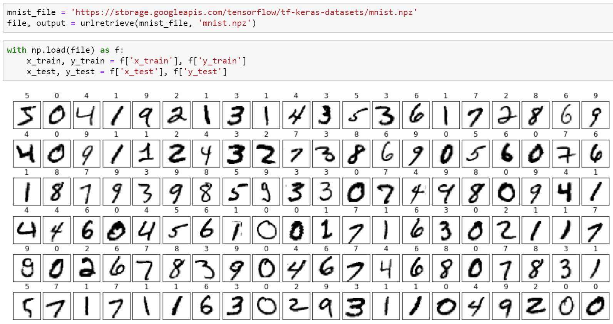
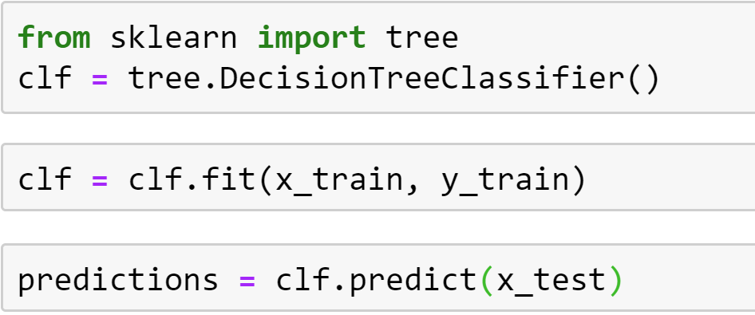
scikit-learn – concepts
You “pick” the function “shape” – in scikit-learn these are called classifiers
You “fit” the data to the classifier
You use the classifier to predict

Slide 33
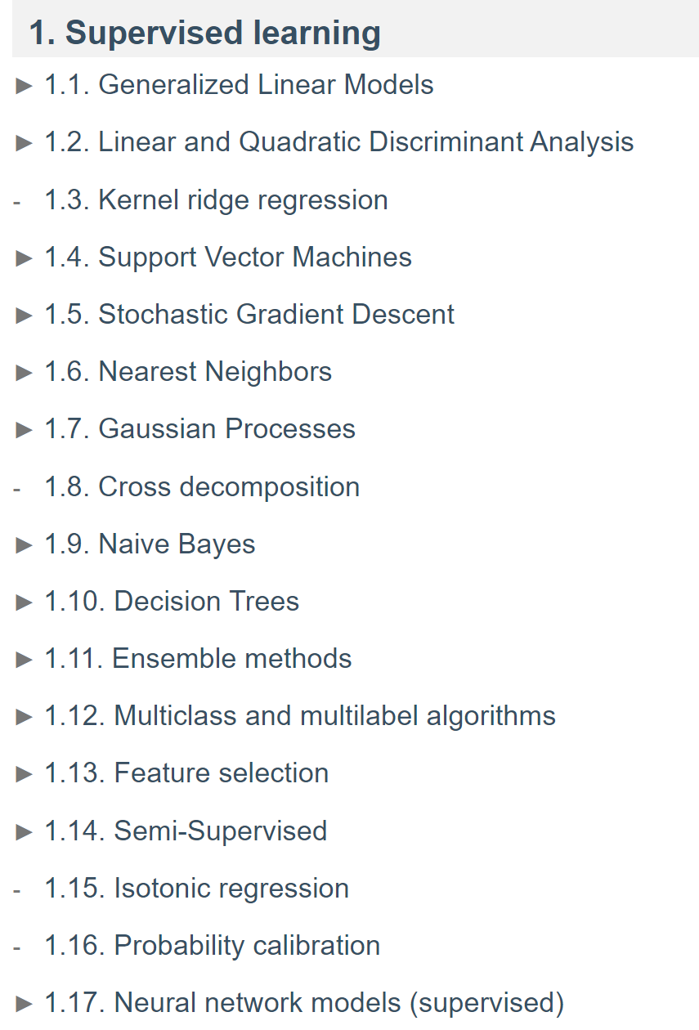
scikit-learn – classifiers
source: https://scikit-learn.org/stable/user_guide.html

Slide 34
scikit-learn – concepts
Questions?

Slide 35
science
Notes:
This is the idealized process
Make sure to include the notion of exploring data / visualizing data
Sometimes ML isn’t even needed based upon exploration

Slide 36
science
Notes:
This is what actually happens: the “loop of pain”, when we discover our assumptions were wrong, or the data was inadequate, or that we needed to solve a different problem entirely.

Slide 37
TensorFlow 2.0

Slide 38
TensorFlow – concepts
You “craft” the function “shape” – in TensorFlow this is a model
You “optimize” the model using a cost/loss function and optimizer
data
TensorFlow
model
You use the model to predict
code
input
answers

Slide 39




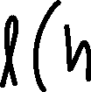
TensorFlow – concepts
model – the function shape we construct
cost/loss function – a function that tells us how bad we are at predicting
optimizer – method for reducing how bad we are at predicting

Slide 40
TensorFlow – concepts
You “craft” the function “shape” – in TensorFlow this is a model
You “optimize” the model using a cost/loss function and optimizer
data
TensorFlow
model
You use the model to predict
code
input
answers

Slide 41
TensorFlow – concepts

Slide 42
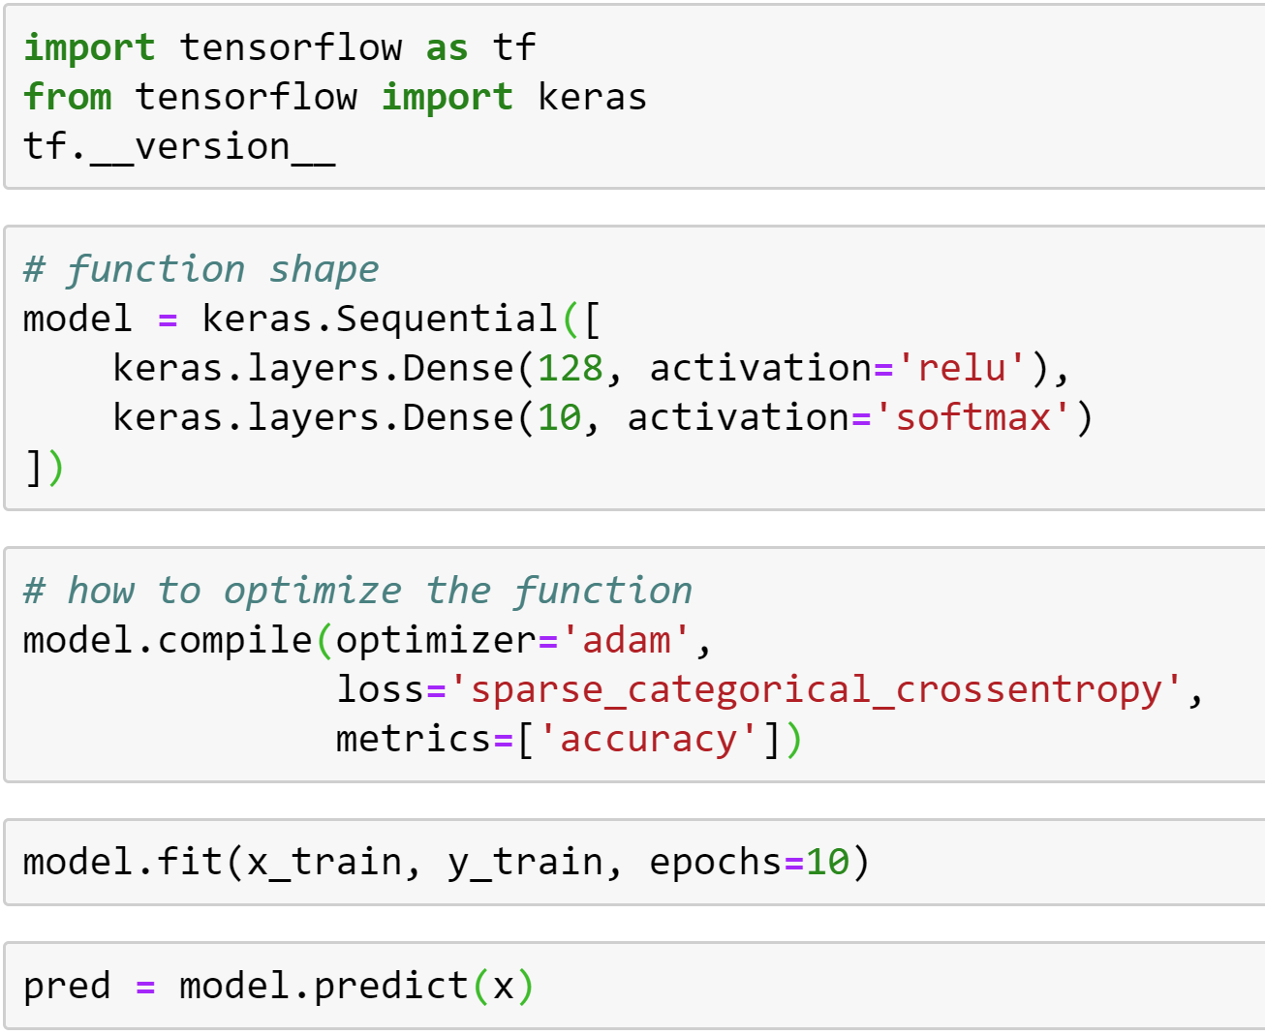
TensorFlow – concepts
You “craft” the function “shape” – in TensorFlow this is a model
You “optimize” the model using a cost/loss function and optimizer
You use the model to predict

Slide 43
TensorFlow – optimizers
class Adadelta: Optimizer that implements the Adadelta algorithm.
class Adagrad: Optimizer that implements the Adagrad algorithm.
class Adam: Optimizer that implements the Adam algorithm.
class Adamax: Optimizer that implements the Adamax algorithm.
class Ftrl: Optimizer that implements the FTRL algorithm.
class Nadam: Optimizer that implements the NAdam algorithm.
class Optimizer: Updated base class for optimizers.
class RMSprop: Optimizer that implements the RMSprop algorithm.
class SGD: Stochastic gradient descent and momentum optimizer.

Slide 44
TensorFlow – loss functions
class BinaryCrossentropy: Computes the cross-entropy loss between true labels and predicted labels.
class CategoricalCrossentropy: Computes the crossentropy loss between the labels and predictions.
class CategoricalHinge: Computes the categorical hinge loss between y_true and y_pred.
class CosineSimilarity: Computes the cosine similarity between y_true and y_pred.
class Hinge: Computes the hinge loss between y_true and y_pred.
class Huber: Computes the Huber loss between y_true and y_pred.
class KLDivergence: Computes Kullback Leibler divergence loss between y_true and y_pred.
class LogCosh: Computes the logarithm of the hyperbolic cosine of the prediction error.
class MeanAbsoluteError: Computes the mean of absolute difference between labels and predictions.
class MeanAbsolutePercentageError: Computes the mean absolute percentage error between y_true and y_pred.
class MeanSquaredError: Computes the mean of squares of errors between labels and predictions.
class MeanSquaredLogarithmicError: Computes the mean squared logarithmic error between y_true and y_pred.
class Poisson: Computes the Poisson loss between y_true and y_pred.
class SparseCategoricalCrossentropy: Computes the crossentropy loss between the labels and predictions.
class SquaredHinge: Computes the squared hinge loss between y_true and y_pred.

Slide 45
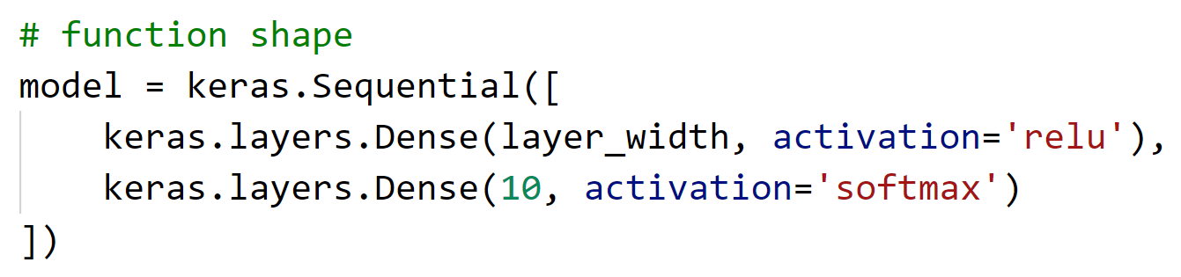
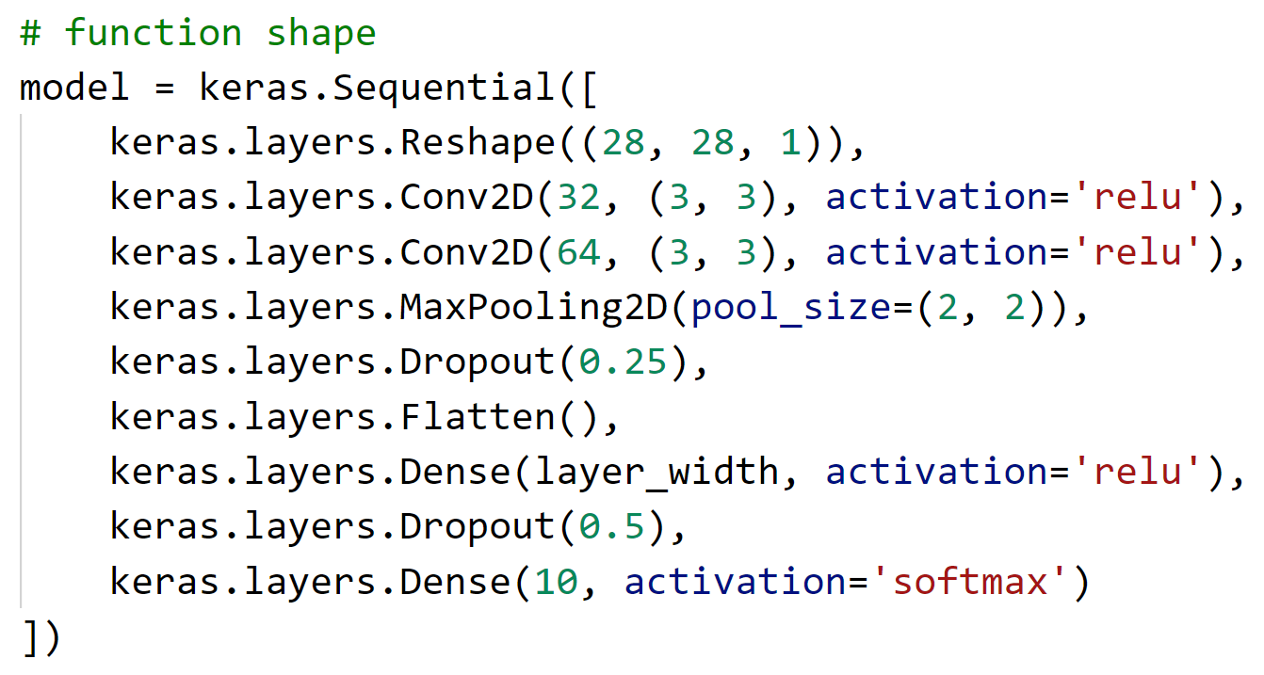
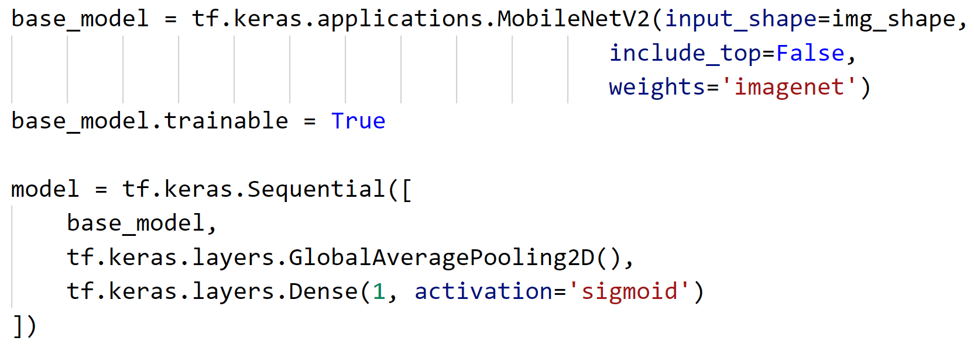
TensorFlow – models

Slide 46
TensorFlow – concepts
Questions?

Slide 47
Lab
Hands on with scikit-learn and TensorFlow

Slide 48
Login or Create an Azure Account
Claim
Claim a pass over at aka.ms/dlworkshop
Create
Go to aka.ms/globalaiazure to create and Azure Account
Redeem
Go to www.microsoftazurepass.com to redeem a $100 Azure Credit

Slide 49
Workshop Overview
aka.ms/CloudScaleML

