Slide 1


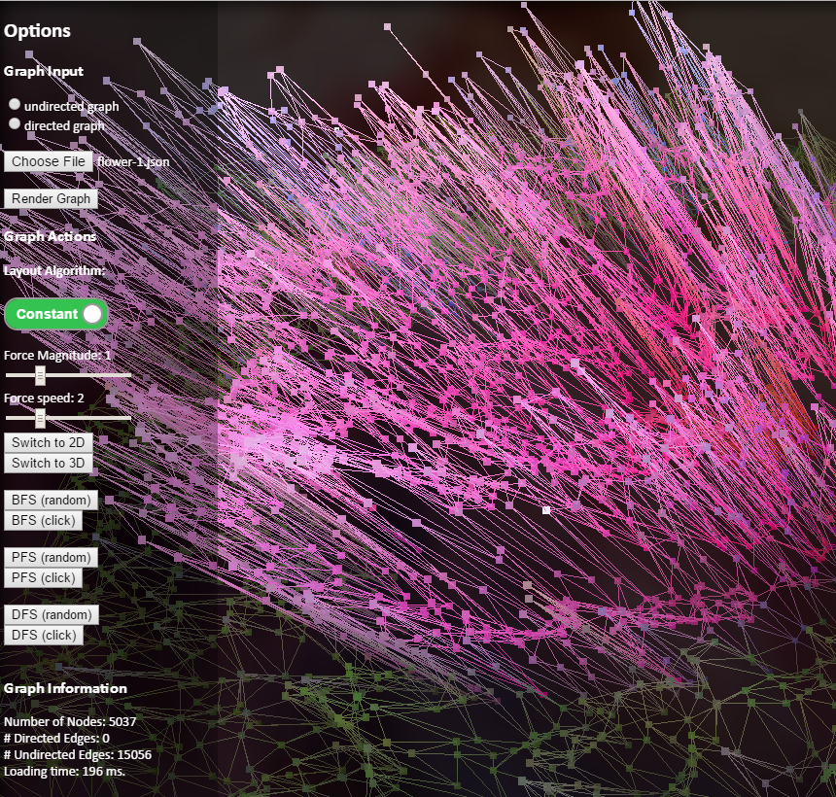
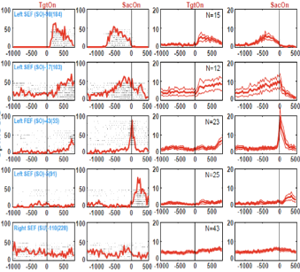
CROSS
INIT
Node / edge perturbation
Activation function parameter perturbation
?
?
MUTATE
EVAL
?
Simulate environmental influences on single neurons or the whole system at once
?
SELECT
EXIT?

Slide 2
CROSS
INIT
?
?
MUTATE
EVAL
?
?
SELECT
EXIT?
Node / edge perturbation
Activation function parameter perturbation
Simulate environmental influences on single neurons or the whole system at once

