Slide 1
00-FRONTMATTER
Human-Centered AI Course
LV 706.046 AK HCI 2020
Mini-Projects from Explainable AI
Professor: Andreas Holzinger
Supervisor: Bernd Malle
Human-Centered AI (Holzinger Group)
Institute for Interactive Systems and Data Science, TU Graz
and Institute for Medical Informatics, Statistics & Documentation, Medical University Graz
Online: https://human-centered.ai/lv-706-046-ak-hci-2020-explainable-ai
Notes:
Current as of 17.09.2019 05:30 PCT – Created 01.07.2019 06:00 CET
https://human-centered.ai/hcai-research-seminar-2020/

Slide 2
General
Both mini-projects offer a lot of freedom as far as details are concerned – I will provide some general goals, but you are welcome to go on your own forays!
Underlying data for both tasks are e-commerce datasets, since those are readily available & unproblematic from a privacy standpoint
Communication will happen online for the start, since I will only be back in Austria early May
Task details will follow within the next 10 days – I am still collecting all the materials / putting together the pipelines ;-)

Slide 3
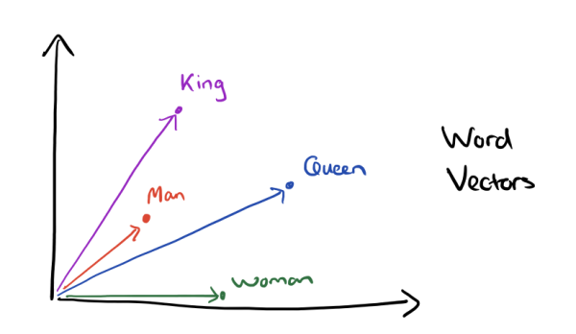
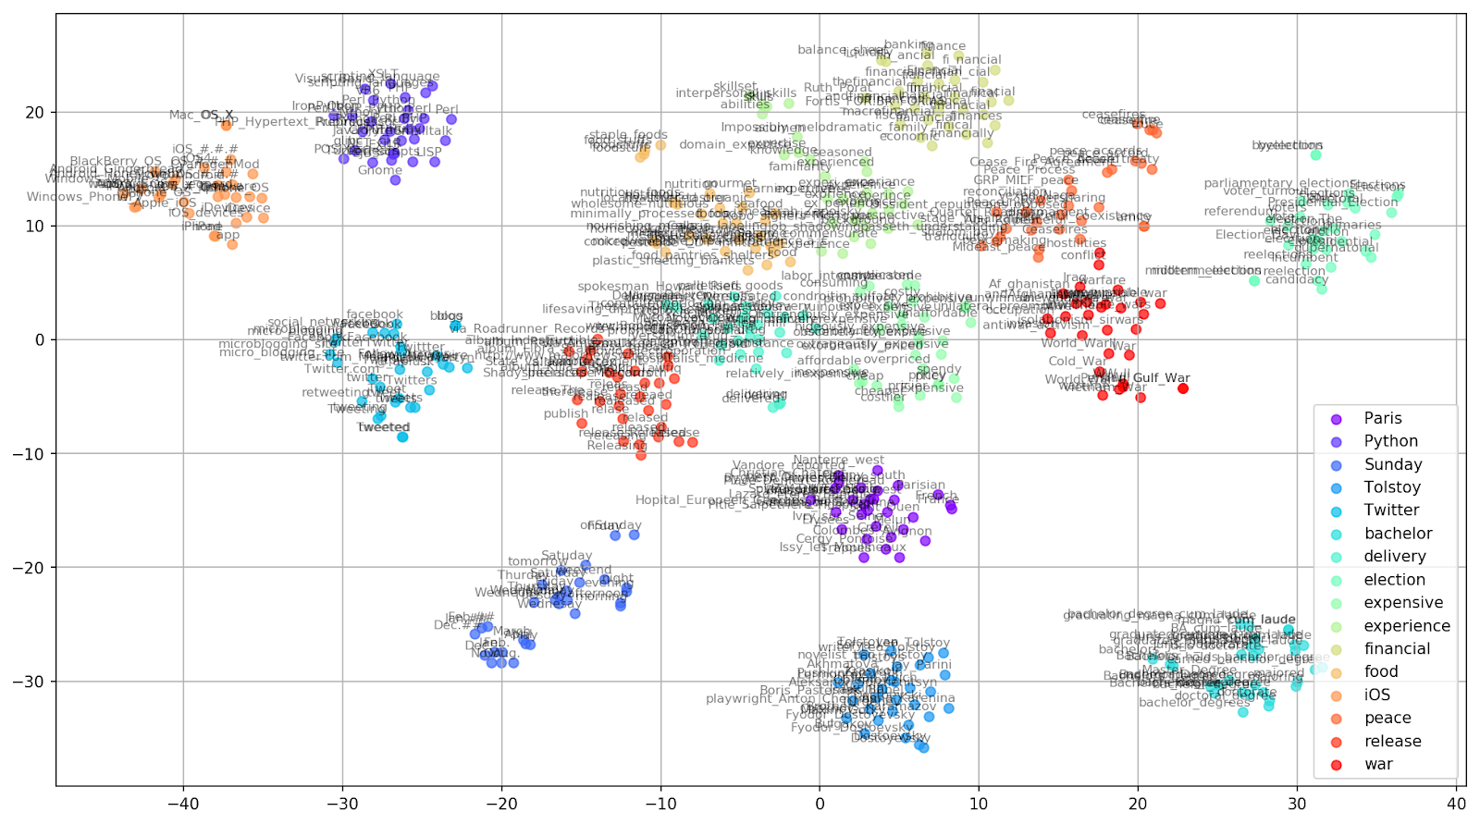
Project 1 – Analysis of Word Vector embeddings
Visualization & Analysis of Word Vector Embeddings
of different models
via different techniques
describing (explaining?) how they discriminate / cluster
https://towardsdatascience.com/google-news-and-leo-tolstoy-visualizing-word2vec-word-embeddings-with-t-sne-11558d8bd4d
https://www.depends-on-the-definition.com/guide-to-word-vectors-with-gensim-and-keras/

Slide 4
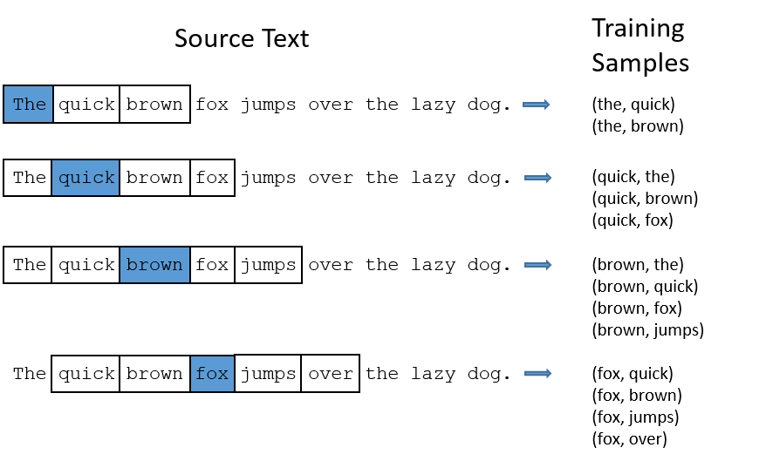
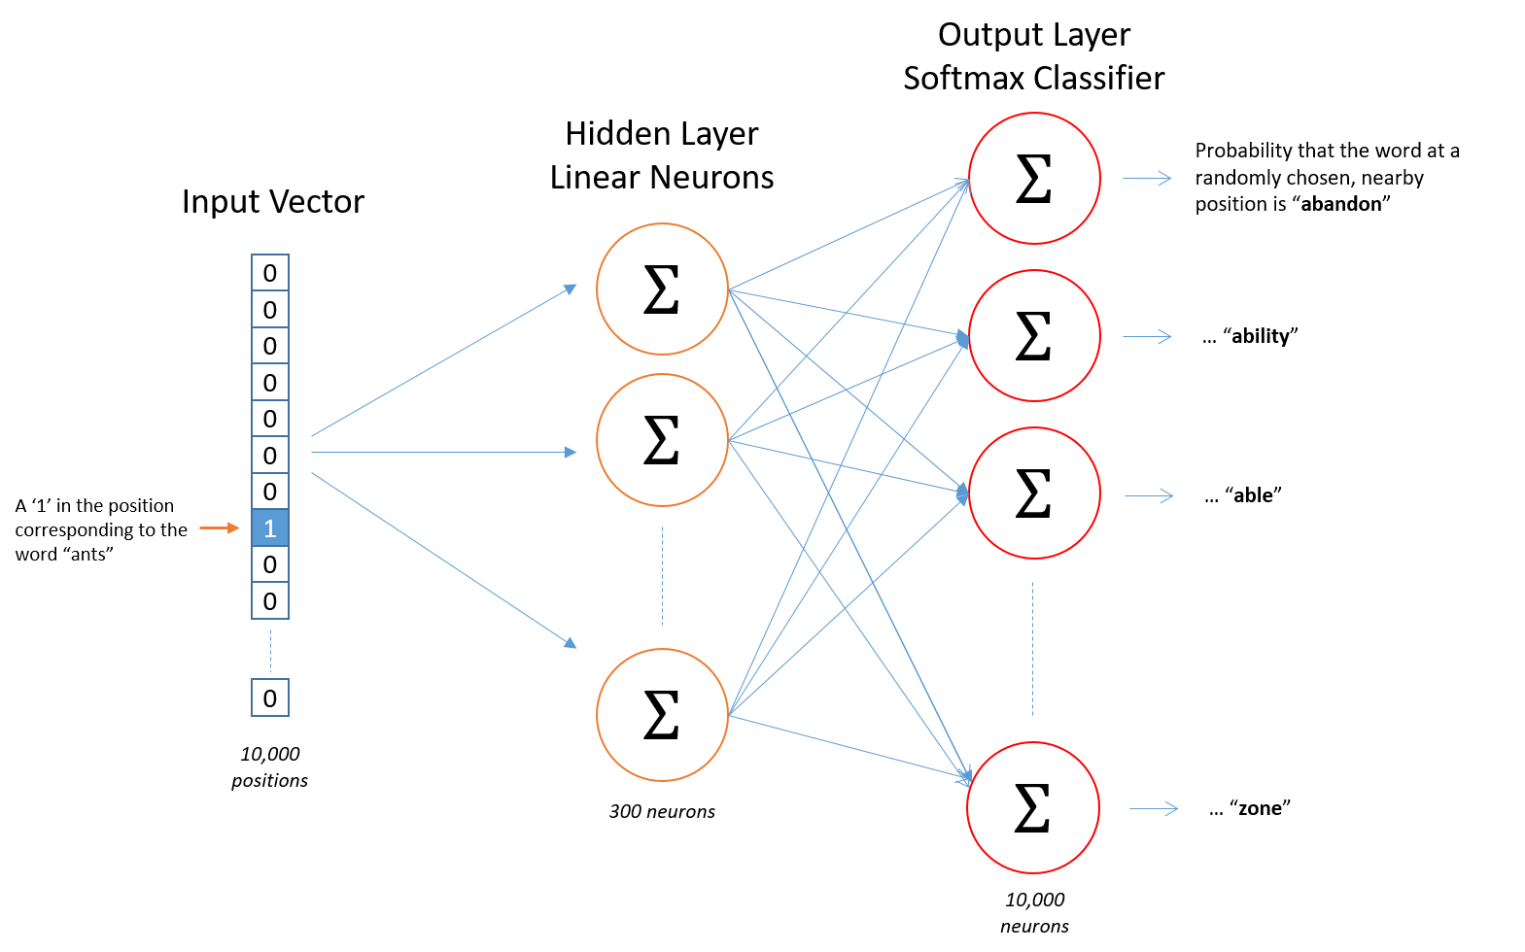
Project 1 – Analysis of Word Vector embeddings
"Word embeddings are mathematical models that encode word relations within a vector space. They are created by an unsupervised training process based on cooccurrence information between wordsin a large corpus"
"define a fake task for the NN"
- context prediction in the case of skip-gram
"build a shallow architecture, train & throw away the outputs"
- we only need the embeddings
http://mccormickml.com/2016/04/19/word2vec-tutorial-the-skip-gram-model/

Slide 5
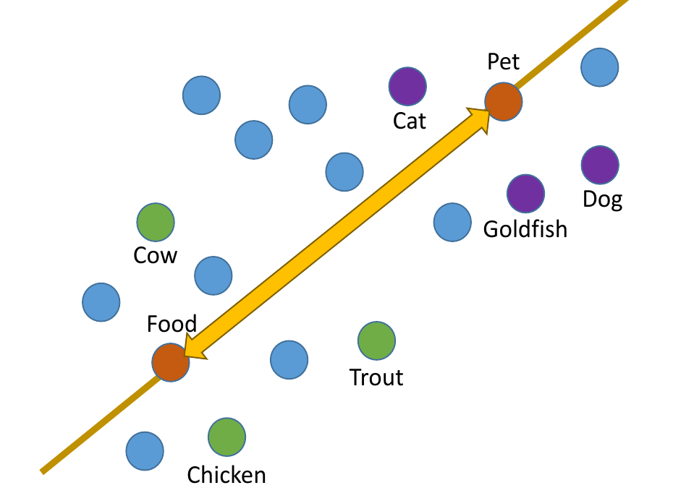
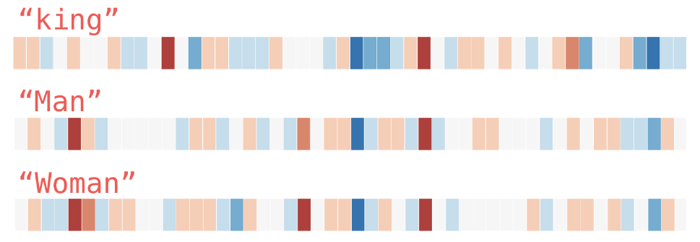
Project 1 – Analysis of Word Vector embeddings
Tasks:
learn how to interpret similarity in the vector space
understand the influence of source corpora on the embeddings
analyze neighborhoods – what is (un)expected?
predict & test consequences of changes in parameter settings / pre-processing of input data on the resulting model
=> "develop an intuition for embeddings as a basis for future explanations"
http://jalammar.github.io/illustrated-word2vec/

Slide 6
Project 2 – Visualization & anim. of graph interaction
Visualization of personalized recommender graphs, explanations & animation of their change over time
Starting with a general sub-graph we draw from a

Slide 7
Project 2 – Visualization & anim. of graph interaction

Slide 8
Project 2 – Visualization & anim. of graph interaction

Slide 9

Thank you!
Notes:
My DEDICATION is to make data valuable … Thank you!

