Slide 1
00-FRONTMATTER
Human-Centered AI Course
LV 706.046 AK HCI 2020
Mini-Projects from Explainable AI
Professor: Andreas Holzinger
Supervisor: Bernd Malle
Human-Centered AI (Holzinger Group)
Institute for Interactive Systems and Data Science, TU Graz
and Institute for Medical Informatics, Statistics & Documentation, Medical University Graz
Online: https://human-centered.ai/lv-706-046-ak-hci-2020-explainable-ai
Notes:
Current as of 17.09.2019 05:30 PCT – Created 01.07.2019 06:00 CET
https://human-centered.ai/hcai-research-seminar-2020/

Slide 2
General
Both mini-projects offer a lot of freedom as far as details are concerned – I will provide some general goals, but you are welcome to go on your own forays!
Underlying data for both tasks are e-commerce datasets, since those are readily available & unproblematic from a privacy standpoint
Communication will happen online for the start, since I will only be back in Austria early May
Task details, materials and code will follow within the next 2 weeks – I am still collecting all the parts & assembling the pipelines ;-)

Slide 3
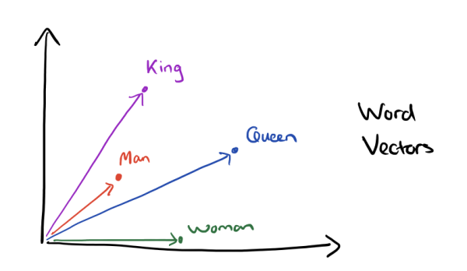
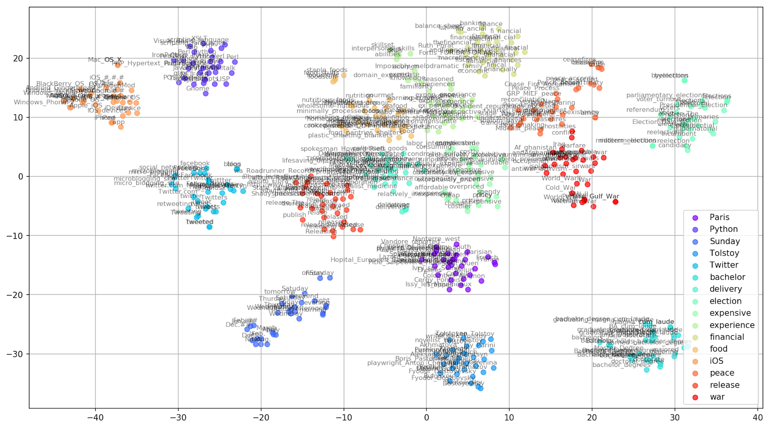
Project 1 – Analysis of Word Vector embeddings
Visualization & Analysis of Word Vector Embeddings
of different models
via different techniques
describing (explaining?) how they discriminate / cluster
https://towardsdatascience.com/google-news-and-leo-tolstoy-visualizing-word2vec-word-embeddings-with-t-sne-11558d8bd4d
https://www.depends-on-the-definition.com/guide-to-word-vectors-with-gensim-and-keras/

Slide 4
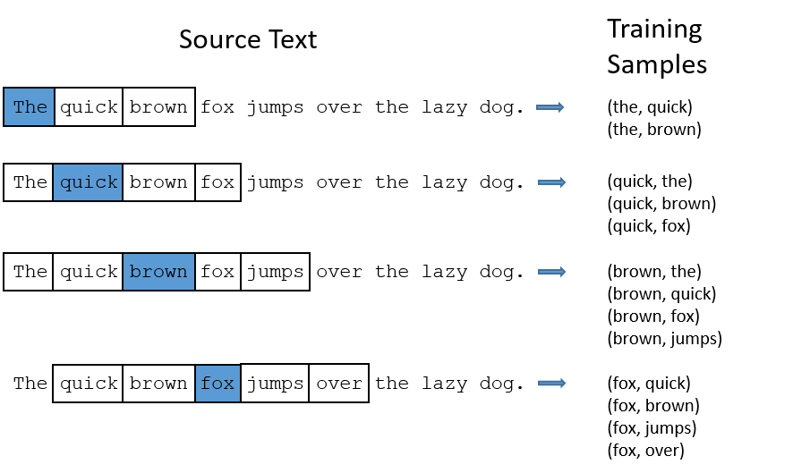
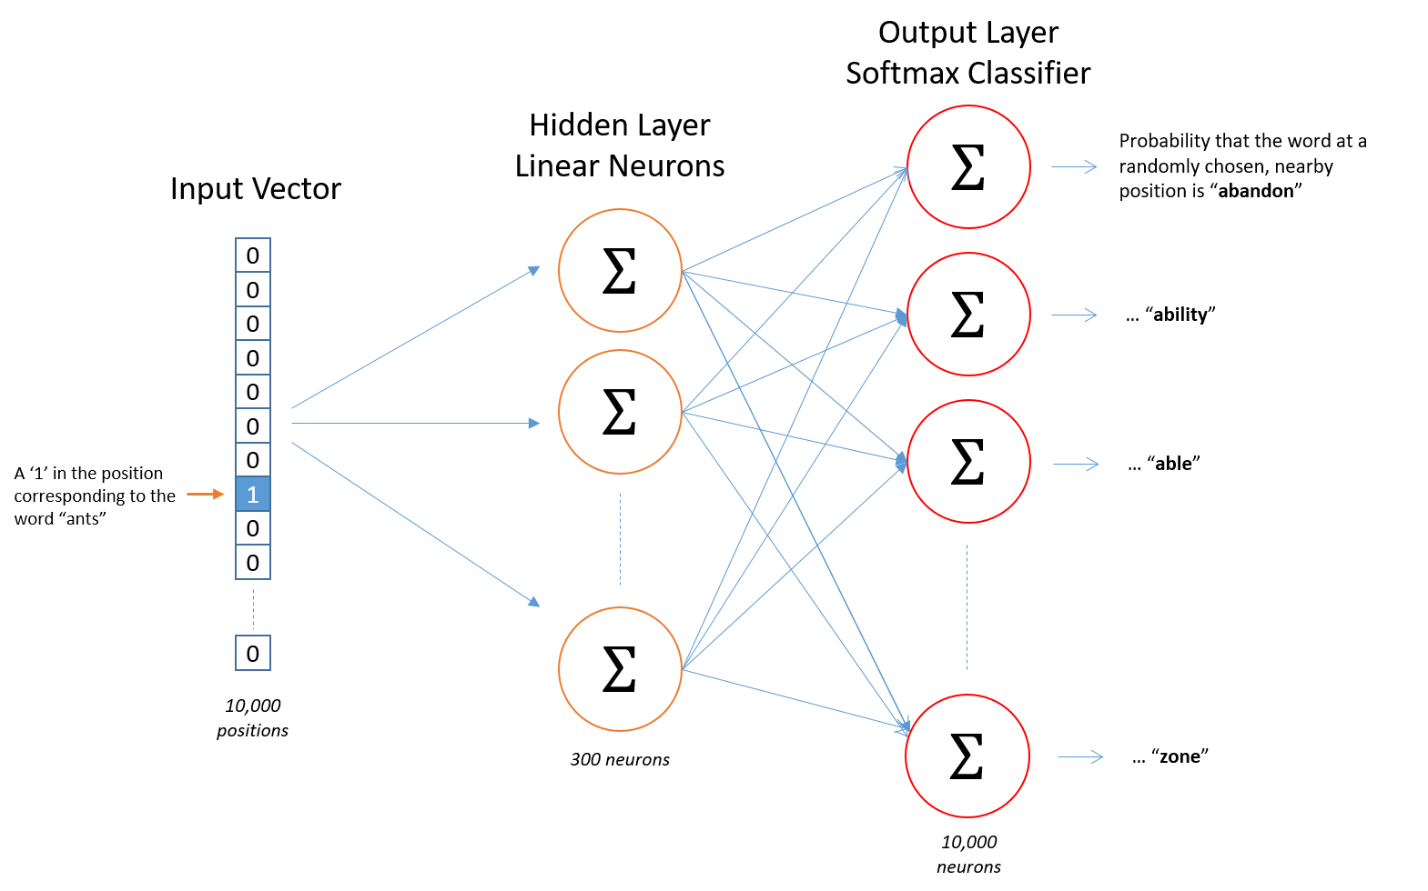
Project 1 – Background
"Word embeddings are mathematical models that encode word relations within a vector space. They are created by an unsupervised training process based on cooccurrence information between wordsin a large corpus"
"define a fake task for the NN"
- context prediction in the case of skip-gram
"build a shallow architecture, train & throw away the outputs"
- we only need the embeddings
http://mccormickml.com/2016/04/19/word2vec-tutorial-the-skip-gram-model/

Slide 5
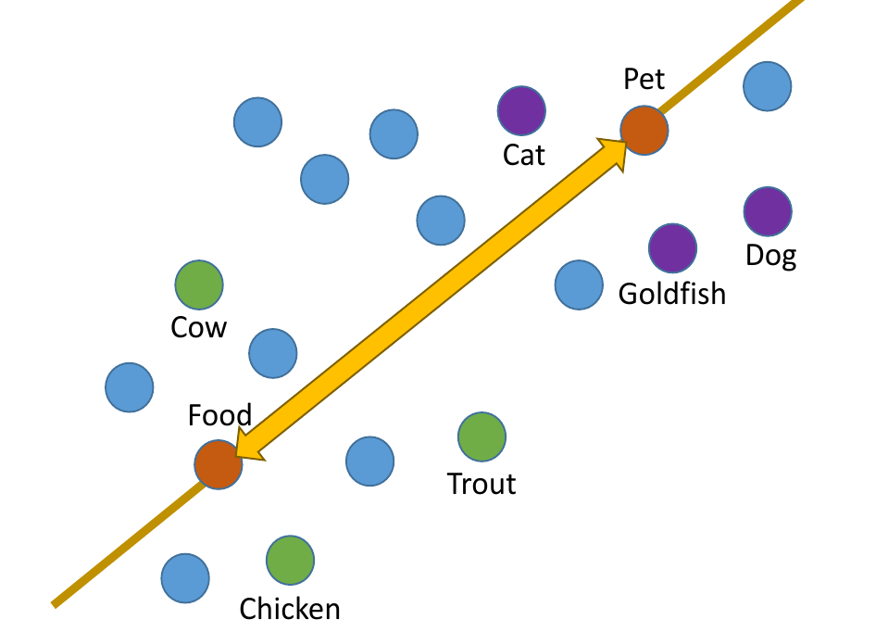
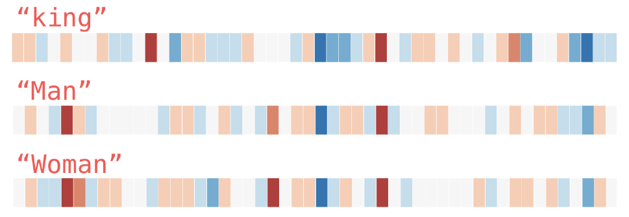
Project 1 – Tasks
Tasks:
learn how to interpret similarity in the vector space
understand the influence of source corpora on the embeddings
analyze neighborhoods – what is (un)expected?
predict & test consequences of changes in parameter settings / pre-processing of input data on the resulting model
=> "develop an intuition for embeddings as a basis for future explanations"
Heimerl, F., & Gleicher, M. (2018). Interactive Analysis of Word Vector Embeddings. Computer Graphics Forum, 37(3). doi:10.1111/cgf.13417
http://jalammar.github.io/illustrated-word2vec/

Slide 6
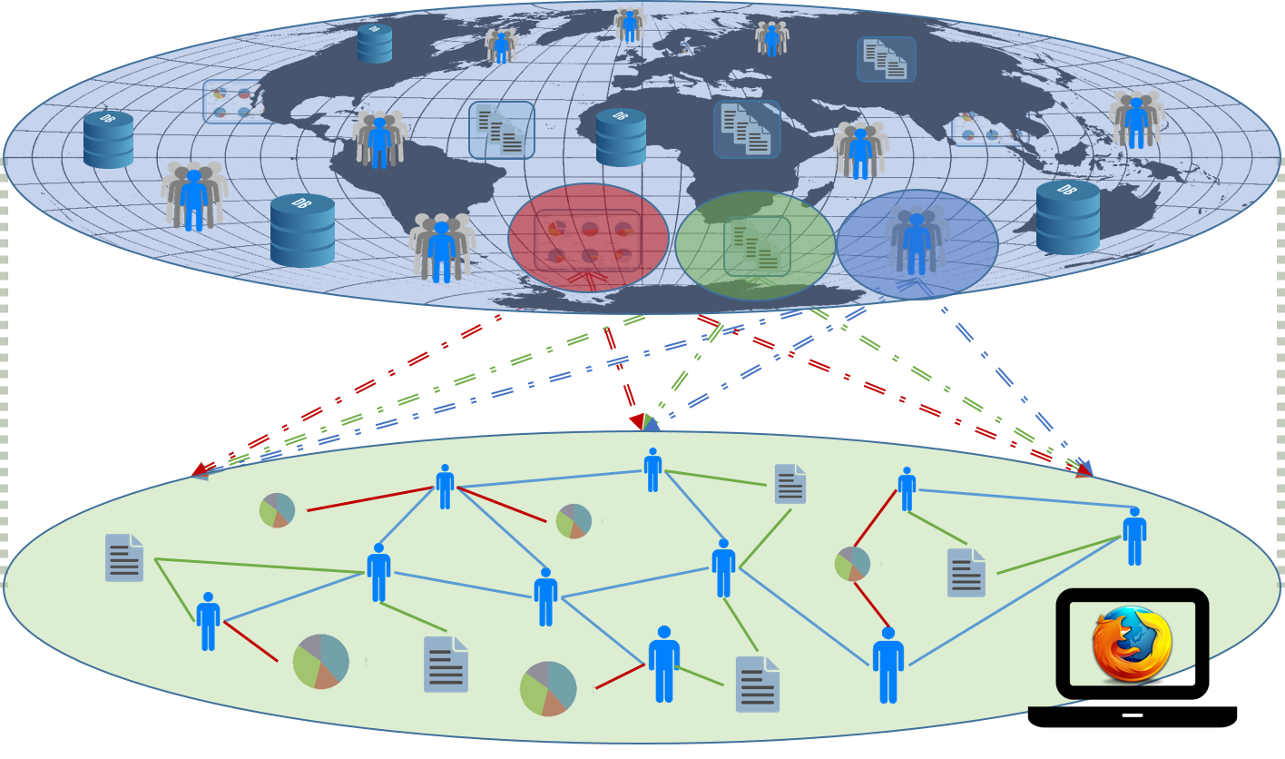
Project 2 – Visualization of graph interaction
Visualization of personal recommender graphs ("Local Sphere" ) & their change over time
Drawing from globally
available resources (e.g. a
webshop database en-
riched similarities)
each user derives her own
local sub-graph representing
her context / potential interests. As she interacts with the system (explores & follows / ignores visual clues), this context is refined & the graph should respond accordingly.
Bernd Malle, Nicola Giuliani, Peter Kieseberg, and Andreas Holzinger. The More the Merrier - Federated Learning from Local Sphere Recommendations. In Machine Learning and Knowledge Extraction, IFIP CD-MAKE, Lecture Notes in Computer Science LNCS 10410, pages 367–374. Springer, Cham, 2017. doi: 10.1007/978-3-319-66808-6 24.

Slide 7
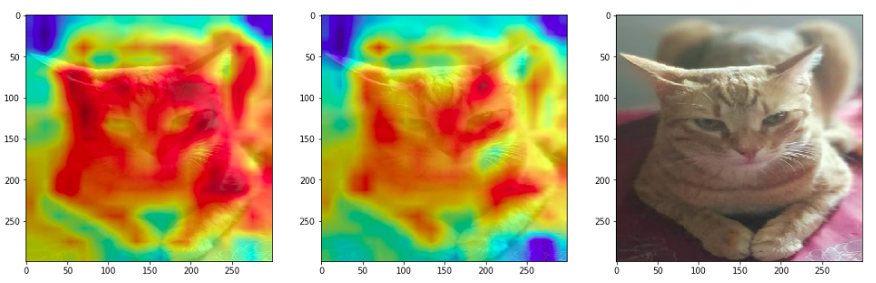
Project 2 – Background
Explainability of deep learning systems is a must, but still in the early stages (except for cat pics ;-)
non-visual and / or higher dimensional data are not intuitive to the human brain – decisions made in those spaces aren't either
graphs are a convenient way to break-down high-dimensional information by reducing their complexity to concepts like similarity, connection, and influence.
understanding which graph metrics will change with user interactions will help develop an intuition about what factors in the original high-dimensional space are relevant for decisions!
https://medium.com/google-developer-experts/interpreting-deep-learning-models-for-computer-vision-f95683e23c1d

Slide 8
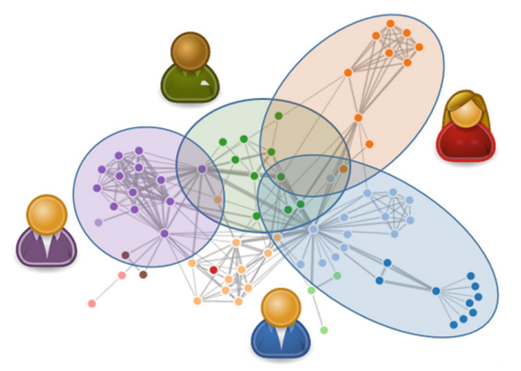
Project 2 – Tasks
Tasks:
Research graph visualization algorithms pertinent to recommenders (node & edge types, cluster)
Either extend our existing (Graphinius) VIS library or decide on a different one (but make sure it's properly extensible)
Highlight recommendations and influence factors (if available)
Visualize continuous changes in the graph
due to user interaction (vids)
If time permits, visualize
several local spheres together
Graphs, recommender & event-
stream will be provided by us ;-)

Slide 9

Thank you!
Notes:
My DEDICATION is to make data valuable … Thank you!

