Slide 1
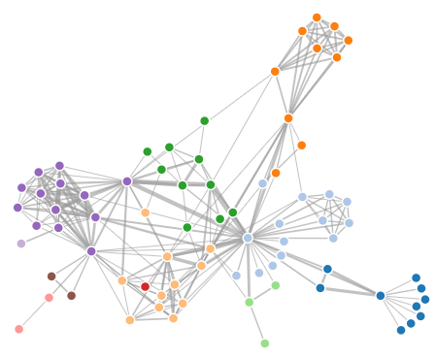




Global Population
Bag A
Bag B
Bag C

