Slide 1
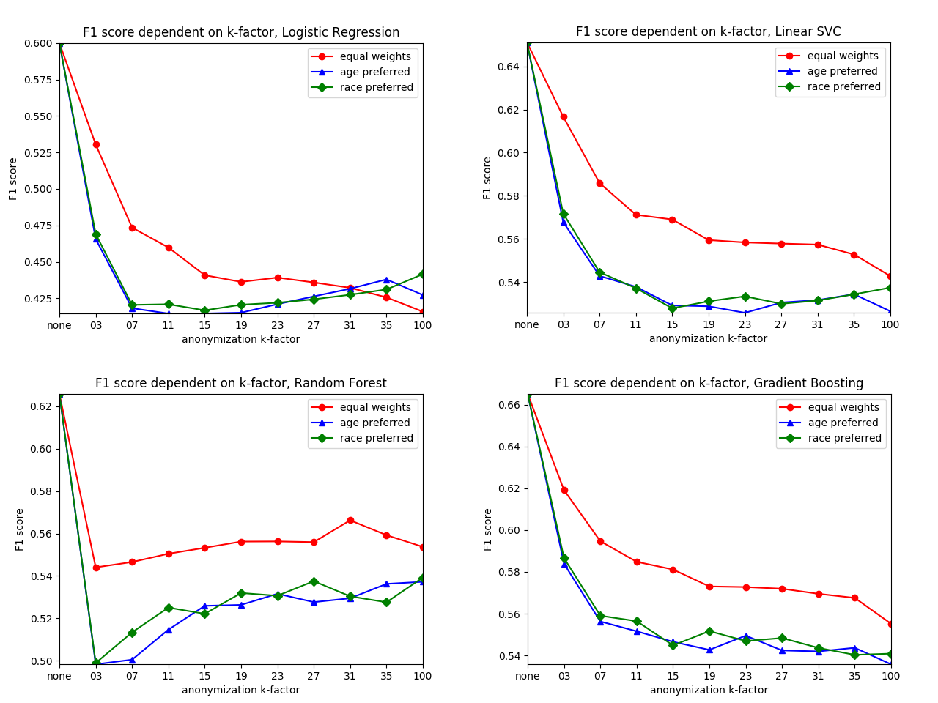

MC on anonymized data - education_num
-) results almost as expected
-) same shape as with binary classification
-) RF (and to slight degree LR & LinSVC) show improvement with increasing k… ?????

Slide 2
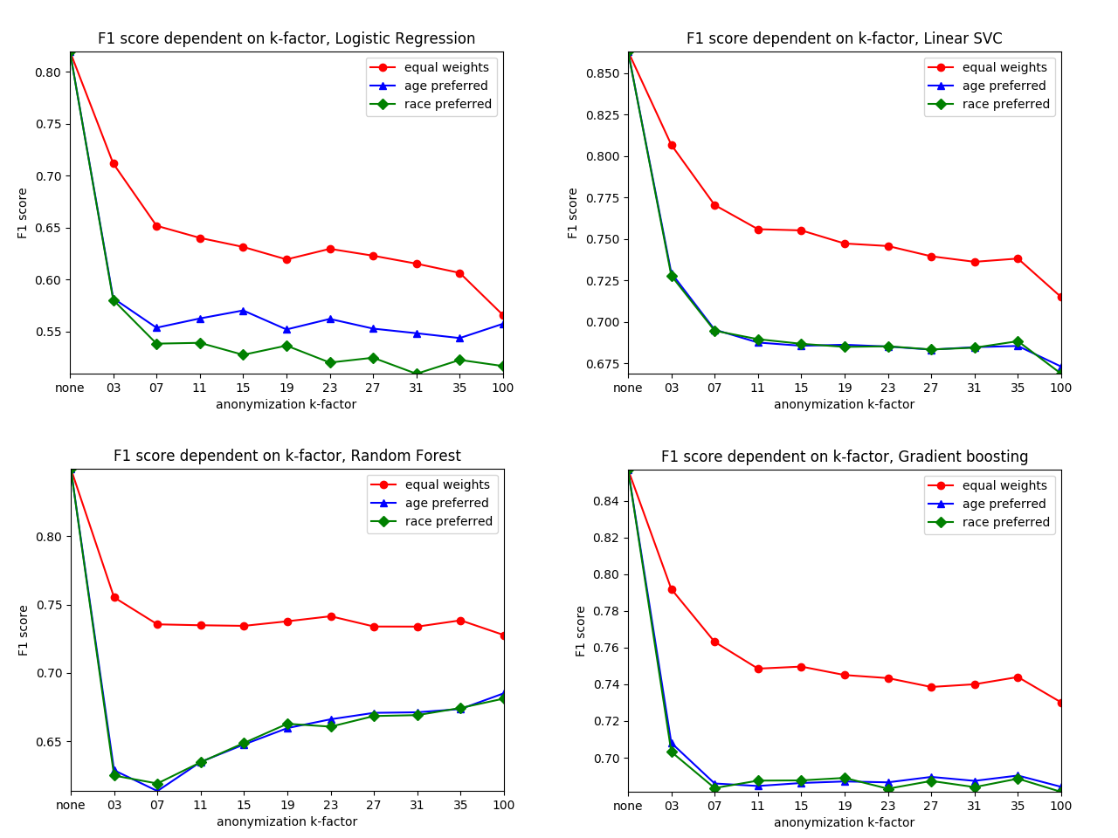
MC on anonymized data - marital_status
-) results almost as expected
-) same shape as with binary classification
-) RF shows improvement with increasing k…?
-) GB stays practically stable?

Slide 3
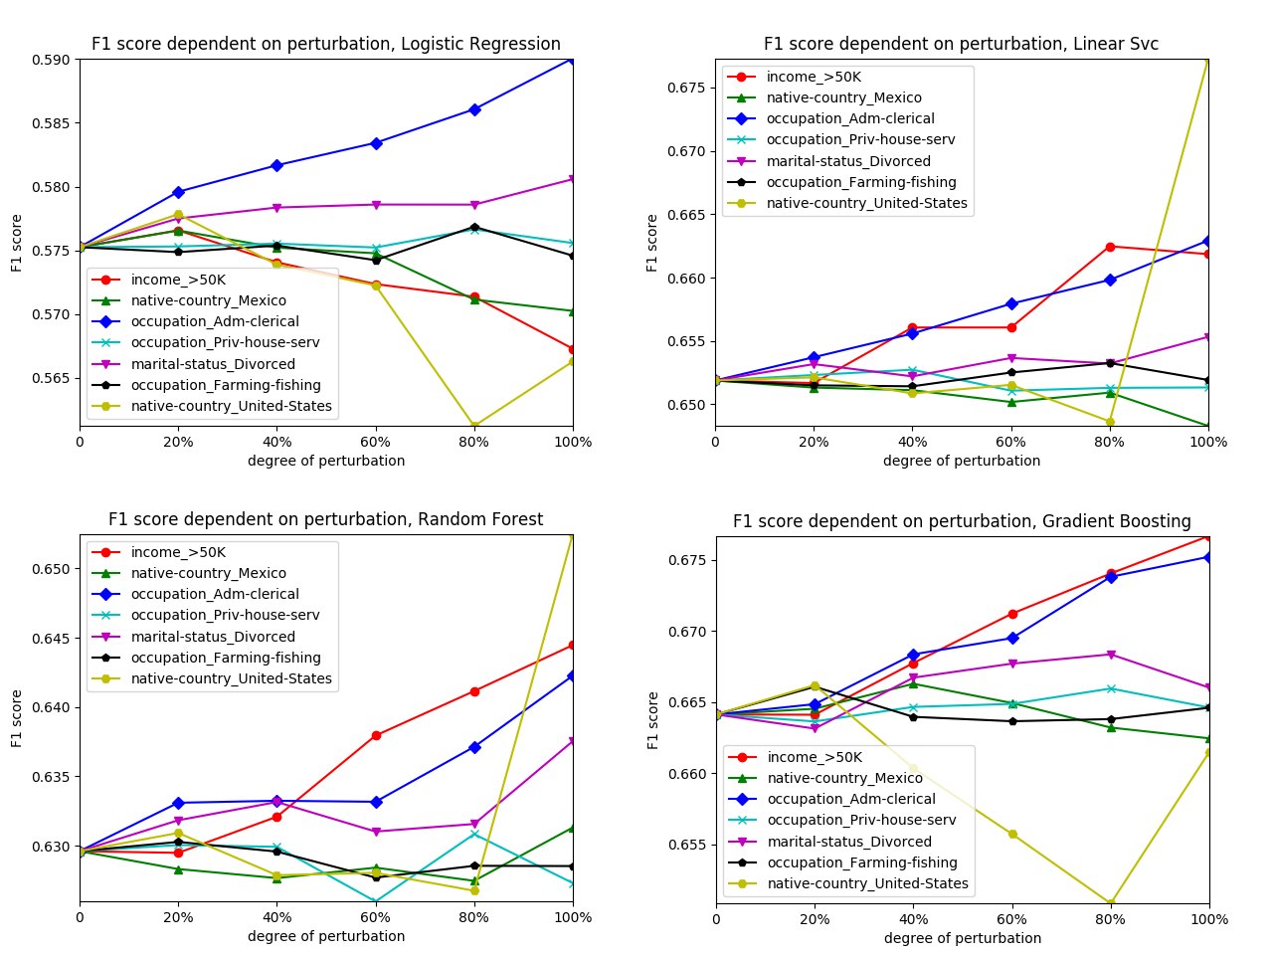
MC on perturbed data - education_num
-) results as expected
-) explanation gives insight into the adult DS topology
-) relevant for a ML paper ?? (seems to be more data science)

Slide 4
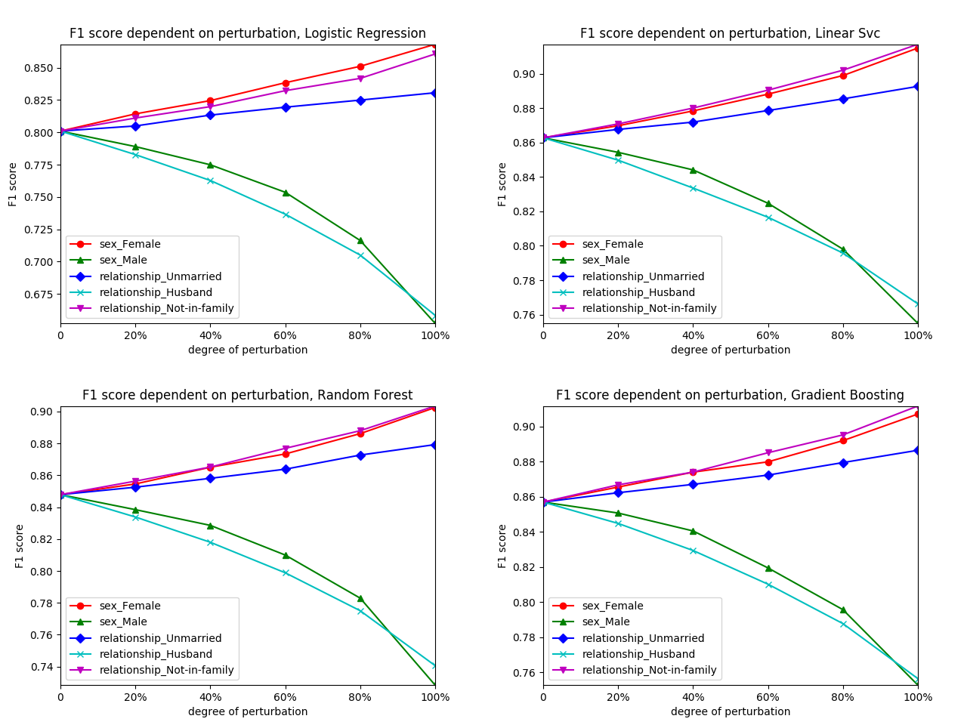
MC on perturbed data - marital_status
-) wonderful !!
-) results can be explained perfectly
-) results might be very relevant for later use
-) explains what to look for in a dataset when perturbing by removing significant columns

Slide 5
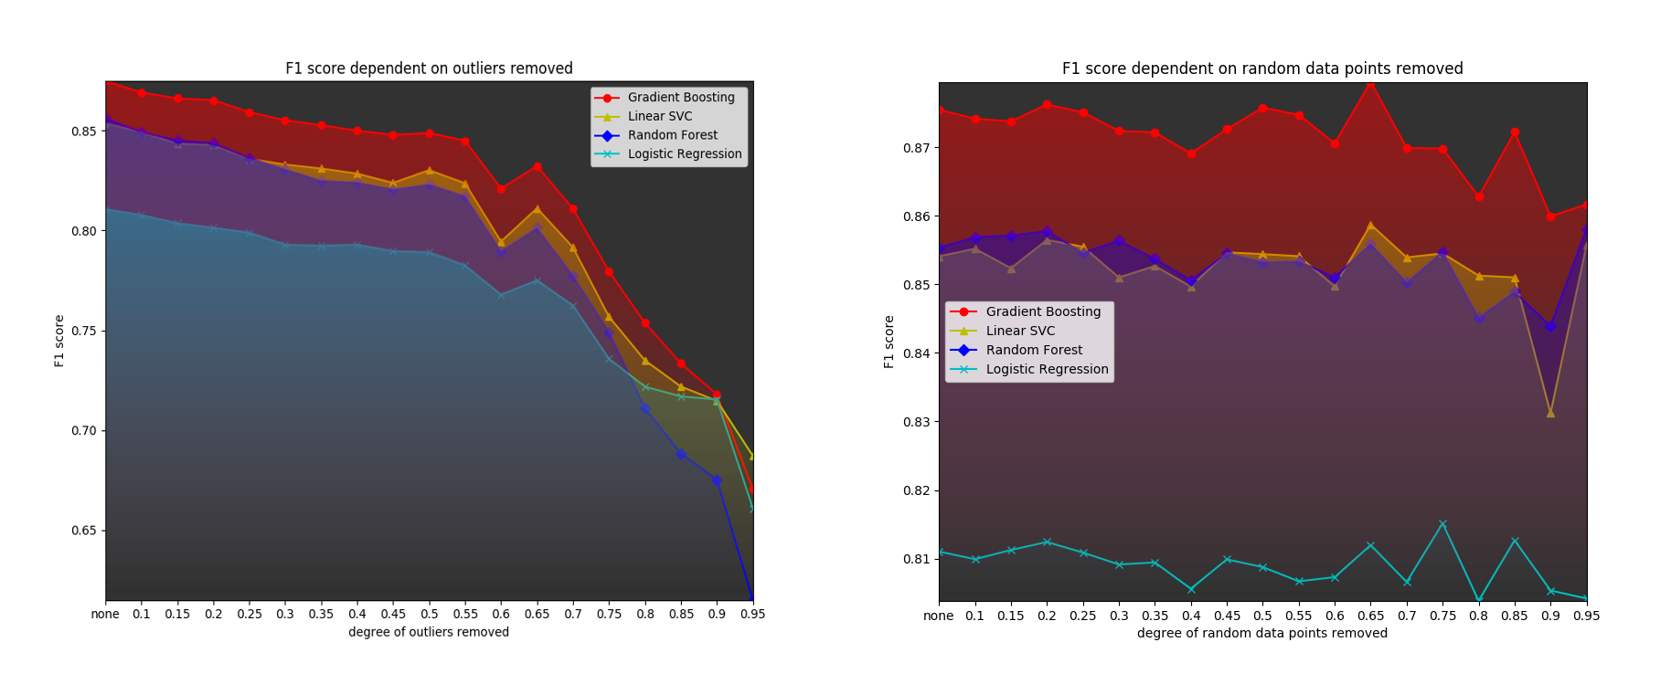
MC on outlier-filtered vs. randomly deleted data - income
-) clear behavior consistent across all classifiers
-) maybe good explanation
-) should performance not increase with less variance ???
-) maybe not a good explanation

Slide 6
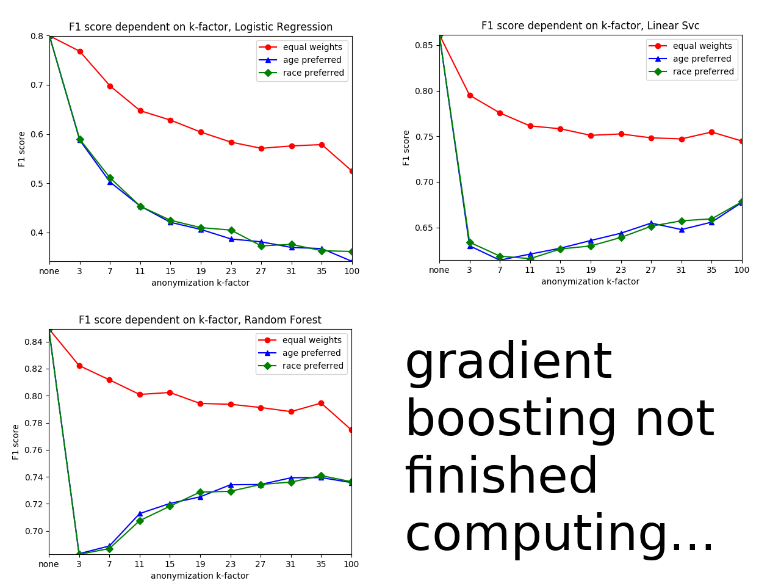
MC on anonymized data -
(30% outliers removed) - marital_status
-) results as expected with only slight deviance from ‘normal’ anonymization
-) same problem with RF
-) equal seems to get slighly better results, others worse (except RF)

