Slide 1
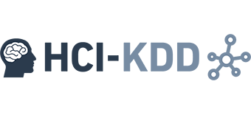

Miniconf, 2016-12-19
Graph Recommenders
(in the Browser)
Bernd Malle, PhD Student
Benedikt Gansinger, BSc Student
b.malle@hci-kdd.org
b.gansinger@hci-kdd.org

Slide 2
Introduction / TOC
Main idea for local graph recommenders
Desired outcome
Experimental Workflow
Visualization
Datasets (anonymized FB graphs)
Enriching anonymized graphs
Graph recommender algorithm
Future work

Slide 3
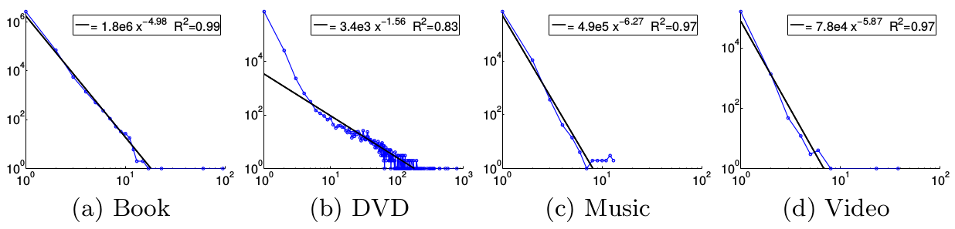
The local sphere ( idea ) 1/2
A study of recommendation cascades (clusters) in an online shopping network of millions of users showed that:
The average size of cascades was relatively small (maximum ~10 for all but DVDs)
The radius of those cascades (graphs) is on the average less than 2 (degrees of separation)
Leskovec, Jure, Ajit Singh, and Jon Kleinberg. "Patterns of influence in a recommendation network." Pacific-Asia Conference on Knowledge Discovery and Data Mining. Springer Berlin Heidelberg, 2006.

Slide 4
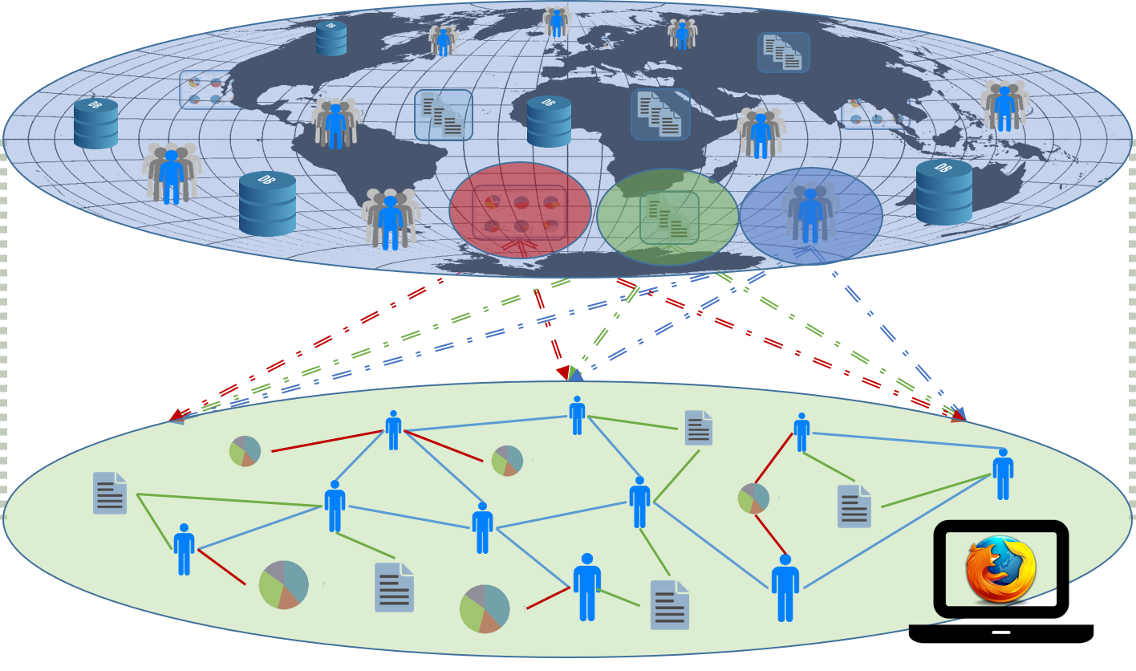
The local sphere ( idea ) 2/2
Pub/Sub in modern WebApps

Slide 5
Desired outcome
Better understanding of the influence factors in graph based recommendations
Better understanding of the complexity / runtime behavior of graph based recommenders
Especially useful for larger graphs outside our experimental scope
Basis for further experiments in ML on perturbed knowledge bases
Working software ;)
Notes:
TODO get better picture

Slide 6
Experimental workflow
Researcher will navigate to the Website
Chooses from several pre-defined graphs
Recommendation mode: single / all users
Recommendations are approved /rejected or rated
The feedback alters the underlying feature vectors
This can also affect graph structure (through user similarities)
Recommendations are re-computed… this cycle continues until researcher has enough data to write a paper about it ;)
Notes:
TODO get better picture

Slide 7
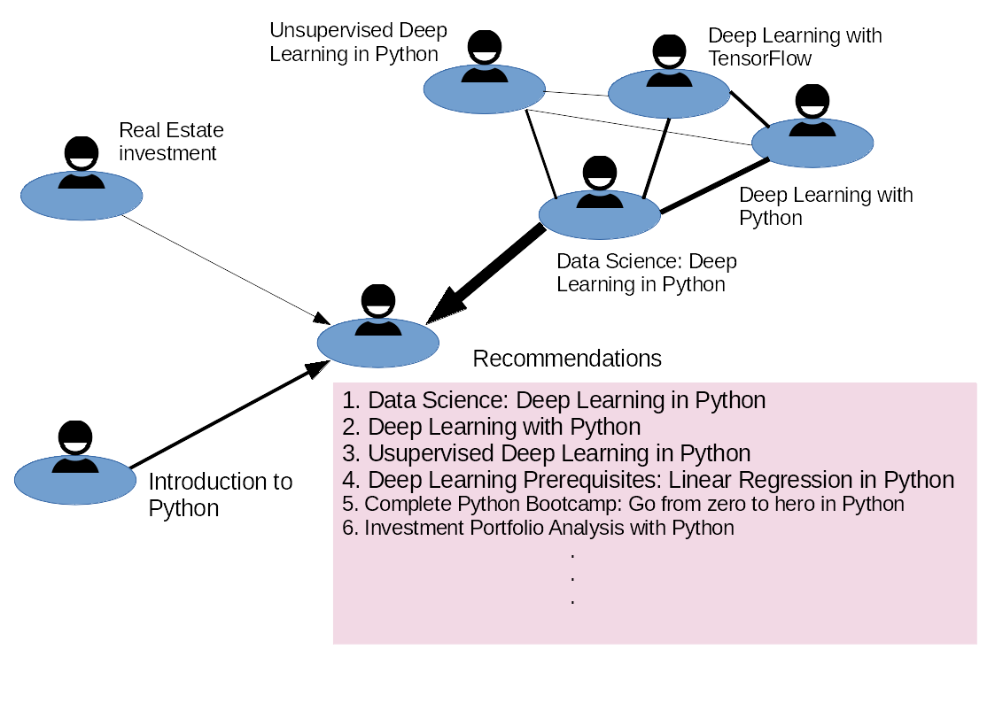
Visualization
Notes:
TODO @Bernd:

Slide 8
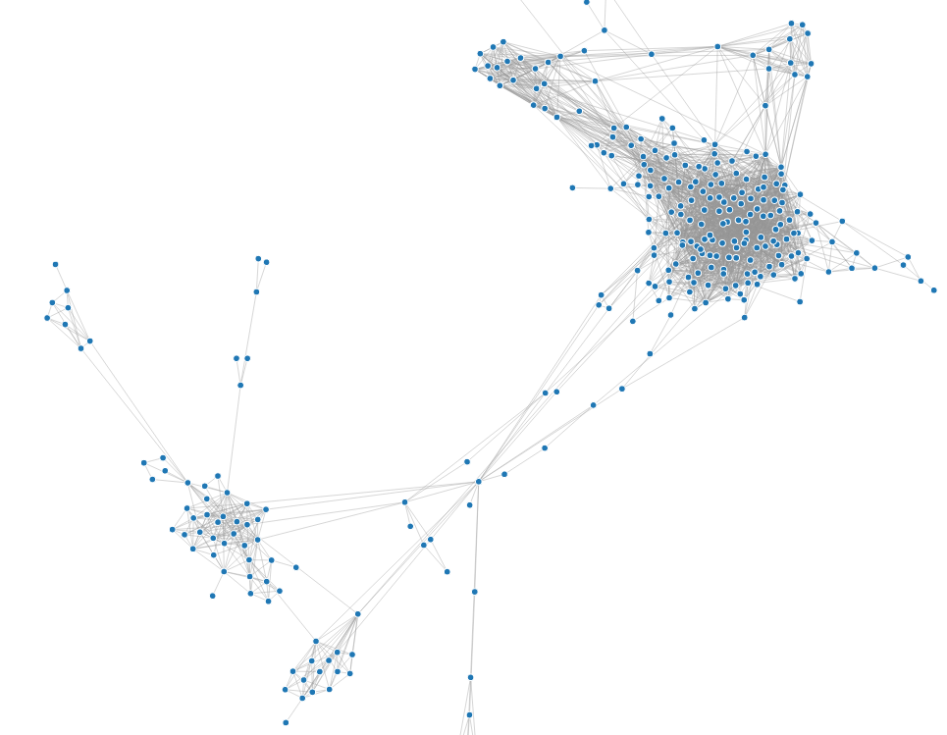


Datasets (anonymized FB graphs)
Anonymized FB graphs provided by SNAP (Stanford Network Analysis Project)
10 FB EGO-graphs: social network from the perspective of one user => shows only relations among friends
Just the structure is provided
Content has to be re-generated
(if necessary)
?

Slide 9
Enriching anonymized graphs

Slide 10
Graph recommender algorithm

Slide 11
Future work
Scaling of graph algorithm to real-sized DBs?
Implementation of local sphere idea?
Perturbation of graphs:
adding / removing nodes / edges
Perturbing node feature vectors
Targeting specific graph metrics:
Centralities
Components
Flow properties (throughput …)

Slide 12
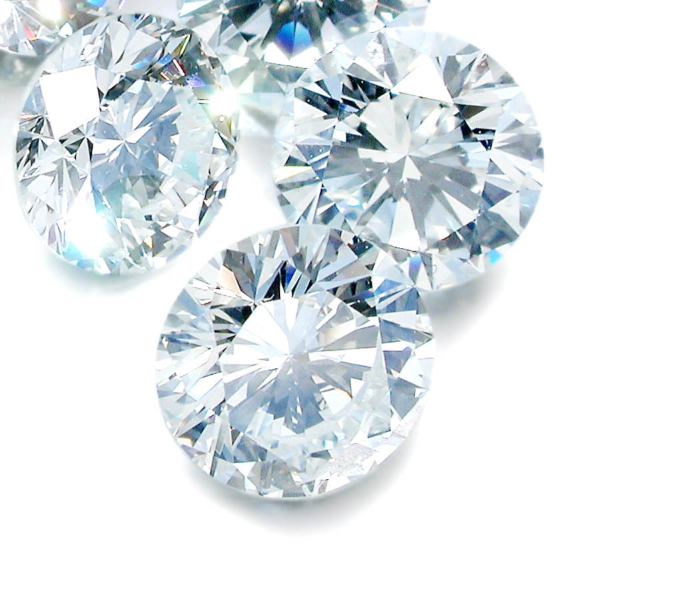
Thank you!
Notes:
My DEDICATION is to make data valuable … Thank you!

