Slide 1





Traditional request / response model < 2005
initial page request
client requests new page
server sends page
server sends page
user interacts with page

Slide 2

Longpolling via Ajax 2005 - 2012 (& still in use)
initial page request
are there new data?
are there new data?
are there new data?
server sends page
NO
NO
YES
this goes on forever...

Slide 3
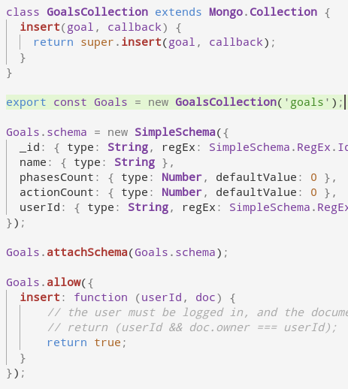
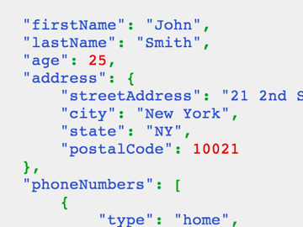
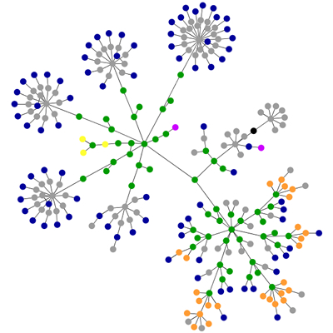
Modern Pub/Sub with constant synchronization
this is what the server resolves & constantly syncs to the client
DB
Pub
this is what the server would allow me to see
Sub
this is what I request to see

