Slide 1
WP4 ‒ Supervised Federated ML
FeatureCloud: Providing the worldwide first technological solution to ensure full patient data control
Bernd Malle Medical University Graz
4th FC Consortium meeting 09/01/2020

Slide 2

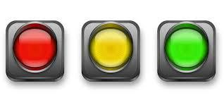

WP4 – Status: Progress to date
Please list your progress on milestones and deliverables of your WP here in this overview table:
No. | Title | Month | Date | Status
D 4.1 | “Survey on graph parallelism” | 6 | 12/31/2019
D 4.2 | “Survey on graph types” | 6 | 12/31/2019
D 4.4 | “Experimental results for shape and composition of connection surfaces” | 18 | 12/31/2020
MS 25 | “Insight into graph partitions” | 18 | 12/31/2020

Slide 3
WP4 – Status: Progress to date
Our original thought was to tackle graphs in a traditional way
assume a global (connected) graph
distribute it optimally or not via partitioning (KL, MCMF, RW, …)
This idea came from an experimental mindset, where we assumed having a certain dataset which we could compute globally
then split the data & compare with distributed results
Reality however will actually determine datasets and their locality (distribution for us. Also, graph types will never be ”text-book pure”
Also, in modern network representation learning approaches (RW-based / GCNs) strict graph classes are rarely (never) mentioned
Quick experiments: graph (sim) recommenders / w|d2v|ft embeddings
Conclusion: The formulation of our original work packages and tasks changed rather significantly towards GRL & node / graph embeddings…

Slide 4
WP4 – What have we learned?
Cannot use spectral graph theory (e.g. feeding an Adjacency or Laplace matrix into a CNN)
this would assume we know all nodes in beforehand
every change in the graph would trigger a complete re-computation
also unrealistic on distributed graphs, or if parts of the data are sensitive
Cannot use transductive methods (which propagate labels based on some proximity assumption)
with a random walk (like deepwalk), it depends whether the local graphs are sizeable enough for expressive vectors.
Therefore, neighbourhood-aggregation is much more promising
can be sampled for each node => built-in parallelization
don't need to compute the whole graph at once
can learn weight matrices forming an inductive model, so we can classify previously unseen nodes later on

Slide 5
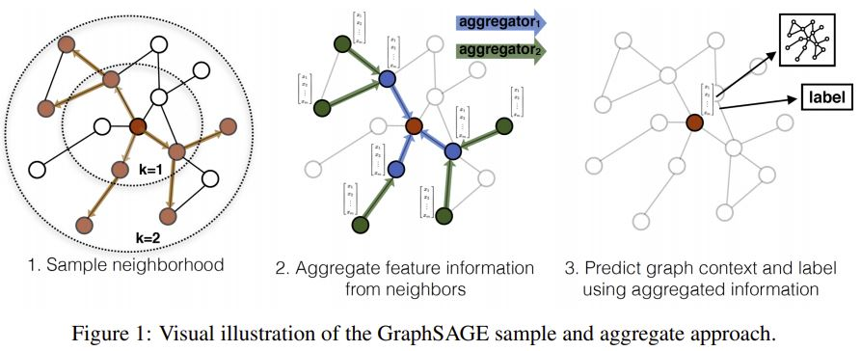
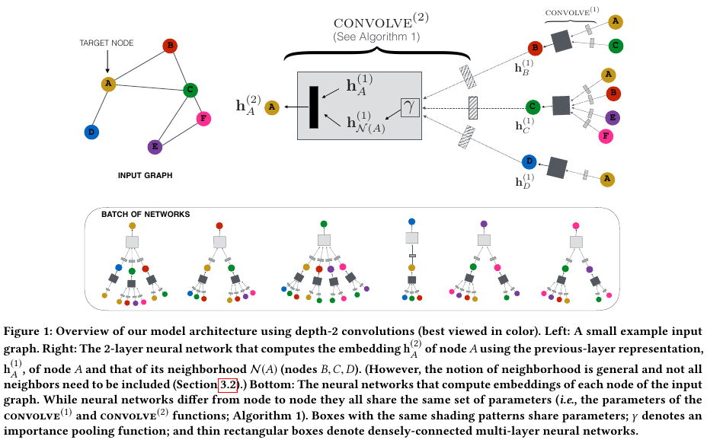
WP4 – Schematic overview of neighbourhood aggregation (GraphSAGE)
Supervised – or – unsupervised
Rex Ying, Ruining He, Kaifeng Chen, Pong Eksombatchai, William L. Hamilton, and Jure Leskovec. Graph convolutional neural networks for web-scale recommender systems. Proceedings of the ACM SIGKDD International Conference on Knowledge Discovery and Data Mining, pages 974–983, 2018. doi: 10.1145/3219819.3219890.
W. L. Hamilton, R. Ying, J. Leskovec, Inductive representation learning on large graphs, Advances in Neural Information Processing Systems 2017- Decem (Nips) (2017) 1025–1035. arXiv:1706.02216.
Sample a neighbourhood for each node
The sampling strategy can be flexible
Learn aggregation weight matrices
Aggregators can be simple (mean) or more complex
LSTMs performed really well, but we don’t know why

Slide 6
WP4 – Next important steps
Medical University Graz has a dataset of 1.3 million patients with diagnosis spanning multiple organs
the data-set is human generated (also doctor generated = wordings…)
a decision tree has been constructed manually (= ground truth / ~120 rules)
Interesting questions include
how to learn embeddings / node representations directly on that corpus?
how do the embeddings / reps change if we learn on a graph initialized according to human bias (edges between patients in same age cohorts etc...)
matching nodes representing same diagnoses that are expressed in different wording? (“Fusion”)
Building a controlled (graph) "vocabulary" for interesting regions in images (cell clusters) and their relations
e.g. shape descriptions of lymph nodes.. (this is going to be a Masters thesis)
we could later use this to extract graphs out of images

Slide 7
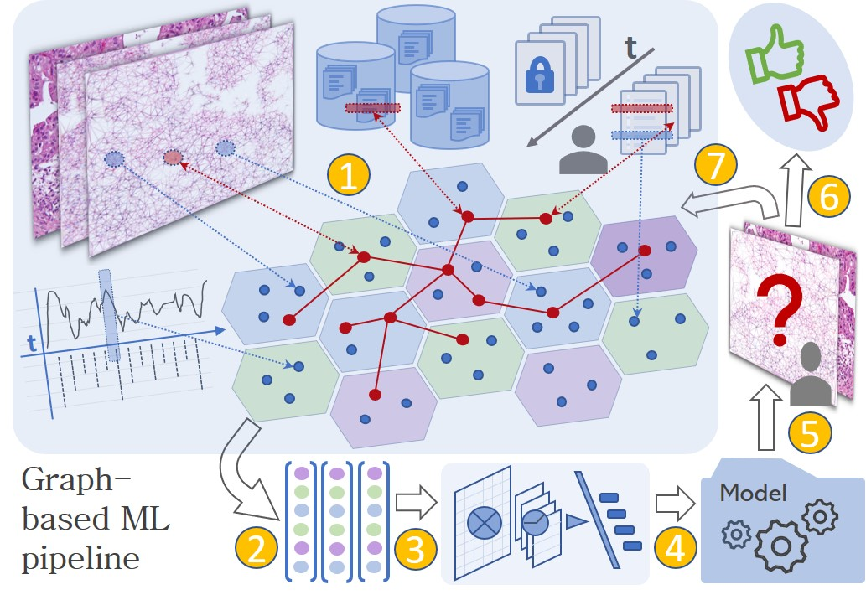
WP4 – Next important steps – Grand vision
VISION: it would make sense to bring features from different modalities (images, text, DB, timeseries, *omics..) into one embedding space, so we can…
train algorithms to classify/predict on such enriched DBs
make explanations more contextual for the medical experts
produce human-understandable counterfactuals (e.g. "if blood pressure was higher, this cell-cluster would mean something different")

Slide 8
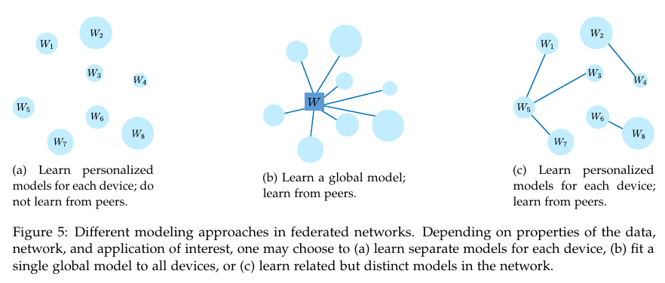
WP4 – Critical issues & items for discussion
Feasibility of multi-modal graph /
embeddings construction
Graph cell extraction from images already works, but as far as we know they don’t include other modalities
How to align embeddings across different modalities
How to sample neighborhoods across the network? -> DON’T ??
can we replace raw data with anonymized feature vectors?
or just use aggregated vectors from other subgraphs (nodes represent whole subgraphs)
How to learn a collaboration graph? (task / objective function similarity measure)
Tian Li, Anit Kumar Sahu, Ameet Talwalkar, and Virginia Smith. Federated Learning: Challenges, Methods, and Future Directions. pages 1–21, 2019. URL http://arxiv.org/abs/1908.07873.

Slide 9
Please mind the time for your presentation - see agenda.
Thank you.

