Slide 1
Explainability vs Privacy
In [social / information / communication] networks

Slide 2





Information propagation
State changes in one node influences the state of all connected nodes
Changes propagate along edges
Explainability means that we can trace the origin of any given change in any given node
Privacy means that information contained in one (group of) node(s) is not visible to other nodes
A
D
B
F
C
E

Slide 3
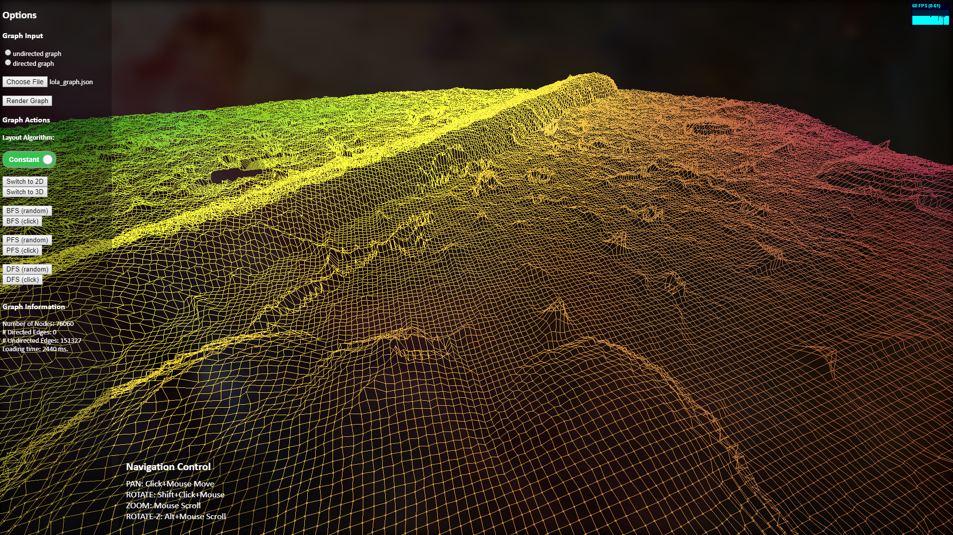
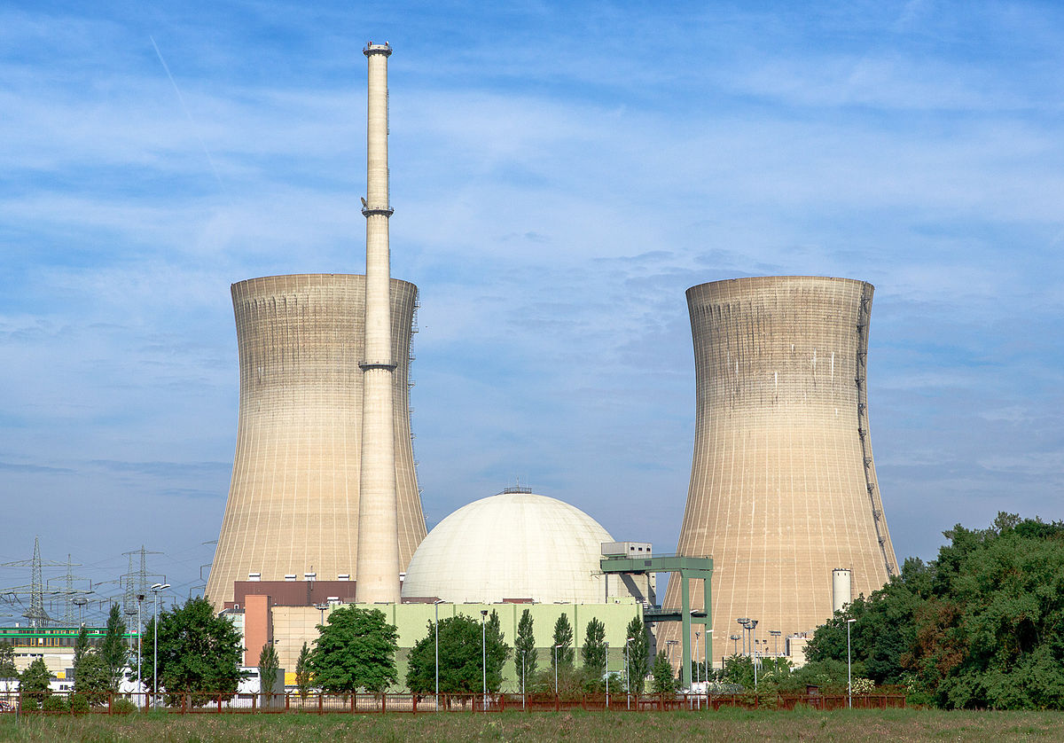
Example: WEATHER GRID
What is the chance that a potential hurricane could damage that nuclear power plant ?
Should we shut it down pre-emptively ?
Costs vs lives…
Explanatory factors of utmost importance
No privacy concerns!

Slide 4
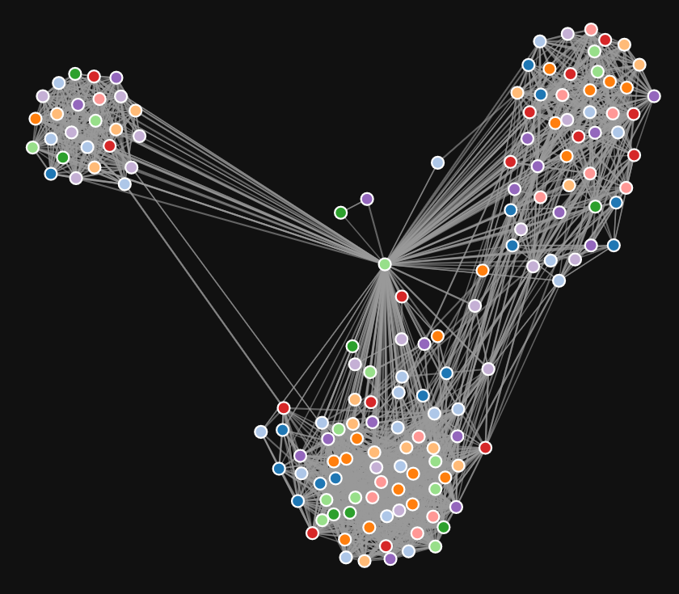
Graph anonymization
Recommendations made to a user in a social network might originate from a remote cluster in the graph
People may not directly know each other, but be connected only via an intermediary
If we anonymize information, we secure privacy – but we limit our ability to explain state changes - or recommendations

Slide 5
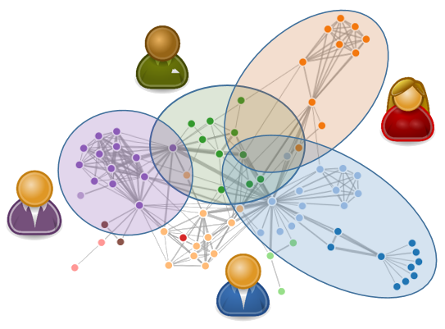
Local sphere recommender
A composite model of Explainability / privacy in a knowledge graph
Each user has:
Their own resources / interests
additional private information
The sum of which is called their ‘local sphere’
Overlapping interests / concepts are shared
Personal information is held private
The recommender algorithm works client-side, taking globally available (overlapping) information, combining it with locally-held private information to compute relevant recommendations
This model has other advantages too:
Scalability
Responsiveness
Security - personal information cannot be hacked in a central place

