Slide 1
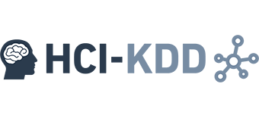

Miniconf, 2016-12-19
Graph Recommenders
(in the Browser)
Bernd Malle, PhD Student
Benedikt Gansinger, BSc Student
b.malle@hci-kdd.org
b.gansinger@hci-kdd.org

Slide 2
Introduction / TOC
Main idea for local graph recommenders
Desired outcome
Experimental Workflow
Visualization
Graph recommender algorithm
Datasets (anonymized FB graphs)
Enriching anonymized graphs
Modeling a stochastic process
Future work

Slide 3
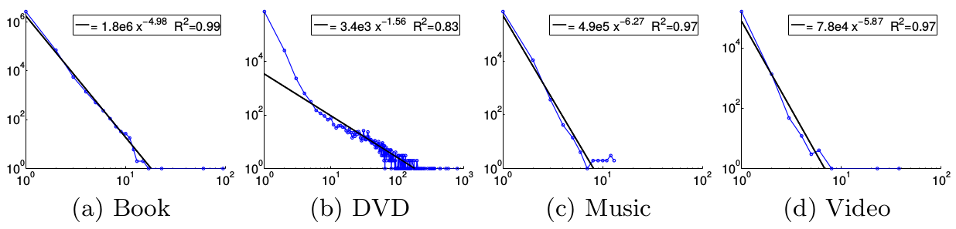
Motivation: The local sphere ( idea ) 1/2
A study of recommendation cascades (clusters) in an online shopping network of millions of users showed that:
The average size of cascades was relatively small (maximum ~10 for all but DVDs)
The radius of those cascades (graphs) is on the average less than 2 (degrees of separation)
Leskovec, Jure, Ajit Singh, and Jon Kleinberg. "Patterns of influence in a recommendation network." Pacific-Asia Conference on Knowledge Discovery and Data Mining. Springer Berlin Heidelberg, 2006.

Slide 4
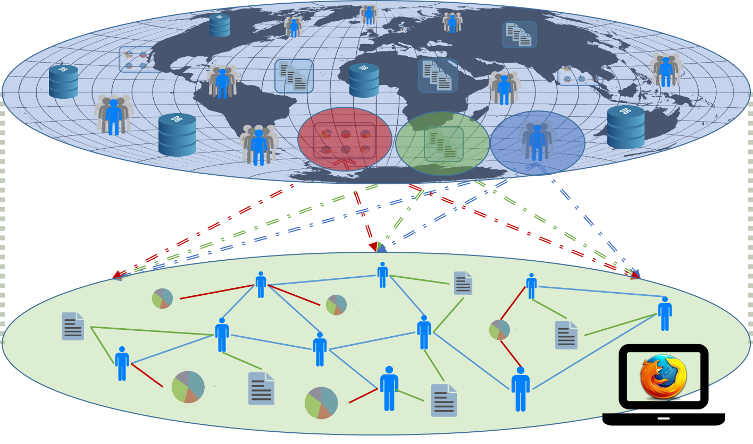
Motivation: The local sphere ( idea ) 2/2
Pub/Sub in modern WebApps

Slide 5
Desired outcome
Better understanding of the influence factors in graph based recommendations
Better understanding of the complexity / runtime behavior of graph based recommenders
Especially useful for larger graphs outside our experimental scope
Basis for further experiments in ML on perturbed knowledge bases => “Playground project”
Working software ;)
Notes:
TODO get better picture

Slide 6
Experimental workflow
Researcher will navigate to the Website
Chooses from several pre-defined graphs
Recommendation mode: single / all users
We are recommending Udemy courses
Recommendations are approved /rejected or rated
The feedback alters the underlying feature vectors
This can also affect graph features / metrics (e.g. edge weights through user similarities)
Recommendations are re-computed… this cycle continues until researcher has enough data to write a paper about it ;)
Notes:
TODO get better picture

Slide 7
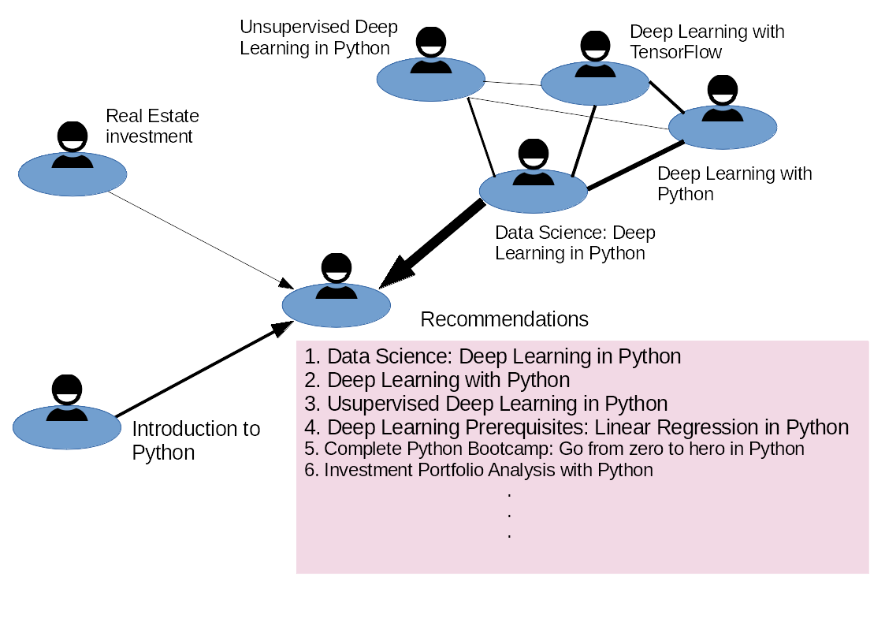
Visualization
Notes:
TODO @Bernd:

Slide 8
Graph recommender algorithm
Not yet determined, but recommenders can build on several factors:
Collaborative filtering – recommend what others have done / chosen (the typical amazon recommender)
Content based filtering (building a user profile)
A model of the user's preference
A history of the user's interaction with the recommender
Network structure
So which dataset is accessible to us ?

Slide 9
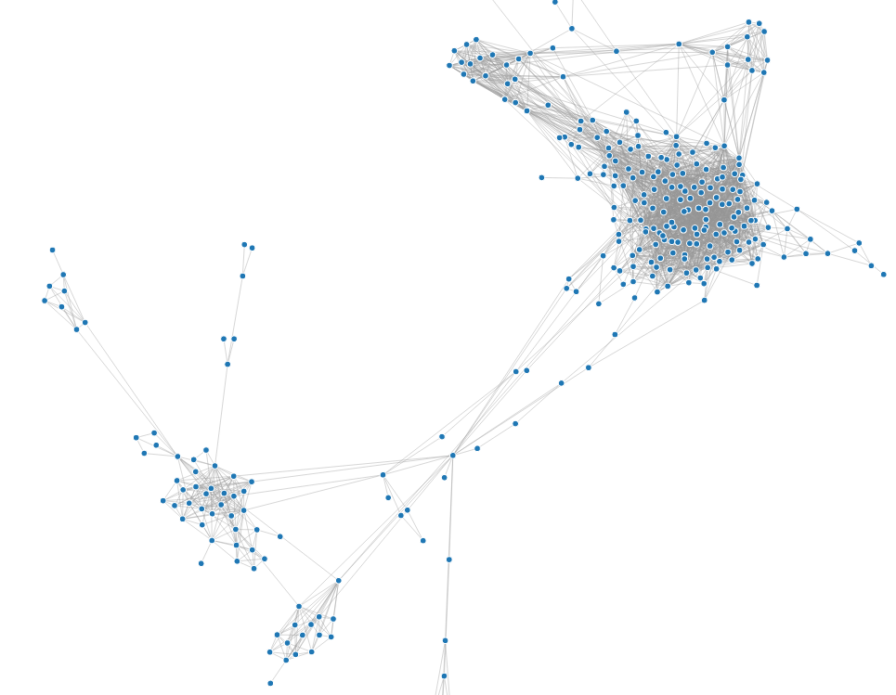


Datasets (anonymized FB graphs)
Anonymized FB graphs provided by SNAP (Stanford Network Analysis Project)
10 FB EGO-graphs: social network from the perspective of one user => shows only relations among friends
Just the structure is provided
Content has to be re-generated
(if necessary)
?

Slide 10
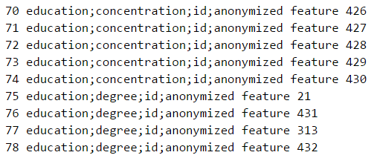
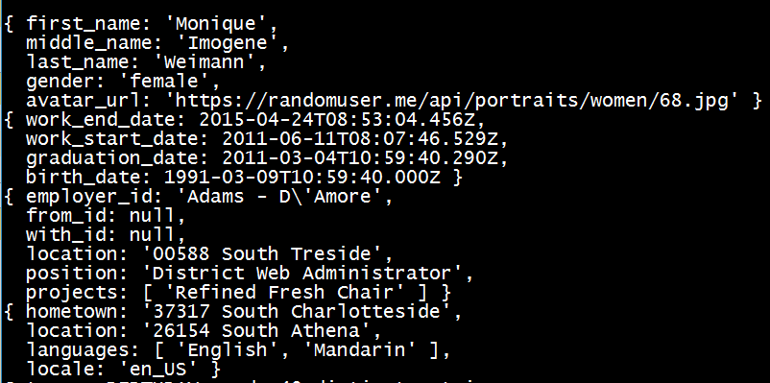

Enriching anonymized graphs 1/2
?
Random fake data generator…?
https://randomuser.me/api/portraits/women/68.jpg

Slide 11
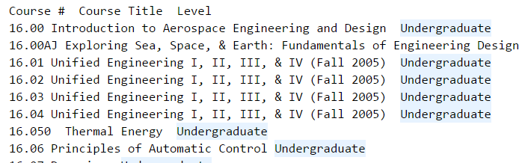
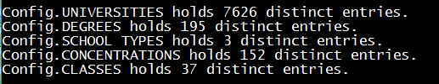
Enriching anonymized graphs 2/2
OK – so we have enough data, but how to assign them realistically to our users considering the FB graph?

Slide 12
Modeling a stochastic process
Our anonymized graph might give us different schools (anonymous features) for 2 connected users
But which schools should we assign? Random ones?
Certainly, the likelihood for 2 people to be acquainted is higher if they attend geographically close schools (MIT / Harvard) than far apart (MIT / TU Graz)
What about qualifications / interests / languages etc.??
We need to base our data generators on stochastic processes resembling reality => Probably a significant project in itself !

Slide 13
Future work
Scaling of graph algorithm to real-sized DBs?
Implementation of local sphere idea?
How to connect to a super-graph
Perturbation of graphs:
adding / removing nodes / edges
Perturbing node feature vectors
Targeting specific graph metrics:
Centralities
Components
Flow properties (throughput etc. …)

Slide 14
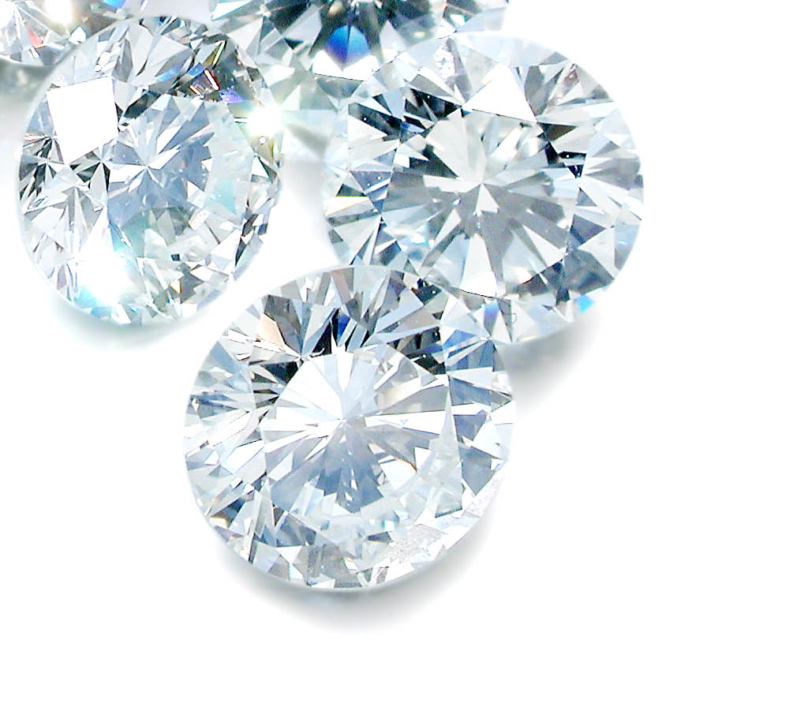
Thank you!
Notes:
My DEDICATION is to make data valuable … Thank you!

