Slide 1
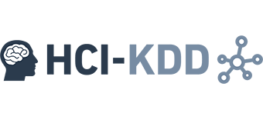

CD-MAKE 2017
The more the merrier -
Federated learning from local sphere recommendations
Bernd Malle, Nicola Giuliani, Andreas Holzinger
b.malle@hci-kdd.org

Slide 2
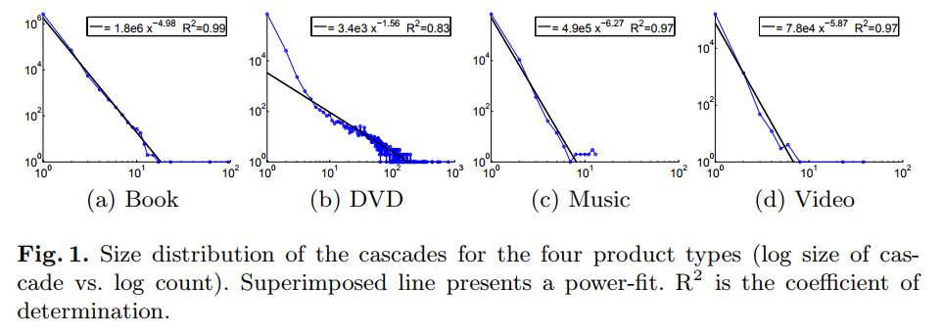
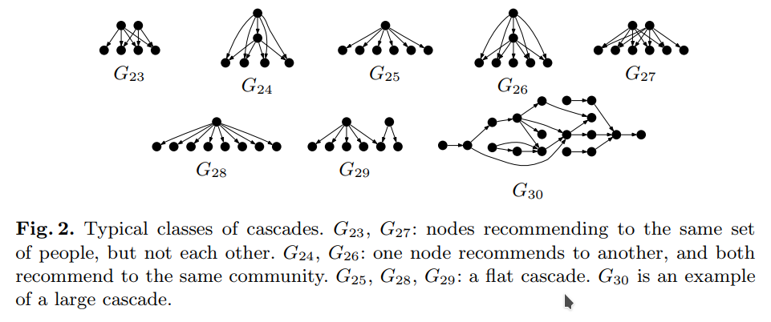
Recommendation Cascades
Leskovec, Jure, Ajit Singh, and Jon Kleinberg. "Patterns of influence in a recommendation network." Pacific-Asia Conference on Knowledge Discovery and Data Mining. Springer, Berlin, Heidelberg, 2006.

Slide 3
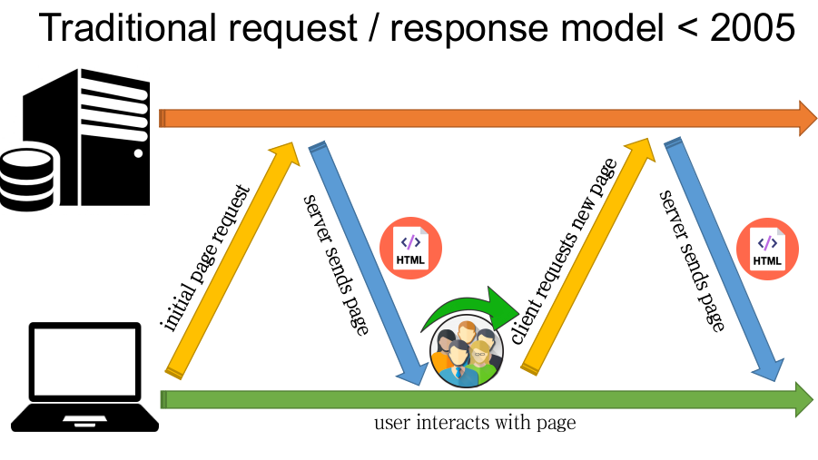
Traditional request / response cycle

Slide 4
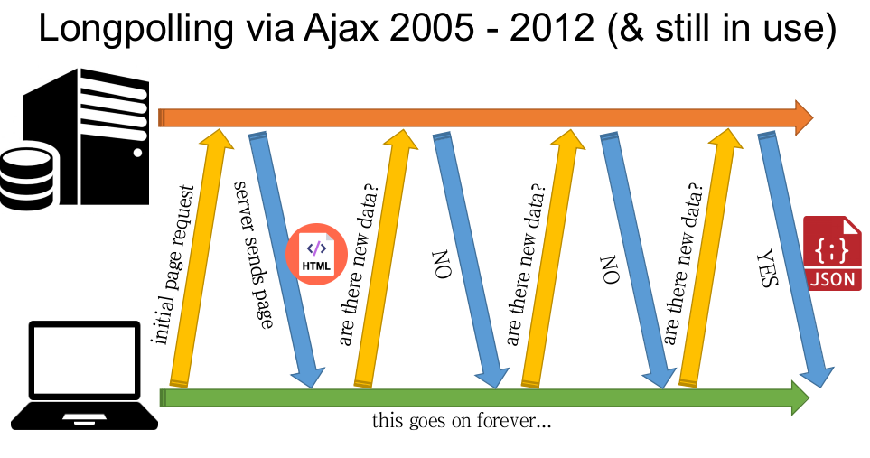
Longpolling / Ajax

Slide 5
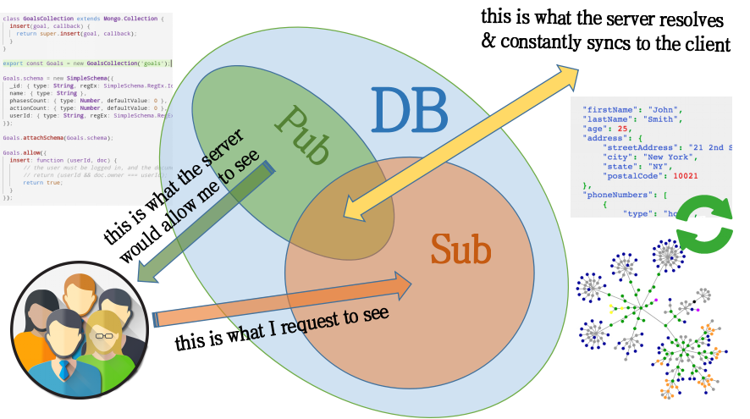
Traditional request / response cycle

Slide 6
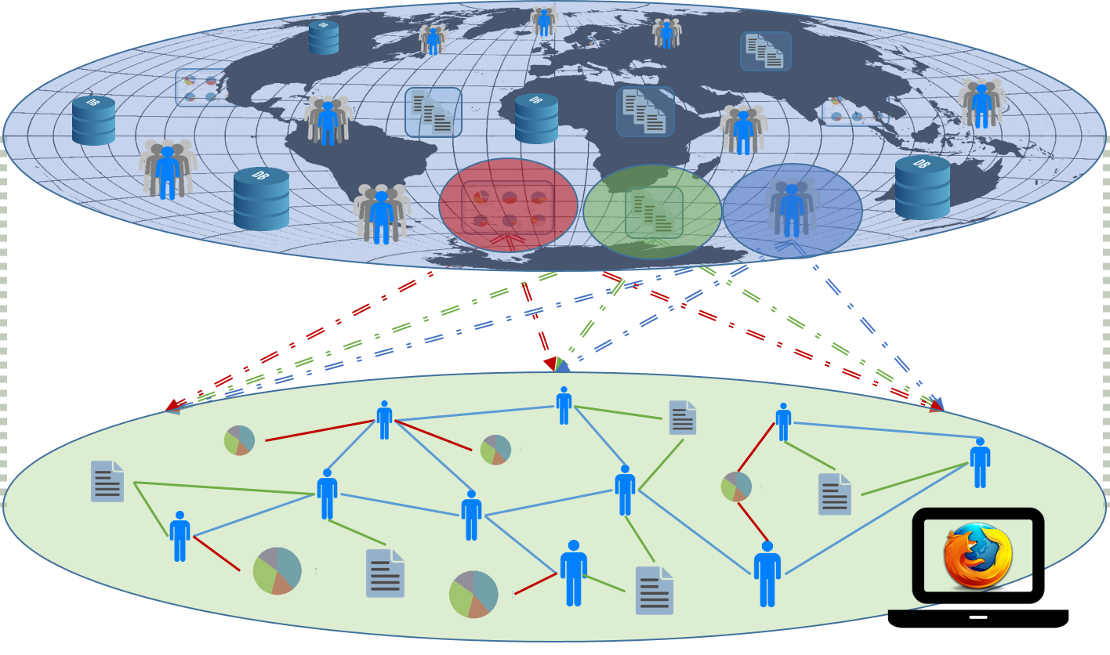
Global Sphere / Local Sphere

Slide 7
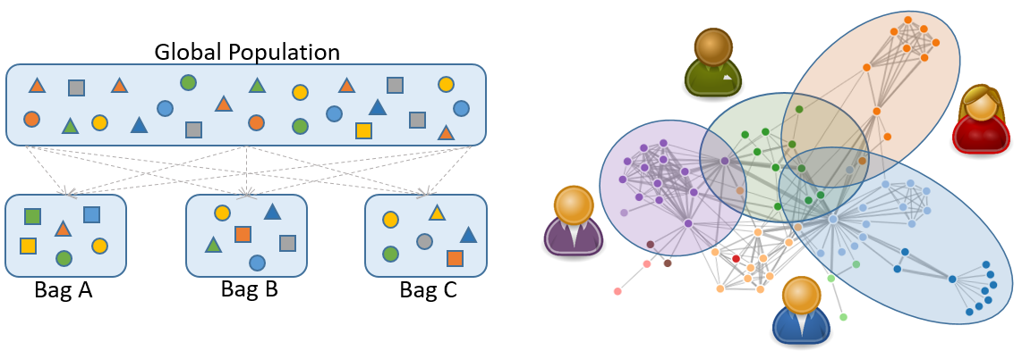
Traditional request / response cycle

Slide 8
GDPR - The right to be forgotten & more...
Basically: A user has the right to have their data deleted from a database upon request
The processing of personal data is expressely prohibited: age, race, income, socioeconomic status...
BUT: algorithms must not be implicitly discriminating either!
Think about recommender systems... just collaborative filtering...
From May 2018 onwards, the GDPR will come into force and violations carry a severe penalty (like 4% of revenue)
Notes:
Prepared for having this law now only applied to front-end databases but also to statistical of ML knowledge bases…

Slide 9

Thank you!
Notes:
My DEDICATION is to make data valuable … Thank you!

