Slide 1
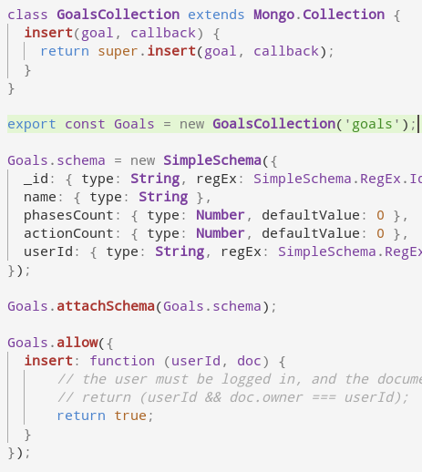
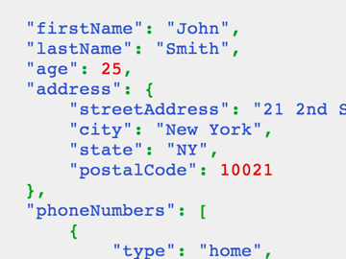
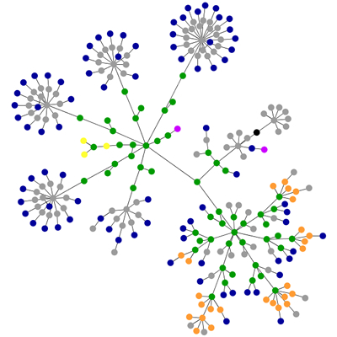

this is what the server resolves & constantly syncs to the client
DB
this is what the server would allow me to see
this is what I request to see

