Slide 1


CD-MAKE 2017
DO NOT DISTURB?
Classifier behavior on perturbed datasets
Bernd Malle, Andreas Holzinger
b.malle@hci-kdd.org

Slide 2

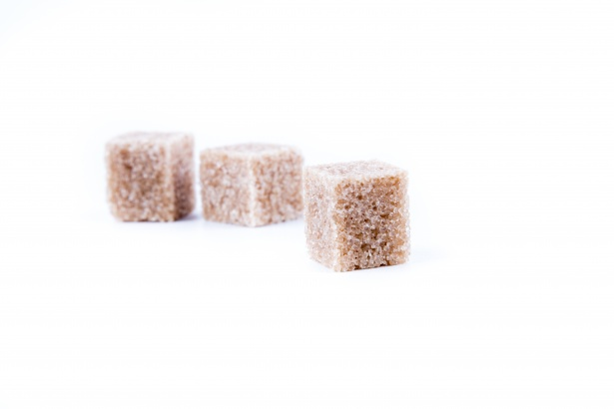

Privacy in the 21st century… ??
Private Data
Data protection laws
Technological progess

Slide 3
GDPR - The right to be forgotten & more...
Basically: A user has the right to have their data deleted from a database upon request
from which databases? backup? statistics? ML???
The processing of personal data is expressely prohibited: age, race, income, socioeconomic status...
BUT: algorithms must not be implicitly discriminating either!
Think about recommender systems ( collaborative filtering ) ...
From May 2018 onwards, the GDPR will come into force and violations carry a severe penalty (a few % of revenue...)
Notes:
Prepared for having this law now only applied to front-end databases but also to statistical of ML knowledge bases…

Slide 4
Different experimental scenarios
Simulate users exercising their “right to be forgotten” in the worst way possible – requesting the erasure of the most valuable data points in the knowledge base.
Anonymizing data in the first place and applying our classifiers on that anonymized datasets.
Perform a variant of 1) and delete "outliers" -> decrease variance in the dataset
Combine outlier removal and anonymization (two detrimental forces at work)
Notes:
But how is this different from simply feeding an algorithm less information in the first place? Shouldn’t the results be the same? YES – but when seen from the standpoint of worldwide competition between different countries / blocks of countries with different privacy laws, it may become crucial to develop a feeling for the magnitude of competitive loss…

Slide 5
Scenario 1
Scenario 1
Selective deletion of valuable data points
"simulating worst possible user behavior"
Notes:
MEASURING PROPERLY AND OBJECTIVELY THE EFFECT OF ANONYMIZATION ?!?!
For specific problems => re-running ML algorithms and measuring the drop in accuracy etc…

Slide 6
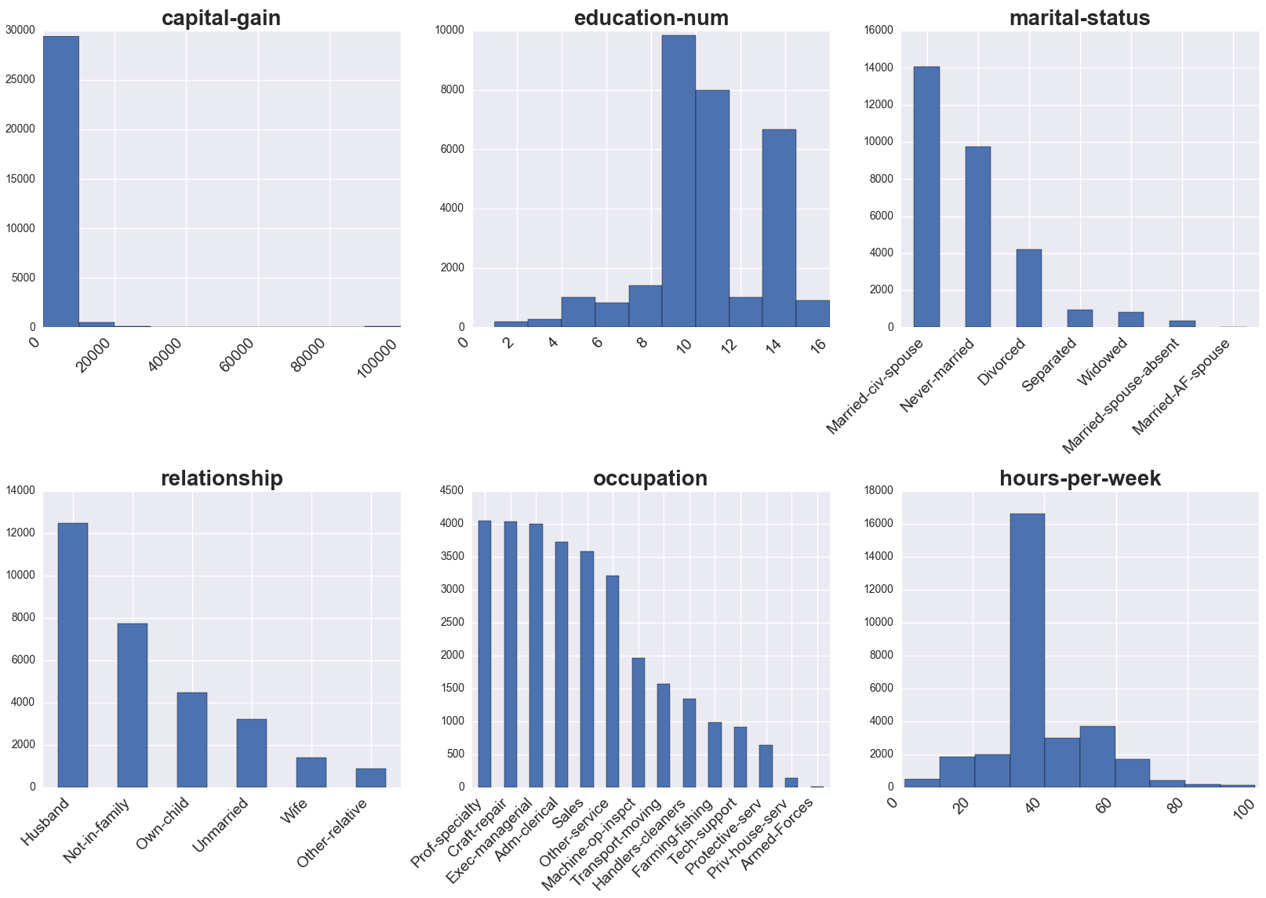
Adult dataset original distribution

Slide 7
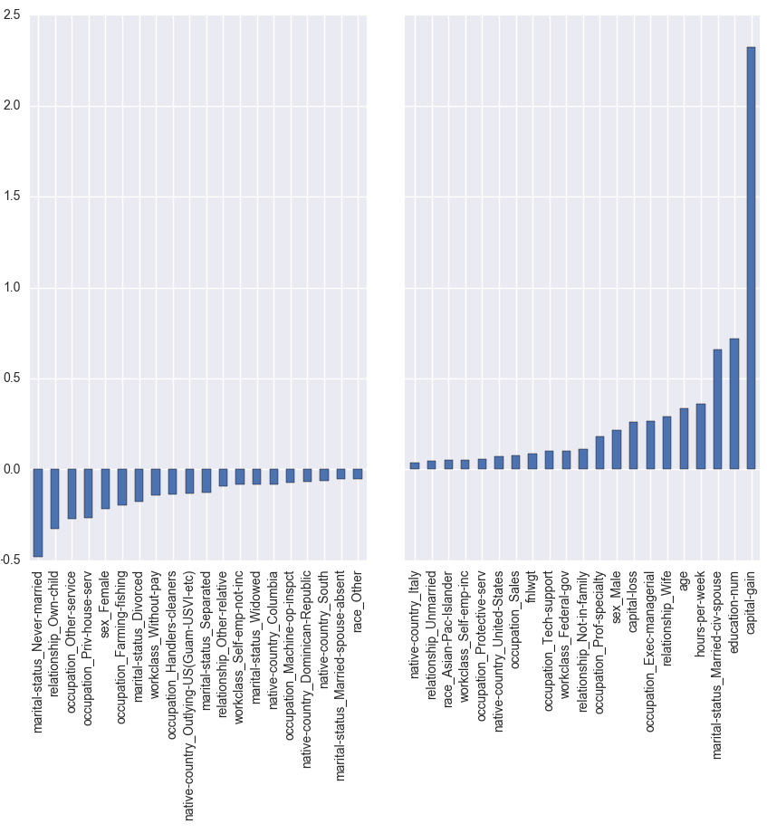
Find the most (in-)valuable data points
Train a logistic regression classifier
Retrieve the log coefficients
Highest coefs represent attribute values that contributed most to classifier certainty
Lowest were most confusing to the algorithm (noise?)

Slide 8
Selective deletion – prepared datasets
We used multi-class classification with the targets
marital status => 7 categories
education_num => 14 continuous values, but clustered into 4 groups during preprocessing
For each identified attribute value (occupation: administrative clerk) identified as valuable: delete 20%-100% of their containing rows in 5 steps
This produced 5*#attributes new datasets per target
We then used 4 classifiers on those data

Slide 9
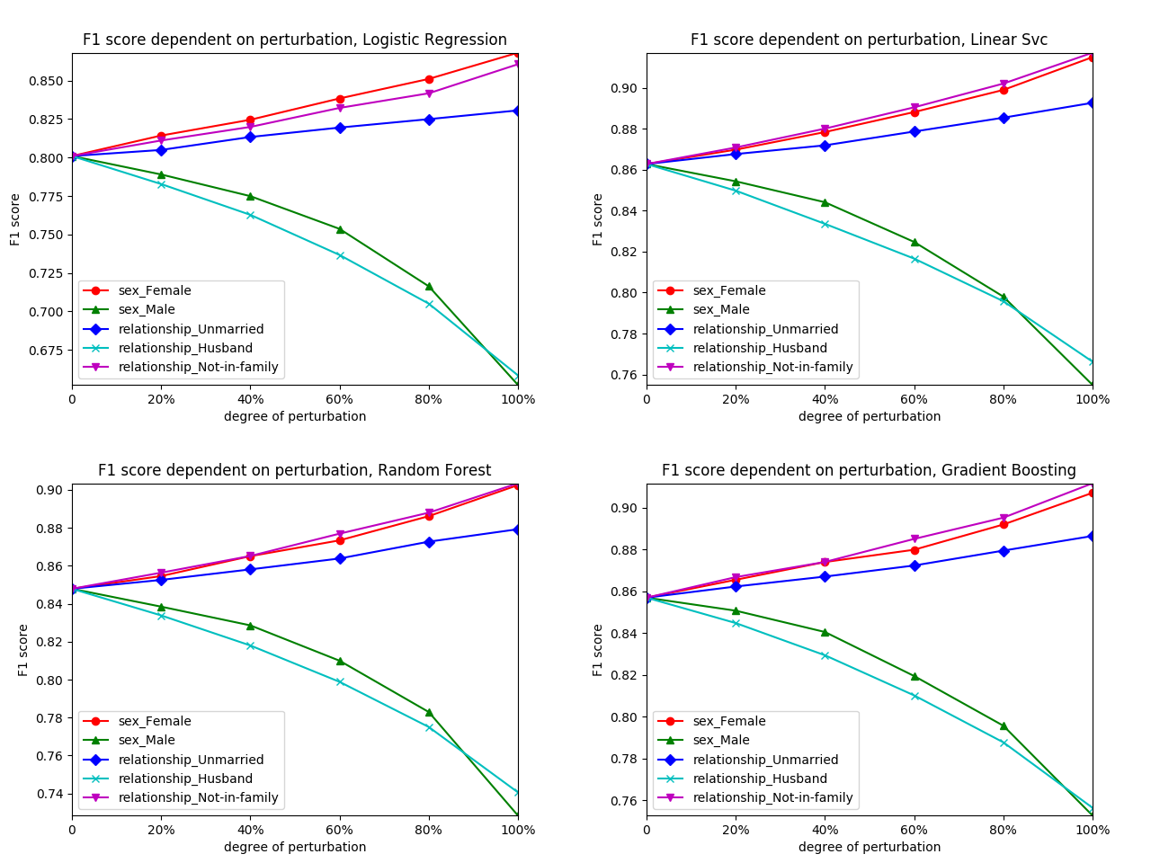
Selective deletion - Results marital status

Slide 10
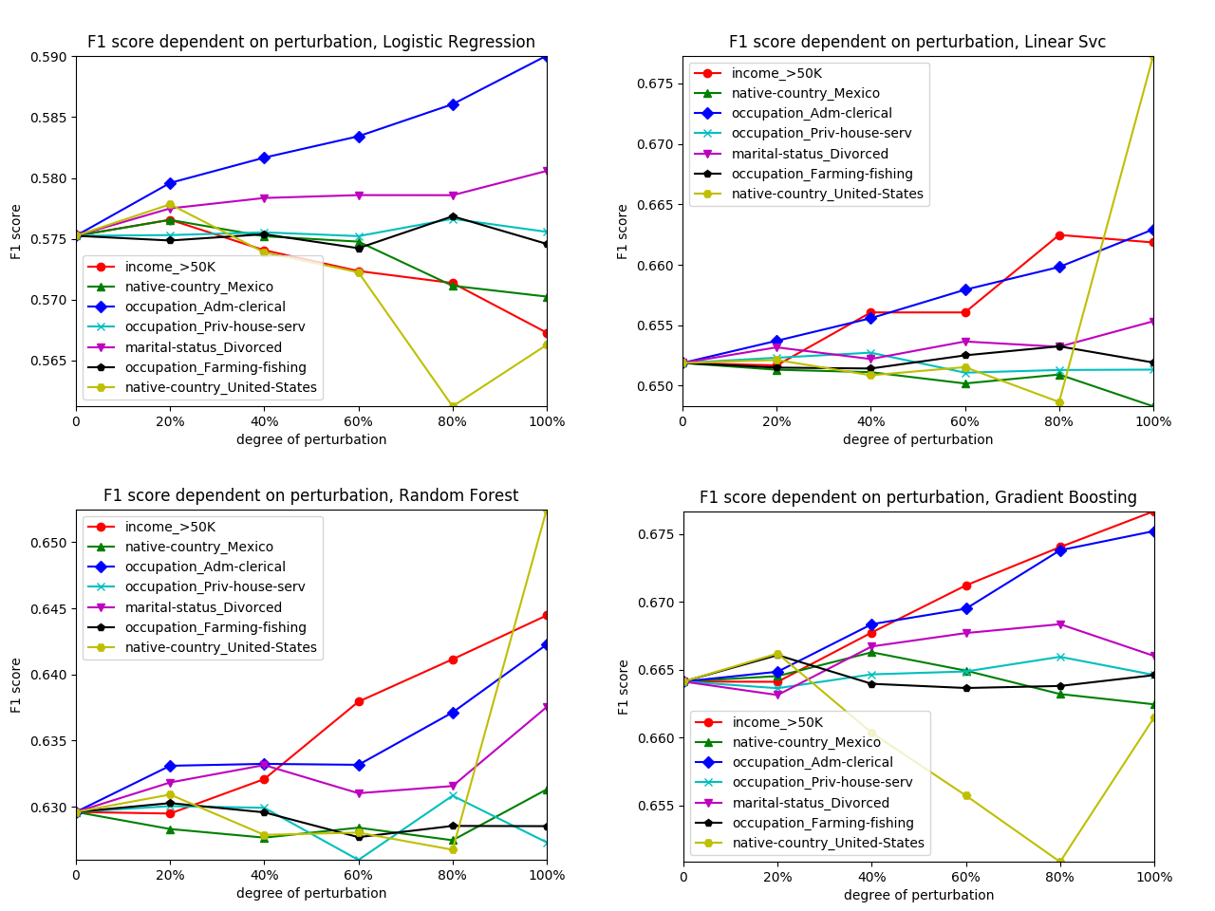
Selective deletion - Results education_num

Slide 11
Scenario 2
Scenario 2
Wholesale anonymization of the knowledge base
"practical measurement of k-anonymization impact"
Notes:
MEASURING PROPERLY AND OBJECTIVELY THE EFFECT OF ANONYMIZATION ?!?!
For specific problems => re-running ML algorithms and measuring the drop in accuracy etc…

Slide 12
Properties & General Approach
Data properties => Reduce granularity
Identifiers := immediately reveal identity
name, email, phone nr., SSN
=> DELETE
Sensitive data
medical diagnosis, symptoms, drug intake, income
=> NECESSARY, KEEP
Quasi-Identifiers := used in combination to retrieve identity
Age, zip, gender, race, profession, education
=> MAYBE USEFUL
=> MANIPULATE / GENERALIZE
Name | Age | Zip | Gender | Disease
Alex | 25 | 41076 | Male | Allergies
… | … | … | … | …

Slide 13
K Anonymization criterion
k-anonymity: for every entry in the DS, there must be at least k-1 identical entries (w.r.t. QI's) => this is 3-anon:
Node | Name | Age | Zip | Gender | Disease
X1 | Alex | 25 | 41076 | Male | Allergies
X2 | Bob | 25 | 41075 | Male | Allergies
X3 | Charlie | 27 | 41076 | Male | Allergies
X4 | Dave | 32 | 41099 | Male | Diabetes
X5 | Eva | 27 | 41074 | Female | Flu
X6 | Dana | 36 | 41099 | Female | Gastritis
X7 | George | 30 | 41099 | Male | Brain Tumor
X8 | Lucas | 28 | 41099 | Male | Lung Cancer
X9 | Laura | 33 | 41075 | Female | Alzheimer
Node | Age | Zip | Gender | Disease
X1 | 25-27 | 4107* | Male | Allergies
X2 | 25-27 | 4107* | Male | Allergies
X3 | 25-27 | 4107* | Male | Allergies
X4 | 30-36 | 41099 | * | Diabetes
X5 | 27-33 | 410** | * | Flu
X6 | 30-36 | 41099 | * | Gastritis
X7 | 30-36 | 41099 | * | Brain Tumor
X8 | 27-33 | 410** | * | Lung Cancer
X9 | 27-33 | 410** | * | Alzheimer

Slide 14
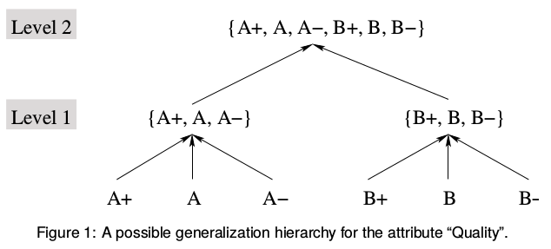
Generalization hierarchies
Generalization (hierarchies)
fixed ruleset
range partitioning (numerical values...)
Suppression
Special case of generalization (with one level)
Graphics Source: Bayardo, R. J., & Agrawal, R. (2005, April). Data privacy through optimal k-anonymization. In Data Engineering, 2005. ICDE 2005. Proceedings. 21st International Conference on (pp. 217-228). IEEE.

Slide 15
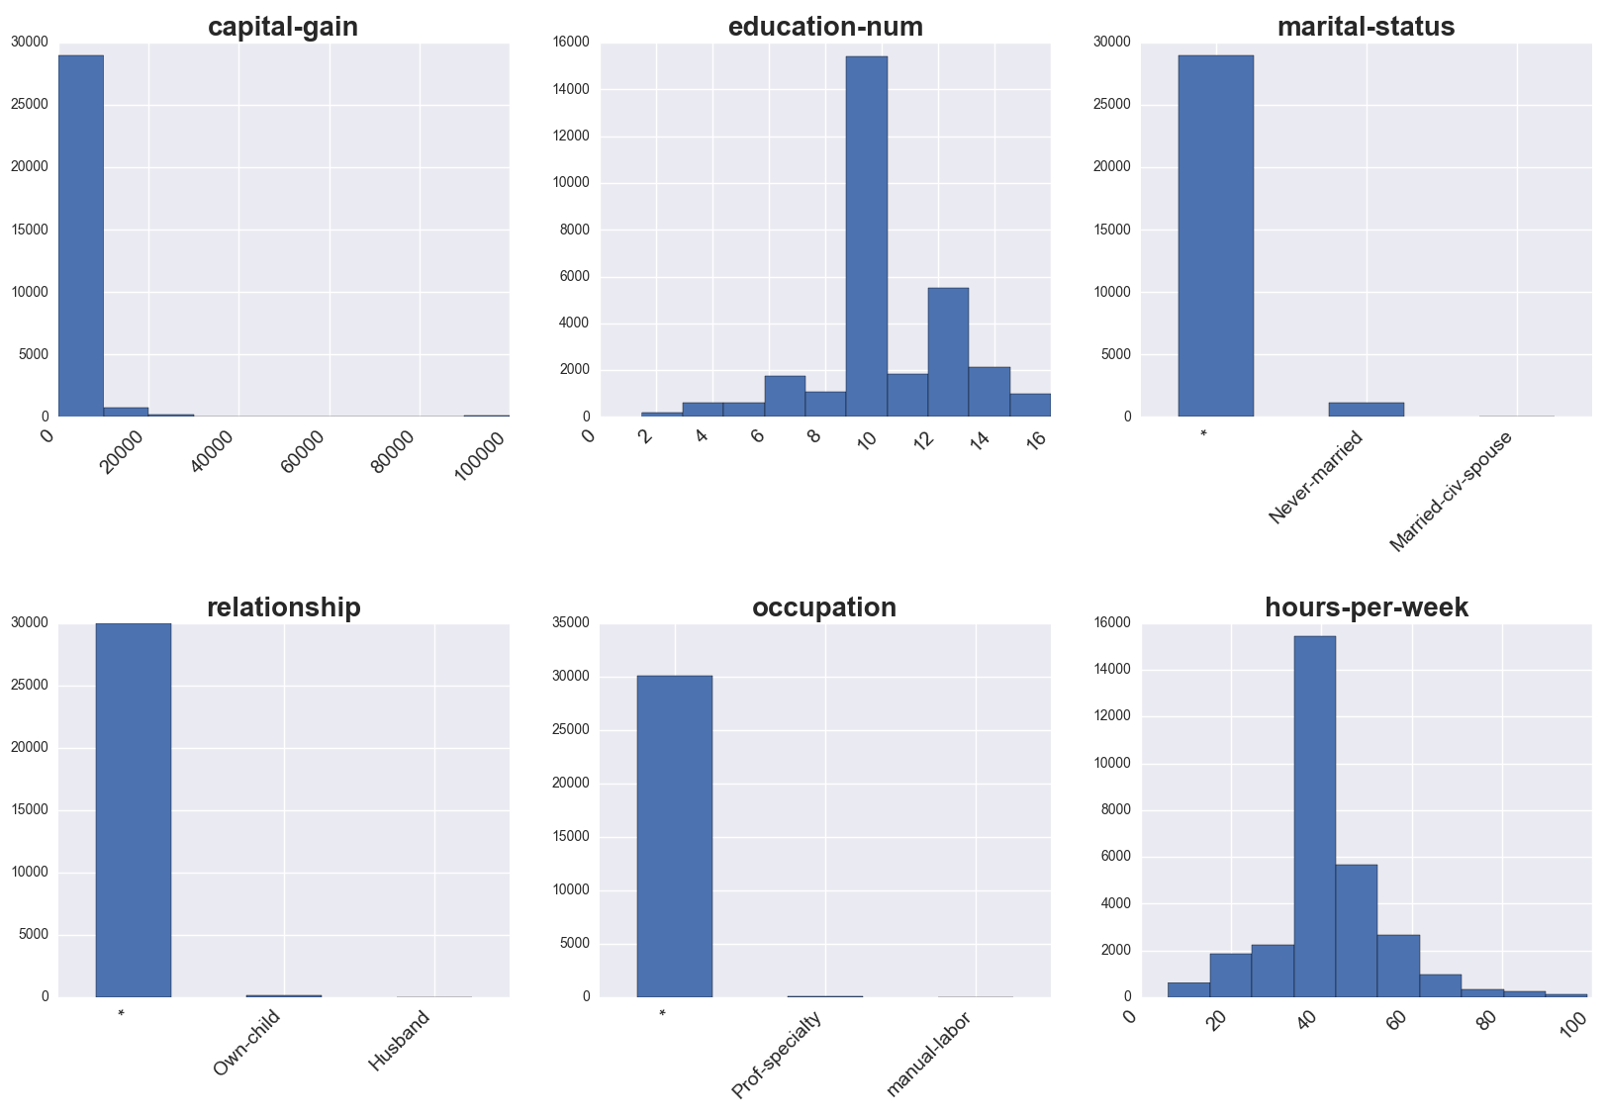
Anonymization - datasets
Notes:
Non-obvious for the numerical columns
Ranges => Averages of ranges…
Of course you get one of those for each combination of k-factor / weight vector applied…

Slide 16
Anonymization – prepared datasets
We used k-factors of:
range(3; 35; 4) as well as 100
Each combined with three different weight vectors
Equal weights for all columns
Age preferred (0.88 vs 0.01 rest)
Race preferred (0.88 vs. 0.01 rest)
Resulting in 15 differently anonymized data sets

Slide 17
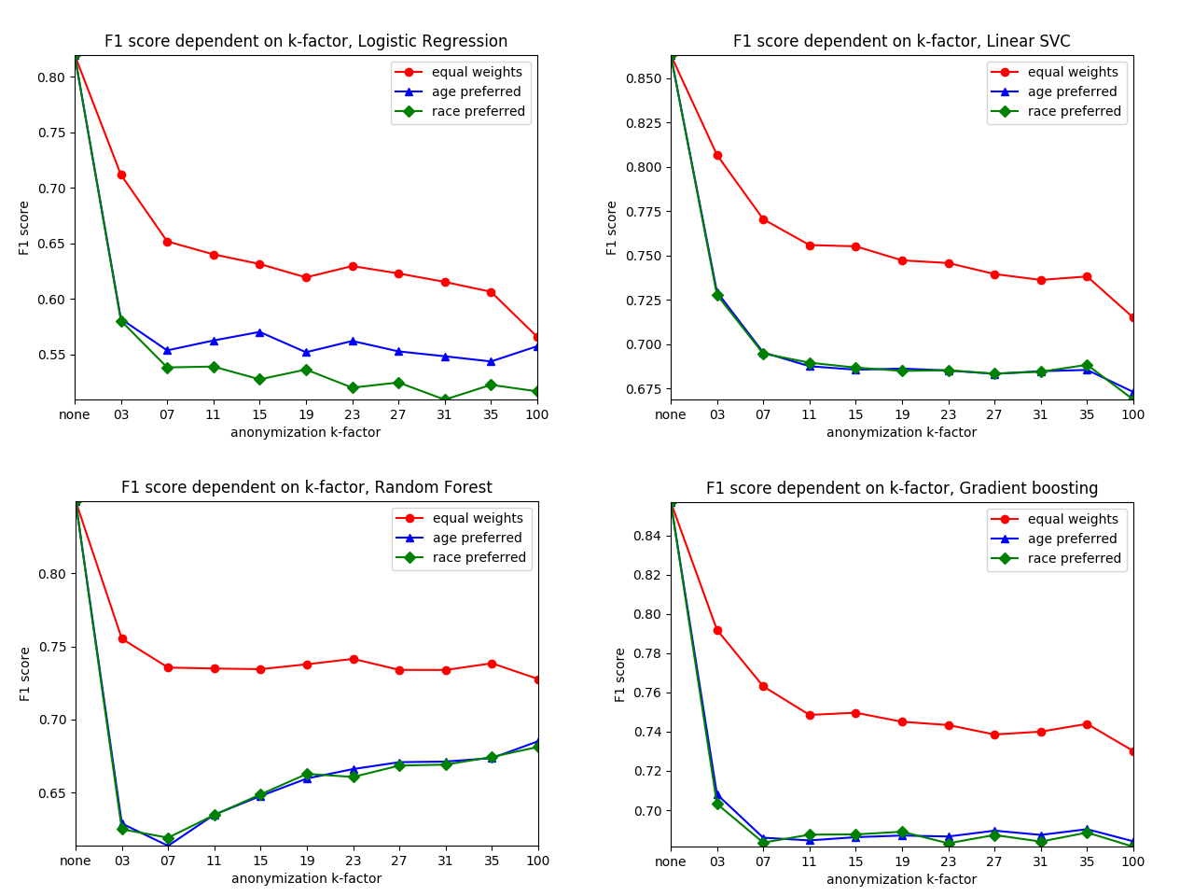
ML on Anonymization - Marital Status
Notes:
There’s much more loss incurred directly at the “beginning”

Slide 18
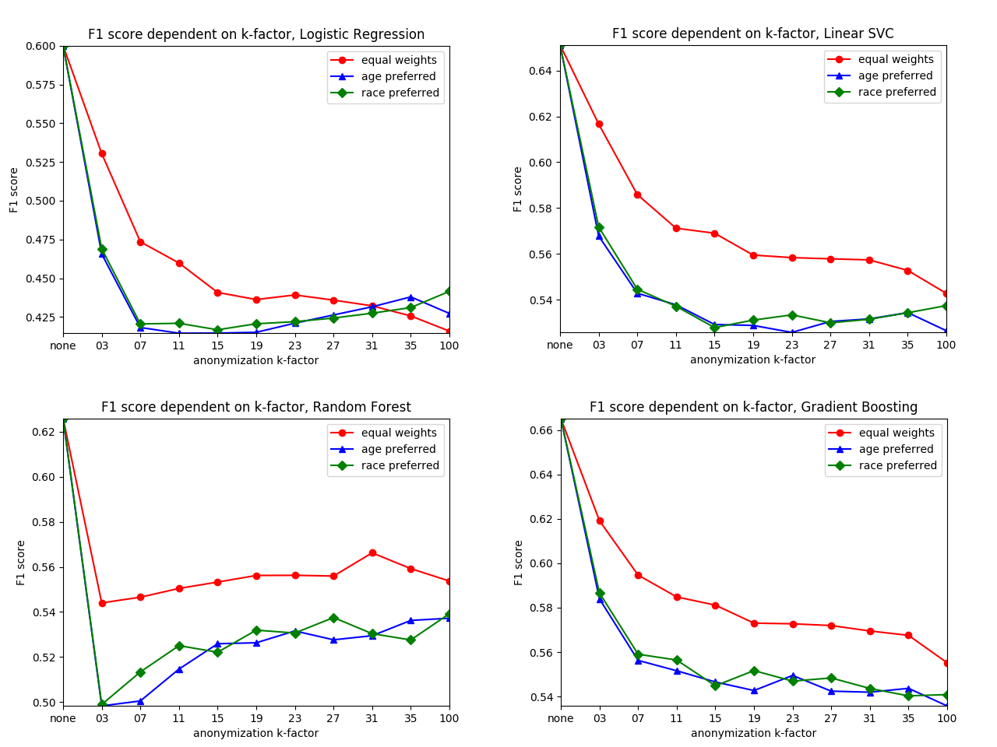
ML on Anonymization - Education Num
Notes:
There’s much more loss incurred directly at the “beginning”

Slide 19
Scenario 3
Scenario 3
Outlier removal
"criminals / hate speech removal"
Notes:
MEASURING PROPERLY AND OBJECTIVELY THE EFFECT OF ANONYMIZATION ?!?!
For specific problems => re-running ML algorithms and measuring the drop in accuracy etc…

Slide 20
Outlier removal – prepared datasets
This time we used income as target attribute (just for comparison to our earlier work..)
"outlier" range(5; 95; 5)
Of course such a range of outliers is simply a mutilation of the data set in order to decrease variance
How do our classifiers perform with data becoming a more and more homogeneous lump of points?
We also compared it to random deletion over the same range (to make sure it's not just the data set size...)

Slide 21
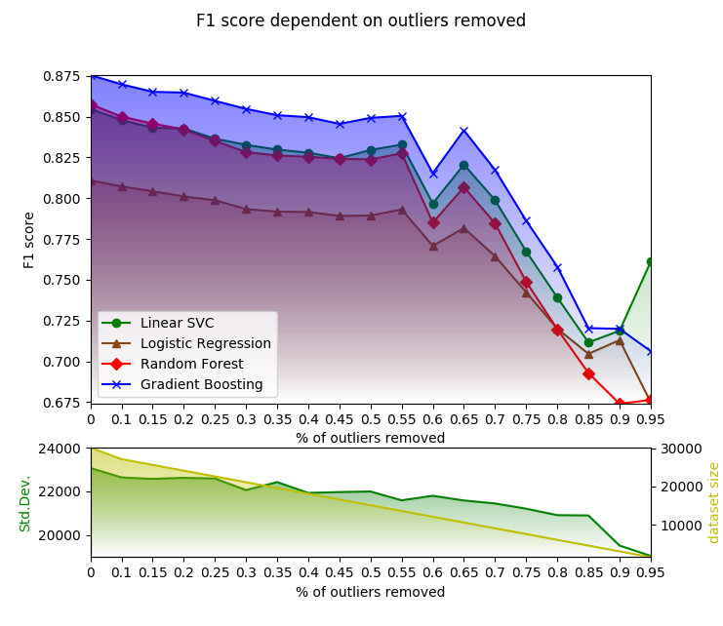
Outlier removal
Notes:
There’s much more loss incurred directly at the “beginning”

Slide 22
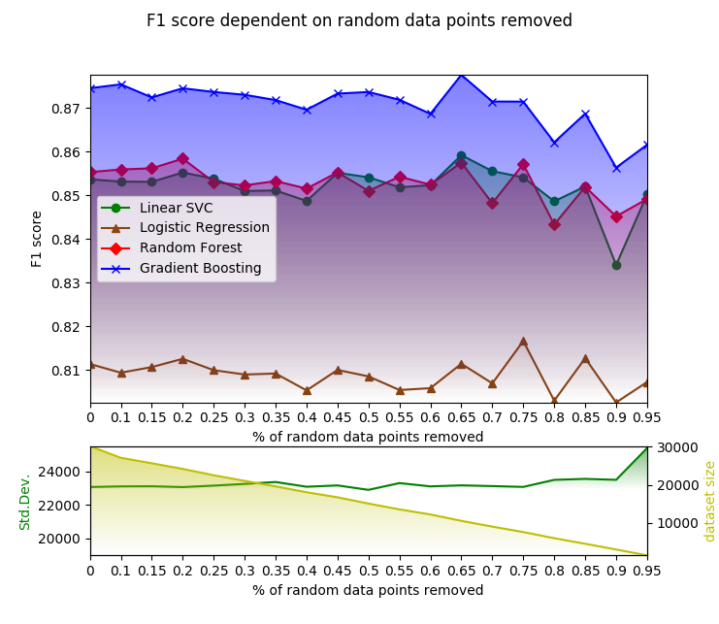
Random deletion
Notes:
There’s much more loss incurred directly at the “beginning”

Slide 23
Scenario 4
Scenario 4
Outlier removal -> then anonymization
Notes:
MEASURING PROPERLY AND OBJECTIVELY THE EFFECT OF ANONYMIZATION ?!?!
For specific problems => re-running ML algorithms and measuring the drop in accuracy etc…

Slide 24
Outlier removal + anonymization - datasets
Outliers decrease variance => make it harder for an algorithm to discriminate
But more homogeneous data allow algorithms to find shallower generalization levels => less information loss during anonymization
What will those two detrimental forces produce?
scenario this time: "outlier" removal fixed at 30%
then anonymization like before (k=3..35, 100)

Slide 25
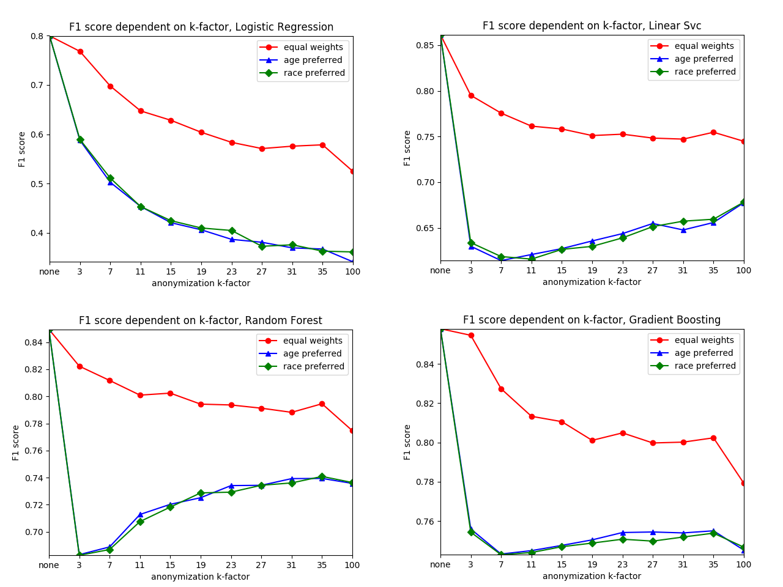
ML on Anonymization on outliers removed
Notes:
There’s much more loss incurred directly at the “beginning”

Slide 26
Lessons Learned
Succumbing to the “right-to-be-forgotten” still seems better than performing ML on (crudely) anonymized DBs
But => Less variance in the data-set makes it harder for algorithms to discriminate (and computationally costlier)
ML on anonymization on outlier removal produced surprisingly good results in the case of Gradient Boost & Logistic Regression
We (...somebody) should verify this on a multitude of interesting datasets, anonymization algorithms etc.
Notes:
PLUS – other tabular Datasets (less skewed ones)

Slide 27
Future Work
Different forms of ML => Prediction, Clustering, Pattern Recognition, etc.
Different forms of anonymization => l,t,delta, perturbation (eps-diff-priv), micro-aggregation
Experiments on different data structures => especially graphs (social networks) would be interesting and highly relevant in our age
We (...somebody) should verify this on a multitude of interesting datasets, anonymization algorithms etc.
Notes:
PLUS – other tabular Datasets (less skewed ones)

Slide 28

Thank you!
Notes:
My DEDICATION is to make data valuable … Thank you!

