Slide 1

Towards Open Data Sets
(k)-Anonymization
of Patient EHR Data
Bernd Malle
b.malle@hci-kdd.org Holzinger Group - www.hci-kdd.org

Slide 2
Overview / Contents
1. Introduction & Motivation
2. Properties of data & General approach
3. Limits of anonymization
4. Anonymization criteria
5. (Some) Algorithmic Approaches
6. Can iML help in anonymization?

Slide 3

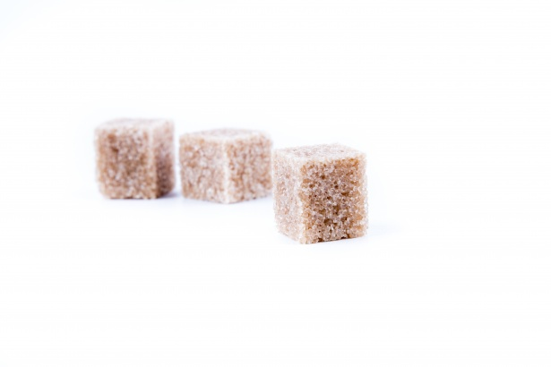

Privacy in the 21st century… ??
Privacy
Data protection laws
Technological progess

Slide 4
The right to be forgotten
Basically: A user has the right to have their data deleted from a database upon request
In past cases, the requirement only meant deletion from a search index (due to EU tech ignorance)
From 2018 onwards, the “right to be forgotten” will be part of the new EU data protection rules
Since one cannot foresee which (non-existing) laws will be enforced by the European bureaucracy in the future (see Apple..), it would be wise to be prepared…
There is even a proposal by German data protection advocates to restrict automated processing of anonymized data which “might” be de-anonymizable…
Notes:
Prepared for having this law now only applied to front-end databases but also to statistical of ML knowledge bases…

Slide 5




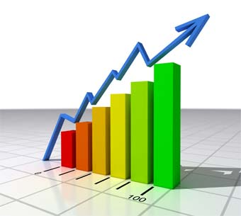
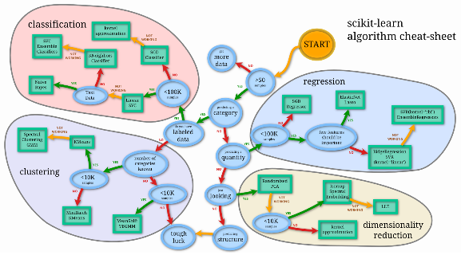
Impact on different DB layers
Less convenient service?
OLTP
Backups
System failures?
Incomplete statistics?
ML performance…?
Notes:
User ⬄ OLTP => Archive => statistics => ML

Slide 6

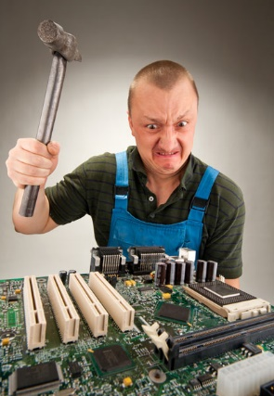


Whom does it concern?
Less convenient service?
Re-appearing items?
Incomplete statistics?
ML performance…?
Notes:
User ⬄ OLTP => Archive => statistics => ML
If already deleted data re-appears, the sysadmin’s job disappears :D

Slide 7
Two different experimental scenarios
1. Simulate users exercising their “right to be forgotten” in the worst way possible – requesting the erasure of the most valuable data points in the knowledge base.
In the future extendable to
Outlier deletion first (anomalous users have higher probability to request their data deleted)
Perturbation via addition of ‘targeted’ noise
2. Try to circumnavigate the re-creation of our ML databases by anonymizing them in the first place and applying our learning algorithms on that anonymized datasets.
Notes:
But how is this different from simply feeding an algorithm less information in the first place? Shouldn’t the results be the same? YES – but when seen from the standpoint of worldwide competition between different countries / blocks of countries with different privacy laws, it may become crucial to develop a feeling for the magnitude of competitive loss…

Slide 8
Scenario One
Scenario One
implies
Selectively deleting (valuable) data points

Slide 9
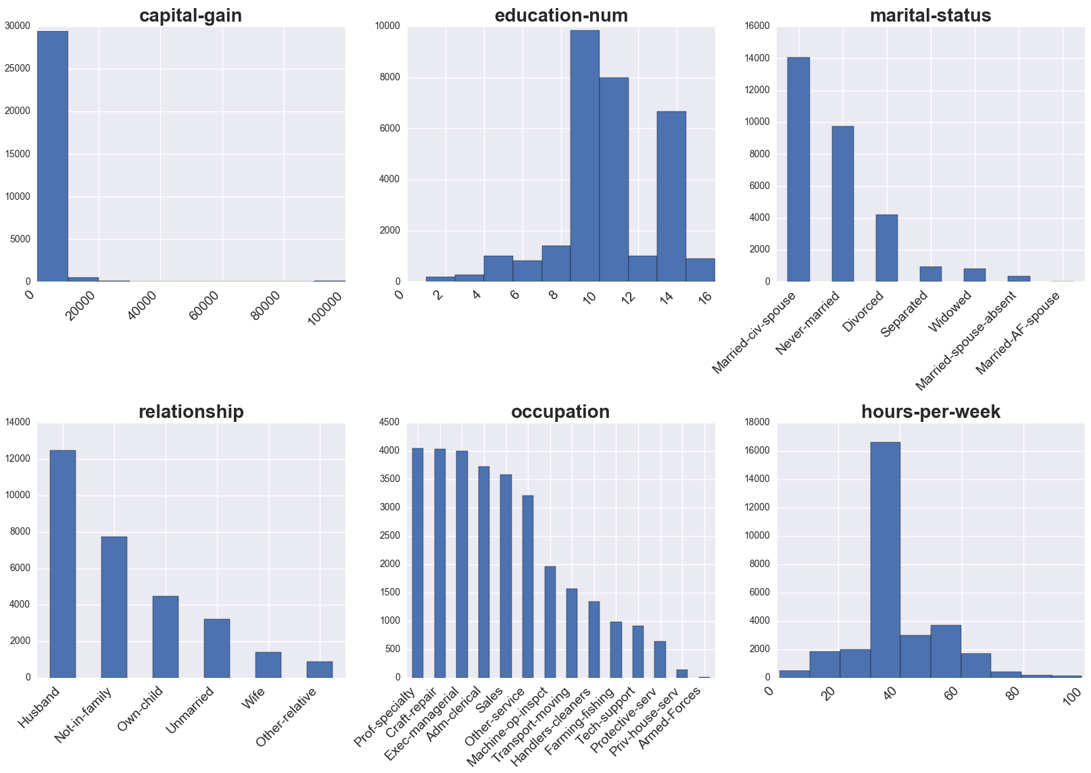
Adult dataset original distribution

Slide 10
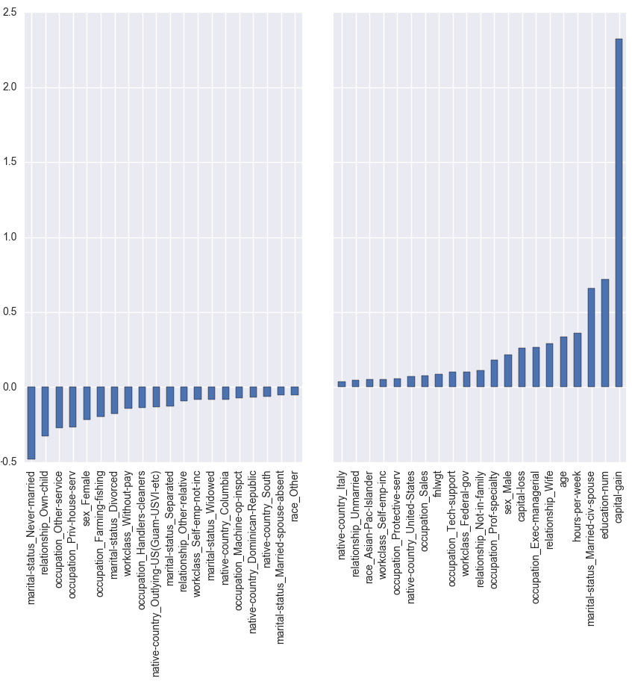
Find the most valuable data points
Preprocess dataset
Train some logistic classifier on it
Retrieve the coefficients learned by the Log.Class.
Sort & use the best xyz as most valuable columns

Slide 11
Selective deletion – prepared datasets
After extracting the 3 attribute values contributing the most information to the classifier
We construct new datasets with 0.2, 0.4, 0.6, 0.8 and 1.0 fractions of those data rows missing
Thereby constructing 15 new data sets
To use 4 different classifiers on…

Slide 12
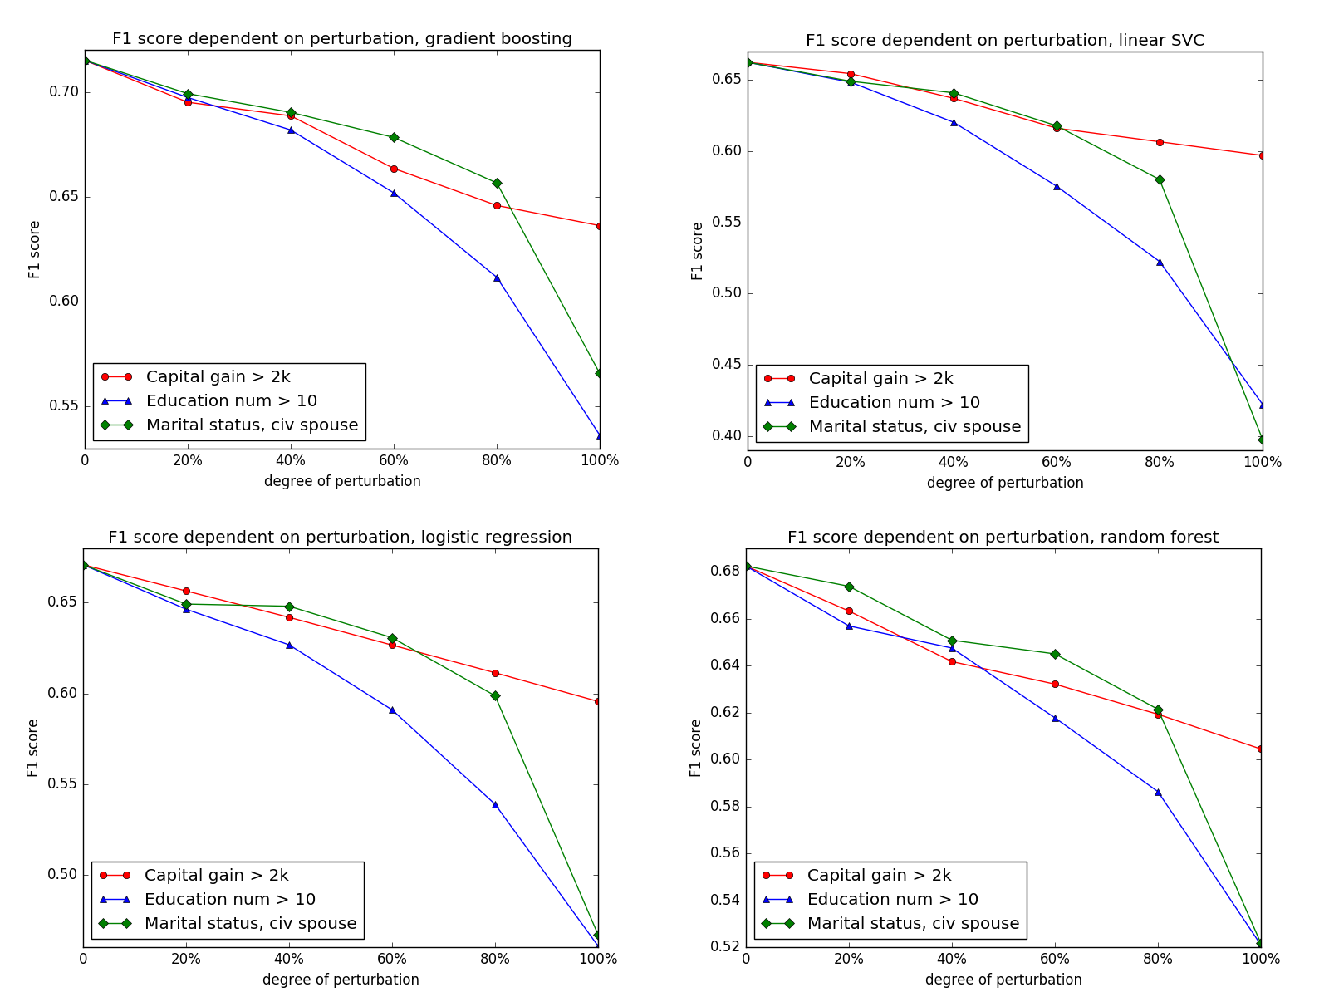
Selective deletion - Results

Slide 13
Scenario Two
Scenario Two
implies
Wholesale anonymization of the knowledge base
Notes:
MEASURING PROPERLY AND OBJECTIVELY THE EFFECT OF ANONYMIZATION ?!?!
For specific problems => re-running ML algorithms and measuring the drop in accuracy etc…

Slide 14
Introduction & Motivation
Public release of sensitive information is useful for
Statistics => education, grant proposals ;-)
Research => prediction of disease spreading etc.
However, personal identities need to be concealed
In the past, simple approaches have failed to provide sufficient security:
data linkage of publicly available datasets
Netflix database, which was linked with the IMDB movie ratings database (via date of rating) => at least one user was re-identified

Slide 15

Introduction & Motivation
Re-Identifying the NYC Taxi Ride Dataset
Find suspicious data
Figure out what ONE hash represents (‘0’)
Figure out input domain for hashes
=> Medallions are 4-5 digits
=> ~20M possibilities
Construct inverted LUT
DS hacked !!!
We need robust
anonymization techniques

Slide 16
Properties & General Approach
Data properties => Reduce granularity
Identifiers := immediately reveal identity
name, email, phone nr., SSN
=> DELETE
Sensitive data
medical diagnosis, symptoms, drug intake, income
=> NECESSARY, KEEP
Quasi-Identifiers := used in combination to retrieve identity
Age, zip, gender, race, profession, education
=> MAYBE USEFUL
=> MANIPULATE / GENERALIZE
Name | Age | Zip | Gender | Disease
Alex | 25 | 41076 | Male | Allergies
… | … | … | … | …

Slide 17
Anonymization criteria 1/4
k-anonymity: for every entry in the DS, there must be at least k-1 identical entries (w.r.t. QI's) => this is 3-anon:
Node | Name | Age | Zip | Gender | Disease
X1 | Alex | 25 | 41076 | Male | Allergies
X2 | Bob | 25 | 41075 | Male | Allergies
X3 | Charlie | 27 | 41076 | Male | Allergies
X4 | Dave | 32 | 41099 | Male | Diabetes
X5 | Eva | 27 | 41074 | Female | Flu
X6 | Dana | 36 | 41099 | Female | Gastritis
X7 | George | 30 | 41099 | Male | Brain Tumor
X8 | Lucas | 28 | 41099 | Male | Lung Cancer
X9 | Laura | 33 | 41075 | Female | Alzheimer
Node | Age | Zip | Gender | Disease
X1 | 25-27 | 4107* | Male | Allergies
X2 | 25-27 | 4107* | Male | Allergies
X3 | 25-27 | 4107* | Male | Allergies
X4 | 30-36 | 41099 | * | Diabetes
X5 | 27-33 | 410** | * | Flu
X6 | 30-36 | 41099 | * | Gastritis
X7 | 30-36 | 41099 | * | Brain Tumor
X8 | 27-33 | 410** | * | Lung Cancer
X9 | 27-33 | 410** | * | Alzheimer
There are 2 possible attacks on k-anonymity though…

Slide 18

Anonymization criteria 2/4
Homogeneity attack:
all entries contain the same piece of sensitive information (Allergies)
Background knowledge attack:
Given two entries with identical QI sets: One has lung cancer, the other diabetes…
Node | Age | Zip | Gender | Disease
X1 | 25-27 | 4107* | Male | Allergies
X2 | 25-27 | 4107* | Male | Allergies
X3 | 25-27 | 4107* | Male | Allergies
Node | Age | Zip | Gender | Disease
X8 | 27-33 | 410** | * | Lung Cancer
X9 | 27-33 | 410** | * | Diabetes

Slide 19
Anonymization criteria 3/4
l-diversity: for every "equivalence class" of (at least k) QI-duplicates, there must be at least l different "well represented" values for the sensitive attribute
2 possible attacks:
Skewness attack:
cancer = positive 1% / negative 99%
Chances are still
Semantic closeness attack:
gastritis / gastric ulcer
Node | QI | Cancer | Drugs
X1 | * | Y | xyz…
X2 | * | Y | xyz…
X3 | * | Y | xyz…
X4 | * | N | xyz…
X5 | * | Y | xyz…
X6 | * | Y | xyz…
X7 | * | N | xyz…
X8 | * | N | xyz…
X9 | * | N | xyz…

Slide 20
Anonymization criteria 4/4
t-closeness: an equivalence class has t-closeness if the intra-class distribution of a sensitive attribute differs no more than a threshold t from it's global distribution (whole dataset). The whole DS has t-closeness if this holds for every equivalence class it contains.
basic idea:
we do not want an attacker to gain too much insight (additional information) by looking at the data
additional information => surprise (delta expectation)
the closer our local and global distributions are => the less our local group deviates from expectations

Slide 21
Algorithmic approaches 1 / 3
Different kinds of data input format
Microdata
data at the granularity of individuals (table row)
2. Graph data -> social network data, in which
nodes represent microdata
edges represent their structural context
graph data are harder to anonymize
It's harder to model the background knowledge of an attacker.
It is harder to quantify the information loss of modifications.
Modifications can propagate through the network.

Slide 22
Algorithmic approaches 3/3
Perturbative
Adding noise only distribution counts
Value perturbation => numerical attributes
Graph perturbation
(randomly) adding / deleting nodes / edges
Microaggregation / Clustering
Replace node data by centroid data
good for numerical data, but possible also for others given rules
Ensures k-anonymity only when computed over all attributes at the same time
Exact optimal only in P when computed over just 1 attribute (else heuristic)

Slide 23
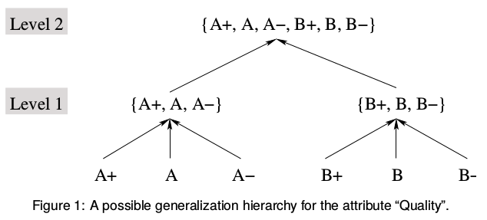
Algorithmic approaches 2/3
Non-perturbative
Generalization (hierarchies)
fixed ruleset
range partitioning (numerical values...)
Suppression
Special case of generalization (with one level)
Graphics Source: Bayardo, R. J., & Agrawal, R. (2005, April). Data privacy through optimal k-anonymization. In Data Engineering, 2005. ICDE 2005. Proceedings. 21st International Conference on (pp. 217-228). IEEE.

Slide 24
Anonymization – Greedy clustering 1/4
“Social Network Greedy Anonymization” (SaNGreeA)
Anonymizes a dataset w.r.t 2 information categories:
Feature vector values => traditional, tabular
Graph structure => edge configuration
Based on the concept of ‘greedy’ clustering
Which poses the question:
How do we choose the next node to add to a cluster w.r.t the above two criteria?
! We need some (good) cost functions !
Notes:
Other k-anonymization algorithms:
-) Incognito - full-domain generalization algorithm that builds a generalization lattice and traverses it using a bottom-up breadth-first search
-) Mondrian - a greedy multidimensional algorithm that partitions the domain space recursively into several regions
-) Datafly - a greedy heuristic algorithm
-) Privacy-Preserving Data Publishing
-) Privacy-Preserving Data Mining (PPDM)
-) Statistical Disclosure Control (SDC)

Slide 25
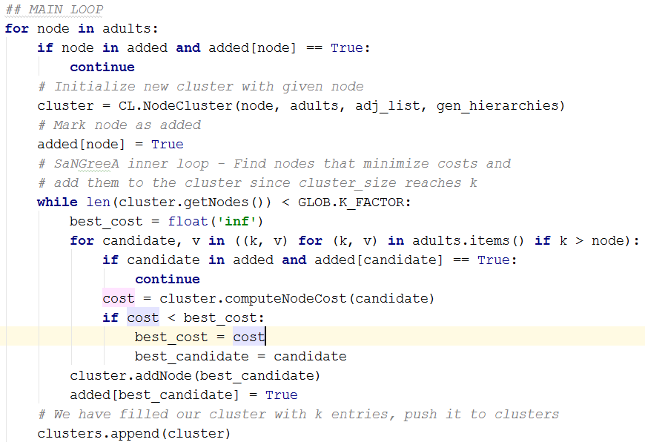
Greedy anonymization Main Loop
Notes:
Choose a node (data row / point) => start a cluster with it
Iterate over all other nodes => choose the one which minimizes merge costs
Add to cluster and count costs
Once cluster has reached size k, stop
Go back to 1)

Slide 26
Anonymization – Greedy clustering 2/4
Generalization Information loss (GIL)
Based on content of nodes
We assume
Continuous properties (age, body height, …)
Candidate Nodes hold a particular value
Clusters have either particular value (at the start) or a generalized range
In order to incorporate the node into the cluster, we may have to generalize this range further, increasing the cost.
Categorical properties (work class, native-country, …)
Same preconditions as above
We use generalization hierarchies to determine the cost of clustering
Notes:
ALSO : adding a numerical value to an already existing range (without expansion) adds to the cost via increased size of cluster..

Slide 27
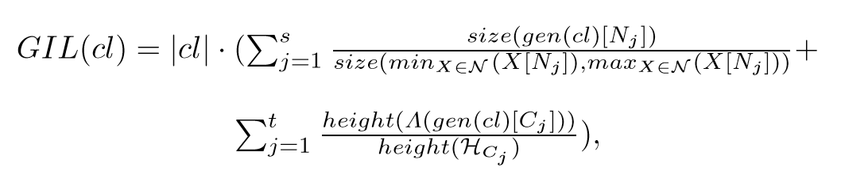
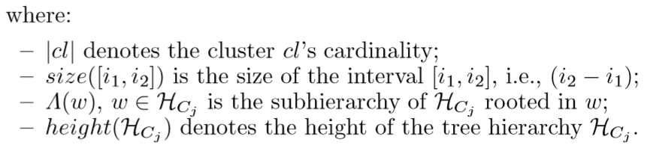
Anonymization – Greedy clustering 3/4
Generalization information loss function:
Campan, A. and Truta, T.M., 2009. Data and structural k-anonymity in social networks. In Privacy, Security, and Trust in KDD (pp. 33-54). Springer Berlin Heidelberg.

Slide 28
Anonymization – Greedy clustering 4/4
Example GIL:
age_range overall = [11 – 91]
In order to cluster some nodes, we need to generalize 27 to [20 - 30]
Cost = (30-20)/(91-11) = 1/8
Given a generalization hierarchy ‘native-country’ with 4 levels
In order to cluster, we need to generalize ‘Austria’, ‘France’, or ‘Portugal’ to ‘Western Europe’, which is 1 level higher
Cost = 1/4

Slide 29
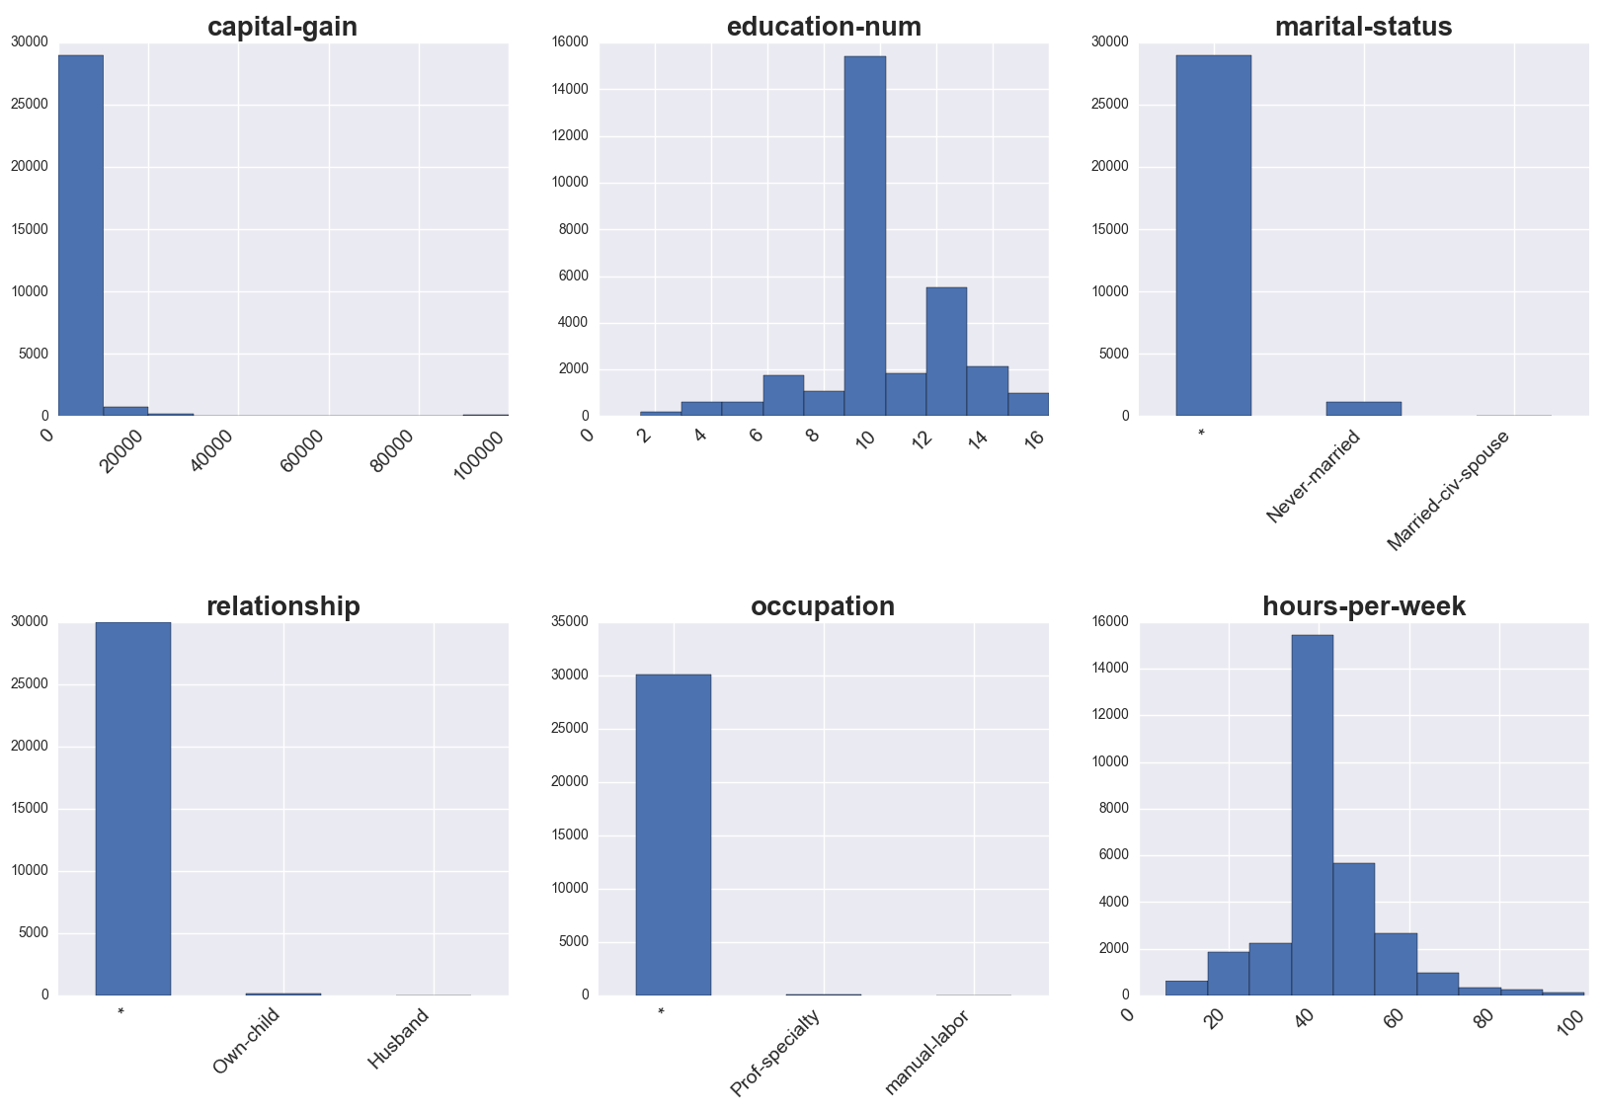
Anonymization - datasets
Notes:
Non-obvious for the numerical columns
Ranges => Averages of ranges…
Of course you get one of those for each combination of k-factor / weight vector applied…

Slide 30
Anonymization – prepared datasets
We used k-factors of:
3, 7, 11, 15 and 19
Each combined with three different weight vectors
Equal weights for all columns
Age preferred (0.88 vs 0.01 rest)
Race preferred (0.88 vs. 0.01 rest)
Resulting in 15 differently anonymized data sets

Slide 31
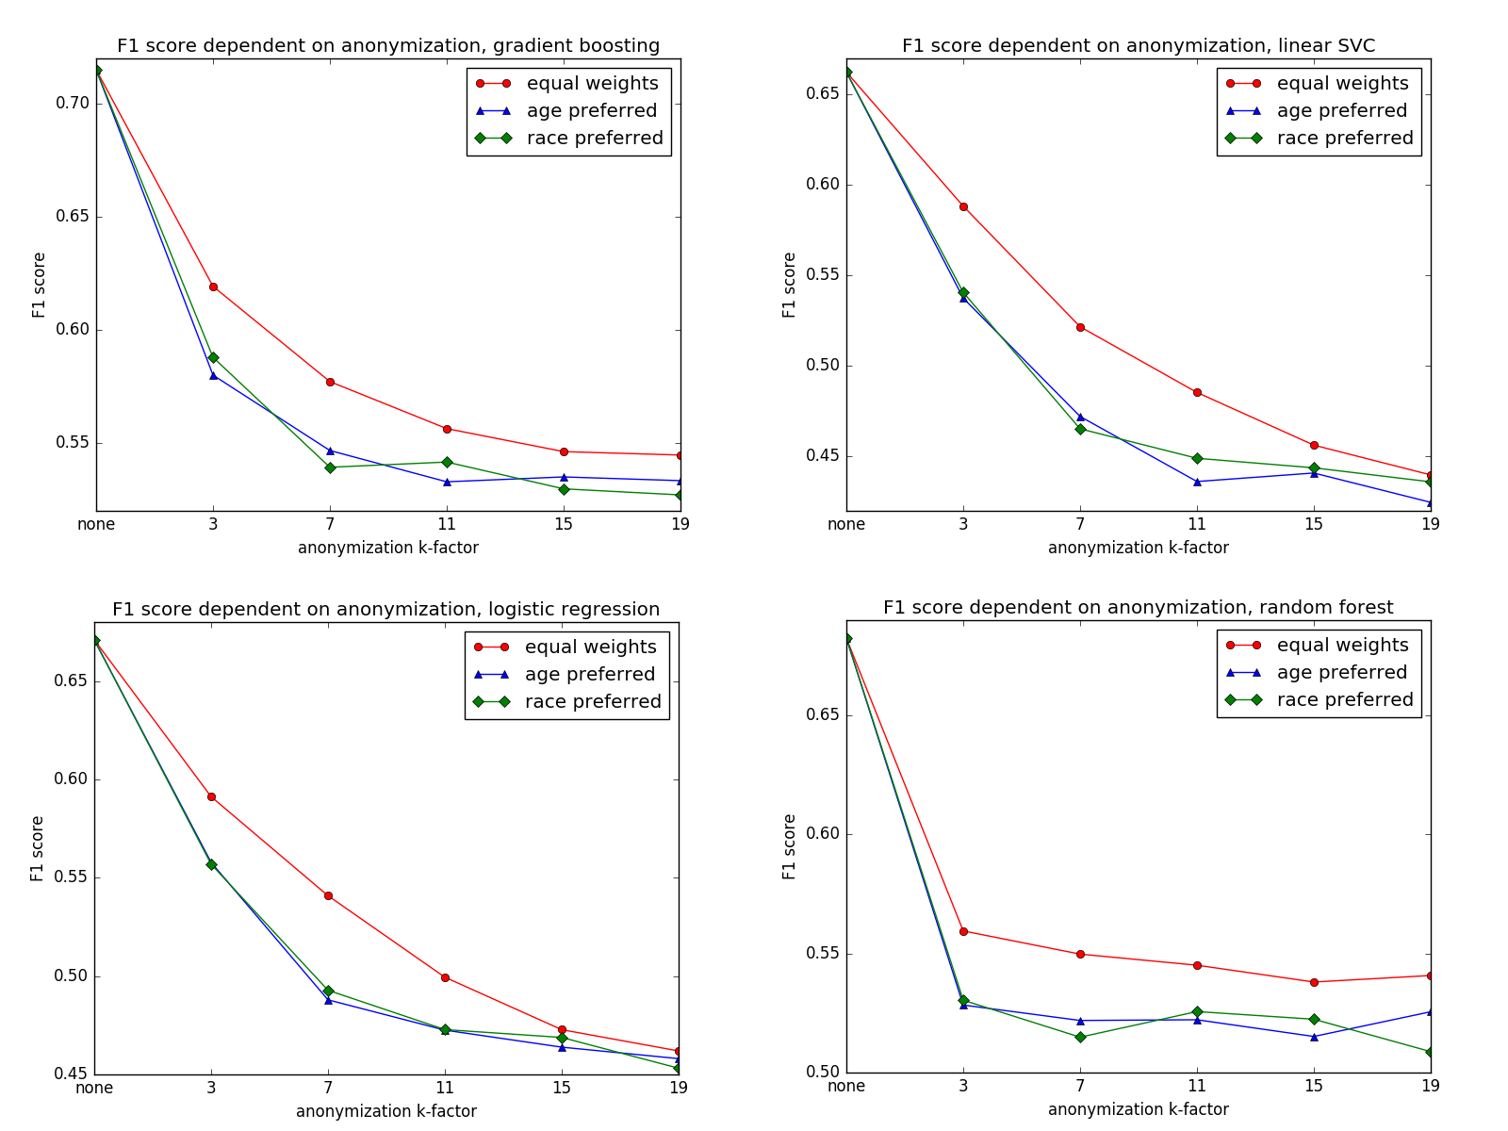
ML on Anonymization - Results
Notes:
There’s much more loss incurred directly at the “beginning”

Slide 32
Initial Conclusions
Succumbing to the “right-to-be-forgotten” still seems better than performing ML on anonymized DBs
A whole lot of future research is needed in order to corroborate and expand on those results
Extension to other ML approaches
=> Prediction, Clustering, Dim. Reduction, Pattern Rec.
Other perturbation techniques
Graph-based datasets
Notes:
PLUS – other tabular Datasets (less skewed ones)

Slide 33
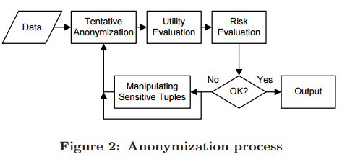
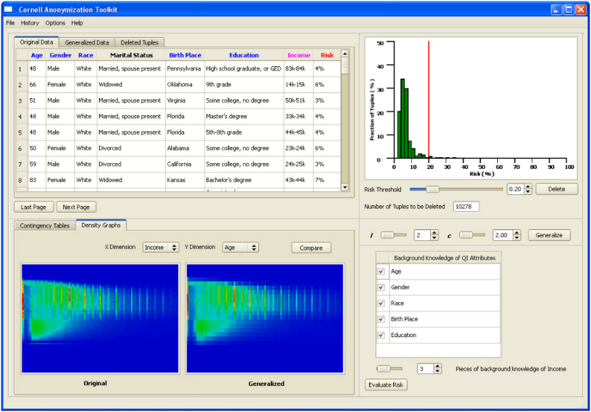
Can iML help anonymization 1/3 ?
Examples of iML?
The CAT (Cornell anonymization toolkit) as well as ARX (TU Munich) allow you to run utility / risk analysis
However, they are not interactive, but only support re-running your experiment with new settings…

Slide 34
Can iML help anonymization 2/3 ?
Possibilities to bring iML into anonymization?
Distance functions for Clustering
Information loss measures
Both are subjective
“Optimality” will also depend on the specific domain (medical vs. financial data)
So interactive / reinforcement learning could be applied by involving a domain expert

Slide 35
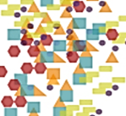
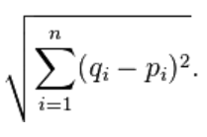

Can iML help anonymization 3/3 ?
Case: data similarity:
Subset of Data
Sample
presented to User
User decides
Update data + learn Heuristics
Which two are more similar?

Slide 36
Weight Vectors 1/2
[55 - 76] | * | North_America | Male | * | Married-civ-spouse
[55 - 76] | * | North_America | Male | * | Married-civ-spouse
[55 - 76] | * | North_America | Male | * | Married-civ-spouse
51 | Private | United-States | Male | White | Married-civ-spouse
[48 - 70] | Private | America | Male | White | *
[48 - 70] | Private | America | Male | White | *
[48 - 70] | Private | America | Male | White | *
Notes:
Question of weight vectors:
REVERSE MENTAL MODEL
Age => Probably interesting for many application areas
Race => Maybe interesting for certain kinds of diseases
Marital status => e.g. insurance companies want to conduct risk assessment for household policy

Slide 37
Weight Vectors 2/2
Applying a weight vector to our desired columns will change our cost function and thereby produce different anonymization results:
age | workclass | native-country | sex | race | marital-status
0.1667 | 0.1667 | 0.1667 | 0.1667 | 0.1667 | 0.1667
age | workclass | native-country | sex | race | marital-status
0.95 | 0.01 | 0.01 | 0.01 | 0.01 | 0.01

Slide 38
Conclusion
Conclusion: the level of privacy / security of data will always remain subjective with regard to the data set as well as potential attackers !!
You can never answer the question: "Will this algorithm be good enough for our purposes?" without testing it thoroughly for your specific use cases on YOUR OWN DATA…
Data that might seem safe today might become unsafe again in the future (additional

Slide 39

Thank you!
Notes:
My DEDICATION is to make data valuable … Thank you!

