Slide 1


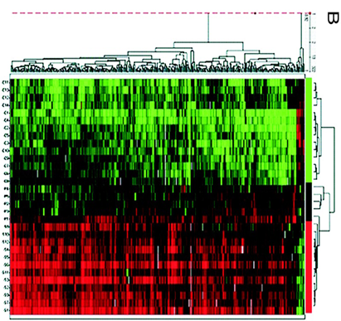

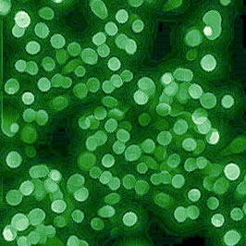

185.A83 Machine Learning for Health Informatics
2017S, VU, 2.0 h, 3.0 ECTS Tutorial 01 - 21.03.2017
Tutorial on Data and Image Augmentation
marcus.bloice@medunigraz.at http://hci-kdd.org/machine-learning-for-health-informatics-course
$$ℝ^{2}$$
$$ℝ^{n}$$
Notes:
Draft Status as of 12.03.2016 12:00
Dear Students, welcome to the class 185.A83

Slide 2
Schedule
01. Introduction and Overview
02. Fundamentals of Data, Information and Knowledge
03. Experiments in ML for Health Informatics
04. N.N.
05. Deep Learning for Health Informatics
06. N.N.
07. N.N.
08. N.N.
09. N.N.
10. N.N.

Slide 3
Keywords
Deep Learning
Neural Networks
Deep Belief Networks
Deep Boltzmann machines
Deep Structural Learning
Etc

Slide 4
Definitions
Deep Learning := ML method based on learning representations of data. An observation (e.g., an image) can be represented in many ways such as a vector of intensity values per pixel, or in a more abstract way as a set of edges, regions of particular shape, etc.
Feature:= specific measurable property of a phenomenon being observed.
Feature engineering:= using domain knowledge to create features useful for ML. (“Applied ML is basically feature engineering. Andrew Ng”).
Feature learning:= transformation of raw data input to a representation, which can be effectively exploited in ML.

Slide 5

Thank you!
Notes:
My DEDICATION is to make data valuable … Thank you!

Slide 6
Sample Questions
Why?
What?
Which?
How?
…

Slide 7
Appendix

