Slide 1
Talk: Graph embeddings as building blocks for decentralized learning.
FeatureCloud: Providing the worldwide first technological solution to ensure full patient data control
Bernd Malle Medical University Graz
Monthly FC Seminar 11/02/2020

Slide 2
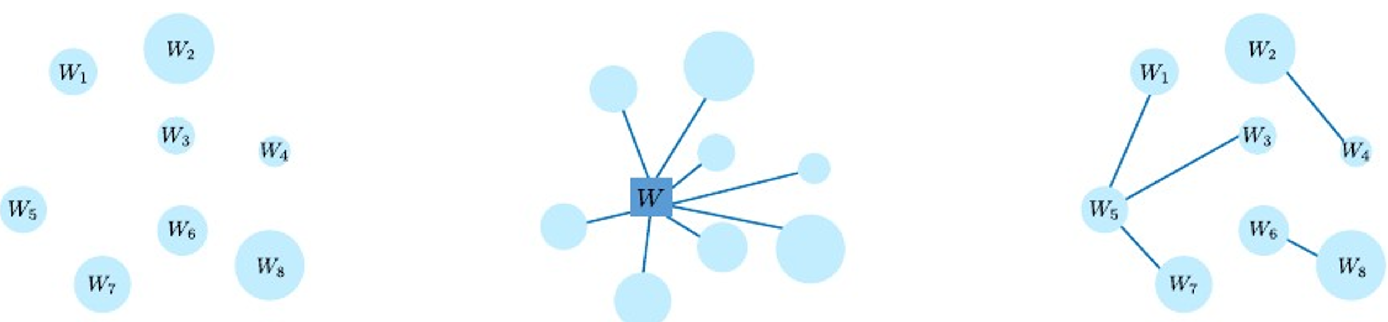
2 basic strategies for Federated Learning
Centralized model updates => server as the bottleneck
Server has full control
Server as the bottleneck
Server as the vulnerable point (central point of attack)
de-centralized learning
"local spheres" exchange information
Flexible
Less “hackable”
Harder to orchestrate / merge into a global model
Tian Li, Anit Kumar Sahu, Ameet Talwalkar, and Virginia Smith. Federated Learning: Challenges, Methods, and Future Directions. pages 1–21, 2019. URL http://arxiv.org/abs/1908.07873.

Slide 3
Challenges for decentralized learning (1/2)
Vantage point: we need some representations, either in raw or model space, which are suitable for federated / de-centralized learning.
ensemble methods like Random Forest (Marburg ;-) are "naturally" distributable -> just compute small bags of trees locally and then merge them together globally
graphs as well can be seen as naturally distributable via their subgraphs / components / clusters
IF the subgraphs are clearly defined (problem in traditional graph clustering)
We cannot send raw data over the wire
so we need to pre-compute local representations & exchange those
but at which level? node - cluster - component - subgraph ?
We have to consider limited bandwidth
representations should be dense & compressed
low-dimensional embeddings

Slide 4
Challenges for decentralized learning (2/2)
We want to avoid the `gossip` problem
only some local models should talk to one another
which ones should communicate, and can we learn that automatically?
We want to utilize the learned representations in many different tasks
no supervised end-2-end learning, as this would result in many different embeddings, which have to be re-computed for each task
But first things first -> we need good local graph representations !!

Slide 5
Embeddings
Embeddings are dense, low-dimensional representations of a higher-dimensional input space which carry conceptual meaning (in the case of words: semantic meaning)
force the embedder to align a similarity metric (usually cosine) inside the embedding space with a similarity metric in the original space
e.g. 'word co-occurrence => cosine similarity'
BUT, it could generally be any (pairwise) metric in the original space
ML on graphs is different than on images or sequence data
graphs are generally not regular (5 vs. 5000 friends)
graphs don't exhibit spatial locality -> we can permute rows and columns of an adj. matrix, and it's still the same graph (not with images)

Slide 6
Graphs from embeddings (because often, we do not have natural graphs)
We want to construct graphs from embeddings
naive approach: (cosine) similarity-based => kNN-graphs
construction of kNN-graphs is a whole area in itself, with approaches like `spatial Partitioning`, `random projections` etc.
Can we also construct similarity graphs from a graph?? -> In principle yes:
overlapping neighborhoods? - OR -
1. conduct random walks of length $k$ from each node
2. group the walks by node label
3. measure the pairwise Jaccard distance of nodes w.r.t. the nodes on their random walks
4. of course, this only works if the graph is well-connected (unreachable similar nodes will never be discovered).

Slide 7
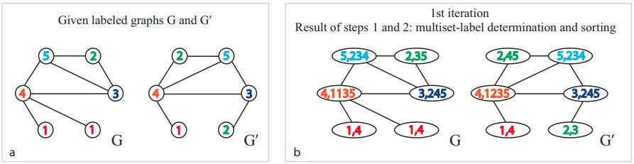
Embeddings from graphs (Content + Structure)
We want to generate embeddings from graphs
we do not "only" want to use content (feature vectors of nodes) to yield our embeddings
but also the `network structure` should flow into the representation
explain GraphSAGE (or better: neighborhood aggregation methods)
the idea goes back to Weisfeiler-Lehman Kernels, which assign each node a compressed label based on the initial label of it's neighbours - and it repeats this for all nodes until two labels of $G$ and $G'$ diverge, then it stops - if it never stops, two graphs *might* be isomorphic (but it's not guaranteed)
Nino Shervashidze, Pascal Schweitzer, Erik Jan van Leeuwen, Kurt Mehlhorn, and Karsten M. Borgwardt. 2011. Weisfeiler-Lehman Graph Kernels. J. Mach. Learn. Res. 12, null (2/1/2011), 2539–2561.

Slide 8
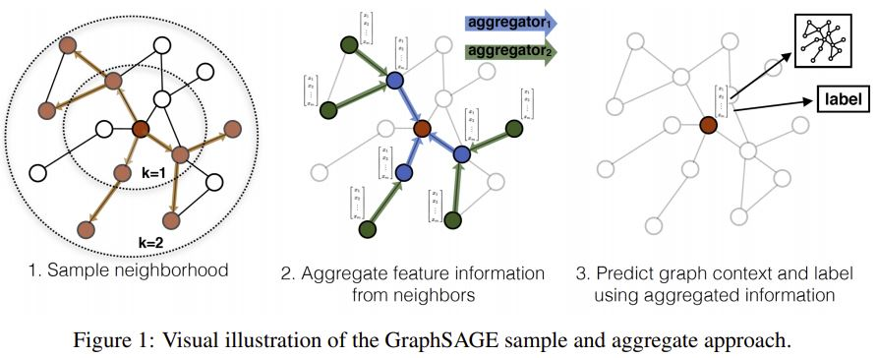
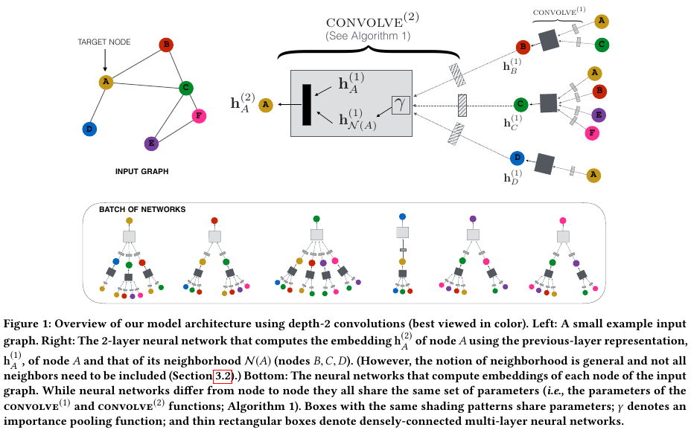
WP4 – Schematic overview of neighbourhood aggregation (GraphSAGE)
Supervised – or – unsupervised
Rex Ying, Ruining He, Kaifeng Chen, Pong Eksombatchai, William L. Hamilton, and Jure Leskovec. Graph convolutional neural networks for web-scale recommender systems. Proceedings of the ACM SIGKDD International Conference on Knowledge Discovery and Data Mining, pages 974–983, 2018. doi: 10.1145/3219819.3219890.
W. L. Hamilton, R. Ying, J. Leskovec, Inductive representation learning on large graphs, Advances in Neural Information Processing Systems 2017- Decem (Nips) (2017) 1025–1035. arXiv:1706.02216.
Sample a neighbourhood for each node
The sampling strategy can be flexible
Learn aggregation weight matrices
this is actually a miracle… ;-)
Aggregators can be simple (mean) or more complex
LSTMs performed really well, but we don’t know why
Distance-influenced metric…

Slide 9
Tandem?
Can those two approaches work in tandem & improve upon each other?
embeddings can capture similarity between nodes that are not reachable from one another
embeddings can capture similarity between nodes that are far from one another in a (general) input graph (like co-authorship or co-purchase)
what does the farther-distance structure in a similarity graph represent? Are there transitive effects in "similarity space" and how will they influence embeddings

Slide 10
Approaches / research avenues
1. Embeddings -> kNN (similarity) recommender -> rule extraction from user feedback -> graphs -> better embeddings
can apply to product recommendations or to regions of a histo-pathological image (which cells are the same)
could elicit counterfactuals (what are similar points that fall into a different class) -> which criteria lead to the class change?
2. Embeddings -> kNN-graph -> better embeddings -> better graph -> ...?
needs kNN-graph construction
then fed into GraphSAGE
graph representation (embedding) used to construct better graph -> Loop…
3. Embedding spaces representing different metrics (other than similarity) in the input space

Slide 11
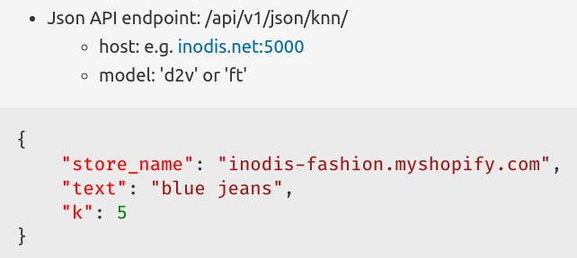
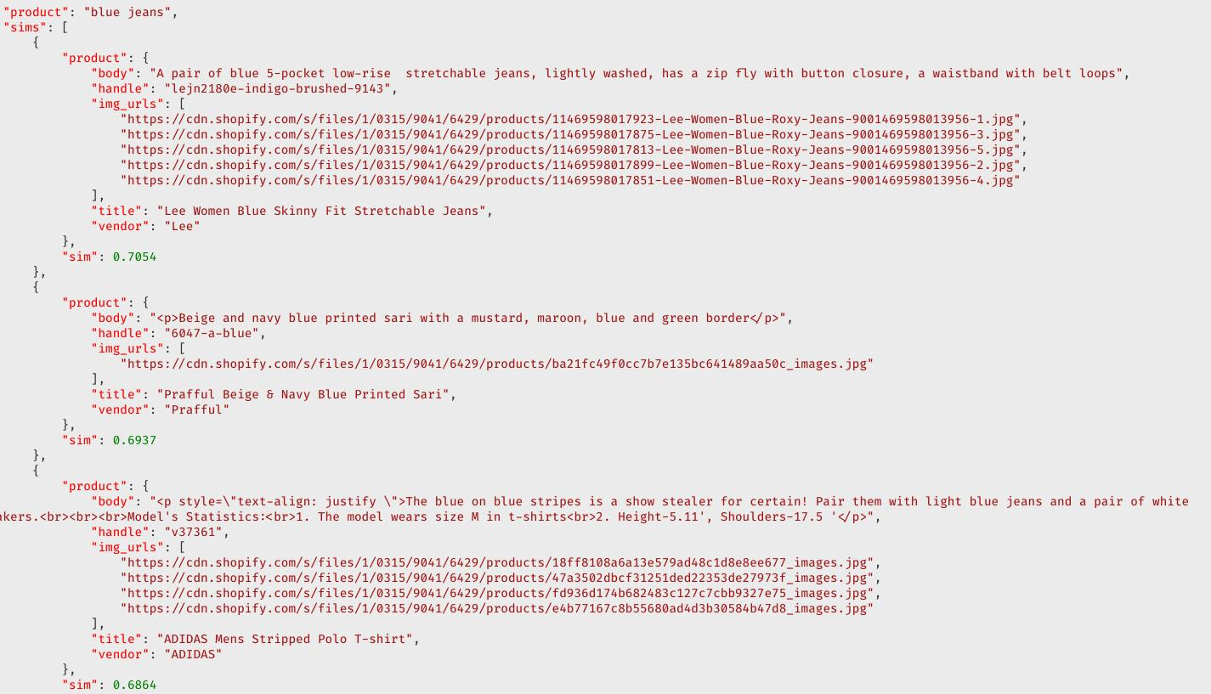
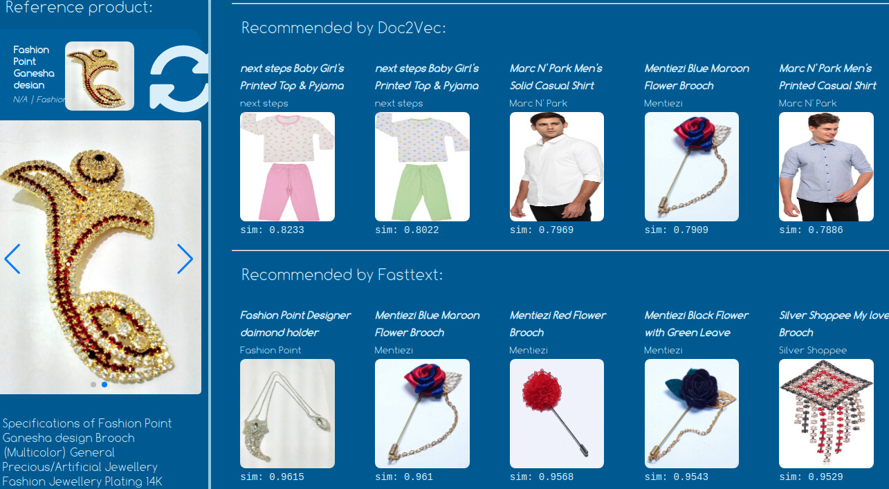
Setup

Slide 12
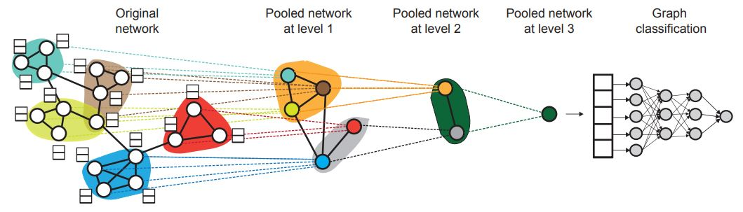
Future challenges (1/3)
Hierarchical representation of local (sub)graphs -> which works best?
aggregation / concatenation (mean/max/etc.)
a collection of virtual nodes spanning interesting clusters / walks of nodes
sampling strategies such as Random Walks, where the local graph structure itself is translated to fixed-size vectors -> then fed to an embedder
Rex Ying, Jiaxuan You, Christopher Morris, Xiang Ren, William L. Hamilton, and Jure Leskovec. 2018. Hierarchical graph representation learning with differentiable pooling. In Proceedings of the 32nd International Conference on Neural Information Processing Systems (NIPS'18). Curran Associates Inc., Red Hook, NY, USA, 4805–4815.

Slide 13
Future challenges (2/3)
Semantic alignment
under the assumption that when exchanging representation, the recipient can actually *decode* their meaning
=> DIFFERENT SEMANTIC CONCEPT SPACES because of local geometry
how to align those local geometries efficiently is an open problem
pre-train local embeddings as a whole, then try to align them in a post-processing step (has been done via the smoo )
since we're passing messages along edges, we can treat a local sphere or parts thereof as a subgraph, compute it's representation, then send them along an imaginary edge to a different local sphere
QUESTION: do we connect spheres 1:1 with only one possible edge or should multiple regions / sub(sub-)graphs of one local sphere connect to different regions in another (level of granularity)
Explainability…

Slide 14
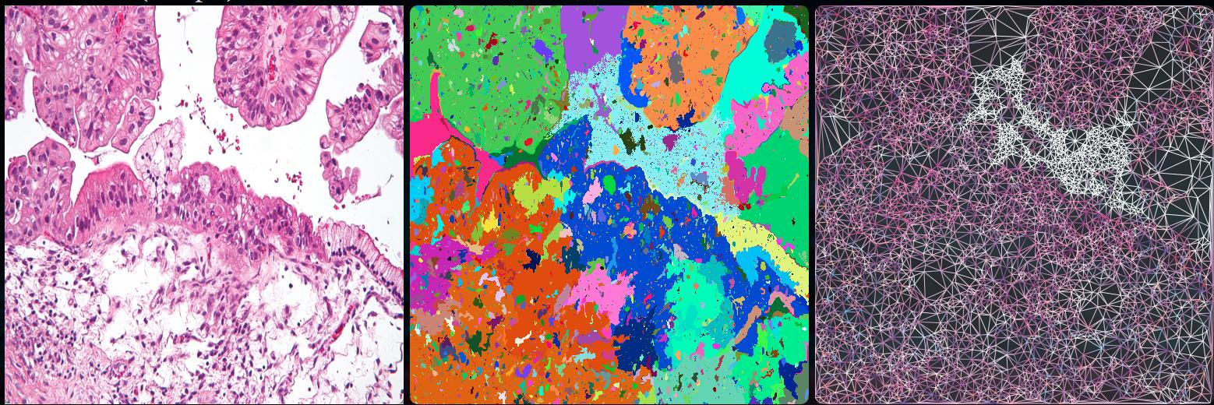
Future challenges (3/3)
Once we have a *"lego toolkit"* of methods, metrics & a software pipeline, we can aim at more ambitious goals:
1. extract graphs from histopatho images including labels for nodes / edges
cell graph extraction methods already exist
show our earlier graph extractor (fasttext as inspiration...)
2. extract graphs from unstructured text (patient data), medial knowledge bases, *omics etc.
3. attempt to fuse them into a multimodal graph living in a shared concept space (same embedding dimensions)
Source: Bernd Malle

