Slide 1


Slide 2


Workshop 2: Anonymisierung
27.09.2017

Slide 3
Continuous (strEAMING) data anonymization
Problems and Solution Approaches
2017 - SBA Research gGmbH

Slide 4
Basics
Traditional data is
* finite
* persistent
Streaming data is
* continuous
* potentially infinite
* time varying (concept drift !?)
=> Generally we want to analyze (almost) in real time
2017 - SBA Research gGmbH

Slide 5
General streaming problems
* Unordered (out-of-sequence)
* Delays
* High latency
* Multiple streams
* "Skew": Delay between event & and processing time
* If a person appears more than k times, and their 'packages' arrive immediately in sequence, they could fill up an equivalence class without being generalized at all, increasing the risk of re-identification significantly
2017 - SBA Research gGmbH

Slide 6
Streaming anonymization problems
* local recoding incurs less information loss, although still not mathematically optimal
- since k-anonymization is combinatorial optimization
- and the number of possible combinations is exponential (k-anonym. even NP hard)
- but greedy clustering is still polynomial (O(n^2))
* determining a global generalization level incurs more information loss
- but can be done in (near) linear time
- phase 1: observation and determination
- phase 2: generalizing while instances are coming in
2017 - SBA Research gGmbH

Slide 7
Criteria achievable via greedy streaming
* k-anonymity: Yes, if we simply 'fill buckets'
- can't do it one-by-one => generalization level would depend on instance arrival order
- but we will definitely over-generalize
* l-diversity: Yes, same as k-anonymity
- but it will compound our data loss problem by forcing us to observe the l-criterion immediately
* t-closeness: Not precisely, as we do not know the global distribution of attribute values yet
2017 - SBA Research gGmbH

Slide 8
Algorithm 1: CASTLE (adaptive clustering)
* n-bucket approach
* Basic ideas:
- sequential cluster creation (inverse to SaNGreeA)
- guarantees on time delay (e.g. for outlier detection)
* infinite append-only sequence of tuples
* QI attributes define a metric space, such that tuples can be considered points in this space
* cluster C over input is defined as a set of intervals, called range intervals, in the quasi-identifier attribute domains
2017 - SBA Research gGmbH

Slide 9
Algorithm 1: CASTLE - cont’d
* In case a new tuple cannot be added to an existing cluster, a new cluster is formed with this instance
* also, tuples cannot exceed a certain age.. if they do & a cluster has already reached size = k, the whole cluster is output as equivalence class
* else the cluster is merged with similar clusters & output
* threshold parameter t can also be used to adapt to stream distribution => well clustered tuples will force the stream into lower-generalized clusters
2017 - SBA Research gGmbH

Slide 10
Algorithm 2: FAANST (numerical streaming)
1. fill up a window of samples first
2. then run k-means clustering on the initial windows
- clusters which reach size >= k are output immediately
- clusters which reach information loss < threshold are called 'accepted clusters' and memorized
3. fill up new cluster
- instances that fall into accepted clusters are generalized the same way instantly
- others: run k-means again
2017 - SBA Research gGmbH

Slide 11
A third idea...
1. start computing gen-hierarchies after cold-start / starting window / last-day heuristics
2. generalize incoming instances according to that metric
3. Keep a hash-map in which new instances are recorded according to their QI's gen level
- has all QI's in their generalized form together
- the value to each key is an array
- this collision list forms a natural equivalence class
4. Once a 'bucket' reaches size=k, output and remove it
2017 - SBA Research gGmbH

Slide 12
solution for discrete samples - sangreea DEMO w/ weights
classical k-anonymization
2017 - SBA Research gGmbH

Slide 13
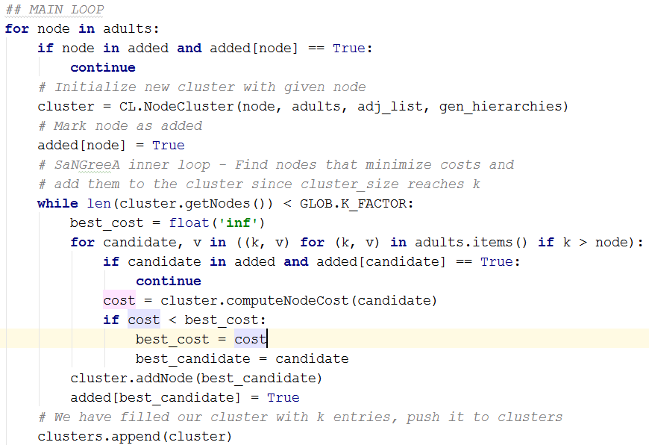
2017 - SBA Research gGmbH

Slide 14
PRIVAcy aware machine learning
Anonymization for a purpose
2017 - SBA Research gGmbH

Slide 15
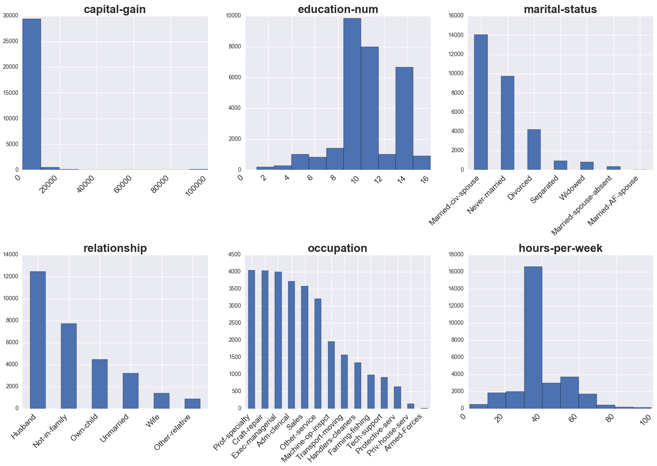
Adult data original distribution
2017 - SBA Research gGmbH

Slide 16
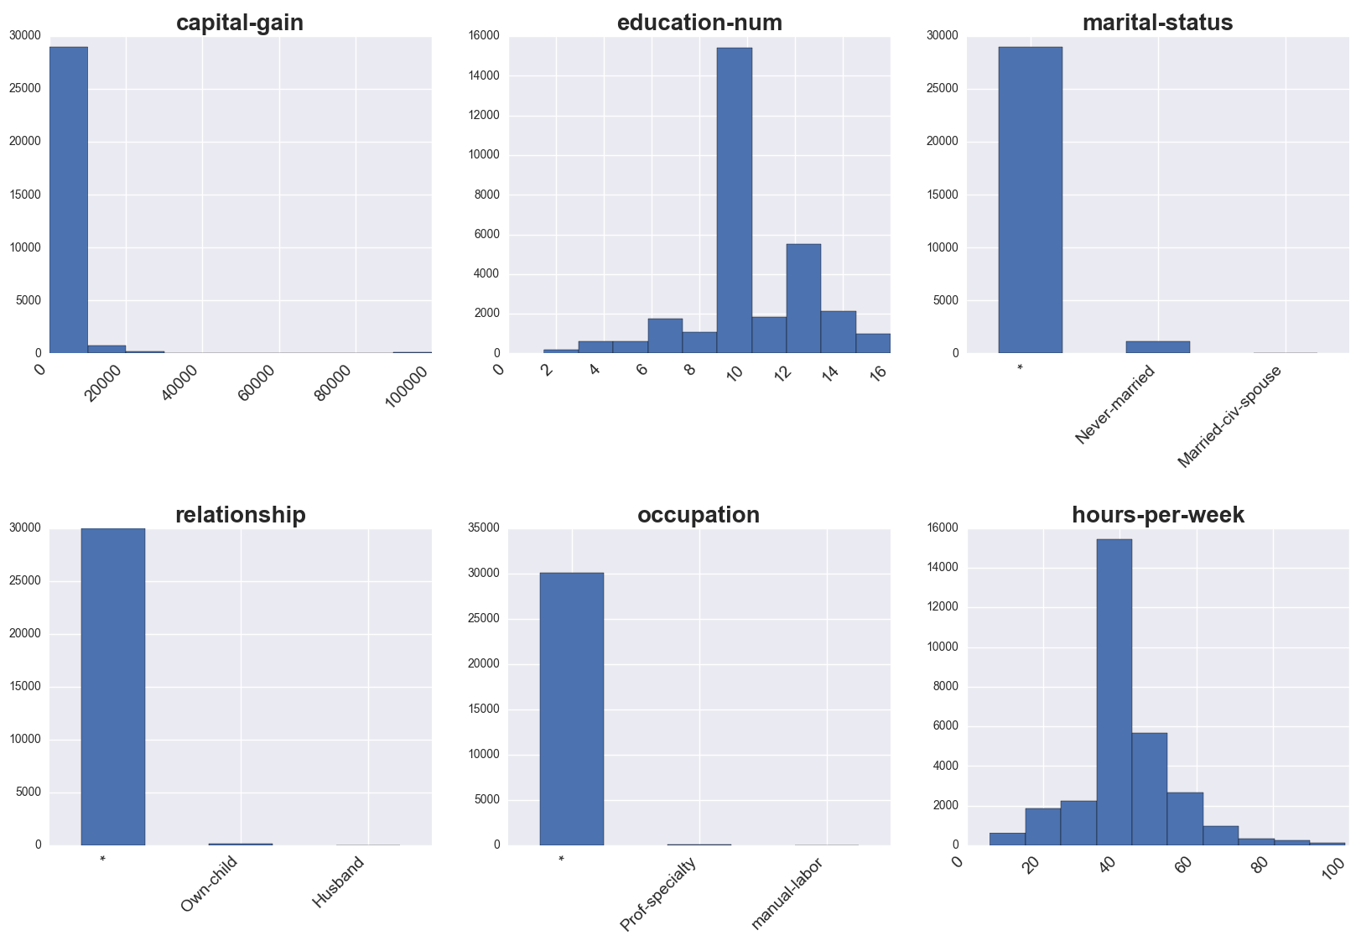
Adult data anonymized distribution
2017 - SBA Research gGmbH

Slide 17
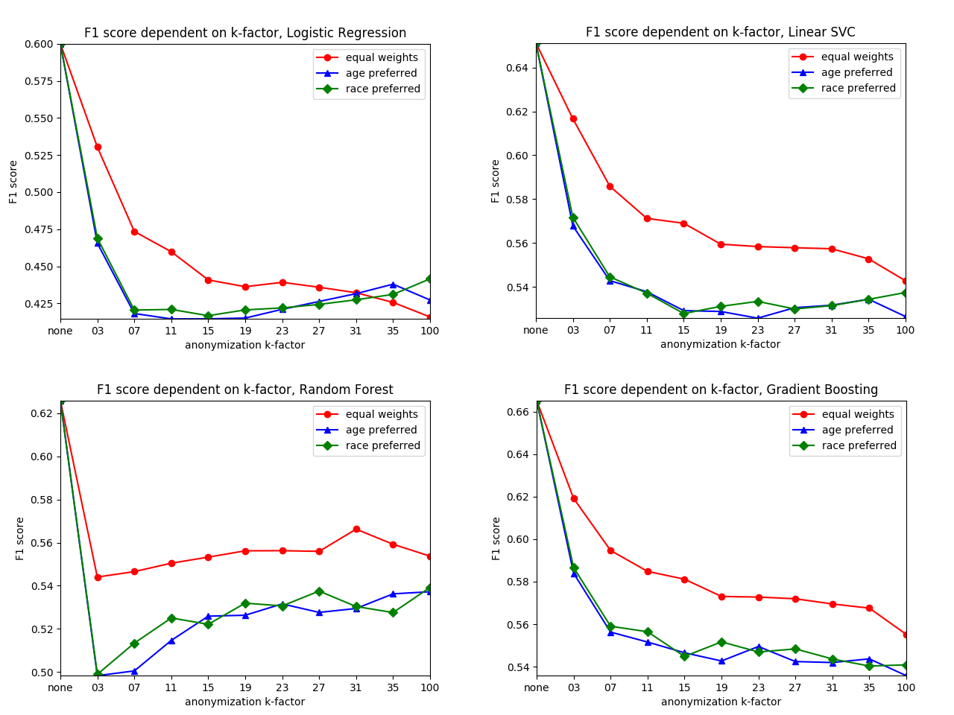
Classifier performance on education
2017 - SBA Research gGmbH

Slide 18
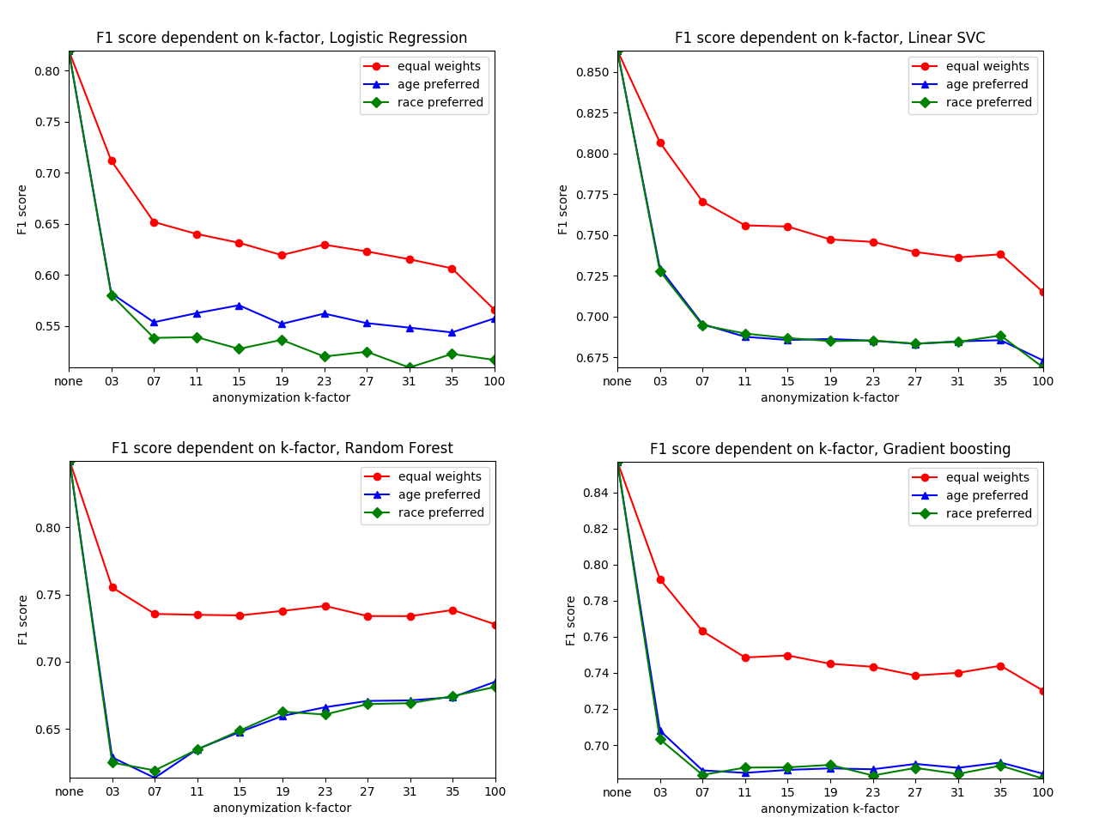
Classifier performance on marital status
2017 - SBA Research gGmbH

Slide 19
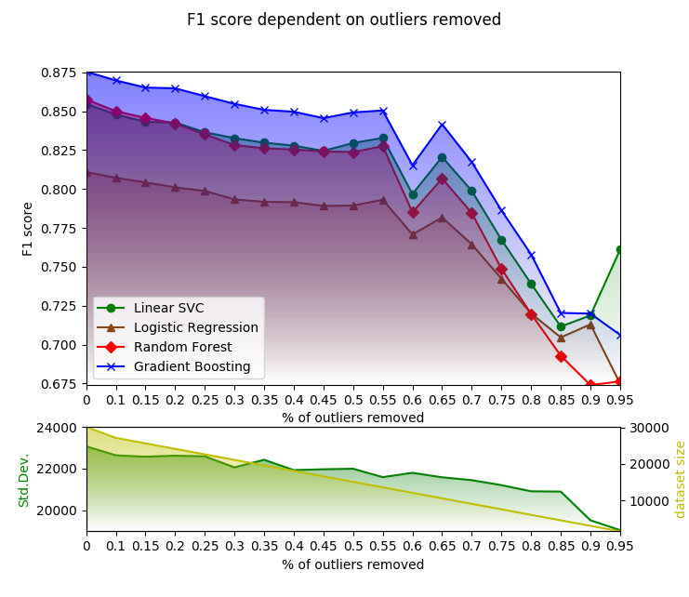
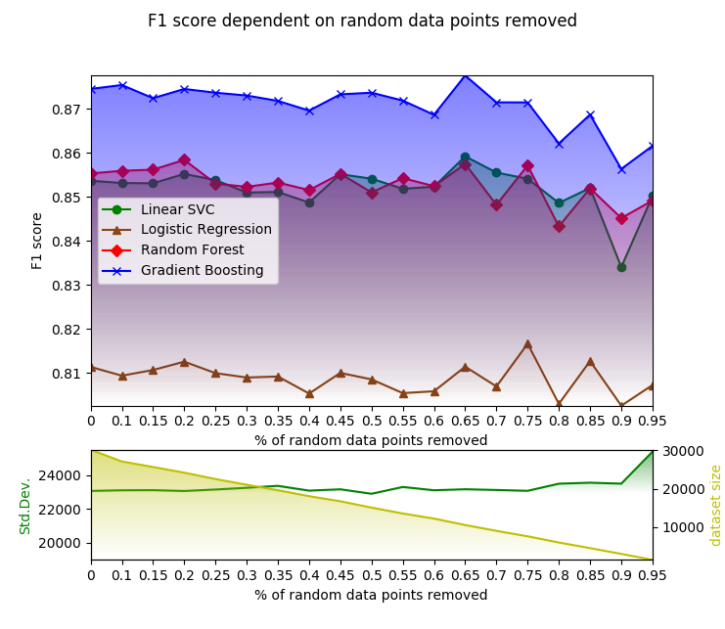
Classifier on outliers (=variance) removed
2017 - SBA Research gGmbH

Slide 20
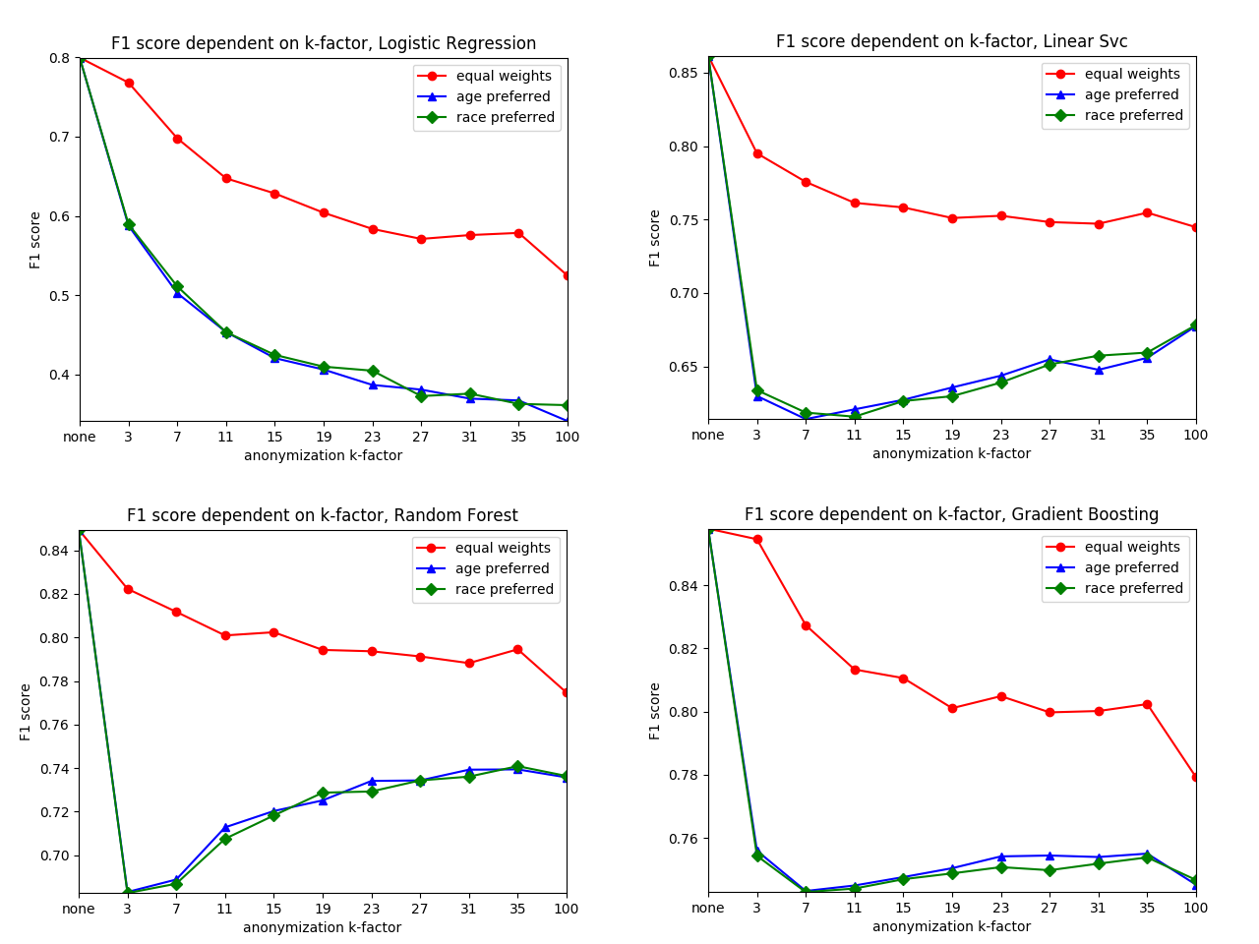
Classifiers on outliers removed => anon
2017 - SBA Research gGmbH

Slide 21
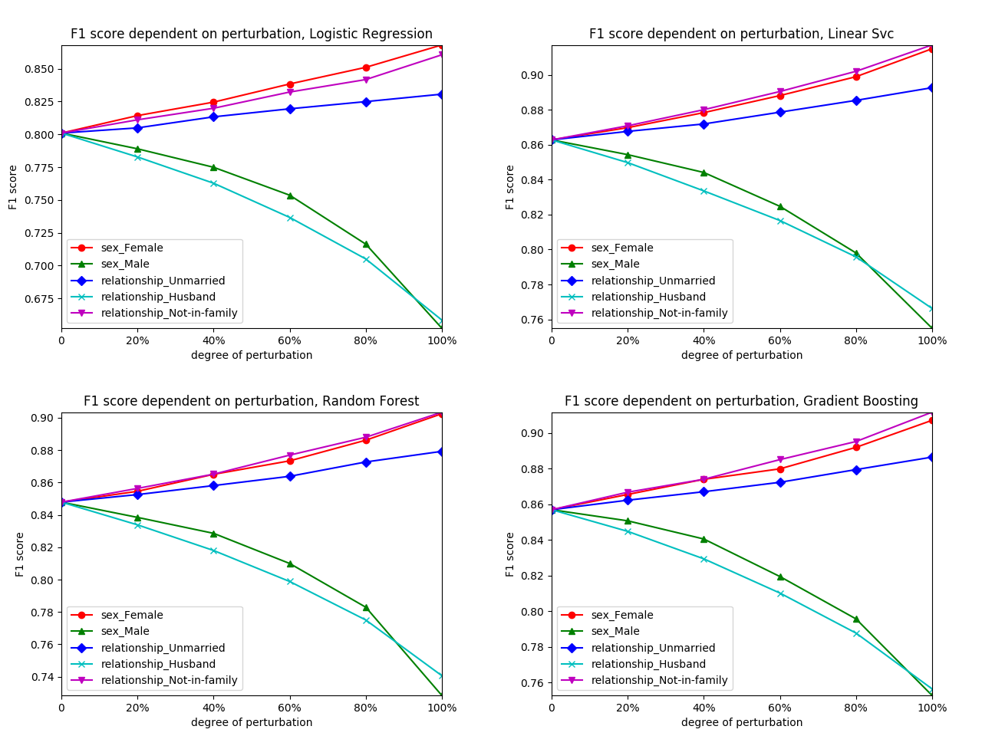
Comparison: simple data deletion
2017 - SBA Research gGmbH

Slide 22
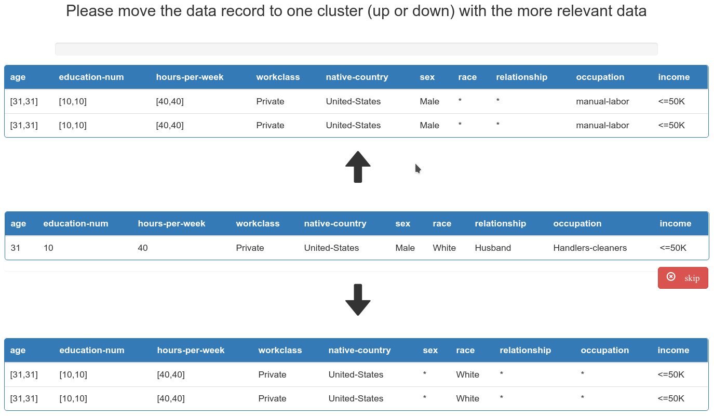
Different preferences for data preservation

Slide 23
Leads to different weight vectors
age | workclass | native-country | sex | race | marital-status
0.1667 | 0.1667 | 0.1667 | 0.1667 | 0.1667 | 0.1667
age | workclass | native-country | sex | race | marital-status
0.95 | 0.01 | 0.01 | 0.01 | 0.01 | 0.01
2017 - SBA Research gGmbH

Slide 24
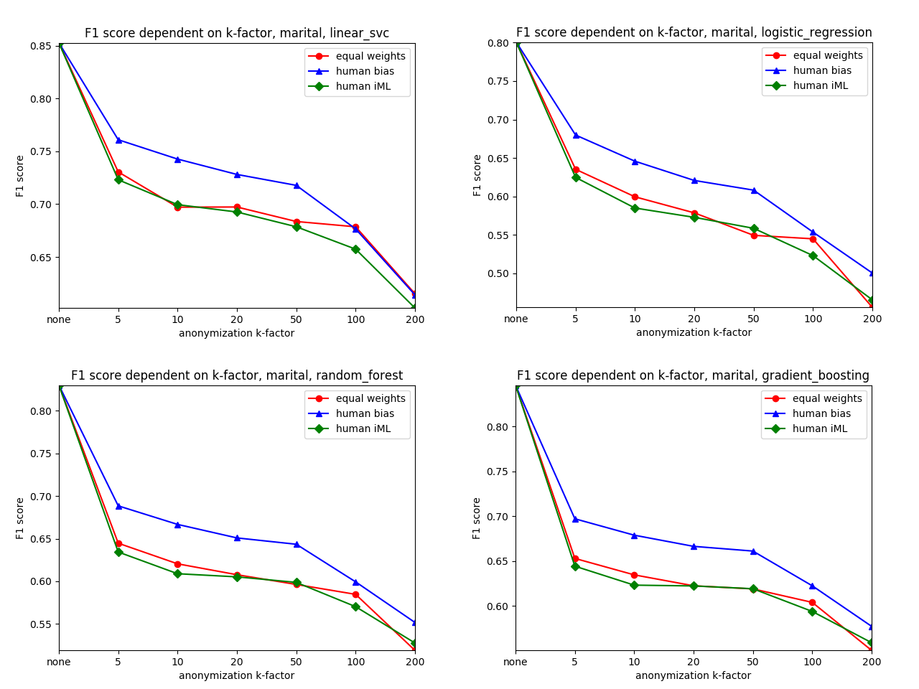
Adult data anonymized distribution
2017 - SBA Research gGmbH

Slide 25
Contact: Peter Kieseberg & Bernd Malle
SBA Research gGmbH
Favoritenstraße 16, 1040 Wien
[pkieseberg, bmalle]@sba-research.org

