Slide 1


IAL Workshop 2017
ECML/PKDD
Interactive Anonymization
for Privacy aware Machine Learning
Bernd Malle, Peter Kieseberg, Andreas Holzinger
b.malle@hci-kdd.org

Slide 2
Section 1
Section 1
GDPR & it's effects
Notes:
MEASURING PROPERLY AND OBJECTIVELY THE EFFECT OF ANONYMIZATION ?!?!
For specific problems => re-running ML algorithms and measuring the drop in accuracy etc…

Slide 3
GDPR 1/2
General Data Protection Regulation
The processing of personal data is expressely prohibited: age, race, income, socioeconomic status...
BUT: algorithms must not be implicitly discriminating either!
Think about recommender systems
- an individual buying decision is influenced by factors like age, social group, income etc.
- just collaborative filtering would therefore be implicitly discriminating
- but of course it *has to be* or it is useless...
Notes:
Prepared for having this law now only applied to front-end databases but also to statistical of ML knowledge bases…

Slide 4
GDPR - Possibilities & Consequences
From May 2018 onwards, the GDPR will come into force and violations carry a severe penalty (max. ~4% of revenue)
It's going to be an interesting year ;)
- will Amazon, Facebook etc. turn off their services in the EU?
There are only 2 ways to deal with this:
1. Don't use personal data (plus the right to be forgotten...)
2. Wholesale anonymization of datasets to be trained on
What is the performance penalty
Notes:
Prepared for having this law now only applied to front-end databases but also to statistical of ML knowledge bases…

Slide 5

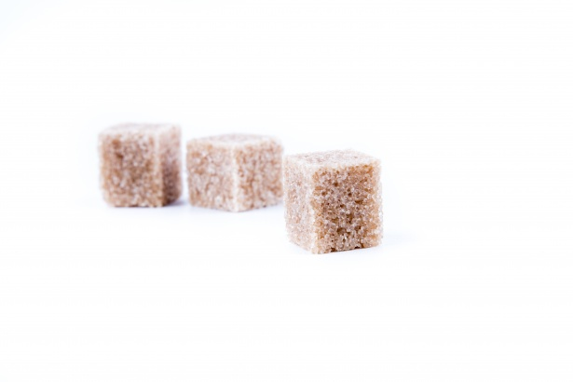

Privacy in the 21st century… ??
Private Data
Data protection laws
Technological progess

Slide 6
Section 2
Section 2:
k-anonymization
Notes:
MEASURING PROPERLY AND OBJECTIVELY THE EFFECT OF ANONYMIZATION ?!?!
For specific problems => re-running ML algorithms and measuring the drop in accuracy etc…

Slide 7
Properties & General Approach
Data properties => Reduce granularity
Identifiers := immediately reveal identity
name, email, phone nr., SSN
=> DELETE
Sensitive data
medical diagnosis, symptoms, drug intake, income
=> NECESSARY, KEEP
Quasi-Identifiers := used in combination to retrieve identity
Age, zip, gender, race, profession, education
=> MAYBE USEFUL
=> MANIPULATE / GENERALIZE
Name | Age | Zip | Gender | Disease
Alex | 25 | 41076 | Male | Allergies
… | … | … | … | …

Slide 8
K Anonymization criterion
k-anonymity: for every entry in the DS, there must be at least k-1 identical entries (w.r.t. QI's) => this is 3-anon:
Node | Name | Age | Zip | Gender | Disease
X1 | Alex | 25 | 41076 | Male | Allergies
X2 | Bob | 25 | 41075 | Male | Allergies
X3 | Charlie | 27 | 41076 | Male | Allergies
X4 | Dave | 32 | 41099 | Male | Diabetes
X5 | Eva | 27 | 41074 | Female | Flu
X6 | Dana | 36 | 41099 | Female | Gastritis
X7 | George | 30 | 41099 | Male | Brain Tumor
X8 | Lucas | 28 | 41099 | Male | Lung Cancer
X9 | Laura | 33 | 41075 | Female | Alzheimer
Node | Age | Zip | Gender | Disease
X1 | 25-27 | 4107* | Male | Allergies
X2 | 25-27 | 4107* | Male | Allergies
X3 | 25-27 | 4107* | Male | Allergies
X4 | 30-36 | 41099 | * | Diabetes
X5 | 27-33 | 410** | * | Flu
X6 | 30-36 | 41099 | * | Gastritis
X7 | 30-36 | 41099 | * | Brain Tumor
X8 | 27-33 | 410** | * | Lung Cancer
X9 | 27-33 | 410** | * | Alzheimer

Slide 9
Limits of anonymization
Trade-off between:
Data utility => min. information loss
Privacy => max. information loss
Both can be easily achieved (but not together)
Node | Name | Age | Zip | Gender | Disease
X1 | Alex | 25 | 41076 | Male | Allergies
X2 | Bob | 25 | 41075 | Male | Allergies
X3 | Charlie | 27 | 41076 | Male | Allergies
X4 | Dave | 32 | 41099 | Male | Diabetes
X5 | Eva | 27 | 41074 | Female | Flu
X6 | Dana | 36 | 41099 | Female | Gastritis
X7 | George | 30 | 41099 | Male | Brain Tumor
X8 | Lucas | 28 | 41099 | Male | Lung Cancer
X9 | Laura | 33 | 41075 | Female | Alzheimer
Node | Age | Zip | Gender | Disease
X1 | * | * | * | Allergies
X2 | * | * | * | Allergies
X3 | * | * | * | Allergies
X4 | * | * | * | Diabetes
X5 | * | * | * | Flu
X6 | * | * | * | Gastritis
X7 | * | * | * | Brain Tumor
X8 | * | * | * | Lung Cancer
X9 | * | * | * | Alzheimer

Slide 10
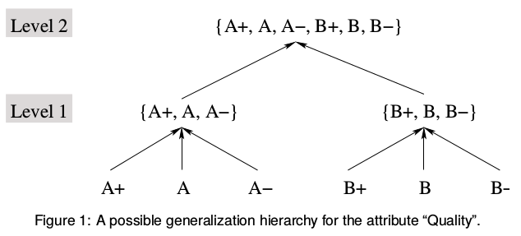
Generalization hierarchies
Generalization (hierarchies)
fixed ruleset
range partitioning (numerical values...)
Suppression
Special case of generalization (with one level)
Graphics Source: Bayardo, R. J., & Agrawal, R. (2005, April). Data privacy through optimal k-anonymization. In Data Engineering, 2005. ICDE 2005. Proceedings. 21st International Conference on (pp. 217-228). IEEE.

Slide 11
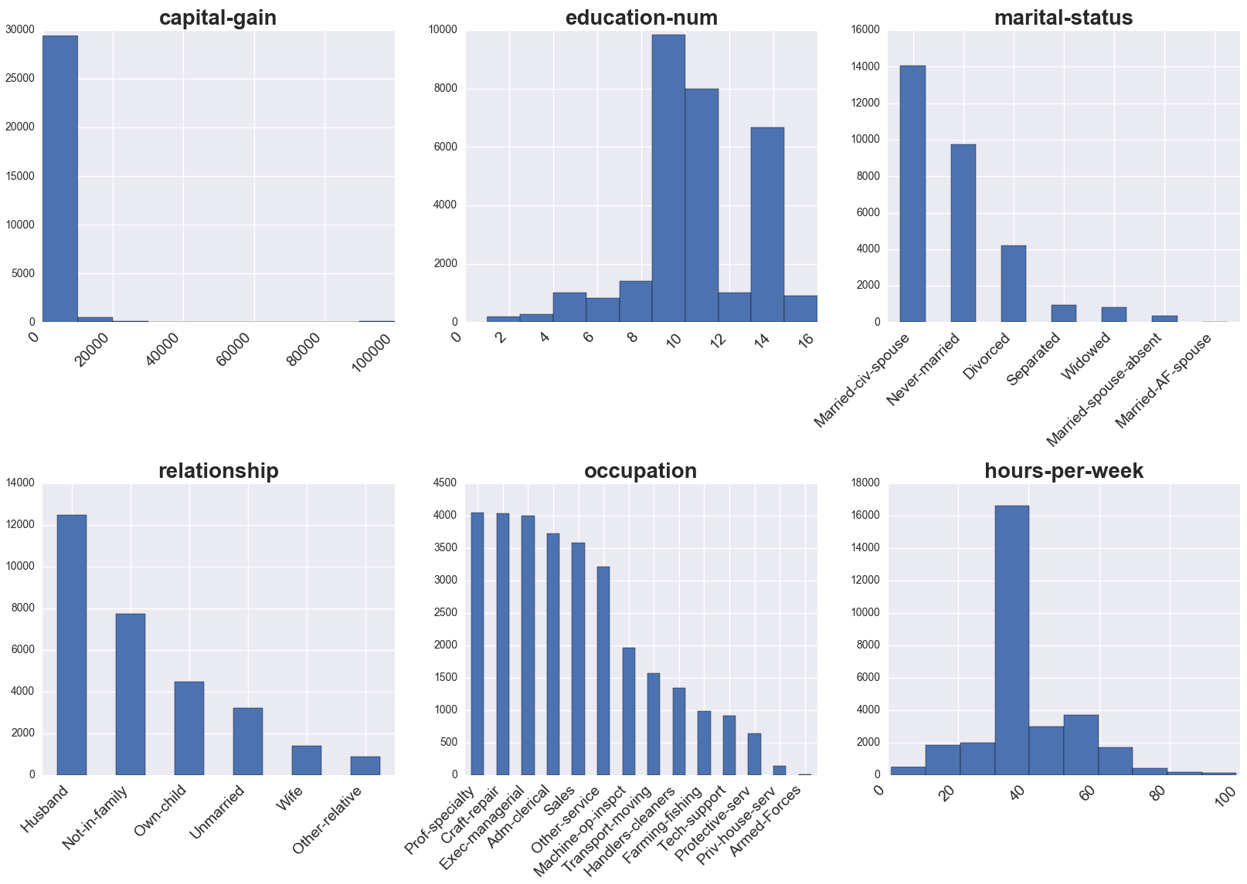
Adult dataset original distribution

Slide 12
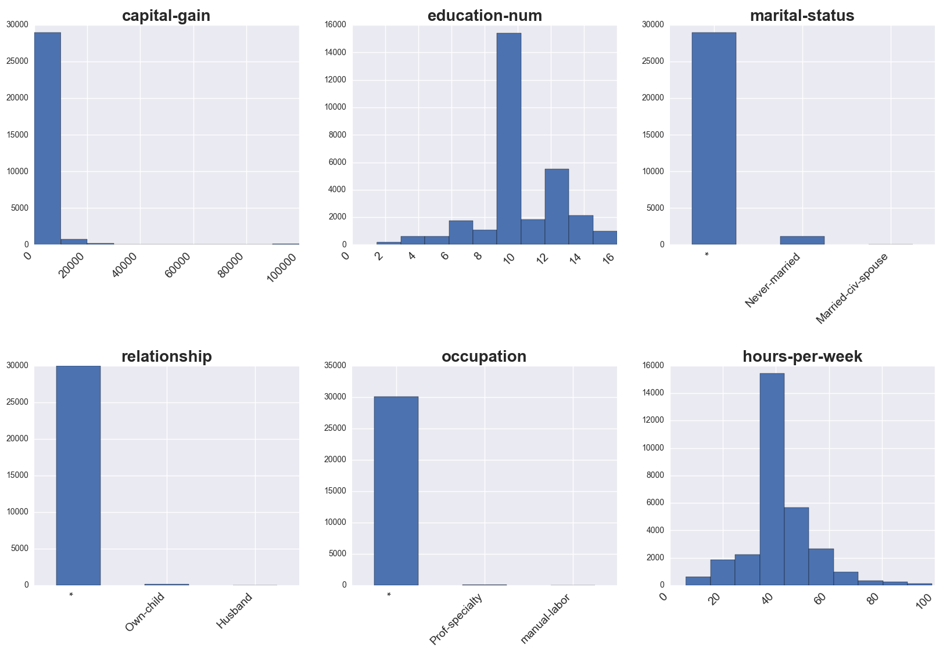
Anonymization - datasets
Notes:
Non-obvious for the numerical columns
Ranges => Averages of ranges…
Of course you get one of those for each combination of k-factor / weight vector applied…

Slide 13
Weight Vectors 1/2
[51 - 76] | * | North_America | Male | * | Married-civ-spouse
[51 - 76] | * | North_America | Male | * | Married-civ-spouse
[51 - 76] | * | North_America | Male | * | Married-civ-spouse
57 | Private | United-States | Male | White | Married-civ-spouse
[48 - 70] | Private | America | Male | White | *
[48 - 70] | Private | America | Male | White | *
[48 - 70] | Private | America | Male | White | *
Notes:
Question of weight vectors:
REVERSE MENTAL MODEL
Age => Probably interesting for many application areas
Race => Maybe interesting for certain kinds of diseases
Marital status => e.g. insurance companies want to conduct risk assessment for household policy

Slide 14
Weight Vectors 2/2
Applying a weight vector to our desired columns will change our cost function and thereby produce different anonymization results:
age | workclass | native-country | sex | race | marital-status
0.1667 | 0.1667 | 0.1667 | 0.1667 | 0.1667 | 0.1667
age | workclass | native-country | sex | race | marital-status
0.95 | 0.01 | 0.01 | 0.01 | 0.01 | 0.01

Slide 15
Section 3
Section 3
Experiments & results
Notes:
MEASURING PROPERLY AND OBJECTIVELY THE EFFECT OF ANONYMIZATION ?!?!
For specific problems => re-running ML algorithms and measuring the drop in accuracy etc…

Slide 16
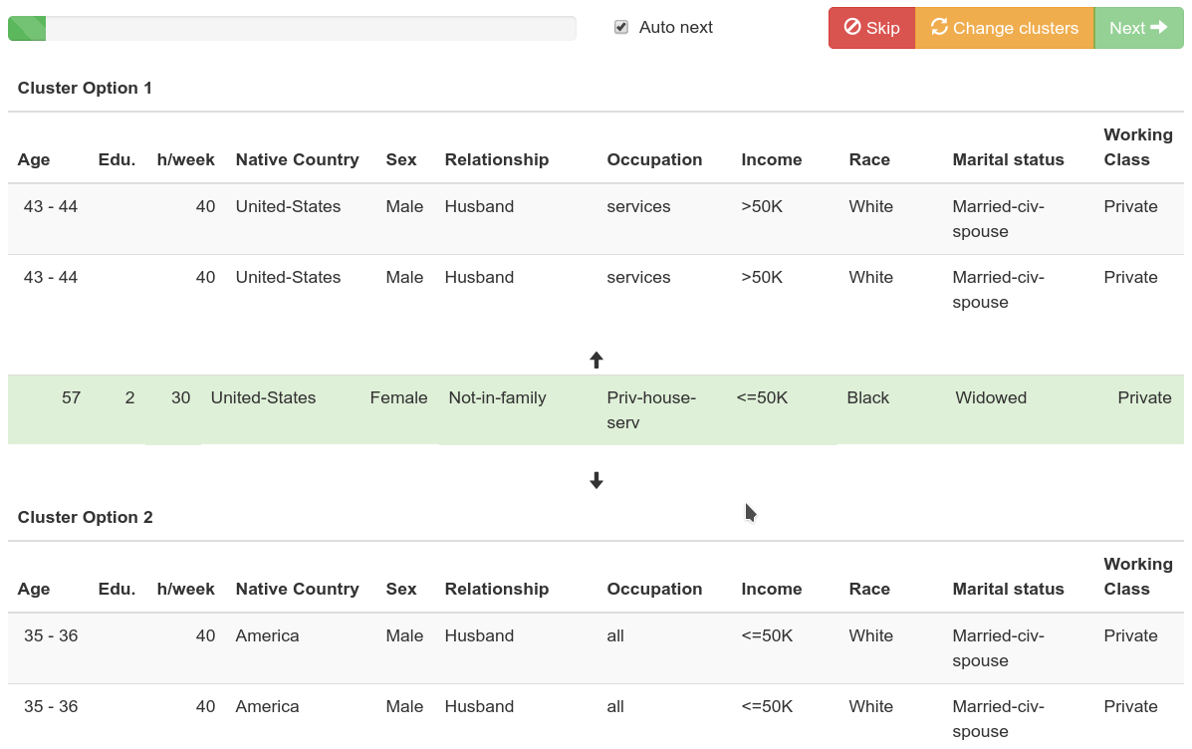
Conclusions
Notes:
PLUS – other tabular Datasets (less skewed ones)

Slide 17
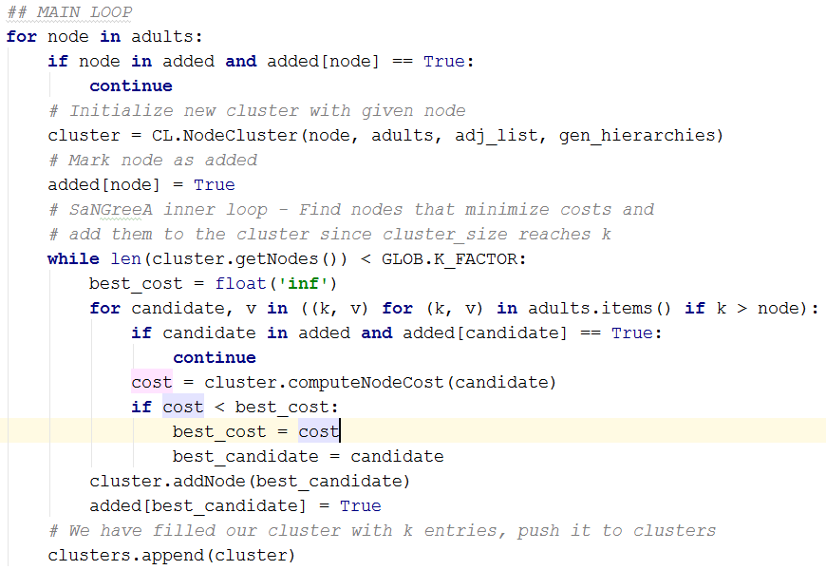
SaNGreeA Main Loop
Notes:
Choose a node (data row / point) => start a cluster with it
Iterate over all other nodes => choose the one which minimizes merge costs
Add to cluster and count costs
Once cluster has reached size k, stop
Go back to 1)

Slide 18
Anonymization – prepared datasets
We used k-factors of:
[5, 10, 20, 50, 100, 200]
combined with 129 weight vectors from the categories:
> Equal weights for all columns
> Human bias
> Human interactive Learning
Resulting in 774 differently anonymized data sets
(775 including the original)

Slide 19
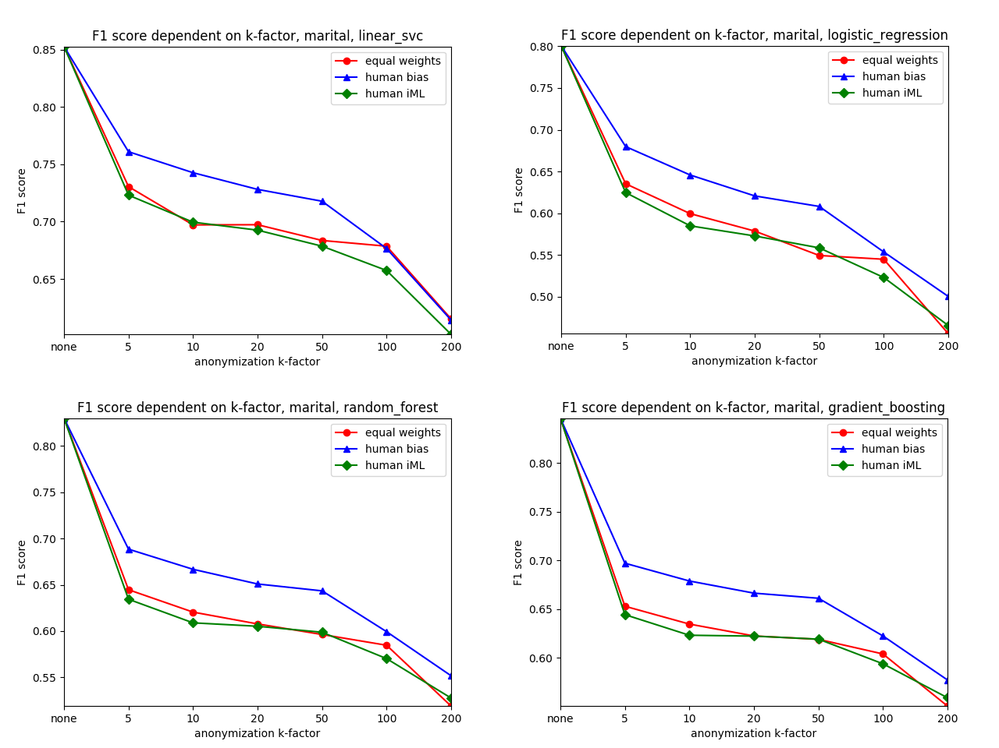
Results - Marital status
Notes:
There’s much more loss incurred directly at the “beginning”

Slide 20
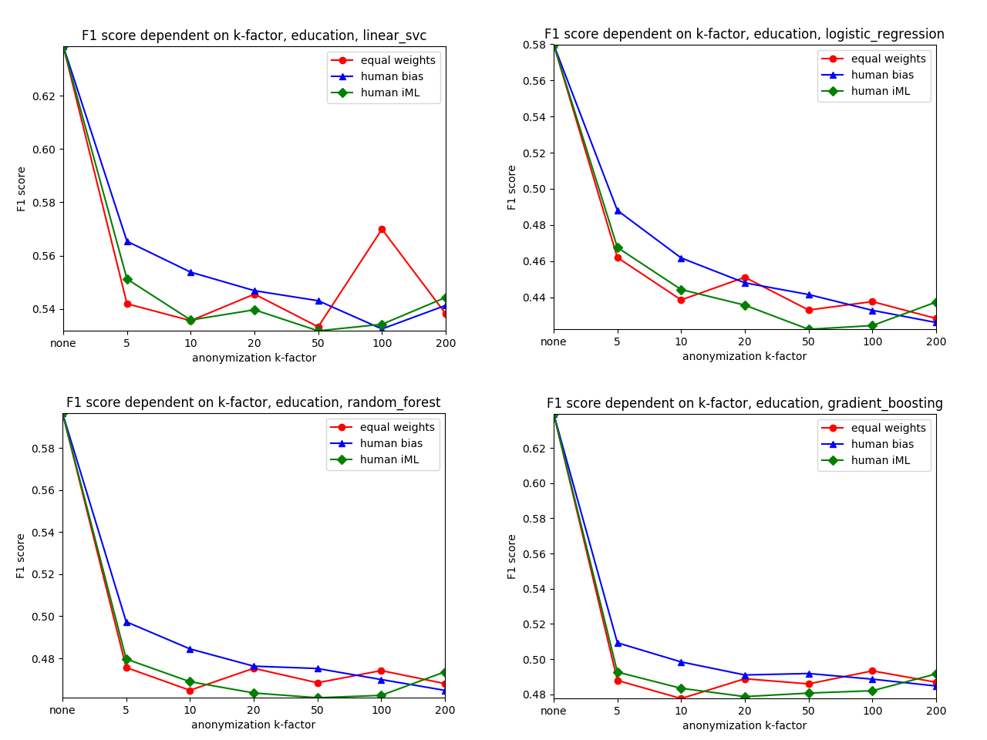
Results - Education num
Notes:
There’s much more loss incurred directly at the “beginning”

Slide 21
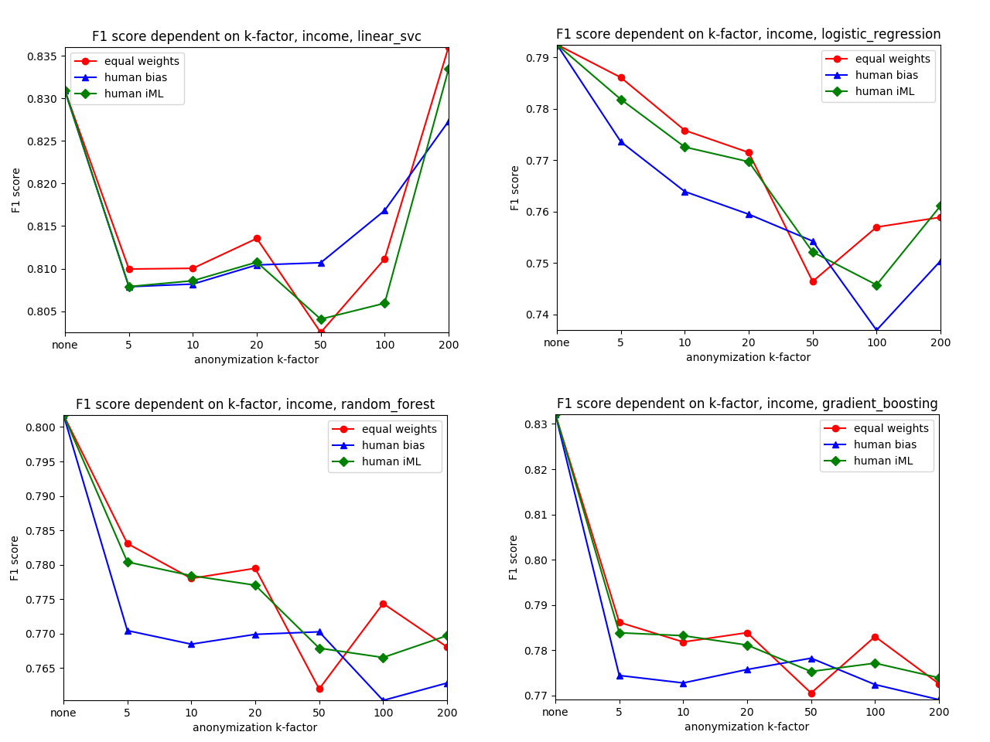
Results - Income
Notes:
There’s much more loss incurred directly at the “beginning”

Slide 22
Future work
Faster algorithm.
- increase number of data points to be considered during real-time experimens => better choice for users / no premature over-gen...
Expert domain, domain experts.
- professional human insights could make a difference over general setting
- domain experts have higher motivation than students ;)
Different "packaging"
- Recommenders in a social network
- Gamification
Different data
- Finding patterns in medical images
- but is interactive learning better for "constraint injection"

Slide 23

Thank you!
Notes:
My DEDICATION is to make data valuable … Thank you!

